Slide 1
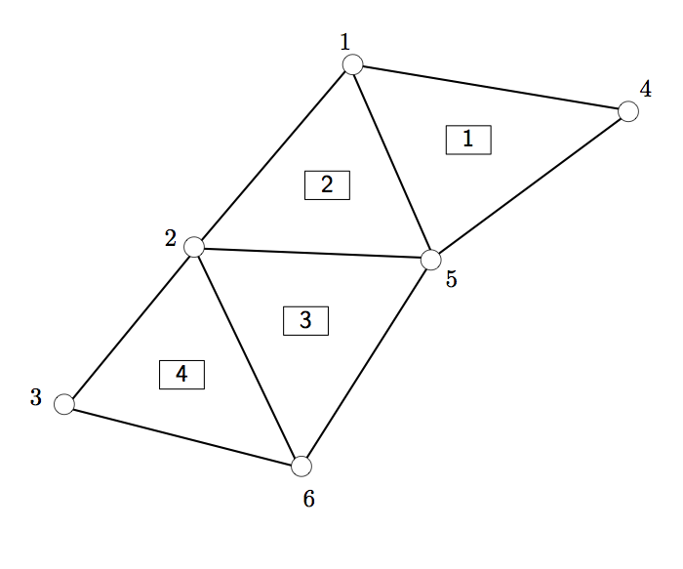
Δx
Δx
1
2
3
i-1
i
i+1
n-2
n-1
n
Nodes
Elements

