Slide 1
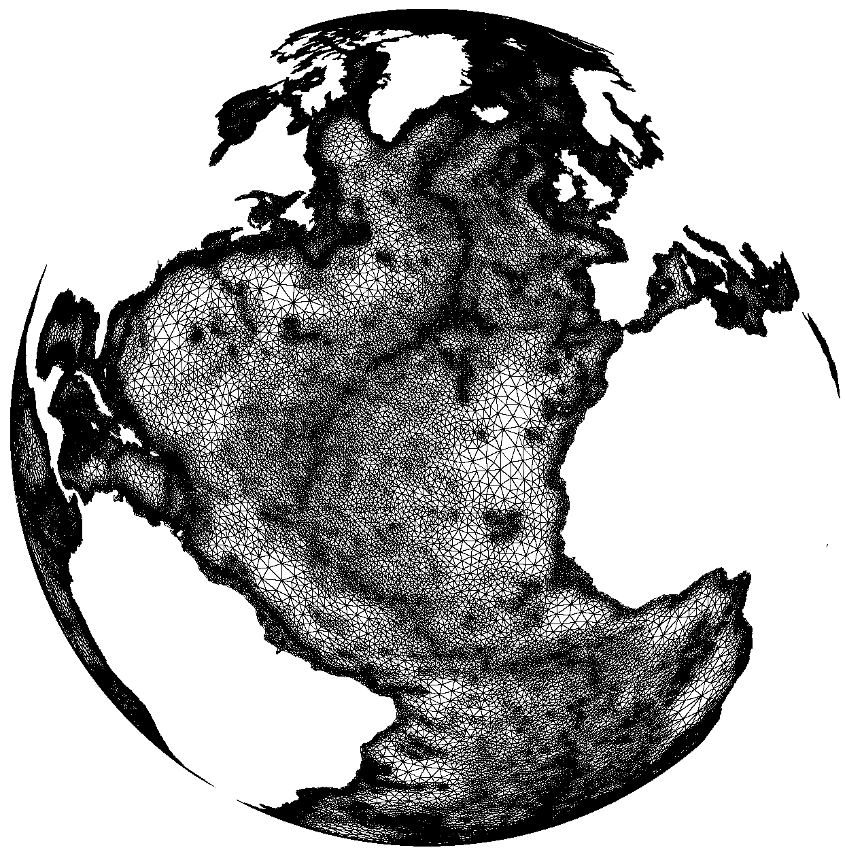
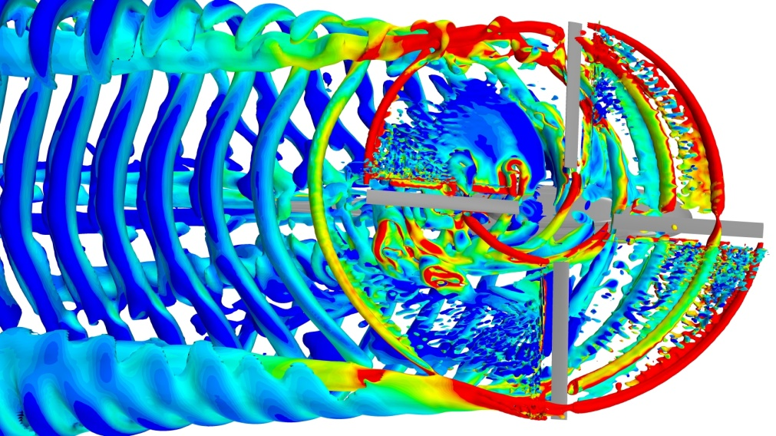
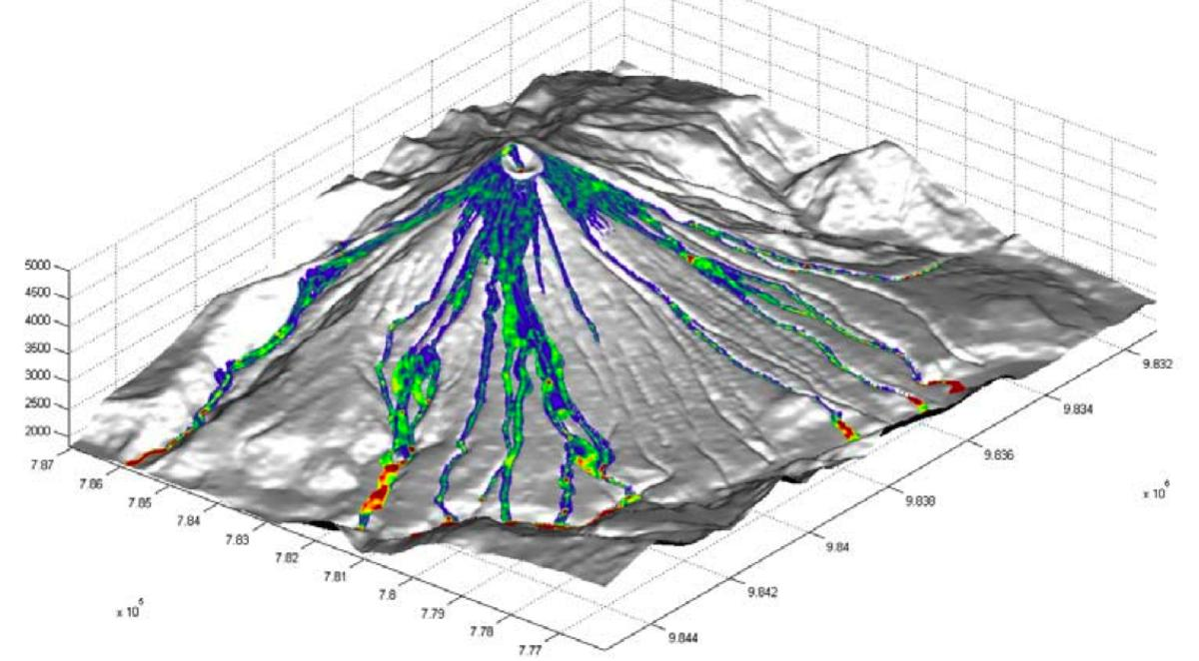
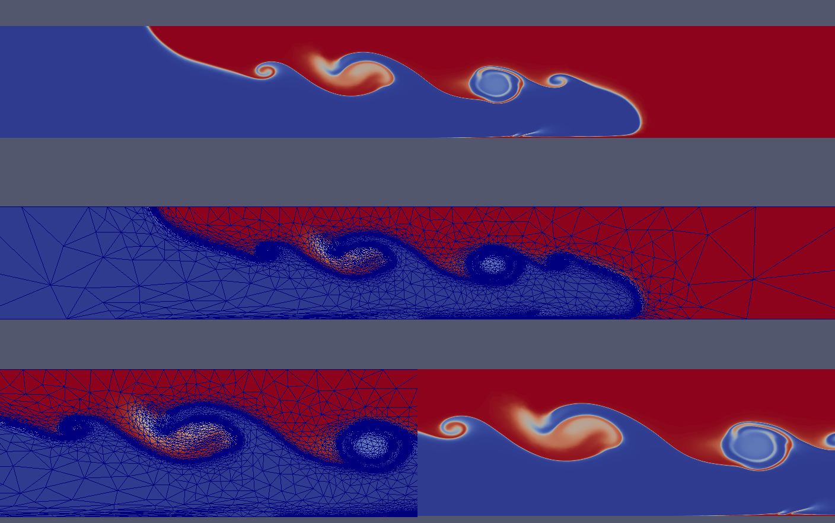
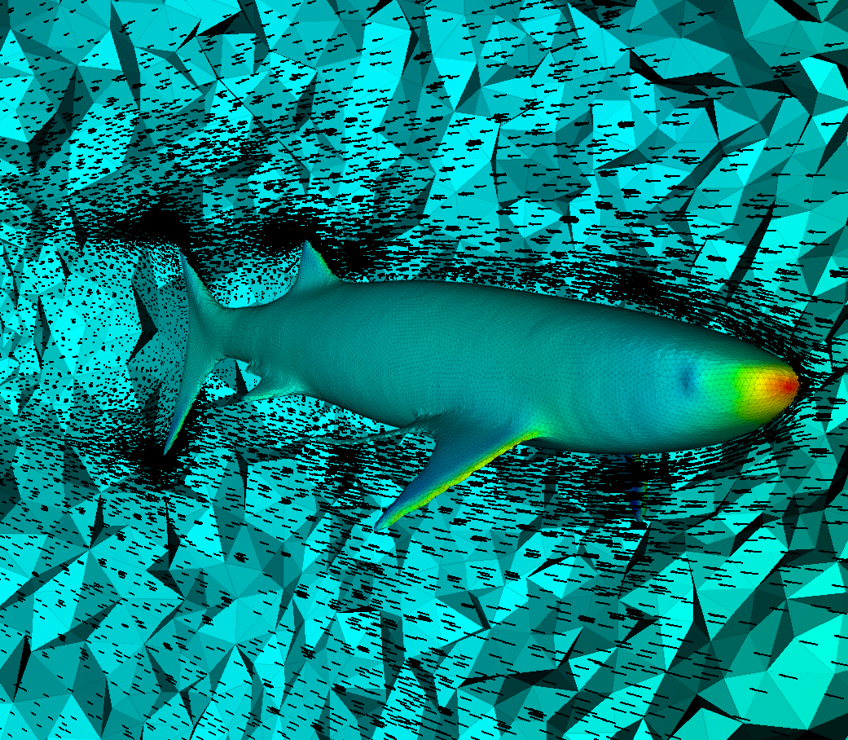
Pyroclastic flows: volcano eruption, http://www.disasterscharter.org/web/charter/home
Isosurfaces in a mixing tankhttp://www.cd-adapco.com/products/star-ccm%C2%AE
Ocean recirculation bottom: Mediterranean sea, http://www3.imperial.ac.uk/earthscienceandengineering/research/amcg/software
Lock exchange problem: mixing of 2 fluids of different densities (Navier-Stokes + thermal advection-diffusion equations under Boussinesq approximation). The simulation was performed using unstructured triangular mesh.
Study of shark evolution: Palaeo-hydrodynamics http://www3.imperial.ac.uk/earthscienceandengineering/research/amcg/software

