Slide 1
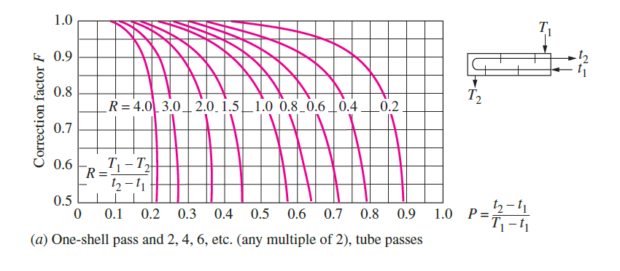
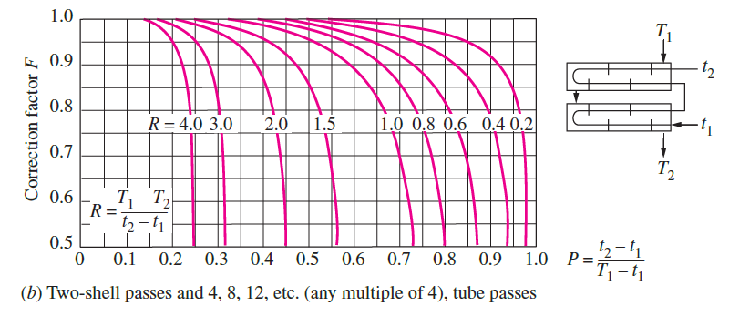
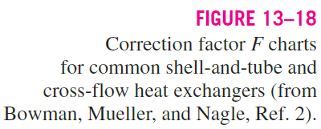
Figure 10.8
Extracted from Y.A. Cengel, “Heat Transfer: A Practical Approach”, 2nd Edition.

