Slide 1
Correlation between a neighborhood real estate price and its surrounding venues
Capstone project
IBM Data Science Professional Certificate
May 2019

Slide 2
Synopsis
Part 1: Problem Description
The main goal will be exploring the neighborhoods of New York city in order to extract the correlation between the real estate value and its surrounding venues.
The target audience for this report are:
Real estate makers and planners who can decide what kind of venues to put around their products to maximize selling price.
Houses sellers who can optimize their advertisements.
Potential buyers who can roughly estimate the value of a house based on the surrounding venues and the average price.

Slide 3
Synopsis
Part 2: Data We Need
New York city neighborhoods were chosen as the observation target :
The diversity of prices between neighborhoods. For example, a 2-bedrooms condo in Central Park West, Upper West Side can cost $4.91 million on average; while in Inwood, Upper Manhattan, just 30 minutes away, it's only $498 thousands.
The availability of geo data which can be used to visualize the dataset onto a map.
The type of real estate to be considered is 2-bedroom condo, which is common for most normal nuclear families.

Slide 4
Synopsis
Part 2: Data We Need
The process of collecting and clean data:
Scrap the CityRealty webpage for a list of New York city neighborhoods.
Find the center coordinates and their border of geographic data of the neighborhoods.
For each neighborhood, pass the obtained coordinates to FourSquare API. The “explore” endpoint will return a list of surrounding venues in a pre-defined radius.
Count the occurrence of each venue type in a neighborhood. Then apply one hot encoding to turn each venue type into a column with their occurrence as the value.
Standardize the average price by removing the mean and scaling to unit variance.

Slide 5
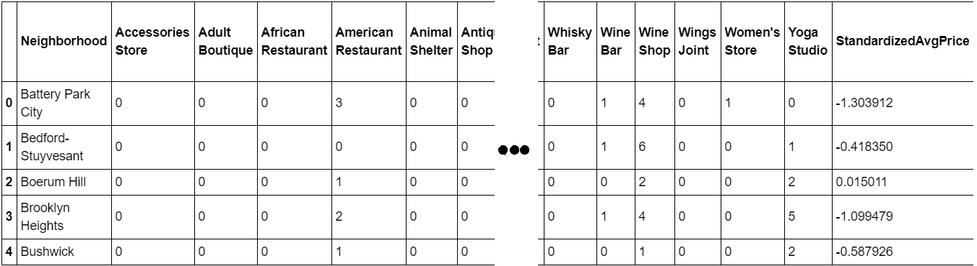
Main Article
Part 1: Cleaned dataset for processing"

Slide 6
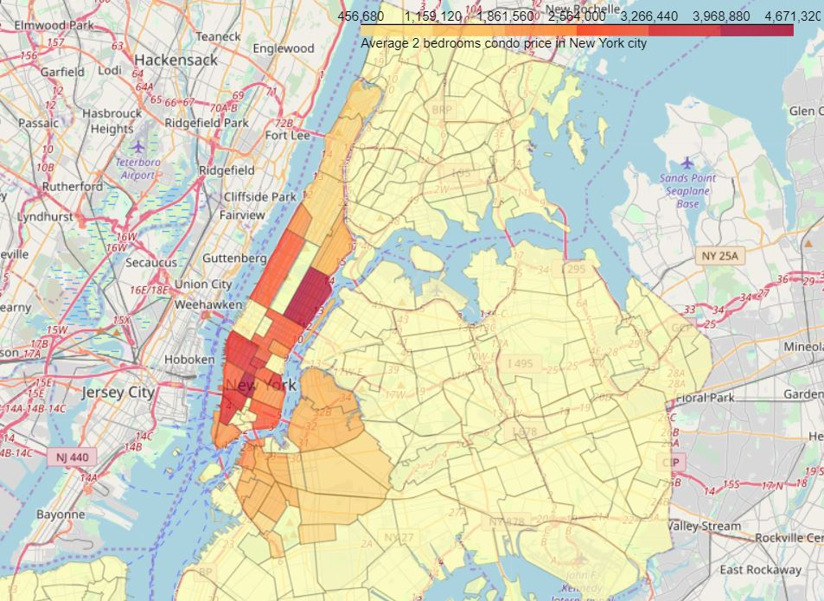
Main Article
Part 1 Insights using dataset for house pricing

Slide 7
Main Article
Part 2: Performing Regressions and other techniques.
After finding the list of neighborhoods, we then connect to the Foursquare API to gather information about venues inside each and every neighborhood.
We can performed Linear Regression and other techniques.

Slide 8
Results
The models didn’t perform particularly well to our liking.
Reasons could be -
The real estate price is hard to predict.
The data is incomplete (small sample size, missing deciding factors).
The machine learning techniques are chosen or applied poorly.

Slide 9
Main Article
Part 3: Processing the Retrieved Data and Creating a DataFrome for All the Venues inside the Scarborough
When the data is completely gathered, we will perform processing on that raw data to find our desirable features for each venue. Our main feature is the category of that venue. After this stage, the column "Venue's Category" wil be One-hot encoded and different venues will have different feature-columns. After On-hot encoding we will integrate all restaurant columns to one column "Total Restaurants" and all food joint columns to "Total Joints" column.

Slide 10
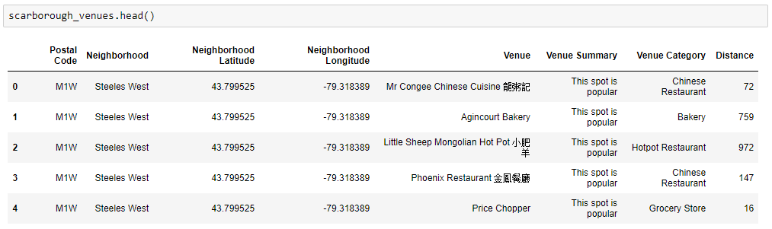
Main Article
Part 3: Processing the Retrieved Data and Creating a DataFrome for All the Venues inside the Scarborough

Slide 11
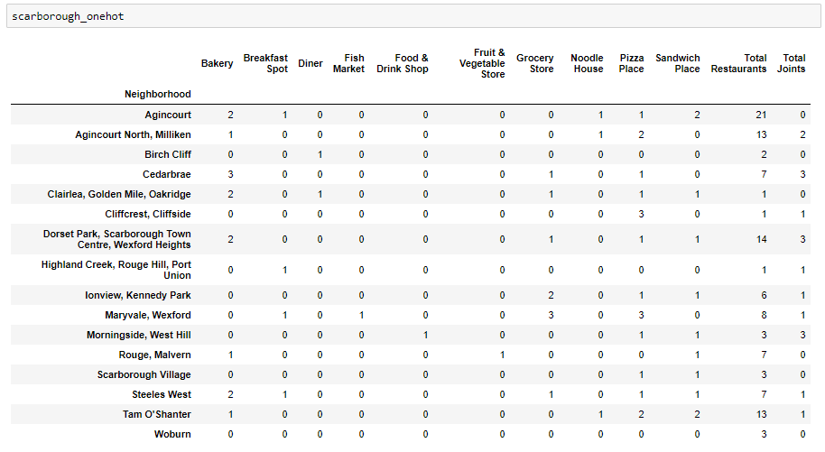
Now, the dataset is fully ready to be used for machine learning (and statistical analysis) purposes.

Slide 12
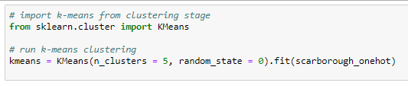
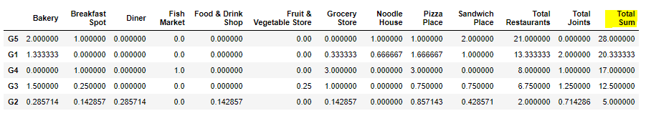
Main Article
Part 4: Applying one of Machine Learning Techniques (K-Means Clustering)

Slide 13
Decision Making and Reporting Results
Now, we focus on the centers of clusters and compare them for their "Total Restaurants" and their "Total Joints". The group which its center has the highest "Total Sum" will be our best recommendation to the contractor. {Note: Total Sum = Total Restaurants + Total Joints.} This algorithm although is pretty straightforward yet is strongly powerful.

Slide 14
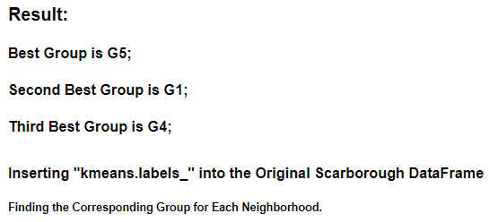
Decision Making and Reporting Results

Slide 15
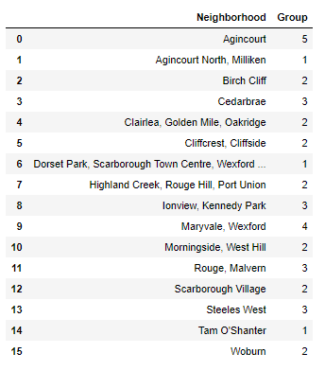
Decision Making and Reporting Results

Slide 16
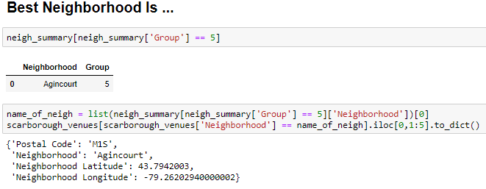
Decision Making and Reporting Results

Slide 17

Image is from: https://contenthub-static.grammarly.com/blog/wp-content/uploads/2017/10/thank-you-760x400.jpg

