Slide 1
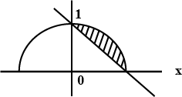
Solution

Slide 2
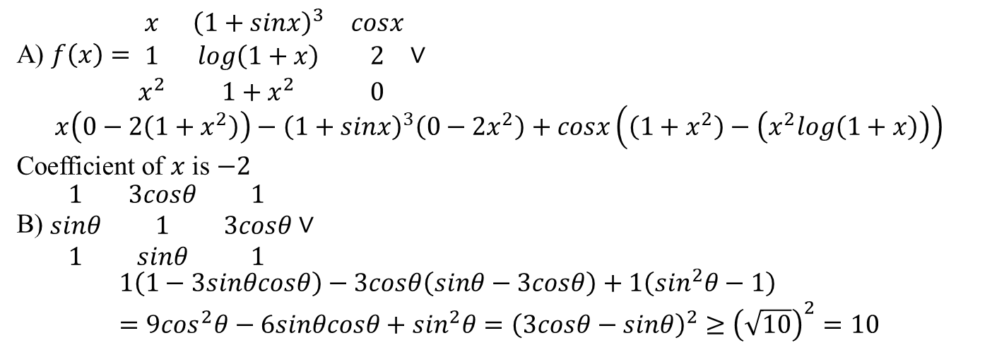
A) $f\left(x\right)=\begin{matrix}x & {\left(1+sinx\right)}^{3} & cosx \\ 1 & log\left(1+x\right) & 2 \\ x^{2} & 1+x^{2} & 0\end{matrix}∨$ $$x\left(0−2\left(1+x^{2}\right)\right)−{\left(1+sinx\right)}^{3}\left(0−2x^{2}\right)+cosx\left(\left(1+x^{2}\right)−\left(x^{2}log\left(1+x\right)\right)\right)$$ Coefficient of $x$ is $−2$ B) $\begin{matrix}1 & 3cosθ & 1 \\ sinθ & 1 & 3cosθ \\ 1 & sinθ & 1\end{matrix}∨$ $$1\left(1−3sinθcosθ\right)−3cosθ\left(sinθ−3cosθ\right)+1\left(\sin^{2}θ−1\right)=9\cos^{2}θ−6sinθcosθ+\sin^{2}θ={\left(3cosθ−sinθ\right)}^{2}≥{\left(\sqrt{10}\right)}^{2}=10$$

Slide 3
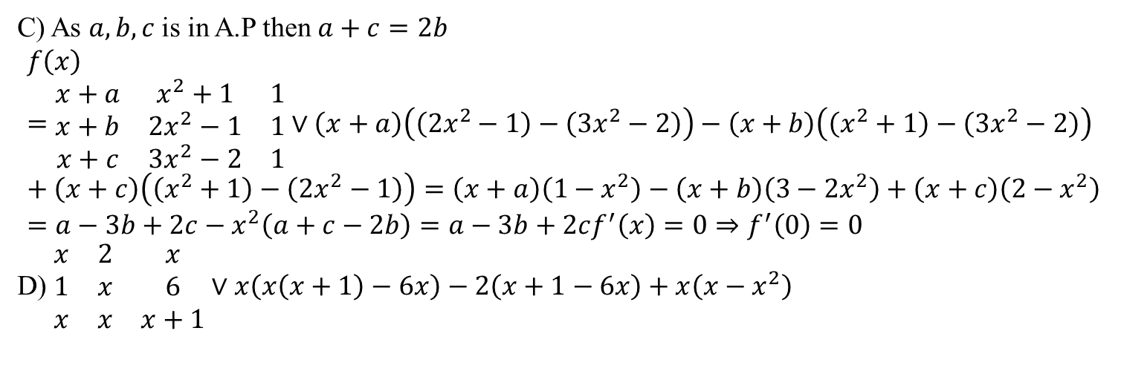
C) As $a,b,c$ is in A.P then $a+c=2b$ $$f\left(x\right)=\begin{matrix}x+a & x^{2}+1 & 1 \\ x+b & 2x^{2}−1 & 1 \\ x+c & 3x^{2}−2 & 1\end{matrix}∨\left(x+a\right)\left(\left({2x}^{2}−1\right)−\left(3x^{2}−2\right)\right)−\left(x+b\right)\left(\left(x^{2}+1\right)−\left(3x^{2}−2\right)\right)+\left(x+c\right)\left(\left(x^{2}+1\right)−\left({2x}^{2}−1\right)\right)=\left(x+a\right)\left(1−x^{2}\right)−\left(x+b\right)\left(3−2x^{2}\right)+\left(x+c\right)\left(2−x^{2}\right)=a−3b+2c−x^{2}\left(a+c−2b\right)=a−3b+2cf^{′}\left(x\right)=0⇒f^{′}\left(0\right)=0$$ D) $\begin{matrix}x & 2 & x \\ 1 & x & 6 \\ x & x & x+1\end{matrix}∨x\left(x\left(x+1\right)−6x\right)−2\left(x+1−6x\right)+x\left(x−x^{2}\right)$

