Slide 1
FUZZY ANALYTIC HIERARCHY PROCESS METHOD
Department of Industrial System and Engineering
International University
Speaker: Ha Thi Xuan Chi
Notes:
Multi-criteria decision making
Depart.of ISE-IU

Slide 2
CONTENTS
Review of AHP
Basic of fuzzy set theory
Fuzzy AHP procedure
Applications
Homework
Depart. of ISE- International University
Notes:
Depart.of ISE-IU
Multi-criteria decision making

Slide 3
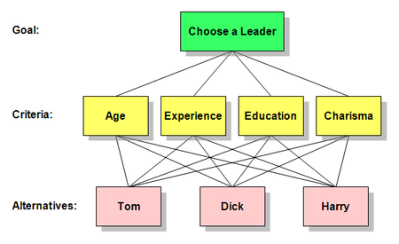

1. REVIEW OF AHP
Depart. of ISE- International University

Slide 4
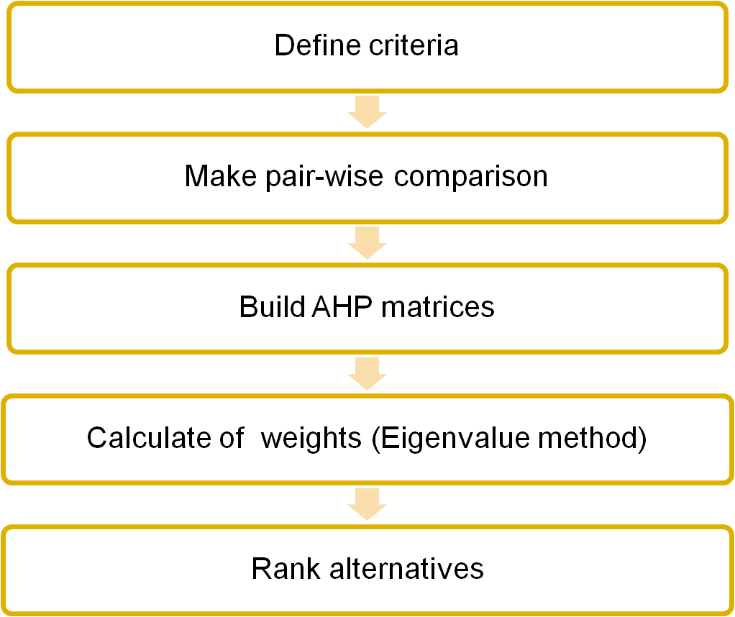
THE PROCEDURE OF AHP
Depart. of ISE- International University
Notes:
Depart.of ISE-IU
Multi-criteria decision making

Slide 5
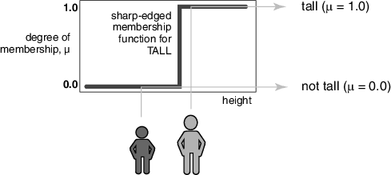
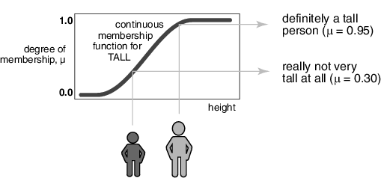


2. BASIC OF FUZZY SET THEORY
Example:
The set of tall men. People taller than or equal to 6 feet are tall.
Classical set
Fuzzy set
The membership function says: tall or not tall.
Only tall men belong to the set.
Works nicely for binary operations and mathematics
Makes no difference between somebody who is 6 feet 1 inch and someone who is 7 feet
The degree of membership function : Very tall, tall, not very tall,…
Every man belongs to the fuzzy set
Work as nicely in describing the real world
Give degree of high for each man
Give degree of high membership function for each man in the set
Are you taller than or equal to 6 feet?
How tall are you?

Slide 6


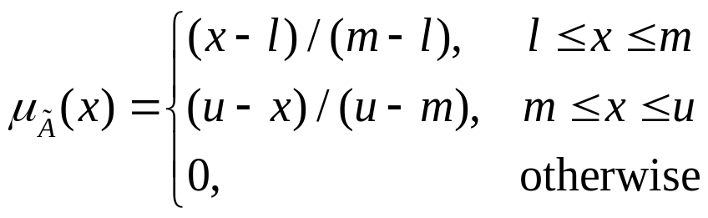
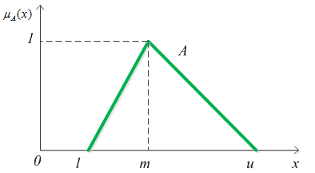
Fuzzy numbers:
A fuzzy number on R is a TFN if its membership function
is equal to:
Where: l stand for the lower value of the fuzzy number
u upper bounds value of the fuzzy number
m for the modal value of the fuzzy number
Depart. of ISE- International University
Fig. 1. The membership function of the triangular fuzzy number

Slide 7

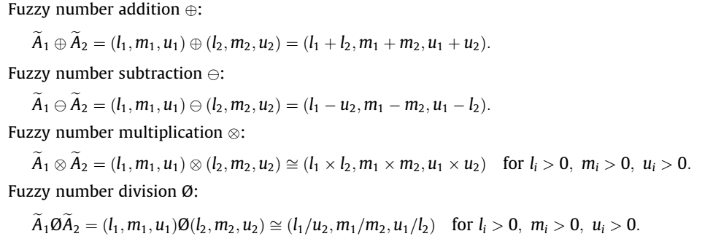
Basic arithmetic operations
Depart. of ISE- International University

Slide 8
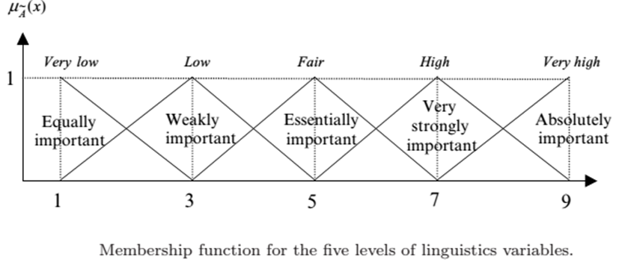
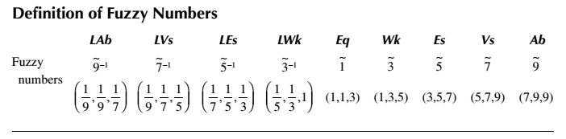
Linguistic variable: a variable that takes words or sentences in natural language as its value.
Depart. of ISE- International University

Slide 9
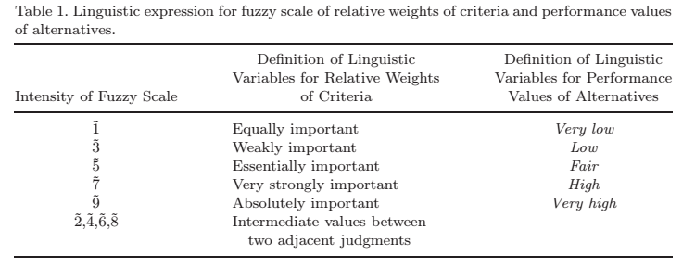
Depart. of ISE- International University

Slide 10












Applying fuzzy in AHP
Age
Experience
Scale:
Fuzzy AHP
(7,9,9) (5,7,9) (3,5,7) (1,3,5) (1,1,1) (1/5,1/3,1) (1/7, 1/5,1/3) (1/5,1/7,1/9) (1/9,1/9,1/7)
AHP
9 7 5 3 1 1/3 1/5 1/7 1/9
Extremely
Important
Equal
Important
Extremely
Very important
Moderate important
Moderate important
Very important
Depart. of ISE- International University

Slide 11
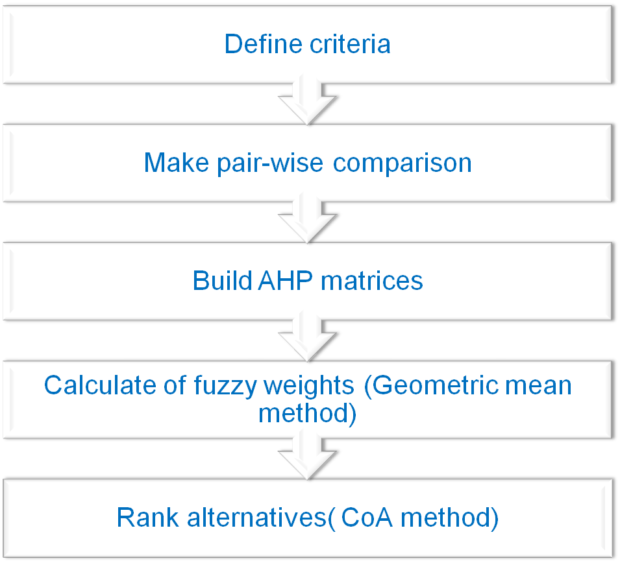
3. FUZZY AHP PROCEDURES
Depart. of ISE- International University

Slide 12







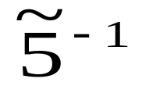









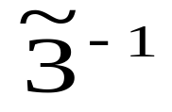
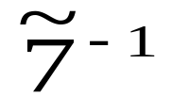




BUILD A MATRIX
Education
Age
Experience
Charisma
Age
Experience
Education
Charisma
Depart. of ISE- International University

Slide 13
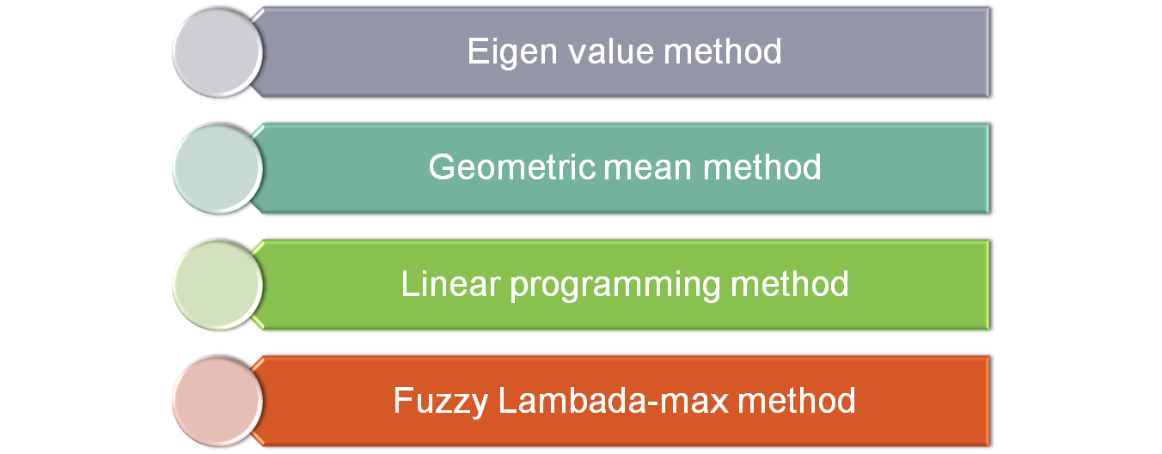
HOW TO CALCULATE FUZZY WEIGHTS
Depart. of ISE- International University

Slide 14




Geometric mean method (Buckey 1985)
Where
where is the fuzzy comparison value of criterion j to criterion m
is the geometric mean of fuzzy comparison value of criterion
j to each criterion
is the fuzzy weight of the j^{th} criterion and can be indicated by triangular fuzzy numbers
Depart. of ISE- International University

Slide 15






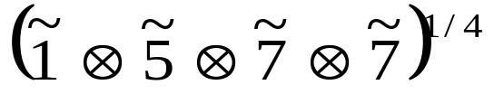





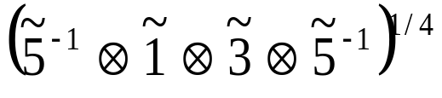




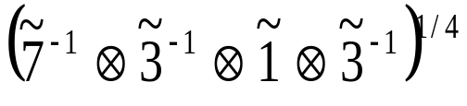






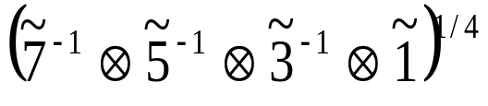
Calculate fuzzy weight of criterion
(Geometric mean method)
Fuzzy Geometric mean of criteria (r_{j})
Education
Age
Experience
Charisma
Age
Experience
Education
Charisma
1
Depart. of ISE- International University

Slide 16
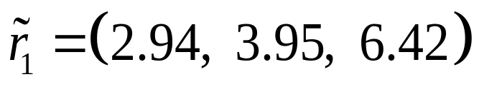

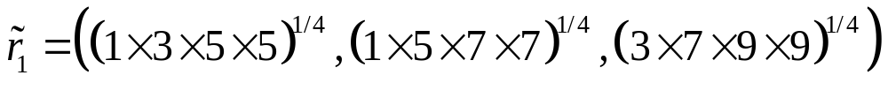

Fuzzy Geometric mean value of criteria (r_{j})
Depart. of ISE- International University

Slide 17


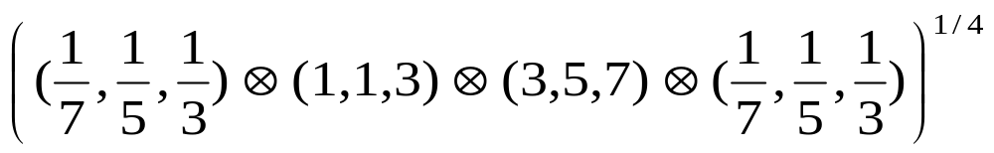
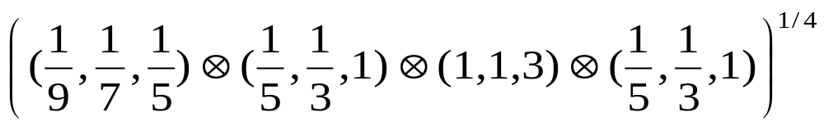


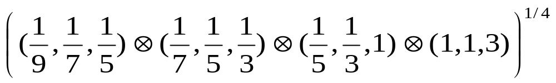
Calculate in the same way
Depart. of ISE- International University

Slide 18








Fuzzy weights of criteria(w_{j})
Fuzzy Geometric mean value of criteria (r_{i})
Depart. of ISE- International University

Slide 19
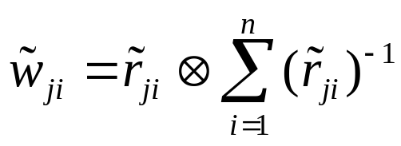

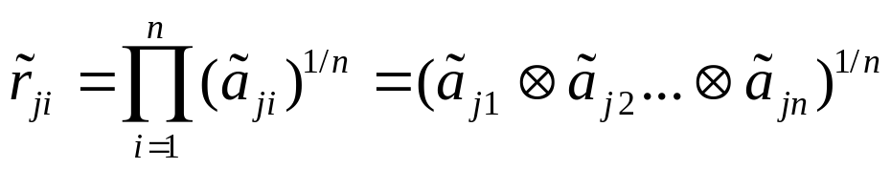




Calculate the fuzzy weights of Alternatives under each criterion ( Geometric mean method)
where is the fuzzy comparison value of alternative i to n under the j^{th} criterion
is the geometric mean of fuzzy comparison value of the j^{th} criterion to the i^{th} alternative
is the fuzzy weight of the alternative i to n under the j^{th} criterion and can be indicated by triangular fuzzy number
Depart. of ISE- International University

Slide 20




Pair wise comparison of Candidates for Age
 | Tom | Dick | Harry
Tom | (1,1,3) | (3,5,7) | (1,3,5)
Dick | (1/7,1/5,1/3) | (1,1,3) | (1/5,1/3,1)
Harry | (1/5,1/3,1) | (1,3,5) | (1,1,3)
Depart. of ISE- International University

Slide 21
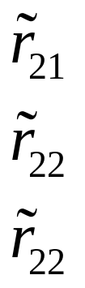
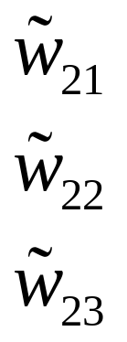
Pair wise comparison of Candidates for Experience
 | Tom | Dick | Harry
Tom | (1,1,3) | (1/7,1/5,1/3) | (1/5,1/3,1)
Dick | (3,5,7) | (1,1,3) | (1,3,5)
Harry | (1,3,5) | (1/5,1/3,1) | (1,1,3)
Depart. of ISE- International University

Slide 22


Pair wise comparison of Candidates for Education
 | Tom | Dick | Harry
Tom | (1,1,3) | (1/5,1/3,1) | (1/7,1/5,1/3)
Dick | (1,3,5) | (1,1,3) | (1/9,1/7,1/5)
Harry | (3,5,7) | (5,7,9) | (1,1,3)
Depart. of ISE- International University

Slide 23
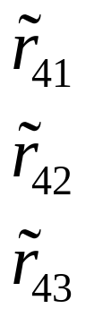

Pair wise comparison of Candidates for Charisma
 | Tom | Dick | Harry
Tom | (1,1,3) | (1,3,5) | (3,5,7)
Dick | (1/5,1/3,1) | (1,1,3) | (1/9,1/7,1/5)
Harry | (1/9,1/7,1/5) | (5,7,9) | (1,1,3)
Depart. of ISE- International University

Slide 24
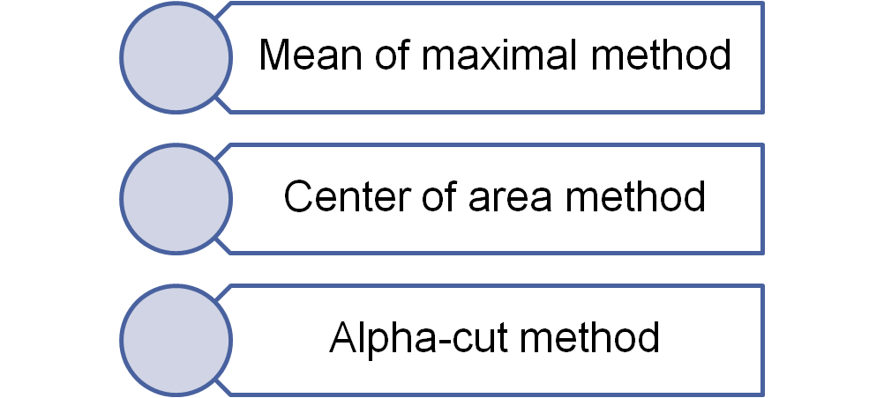
How to rank alternatives
Depart. of ISE- International University

Slide 25
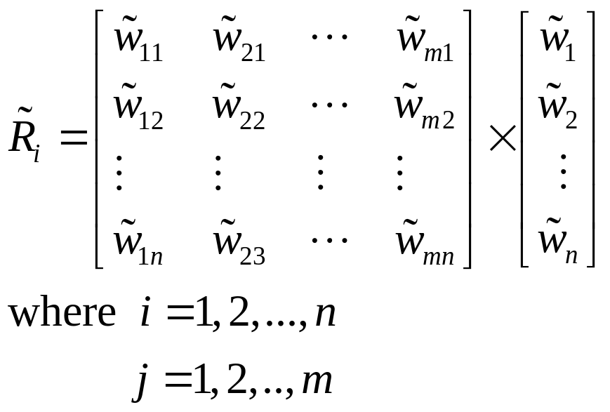
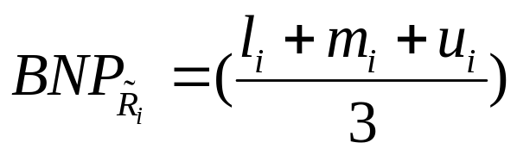
CoA method
The final fuzzy weight value of each alternative :
The best non-fuzzy performance value:
Depart. of ISE- International University

Slide 26
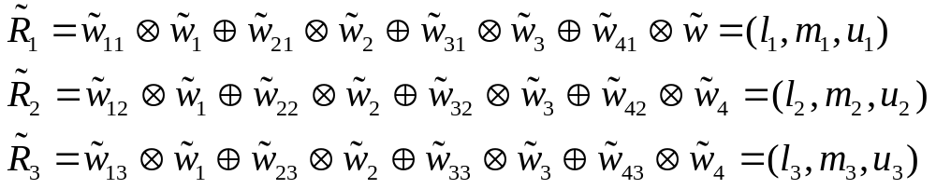
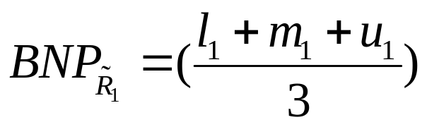
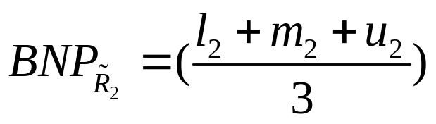

The final fuzzy weight value of each alternative :
The best non-fuzzy performance value:
Depart. of ISE- International University

Slide 27
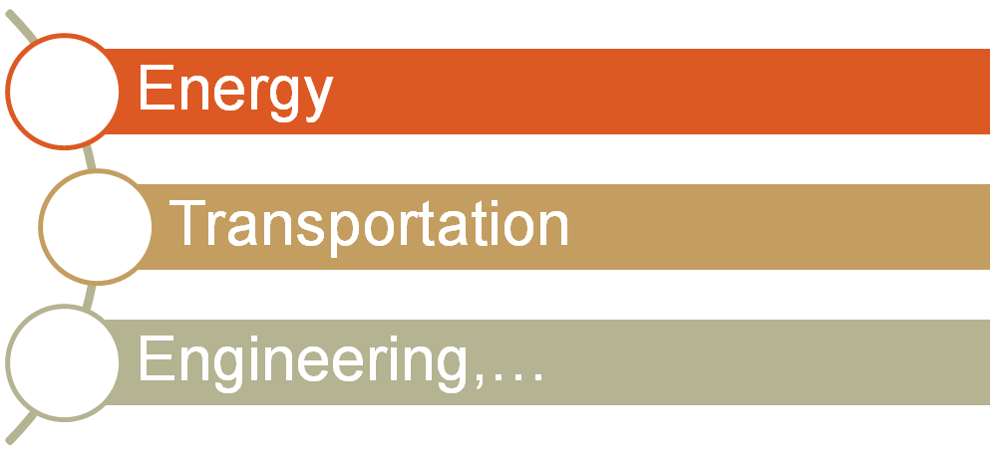
4. APPLICATIONS
Apply for dealing with multi-criteria solving problems:
Depart. of ISE- International University

Slide 28
5. HOMEWORK
Please use fuzzy AHP method to find the ranking order of alternatives in the above-mentioned example.
Depart. of ISE- International University

