Slide 1
Lecturer: Assoc. Prof. Ho Thanh Phong International University, VNU-HCM 2016
MCDM
Multi-Criteria Decision Making

Slide 2
Grading:
Midterm Exam: 30%
Final Exam: 40%
Homeworks: 10%
Project: 20%
Textbook:
“Multiple Attribute Decision Making: Methods and applications”. Gwo-Hshiung Tzeng & Jih-Jeng Huang, CRC Press, Taylor & Francis Group, 2011 by Taylor & Francis Group.

Slide 3
CONTENTS:
MCDM definition
Problem solving steps
Criteria specifications
Weighting the criteria
Standardizing the raw scores
Problem solving techniques

Slide 4
MCDM Definitions
Almost (if not all) decision making problems deal with multiple objectives/criteria.
MCDM includes MODM and MADM:
MODM (Multiple Objective DM): Finding out the set of non-dominated solutions from infinite solutions, according to multiple conflicting objectives.
MADM (Multiple Attribute DM): selection of the best solution from a set of alternatives, each of which is evaluated against multiple conflicting criteria.
Conflicting property: by nature, people consider conflicting objectives or conflicting criteria, if not, they can be combined.

Slide 5
MCDM Definitions
Goal: set of target values which are expected to achieve. (ex: 1000 ton of material next year)
Objectives: directions of achievements, improvements (ex: Maximize Profit)
Criteria: A set of attributes used to evaluate alternatives (ex: Price will be used to evaluate a product to buy).
Factor: A set of similar of attributes and/or actions grouped together to reflect some evaluation.
Alternatives: A set of options (after screening)

Slide 6
Examples of Multi-Criteria Problems
In determining an electric route for power transmission in a city, several criteria could be considered:
Cost
Health
Reliability
Importance of areas

Slide 7
Examples of Multi-Criteria Problems
Locating a nuclear power plant involves criteria such as:
Safety
Health
Environment
Cost

Slide 8
Problem solving steps:
1) Establish the decision context, the decision objectives (goals), and identify the decision maker(s).
2) Identify the alternatives.
3) Identify the criteria (attributes) that are relevant to the decision problem.

Slide 9
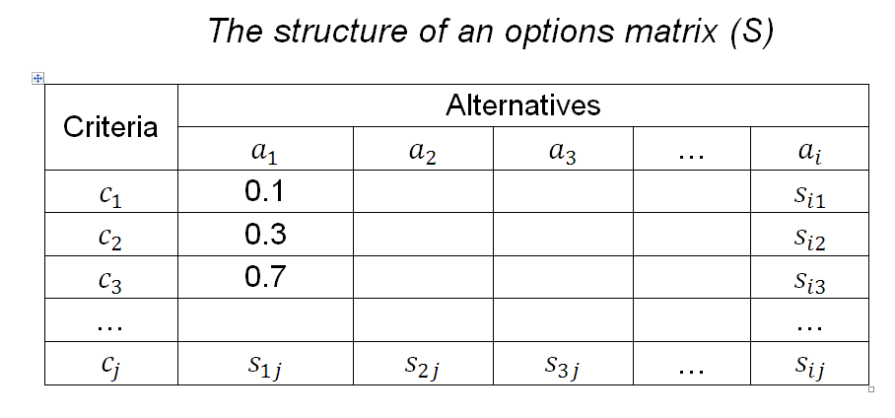
Problem solving steps:
4) For each of the criteria, assign scores to measure the performance of the alternatives against each of these and construct an evaluation matrix (often called an options matrix or a decision table).

Slide 10
Problem solving steps:
5) Standardize the raw scores to generate a priority scores matrix or decision table.
6) Determine a weight for each criterion to reflect how important it is to the overall decision.

Slide 11
Problem solving steps:
7) Use aggregation functions (also called decision rules) to compute an overall assessment measure for each decision alternative by combining the weights and priority scores.
8) Perform a sensitivity analysis to assess the robustness of the preference ranking to changes in the criteria scores and/or the assigned weights.

Slide 12
Criteria characteristics
Completeness: It is important to ensure that all of the important criteria are included.
Redundancy: In principle, criteria that have been judged relatively unimportant or to be duplicates should be removed at a very early stage.
Operationality: It is important that each alternative can be judged against each criterion.

Slide 13
Criteria characteristics
Mutual independence of criteria:
Straightforward applications of MCDM require that preferences associated with the consequences of the alternatives are independent of each other from one criterion to the next.
Number of criteria: An excessive number of criteria leads to extra analytical effort in assessing input data and can make communication of the results of the analysis more difficult.

Slide 14
Weighting the criteria:
Direct Determination
Rating, Point allocation, Categorization
Ranking
Swing
Trade-off
Ratio (Eigenvector prioritization)
Indirect Determination
Centrality
Regression – Conjoint analysis
Interactive

Slide 15
Weighting the criteria:
-The ranking method: In this method, the criteria are simply ranked in perceived order Of importance by decision- makers: c1 > c2 > c3 > … > ci . The method assumes that the weights are non-negative and sum to 1.
- Rating method: The point allocation approach is based on allocating points ranging from 0 to 100, where 0 indicates that the criterion can be ignored, and 100 represents the situation where only one criterion need to be considered. In ratio estimation procedure which is a modification of the point allocation method. A score of 100 is assigned to the most important criterion and proportionally smaller weights are given to criteria lower in the order. The score assigned for the least important attribute is used to calculate the ratios.

Slide 16
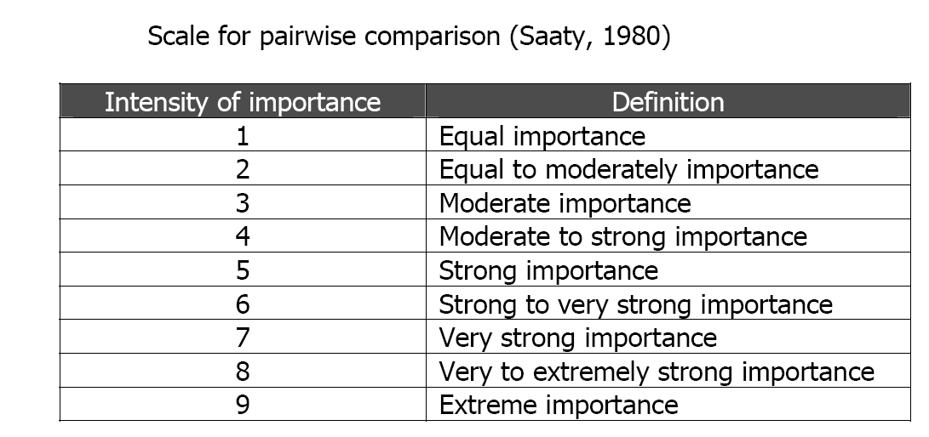
Weighting the criteria:
- Pair wise comparison method: involves pair wise comparisons to create a ratio matrix. It uses scale table for pair wise comparisons and then computes the weights.

Slide 17
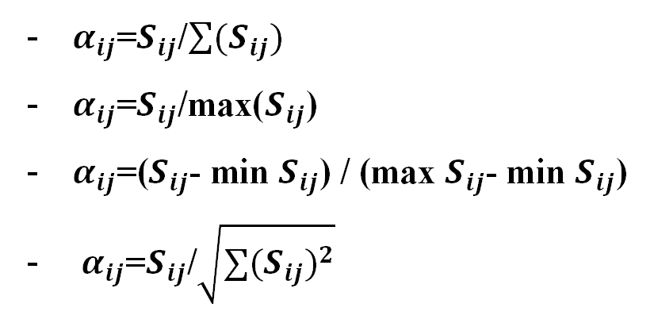
Standardizing the raw scores
Because usually the various criteria are measured in different units, the scores in the evaluation matrix S have to be transformed to a normalized scale. some methods are :

Slide 18
Problem solving techniques
Some problem solving techniques are :
SAW (Simple Additive Weighting)
TOPSIS (Technique for Order Preference by Similarity to the Ideal Solution)
ELECTRE (Elimination et Choice Translating Reality)
BAYESIAN NETWORK BASED FRAMEWORK
AHP (The Analytical Hierarchy Process)
SMART (The Simple Multi Attribute Rating Technique )
ANP (Analytic network process)

Slide 19
The selection of the models are based on the following evaluation criteria suggested by Dodgson et al. (2001):
• internal consistency and logical soundness;
• transparency;
• ease of use;
• data requirements are consistent with the importance of the issue being considered;
• realistic time and manpower resource requirements for the analytical process;
• ability to provide an audit trail; and
• software availability, where needed.

Slide 20
SAW (Simple Additive Weighting):
Multiplies the normalized value of the criteria for the alternatives with the importance of the criteria .the alternative with the highest score is selected as the preferred one.

Slide 21
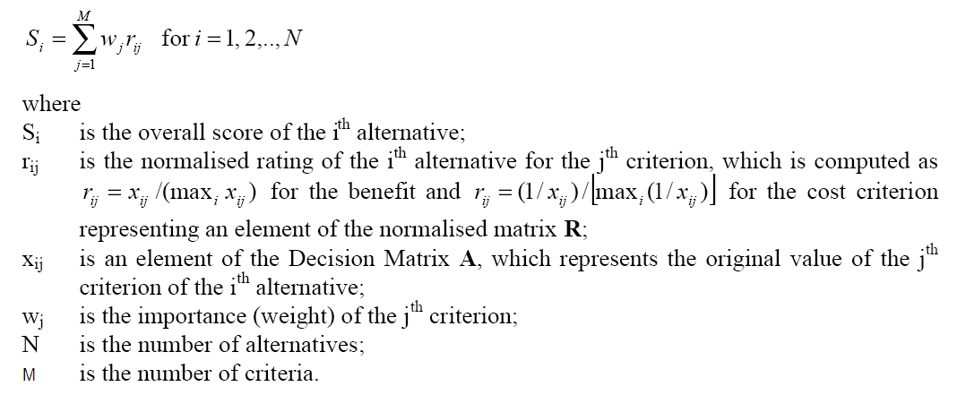
SAW (Simple Additive Weighting):

Slide 22
A simple example of using SAW method
Objective
Selecting a car
Criteria
Style, Reliability, Fuel-economy
Alternatives
Civic Coupe, Saturn Coupe, Ford Escort, Mazda Miata

Slide 23
Weights and Scores
Weight 0.3 0.4 0.3 Si
Style
Reliability
Fuel Eco.
Civic
7 9 9
8.4
7.6
7.5
7.0
Saturn
8 7 8
Ford
9 6 8
6 7 8
Mazda

Slide 24
TOPSIS (Technique for Order Preference by Similarity to the Ideal Solution)
In this method two artificial alternatives are hypothesized:
Ideal alternative: the one which has the best level for all attributes considered.
Negative ideal alternative: the one which has the worst attribute values.
TOPSIS selects the alternative that is the closest to the ideal solution and farthest from negative ideal alternative.

Slide 25
Input to TOPSIS
TOPSIS assumes that we have m alternatives (options) and n attributes/criteria and we have the score of each option with respect to each criterion.
Let x_{ij} score of option i with respect to criterion j
We have a matrix X = (x_{ij}) m×n matrix.
Let J be the set of benefit attributes or criteria (more is better)
Let J' be the set of negative attributes or criteria (less is better)

Slide 26
Steps of TOPSIS
Step 1: Construct normalized decision matrix.
This step transforms various attribute dimensions into non-dimensional attributes, which allows comparisons across criteria.
Normalize scores or data as follows:
r_{ij} = x_{ij}/ √(Σx²_{ij}) for i = 1, …, m; j = 1, …, n
^{i}

Slide 27
Steps of TOPSIS
Step 2: Construct the weighted normalized decision matrix.
Assume we have a set of weights for each criteria w_{j} for j = 1,…n.
Multiply each column of the normalized decision matrix by its associated weight.
An element of the new matrix is:
v_{ij} = w_{j} r_{ij}

Slide 28
Steps of TOPSIS
Step 3: Determine the ideal and negative ideal solutions.
Ideal solution.
A* = { v₁* , …, v_{n}*}, where
v_{j}* ={ max (v_{ij}) if j ∈ J ; min (v_{ij}) if j ∈ J' }
i i
Negative ideal solution.
A' = { v₁' , …, v_{n}' }, where
v' = { min (v_{ij}) if j ∈ J ; max (v_{ij}) if j ∈ J' }
^{i} ^{i}

Slide 29
Steps of TOPSIS
Step 4: Calculate the separation measures for each alternative.
The separation from the ideal alternative is:
S_{i} * = [ Σ (v_{j}*– v_{ij})² ] ^{½} i = 1, …, m
^{j}
Similarly, the separation from the negative ideal alternative is:
S'_{i} = [ Σ (v_{j}' – v_{ij})² ] ^{½} i = 1, …, m
^{j}

Slide 30
Steps of TOPSIS
Step 5: Calculate the relative closeness to the ideal solution C_{i}*
C_{i}* = S'_{i} / (S_{i}* +S'_{i} ) , 0 < Ci* < 1
Select the Alternative with C_{i}* closest to 1.

Slide 31
An example of using TOPSIS method
Weight 0.1 0.4 0.3 0.2
Style
Reliability
Fuel Eco.
Cost
Civic
7 9 9 8
Saturn
8 7 8 7
Ford
9 6 8 9
6 7 8 6
Mazda

Slide 32
Steps of TOPSIS
Step 1: calculate (Σx²_{ij} )^{1/2} for each column and
divide each column by that to get rij
Style
Rel.
Fuel
Cost
Civic
0.46 0.61 0.54 0.53
Saturn
0.53 0.48 0.48 0.46
Ford
0.59 0.41 0.48 0.59
0.40 0.48 0.48 0.40
Mazda

Slide 33
Steps of TOPSIS
Step 2 : multiply each column by w_{j} to get vij.
Style+
Rel.+
Fuel+
Cost -
Civic
0.046 0.244 0.162 0.106
Saturn
0.053 0.192 0.144 0.092
Ford
0.059 0.164 0.144 0.118
0.040 0.192 0.144 0.080
Mazda

Slide 34
Steps of TOPSIS
Step 3 (a): determine ideal solution A*.
A* = {0.059, 0.244, 0.162, 0.080}
Style
Rel.
Fuel
Cost
Civic
0.046 0.244 0.162 0.106
Saturn
0.053 0.192 0.144 0.092
Ford
0.059 0.164 0.144 0.118
0.040 0.192 0.144 0.080
Mazda

Slide 35
Steps of TOPSIS
Step 3 (b): find negative ideal solution A'.
A' = {0.040, 0.164, 0.144, 0.118}
Style
Rel.
Fuel
Cost
Civic
0.046 0.244 0.162 0.106
Saturn
0.053 0.192 0.144 0.092
Ford
0.059 0.164 0.144 0.118
0.040 0.192 0.144 0.080
Mazda

Slide 36
Steps of TOPSIS
Step 4 (a): determine separation from ideal solution A* = {0.059, 0.244, 0.162, 0.080}
S_{i}* = [ Σ (v_{j}*– v_{ij})² ] ^{½} for each row ^{j}
Style
Rel.
Fuel
Cost
Civic
(.046-.059)² (.244-.244)² (0)² (.026)²
Saturn
(.053-.059)² (.192-.244)² (-.018)² (.012)²
Ford
(.053-.059)² (.164-.244)² (-.018)² (.038)²
Mazda
(.053-.059)² (.192-.244)² (-.018)² (.0)²

Slide 37
Steps of TOPSIS
Step 4 (a): determine separation from ideal solution Si*
Σ(v_{j}*–v_{ij})²
Si* = [ Σ (v_{j}*– v_{ij})² ] ^{½}
Civic
0.000845 0.029
Saturn
0.003208 0.057
Ford
0.008186 0.090
Mazda
0.003389 0.058

Slide 38
Steps of TOPSIS
Step 4: determine separation from negative ideal solution Si'
Σ(v_{j}'–v_{ij})²
Si' = [ Σ (vj'– vij)2 ] ½
Civic
0.006904 0.083
Saturn
0.001629 0.040
Ford
0.000361 0.019
Mazda
0.002228 0.047

Slide 39
Steps of TOPSIS
Step 5: Calculate the relative closeness to the ideal solution Ci* = S'_{i} / (S_{i}* +S'_{i} )
S'_{i} /(S_{i}*+S'_{i})
Ci*
Civic
0.083/0.112 0.74 ← BEST
Saturn
0.040/0.097 0.41
Ford
0.019/0.109 0.17
Mazda
0.047/0.105 0.45

Slide 40
AHP (The Analytical Hierarchy Process)
AHP uses a hierarchical structure and pairwise comparisons.
An AHP hierarchy has at least three levels:
1) the main objective of the problem at the top.
2) multiple criteria that define alternatives in the middle.(m)
3) competing alternatives at the bottom.(n)

Slide 41
Steps of AHP
Criteria weighting must be determined using (m*(m-1))/2 pair wise comparisons.
Alternatives scoring using m*((n*(n-1))/2) pair wise comparisons between alternatives for each criteria.
After completing pair wise comparisons AHP is just the hierarchical application of SAW.

Slide 42
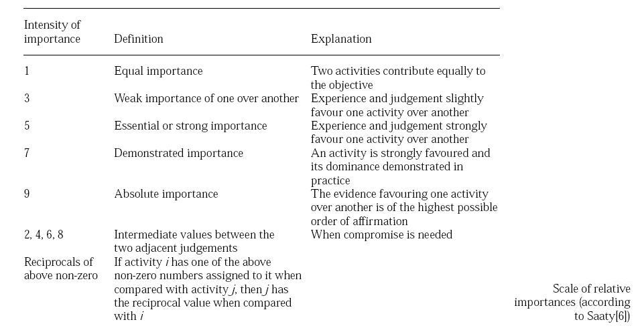
Scale of relative importance table

Slide 43
Analytic Hierarchy Process
The Analytic Hierarchy Process (AHP), is a procedure designed to quantify managerial judgments of the relative importance of each of several conflicting criteria used in the decision making process.

Slide 44
Analytic Hierarchy Process
Step 1: List the Overall Goal, Criteria, and Decision Alternatives
Step 2: Develop a Pairwise Comparison Matrix
Rate the relative importance between each pair of decision alternatives. The matrix lists the alternatives horizontally and vertically and has the numerical ratings comparing the horizontal (first) alternative with the vertical (second) alternative.
Ratings are given as follows:
. . .
------- For each criterion, perform steps 2 through 5 -------

Slide 45
Analytic Hierarchy Process
Step 2: Pairwise Comparison Matrix (continued)
Compared to the second
alternative, the first alternative is: Numerical rating
extremely preferred 9
very strongly preferred 7
strongly preferred 5
moderately preferred 3
equally preferred 1

Slide 46
Analytic Hierarchy Process
Step 2: Pairwise Comparison Matrix (continued)
Intermediate numeric ratings of 8, 6, 4, 2 can be assigned. A reciprocal rating (i.e. 1/9, 1/8, etc.) is assigned when the second alternative is preferred to the first. The value of 1 is always assigned when comparing an alternative with itself.

Slide 47
Analytic Hierarchy Process
Step 3: Develop a Normalized Matrix
Divide each number in a column of the pairwise comparison matrix by its column sum.
Step 4: Develop the Priority Vector
Average each row of the normalized matrix. These row averages form the priority vector of alternative preferences with respect to the particular criterion. The values in this vector sum to 1.

Slide 48
Analytic Hierarchy Process
Step 5: Calculate a Consistency Ratio
The consistency of the subjective input in the pairwise comparison matrix can be measured by calculating a consistency ratio. A consistency ratio of less than .1 is good. For ratios which are greater than .1, the subjective input should be re-evaluated.
Step 6: Develop a Priority Matrix
After steps 2 through 5 has been performed for all criteria, the results of step 4 are summarized in a priority matrix by listing the decision alternatives horizontally and the criteria vertically. The column entries are the priority vectors for each criterion.

Slide 49
Analytic Hierarchy Process
Step 7: Develop a Criteria Pairwise Development Matrix
This is done in the same manner as that used to construct alternative pairwise comparison matrices by using subjective ratings (step 2). Similarly, normalize the matrix (step 3) and develop a criteria priority vector (step 4).
Step 8: Develop an Overall Priority Vector
Multiply the criteria priority vector (from step 7) by the priority matrix (from step 6).

Slide 50
Determining the Consistency Ratio
Step 1:
For each row of the pairwise comparison matrix, determine a weighted sum by summing the multiples of the entries by the priority of its corresponding (column) alternative.
Step 2:
For each row, divide its weighted sum by the priority of its corresponding (row) alternative.
Step 3:
Determine the average, λ_{max}, of the results of step 2.

Slide 51
Determining the Consistency Ratio
Step 4:
Compute the consistency index, CI, of the n alternatives by: CI = (λ_{max} - n)/(n - 1).
Step 5:
Determine the random index, RI, as follows:
Number of Random Number of Random
Alternative (n) Index (RI) Alternative (n) Index (RI)
3 0.58 6 1.24
4 0.90 7 1.32
5 1.12 8 1.41
Step 6:
Compute the consistency ratio: CR = CR/RI.

Slide 52
Example: Gill Glass
Designer Gill Glass must decide which of three manufacturers will develop his "signature" toothbrushes. Three factors seem important to Gill: (1) his costs; (2) reliability of the product; and, (3) delivery time of the orders.
The three manufacturers are Cornell Industries, Brush Pik, and Picobuy. Cornell Industries will sell toothbrushes to Gill Glass for $100 per gross, Brush Pik for $80 per gross, and Picobuy for $144 per gross. Gill has decided that in terms of price, Brush Pik is moderately preferred to Cornell and very strongly preferred to Picobuy. In turn Cornell is strongly to very strongly preferred to Picobuy.

Slide 53
Example: Gill Glass
Hierarchy for the Manufacturer Selection Problem
Overall Goal
Select the Best Toothbrush Manufacturer
Criteria
Cost
Reliability
Delivery Time
Cornell
Brush Pik
Picobuy
Cornell
Brush Pik
Picobuy
Cornell
Brush Pik
Picobuy
Decision
Alternatives

Slide 54
The accounting department has determined that in terms of criteria, cost is extremely preferable to delivery time and very strongly preferable to reliability, and that reliability is very strongly preferable to delivery time.

Slide 55
Pairwise Comparison Matrix for Criteria
Cost Reliability Delivery
Cost 1 7 9
Reliability 1/7 1 7
Delivery 1/9 1/7 1

Slide 56
Normalized Matrix for Criteria
Divide each entry in the pairwise comparison matrix by its corresponding column sum.
Cost Reliability Delivery
Cost 63/79 49/57 9/17
Reliability 9/79 7/57 7/17
Delivery 7/79 1/57 1/17

Slide 57
Priority Vector For Criteria
The priority vector is determined by averaging the row entries in the normalized matrix. Converting to decimals we get:
Cost: (63/79 + 49/57 + 9/17)/3 = .729
Reliability: ( 9/79 + 7/57 + 7/17)/3 = .216
Delivery: ( 7/79 + 1/57 + 1/17)/3 = .055

Slide 58
Determine Inconsistency Ratio (CR)
Checking Consistency
Multiply each column of the pairwise comparison matrix by its priority:
1 7 9 2.736
0.729 1/7 + .216 1 + .055 7 = 0.705
1/9 1/7 1 0.167
Divide these number by their priorities to get:
2.736/0.729 = 3.753
0.705/0.216 = 3.264
0.167/0.055 = 3.034

Slide 59
Checking Consistency
Average the above results to get λ_{max}.
λ_{max} = (3.753 + 3.264 + 3.034)/3 = 3.35
Compute the consistence index, CI, for two terms.
CI = (λ_{max} - n)/(n - 1) = (3.35 - 3)/2 = 0.175
Compute the consistency ratio, CR, by CI/RI, where RI = .58 for 3 factors:
CR = CI/RI = 0.175/0.58 = 0.30
Since the consistency ratio, CR, is > 0.10, this should not be acceptable range for consistency.

Slide 60
Example: Gill Glass
Forming the Pairwise Comparison Matrix For Cost
Since Brush Pik is moderately preferred to Cornell, Cornell's entry in the Brush Pik row is 3 and Brush Pik's entry in the Cornell row is 1/3.
Since Brush Pik is very strongly preferred to Picobuy, Picobuy's entry in the Brush Pik row is 7 and Brush Pik's entry in the Picobuy row is 1/7.
Since Cornell is strongly to very strongly preferred to Picobuy, Picobuy's entry in the Cornell row is 6 and Cornell's entry in the Picobuy row is 1/6.

Slide 61
Example: Gill Glass
Pairwise Comparison Matrix for Cost
Cornell Brush Pik Picobuy
Cornell 1 1/3 6
Brush Pik 3 1 7
Picobuy 1/6 1/7 1

Slide 62
Normalized Matrix for Cost
Divide each entry in the pairwise comparison matrix by its corresponding column sum. For example, for Cornell the column sum = 1 + 3 + 1/6 = 25/6. This gives:
Cornell Brush Pik Picobuy
Cornell 6/25 7/31 6/14
Brush Pik 18/25 21/31 7/14
Picobuy 1/25 3/31 1/14

Slide 63
Priority Vector For Cost
The priority vector is determined by averaging the row entries in the normalized matrix. Converting to decimals we get:
Cornell: ( 6/25 + 7/31 + 6/14)/3 = .298
Brush Pik: (18/25 + 21/31 + 7/14)/3 = .632
Picobuy: ( 1/25 + 3/31 + 1/14)/3 = .069

Slide 64
Checking Consistency
Multiply each column of the pairwise comparison matrix by its priority:
1 1/3 6 0.923
.298 3 + .632 1 + .069 7 = 2.009
1/6 1/7 1 0.209
Divide these number by their priorities to get:
.923/.298 = 3.097
2.009/.632 = 3.179
.209/.069 = 3.029

Slide 65
Checking Consistency
Average the above results to get λ_{max}.
λ_{max} = (3.097 + 3.179 + 3.029)/3 = 3.102
Compute the consistence index, CI, for two terms.
CI = (λ_{max} - n)/(n - 1) = (3.102 - 3)/2 = .051
Compute the consistency ratio, CR, by CI/RI, where RI = .58 for 3 factors:
CR = CI/RI = .051/.58 = .088
Since the consistency ratio, CR, is less than .10, this is well within the acceptable range for consistency.

Slide 66
Gill Glass has determined that for reliability, Cornell is very strongly preferable to Brush Pik and equally preferable to Picobuy. Also, Picobuy is strongly preferable to Brush Pik.

Slide 67
Pairwise Comparison Matrix for Reliability
Cornell Brush Pik Picobuy
Cornell 1 7 2
Brush Pik 1/7 1 5
Picobuy 1/2 1/5 1

Slide 68
Normalized Matrix for Reliability
Divide each entry in the pairwise comparison matrix by its corresponding column sum. For example, for Cornell the column sum = 1 + 1/7 + 1/2 = 23/14. This gives:
Cornell Brush Pik Picobuy
Cornell 14/23 35/41 2/8
Brush Pik 2/23 5/41 5/8
Picobuy 7/23 1/41 1/8

Slide 69
Priority Vector For Reliability
The priority vector is determined by averaging the row entries in the normalized matrix. Converting to decimals we get:
Cornell: (14/23 + 35/41 + 2/8)/3 = .571
Brush Pik: ( 2/23 + 5/41 + 5/8)/3 = .278
Picobuy: ( 7/23 + 1/41 + 1/8)/3 = .151
Checking Consistency
Gill Glass’ responses to reliability could be checked for consistency in the same manner as was cost.

Slide 70
Gill Glass has determined that for delivery time, Cornell is equally preferable to Picobuy. Both Cornell and Picobuy are very strongly to extremely preferable to Brush Pik.

Slide 71
Pairwise Comparison Matrix for Delivery Time
Cornell Brush Pik Picobuy
Cornell 1 8 1
Brush Pik 1/8 1 1/8
Picobuy 1 8 1

Slide 72
Normalized Matrix for Delivery Time
Divide each entry in the pairwise comparison matrix by its corresponding column sum.
Cornell Brush Pik Picobuy
Cornell 8/17 8/17 8/17
Brush Pik 1/17 1/17 1/17
Picobuy 8/17 8/17 8/17

Slide 73
Priority Vector For Delivery Time
The priority vector is determined by averaging the row entries in the normalized matrix. Converting to decimals we get:
Cornell: (8/17 + 8/17 + 8/17)/3 = .471
Brush Pik: (1/17 + 1/17 + 1/17)/3 = .059
Picobuy: (8/17 + 8/17 + 8/17)/3 = .471
Checking Consistency
Gill Glass’ responses to delivery time could be checked for consistency in the same manner as was cost.

Slide 74
The accounting department has determined that in terms of criteria, cost is extremely preferable to delivery time and very strongly preferable to reliability, and that reliability is very strongly preferable to delivery time.

Slide 75
Pairwise Comparison Matrix for Criteria
Cost Reliability Delivery
Cost 1 7 9
Reliability 1/7 1 7
Delivery 1/9 1/7 1

Slide 76
Normalized Matrix for Criteria
Divide each entry in the pairwise comparison matrix by its corresponding column sum.
Cost Reliability Delivery
Cost 63/79 49/57 9/17
Reliability 9/79 7/57 7/17
Delivery 7/79 1/57 1/17

Slide 77
Overall Priority Vector
The overall priorities are determined by multiplying the priority vector of the criteria by the priorities for each decision alternative for each objective.
Priority Vector
for Criteria [ .729 .216 .055 ]
Cost Reliability Delivery
Cornell .298 .571 .471
Brush Pik .632 .278 .059
Picobuy .069 .151 .471

Slide 78
Overall Priority Vector (continued)
Thus, the overall priority vector is:
Cornell: (.729)(.298) + (.216)(.571) + (.055)(.471) = .366
Brush Pik: (.729)(.632) + (.216)(.278) + (.055)(.059) = .524
Picobuy: (.729)(.069) + (.216)(.151) + (.055)(.471) = .109
Brush Pik appears to be the overall recommendation.

Slide 79
Some AHP method shortcomings
Comparison inconsistencies:
decision-makers using AHP often make inconsistent pair wise comparisons.
Rank reversals
changing of relative alternative rankings due to the addition and deletion of alternatives.
Large number of comparisons
where there are either a large number of attributes and/or alternatives to be evaluated.

Slide 80
SMART(The Simple Multi Attribute Rating Technique )
In a general sense, SMART is somewhat like AHP in that a hierarchical structure is created to assist in defining a problem and to organize criteria. However, there are some significant differences between two techniques:
1) SMART uses a different terminology. For example, in SMART the lowest level of criteria in the value tree (or objective hierarchy) are called attributes rather than sub-criteria and the values of the standardized scores assigned to the attributes derived from value functions are called ratings.

Slide 81
2) The difference between a value tree in SMART and a hierarchy in AHP is that the value tree has a true tree structure, allowing one attribute or sub-criterion to be connected to only one higher level criterion.
3) SMART does not use a relative method for standardizing raw scores to a normalized scale. Instead, a value function explicitly defines how each value is transformed to the common model scale. The value function mathematically transforms ratings into a consistent internal scale with lower limit 0, and upper limit 1.

Slide 82
ELECTRE METHOD
ELECTRE developed by Roy (1965) stands for ELimination Et Choix Traduisant la REalit´e (ELimination and Choice Expressing the REality),
ELECTRE is a kind of outranking method.
ELECTRE based on two indexes: concordance and discordance.
If consider two alternatives a and b, outranking defined as follows:
aSb and not bSa ⬅➔ a P b (a is strictly preferred to b).
bSa and not aSb ⬅➔ b P a (b is strictly preferred to a).
aSb and bSa ⬅➔ a I b (a is indifferent to b).
Not aSb and not bSa ⬅➔ a R b (a is incomparable to b).
If we define Concordance index C(a,b) and Discordance index is D(a,b) then:
C(a,b) > C* and D(a,b) < D* ⬅➔ a P b

Slide 83
Introduction to ELECTRE
July 1966, Roy presented a paper in Rome in which he used his formal training in Mathematics to develop a practical decision making system, now known as ELECTRE ( Elimination Et Choice Translating REality)
6 main ELECTRE models : I, II, III, IV, Tri and IS

Slide 84
Electre I
The first version of model devised by Roy (1968):
Solve multi-criteria problems.
Choose a set of preference alternatives.

Slide 85
Electre I (cont)
Include two stages:
Construction of the outranking relation : aims at com-paring in a comprehensive way each pair of actions.
Exploitation of the ranking relationship: used to elaborate (explain) recommendations from the results obtained in the first phase. The nature of the recommendations depends on the problematic (choosing, ranking or sorting).

Slide 86
Stage 1: Construction of the outranking relation
C(a, b) ∈ [0,1].
C(a,b): measure how much a is at least as good as b.
g_{i}(k) : the preferred scores of the i^{th} criterion for the k^{th} alternative.
Q(a, b) : the set of criteria for which a is equal or preferred to b.
W_{i} : weight of criterion i^{th}

Slide 87
D(a, b) ∈ [0,1].
D(a,b): measure the degree to which b is strictly preferred to a
g_{i}(k) : the preferred scores of the i^{th} attribute for the k^{th} alternative
R(a, b) : the set of criteria for which b is strictly preferred to a.
A :the set of all alternatives.

Slide 88
Outranking relation

Slide 89
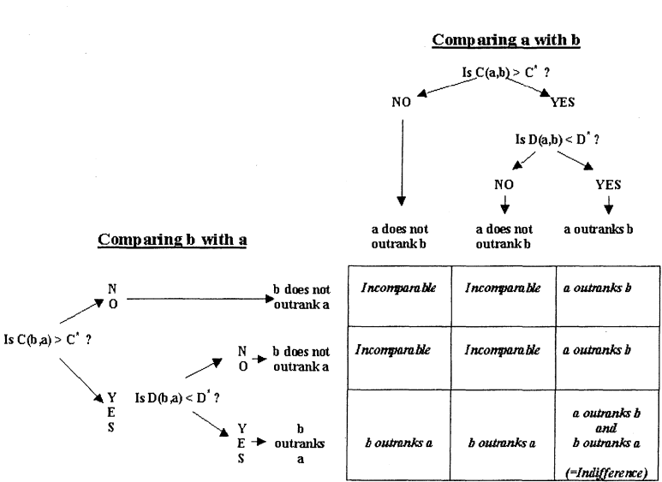
Outrank relation (cont)
Fig I -1. Building an outranking relation
Source: (multi-criteria decision analysis Springer-Science+Business Media, B.V. )

Slide 90
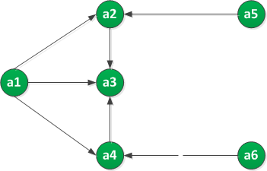
Stage 2: Exploitation of the Ranking Relationships
Electre I, seeks to obtain a partition of the set of all
options ( A) into two subsets N and A\N:
Each option in A\N is outranked by
at least one option in N
The options in N are incomparable
Fig 1. Building and exploiting the outranking relation
N: a kernel of the graph (the set of preferred alternatives)

Slide 91
Ranking procedure of ELECTRE I
Step 1: Collect the weight of criteria given by DM
Step 2: Collect the preferred score of the j^{th} criterion for k^{th} alternatives
 | C1 | C2 | C3
Weighting | 3 | 2 | 1
g_{i}(k) | c1 | c2 | c3
a | 7 | 10 | 4
b | 5 | 6 | 8
c | 7 | 6 | 11
a is equal or preferred
to b

Slide 92
Step 3: Determine Concordance Index
C | a | b | c
a | X | 0.833 | 0.833
b | 0.166 | X | 0.333
c | 0.166 | 0.5 | X

Slide 93
Step 4: Determine Discordance Index
D | a | b | c
a | X | 0.5 | 0.875
b | 1 | X | 0.75
c | 1 | 0 | X

Slide 94
Step 5: DMs define concordance threshold and discordance threshold
Step 6: Check condition
Step 7: Construct the outranking relation graph
Step 8: Determine the kernel of the graph

Slide 95
ELECTRE II
ELECTRE II system (Roy and Bertier, 1971, 1973) differs from ELECTRE I
Rank the options from best to worst, rather than simply establishing an initial kernel.
Give a complete ordering of non-dominated options, unlike ELECTRE I which provides a partial ordering of the non-dominated set.

Slide 96
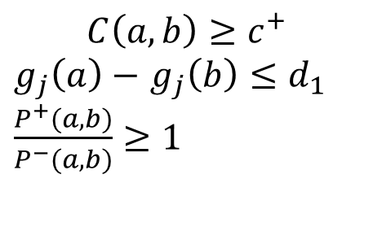
Stage 1: Building the outranking relations
Three concordance thresholds and two discordance thresholds are defined
A strong outranking relation S^{F} and a weak outranking relation S^{f} are built
$$C\left(a,b\right)≥c^{+}$$
$g_{j}\left(a\right)−$ $g_{j}\left(b\right)≤d_{1}$
$\frac{P^{+}(a,b)}{P^{−}(a,b)}≥1$

Slide 97
Outranking relations (cont)
And/Or

Slide 98
Outranking relations (cont)

Slide 99
Ranking procedure of ELECTRE II
Direct ranking procedure
Inverse ranking procedure
Final preorder

Slide 100
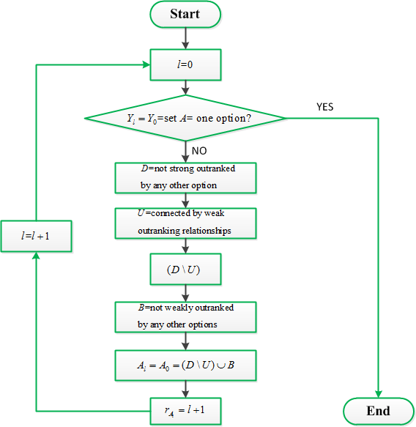
Ranking procedure of ELECTRE II
Fig II-1. Flow chart of direct ranking procedure

Slide 101
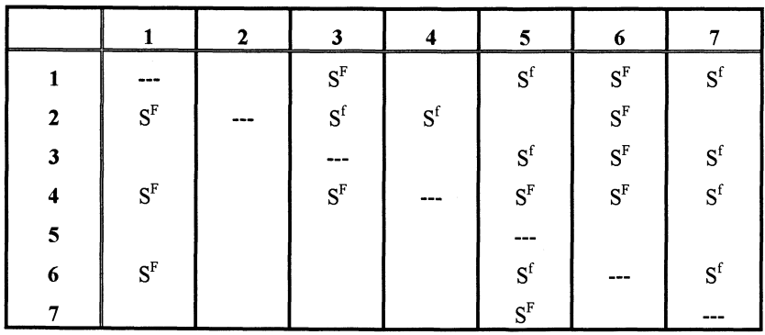
Example for ELECTRE II
Fig II-2. Strong and Weak Outranking Relationships
Source: (M. Rogers et al., ELECTRE and Decision Support © Springer Science+Business Media New York 2000)

Slide 102
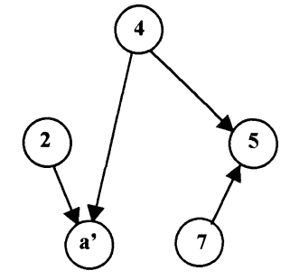
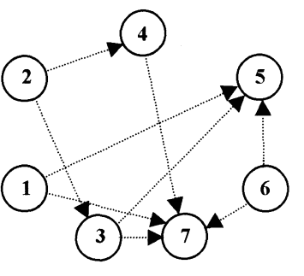
a) Strong outrankings
b) Weak outrankings
Denoted: a’ form a circuit (1,3,6)
Fig II-3. The strong and weak outrankings

Slide 103
Direct ranking procedure
Step 0:
(I = 0)
Set A contains seven options, numbered 1 to 7.
Y_{l} =Y₀ = all seven options
D={2,4,7}.
(Options 2, 4 and 7 are not strongly outranked by any of the other option)
U={2,4,7}.
(All these three options are connected by weak outranking relationships: 2Sf 4 and 4Sf7)

Slide 104
D\U =Ø (Set D minus set U therefore contains no options)
B={2} (Option 2 is not weakly outranked by any other option).
(D-U) U (B) ={2} Option 2, which is given the rank 1 (l + 1), and takes no further part in the direct ranking procedure.
A_{o}= Option 2.

Slide 105
Step 2:
(I = 1)
Y_{l}= Y₂ = {1,3,4,5,6,7}
D={4,7}.
U={4,7}.
D\U =Ø
B={4}
(D-U) U (B) ={4} Option 4, which is given the rank 2 (l + 1), and takes no further part in the direct ranking procedure.
A₁= Option 4. (The best options within step l)

Slide 106
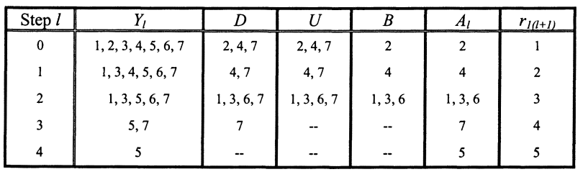
Tab II-1. Summary of Direct Ranking Procedure

Slide 107
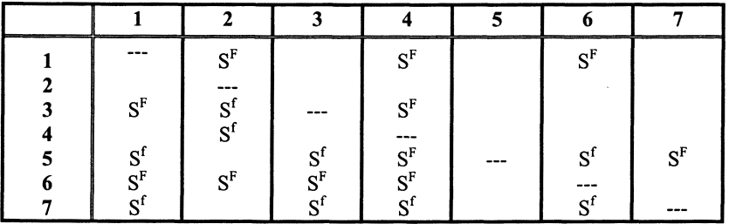
Inverse Ranking Procedure
Tab II-2. Inverted Strong and Weak Outranking Relationships

Slide 108
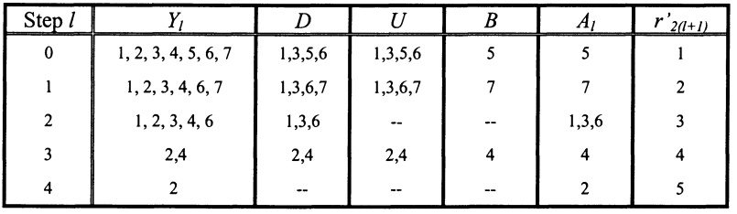
Tab II-3. Unadjusted Inverse Rankings

Slide 109
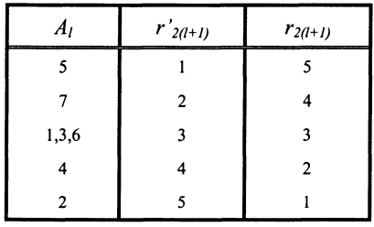
The adjusted inverse rankings r_{2(l+1)} are estimated:
Tab II-4. Adjusted Rankings
r’_{max} : the number of ranking positions in the inverse ranking procedure, equals 5

Slide 110
Final preorder
The Ranking:

Slide 111
ELECTRE III (Roy, 1978)
Uses the pseudo-criterion
Imprecision/uncertainty in the data

Slide 112
Outranking Relation
Concordance Index

Slide 113
The definition of discordance uses a veto threshold:
Discordance Index

Slide 114
The degree of credibility of outranking of b by a :

Slide 115
Exploiting the Outranking Relationships

Slide 116
Qualification

Slide 117
Ranking procedure of ELECTRE III
Descending distillation chain
Ascending order chain
Final ranking

Slide 118
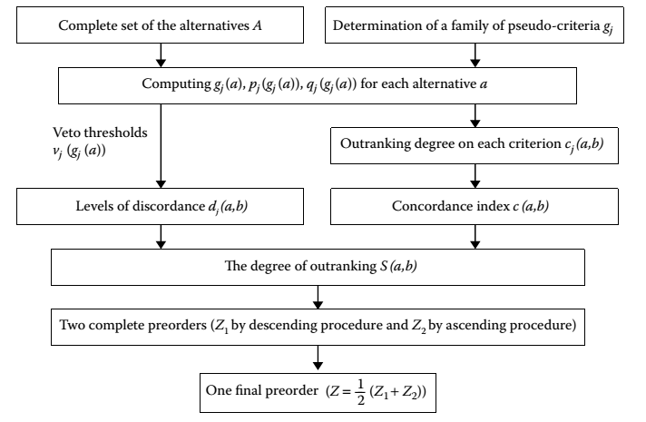
Fig III-1. Procedure of Electre III
(source: Multiple attribute decision making: Methods and Applications)

Slide 119
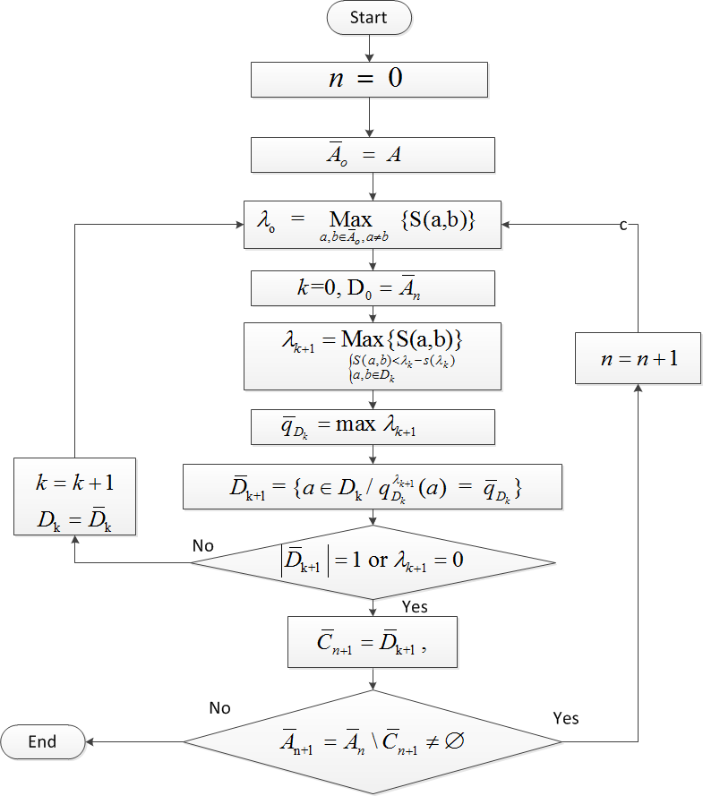
Descending distillation chain
Fig III-2. Flow chart of descending distillation chain

Slide 120
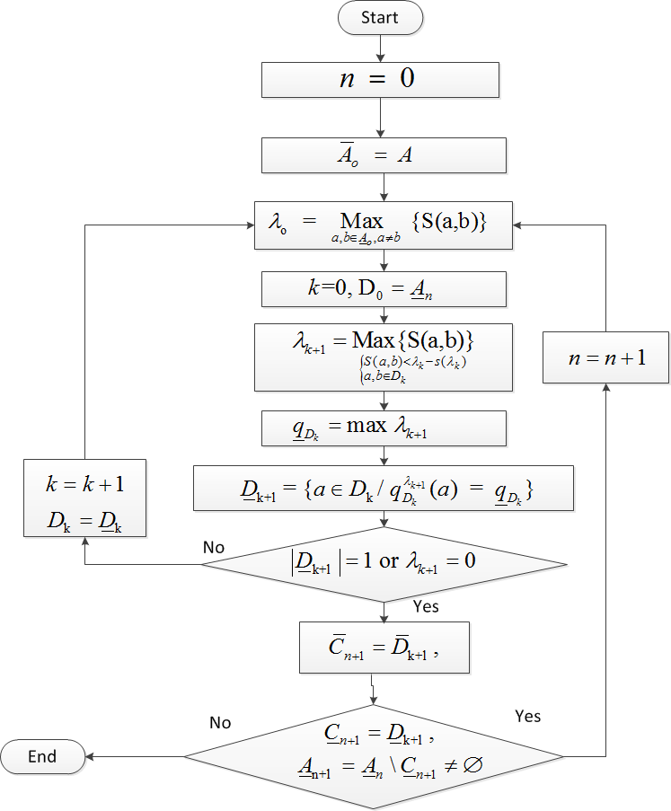
Ascending order chain
Fig III-3. Flow chart of ascending distillation chain

Slide 121
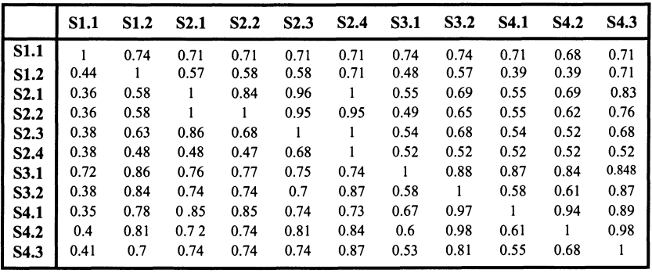
Example for ELECTRE III
Descending distillation chain
Tab III-1. Degree of Credibility Matrix
Source: M. Rogers et al., ELECTRE and Decision Support © Springer Science+Business Media New York 2000

Slide 122
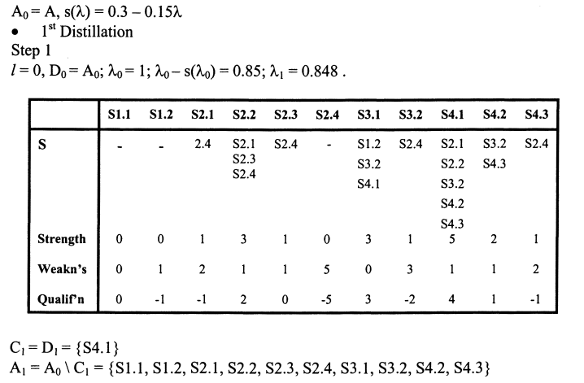
=1 stop
≠ Ø stop

Slide 123
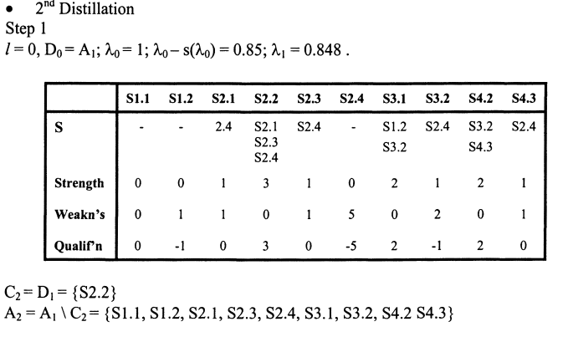

Slide 124
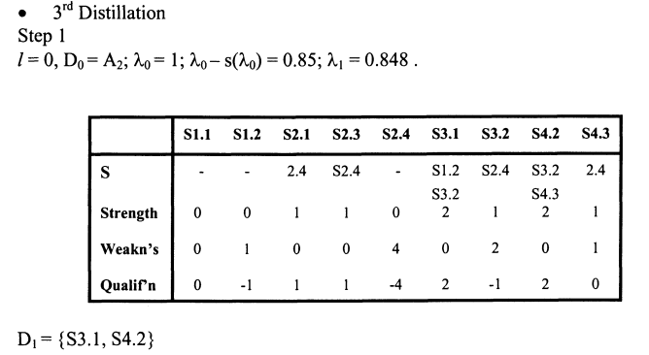
=2 go to step 2
Does S3.1 outrank S4.2 ?

Slide 125
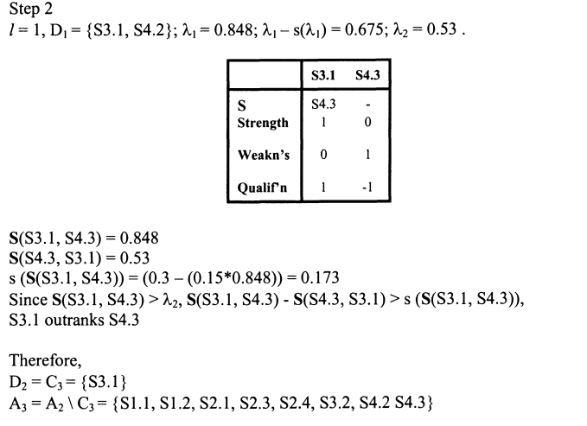

Slide 126
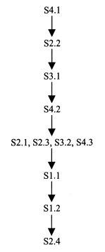
The results of ranking from descending distillation:

Slide 127
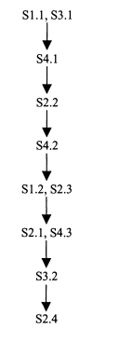
The results of ranking from ascending distillation:

Slide 128
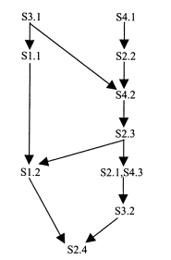
The final ranking

Slide 129
References
M. Rogers et al., ELECTRE and Decision Support © Springer Science+Business Media New York 2000
Valerie Belton ; Theodor J Stewart; Multiple Attribute Decision Analysis: An Integrated Approach © 2002 Springer Science+Business Media Dordrecht
Gwo-Hshiung Tzeng; Jih-Jeng Huang- Multiple Attribute Decision Making: Method and Applications © 2011 by Taylor & Francis Group, LLC CRC Press is an imprint of Taylor & Francis Group, an Informa business

