Slide 1
BWAPI CMPUT 350 Bot - Marvin
Dylan Cassidy
Mickael Zerihoun
Thomas Curnow

Slide 2

Improved scouting abilities for harass
Behaviours:
- Less aggressive
- Builds extractor

Slide 3

Changed the overlord behaviour to match a detector’s
Previous state: stagnant overlords

Slide 4

Exploited Zerg’s advantage in early Pushes, implemented “early pool” strategy to counter mid-game and late-game strategies.
Exceptional Early Game strategy

Slide 5

Implemented strategy involving Lurker Production with smart expanding
Giving basic Burrow/Unburrowing micro, integrated with UalbertaBot’s squad manager.
Great mid-game Strategy.

Slide 6

Takes advantage of Zerg’s early air superiority
Mutalisks have high mobility and is one of the fastest air units to build.

Slide 7
Video

Slide 8
Implemented Smart strategy choosing
Will not chose strategy randomly, will base strategy selection based upon previous victory/losses.
Becomes more effective with a larger number of games played

Slide 9
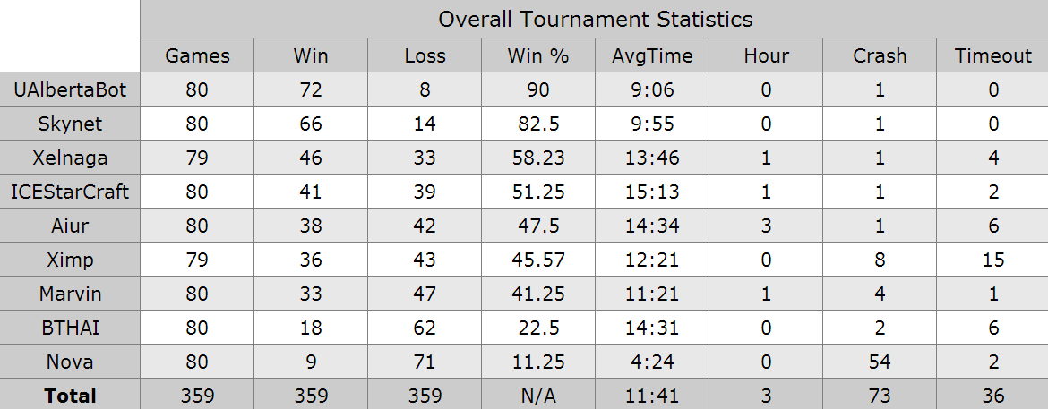
Overall Stats

Slide 10
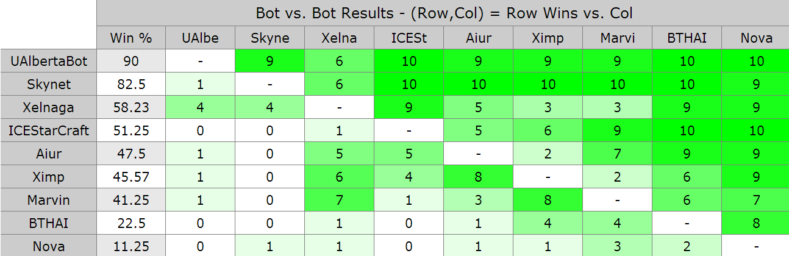
Winners

Slide 11
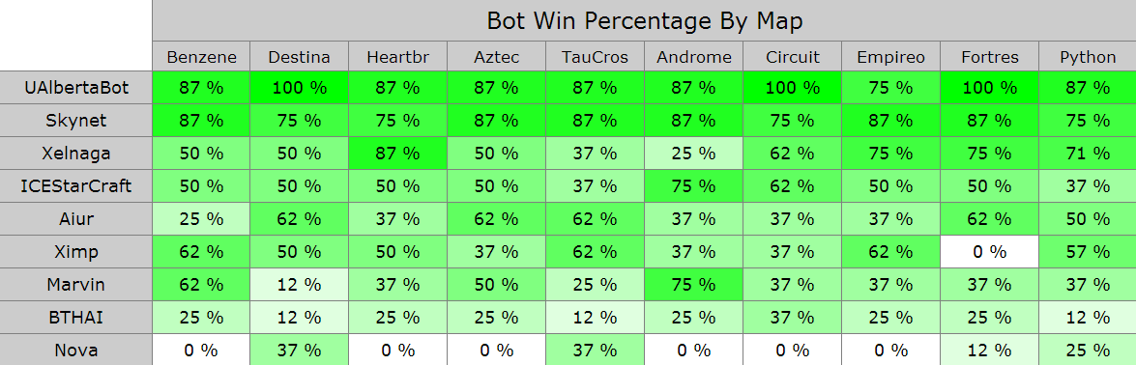
Maps

Slide 12
Advantages and Disadvantages
Zerg Has a lot of race specific advantages, like early detectors, high mobility, fast expansion. Great for map superiority.
Zerg has a disadvantage on larger maps (most tournament maps are larger then the vanilla Blizzard maps) for the Zergling rush due to the distance that Zerglings have to travel

Slide 13
Future Work
The current bot is far too dependent on being Protoss
The build order search for Zerg is more or less broken
Our Mutalisk strategy is vulnerable to rushes
Try more late game strategies

Slide 14
Questions?

Slide 15
Images Source
Images Are from Starcraft BroodWar and Starcrafts
Starcraft Broodwar:
http://us.battle.net/en/
Carbot animations:
http://www.carbotanimations.com/starcrafts/

