Slide 1
Visualizing the
Bureau of Labor Statistics
Employment Dataset
by
Siva Mohan and Curran Kelleher

Slide 2
Outline
Understanding the Dataset
Data Preparation
Visualizations
Issues

Slide 3
Understanding the Dataset as dimensions and measures
Raw data at ftp://ftp.bls.gov/pub/special.requests/cew/
Covers Time from 1990 to 2007
  Data for years, quarters, and months
Covers Space for all US States
  Data for States and Counties
Covers the NAICS Industry hierarchy
Covers Ownership
  Government (Federal, State, Local) and Private
Contains measures employment, annual pay, total wages, and number of establishments (among others)

Slide 4
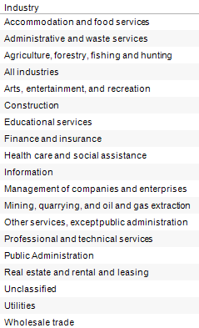
NAICS
North American Industry Classification System
11 Agriculture, Forestry, Fishing and Hunting
111 Crop Production
1111 Oilseed and Grain Farming
11111 Soybean Farming
111110 Soybean Farming
11112 Oilseed (except Soybean) Farming
111120 Oilseed (except Soybean) Farming
11113 Dry Pea and Bean Farming
111130 Dry Pea and Bean Farming
11114 Wheat Farming
111140 Wheat Farming
11115 Corn Farming
111150 Corn Farming
11116 Rice Farming
111160 Rice Farming
11119 Other Grain Farming
111191 Oilseed and Grain Combination Farming
111199 All Other Grain Farming
1112 Vegetable and Melon Farming
11121 Vegetable and Melon Farming
111211 Potato Farming
111219 Other Vegetable (except Potato) and Melon Farming
1113 Fruit and Tree Nut Farming
11131 Orange Groves
111310 Orange Groves
...

Slide 5
Data Preprocessing
We wrote shell scripts to
  Download all raw data files via FTP
  Parse the raw data files (BLS fixed width format)
  Import the raw data files into a MySQL database
We manually imported tables mapping
  BLS “Area Code” → state name
  BLS “Area Code” → state abbreviation
    Necessary for using Tableau's map feature
  NAICS code → industry name
  BLS Ownership code → ownership name

Slide 6
Visualizations

Slide 7
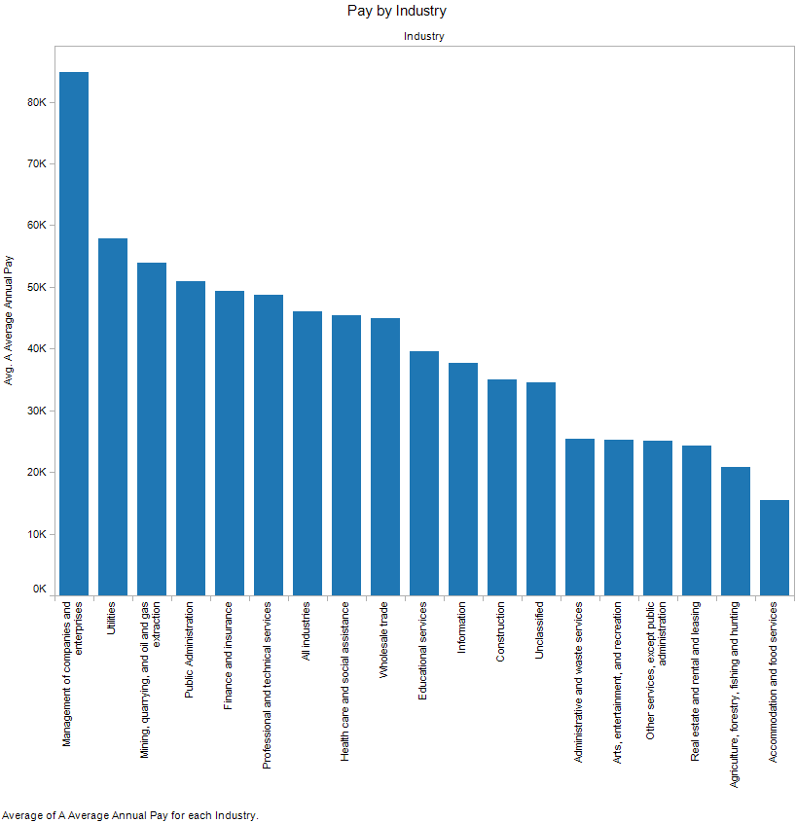

Slide 8
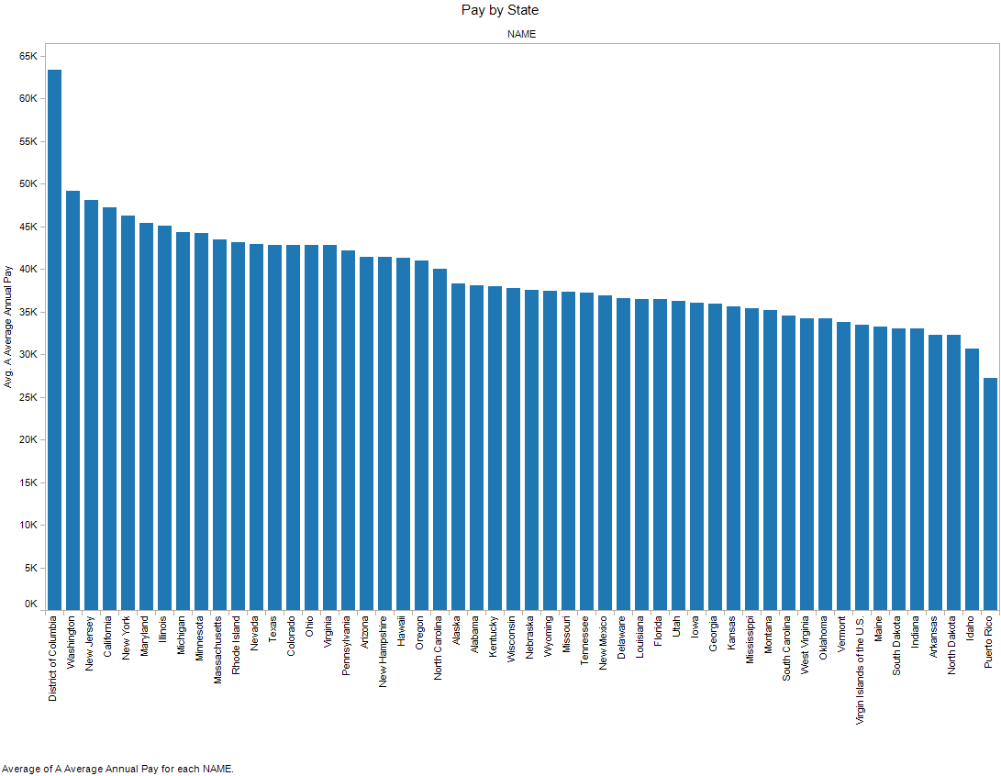

Slide 9
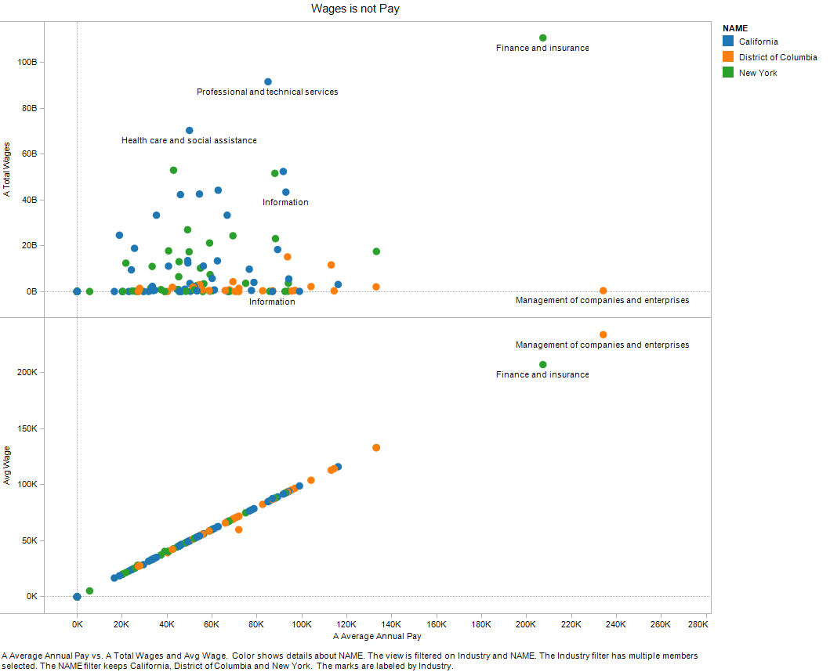

Slide 10
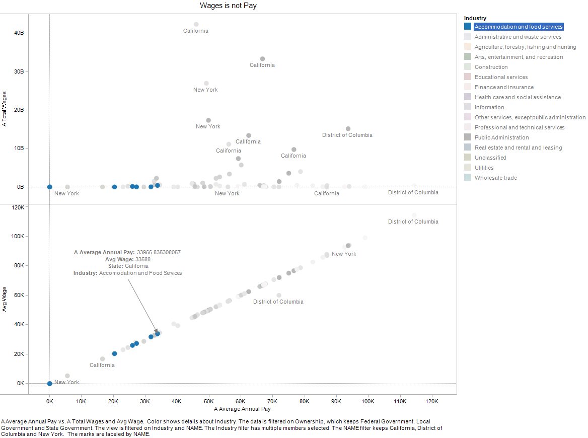

Slide 11
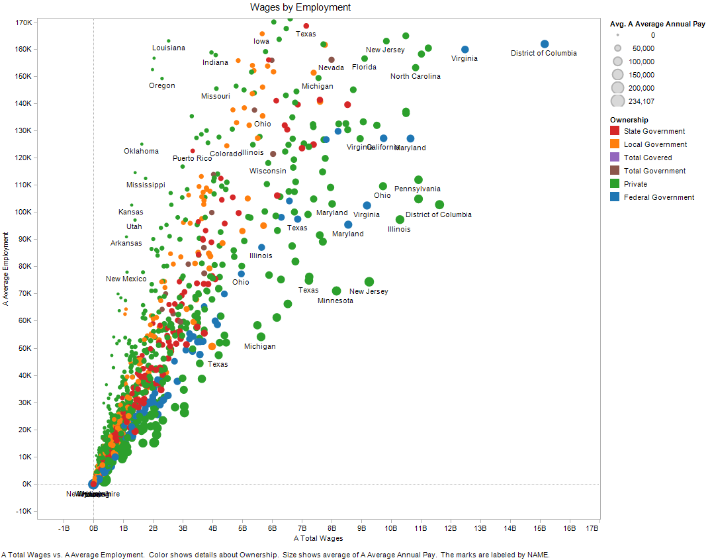

Slide 12
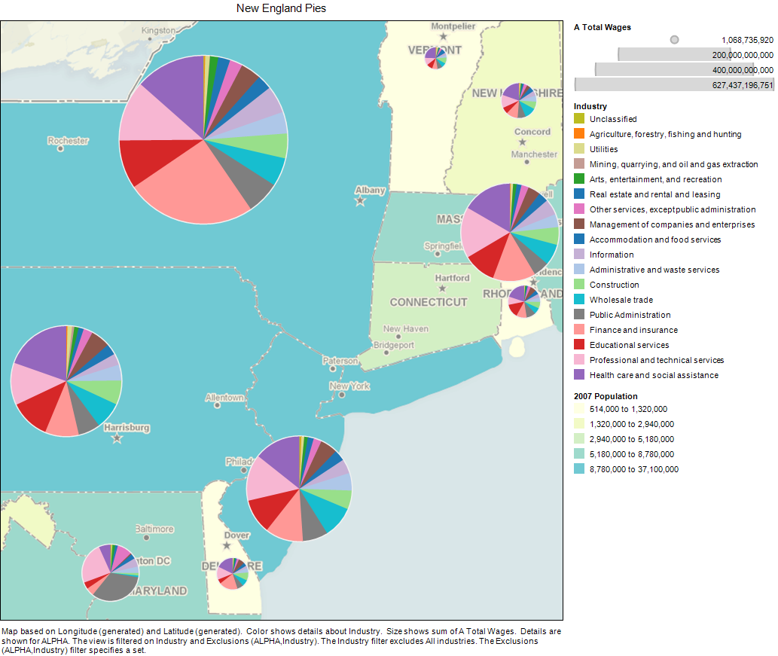

Slide 13
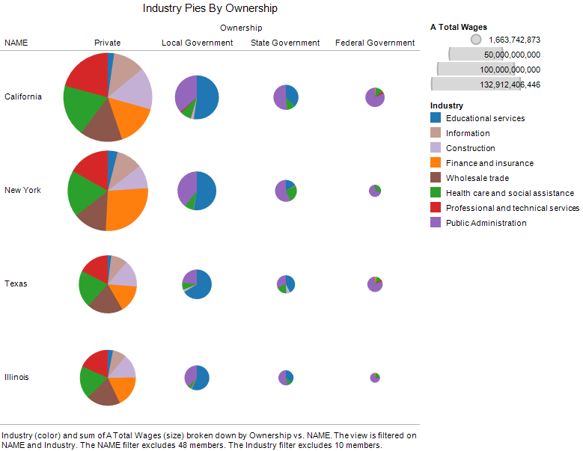

Slide 14
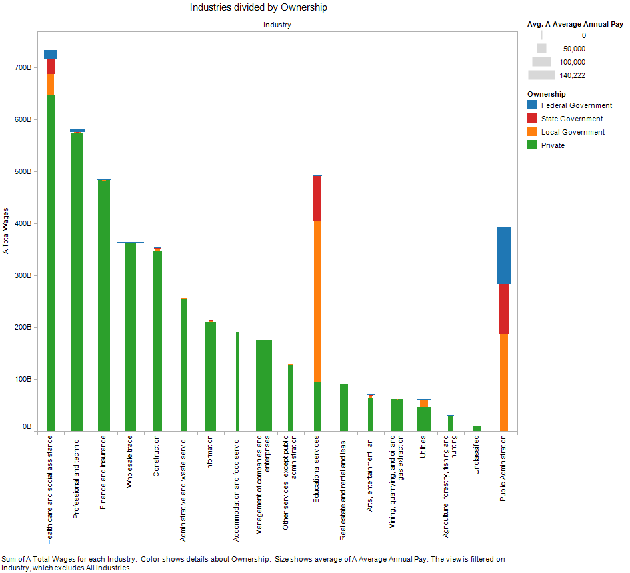

Slide 15
Issues
No support for hierarchical data cubes
  With this we could have seen the whole dataset
County data too large for Tableau (1 min per vis)
Hierarchical time was (seemingly) impossible
  Years in different tables, months in different columns
  Tableau expects each dimension as a single column
We did not document as we went, had to backtrack
“Cancel” query in Tableau didn't stop queries
Overlapping labels occurred often
(seemingly) impossible to probe with many dimensions

Slide 16
the end.

