Slide 1
AP
AgentPass Guard
COLOSSEUM FRONTIER · AI × SOLANA
Agents can now pay.
You decide what they're allowed to buy.
Policy simulator and guard layer for AI agents using pay.sh / x402-style payments on Solana.
Run the demo →
currentlycodinng.github.io/agentpass-guard

Slide 2
AP
AgentPass Guard
THE NEW PROBLEM
02 / 08
Agents can pay. Now humans need controls.
Builders without a policy layer have two bad choices: approve every micro-payment by hand, or hand the agent unlimited credentials. Neither scales.
pay.sh and x402 unlock agent-paid APIs on Solana.
Unrestricted agent wallets are unsafe.
Manual approval for every micro-payment kills autonomy.
Builders need to test budget, allowlist, threshold, and revocation before live spend.
github.com/currentlycodinng/agentpass-guard
Colosseum Frontier · 2026

Slide 3
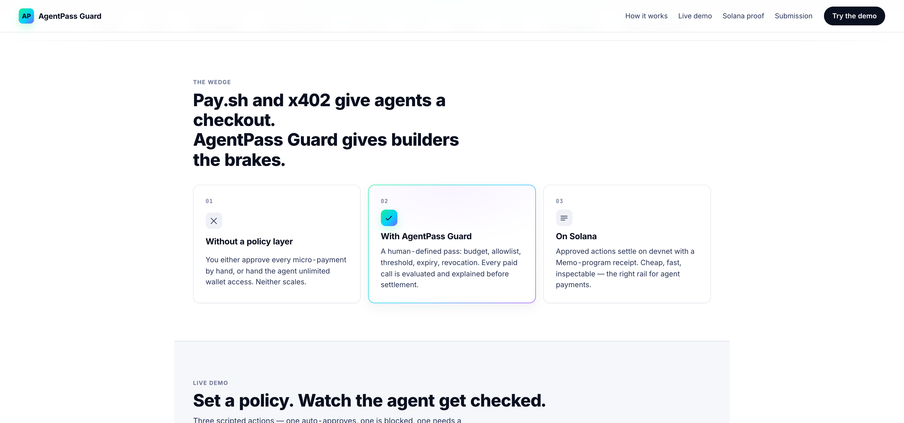
AP
AgentPass Guard
THE PRODUCT
03 / 08
THE WEDGE
Pay.sh and x402 give agents a checkout. We give builders the brakes.
github.com/currentlycodinng/agentpass-guard
Colosseum Frontier · 2026

Slide 4
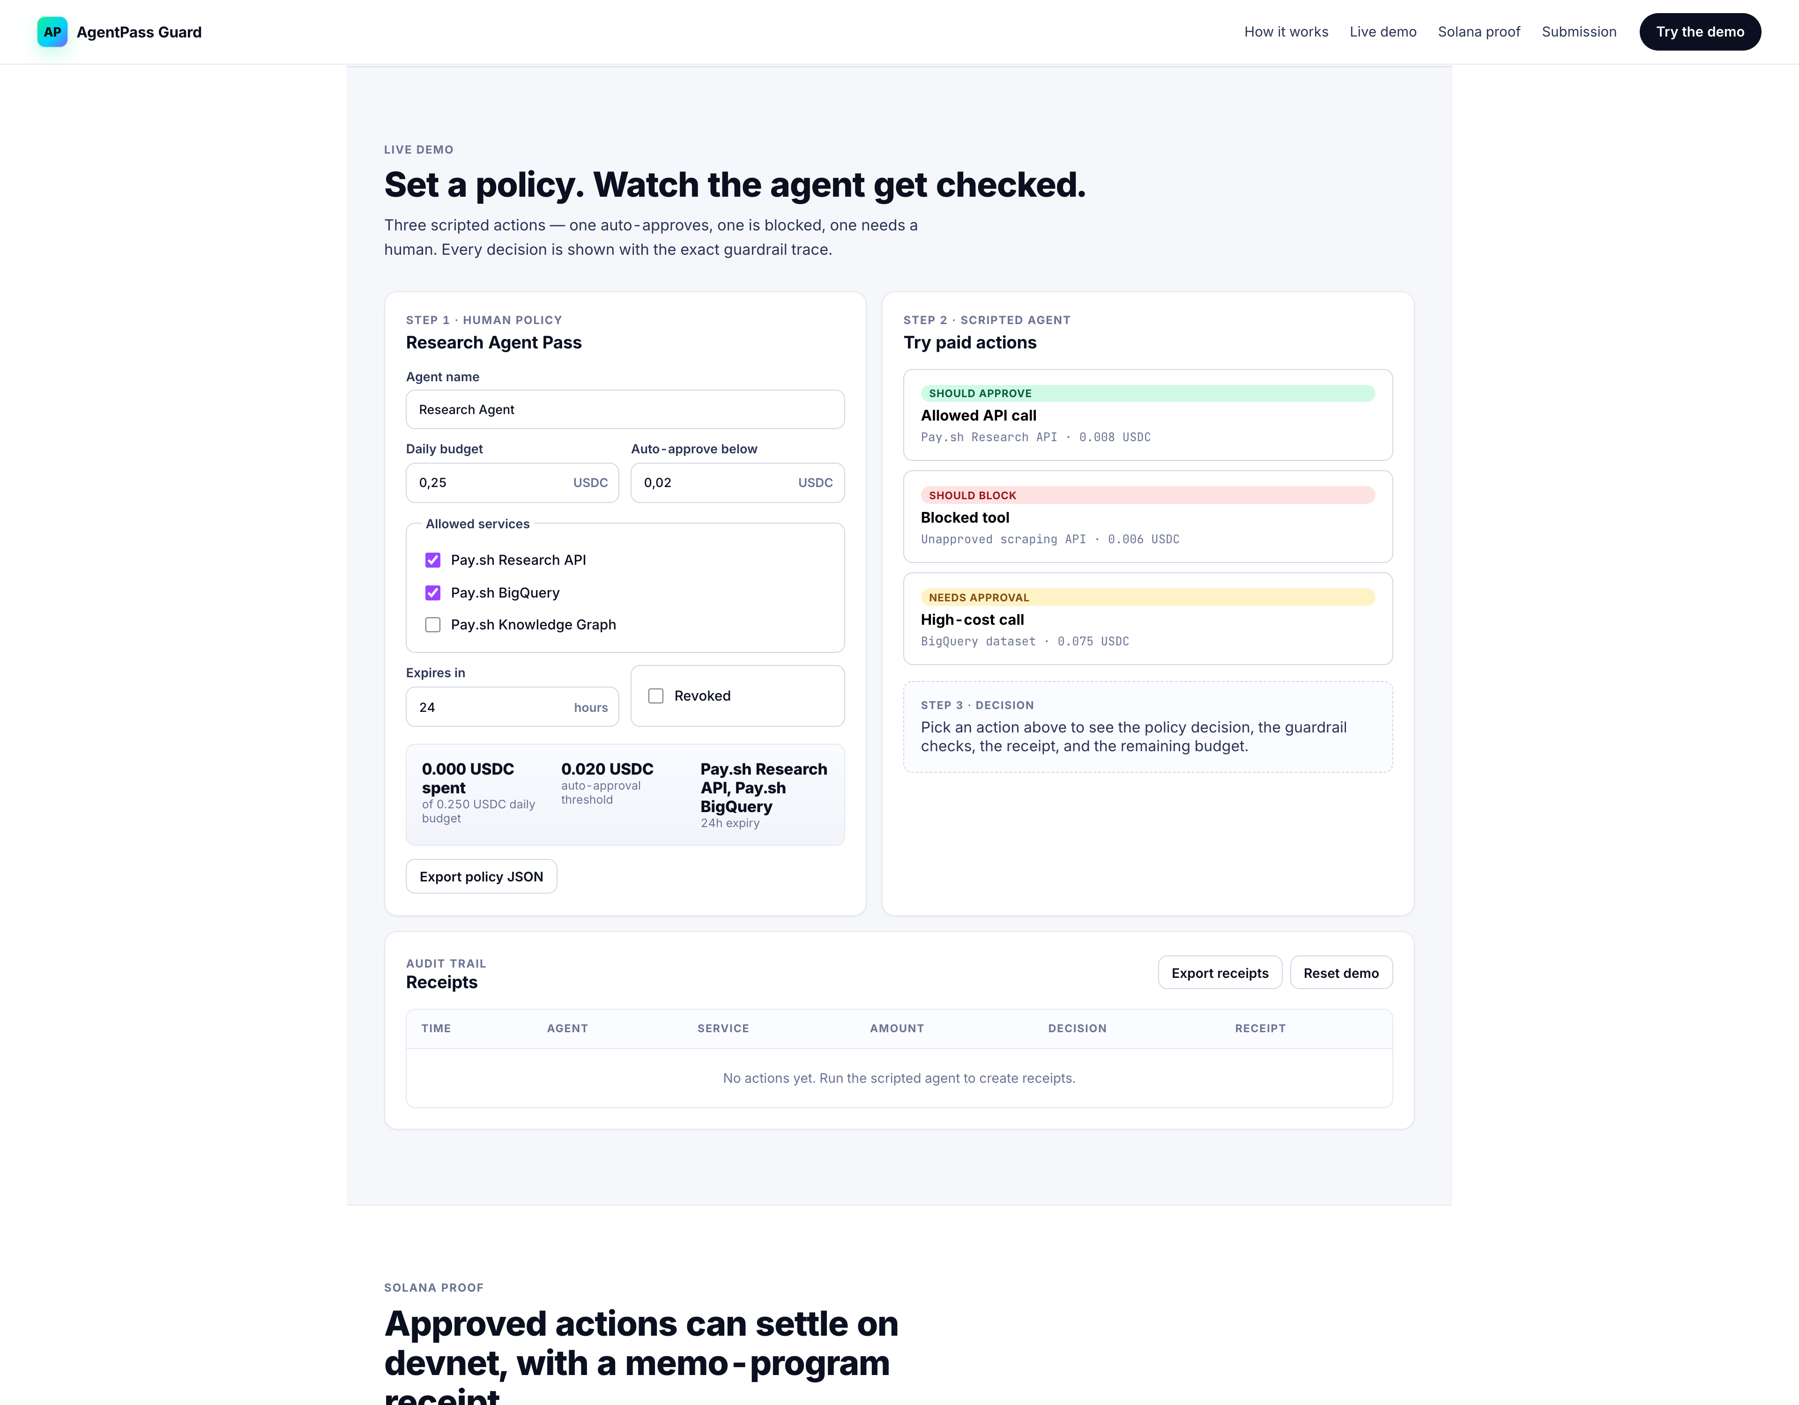
AP
AgentPass Guard
LIVE DEMO
04 / 08
HOW IT RUNS
Set a policy. Watch the agent get checked. Three actions, three traces.
github.com/currentlycodinng/agentpass-guard
Colosseum Frontier · 2026

Slide 5
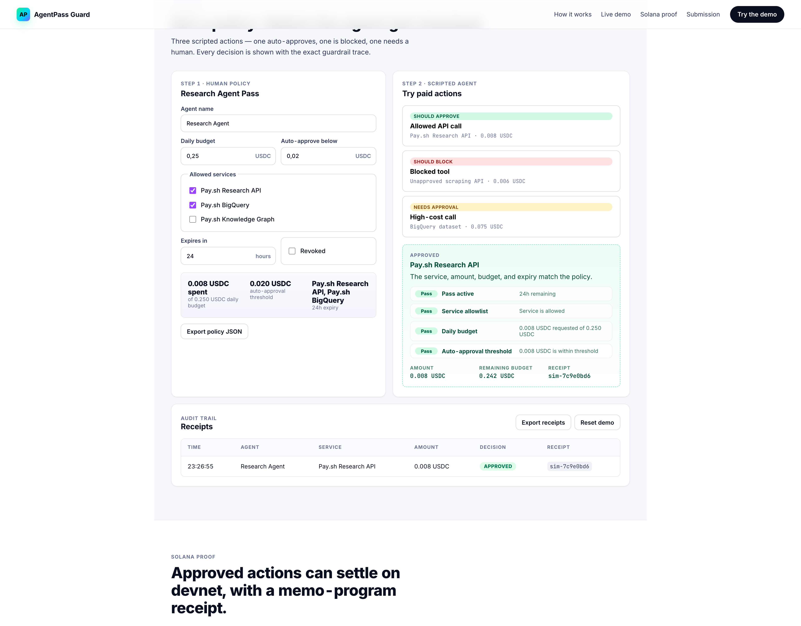
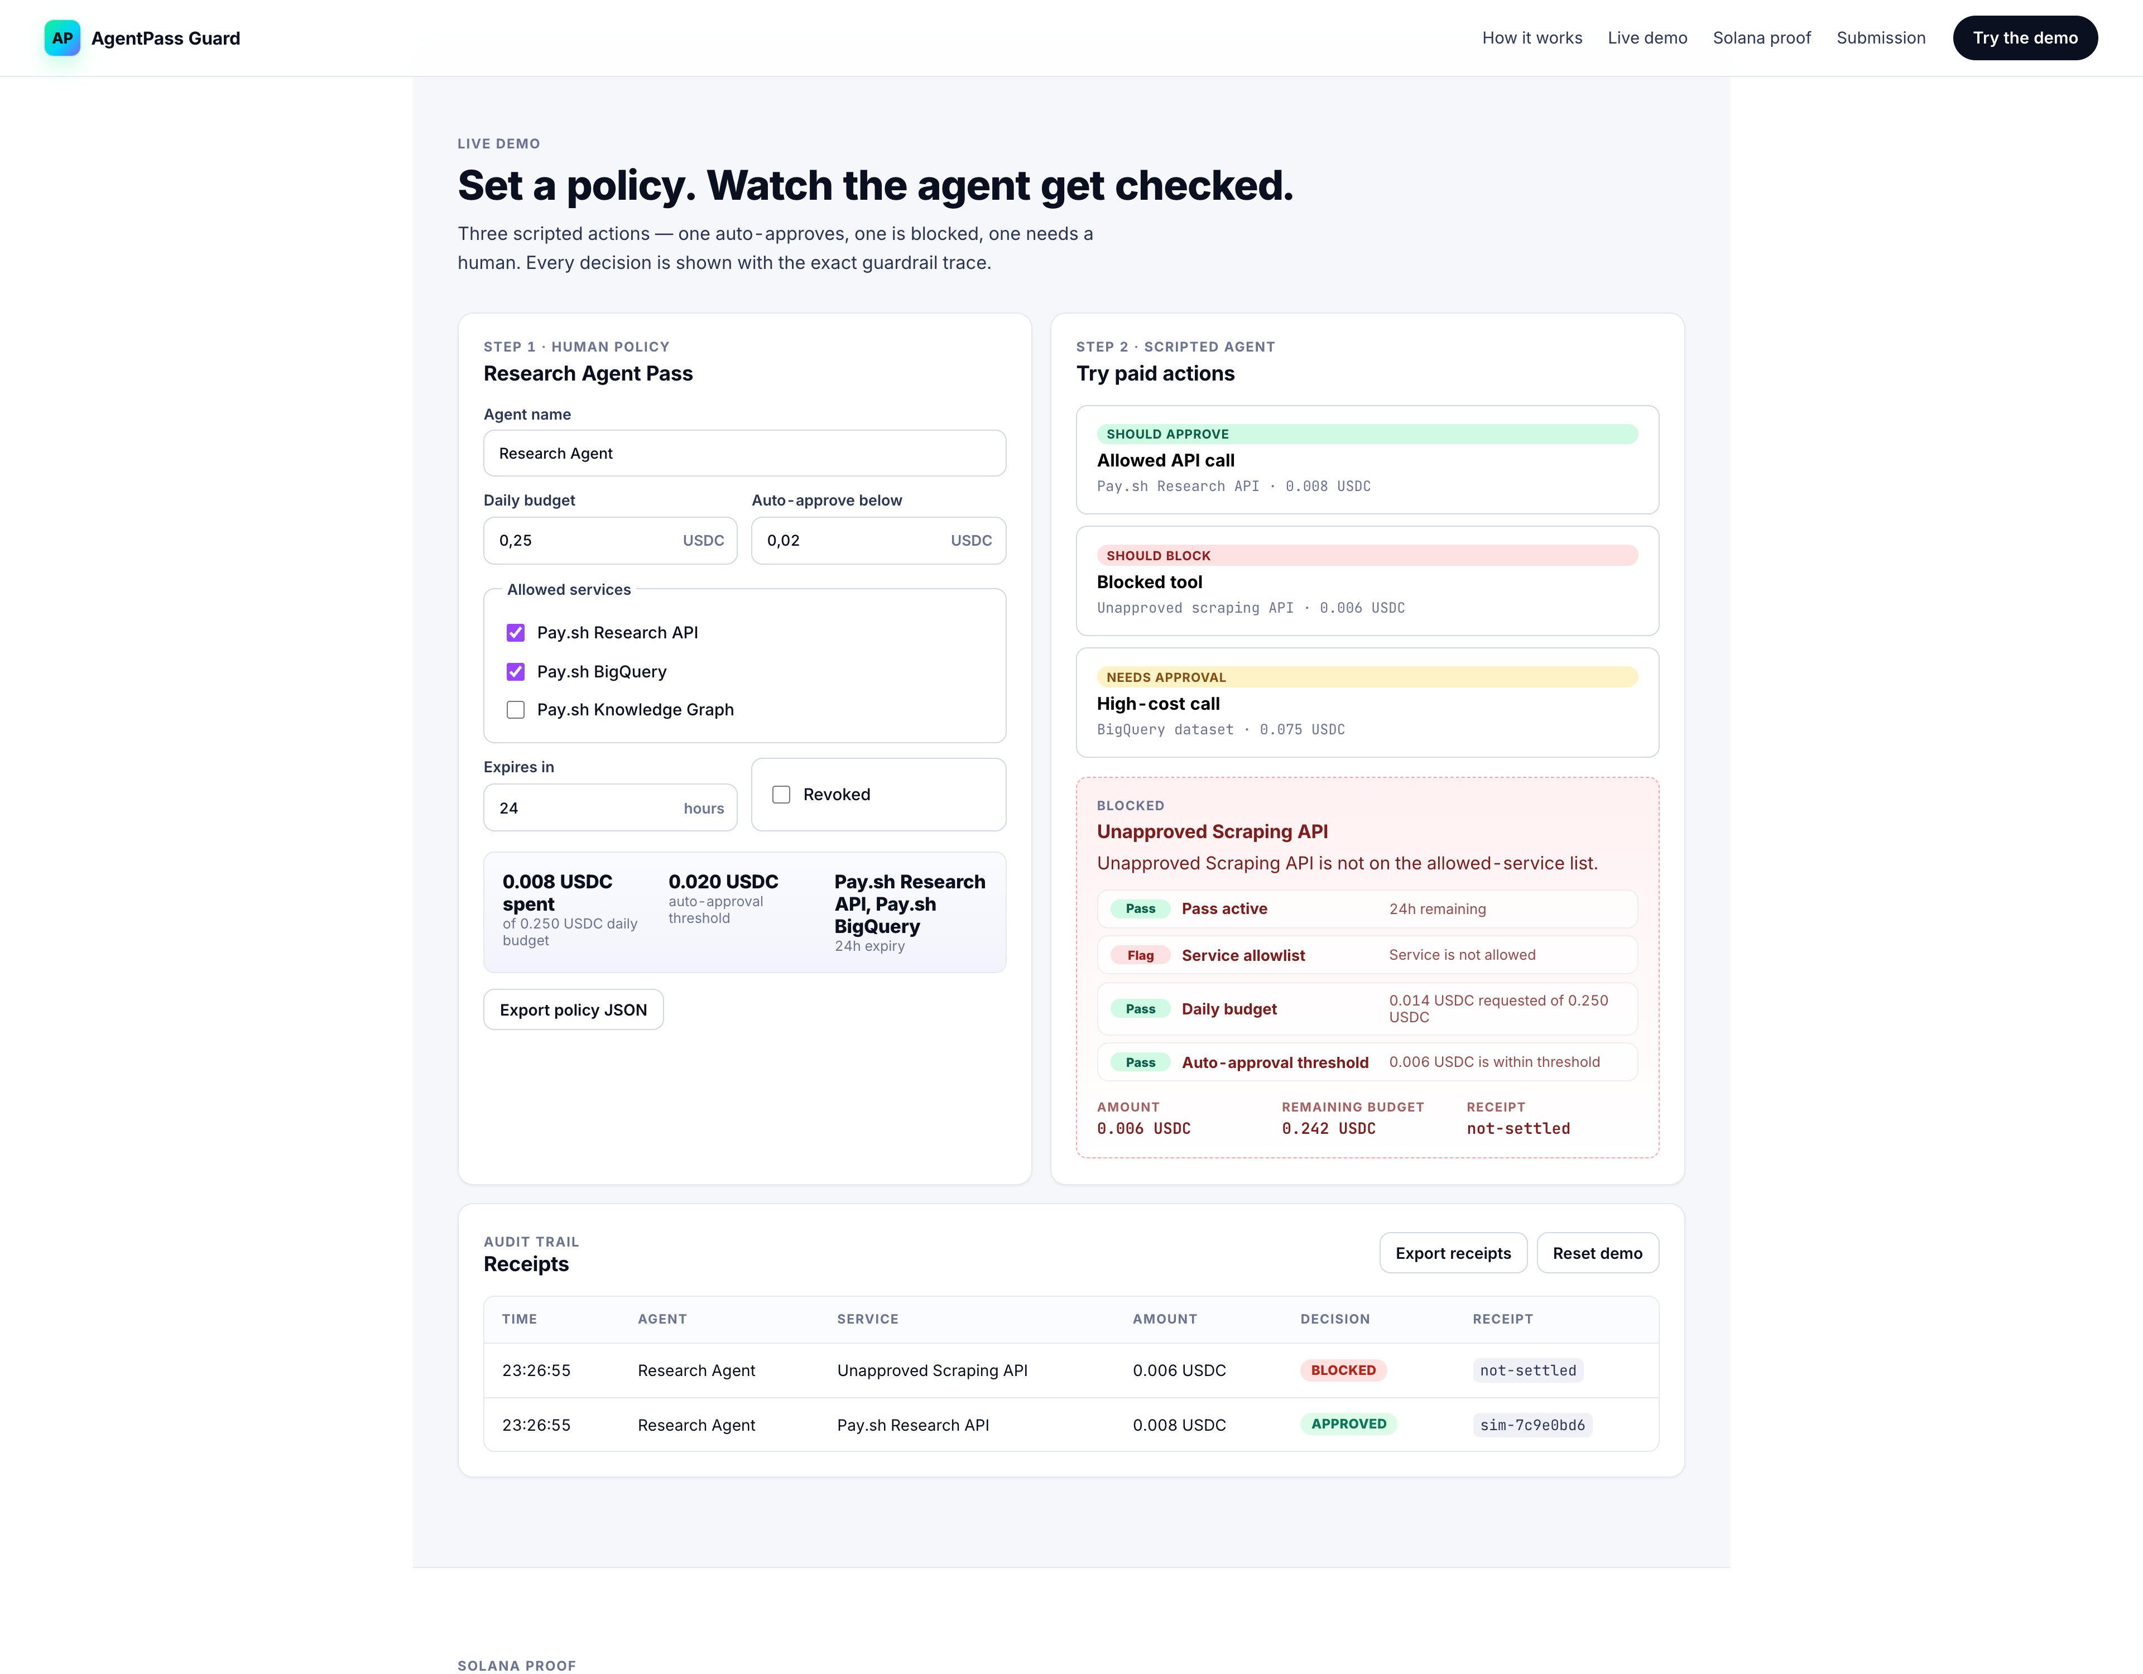
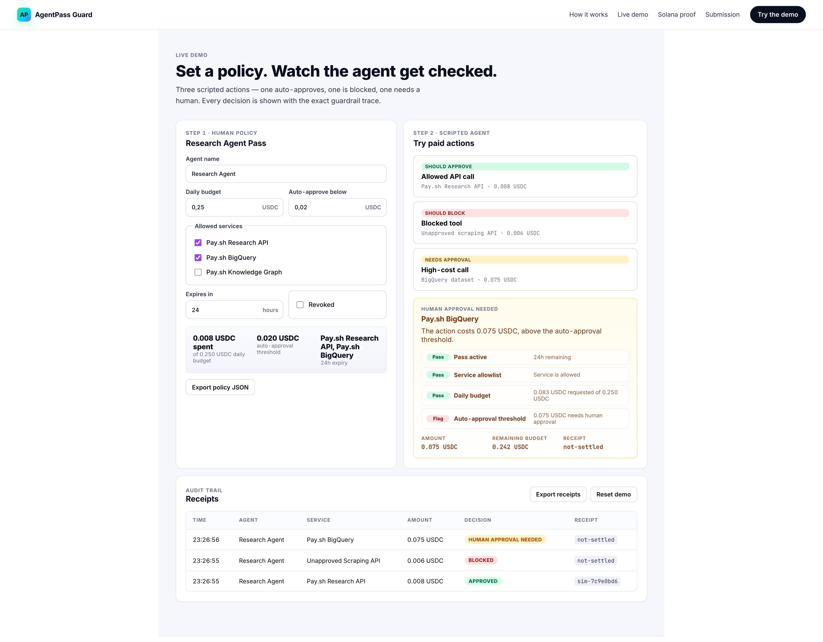
AP
AgentPass Guard
THREE DECISIONS
05 / 08
Approved. Blocked. Paused for human.
0.008 USDC
ALLOWLIST FAIL
0.075 USDC
Auto-approved
Blocked
Needs human
github.com/currentlycodinng/agentpass-guard
Colosseum Frontier · 2026

Slide 6
AP
AgentPass Guard
WHY SOLANA
06 / 08
Small, frequent, programmatic — with receipts.
Fast confirmation keeps agent workflows interactive.
DEVNET PROOF
Low fees make sub-cent API payments economically viable.
$ npm run devnet:demo
Wallet-native identities map cleanly to autonomous agents.
Creates a temp wallet, sends a tiny payment, attaches a Memo-program receipt, prints the explorer link. Falls back to a simulated receipt if the public faucet is rate-limited.
Memo program turns each settlement into an inspectable receipt.
github.com/currentlycodinng/agentpass-guard
Colosseum Frontier · 2026

Slide 7
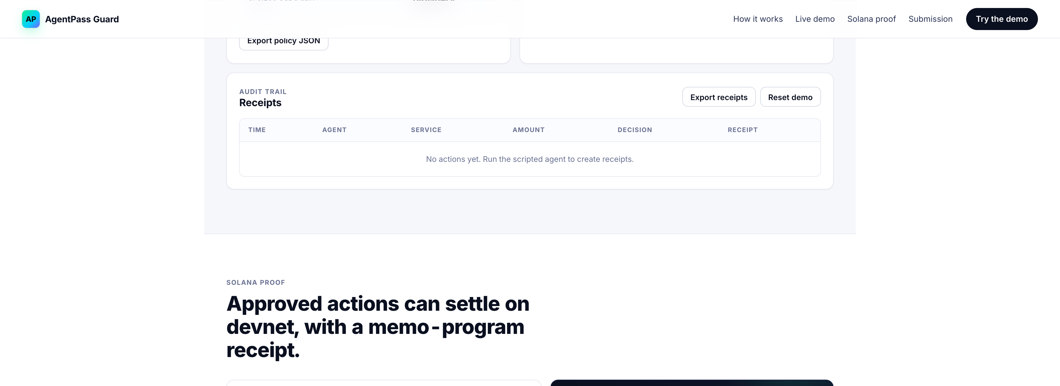
AP
AgentPass Guard
BUILT SO FAR
07 / 08
WHAT'S SHIPPING
Static app. No backend. Judges run it in 30 seconds.
github.com/currentlycodinng/agentpass-guard
Colosseum Frontier · 2026

Slide 8
AP
AgentPass Guard
PATH AFTER FRONTIER
08 / 08
From local simulator to production guardrail.
Land with AI builders and student teams using paid APIs.
WHY THIS CAN WIN
Add SPL USDC settlement and pay.sh / x402 request parsing.
Completes the rail.
Add team approval workflows, anomaly alerts, and spend analytics.
The problem is current. The demo is concrete. The Solana integration is real. The wedge does not fight the ecosystem — it completes it.
Move policy checks into wallet middleware and server-side authorization.
AgentPass Guard
currentlycodinng.github.io/agentpass-guard
github.com/currentlycodinng/agentpass-guard
Colosseum Frontier · 2026

