Slide 1
Untitled
bia

Slide 2
titulo 2
Carregar os pacotes
ggplot(mtcars) + geom_point(aes(x = wt, y = mpg))

Slide 3
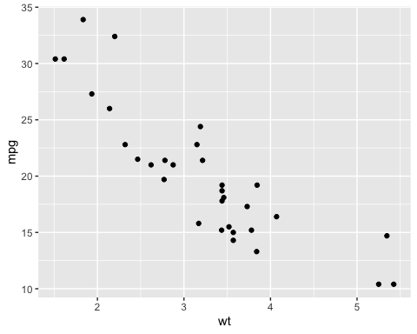

Slide 4
ggplot(mtcars) + geom_point(aes(x = wt, y = mpg))

Slide 5
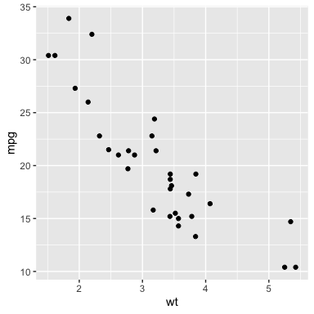
Gráfico da base mtcars

Slide 6
ggplot(mtcars) + geom_point(aes(x = wt, y = mpg))

Slide 7


Slide 8
 | mpg | cyl | disp | hp | drat | wt | qsec | vs | am | gear | carb
Mazda RX4 | 21.0 | 6 | 160 | 110 | 3.90 | 2.620 | 16.46 | 0 | 1 | 4 | 4
Mazda RX4 Wag | 21.0 | 6 | 160 | 110 | 3.90 | 2.875 | 17.02 | 0 | 1 | 4 | 4
Datsun 710 | 22.8 | 4 | 108 | 93 | 3.85 | 2.320 | 18.61 | 1 | 1 | 4 | 1
Hornet 4 Drive | 21.4 | 6 | 258 | 110 | 3.08 | 3.215 | 19.44 | 1 | 0 | 3 | 1
Hornet Sportabout | 18.7 | 8 | 360 | 175 | 3.15 | 3.440 | 17.02 | 0 | 0 | 3 | 2

Slide 9
o resultado é 2. O mpg do carro Mazda é 21.

Slide 10
Importação
## [1] "/Users/beatrizmilz/Documents/Curso-R/cursos/visualizacao-relatorios/202107-visualizacao/exemplos_de_aula/01-rmarkdown"
## Rows: 3,713 ## Columns: 15 ## $ titulo <chr> "Avatar", "Pirates of the Caribbean: At World's End", "… ## $ ano <int> 2009, 2007, 2012, 2012, 2007, 2010, 2015, 2016, 2006, 2… ## $ diretor <chr> "James Cameron", "Gore Verbinski", "Christopher Nolan",… ## $ duracao <int> 178, 169, 164, 132, 156, 100, 141, 183, 169, 151, 150, … ## $ cor <chr> "Color", "Color", "Color", "Color", "Color", "Color", "… ## $ generos <chr> "Action|Adventure|Fantasy|Sci-Fi", "Action|Adventure|Fa… ## $ pais <chr> "USA", "USA", "USA", "USA", "USA", "USA", "USA", "USA",… ## $ classificacao <chr> "A partir de 13 anos", "A partir de 13 anos", "A partir… ## $ orcamento <int> 237000000, 300000000, 250000000, 263700000, 258000000, … ## $ receita <int> 760505847, 309404152, 448130642, 73058679, 336530303, 2… ## $ nota_imdb <dbl> 7.9, 7.1, 8.5, 6.6, 6.2, 7.8, 7.5, 6.9, 6.1, 7.3, 6.5, … ## $ likes_facebook <int> 33000, 0, 164000, 24000, 0, 29000, 118000, 197000, 0, 5… ## $ ator_1 <chr> "CCH Pounder", "Johnny Depp", "Tom Hardy", "Daryl Sabar… ## $ ator_2 <chr> "Joel David Moore", "Orlando Bloom", "Christian Bale", … ## $ ator_3 <chr> "Wes Studi", "Jack Davenport", "Joseph Gordon-Levitt", …

