Slide 1
Exemplo da aula
Beatriz

Slide 2

R Markdown
This is an R Markdown document. Markdown is a simple formatting syntax for authoring HTML, PDF, and MS Word documents. For more details on using R Markdown see http://rmarkdown.rstudio.com.
Titulo de nivel 3
Beatriz
Andressa
Vitor
Gabriel
Daniel

Slide 3
Col1 | Col2 | Col3
getwd()
## [1] "/Users/beatrizmilz/Desktop/material-curso-relatorios/praticas"
llalalalla
🤣
CTRL ALT I
sample(1:100, 5)
## [1] 33 52 47 74 98
# use comentários!
sample(1:100, 5)
Legenda

Slide 4
When you click the Knit button a document will be generated that includes both content as well as the output of any embedded R code chunks within the document. You can embed an R code chunk like this:
summary(cars)
## speed dist ## Min. : 4.0 Min. : 2.00 ## 1st Qu.:12.0 1st Qu.: 26.00 ## Median :15.0 Median : 36.00 ## Mean :15.4 Mean : 42.98 ## 3rd Qu.:19.0 3rd Qu.: 56.00 ## Max. :25.0 Max. :120.00

Slide 5
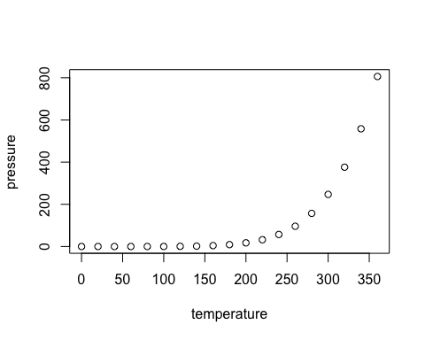
Including Plots
You can also embed plots, for example:

Slide 6
Note that the echo = FALSE parameter was added to the code chunk to prevent printing of the R code that generated the plot.

