Slide 1
MIMIC III Preprocessing Explained
Changsoo Kim, Akhmad Hutomo, Curt Tigges, Gabriel Sandoval
Apr. 10, 2021
Notes:
Akhmad Hutomo
University of Illinois at Urbana-Champaign, Urbana, IL, USA
ahutomo2@illinois.edu
Changsoo Kim
University of Illinois at Urbana-Champaign, Urbana, IL, USA
ck37@illinois.edu
Curt Tigges
University of Illinois at Urbana-Champaign, Urbana, IL, USA
ctigges2@illinois.edu
Gabriel Sandoval
University of Illinois at Urbana-Champaign, Urbana, IL, USA
grs4@illinois.edu

Slide 2
An Empirical Evaluation of CNNs and RNNs for ICD-9 Code Assignment using MIMIC-III Clinical Notes
https://arxiv.org/abs/1802.02311

Slide 3
Overview
https://github.com/tiratano/clinical-notes-diagnosis-dl-nlp/blob/master/code/python3/preprocess.ipynb
enters to space
('[\n\r]+' ➔ ' ')
NOTEEVENTS.csv
(raw clinical notes)
NOTEEVENTS-2.csv
(cleaned version
of clinical notes)
DIAGNOSES_ICD.csv
(admission ➔ ICD9 code)
D_ICD_DIAGNOSES.csv
(ICD9 code map)

Slide 4
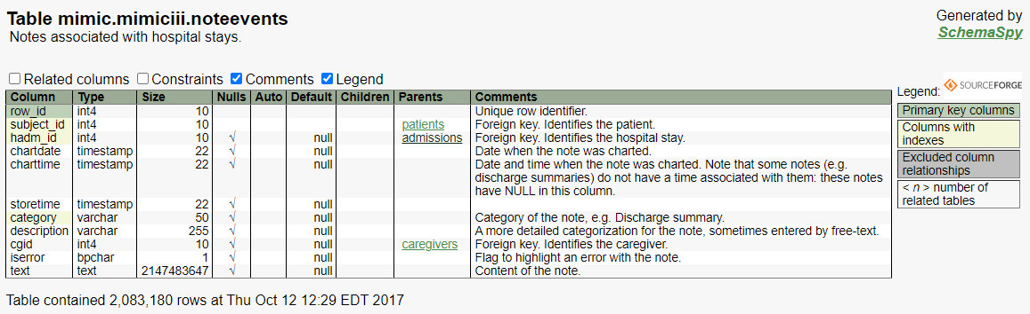
NOTEEVENTS table
Notes:
https://mit-lcp.github.io/mimic-schema-spy/tables/noteevents.html

Slide 5
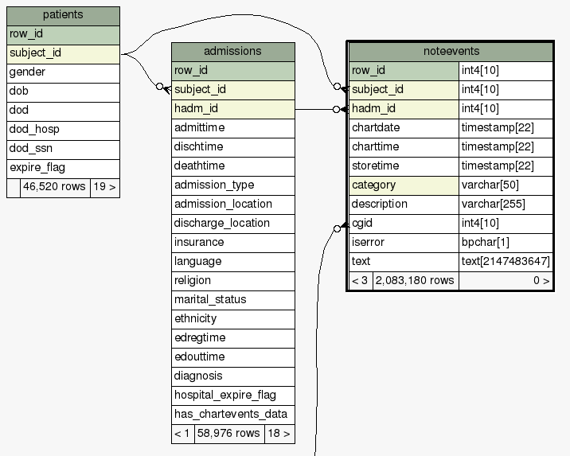
NOTEEVENTS table relation
One patient has multiple hospital admissions

Slide 6
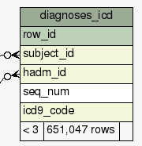
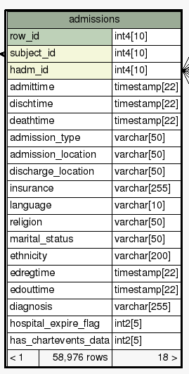
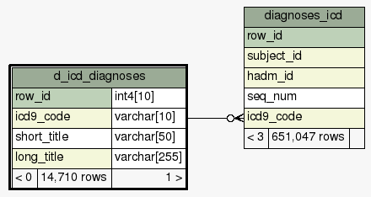
NOTEEVENTS table relation
One hospital admissions has multiple ICD codes.
ICD code (technically) has many titles.
* In my inspection, there is only one title per ICD code.

Slide 7
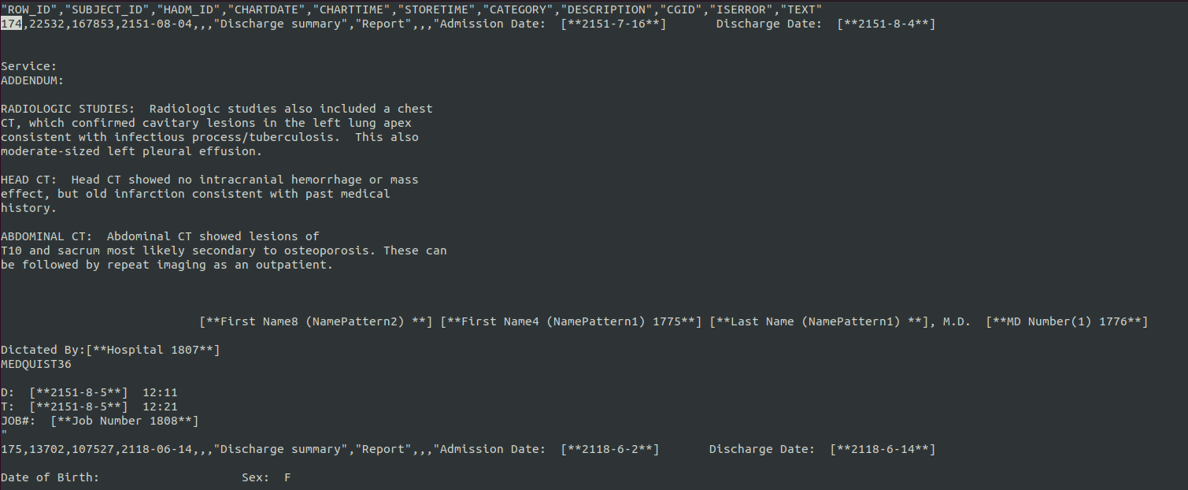
NOTEEVENTS table relation
1
2
3
4
5
6
7
8
9
10
11

Slide 8

NOTEEVENTS table relation
patient ID: 22532
admission ID: 167853
ICD code: 01193 …
grep ^167853 DIAGNOSES_ICD.csv
250889,22532,167853,1,"01193" (lung)
250890,22532,167853,2,"4254" (heart) ?
250891,22532,167853,3,"42731" (heart) ?
250892,22532,167853,4,"2639" (nutrition) ?
250893,22532,167853,5,"2762" (acid blood) ?
250894,22532,167853,6,"5070" (lung)
250895,22532,167853,7,"5119" (pleural effusion)
250896,22532,167853,8,"2113" (colon) ?
Notes:
Acidosis: an excessively acid condition of the body fluids or tissues. (체액이 산성으로)
2113 Benign neoplasm of colon: 결장(colon=intestine=창자)에 발생한 양성종양

Slide 9
NOTEEVENTS table relation
https://dexur.com/icd9/01193/
01193 - Pulmonary tuberculosis(폐결핵), unspecified, tubercle bacilli (결핵균) found (in sputum) by microscopy
Pulmonary: relating to the lungs.
tuberculosis: an infectious bacterial disease characterized by the growth of nodules (tubercles) in the tissues, especially the lungs.
tubercle: a small nodular lesion in the lungs or other tissues, characteristic of tuberculosis.
bacilli: a disease-causing bacterium.
sputum: a mixture of saliva and mucus coughed up from the respiratory tract, typically as a result of infection or other disease and often examined microscopically to aid medical diagnosis.
microscopy: the use of the microscope.
Notes:
Pulmonary: relating to the lungs. (폐의)
tuberculosis: an infectious bacterial disease characterized by the growth of nodules (tubercles) in the tissues, especially the lungs. 결핵
tubercle: a small nodular lesion in the lungs or other tissues, characteristic of tuberculosis. (결절, 종기, 돌출된 피부, 작은 혹)
sputum: a mixture of saliva and mucus coughed up from the respiratory tract, typically as a result of infection or other disease and often examined microscopically to aid medical diagnosis. (담)

Slide 10
NOTEEVENTS table relation
https://dexur.com/icd9/4254/
Other primary cardiomyopathies
cardiomyopathies: chronic disease of the heart muscle
Notes:
cardiomyopathy: chronic disease of the heart muscle. (심근병증 – 심장 근육의 병)

Slide 11
NOTEEVENTS table relation
https://dexur.com/icd9/42731/
Atrial fibrillation
atrial: relating to a cavity or chamber in the body (especially one of the upper chambers of the heart)
fibrillation: rapid, irregular, and unsynchronized contraction of muscle fibers. An important occurrence is with regard to the heart.
Notes:
atrial: relating to a cavity or chamber in the body (especially one of the upper chambers of the heart) 심방
fibrillation:

Slide 12
NOTEEVENTS table relation
https://dexur.com/icd9/2639/
Unspecified protein-calorie malnutrition
malnutrition: lack of proper nutrition, caused by not having enough to eat, not eating enough of the right things, or being unable to use the food that one does eat.
Notes:
protein-calorie malnutrition: 단백질 칼로리 영양 실조

Slide 13
NOTEEVENTS ex) admission #167853
ICD9 Code: 01193
Pulmonary tuberculosis
Admission Date: [**2151-7-16**]
Discharge Date: [**2151-8-4**]
Service:
ADDENDUM:
RADIOLOGIC STUDIES: Radiologic studies also included a chest CT, which confirmed cavitary lesions in the left lung apex consistent with infectious process/tuberculosis. This also moderate-sized left pleural effusion (폐에 물).
HEAD CT: Head CT showed no intracranial hemorrhage or mass effect, but old infarction consistent with past medical history.
ABDOMINAL CT: Abdominal CT showed lesions of T10 and sacrum (엉치뼈) most likely secondary to osteoporosis (골다공증). These can be followed by repeat imaging as an outpatient.
[**First Name8 (NamePattern2) **] [**First Name4 (NamePattern1) 1775**] [**Last Name (NamePattern1) **], M.D. [**MD Number(1) 1776**]
Dictated By:[**Hospital 1807**] MEDQUIST36
D: [**2151-8-5**] 12:11
T: [**2151-8-5**] 12:21
JOB#: [**Job Number 1808**]
tuberculosis(결핵): an infectious bacterial disease characterized by the growth of nodules (tubercles) in the tissues, especially the lungs.
A pleural effusion is an unusual amount of fluid around the lung.
Notes:
ADDENDUM: appendix
RADIOLOGIC: relating to the science of X-rays and other high-energy radiation (방사선의)
ABDOMINAL: relating to the abdomen (복부의)
cavitary: characterized by an empty space within a solid object. (공간이 비어 있는)
cavitary lesion: cavitary wound (공간이 비게 되는 상처)
apex: top
tuberculosis: an infectious bacterial disease characterized by the growth of nodules (tubercles) in the tissues, especially the lungs. 결핵
pleural effusion: an unusual amount of fluid around the lung. 흉막삼출 (폐에 물이 차는 현상)
intracranial: within the skull
hemorrhage: an escape of blood from a ruptured blood vessel, especially when profuse. (출혈)
sacrum: a triangular bone in the lower back formed from fused vertebrae and situated between the two hipbones of the pelvis. (엉치뼈)
osteoporosis: a medical condition in which the bones become brittle and fragile from loss of tissue, typically as a result of hormonal changes, or deficiency of calcium or vitamin D. (골다공증)
outpatient: a patient who receives medical treatment without being admitted to a hospital. (외래진료 = not 입원진료)

Slide 14
NOTEEVENTS ex) admission #167118
Admission Date: [**2118-6-2**] Discharge Date: [**2118-6-14**]
Date of Birth: Sex: F
Service: MICU and then to [**Doctor Last Name **] Medicine
HISTORY OF PRESENT ILLNESS: This is an 81-year-old female
with a history of emphysema (not on home O2), who presents
with three days of shortness of breath thought by her primary
care doctor to be a COPD flare. Two days prior to admission,
she was started on a prednisone taper and one day prior to
admission she required oxygen at home in order to maintain
oxygen saturation greater than 90%. She has also been on
levofloxacin and nebulizers, and was not getting better, and
presented to the [**Hospital1 18**] Emergency Room.
288 lines more!

Slide 15
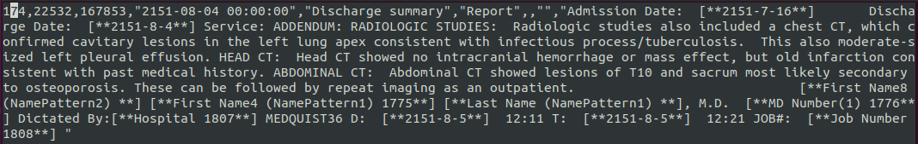
Cleaned Clinical Text
1
2
3
4
5
6
7
8
9
CF) No chart time & no store time

Slide 16
Note category
In the preprocess.py,
we only focus on "Discharge summary"
cat NOTEEVENTS-2.csv | awk -F"," '{print $5}' | sort | uniq -c | sort -r
# | Category | Count | %
1 | Nursing | 223,556 | 30.28%
2 | ECG | 209,051 | 28.31%
3 | Physician | 141,624 | 19.18%
4 | Discharge summary | 59,652 | 8.08%
5 | Echo | 45,794 | 6.20%
6 | Respiratory | 31,739 | 4.30%
7 | Nutrition | 9,418 | 1.28%
8 | General | 8,301 | 1.12%
9 | Rehab Services | 5,431 | 0.74%
10 | Social Work | 2,670 | 0.36%
11 | Case Management | 967 | 0.13%
12 | Pharmacy | 103 | 0.01%
13 | Consult | 98 | 0.01%
Notes:
http://citeseerx.ist.psu.edu/viewdoc/download?doi=10.1.1.49.816&rep=rep1&type=pdf
We are using the discharge summaries rather than the entire patient medical record, because this is the part of the medical record that has been computerized.

Slide 17
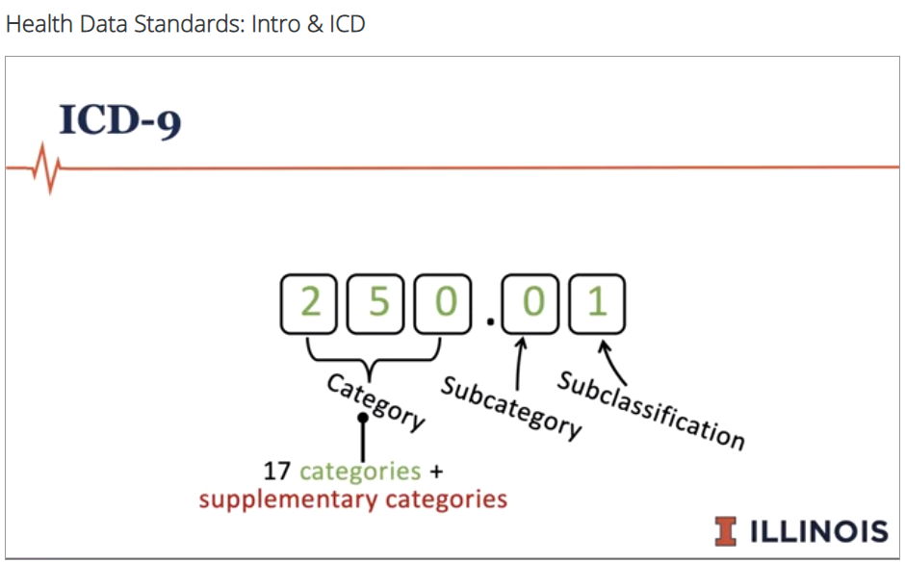
ICD-9 structure (major 17 categories)
Notes:
major 17 categories: only numerical digit
supplementary categories: start with V or E

Slide 18
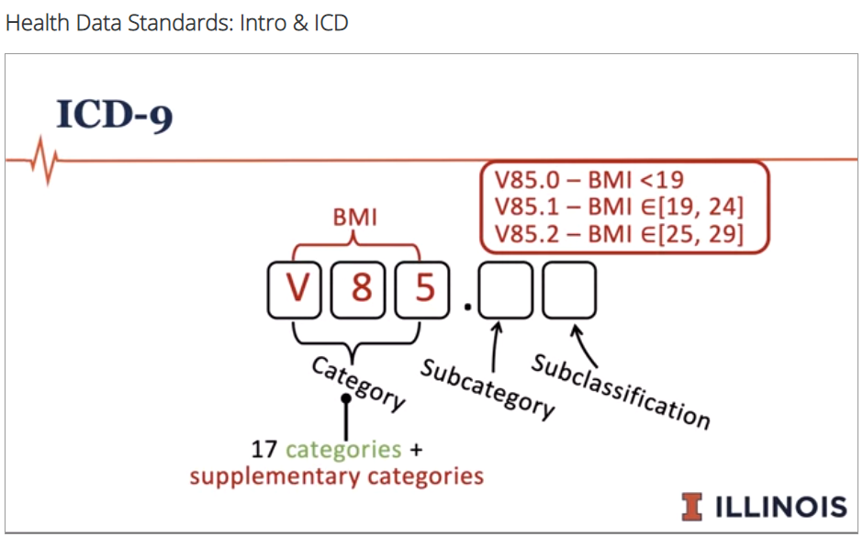
ICD-9 structure (supplementary categories)
Notes:
major 17 categories: only numerical digit
supplementary categories: start with V or E

Slide 19
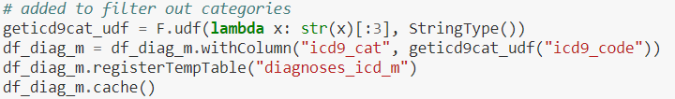
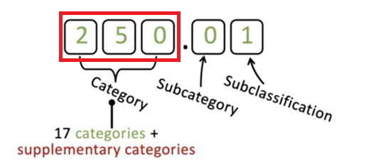
diagnoses_icd_m
F.udf = pyspark's User Defined Functions
str(x)[:3]

Slide 20
diag_o_rdd ➔ diagnoses_icd_o
one icd to one hadm_id
(take the smallest seq number as primary)
Table: diagnoses_icd_o

Slide 21
PySpark tables
Table | Description
noteevents | All note events
noteevents2 | "Discharge summary" note events
diagnoses_icd_m | Diagnosis's result + icd9_category
diagnoses_icd_o | One icd to one hadm_id (take the smallest seq number as primary)
hadm_id_list | Distinct hadm_id list in noteevents
subject_id_list | Distinct subject_id(=patient_id) list in noteevents
diagnoses_icd_desc | Icd9 code description
diagnoses_icd_o2 | One icd to one hadm_id + icd9_cat
diagnoses_icd_m2 | Diagnosis's result + icd9_category (same??)

Slide 22

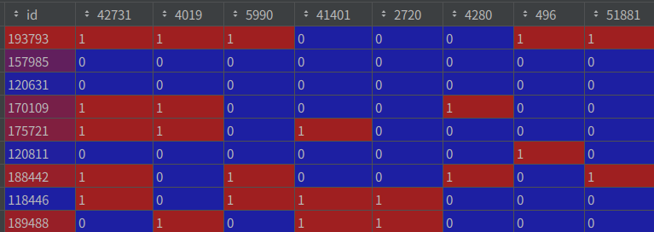
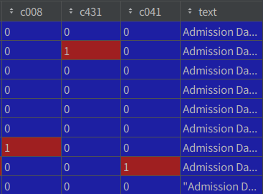
Final merged data
DATA_HADM (Hospital ADMission)
DATA_HADM_CLEANED
cleaned EHR
fee-text
top 50
ICD9 codes
top 50
ICD9 categories
hospital admission id

Slide 23
CAML - preprocessing
https://arxiv.org/pdf/1802.05695.pdf
https://github.com/jamesmullenbach/caml-mimic/blob/master/notebooks/dataproc_mimic_III.ipynb

Slide 24
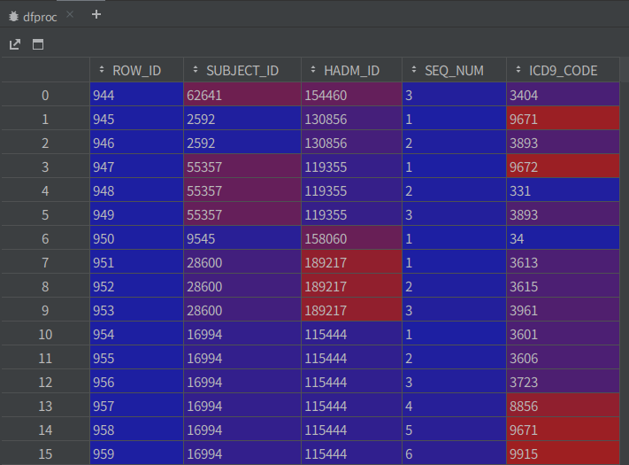
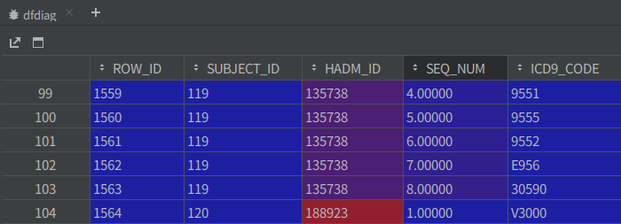
CAML – reformat
procedure code: 1234 => 12.34
diagnosis code: 12345 => 123.45
absolute_code
955.1
955.1
955.2
E95.6
305.90
V30.00
Notes:
def reformat(code, is_diag):
"""
Put a period in the right place because the MIMIC-3 data files exclude them.
Generally, procedure codes have dots after the first two digits,
while diagnosis codes have dots after the first three digits.
"""
code = ''.join(code.split('.'))
if is_diag:
if code.startswith('E'):
if len(code) > 4:
code = code[:4] + '.' + code[4:]
else:
if len(code) > 3:
code = code[:3] + '.' + code[3:]
else:
code = code[:2] + '.' + code[2:]
return code

Slide 25

CAML - dfcodes
dfcodes = pd.concat([dfdiag, dfproc])
# just concat all the codes
a = pd.DataFrame([1])
b = pd.DataFrame([2])
c = pd.concat([a, b]) # [1, 2]
➔ ALL_CODES.csv
uniq code = 8994

Slide 26
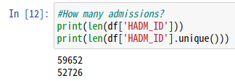
CAML - preprocess
Select only discharge summaries and their addenda
remove punctuation and numeric-only tokens
ex) removing "500" but keeping "250mg"
lowercase all tokens
disch_full.csv = discharged full data

Slide 27
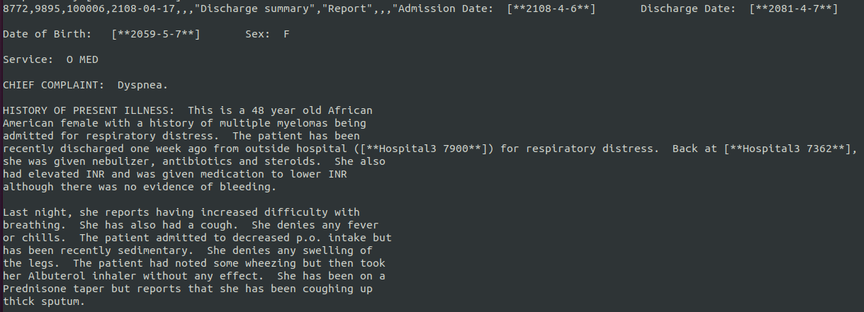
CAML - preprocess
#retain only alphanumeric
tokenizer = RegexpTokenizer(r'\w+')
ex) removing "500" / keeping "250mg"
Notes:
admission date discharge date date of birth sex f service o med chief complaint dyspnea history of present illness this is a year old african american female with a history of multiple myelomas being admitted for respiratory distress the patient has been recently discharged one week ago from outside hospital hospital3 for respiratory distress back at hospital3 she was given nebulizer antibiotics and steroids she also had elevated inr and was given medication to lower inr although there was no evidence of bleeding last night she reports having increased difficulty with breathing she has also had a cough she denies any fever or chills the patient admitted to decreased p o intake but has been recently sedimentary she denies any swelling of the legs the patient had noted some wheezing but then took her albuterol inhaler without any effect she has been on a prednisone taper but reports that she has been coughing up thick sputum she went to her primary care provider today but could not say ..

Slide 28
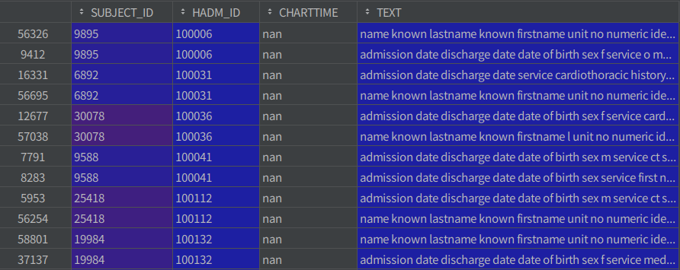
CAML – duplicated admission with different text
Notes:
name known lastname known firstname unit no numeric identifier admission date discharge date date of birth sex f service addendum to her admission note date of discharge will be for her multiple myeloma patient was given treatment with vincristine and doxil she was then treated with decadron for four days at dosing of mg po q day she will remain on allopurinol prophylaxis for one week postchemotherapy she was seen by dr first name stitle regarding future bone marrow transplant for her multiple myeloma and she will follow up with oncology dr last name stitle and dr last name stitle on in regards to her congestive obstructive pulmonary disease patient did improve while in the hospital she saturated at on room air both at rest and with walking she is to continue on her inhaler regimen along with the singulair she will be put on a very long prednisone taper with starting after the decadron treatment her prednisone taper will include mg for three days then mg for days then mg for days mg f..
admission date discharge date date of birth sex f service o med chief complaint dyspnea history of present illness this is a year old african american female with a history of multiple myelomas being admitted for respiratory distress the patient has been recently discharged one week ago from outside hospital hospital3 for respiratory distress back at hospital3 she was given nebulizer antibiotics and steroids she also had elevated inr and was given medication to lower inr although there was no evidence of bleeding last night she reports having increased difficulty with breathing she has also had a cough she denies any fever or chills the patient admitted to decreased p o intake but has been recently sedimentary she denies any swelling of the legs the patient had noted some wheezing but then took her albuterol inhaler without any effect she has been on a prednisone taper but reports that she has been coughing up thick sputum she went to her primary care provider today but could not say ..

Slide 29
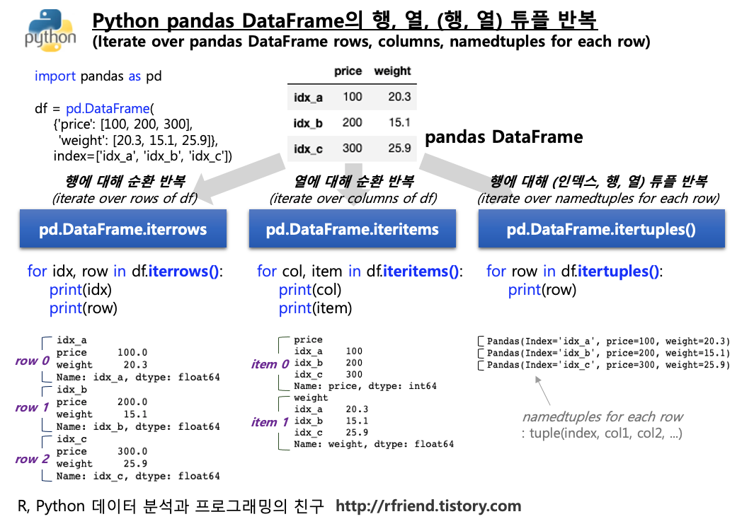
[REMIND] itertuple
row[0] = index
row[1] = dict value
row[1]["TEXT"] = abc ..
row[4] = abc ..

Slide 30
CAML – tokens and types
uniq words = 150,853 (150 k)
every word = 79,801,402 (79 m)

Slide 31
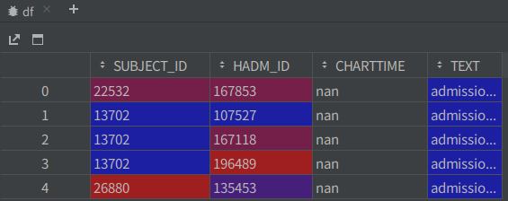
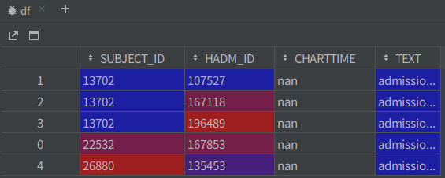
df.sort_values

Slide 32
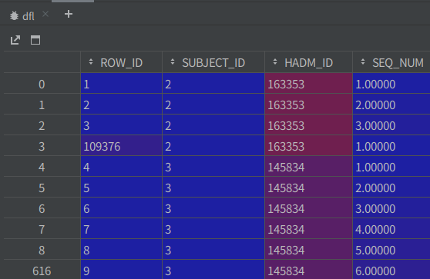
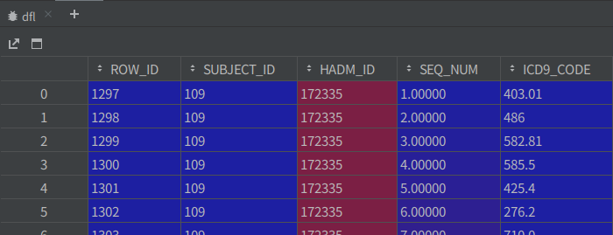
dfl.sort_values

Slide 33
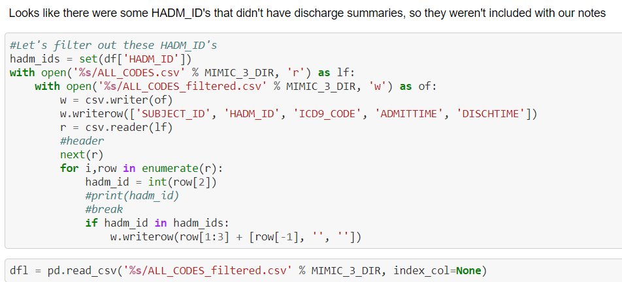
Remove HADM_ID that have no discharge summaries

Slide 34
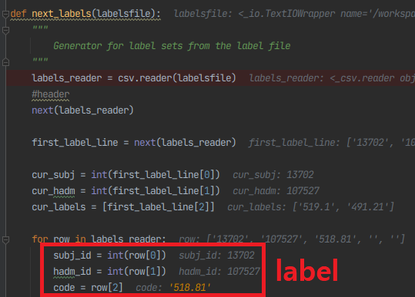
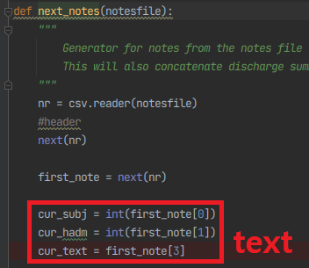
concat_data
subj_id, hadm_id, text, code1;code2;code3;…
full code list

Slide 35
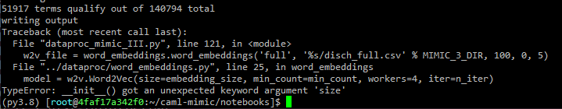
gensim 4
https://stackoverflow.com/questions/53195906/getting-init-got-an-unexpected-keyword-argument-document-this-error-in
The year is 2021 and if you're here for the same reason I am,
it's because you're getting the same error on the size parameter.
You need to use vector_size instead.
iter => epochs
index2word => index_to_key
Notes:
torch
'1.8.1+cu102'
gensim
>>> gensim.__version__
'4.0.1'
File "/workspace/caml-mimic/notebooks/dataproc_mimic_III.py", line 33, in <module>
model = w2v.Word2Vec(vector_size=1, min_count=1, workers=4, iter=5)
TypeError: __init__() got an unexpected keyword argument 'iter'
writing embeddings to /workspace/caml-mimic/mimicdata/mimic3/processed_full.w2v
Traceback (most recent call last):
File "dataproc_mimic_III.py", line 142, in <module>
extract_wvs.gensim_to_embeddings('%s/processed_full.w2v' % MIMIC_3_DIR, '%s/vocab.csv' % MIMIC_3_DIR, Y)
File "../dataproc/extract_wvs.py", line 28, in gensim_to_embeddings
W, words = build_matrix(ind2w, wv)
File "../dataproc/extract_wvs.py", line 42, in build_matrix
W = np.zeros((len(ind2w)+1, len(wv.word_vec(wv.index2word[0])) ))
File "/root/anaconda3/envs/py3.8/lib/python3.8/site-packages/gensim/models/keyedvectors.py", line 634, in index2word
raise AttributeError(
AttributeError: The index2word attribute has been replaced by index_to_key since Gensim 4.0.0.
See https://github.com/RaRe-Technologies/gensim/wiki/Migrating-from-Gensim-3.x-to-4

Slide 36
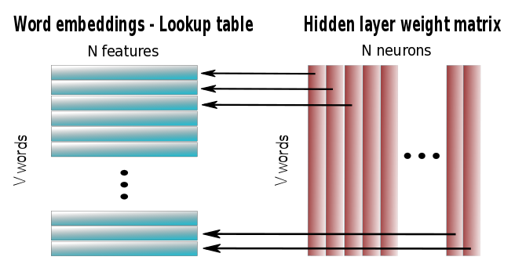
word_embedding
Word embeddings => lookup table
embedding size = 100
https://ricardokleinklein.github.io/2017/09/25/word2vec.html

Slide 37
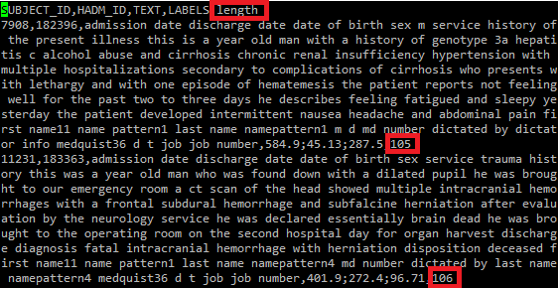
train_50.csv
sort by word count
cf) variable length column code
cf) fixed sized column code

Slide 38
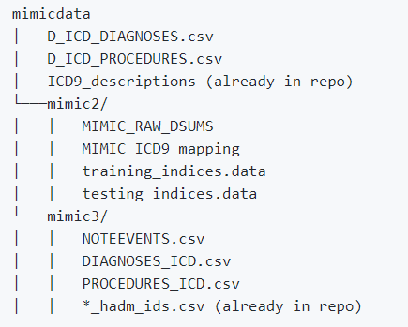
Requirements
FileNotFoundError: [Errno 2] No such file or directory: '/workspace/caml-mimic/mimicdata/D_ICD_DIAGNOSES.csv'
Should upload files in advance
models
Should create a folder to train in advance

Slide 39
Steps to reproduce
2021-04-15 00:40:47 (496.776): end
1. preprocessing
notebooks/dataproc_mimic_III.ipynb using Jupyter notebook.
“Run all”. Make sure to put appropriate values in constants.py
2. training
python training.py mimicdata/mimic3/train_50.csv mimicdata/mimic3/vocab.csv 50 conv_attn 200 --filter-size 10 --num-filter-maps 50 --dropout 0.2 --patience 10 --criterion prec_at_8 --lr 0.0001 --embed-file mimicdata/mimic3/processed_full.embed --gpu
3. evaluation
python get_metrics_for_saved_predictions.py predictions/CAML_mimic3_50
2021-04-15 01:58:30 (1848.309): end
2021-04-15 01:59:11 (1.360): end
Notes:
[TEST RESULT]
[MACRO] accuracy, precision, recall, f-measure, AUC
0.3607, 0.5705, 0.4562, 0.5070, 0.8549
[MICRO] accuracy, precision, recall, f-measure, AUC
0.3916, 0.6310, 0.5080, 0.5628, 0.8806
rec_at_5: 0.5295
prec_at_5: 0.5587
saved metrics, params, model to directory /workspace/caml-mimic/models/conv_attn_Apr_15_01:27:51
TOTAL ELAPSED TIME FOR conv_attn MODEL AND 200 EPOCHS: 1848.303468
[Validation result from test get_metrics_for_saved_predictions.py]
loading predictions
loading ground truth
reformatting predictions
1729it [00:00, 54185.76it/s]
evaluating all other metrics
[MACRO] accuracy, precision, recall, f-measure
0.3933, 0.6035, 0.4799, 0.5346
[MICRO] accuracy, precision, recall, f-measure
0.4431, 0.7144, 0.5384, 0.6141

Slide 40
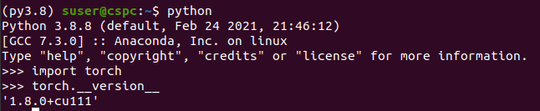
training error
CF) DLH #HW5 GNN
pytorch-geometric
torch
'1.8.1+cu102'
CUDA
nvcc –version
Cuda compilation tools, release 11.0, V11.0.167
Build cuda_11.0_bu.TC445_37.28358933_0
https://pytorch.org/get-started/previous-versions/
# CUDA 11.0
pip install torch==1.8.0+cu111 -f https://download.pytorch.org/whl/torch_stable.html
⬅ cu102 means CUDA v10.2
Notes:
A100-SXM4-40GB with CUDA capability sm_80 is not compatible with the current PyTorch installation.
The current PyTorch install supports CUDA capabilities sm_37 sm_50 sm_60 sm_70.
If you want to use the A100-SXM4-40GB GPU with PyTorch, please check the instructions at https://pytorch.org/get-started/locally/
Traceback (most recent call last):
File "training.py", line 360, in <module>
main(args)
File "training.py", line 41, in main
epochs_trained = train_epochs(args, model, optimizer, params, dicts)
File "training.py", line 83, in train_epochs
os.mkdir(model_dir)
FileNotFoundError: [Errno 2] No such file or directory: '/workspace/caml-mimic/models/conv_attn_Apr_15_00:59:45'

Slide 41
training warning
F.sigmoid => torch.sigmoid
F.tanh => torch.tanh
Notes:
training.py:256: UserWarning: volatile was removed and now has no effect. Use `with torch.no_grad():` instead.
data, target = Variable(torch.LongTensor(data), volatile=True), Variable(torch.FloatTensor(target))
/root/anaconda3/envs/py3.8/lib/python3.8/site-packages/torch/nn/functional.py:1709: UserWarning: nn.functional.sigmoid is deprecated. Use torch.sigmoid instead.
warnings.warn("nn.functional.sigmoid is deprecated. Use torch.sigmoid instead.")
/root/anaconda3/envs/py3.8/lib/python3.8/site-packages/torch/nn/functional.py:1698: UserWarning: nn.functional.tanh is deprecated. Use torch.tanh instead.
warnings.warn("nn.functional.tanh is deprecated. Use torch.tanh instead.")

Slide 42
Summary
MIMIC III
raw data
train_50.csv
dev_50.csv
test_50.csv
Train
Test
Top 50 codes
vocab.csv
admission
date
…
Word2Vec
processed_full.embed
binary file
dataproc_mimic_iii.py
train.py
get_metrics_for_saved_predictions.py

Slide 43
Removing stop words
Notes:
Akhmad Hutomo
University of Illinois at Urbana-Champaign, Urbana, IL, USA
ahutomo2@illinois.edu
Changsoo Kim
University of Illinois at Urbana-Champaign, Urbana, IL, USA
ck37@illinois.edu
Curt Tigges
University of Illinois at Urbana-Champaign, Urbana, IL, USA
ctigges2@illinois.edu
Gabriel Sandoval
University of Illinois at Urbana-Champaign, Urbana, IL, USA
grs4@illinois.edu

Slide 44
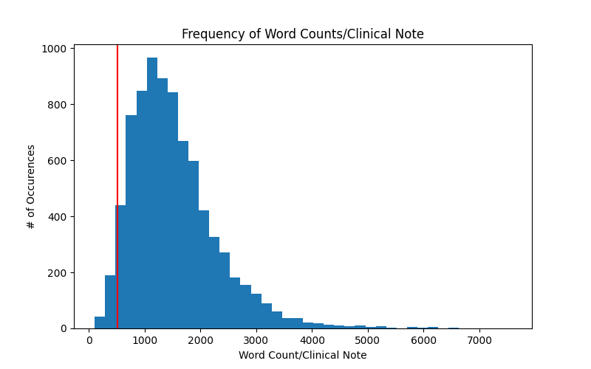
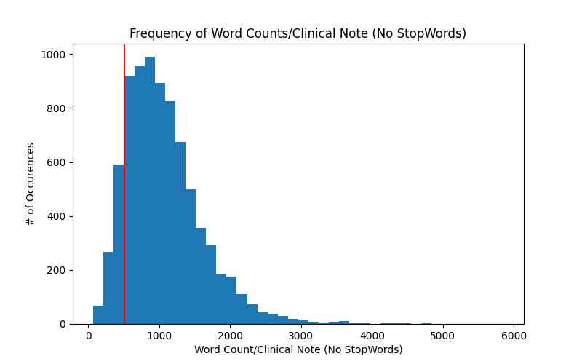
BERT's token size limit: 512
Our data is too long to fit in the BERT's max token length.
Average token length: 1530
Average token length after filtering stop words: 1068
Notes:
for train data

Slide 45
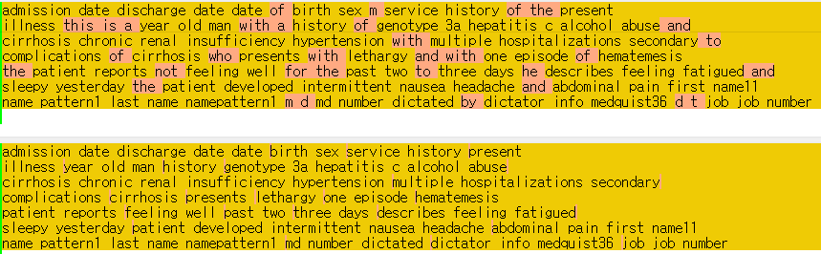
BERT's token size limit: 512
Remove stop-words using nltk library

Slide 46
BERT's token size limit: 512
Train data | Train data | With stop-words
Total | 8066
Avg token length | 1530 | 1068
Over 512 token | 7784 (96.50%) | 7095 (87.96%)
Dev(eval) data | With stop-words | Without stop-words
Total | 1573
Avg token length | 1800 | 1280
Over 512 token | 1559 (99.11%) | 1533 (97.46%)
Test data | With stop-words | Without stop-words
Total | 1729
Avg token length | 1826 | 1300
Over 512 token | 1713 (99.01%) | 1678 (97.05%)

