Slide 1
HP ZGX Fury G1n
Datacenter-class AI. Deskside footprint.
Author: Curtis Burkhalter, PhD, Technical PMM, ACS AI Solutions
April 2026

Slide 2
AI spend is scaling.
Production AI shouldn’t require a data center
"We spend in excess of $35K/month to develop AI on the cloud." - HP customer, Federal SI
"AI inference is costing us about $45K/quarter on Azure." - HP AI Innovation Lead
Common friction points:
Cloud AI costs are unpredictable and escalating
Queue times slow development velocity
Compliance requirements block cloud processing of sensitive data
Data centers require massive capital investment
HP ZGX Fury: Production-grade AI compute - without compromising on security or predictability.

Slide 3
AI economics: the spending paradox
280×
320%
Token price drop in 2 years
Rise in enterprise AI spending
Why? Agentic workflows, RAG pipelines, and always-on agents consume compute at rates nobody planned for.
OpenAI: Projected to lose $14B in 2026. Spends $2.25 for every $1 earned.
Anthropic: Over $10B spent on inference and training vs. $5B in cumulative lifetime revenue.
GitHub Copilot: Paused new signups for Pro, Pro+, and Student plans in April 2026.
Source: Product Impact, "The Free Ride Is Over," Apr 2026 | Fortune, Nov 2025 | The Register, Apr 2026 productimpactpod.com/news/ai-economics-most-important-strategy-decision
Notes:
Here's the paradox that's confusing a lot of enterprise finance teams right now. You see all over LinkedIn that the cloud is getting cheaper every day and token prices are a fraction of what they once were. And this is true, cloud token prices have dropped 280x in two years. And yet enterprise AI spending is up 320%. So how is that possible?
The answer is agentic workflows, RAG pipelines, and always-on agents. These consume compute at rates nobody planned for. Even the AI providers themselves are struggling - OpenAI is projected to lose $14 billion this year, spending $2.25 for every dollar earned.
Anthropic has spent over $10B on inference and training against $5B in total revenue. GitHub Copilot paused new signups for Pro plans in April.
The free ride is over. That's the market context we're selling into

Slide 4
Key features & specifications of HP ZGX Fury
748GB
GB300
72 Core
Coherent Memory
NVIDIA Blackwell Ultra
ARM-based CPU
Component | Specification
GPU | 1x NVIDIA Blackwell Ultra
CPU | 1x Grace-72 Core Neoverse V2
Memory | 252GB HBM3e (7.1 TB/s) + 496GB LPDDR5X (396 GB/s)
Storage | 2x PCIe Gen5 M.2 (OS) + 2x PCIe Gen6 M.2 (data)
Networking | ConnectX-8 SuperNIC, 800Gbps total
Form Factor | Convertible tower or rack (5U), liquid cooled, 1600W (20A)
Availability | August 2026

Slide 5
What sets HP apart
Same NVIDIA silicon. Different approach to software and support.
ZGX Toolkit
ZGX CLI
Free
Free
Skip dependency hell. Open-source stack. Productive on day one. No vendor lock-in.
Simple model serving. No licensing required for production inference.
No Licensing Trap
HP Enterprise Support
Predictable TCO
Global coverage
Free for development AND production. No per-token metering. No pricing cliffs.
Enterprise-grade support from a trusted partner. Not a boutique OEM.
HP gives you the silicon and gets out of your way - no licensing tiers, no production pricing cliffs, no dependency on vendor software.

Slide 6
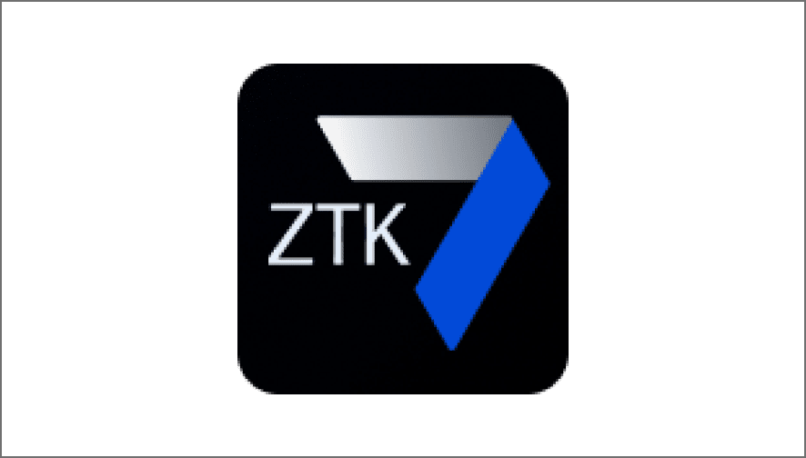

Developer-first AI environment
No token cost Run models locally. No per-request or usage-based fees.
Everything you need, built in.
Device discovery Find ZGXs on the network
Device pairing Connect two network devices in minutes With VS code Start building in minutes
Quick start templates Pre-configured packages and tools
AI development with ZTK
VS code extension
Developer productivity Pre-configured stack so you can build and iterate fast.
Private by design. Your data stays local.
Local fine-tuning Train models securely on your own data
Develop and customize AI locally - with full control

Slide 7

Turn-key inferencing environment
Model inference Run LLMs and other models at scale
Z Runtime
Pull Models
Start Inference Service
Create Endpoints
Monitor & Manage
High-performance local AI execution
OpenAI – compatible APIs Seamless integration with your applications
Fury
API
High performance at scale Low latency, high throughput, concurrent workloads
Pre-configured stacks and CLI-driven workflows to go from model to inference in minutes

Slide 8

From Experimentation to Production
One platform, two tiers - start developing on the Nano, scale to the Fury when your workloads demand it.
HP ZGX Nano
HP ZGX Fury
Where AI development begins
Where AI goes to production
Experiment, fine-tune, and validate locally - no cloud costs, no data leaving your building.
Built for:
AI developers iterating on models up to 70B parameters (fine-tuning) and 200B parameters (local inference). Ideal for prototyping, LoRA/QLoRA fine-tuning, and proof-of-concept development.
Run production inference at departmental scale - serve multiple concurrent users with frontier-class models, on-prem.
Built for:
Teams deploying production AI services, running large-scale fine-tuning, and serving high-throughput inference for enterprise applications. Departmental AI infrastructure without the data center.
Scale up
Spec | Detail
GPU | NVIDIA GB10 Grace Blackwell
Memory | 128 GB coherent unified (273 GB/s)
Tensor Perf. | Up to 1 PFLOP FP4
Form Factor | Compact desktop - 240W
Spec | Detail
GPU | 1x NVIDIA Blackwell Ultra (GB300)
Memory | 748 GB coherent (7.1 TB/s HBM3e + 396 GB/s)
CPU | 72-core Grace Neoverse V2
Form Factor | Tower / 5U rack - liquid cooled, 1600W
The ZGX platform eliminates the false choice between local OR cloud. Start on the Nano - experiment freely, iterate fast, keep your data local. When you're ready for production inference or heavier fine-tuning, scale to the Fury without changing your workflow, and if you still need more power push to the cloud
HP Restricted. For HP internal use only.

Slide 9
The right tool for the right workload
Cloud and on-prem serve different needs. Here's how to choose.
When ZGX Fury is the right fit
When cloud is still the right fit
✓ Data can't leave your facility (HIPAA, ITAR, IP)
✓ You're experimenting and need elastic scale
✓ Cloud costs have become a concern
✓ Workloads are bursty and unpredictable
✓ Queue times are slowing your AI team’s development
✓ No compliance constraints on data processing location
✓ You need deterministic latency for production
✓ You only need access to frontier models via API
✓ You want predictable CapEx, not variable OpEx
✓ You're not yet hitting cost or queue friction
Most organizations use both.
ZGX Fury handles the workloads where cloud isn't the right answer - compliance-sensitive development, cost-sensitive inference, and workflows where data gravity matters.

Slide 10
ZGX Fury: use cases by vertical
AI development & production inference across industries
Healthcare
Government & defense
Product design & mfg
Research labs
AI development
AI development
AI development
AI development
Fine-tune medical imaging models on patient data
Fine-tune LLMs on classified intelligence
Train generative design on simulation data
Knowledge distillation: 400B → 70B models
HIPAA compliant
Proprietary clinical datasets
Iterate without cloud loops
Air-gap capable
Strict security requirements
TAA compliant
IP protection
Internal design libraries
Simulation outputs
748GB fits teacher + student
Internal research data
Previously impossible on-prem
Production inference
Production inference
Production inference
Production inference
Real-time radiology AI assist
Intelligence analyst copilot
Real-time design optimization
Multi-modal experimentation
Deterministic latency
Local diagnostic imaging
Multi-clinician support
Local inference
No external connectivity
SCIF deployable
No queue times
No cloud round-trips
Faster prototyping
Text, PDF, images
Long-context workflows
Prototype on internal data
Why ZGX Fury?
Why ZGX Fury?
Why ZGX Fury?
Why ZGX Fury?
On-prem compliance, zero data movement
Air-gap ready, zero egress
IP protection, predictable costs
Unlock cloud/HPC workloads locally without cloud costs

