Slide 1
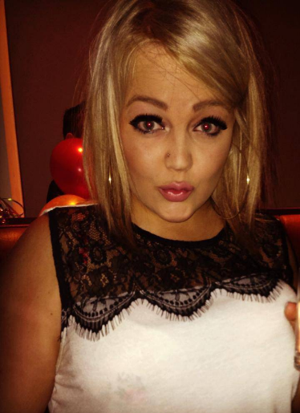
Steph McKay Age: 21
Name Steph McKay
Type Clubber
Role Basic User
Behaviours
Withdraw Amount
Motivations
Only carries her ID and bank card to bars
Technology prevents waiting in bank lines
Pay back some “I owe yous”
Goals
Quick transactions to get back to drinking
Wants to buy that cute dress next payday
Be able to save some money in the future after school
Pain points
Always in a rush
Tends to forget memories/things from the night before
Loves to spend the little money she makes
Small Denominations
Larger Denominations
Type of use
Bank
ATM
Technology Experience
“I am always late...good thing I am too cute to wait in lines.”
early-adopter
not-current
Current money habits
Steph is currently a student and is not worried about saving money at the moment. She loves to go out on weekends to celebrate the end of another school week. She works as a server couple nights of a week. She rarely carries cash on her - she always checks her remaining balance from her spending habits.
Steph prefers to use ATMs and loves they are conveniently located at her favourite places – bars and malls.
Saver
Spender
Time Management/Organization
Early
Late
Time spent checking bank accounts
Less frequent
Often
Notes:
02/17/15

Slide 2
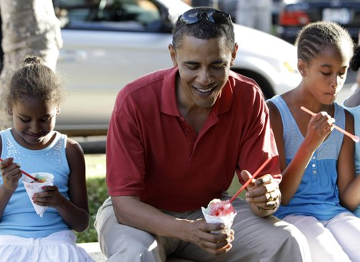
Adam Benner Age: 38
Name Adam Benner
Type Business Man
Role Advanced User
Behaviours
Withdraw Amount
Motivations
Active stock investor
Retirement strategy
Sales commission bonuses
Goals
Set the kids up with their own credit cards
Have enough saved for kids education
Move into a condo when kids in school
Pain points
Multiple credit cards – more to come
Spends a lot of time transferring money between accounts
Wife and him use two different banks
Small Denominations
Larger Denominations
Type of use
Bank
ATM
Number of accounts
“I need to teach my kids about money, they are always asking me for some.”
Few
Many
Current money habits
Adam currently works full-time and married with 2 kids. Adam has many bank accounts and has control over his kids accounts as well. He is always transferring money between accounts, investments and adding to his kids college savings.
Adam usually carries cash around at all times, he takes the family out to eat couple times a month. The kids always ask their dad for some extra money on the weekends.
Saver
Spender
Time Management/Organization
Early
Late
Time spent checking bank accounts
Less frequent
Often
Image source: http://www.gooya.us/photos/2008/10/barak-obama-the-family-man.php
Notes:
02/17/15

