Slide 1
A Mandatory Floor for Engineering Requirements
A method to find the requirements the SMS obligates, in any engineering discipline
7 steps
3 gates
2 disciplines
from standards to a governed floor
decide what belongs in the floor
already done: CM, and R&M with System Health and Human Factors
Briefing | [DATE]
Notes:
This deck presents the method, not a discipline. CM and R&M are the two worked examples, one slide each near the end. The method applies to any engineering discipline that works to industry standards.

Slide 2
The Question Every Discipline Faces
Which of our standard requirements must we perform when the contract does not ask?
The common position
The method's position
“This standard is invoked by contract. If the contract does not require a clause, we are not obligated to perform it.”
Some clauses control hazards our SMS names. Those clauses bind through the SMS, whether or not a contract names them. Skipping one is a Severity 1 to 2 risk-acceptance decision.
What the method delivers
A short list of floor requirements for the discipline, each tied to a clause, an SM-0001 hazard and a documented event.
An owner for every barrier, including the ones another discipline must perform.
One route for exceptions: SMS risk acceptance at the authority the severity requires.
Notes:
Every discipline hears the same argument: the standard is a contract instrument, so silence means no obligation. The method answers it with evidence, clause by clause. Severity here uses the organization's scale: 1 is catastrophic, 2 is severe.

Slide 3
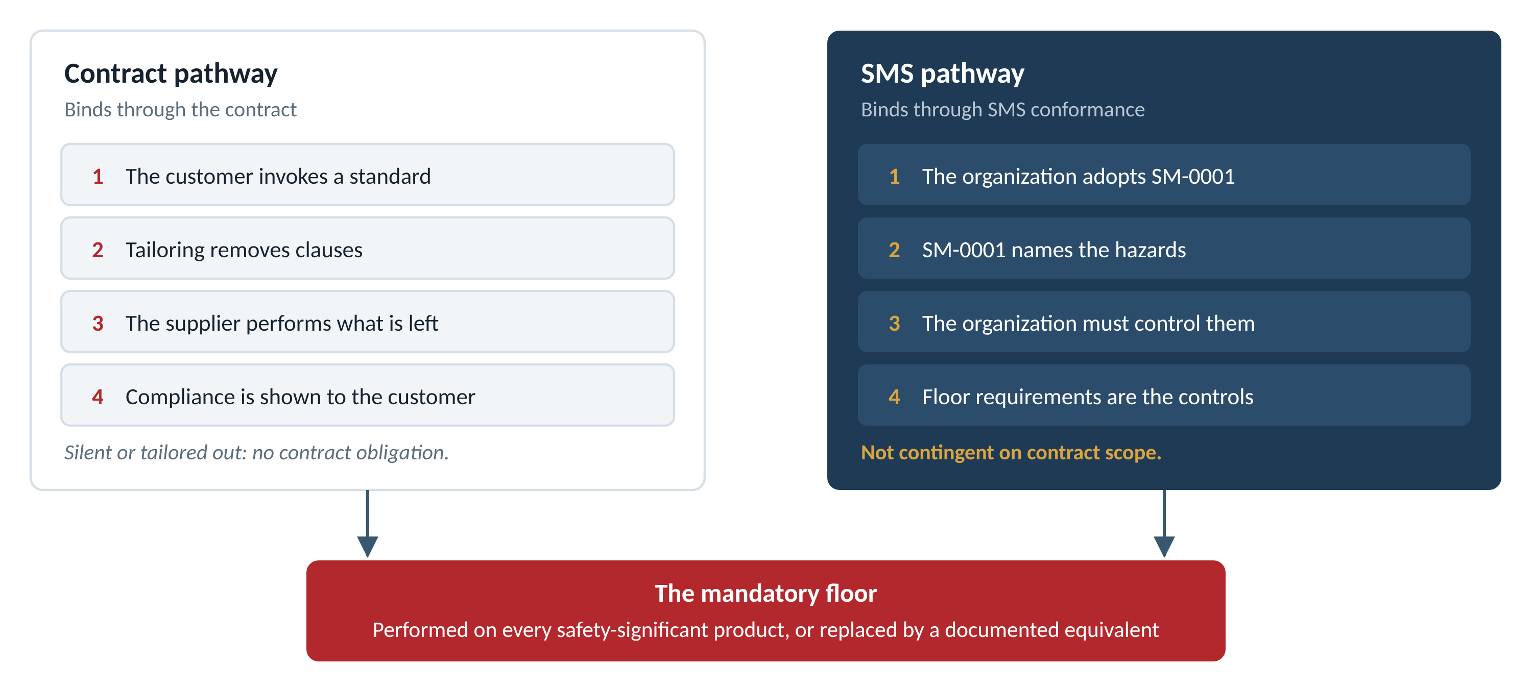
Two Pathways Bind the Organization
The contract may be silent. The SMS is not.
Notes:
The contract pathway is real. Tailoring removes contract obligations. It cannot remove an SMS obligation, because the SMS binds through the organization's own conformance, not through the customer.

Slide 4
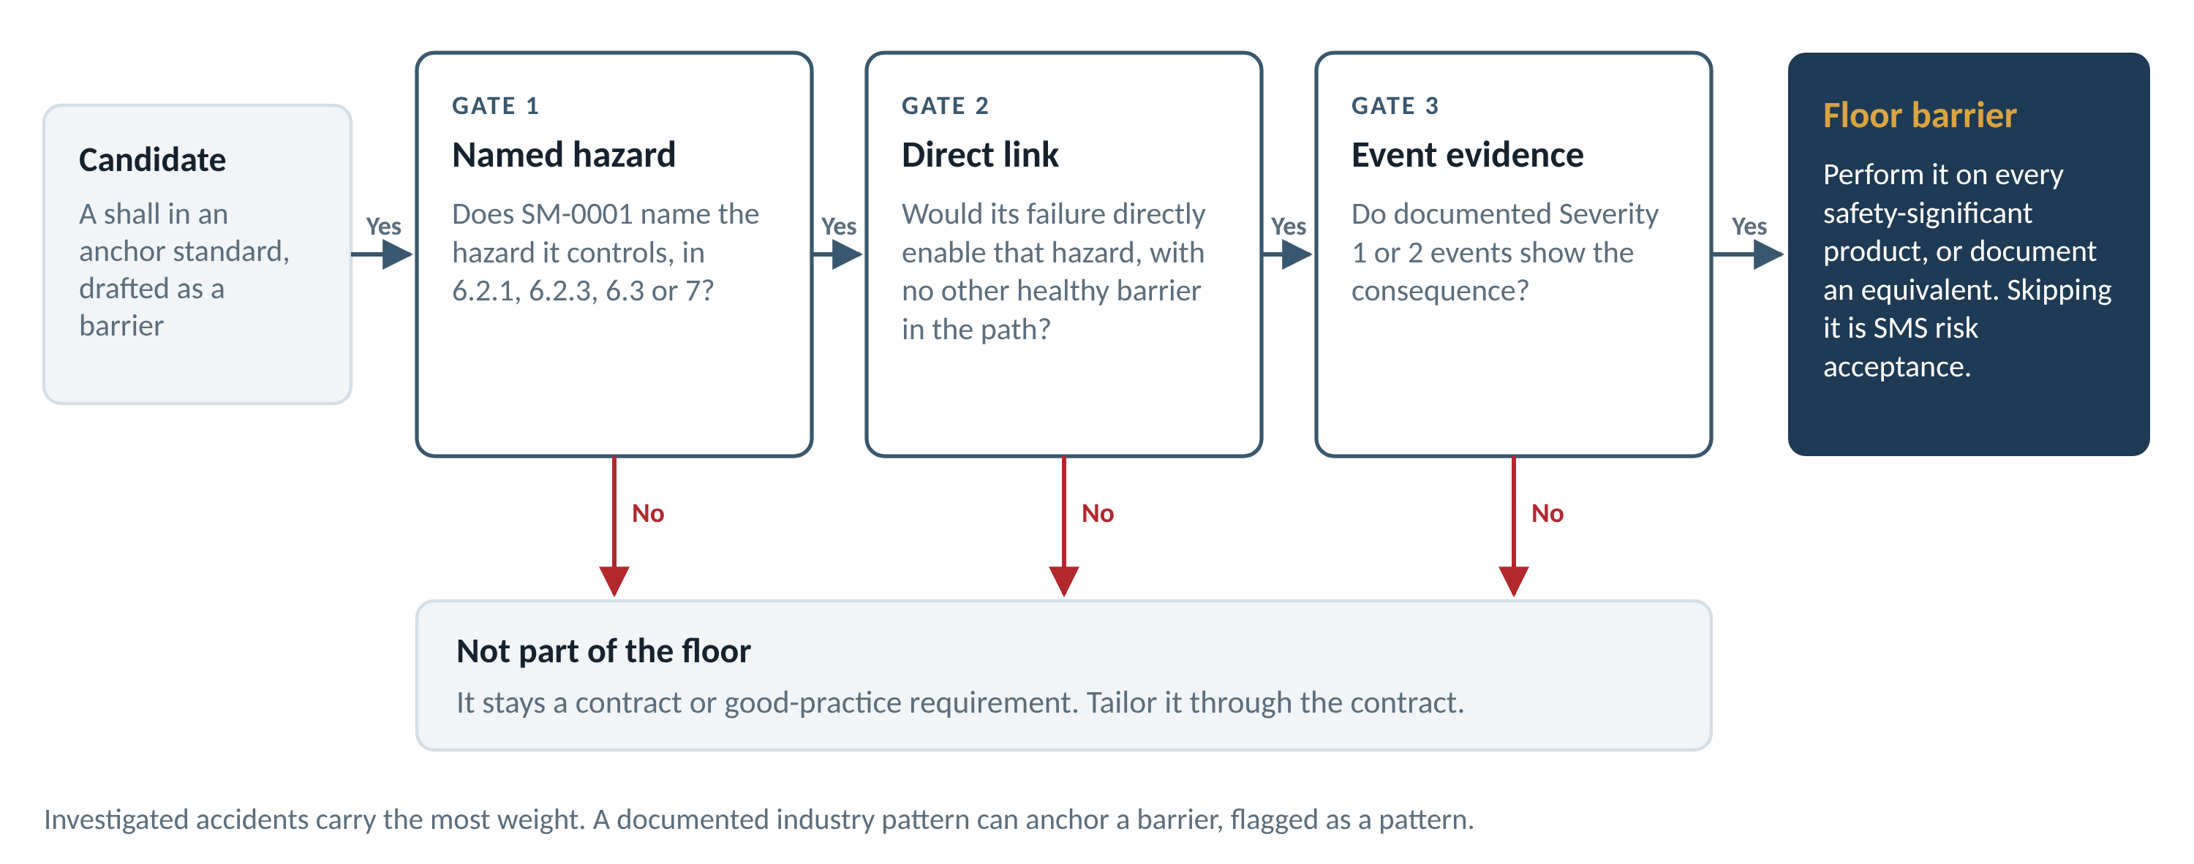
What Makes a Requirement Part of the Floor
Three gates. A requirement that passes all three is an SMS barrier.
Notes:
The gates keep the floor short and defensible. Gate 1 ties the requirement to the SMS standard itself. Gate 2 removes requirements that are only good practice. Gate 3 demands evidence: an investigated accident, or a documented industry pattern flagged as such. Everything that fails stays a contract or good-practice requirement.

Slide 5
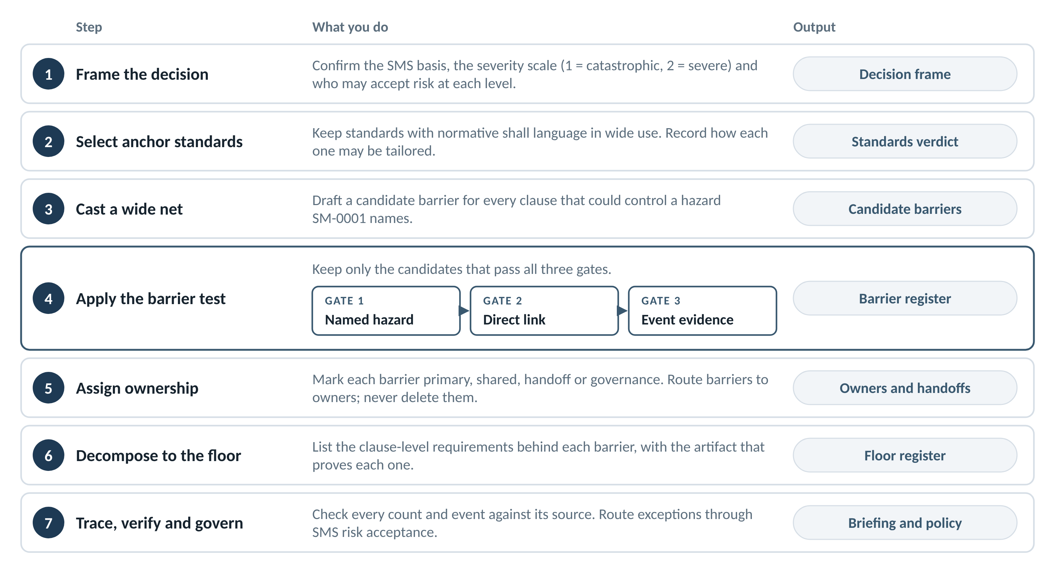
The Method in Seven Steps
Each step produces a record the next step builds on
Notes:
Steps 1 and 2 set the frame and the sources. Steps 3 and 4 find the barriers. Steps 5 and 6 assign owners and break each barrier into clause-level requirements. Step 7 checks the work and puts the floor under SMS governance.

Slide 6
Step 2: Choosing Anchor Standards
A standard must obligate, not advise
1
2
3
4
Normative shall language
Wide use
Current status
A known tailoring rule
Shall statements in the body of the standard. A shall inside a worked example or an appendix does not count.
Standards that aerospace and defense programs have applied for decades carry more weight than new or niche ones.
Active, reaffirmed, or replaced by a named successor. Cancelled and stabilized documents are history, not anchors.
Record how each standard may be tailored. Some allow only additions to a mandatory minimum. Some apply every shall unless an agreement excludes it.
Not anchors
R&M result
Handbooks and guides. Data item descriptions, which are contract instruments. Case studies. Standards whose shall statements sit only in examples.
33 standards reviewed. 7 usable as anchors. 2 marginal.
Notes:
The verdict table is the first record. It says why each standard can or cannot anchor a floor requirement, and how it may be tailored. That second column matters later: a standard that allows only additions to its minimum cannot be tailored below the floor.

Slide 7
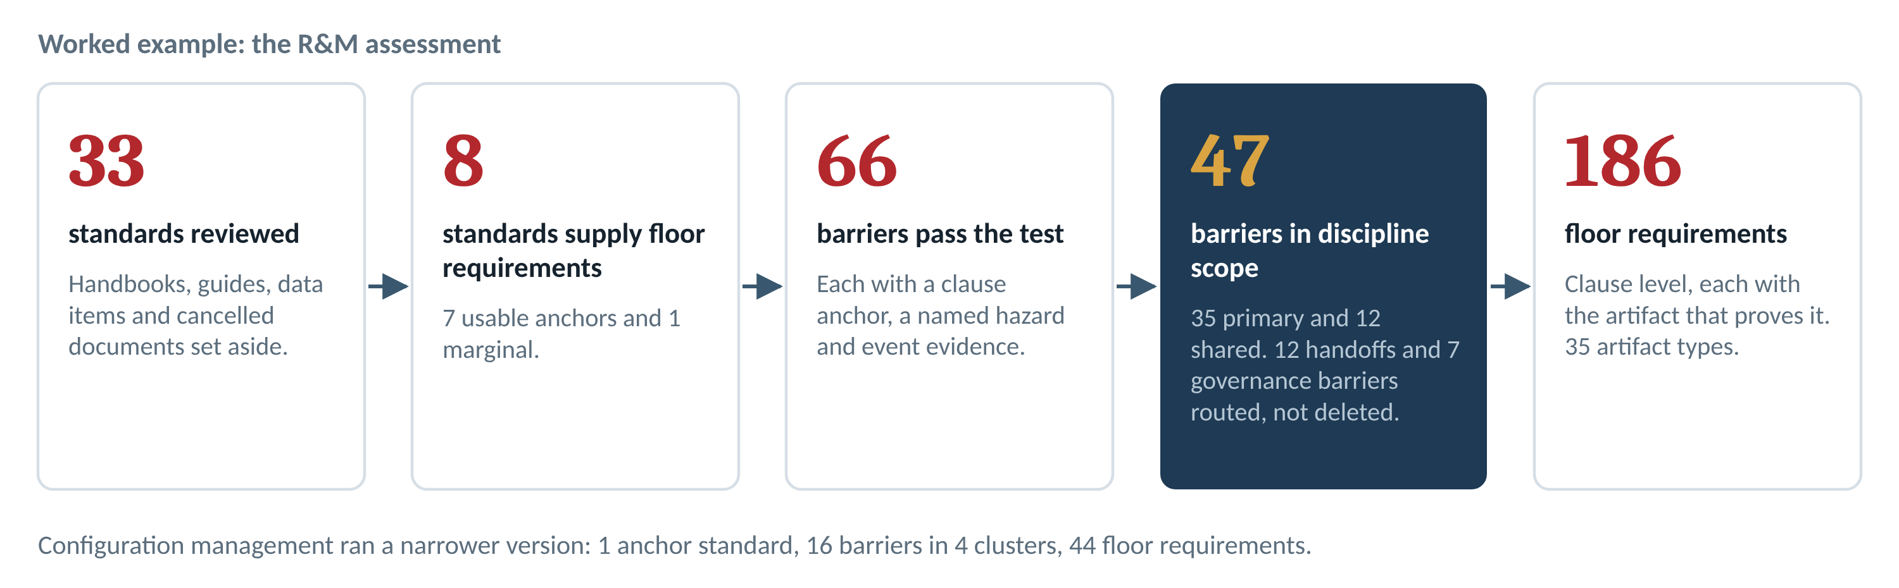
Steps 3 and 4: A Wide Net, Then the Test
Let the standards set the count. R&M landed at 47 barriers. CM landed at 16.
Notes:
Cast wide first, then cut. A forced number invites the question of what was left out. A count that falls out of the barrier test can be defended clause by clause.

Slide 8
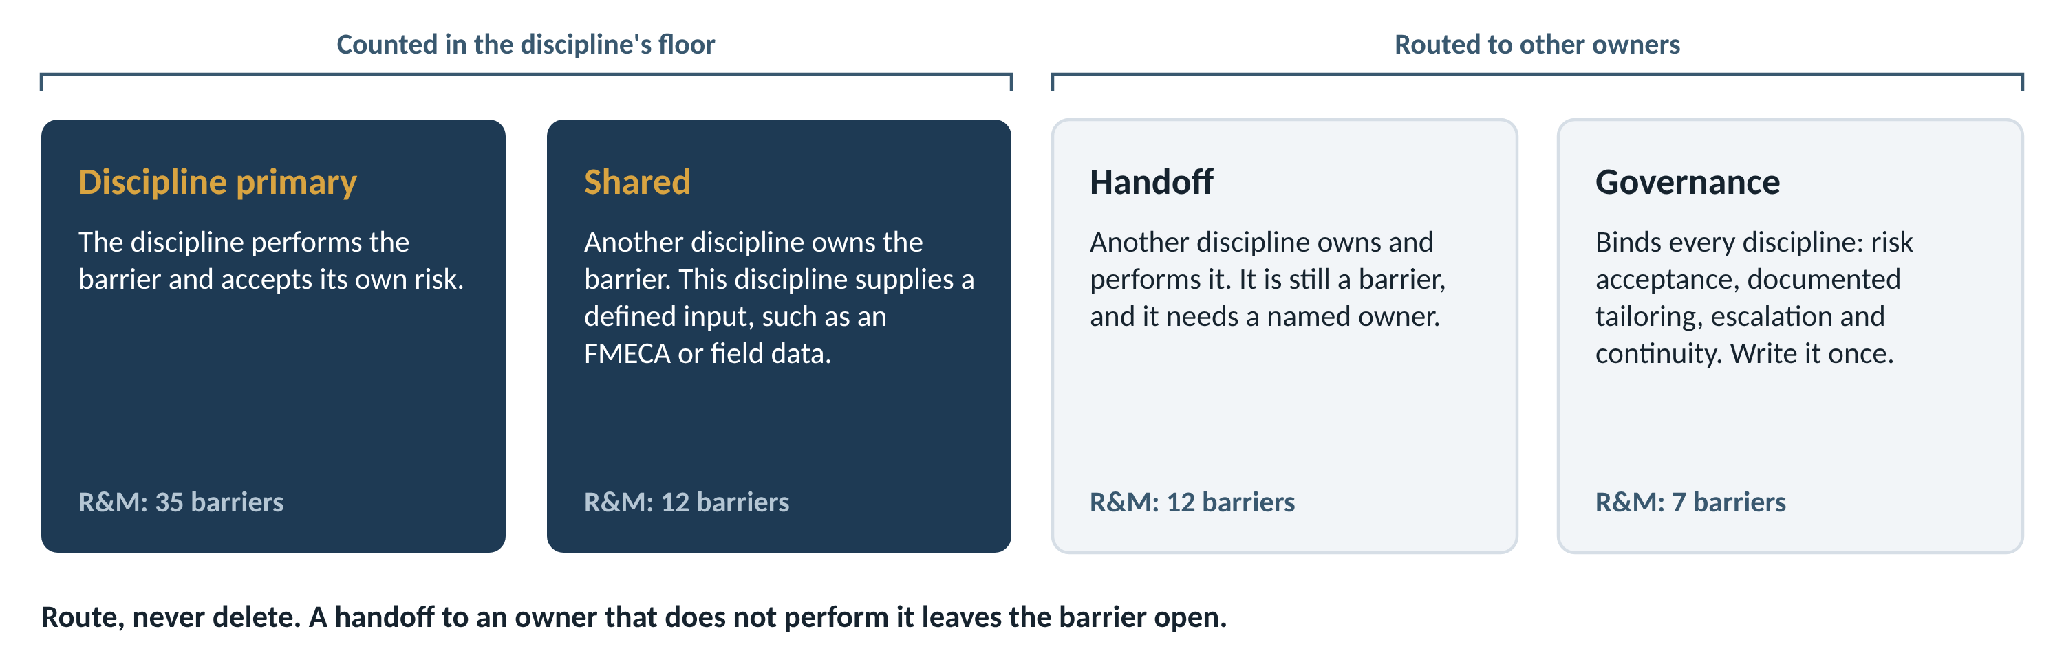
Step 5: Every Barrier Gets an Owner
Overlap with other disciplines is normal. Route it; do not delete it.
Notes:
Most barriers touch more than one discipline. The tiers keep the discipline's floor honest without losing the barriers that belong elsewhere. Governance barriers bind every discipline, so they should be written once.

Slide 9
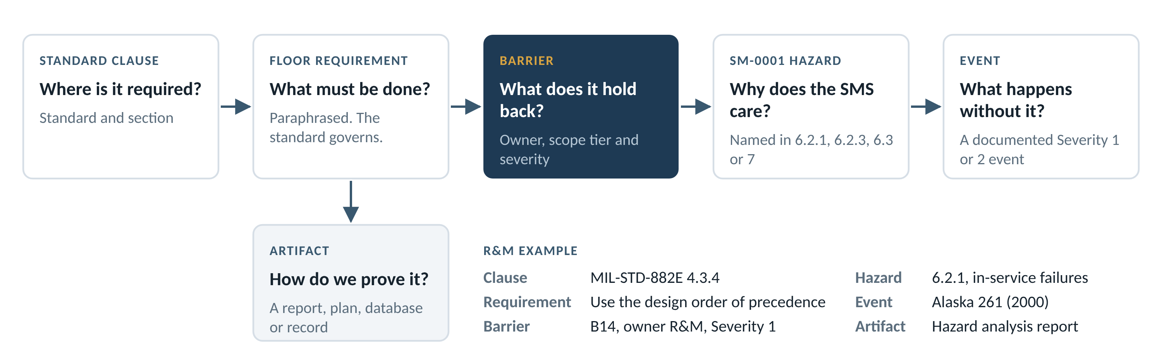
Step 6: The Floor Requirement Record
Each row answers six questions, from clause to proof
Notes:
The floor register holds one row per clause-level requirement. A row that cannot answer all six questions is not finished. The artifact column is what an auditor asks for.

Slide 10
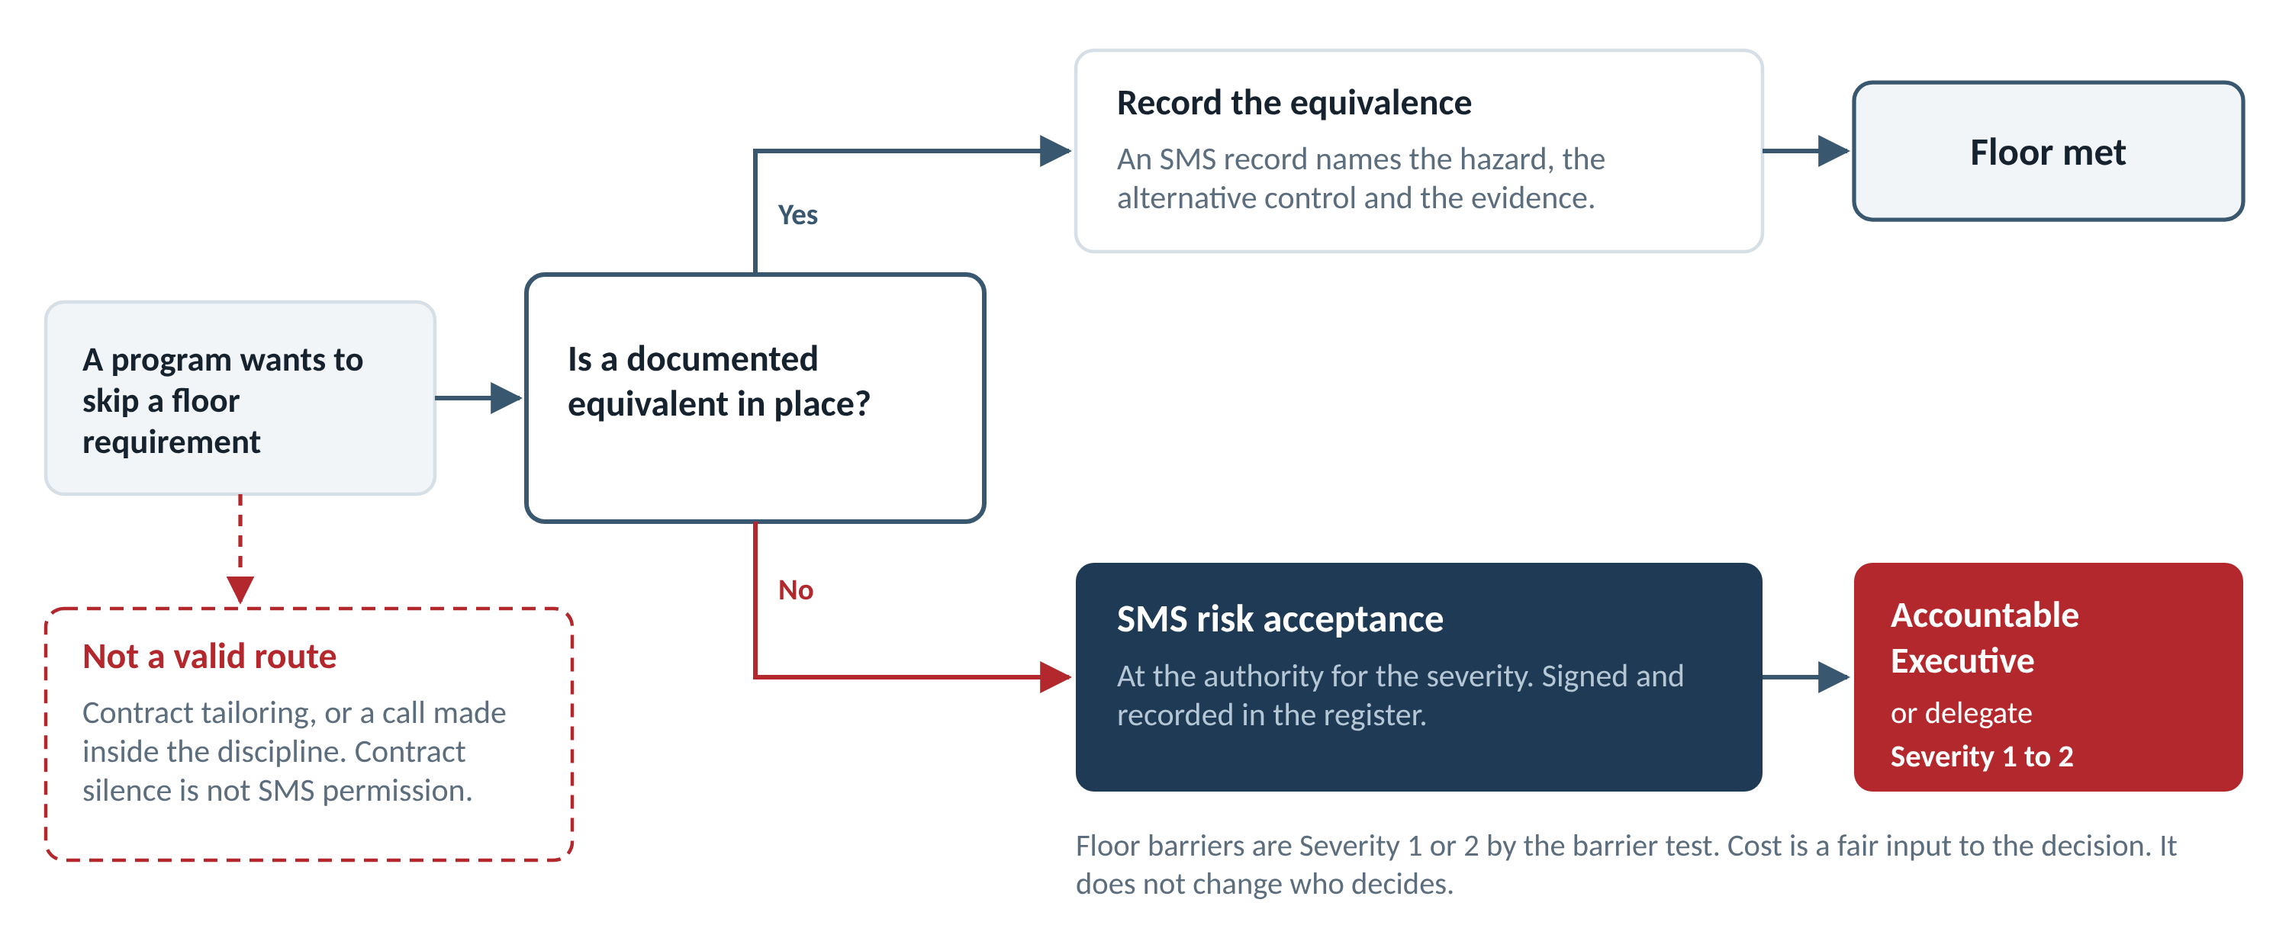
Step 7: Exceptions Go Through SMS Risk Acceptance
Contract tailoring cannot lower the floor
Notes:
There are two legitimate ways out. A documented equivalent that controls the same hazard, recorded as an SMS record. Or a signed risk acceptance at the authority the severity requires. Contract tailoring and a decision made inside the discipline are not routes.

Slide 11
Example 1: Configuration Management
EIA-649-1A: one anchor standard carries the whole floor
1
16
Clusters and anchoring events
1
Hazard ID and critical-item recognition
B1 to B2
anchor standard
barriers in 4 clusters
Alaska 261, Challenger
EIA-649-1A Rev. A
13 anchored in Severity 1 events
2
Change discipline and impact assessment
B3 to B7
American 191, 737 MAX MCAS, Columbia, two industry patterns
44
880+
3
As-designed to as-built reconciliation
B8 to B12
Alaska 1282, KC-46, Air France 4590, Alaska 261
floor requirements
fatalities
4
Supply chain, interfaces and verification
B13 to B16
37 marked Clean for inclusion
Across the events the CM deck cites
Mars Climate Orbiter, Partnair 394, two industry patterns
What CM taught the method: one standard can carry a floor. The barrier test, not the number of clauses, decides what belongs.
Notes:
CM was the first floor built this way: the Sixteen Barriers deck and the CM Floor Register. The CM deck rates its events on the old scale, where 5 was catastrophic. On the organization's scale those are Severity 1 and 2. Five CM barriers rest on a single clause, which is normal when one standard carries the floor.

Slide 12
Example 2: R&M, System Health and Human Factors
Eight standards, six clusters, and overlap with five other disciplines
8
47
Clusters
Barriers
Requirements
1
Hazard and failure mode identification
10
48
standards supply the floor
barriers in 6 clusters
From 33 reviewed
35 primary, 12 shared
2
Risk assessment and classification
5
15
3
Mitigation and design
10
49
186
1,384
4
Verification and test
3
16
5
Maintenance program derivation
11
35
floor requirements
fatalities
35 artifact types prove them
Across 17 events where an R&M barrier failed
6
In-service monitoring and closed loop
8
23
What R&M taught the method: overlap is normal. Ownership tiers route 12 handoffs and 7 governance barriers instead of deleting them.
Notes:
R&M needed more of the method than CM did: eight standards instead of one, and real overlap with Structures, System Safety, Human Engineering, Production Quality and Mechanical Systems. The ownership tiers came from that overlap. The 1,384 counts only events where an R&M floor requirement traces to the failed barrier.

Slide 13
Applying It to the Next Discipline
The same seven steps, the same three gates, the same records
Inputs
People
Outputs
The discipline's candidate standards
SM-0001 hazard lists in 6.2.1, 6.2.3, 6.3 and 7
Investigation reports for candidate events
Handoffs other registers already identified
A discipline lead who knows the standards
A system safety partner for hazards and severity
A reviewer who checks every event against its source
The SMS office, for the authority model
Standards verdict
Barrier register and floor register
Traceability charts and worked traces
One summary slide for leadership
The next disciplines are already named
The R&M handoffs point to Structures (6 barriers), System Safety (3), and Human Engineering, Production Quality and Mechanical Systems (1 each). Each handoff is a starting row for that discipline's register.
Notes:
A new discipline does not start from zero. The handoff tier of each finished register seeds the next one. The reviewer role matters: every event claim must survive a reading of the investigation report.

Slide 14
Guardrails From Two Disciplines
Six rules that kept the work defensible
1
Let the standards set the count
2
Anchor only on normative shalls
3
Paraphrase. The standard governs.
CM has 16 barriers. R&M has 47. Neither number was forced.
A shall in a worked example or an appendix is not an obligation.
Some standards' licenses bar reproduction or AI processing of their text.
4
Check every event at the source
5
Use one severity scale
6
Count from the register, by formula
Alaska 261 had redundant threads. One common cause, inadequate lubrication, defeated both. That correction added an R&M barrier.
1 = catastrophic, 2 = severe. A mixed scale inverts the authority table.
Hand counts drifted more than once during this work.
Notes:
Each rule came from a correction made during the CM and R&M work. Rule 4 is recent: the Alaska 261 jackscrew had two independent load-bearing thread sets. NTSB found the dual-thread design gave no redundancy against wear. The barrier lesson is common-cause failure, not missing redundancy. That correction added R&M barrier 66, which brought R&M from 46 to 47 barriers.

Slide 15
The Ask
Three decisions for leadership
Adopt the method
1
Use it as the standard way to set any discipline's mandatory floor.
Write one governance layer
2
Risk acceptance, documented tailoring and escalation, written once for every discipline.
Run it for the next discipline
3
Start with the R&M handoffs: Structures and System Safety.
Cost is a fair input to any exception. It does not change who must decide.
Notes:
The method is ready to reuse. The governance layer is the piece every discipline shares, so it should be written once, at the SMS level.

