Slide 1
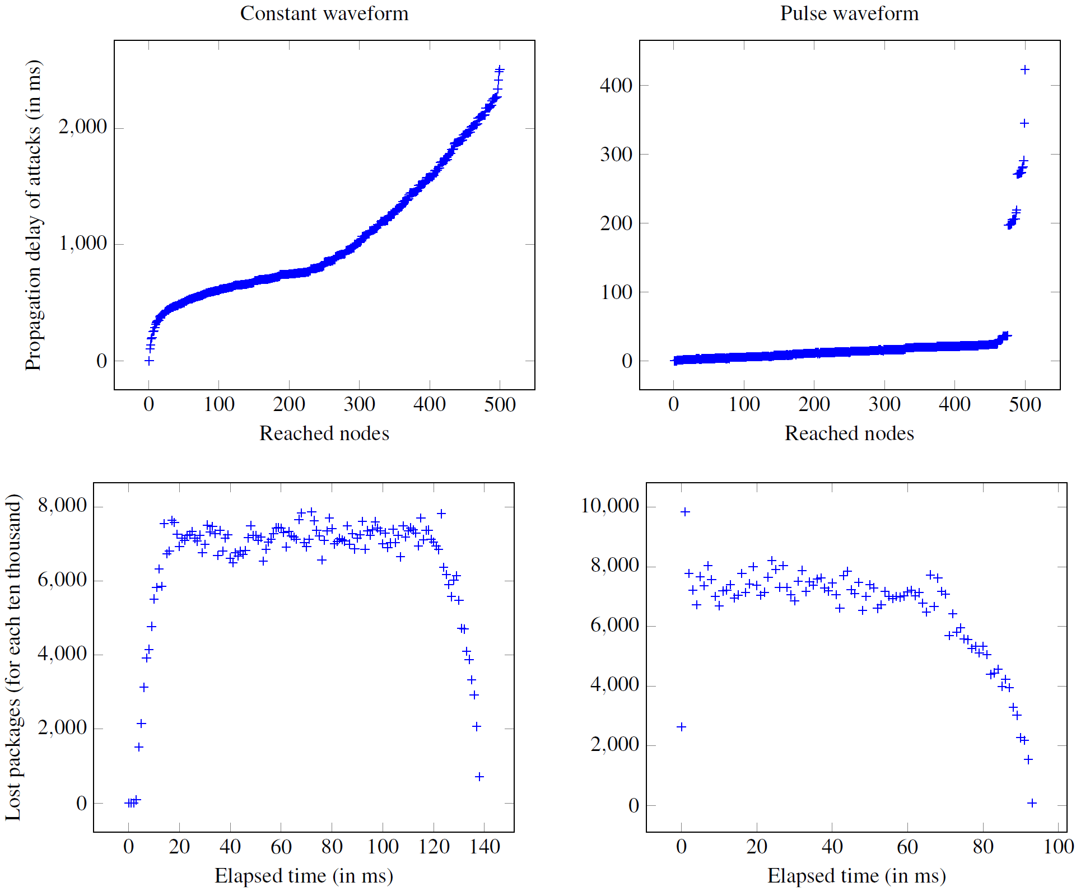
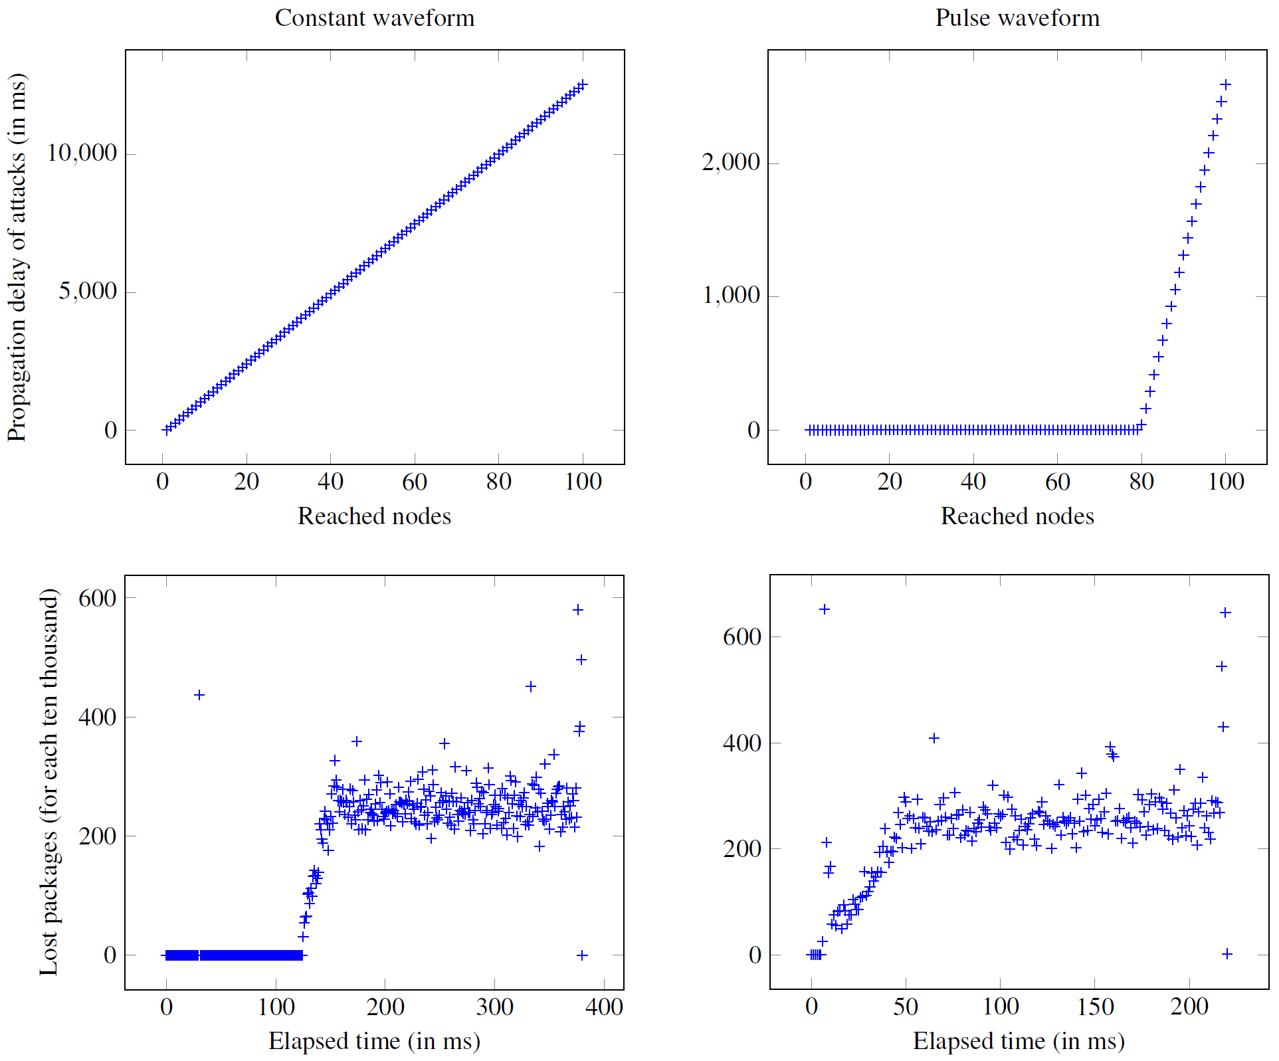
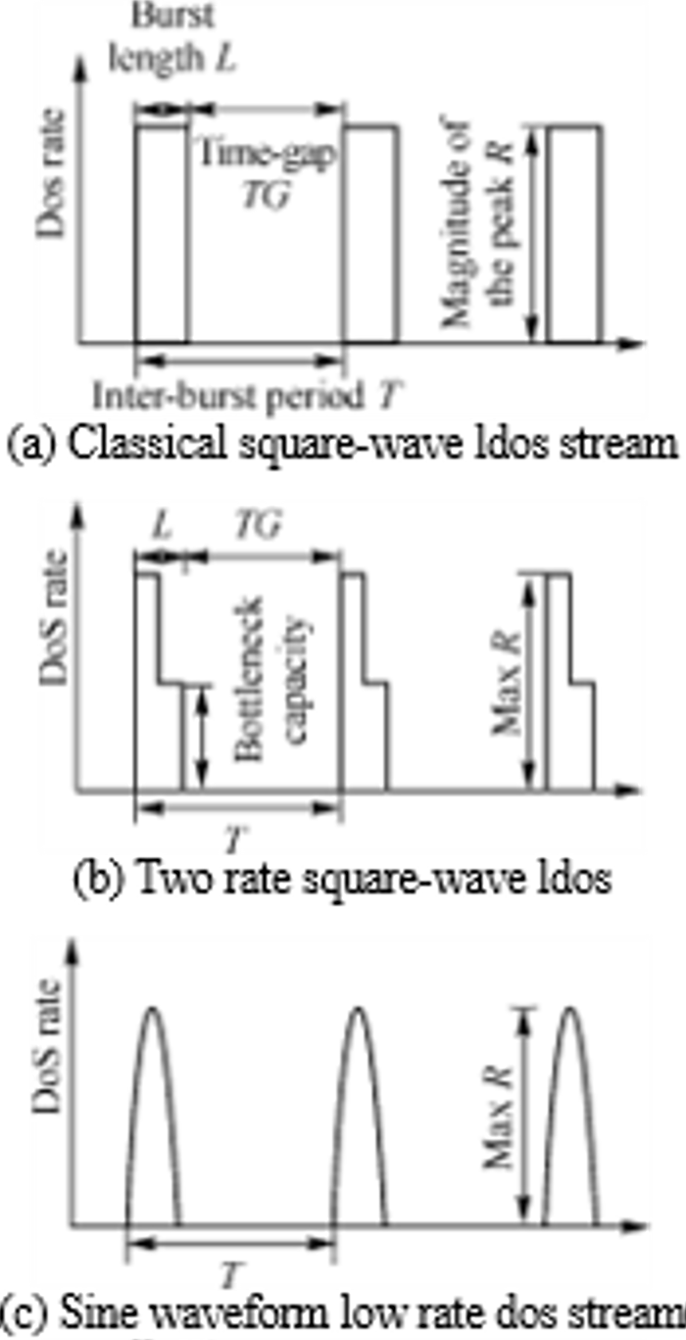
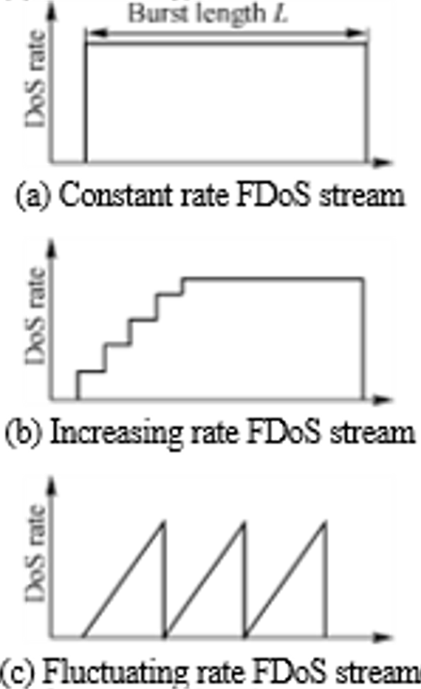
ICSOFT 2019 Exploring DDoS Mechanisms Bruno de Souza Neves, Filipe Mourão Leite, Lucas da Silva Jorge, Rahyan Azin Gondin Paiva, Juliana de Melo Bezerra and Vitor Venceslau Curtis ITA, Brazil
Introduction
Results from Binary Tree topology
This work analyzes the potential impact of Distributed DoS (DDoS) on server’s availability through different mechanisms and topologies of the classical DDoS taxonomy.
Basically, we simulate and discuss the results of attacks for the list and binary tree topologies along with continuous or pulsating stream of requests.
A simple new technique to protect the attacking network is also proposed to difficult DDoS mitigation.
Results from List topology
Simulations of DDoS Attacks
Typical Flood
waveforms
Typical Low Rate
waveforms
DDoS Protection
Besides counterintuitive, the control degree and the level of automation of a DDoS attack expose the attacking network, becoming a great weakness to be explored by mitigation security systems.
We propose the use of indirect communication and partial knowledge of the network (using distributed algorithms) to reduce this weakness.
The simulations were implemented making use of lightweight threads of the Go language and a general computer. For access to the source code, contact the authors.
In the paper, we describe how the simulations were performed in details along with each case of test, discussing the impact achieved by each combination of attack rate dynamic (waveform) and the topologies of the attacking network.
Conclusions
The simulations proved the expected result that a DDoS is slower on propagating the attack but it can cause potential damage to the victim infrastructure.
Moreover, we show that one can easily improve the attacking network leading to difficult mitigation by security systems.

