Slide 1
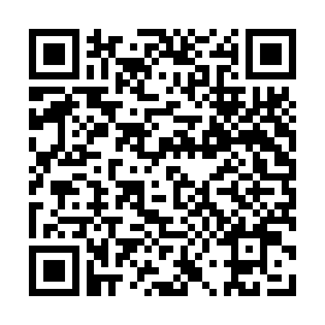
Impact of Student Exposure to Managed Care Courses in Pharmacy School
on Attainment of Managed Care Post-Graduate Year 1 Residencies
Curtis F. Li • Vishal V. Patel • Prof. Luigi Brunetti, Pharm.D., MPH • Hannah Kim, Pharm.D. • Prof. Saira A. Jan, M.S., Pharm.D.
Ernest Mario School of Pharmacy, Piscataway NJ 08854
Background
Results
Limitations
Traditional pharmacists were employed in retail or hospitals.
Changing healthcare environment touches upon medication usage in many diverse fields.
Increasing complexity of medication regimen necessitates a drug expert.
Increasing cost of medication can be alleviated through consultation with an expert in drugs.
Managed Care is a field that controls medication expenses and thus, utilizes the experience of a pharmacist.
Students may enter post-graduate managed care residency programs to specialize in the field.
Students may be influenced to enter a residency due to prior classroom exposure.
The magnitude of effect from classroom courses on student attainment of such residencies is unknown.
Schools with Mandatory Classes | Schools without Mandatory Classes
69 Schools | 66 Schools
Residents from Accredited Residencies | Residents from Unaccredited Residencies
52 Residents | NA
Lack of public information about each school’s 2015 graduating class size.
Data is non-longitudinal and specific to only one graduating class.
Difficulty in obtaining data on class content and curriculum information
No data currently on any unaccredited managed care residency
Everything collected via survey limited by response rate of participants
 | With Mandatory Classes | Without Mandatory Classes
Accredited Residencies | 16 Schools (23 residents) | 19 Schools (29 Residents)
Unaccredited Residencies | NA | NA
Conclusions
Objective
Phase 1 of data collection has been completed, with publicly available data gathered.
Phase 2 of data collection is in progress, to collect non-public data.
Preliminary conclusion from incomplete data appears to show no influence from mandatory classes on managed care residency attainment.
Without additional data from unaccredited residency programs, it is difficult to draw substantial conclusions at this time.
After completion of Phase 2 data collection, a stronger conclusion may be drawn about the influence of mandatory courses.
To observe if there is a correlation between schools with or without mandatory courses related to managed care and the number of graduates that enter a managed care residency.
Total Residencies With Mandatory Classes | Total Residencies without Mandatory Classes
16+__ Schools / 69 Schools (23+__ residents) | 19+__ Schools / 66 Schools (29+__ Residents)
Methods
Data on the current number of residents and their graduating schools will be collected from accredited and unaccredited managed care residencies
Accredited residencies will be obtained via the American Society of Health System Pharmacists and the National Matching Service.
Unaccredited residencies will be obtained via use of a survey.
All accredited pharmacy school’s curriculum will be reviewed for mandatory managed care classes using publicly available sources.
Course descriptions as well as key words such as ‘managed care’, ‘healthcare systems’, ‘health delivery’, or ‘health systems’ will be used to identify relevant courses
Schools will be divided into one of two groups: those with or those without mandatory classes.
The amount of residents from each group of schools will be compared with descriptive statistics.
Schools with Mandatory Classes | Schools without Mandatory Classes
51.1% | 49.9%
Schools with Mandatory Classes Producing Residents | Schools without Mandatory Classes Producing Residents
23.2% | 28.8%
Author Contact Information
Curtis F. Li <curtisli@scarletmail.rutgers.edu>
Vishal V. Patel <patelv23@scarletmil.rutgers.edu>
Disclosure
Residencies With Mandatory Classes | Residencies without Mandatory Classes
44.2% | 55.7%

