Slide 1
Synaptic Terminal Vesicles Release Neuroransmitter
Axon from presynaptic cell V_{pre}(t)
Dendrite
NMDA Receptor
Mg⁺
Postsynaptic Cell
V_{post}(t)
AMPA Receptor

Slide 2
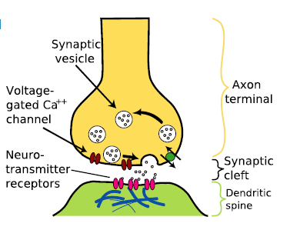
Mg⁺
NMDA Receptor
AMPA Receptor

Slide 3
V_{pre}(t) << V_{th}, S₀ = 0, S(t)→ 0 Time constant =
V_{pre}(t) >> V_{th}, S₀ = 1, S(t)→ 1 Time constant =

Slide 4
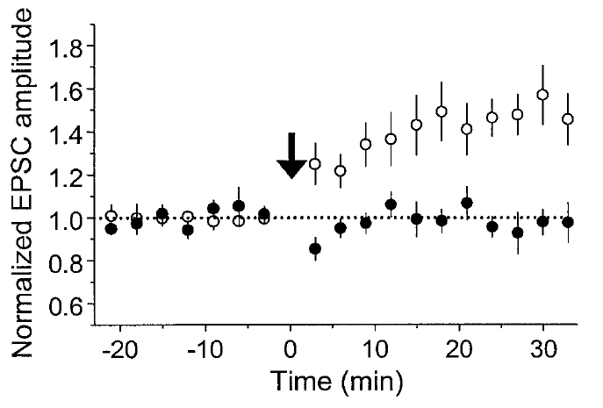
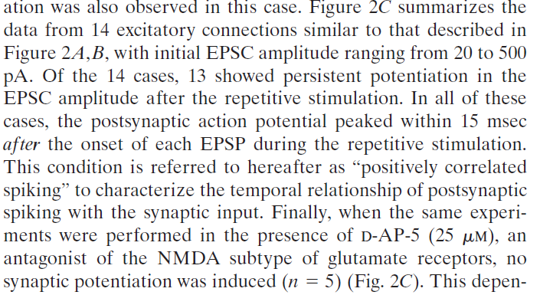
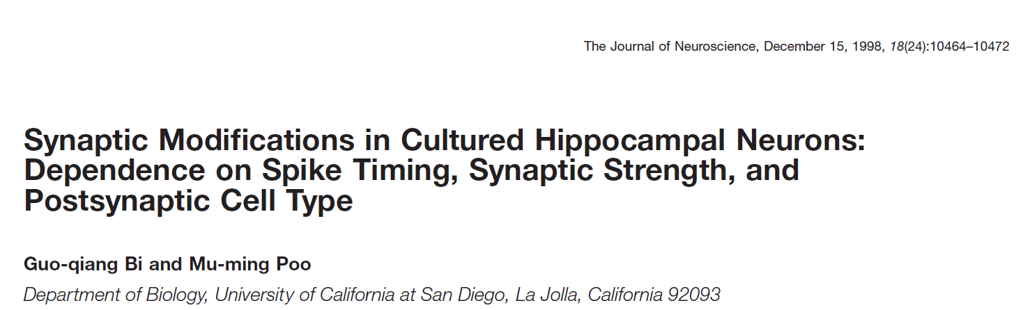
Postsynaptic spike 15ms after presynaptic stimulation
D-AP-5 blocker for NMDA receptors

Slide 5
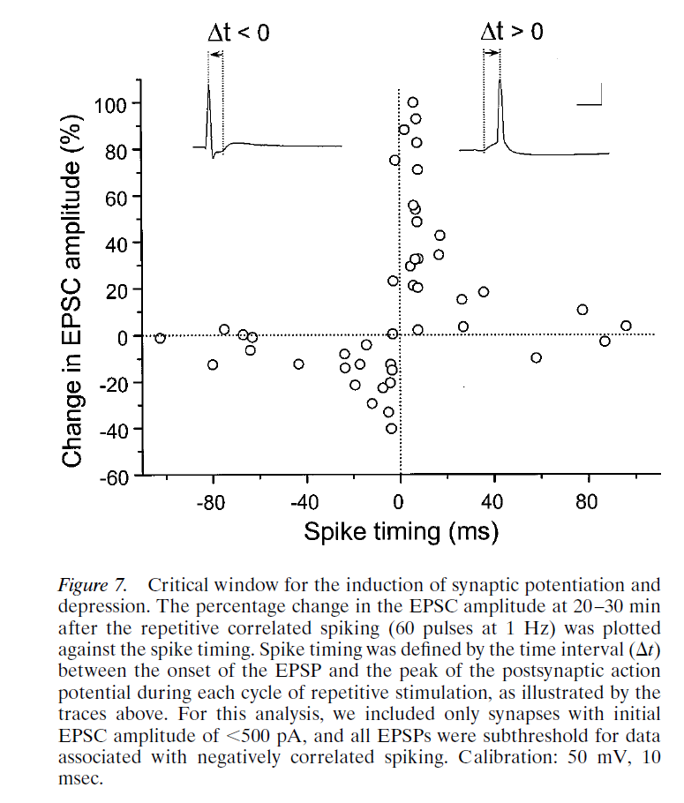

Slide 6
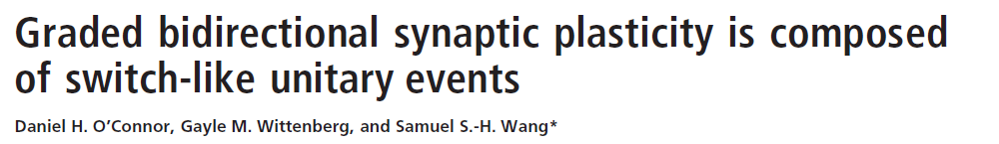
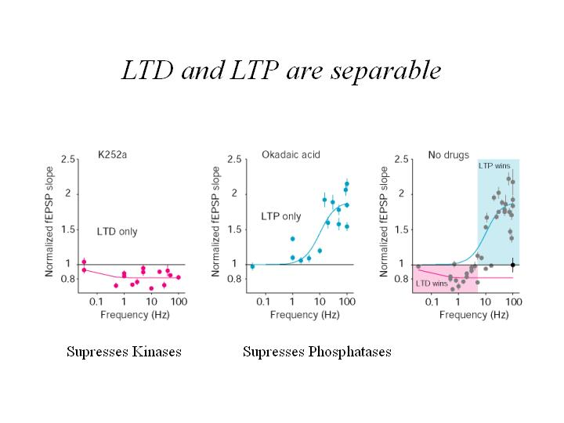
Kinases add Phosphates
Phosphatases remove Phosphates

Slide 7
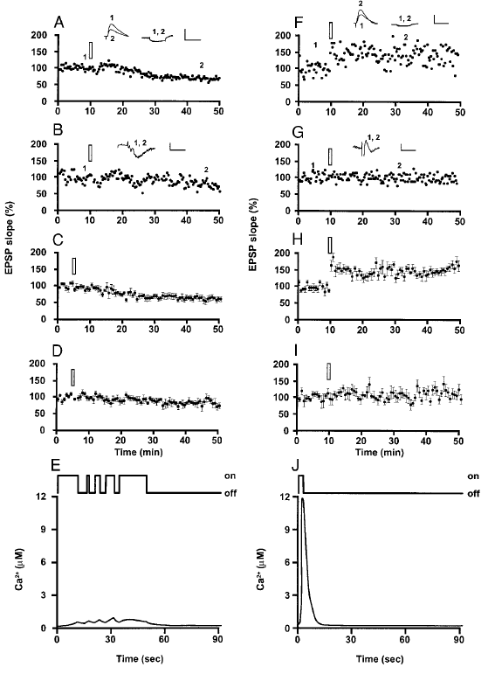
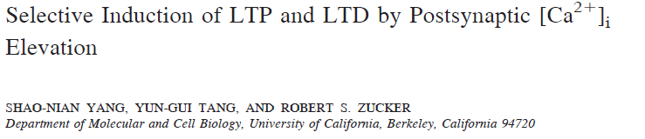

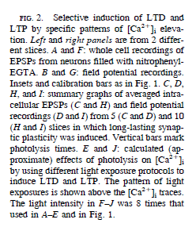

Slide 8
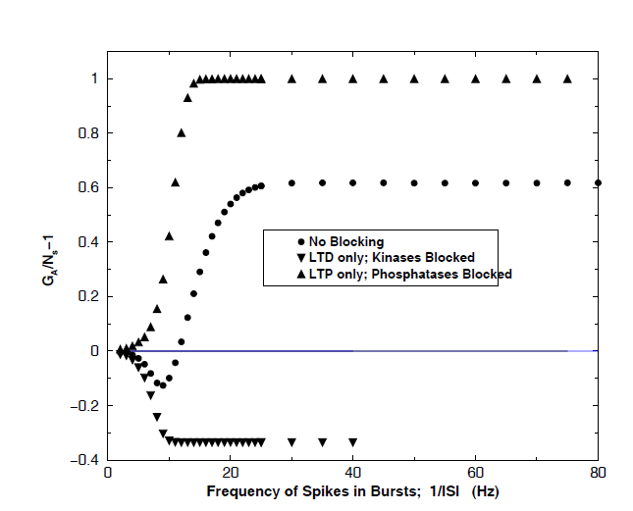
Physical Review E 72, 03`915 (2005)

Slide 9
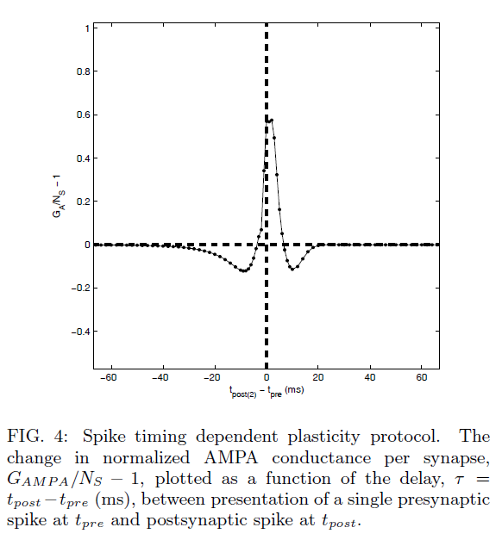

Slide 10
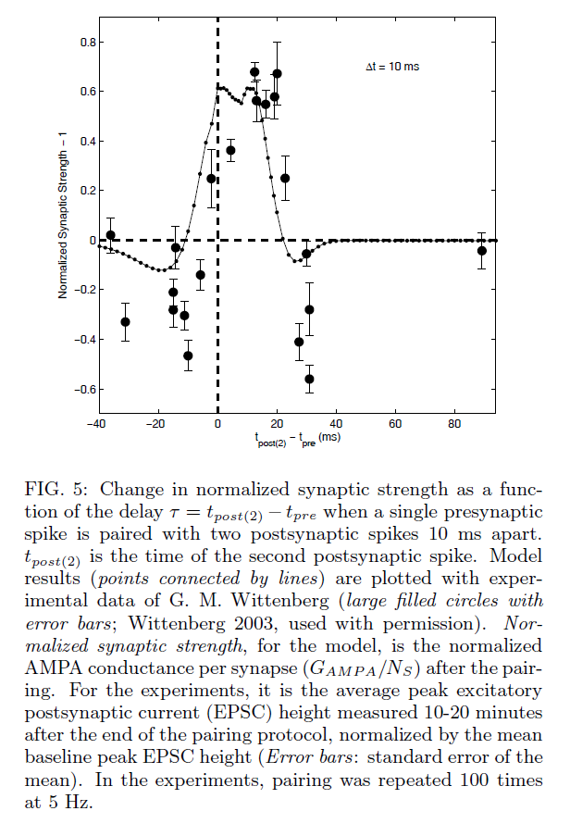

Slide 11
Neuro-folklore:
Changing synaptic strengths =
rewiring neural circuits =
learning and unlearning

