Slide 1
SERVERLESS COMPUTE WITH AWS AND .NET CORE
Migrate legacy code into the serverless realm with AWS Lambda and .NET Core

Slide 3





Slide 5
github
https://github.com/curtisdarst/rcc2019/
Secret key: rcc2019

Slide 7

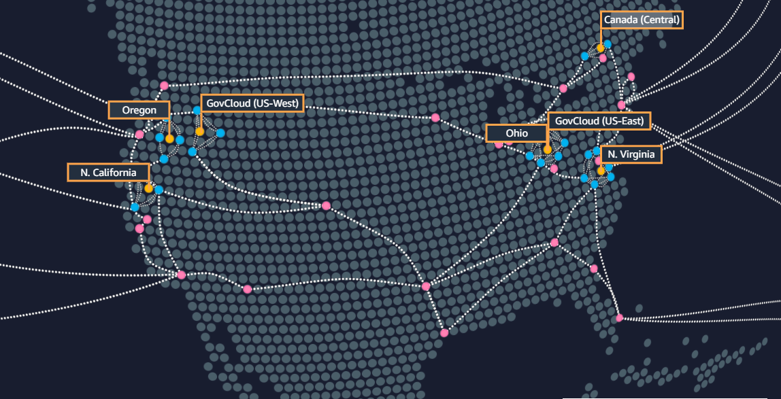

Your App Global
CloudFront (CDN)
Lambda (Compute)
RDS (Database)
Route53(DNS)

Slide 9
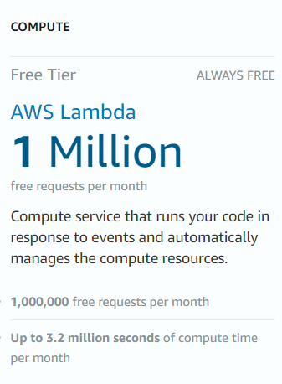
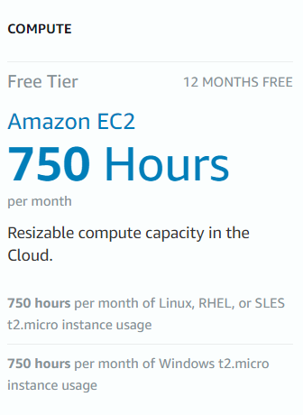
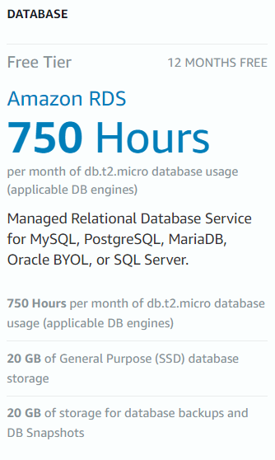
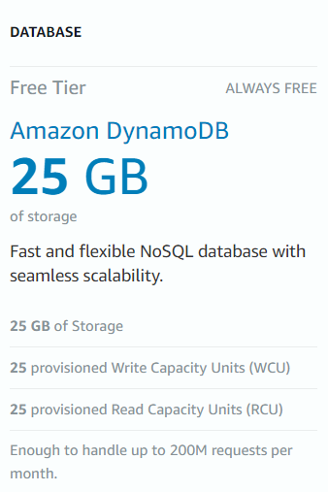
AWS - Amazon Web Services
12 months of free resource (new accounts)
Some services have a permanent free tier

Slide 10
BEFORE YOU START – AKA THIS IS AN IMPORTANT SLIDE
DO NOT EVER publicly post or place a certificate file or password
Always assume user’s data is bad
Use GitHub or similar code repo for storing your work
Enable MFA in AWS
Enable Billing alerts in AWS

Slide 12
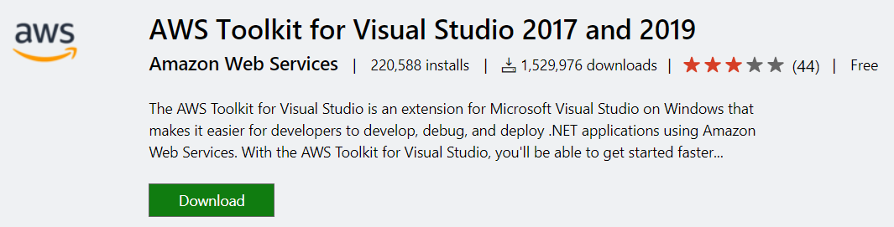
https://github.com/curtisdarst/rcc2019/
Secret key: rcc2019

Slide 13
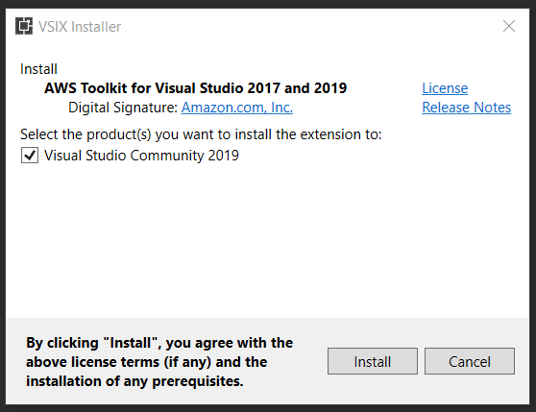

Slide 14
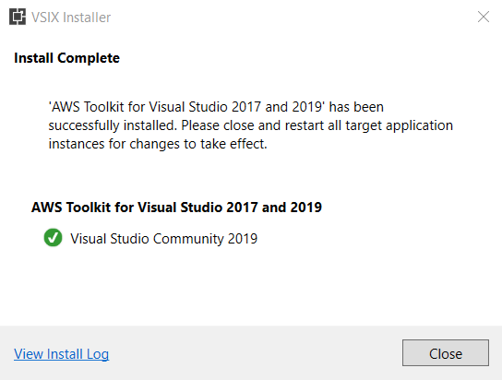

Slide 15
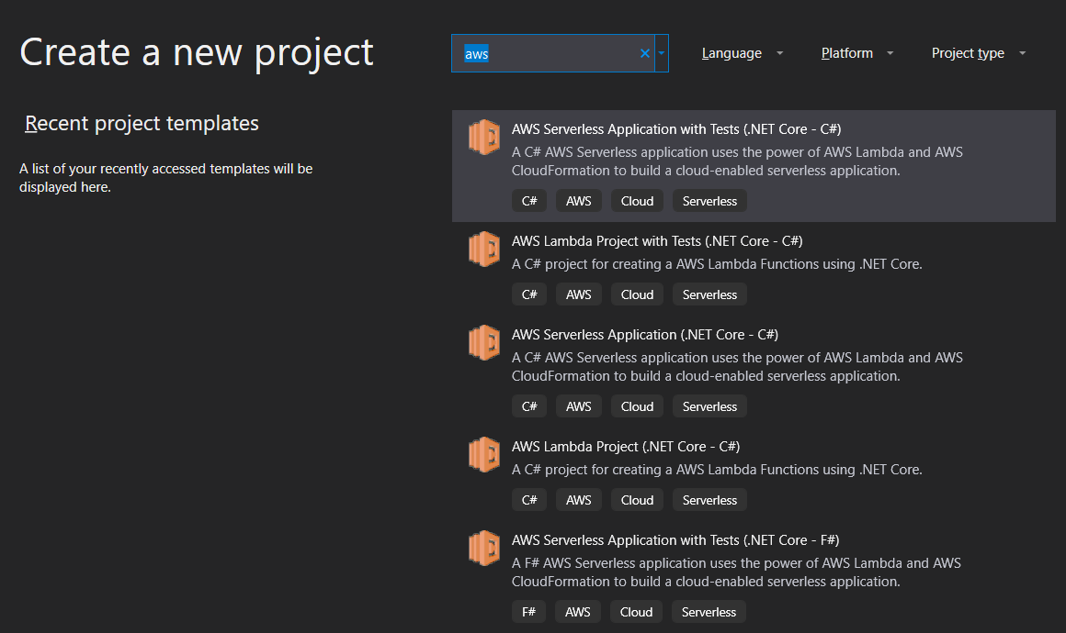

Slide 16
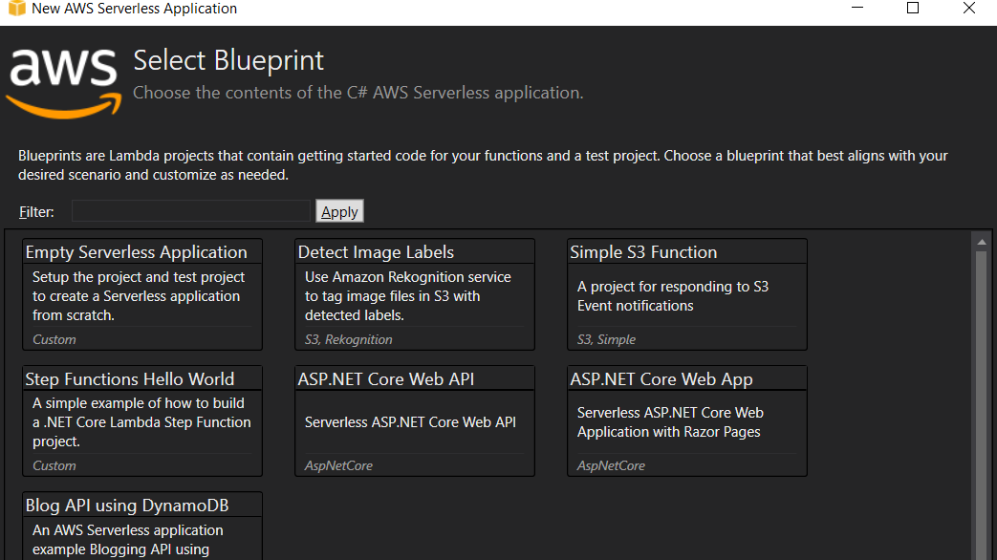

Slide 17
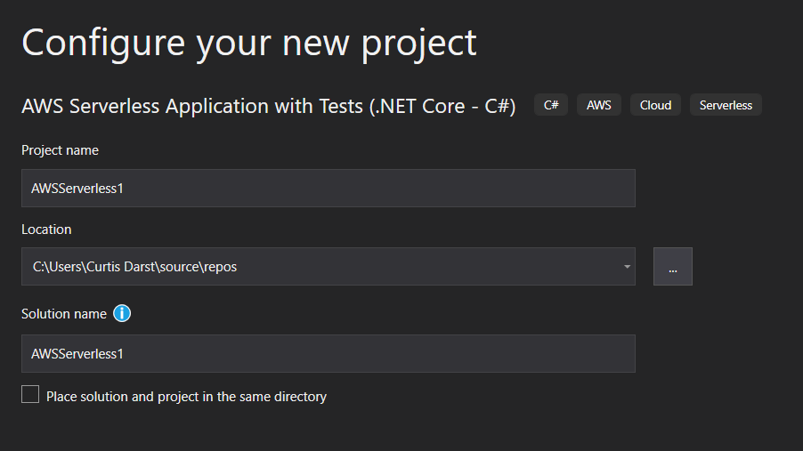

Slide 18
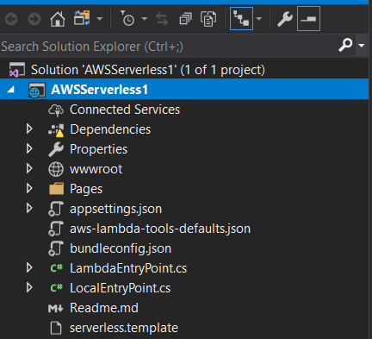

Slide 19
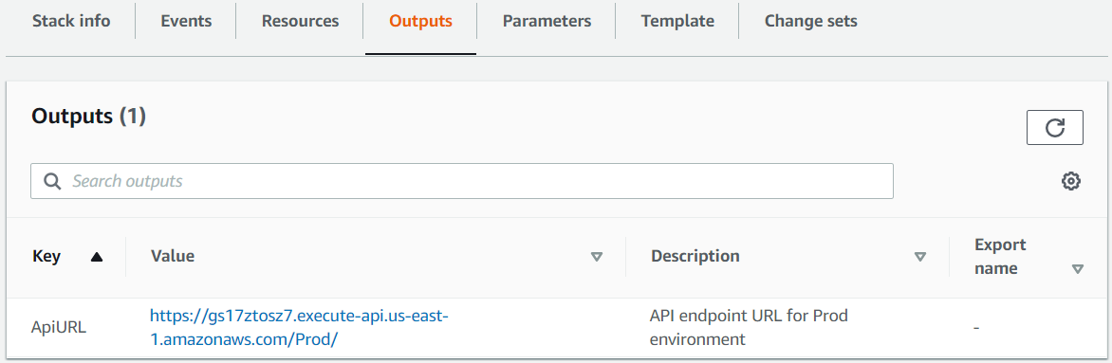

Slide 20
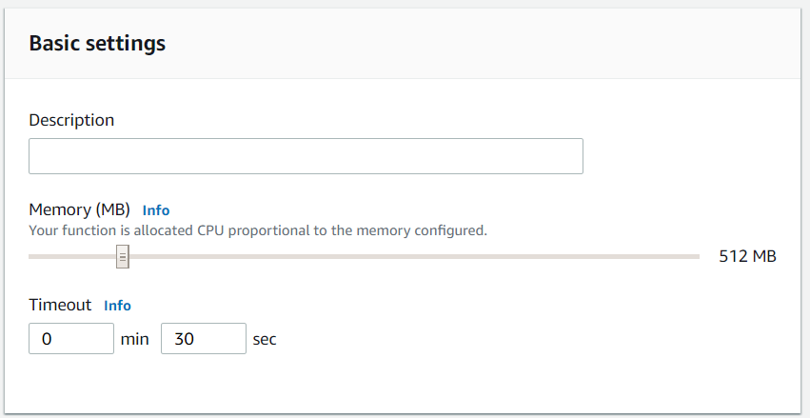
Lambda Memory Settings
The Lambda Memory Setting
Controls the amount of CPU
Will affect timeout
Larger projects will need this increased
Test different settings for best results

Slide 21
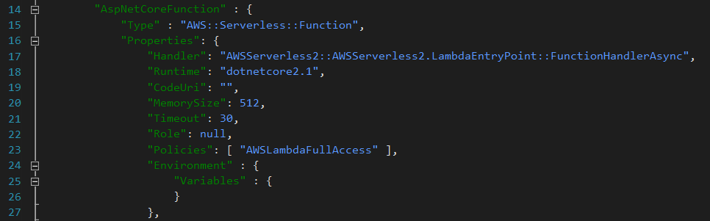
Serverless.template
Changes to Lambda Function in code
Runtime
Memory/cpu
Timeout
Policies

Slide 23
Demo #1
Standard Web application
Talks to Database
Has images
Has Forms
Has Leaderboard
https://github.com/curtisdarst/rcc2019/
Secret key: rcc2019

Slide 24
Demo #2
Typical API
Use Postman to test
Access Keys to test
Please be kind
https://github.com/curtisdarst/rcc2019/
Secret key: rcc2019

Slide 25
github
https://github.com/curtisdarst/rcc2019/
Secret key: rcc2019
*hint hint hint what workout for rcc2019?*
connetionString = "Data Source=mssqlnotserver.c8i9wczc98vn.us-east-1.rds.amazonaws.com;Initial Catalog=workouttracker;User ID=dotNetWebUser;Password=2mT90QN0mOKFemDb83QF";

Slide 26
Resources
Places to Find Additional Help.
AWS Lambda .NET Core GitHub Repository
AWS SDK for .NET GitHub Repository
AWS .NET Developer Blog
AWS .NET Twitter Handle
AWS .NET Developer Guide
Visual Studio 2017 or 2019 https://visualstudio.microsoft.com/vs/
AWS Toolkit for Visual Studio https://aws.amazon.com/visualstudio/
Postman https://www.getpostman.com/

