Slide 1
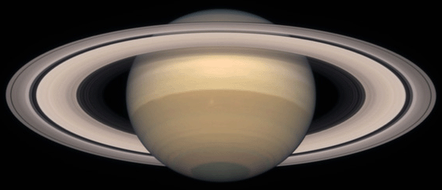
Exploring Saturn
Click here to begin

