Slide 1
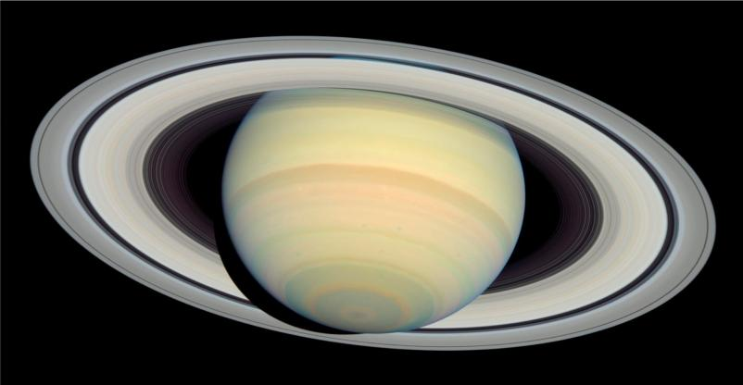
Cassini at Saturn
The Cassini-Huygens spacecraft has produced the most detailed images of Saturn to date.

Slide 2
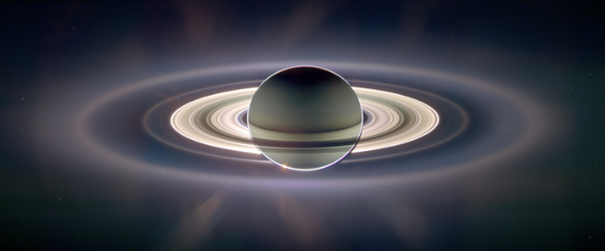
With Saturn sheltering Cassini from the sun's blinding glare, the spacecraft viewed the rings as never before.
(The image color was created by digitally compositing ultraviolet, infrared and clear images then adjusting to resemble natural color.)
Earth is visible through Saturn's G ring
You are here!

Slide 3
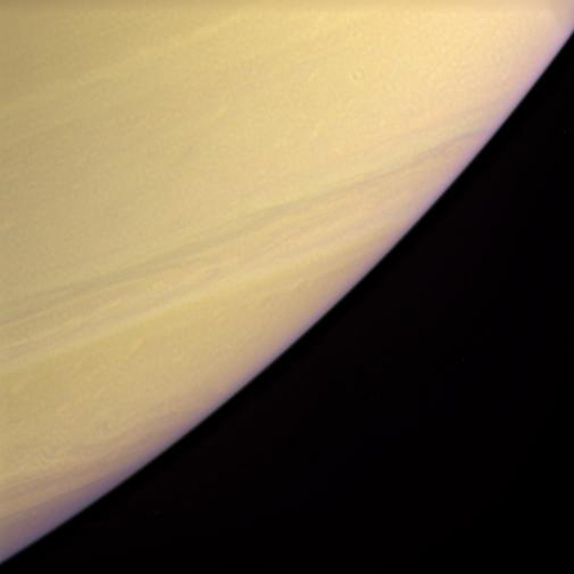
This image of Saturn has had the natural colors enhanced to show the bands of clouds in the southern hemisphere.
Saturn rotates every 10.7 hours, which causes powerful east-west winds that warp the clouds into these horizontal bands.

Slide 4
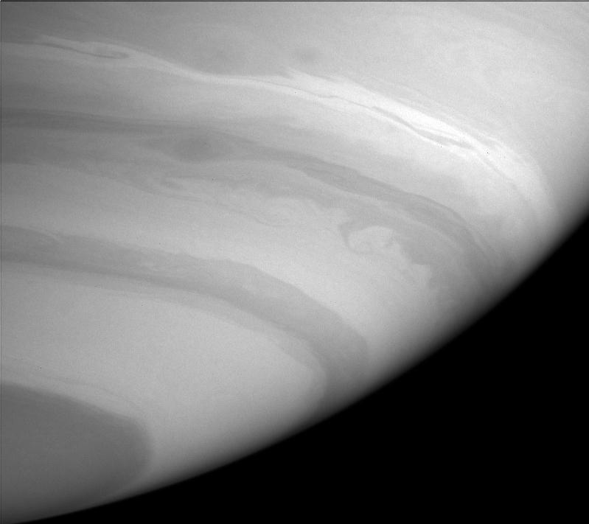
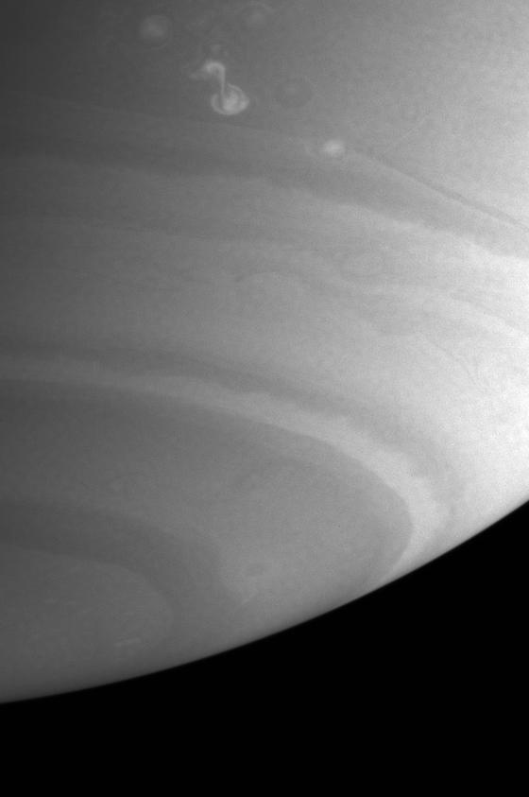
The first orbit by Cassini allowed a closer look at the east to west cloud movement in the planet's upper atmosphere.
These two images, taken one week apart, show how the clouds move and change close to the south pole of Saturn. The right- hand image has bright blobs of a storm system, moving west.

Slide 5
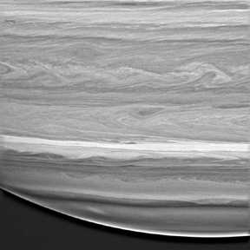
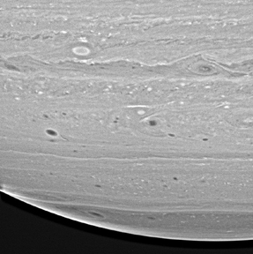
These two images were taken at the same time, but at different infra-red wavelengths. The left-hand image shows streams of east to west moving clouds. The right- hand image shows ovals where storms are happening.
890 nanometers
939 nanometers

Slide 6
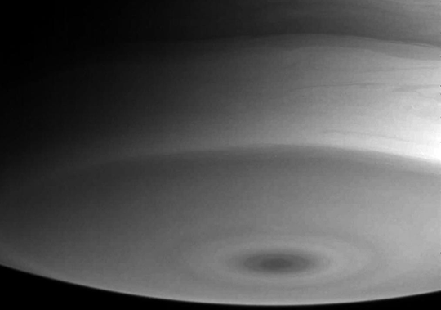
This is a close-up of the south pole of Saturn. The dark spot is a deep cloud-free region right over the south pole. It may be affected by Saturn’s southern magnetic pole which is rich in electromagnetic particles.

Slide 7
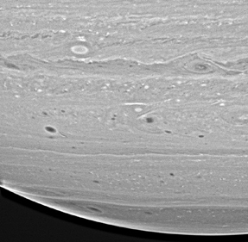
The area around latitude 35 degrees south has more storm activity than other latitudes.
Scientists gave the latitude the nickname "Storm Alley" because of the intense activity.
storms

Slide 8
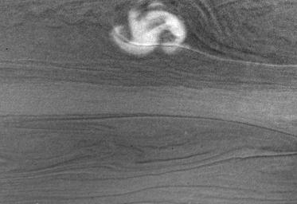
Cassini began detecting radio emissions off this storm.
The emissions may be caused by lightning deep in Saturn's atmosphere below the storm clouds seen here.

Slide 9
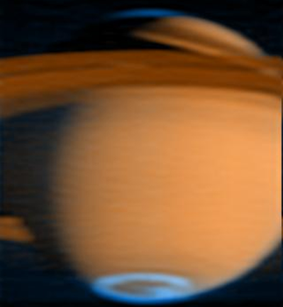
Saturn in False Color
This is a false-color image that shows Saturn's aurora in blue, while normal reflected sunlight is red-orange. Just like Earth's Northern Lights, Saturn forms an oval of excited electrons around each magnetic pole. The aurora shows up clearly in ultra-violet light.

Slide 10
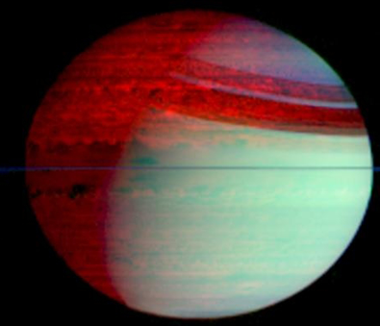
In this false-color image the blue-green color (lower right) is sunlight scattered off clouds. The red color (upper left) is the heat glow from Saturn's warm interior, easily seen on Saturn's night side (top left).
The rings cast a shadow on Saturn so there is no light scattering. The shadow shows up as red stripes.

Slide 11
To find more about the Cassini mission's discoveries so far, return to the main menu and click Cassini Mission Results: Saturn's Rings, Saturn's Moons, or Titan.

