Slide 1
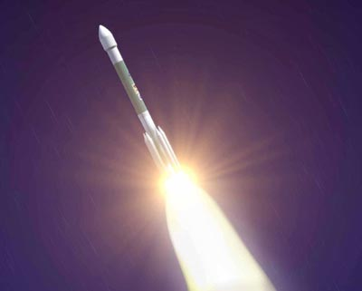
Traveling to Mars
Stowed in the nose cone of this Delta II rocket, the Mars Exploration Rover blasts off from the Kennedy Space Center in Florida. It's destination: the planet Mars.

Slide 2
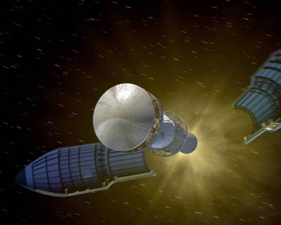
The nose cone of the rocket separates during the launch phase and the Mars Exploration Rover is sent on a seven-month journey to Mars.

Slide 3
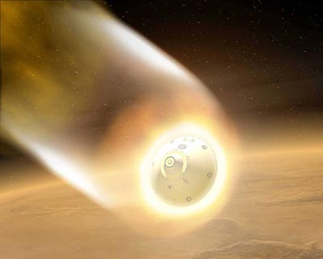
The aeroshell protects the rover from fiery temperatures as it enters the Martian atmosphere.

Slide 4
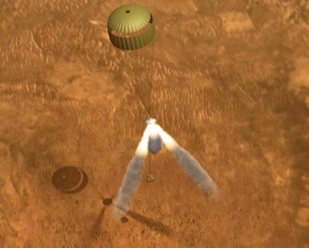
Getting down safely
With the parachute deployed, three retrorockets fired their engines, suspending the lander 30 - 50 feet above the Martian surface.

Slide 5
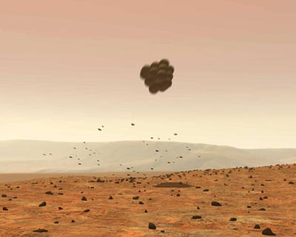
Protected by large airbags, the lander fell away from the parachute, landing safely on Mars.

Slide 6
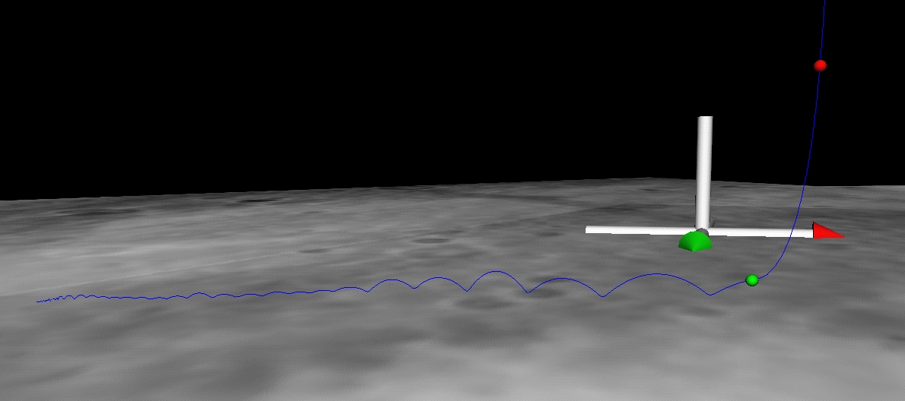
This image shows the path (blue line) taken by the Mars Rover, Spirit as it bounced down to its final resting spot in Gusev Crater, Mars. Data taken by Spirit during descent indicates that the rover bounced 28 times. The green dot shows where the parachute bridle was cut, and the red dot indicates where the main retrorockets were fired.

Slide 7
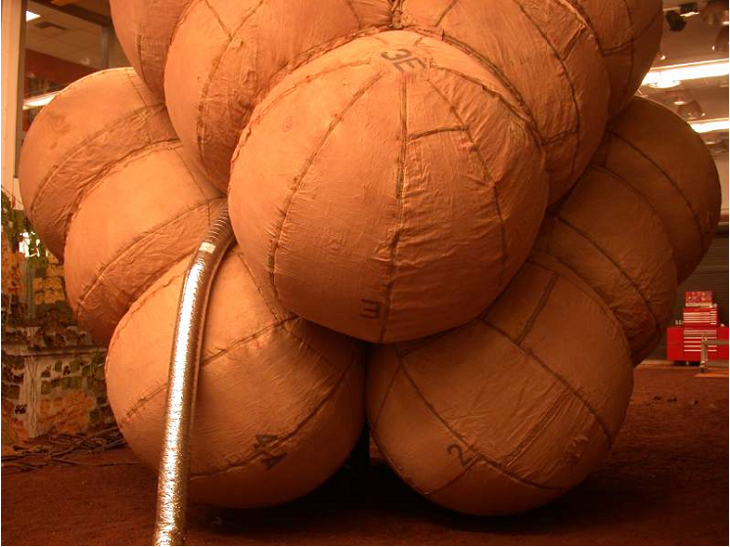
The airbags are fully inflated in this photograph taken at the JPL In-Situ Instrument Laboratory or "Testbed."
The airbags had to be inflated seconds before landing on Mars' surface and deflated once safely on the ground.

Slide 8
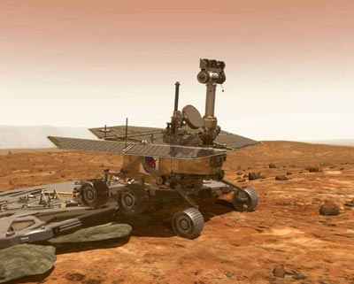
Revving Up the Rover
After bouncing to a stop, the airbags deflate and the lander's petals unfold so the Mars Exploration Rover can drive onto the surface of Mars.

Slide 9
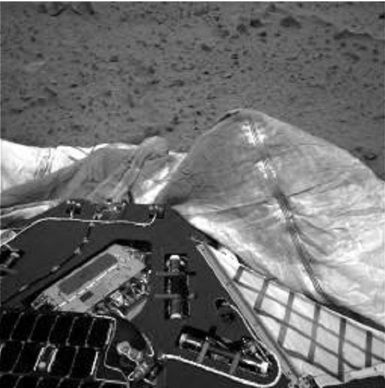
This image, taken by the navigation camera onboard the Mars Rover Spirit, shows the deflated airbags used to protect the rover during landing.
One bright, dust-covered bag is slightly puffed up against the lander.

Slide 10
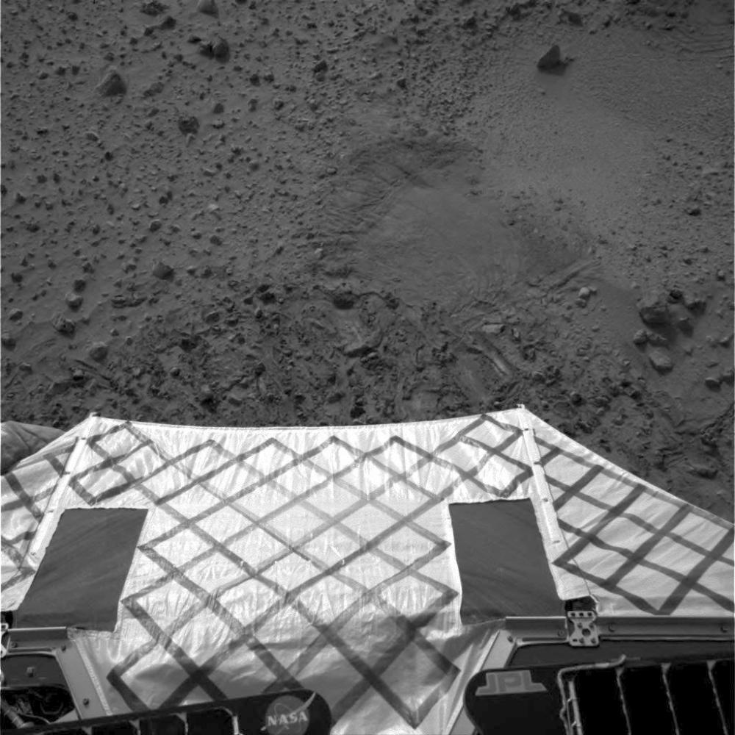
This image captured by the Mars Rover Spirit's navigation camera shows the ramp that the rover descended down to reach the surface.

Slide 11
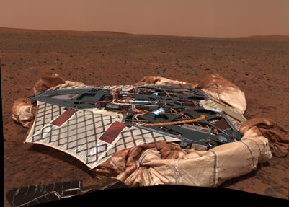
This image mosaic taken by the panoramic camera onboard the Mars Exploration Rover Spirit shows the now-empty lander that carried the rover 283 million miles to Mars. The rover then abandoned the lander to explore independently.

