Slide 1
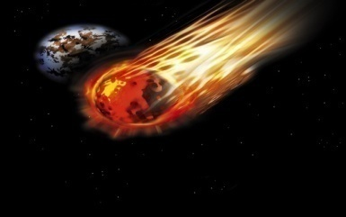
Meteorites
The Basics
Want to know more about meteorites in general? Click the “The Basics” link above .
Dar al Gani 262
How about our Moon meteorite, Dar al Gani 262? Want to know more? Click on “Dar al Gani 262”
Zagami
Want to know more about our Mars meteorite, Zagami? Click the “Zagami” link above .

Slide 2
Meteorites The Basics
Meteorites are rocks… from outer space!
To Find out more about meteorites, click the links below
What are They? | What meteorites are, and where they come from |  | Different Types | The three types of meteorites
What are their Names? | Meteoroid, meteor, meteorite… What do these names mean? |  | Craters | How craters form, and what craters in the solar system look like
Shooting Stars | What’s really happening when you see one, how big are they, and when can you see them? |  | Life Cycle | How a meteorite is ‘born’ how it ‘lives’, and how it ‘dies’
Is it a Space Rock? | How to identify a meteorite from any other rock |  | Age | How old meteorites really are.
Return to Menu

Slide 3
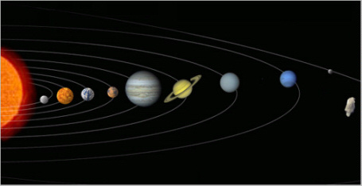
Meteorites The Basics - What are They?
Meteorites are rocks that have come from somewhere else in our solar system. They generally come from asteroids, but can also come from our moon, another planet, or another planet’s moon.
This is a drawing of our solar system.
From left to right, you can see the Sun, Mercury, Venus, Earth, Mars, Jupiter, Saturn, Uranus, Neptune, and Pluto.
The strange, rock-like object on the right of the image is a picture of an asteroid.
Previous
Return to The Basics Page
Next

Slide 4
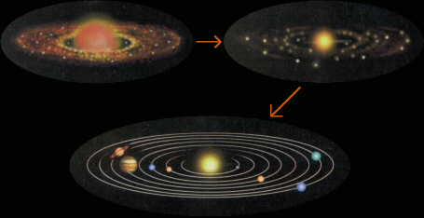
Meteorites The Basics - What are They?
Some meteorites are from material that existed before the planet even formed.
The planets we see today were built up from collisions with smaller objects. Some of these objects were then broken apart due to collisions with each other. Pieces of these objects occasionally land on Earth as meteorites.
Previous
Return to The Basics Page
Next

Slide 5
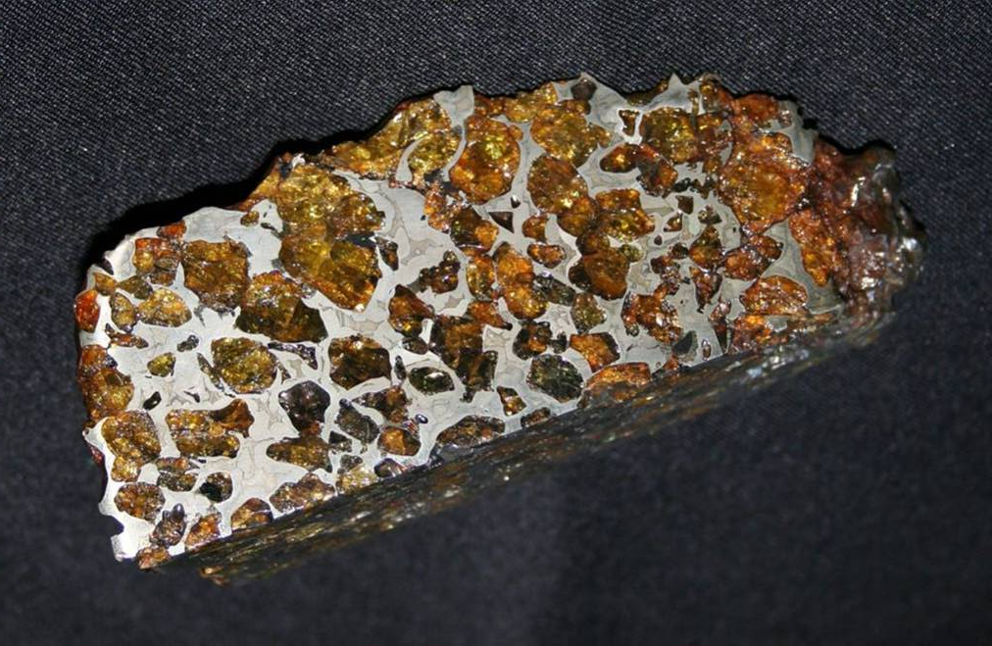
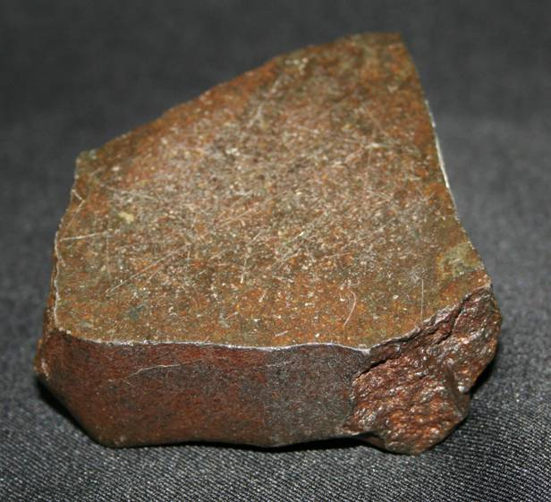
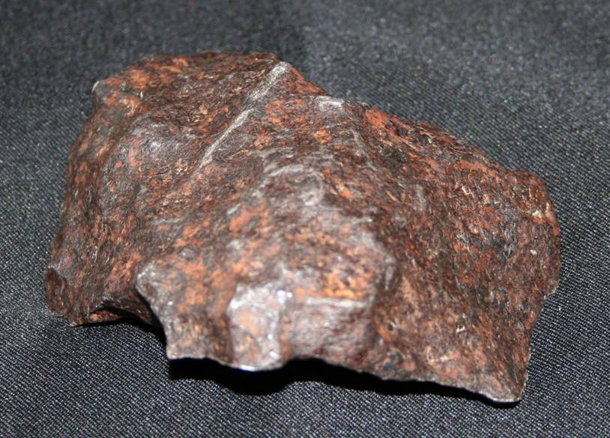
Meteorites The Basics - What are They?
Some meteorites are all stone, some are all iron, and others are part iron and part stone.
a stony meteorite
a stony-iron meteorite
a iron meteorite
Previous
Return to The Basics Page
Next

Slide 6
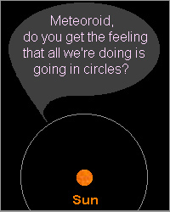
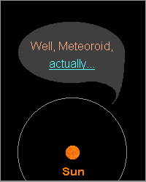
Meteorites The Basics – What are their names?
Meteorites go by different names depending on where they are located
Meteoroid
me•te•or•oid (mee-tee-or-oyd)
A rock that orbits the sun; some are small, the size of a dust grain, and some are miles across.
Learn more about asteroids here.
Previous
Return to The Basics Page
Next

Slide 7
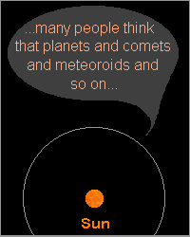
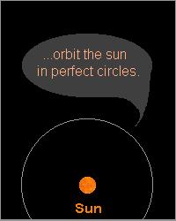
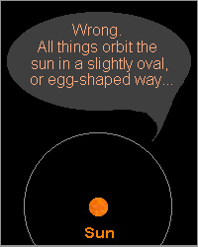

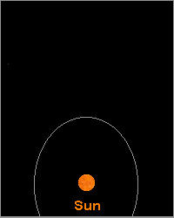
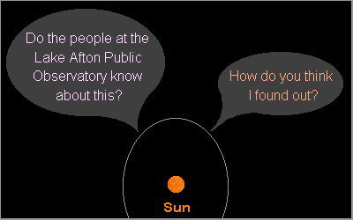
Meteorites The Basics – What are their names?
Previous
Return to The Basics Page

Slide 8
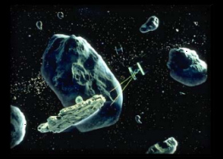
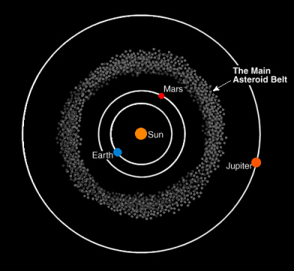
Meteorites The Basics – What are their names?
Asteroids
Asteroids can be anywhere from about 300 feet across (the size of a football field), up to about 600 miles across (the state of Kansas is only 411 miles across from East to West)! Most of the asteroids in our solar system are found in a belt between the planets Mars and Jupiter. This asteroid belt though, is nothing like the asteroid belt in the Star Wars movie, The Empire Strikes Back. In Empire, Han Solo must do some fancy flying to dodge the asteroids. But the asteroids in our solar system are hundreds of miles away from each other.
Several spacecrafts have traveled from Earth to the far reaches of our solar system (through the asteroid belt) without any problems.
Previous
Return to The Basics Page
Next

Slide 9
Meteorites The Basics – What are their names?
Asteroids part 2
As Bob Mitchell, a Project Manager at NASA, puts it, “There's a lot of material in the belt, but there's also an awful lot of space.”
While the majority of asteroids are found in the asteroid belt, some asteroids and comets have orbits that bring them close to Earth.
What are the chances of the Earth colliding with an asteroid or comet? What would happen if it did?
First, the chances of an asteroid or comet colliding with Earth are pretty low. There are no objects that have been seen which follow a path that will send them to Earth.
However, if even a medium-sized asteroid were to hit the Earth, there would be mass destruction, and human civilization could be destroyed.
So is there a way to measure the chances of a collision? Is there a way to measure the possible damage? Yes! It's called the Torino scale.
Previous
Return to The Basics Page
Next

Slide 10
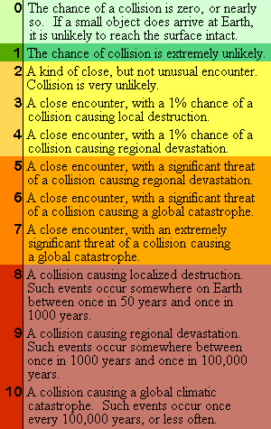
Meteorites The Basics – What are their names?
The Torino Scale
If, at some point in the future, an asteroid or comet does head our way, what will the result be? It depends on its size, speed, as well as other factors. Richard Binzel, from the Massachusetts Institute of Technology, has developed something called the Torino scale. Similar to the Richter scale, which measures Earthquakes, the numbers on the Torino scale combine the chances of being hit by an asteroid or comet with the possible damage that might occur.
chart adapted from Sky & Telescope, June 1998; "The Torino Scale: Gauging the Impact Threat"
In short, a 0 on the Torino scale is nothing to fear (so is a 1 and probably a 2). A 10... well, remember the dinosaurs...?
According to Richard Binzel, "no near-Earth asteroid has ever exceeded level 1 on the Torino scale."
Yet he also has this to say: “Let's hope it stays that way!”
Previous
Return to The Basics Page
Next

Slide 11
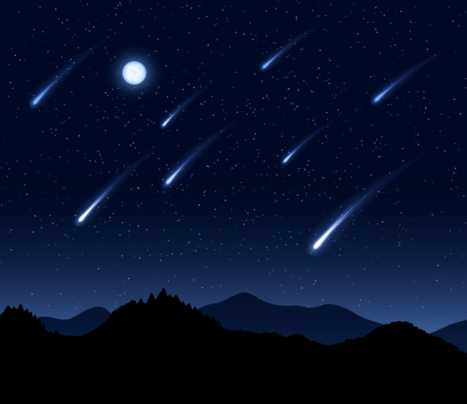
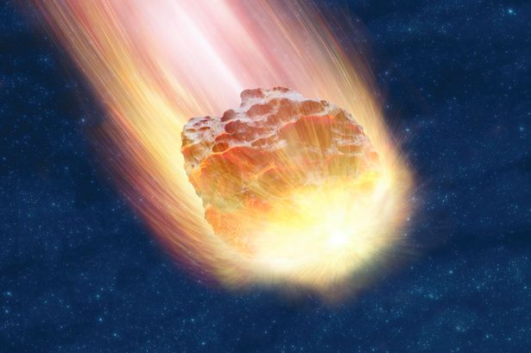
Meteorites The Basics – What are their names?
Meteorites go by different names depending on where they are
meteor
me•te•or (mee-tee-or)
A streak of light across the sky, caused by a meteoroid hitting the Earth's atmosphere.
Meteors are also called shooting stars.
Previous
Return to The Basics Page
Next

Slide 12
Meteorites The Basics – What are their names?
Meteorites go by different names depending on where they are
meteor
me•te•or (mee-tee-or)
A streak of light across the sky, caused by a meteoroid hitting the Earth's atmosphere.
Meteors are also called shooting stars.
Previous
Return to The Basics Page
Next

Slide 13
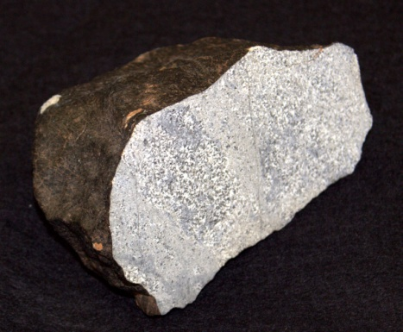
Meteorites The Basics – What are their names?
Meteorites go by different names depending on where they are
meteorite
me•te•or•ite (mee-tee-or-eyet)
A meteoroid – or a piece of one – that made it all the way to the ground and survived.
Identifying a meteorite
Previous
Return to The Basics Page
Next

Slide 14
Meteorites The Basics – What are their names?
Identifying a Meteorite
There are three simple ways to identify a possible meteorite
Most meteorites are usually dark in color, like dark brown or black.
The surface of a meteorite is usually very smooth: no tiny holes.
A magnet, like a refrigerator magnet, will most likely be attracted to a meteorite. This attraction can vary depending on the composition of the meteorite.
To learn more about identifying a rock from space go to the Is It a Space Rock section of The Basics
Previous
Return to The Basics Page
Next

Slide 15

Meteorites The Basics – Shooting Stars
"Shooting star" and "falling star" are two names that are used when describing a brief streak of light traveling across the sky. But the streak of light has nothing to do with stars...
A “shooting star” is caused by a piece of rock the size of a grain of sand. (That’s pretty small!)
A Star is an enormous ball of gas. (Our sun is one million times the size of the Earth! That’s pretty big!)
Previous
Return to The Basics Page
Next

Slide 16
Meteorites The Basics – Shooting Stars
So what causes the streak of light?
A piece of rock enters the atmosphere from space – at which point it's called a "meteor." The meteor is moving so fast, that when it hits the air in our atmosphere there is a great deal of friction created. (If you've ever rubbed your hands together to get them warm in the winter, you've created friction.)
There is so much friction that the air heats up and begins to glow. The streak of light is the glowing trail that the meteor leaves behind as it enters our atmosphere.
Previous
Return to The Basics Page
Next

Slide 17
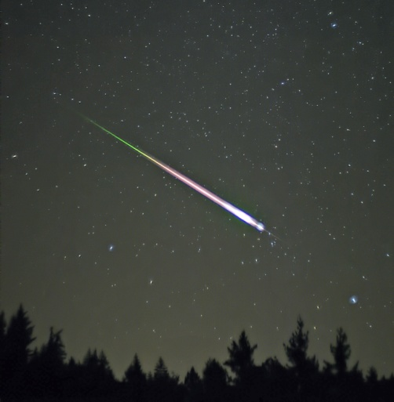
Meteorites The Basics – Shooting Stars
Here are some tips for spotting meteors
Go out on a clear night – it’s hard to see much in the sky even when it’s just partly cloudy
Try to find a spot away from city lights and things that can obstruct your view like buildings and trees.
It’s easier to see meteors when there is no moon in the sky – around a New Moon
It’s easier to see meteors in the early morning hours, between 1am and 4am.
On average you can see 4 to 6 meteors an hour during the night, if you’re away from the city.
Previous
Return to The Basics Page
Next

Slide 18
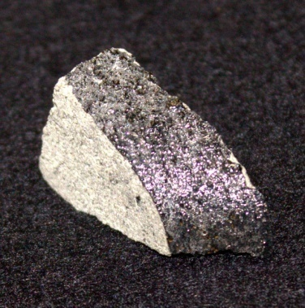
Meteorites The Basics – Is it a Space Rock?
Have you ever found a meteorite? Would you like to know if you had one? Here are three differences between a possible meteorite and an Earth rock.
1. Most meteorites are dark in color (dark brown or black). This dark surface is called a fusion crust.
Our Mars meteorite, Zagami, is pictured here. The dark strip is part of the Original meteorite’s fusion crust.
Previous
Return to The Basics Page
Next

Slide 19
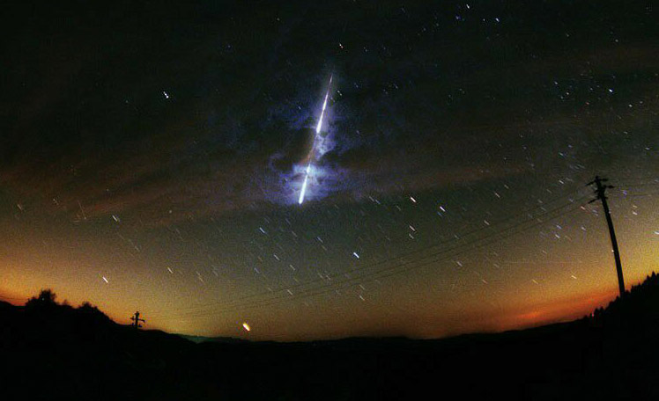
Meteorites The Basics – Is it a Space Rock?
Fusion Crust
A fusion crust is the dark, outer layer found on most meteorites. Space rocks pass through our atmosphere at very high speeds (tens of thousands of miles per hour.) As a result, much friction is created between the rock and the air in the atmosphere. (Have you ever rubbed your hands together to get them warm in the winter? That’s friction.!)
The rock heats up so much that the outer layers melt. The rock then cools rapidly and the melted layers fuse together. Once the rock reaches the surface of the Earth it is called a meteorite, and the meteorite now has a fusion crust.
This crust will usually be a dark color, and will be very smooth.
A meteor- shown to the right- is the trail that is left behind. The same friction that cases the outside of the space rock to melt also adds energy to the atoms and molecules in the air. This energy is released as light thus creating the steak of light sometimes called a “shooting star”
Previous
Return to The Basics Page
Next

Slide 20
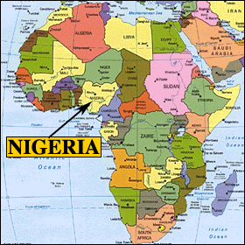
Meteorites The Basics – Is it a Space Rock?
The Original Zagami
The piece of Zagami that we have here on display is only a piece of the original meteorite. The original, about 40 pounds worth of Mars material, fell in Africa, in the country of Nigeria. It fell in 1962, and almost hit a farmer! It didn't, but the shock wave of the meteorite's impact with the ground did knock him over.
Previous
Return to The Basics Page
Next

Slide 21
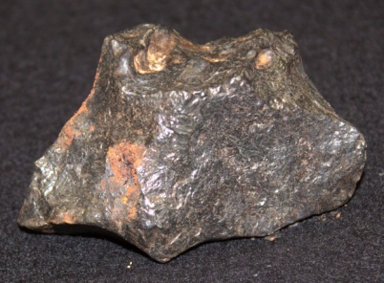
Meteorites The Basics – Is it a Space Rock?
Have you ever found a meteorite? Would you like to know if you had one? Here are three ways to pick out a possible meteorite from an Earth rock.
2.
The surface is very Smooth: no tiny holes. This is also a feature of the fusion crust.
It is a little difficult to see, but the surface of this meteorite is very smooth. You can also see examples of smooth fusion crust by looking at many of the meteorites on display here at the observatory.
Previous
Return to The Basics Page
Next

Slide 22
Meteorites The Basics – Is it a Space Rock?
Have you ever found a meteorite? Would you like to know if you had one? Here are three ways to pick out a possible meteorite from an Earth rock.
2.
The surface is very Smooth: no tiny holes. This is also a feature of the fusion crust.
It is a little difficult to see, but the surface of this meteorite is very smooth. You can also see examples of smooth fusion crust by looking at many of the meteorites on display here at the observatory.
Previous
Return to The Basics Page
Next

Slide 23
Meteorites The Basics – Is it a Space Rock?
Have you ever found a meteorite? Would you like to know if you had one? Here are three ways to pick out a possible meteorite from an Earth rock.
2.
The surface is very Smooth: no tiny holes. This is also a feature of the fusion crust.
It is a little difficult to see, but the surface of this meteorite is very smooth. You can also see examples of smooth fusion crust by looking at many of the meteorites on display here at the observatory.
Previous
Return to The Basics Page
Next

Slide 24
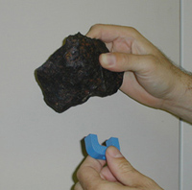
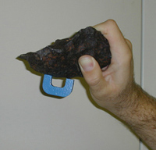
Meteorites The Basics – Is it a Space Rock?
Have you ever found a meteorite? Would you like to know if you had one? Here are three ways to pick out a possible meteorite from an Earth rock.
3.
A refrigerator magnet will probably be attracted to a meteorite, even if only a little bit.
Most meteorites have iron in them. Your refrigerator has iron in it. Magnets easily stick to iron.
Previous
Return to The Basics Page
Next

Slide 25
Meteorites The Basics – Different Types
You know that meteorites are rocks from space…but did you know that there are three different types of meteorites?
Stony
Stony-iron
Iron
Click on the types above to find out more!
If you want to see examples of all three types of meteorites, be sure to visit the meteorite display case here at the observatory.
Previous
Return to The Basics Page
Next

Slide 26
Meteorites The Basics – Different Types
Stony
Stony meteorites are mostly rock, but they still have some iron in them. This means that a magnet will usually be slightly attracted to a stony meteorite.
Since a stony meteorite doesn’t contain much iron, which is a heavy metal, stony meteorites are relatively light.
Some stony meteorites come from material that was originally found on the surface of asteroids or planets.
Previous
Return to The Basics Page
Next

Slide 27

Meteorites The Basics – Different Types
Stony-iron
Stony-iron meteorites are about half rock and half iron. A magnet will certainly be attracted to a stony-iron meteorite.
A stony-iron meteorite will weigh more than a stony meteorite of the same size, and less than an iron meteorite of the same size. This is due to its mixture of rock and metal.
Stony-iron meteorites come from material that was originally found in the region between the core and the surface of asteroids or planets.
Previous
Return to The Basics Page
Next

Slide 28

Meteorites The Basics – Different Types
Iron
Iron meteorites are generally all iron, although they sometimes have just a bit of other metals mixed in. A magnet will certainly be attracted to an iron meteorite.
Since iron meteorites are all metal they are quite heavy.
Iron meteorites come from material that was originally found in the cores of asteroids or planets.
Previous
Return to The Basics Page
Next

Slide 29
Meteorites The Basics – Craters
Craters are made when a meteorite crash lands on the surface of a planet or moon. We see many craters on some of the other planets and moons – including our own moon, as well as here on Earth. We see fewer craters on Earth, however: flowing water, blowing winds, and other weather effects help to cover or destroy the craters formed so long ago.
In this section, you can view images of craters here on Earth, as well as other places in the solar system.
Previous
Return to The Basics Page
Next

Slide 30
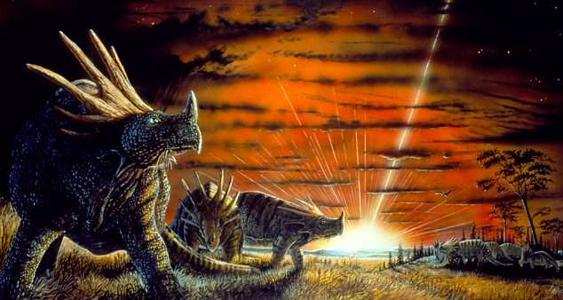
Meteorites The Basics – Craters
A drawing of what the dinosaurs may have seen 65 million years ago.
Previous
Return to The Basics Page
Next

Slide 31
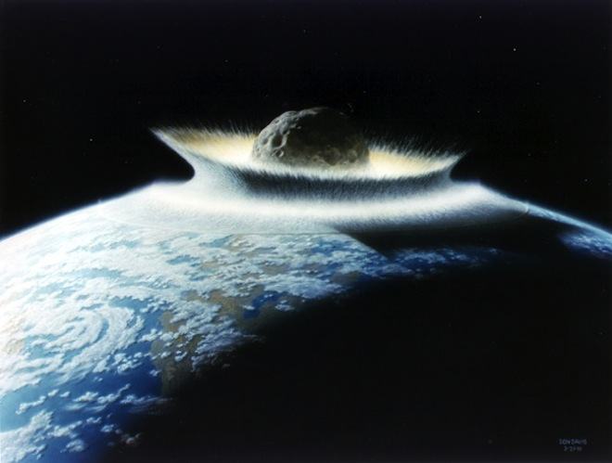
Meteorites The Basics – Craters
An artist’s rendition of a massive meteor crashing into Earth
Previous
Return to The Basics Page
Next

Slide 32
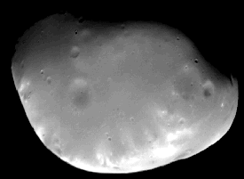
Meteorites The Basics – Craters
Craters on one of Mars’ moons, Deimos
Previous
Return to The Basics Page
Next

Slide 33
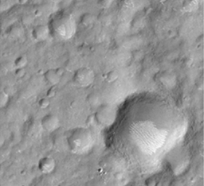
Meteorites The Basics – Craters
Craters on Mars, taken by Mars Global Surveyor, in 1999
Previous
Return to The Basics Page
Next

Slide 34
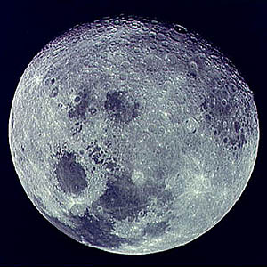
Meteorites The Basics – Craters
Craters on our moon, taken by NASA
Previous
Return to The Basics Page
Next

Slide 35
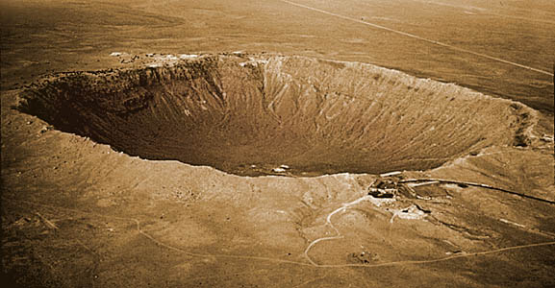
Meteorites The Basics – Craters
Meteor Crater, in Arizona, on Earth
Previous
Return to The Basics Page
Next

Slide 36
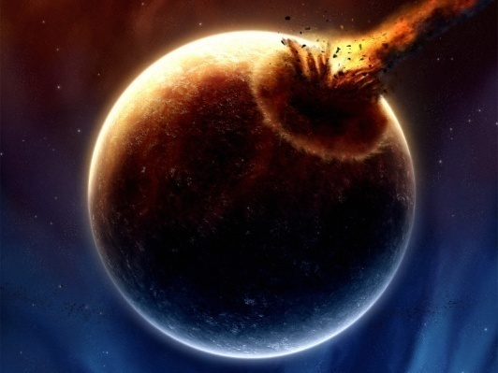
Meteorites The Basics – Life Cycle
The “life” of a meteorite is a complicated thing. First of all, it depends on where the meteorite came from. For this section, you can learn how a typical Mars meteorite might find its way to Earth. However, a typical meteorite from an asteroid, for example, leads a very different life. Ask an Observatory staff member for more information.
The life we describe here is of a typical Mars meteorite. The Observatory’s meteorite, Zagami, is from Mars.
First ,a large meteor crashed into Mars.
A drawing of a very large meteor crashing into a planet, pretend it is Mars.
Previous
Return to The Basics Page
Next

Slide 37
Meteorites The Basics – Life Cycle
Pieces of Mars were launched into space with enough velocity to escape Mars’ gravitational pull. (The minimum velocity required for a smaller object to escape a more massive bodies gravitational effects is called the escape velocity.) These pieces, having escaped Mars, began to orbit the Sun.
Previous
Return to The Basics Page
Next

Slide 38
Meteorites The Basics – Life Cycle
Eventually, at least one meteoroid fount itself in Earth’s path… and the two collided.
A drawing of a very large meteoroid crashing into Earth, now called a meteorite.
Zagami wasn’t nearly as gigantic as the meteorite drawing above: it was only 40 pounds.
Previous
Return to The Basics Page
Next

Slide 39
Meteorites The Basics – Life Cycle
The piece of Mars is now on Earth (probably in many pieces) as a Martian meteorite. If the crash landing was powerful enough, it could have sent pieces of Earth into space, to land somewhere else as an Earth meteorite. The cycle continues.
Zagami fell to Earth in 1962. Weighting only 40 pounds it didn’t create a powerful enough crash to send pieces of Earth into space. However, Zagami is certainly not the biggest meteorite to have crash landed on Earth.
Previous
Return to The Basics Page
Next

Slide 40
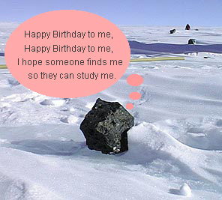
Meteorites The Basics – How Old Are They?
How old are meteorites? That is one of the things that scientists like to know: it helps give them a more complete picture of our solar system. Even for non-scientists, knowing how old a meteorite is can really help to understand our place in the solar system.
Figuring out the age of a meteorite is not exactly the easiest thing to do. First, we have no idea when a meteorite might have left its original home. Second, most meteorites are on Earth for many, many years before someone finds them. The effects of Earth’s weather over the years can change meteorites in ways both big and small.
Previous
Return to The Basics Page
Next

Slide 41
Meteorites The Basics – How Old Are They?
Scientists know how long it takes for the different chemicals and elements in meteorites to break down. It's a bit complicated, but by looking at what chemicals and elements are in meteorites, and how much of each is present, they can make a pretty good estimate about the age of the meteorite.
Some meteorites are very old. They're from the beginnings of the solar system, a very long time ago. Others are younger, and are from places that still exist today, such as planets and asteroids.
Previous
Return to The Basics Page
Return to Menu

Slide 42
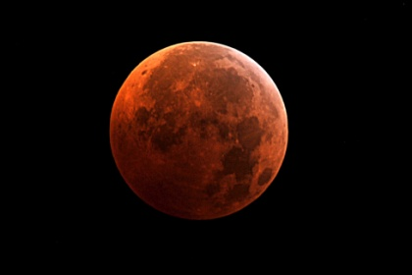
Meteorites Zagami
Zagami is a rock… from the planet Mars!
On October 3rd, 1962, a farmer in Nigeria – a country in Africa – was out in his fields when he heard a loud explosion, and was buffeted by a brief gust of wind. About 10 feet away from this farmer, a 40 pound meteorite had crashed to Earth, creating a hole in the ground 2 feet deep. Since the meteorite fell close to the town of Zagami, it was named after the town.
To find out more about the Mars meteorite, click on the links below.
How did Zagami Get Here? | Find out how a piece of rock gets from Mars to Earth
Is it Really from Mars? | What scientists do to know if a meteorite is from Mars
Return to Menu

Slide 43
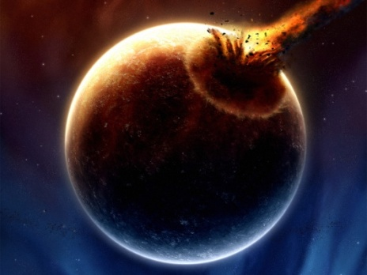
Meteorites Zagami – How Did it Get Here?
The life of a typical Mars meteorite is quite a process. Take, for example, the Mars meteorite on display here at the Observatory, Zagami.
First a Large Meteor crashed into Mars.
A drawing of a very large meteor colliding with a planet: pretend it's Mars
Previous
Return to Zagami Page
Next

Slide 44
Meteorites Zagami – How Did it Get Here?
Pieces of Mars were launched into space with enough velocity to escape Mars’ gravitational pull. (The minimum velocity required for a smaller object to escape a more massive bodies gravitational effects is called the escape velocity.) These pieces, having escaped Mars, began to orbit the Sun.
Previous
Return to Zagami Page
Next

Slide 45
Meteorites Zagami – How Did it Get Here?
Eventually at least one of these meteoroid found itself in Earth’s path and the two collided.
A drawing of a very large meteoroid crashing into Earth, now called a meteorite.
Zagami wasn’t nearly as gigantic as the meteorite drawing above: it was only 40 pounds.
Previous
Return to Zagami Page
Next

Slide 46
Meteorites Zagami – How Did it Get Here?
The piece of Mars is now on Earth (probably in pieces) as a Martian meteorite. If the crash landing was powerful enough, it could have sent pieces of Earth into space, to land somewhere else as an Earth meteorite. The cycle continues.
Zagami fell to Earth in 1962. At only 40 pounds, it didn't create a powerful enough crash to send pieces of Earth into space. However, Zagami is certainly not the biggest meteorite to have crash landed on Earth.
Previous
Return to Zagami Page
Next

Slide 47
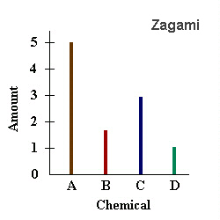
Meteorites Zagami – Is it Really From Mars?
The meteorite Zagami could be from one of many possible places… why do scientists say it’s from Mars?
Zagami crash landed on Earth in 1962. At some point after it landed, scientists tested the meteorite to see what chemicals it contained.
Scientists display the results of the testing in many ways. Here is a (made-up) diagram to give you an idea of how scientists might show the amount of different chemicals in a meteorite like Zagami.
Previous
Return to Zagami Page
Next

Slide 48
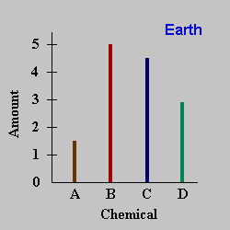
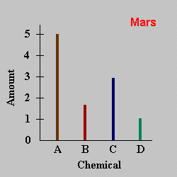
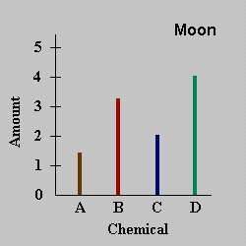
Meteorites Zagami – Is it Really From Mars?
During the early 1970s, the Apollo astronauts brought back many rocks from the Moon. This allowed scientists to find out what chemicals were in Moon rocks.
Scientists had already tested and determined what chemicals were in Earth rocks, and the amount of those chemicals.
In the mid to late 1970s, the Viking mission to Mars took readings of what chemicals were in the soil, and what chemicals were in the Martian atmosphere.
The above graphs are made-up diagrams to give you an idea of how scientists might show the amount of different chemicals
Previous
Return to Zagami Page
Next

Slide 49
Meteorites Zagami – Is it Really From Mars?
Scientists later compared Zagami’s test results with the results from other places
Previous
Return to Zagami Page
Next

Slide 50


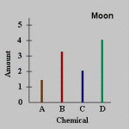

Meteorites Zagami – Is it Really From Mars?
Which place do you think Zagami came from? The Earth, Mars, or our Moon? If you think you have a match for Zagami, click on its matching graph.
?
?
?
Previous
Return to Welcome Page
Return to Zagami

Slide 51
Meteorites Zagami – Is it Really From Mars?
?
Your Answer: Zagami is from on Earth
Wrong. What scientists look for is a match of composition. In other words, is Zagami made of the same stuff as Earth rocks are made of, and in the same amounts? According to these two graphs, Zagami and Earth rocks have the same chemicals, but different amounts. Zagami has much more Chemical A than Earth rocks have. However, Earth rocks have much more Chemical B, Chemical C, and Chemical D than Zagami has. Zagami and Earth are not good matches.
Don't worry: scientists make plenty of mistakes before they figure things out... it's just part of doing science!
Click Here to Try Again!

Slide 52
Meteorites Zagami – Is it Really From Mars?
?
Your Answer: Zagami is from our Moon
Wrong. What scientists look for is a match of composition. In other words, is Zagami made of the same stuff as Moon rocks are made of, and in the same amounts? According to these two graphs, Zagami and Moon rocks have the same chemicals, but different amounts. Zagami has much more Chemical A and Chemical C than Moon rocks have. However, Earth rocks have more Chemical B and Chemical D than Zagami has. Zagami and our Moon are not good matches.
Don't worry: scientists make plenty of mistakes before they figure things out... it's just part of doing science!
Click Here to Try Again!

Slide 53
Meteorites Zagami – Is it Really From Mars?
?
Your Answer: Zagami is from Mars
Right! What scientists look for is a match of composition. In other words, is Zagami made of the same stuff as Mars rocks are made of, and in the same amounts? According to these two graphs, Zagami and Mars rocks have the same chemicals, and they're in the same amounts. Zagami and Mars are perfect matches, so Zagami must be from the planet Mars.
There's just one more interesting thing about Zagami, and how scientists knew it was from Mars... click here to find out more!
Click Here to Go Back!
Return to Menu

Slide 54
Meteorites Zagami – Is it Really From Mars?
?
When scientists were testing Zagami to see what it was made of, they discovered something interesting: Zagami actually had little tiny bubbles of air in the rock! So scientists tested the air bubbles to see what the air was made of. When the Viking mission landers were on Mars during the late 1970s, they tested not only the rocks, but also the Mars air to see what it was made of. Mars air turns out to be mostly carbon dioxide, with some nitrogen and argon as well. Earth's air, for comparison, is mostly nitrogen, with some oxygen as well. (Our Moon has no air – it has no atmosphere.)
Sure enough, the air bubbles in Zagami matches the air found on Mars, meaning Zagami is from the planet Mars.
Click Here to Go Back!
Return to Menu

Slide 55
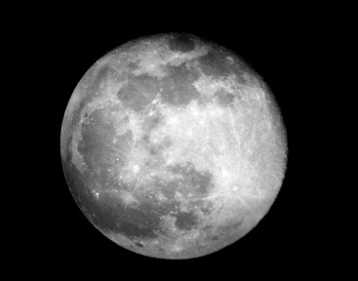
Meteorites Dar al Gani 262
Dar al Gani 262 is a rock… from our Moon!
On March 23, 1997, a meteorite was found in the African country of Libya, near the town of Dar al Gani. It happened to be the 262nd meteorite found near the town, giving the meteorite the name Dar al Gani 262. The meteorite, later identified as coming from our Moon, also happens to be the first moon meteorite found in the Sahara Desert.
To find out more about our Moon meteorite, click on the links below.
How Did Dar al Gani Get Here? | Find out how a piece of rock gets from the Moon to Earth
Is it Really From the Moon? | What scientist do to know if a meteorite is from our moon
Return to Menu

Slide 56
Meteorites Dar al Gani 262 – How Did it Get Here?
The life of a typical Moon meteorite is quite a process. Take, for example, the Moon meteorite on display here at the Observatory, Dar al Gani 262.
First, a large meteor crashed onto the surface of the Moon
A drawing of a very large meteor colliding with a planet: pretend it's our Moon.
Previous
Return to Dar al Gani 262 Page
Next

Slide 57
Meteorites Dar al Gani 262 – How Did it Get Here?
Pieces of the Moon’s surface were launched into space where they began to orbit either Earth or the Sun.
If they began to orbit Earth they can orbit for a few years or tens of thousands of years before falling to the Earth.
Those orbiting the Sun may eventually strike the Earth tens of millions of years after they were ejected from the moon.
Previous
Return to Dar al Gani 262 Page
Next

Slide 58

Meteorites Dar al Gani 262 – How Did it Get Here?
Eventually, at least one meteoroid found itself on a collision course with Earth.
A drawing of a very large meteoroid crashing into Earth, now called a meteorite.
Dar al Gani 262wasn’t nearly as gigantic as the meteorite drawing above; the meteorite weighted less than a pound when it was discovered.
Previous
Return to Dar al Gani 262 Page
Next

Slide 59
Meteorites Dar al Gani 262 – How Did it Get Here?
The piece of the Moon is now on Earth (probably in pieces) as a lunar meteorite. If the crash landing was powerful enough, it could have sent pieces of Earth into space, to land somewhere else as an Earth meteorite. The cycle continues.
Dar al Gani fell to Earth many, many years ago. Weighing less than a pound, it didn't create a powerful enough crash to send pieces of Earth into space. However, Dar al Gani 262 is certainly not the biggest meteorite to have crashed to Earth.
Previous
Return to Dar al Gani 262 Page
Next

Slide 60
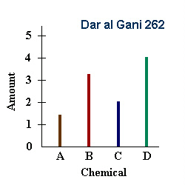
Meteorites Dar al Gani 262 – Is it Really From Our Moon?
The meteorite Zagami could be from one of many possible places… why do scientists say it’s from the Moon?
Althoug Dar al Gani 262 crashed landed on Earth many, many years ago, it was not found until 1977. At some point after it was found, scientists tested the meteorite to see what it was composed of.
Scientists display the results of the testing in many ways. Here is a (made-up) diagram to give you an idea of how scientists might show the amount of different chemicals in a meteorite like Dar al Gana 262.
Previous
Return to Dar al Gani 262 Page
Next

Slide 61
Meteorites Dar al Gani 262 – Is it Really From Our Moon?
In the mid to late 1970s, the Viking mission to Mars took readings of what chemicals were in the soil, and what chemicals were in the Martian atmosphere.
During the early 1970s, the Apollo astronauts brought back many rocks from the Moon. This allowed scientists to find out what chemicals were in Moon rocks.
Scientists had already tested and determined what chemicals were in Earth rocks, and the amount of those chemicals.
The graphs above are made-up diagrams to give you an idea of how scientists might show the amount of different chemicals
Previous
Return to Dar al Gani 262 Page
Next

Slide 62
Meteorites Dar al Gani 262 – Is it Really From Our Moon?
Scientists later compared Dar al Gani 262’s test results with the results from other places
Previous
Return to Dar al Gani 262 Page
Next

Slide 63

Meteorites Dar al Gani 262 – Is it Really From Our Moon?
Which place do you think Dar al Gani 262 came from? The Earth, Mars, or our Moon? If you think you have a match for Dar al Gani 262, click on its matching graph.
?
?
?
Previous
Return to Welcome Page
Return to Dar al Gani 262

Slide 64
Meteorites Dar al Gani 262 – Is it Really From Our Moon?
?
Your Answer: Dar al Gani 262 is from Earth
Wrong. What scientists look for is a match of composition. In other words, is Dar al Gani 262 made of the same stuff as Earth rocks are made of, and in the same amounts? According to these two graphs, Dar al Gani 262 and Earth rocks have the same chemicals, but different amounts. Dar al Gani 262 has more Chemical D than Earth rocks have. Dar al Gani 262 and Earth rocks have roughly the same amount of Chemical A. However, Earth rocks have much more Chemical B and Chemical C than Dar al Gani 262 has. Dar al Gani 262 and Earth are not good matches.
Don't worry: scientists make plenty of mistakes before they figure things out... it's just part of doing science!
Click Here to Try Again!

Slide 65
Meteorites Dar al Gani 262 – Is it Really From Our Moon?
?
Your Answer: Dar al Gani 262 is from our Moon
Right! What scientists look for is a match of composition. In other words, is Dar al Gani 262 i made of the same stuff as Moon rocks are made of, and in the same amounts? According to these two graphs, Dar al Gani 262 and Moon rocks have the same chemicals, and they're in the same amounts. Dar al Gani 262 and our Moon are perfect matches, so Dar al Gani 262 must be from our Moon.
Click Here to Go Back
Return to Menu

Slide 66
Meteorites Dar al Gani 262 – Is it Really From Our Moon?
?
Your Answer: Dar al Gani 262 is from Mars.
Wrong . What scientists look for is a match of composition. In other words, is Dar al Gani 262 made of the same stuff as Mars rocks are made of, and in the same amounts? According to these two graphs, Dar al Gani 262 and Mars rocks have the same chemicals, but different amounts. Dar al Gani 262 has much more Chemical B and Chemical D than Mars rocks have. However, Earth rocks have more Chemical A and Chemical C than Dar al Gani 262 has. Dar al Gani 262 and the planet Mars are not good matches.
Don't worry: scientists make plenty of mistakes before they figure things out... it's just part of doing science!
Click Here to Go Back!

