Slide 1
Figure 1 Data

Slide 2
dataset 1

Slide 3
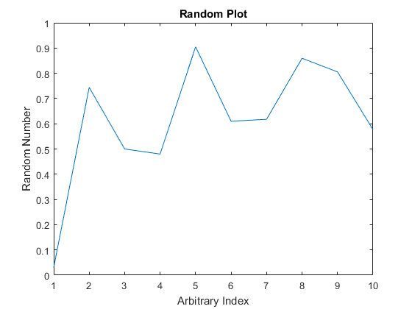

Slide 4
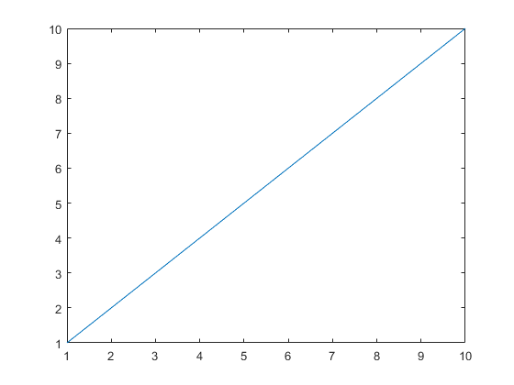

Slide 5
Test Tab

Slide 6
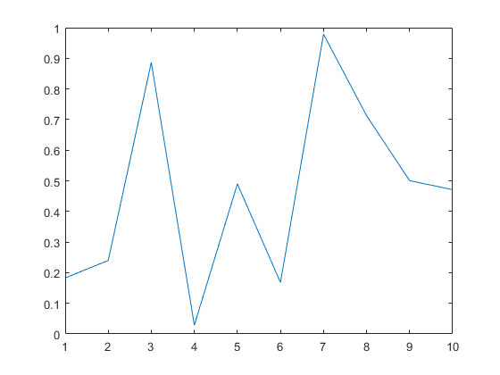

Slide 7
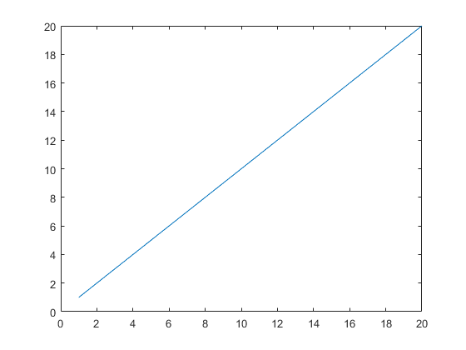

Slide 8
