Slide 1
Senior Design: Steam Heat Controller
Team Members: Curtis Mayberry, Ben Cao,
Thinh Luong, Ben Jusufovic
Advisors: Lee Harker, Jason Boyd
Notes:
Ben Cao

Slide 2
Overview
Project Goals & Concept Diagram
System Decomposition
System Design
Test Plan
Resources and budget
Current Status
Notes:
Ben Cao

Slide 3
Problem Statement
Currently, the old section of Coover utilizes steam valves in order to heat adjacent rooms. In extreme cases, one steam valve controls the temperature in five different rooms through five radiators. This leads to temperature offset in the rooms and continuous adjustment of the valve in order to accommodate the individuals within each room.
Notes:
Ben Jusufovic

Slide 4
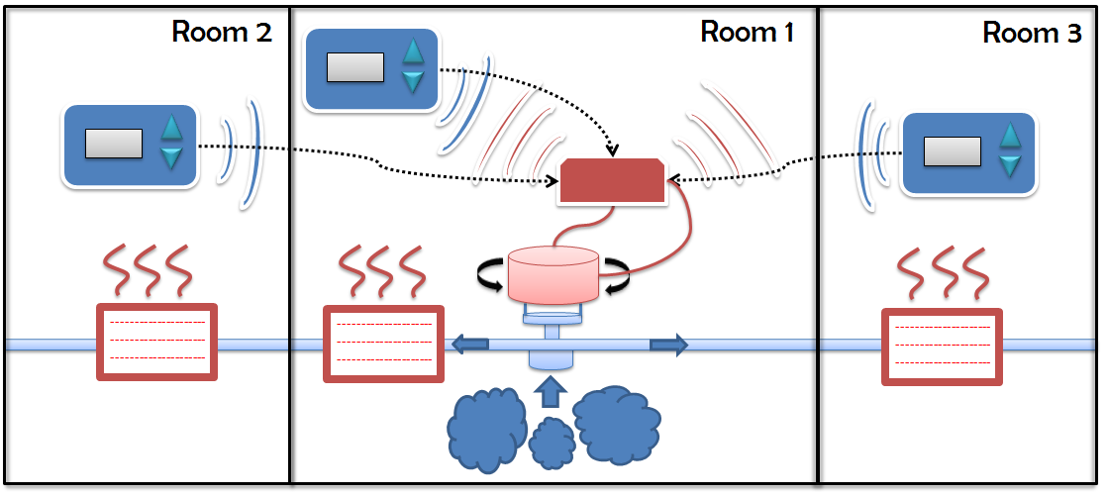
Project Goal
The goal of our project is to provide a user interface that will allow individuals to set a desired temperature within multiple rooms without ambiguity and a heat valve controller unit that will accommodate the desired temperature. Our project will also provide remote system access to Facilities Planning and Management in order to save on energy costs and system management.
Notes:
Ben Jusufovic

Slide 5
Functional Requirements
Intended use as a thermostat helps define:
Effectively control the temperature in the room
Take occupant’s preferences
Multiple room control
External control
Removable mechanical interface
Network interface
Notes:
Ben Cao

Slide 6
Non-Functional Requirements
Considering the user interface unit:
Large LCD - visibility
Graphical based LCD - usability
Gray, green, yellow, or blue tint of LCD -aesthetic appeal.
Large rubber base push buttons - usability.
Translucent push buttons - aesthetic appeal.
Notes:
Ben Cao

Slide 7
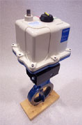
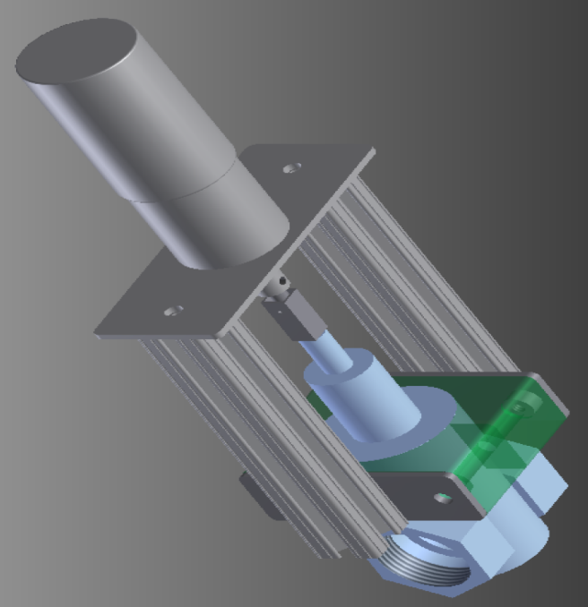
Market Research
Current solutions
Automated Valve & Equipment Co.
Johnson Controls
Our solution
Minimal modification
Adaptable to numerous valves
Simple web interface
Target clients
Coover Building
Sweeney, Gilman, Physics Hall…
Notes:
Thinh Luong

Slide 8
Potential Risks & Mitigation
Hardware failure
Mechanical interface integration delays
Loss of a team member
Short testing window
Power Failure
Component obsolescence
Unexpected lead times
Notes:
Thinh Luong

Slide 9
Constraints
Temperature Sensors controlled by wireless
Mechanical implementation
Temperature differentiation between rooms
Plant restrictions (heat output)
Minimum alteration to existing infrastructure
Limited heat output
User rationality:
Limited testing period
Notes:
Curtis

Slide 10
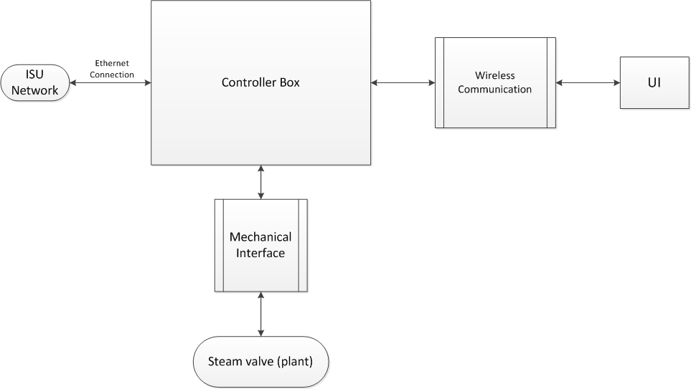
System Decomposition
Notes:
Curtis

Slide 11
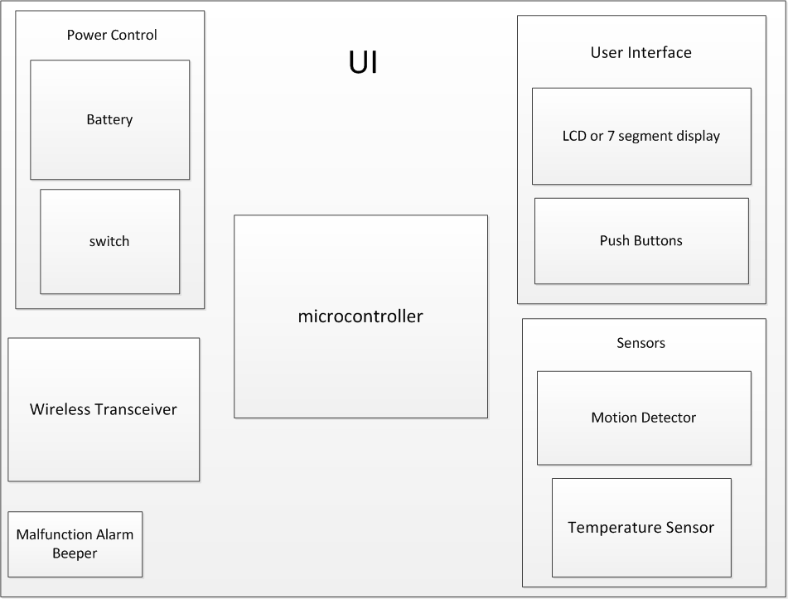
User Interface
Notes:
Curtis

Slide 12
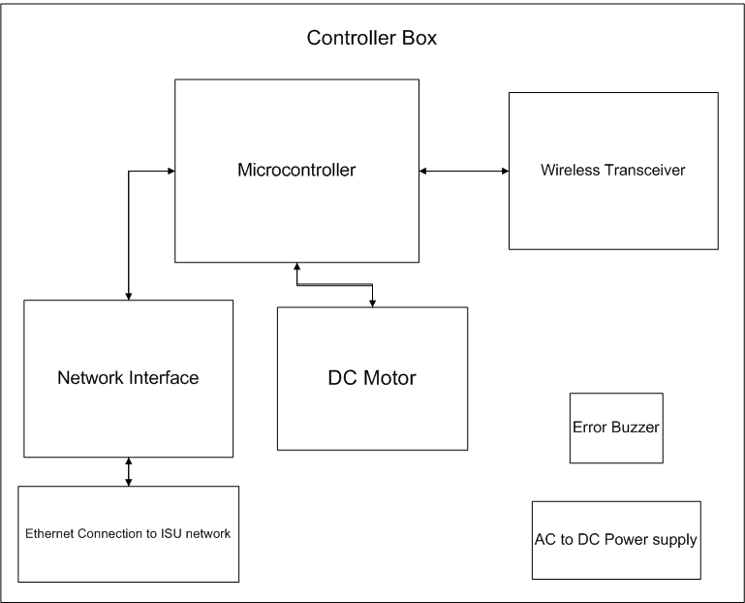
Controller Box
Notes:
Curtis

Slide 13
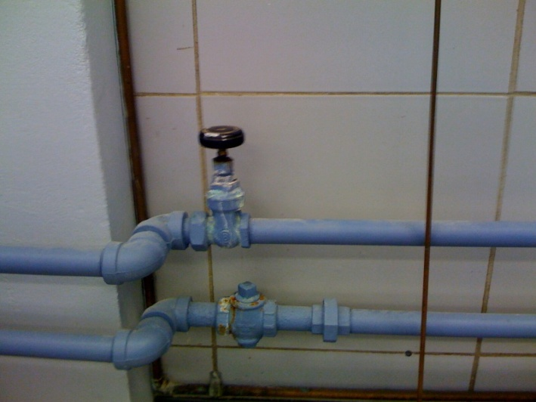
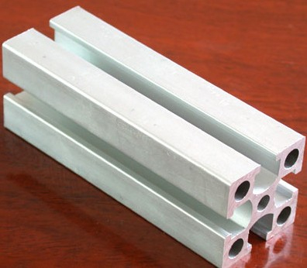
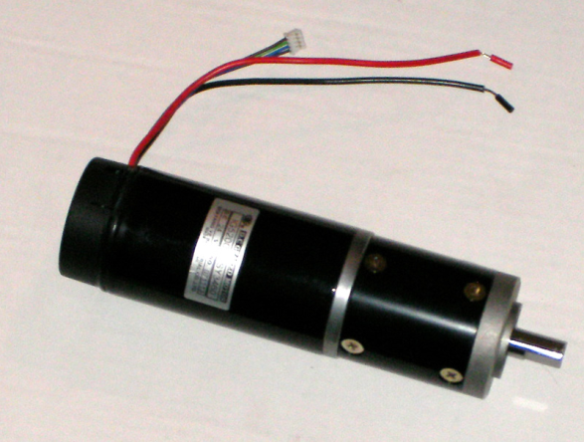
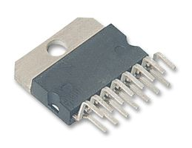
Mechanical Interface
Extruded Aluminum
IG52 Gear motor
L298N Motor Driver
Notes:
Thinh
Photo references:
http://cpc.farnell.com/1/1/19192-dual-full-bridge-driver-4a-op-l298n-stmicroelectronics.html
http://detail.en.china.cn/provide/detail,1065484460.html
http://www.superdroidrobots.com/shop/item.aspx?itemid=937

Slide 14
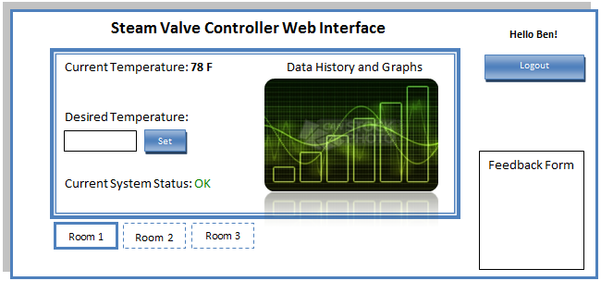
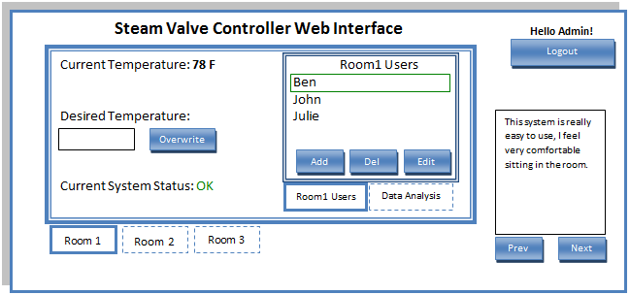
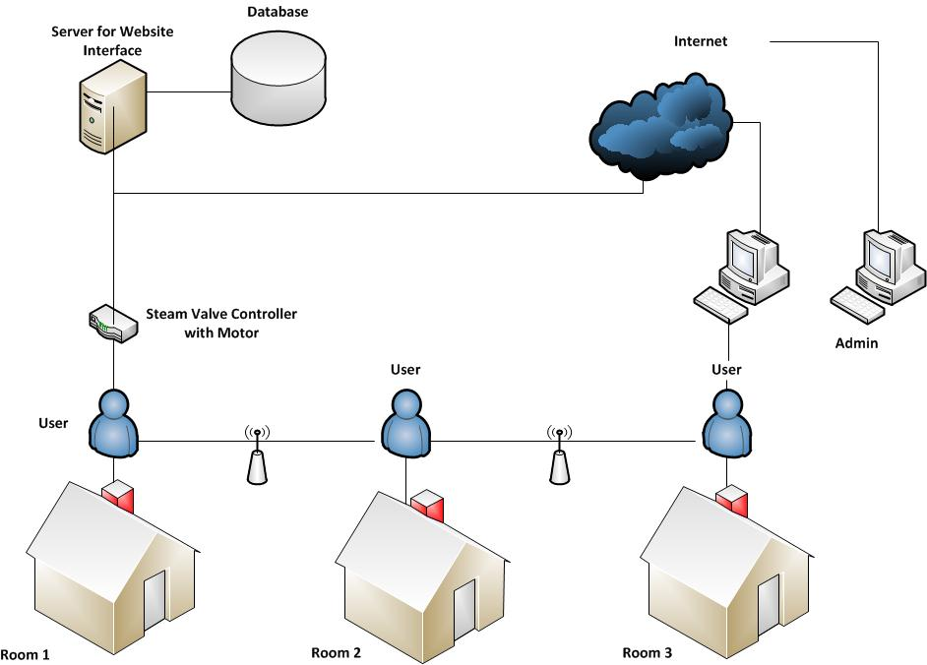
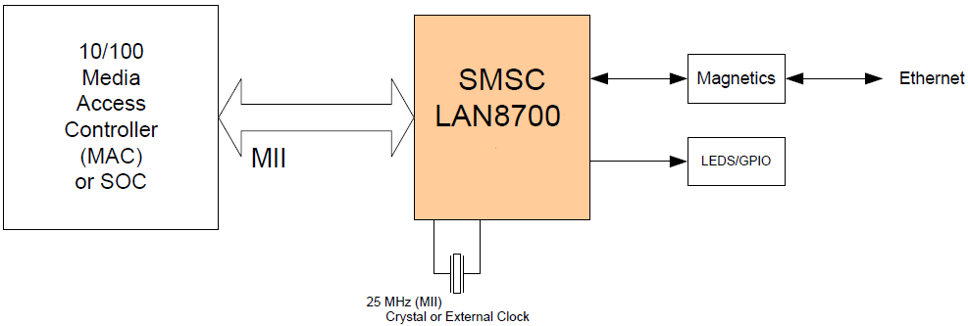
Ethernet and Web Interface
Notes:
Ben Cao

Slide 15
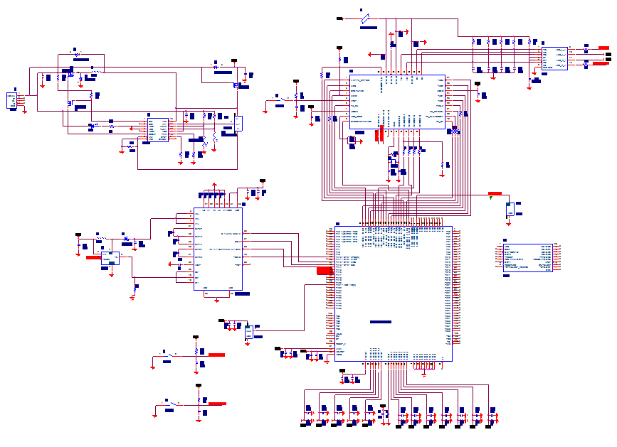
Schematic Design
Notes:
Ben Jusufovic

Slide 16
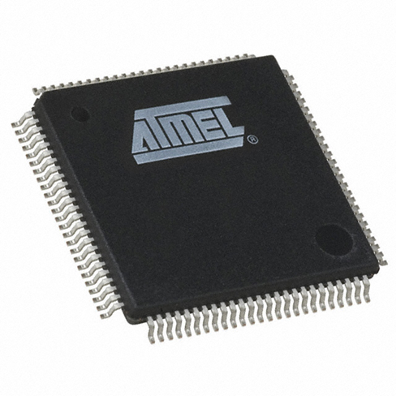
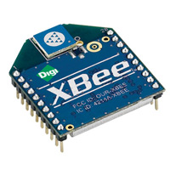
Wireless Transceiver Controller Algorithm
Xbee 802.15.4
Extended range (high power)
PID controller algorithm
32 bit Atmel Microcontroller
Notes:
Curtis

Slide 17
Functional Test Plan
Valve calibration
Range Test
Response Test
Equalization and weighting Test
Environmental and extreme Tests
Monitored extended use testing
Notes:
Curtis Mayberry

Slide 18
Software Test Plan
Component Testing
Microcontroller, Temperature Sensor, and LCD
Ethernet Components
Wireless transceiver
Website Interface
Comprehensive systems
Notes:
Ben Cao

Slide 19
Hardware Test Plan
Power
DC Motor
Microprocessor
LCD
Unit casings
Temperature sensor
Push Buttons
Notes:
Ben Jusufovic

Slide 20
Resource/Cost Estimate
Notes:
Thinh Luong

Slide 21
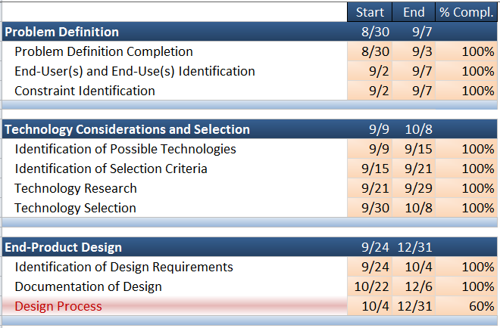

Project Milestones and Current Status
Notes:
Ben Cao

Slide 22
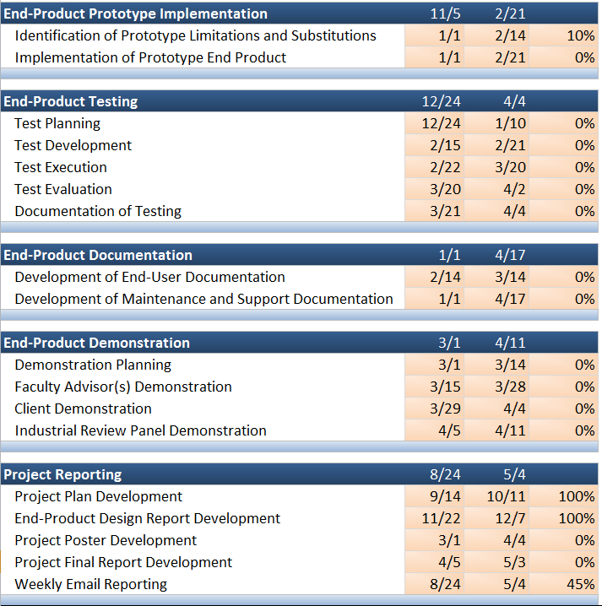
Future Project Milestones and Status
Notes:
Ben Cao

Slide 23
Responsibilities & Contributions
Curtis Mayberry – Webmaster, wireless transceiver, control algorithms design
Ben Cao –Team leader, web interface, Ethernet interface
Ben Jusufovic – Communications liaison, LCD, power system design, schematic design
Thinh Luong – Systems engineer, mechanical interface, motor implementation
Even responsibilities and contributions
Collaborative effort
Notes:
Thinh Luong

Slide 24
Plan for Winter Break
Complete PCB design
Populate PCB
Implement Microcontroller Peripheral Software
Attach mechanical platform and implement controller
Notes:
Ben Jusufovic

Slide 25
Plan for Next Semester
Complete hardware prototype
Complete network interface
Tune controller algorithm
Hardware and software testing
Functional testing
End user documentation
Notes:
Ben Jusufovic

Slide 26
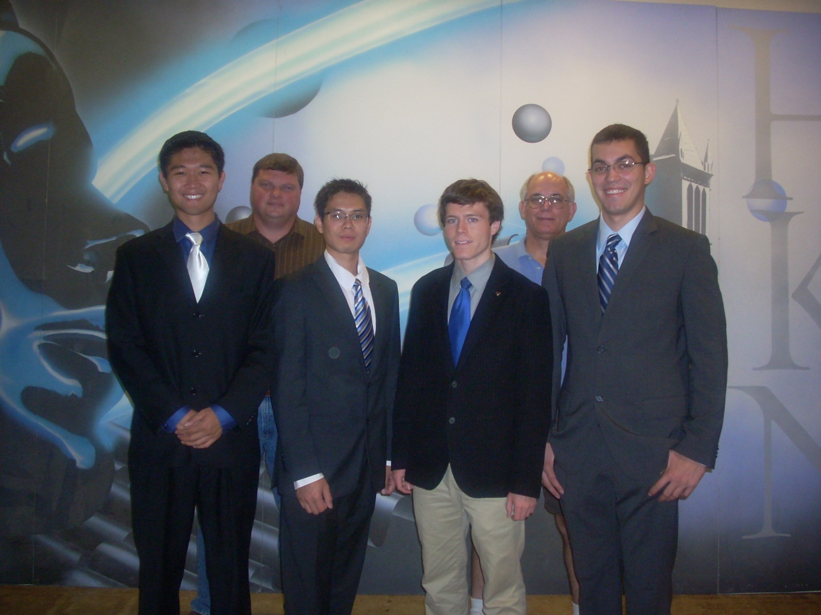
Questions?
Notes:
Thinh Luong

Slide 27

Appendices
Encore!

Slide 28
Controller Box Budget

Slide 29
Control Panel (UI)

Slide 30
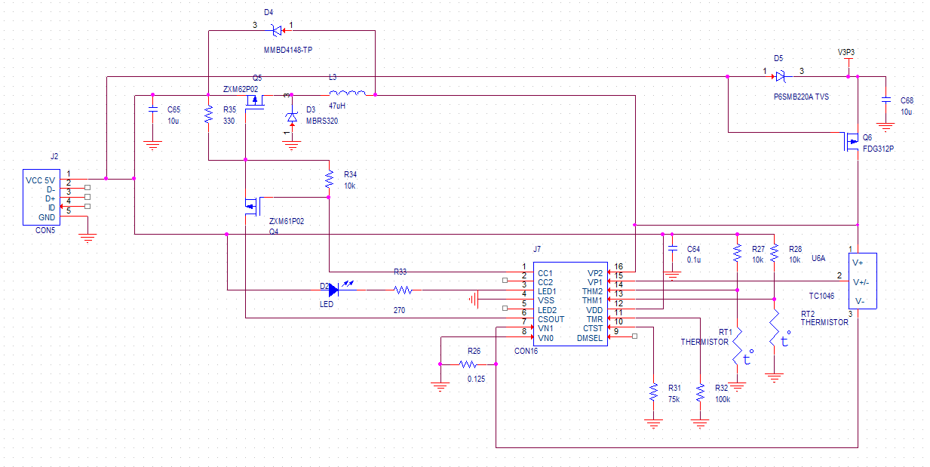
USB Charging Circuitry

Slide 31
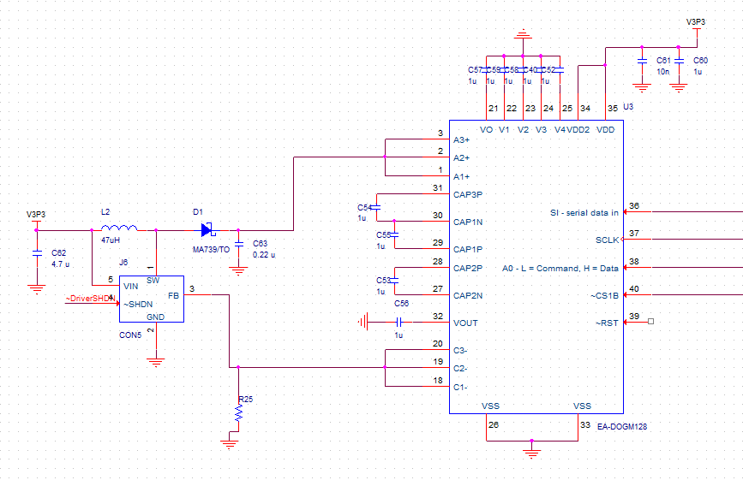
LCD Implementation

Slide 32
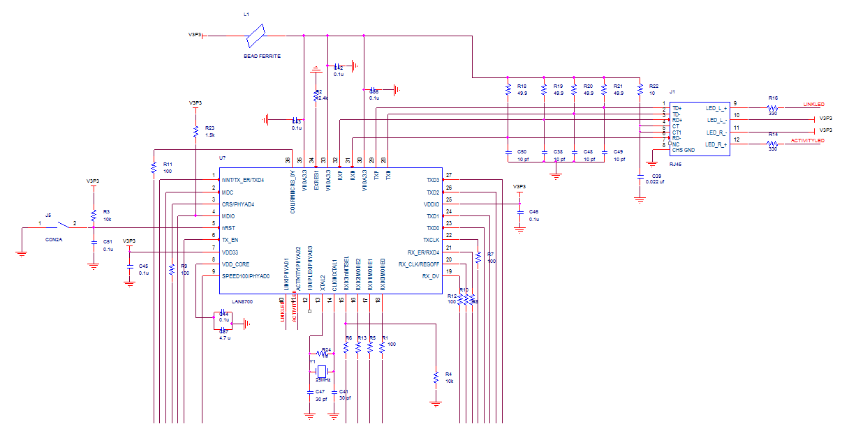
Ethernet Design & RJ45 with Integrated Magnetics

Slide 33
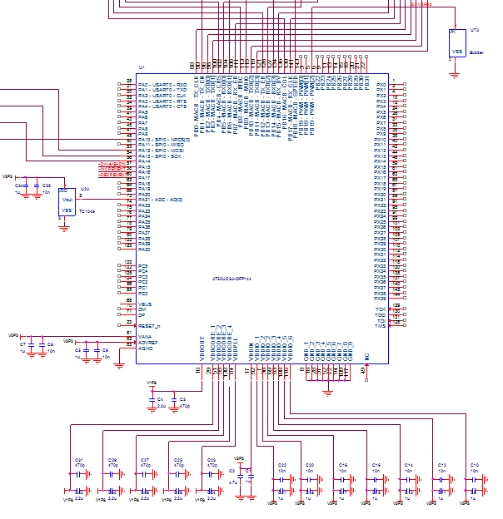
Microcontroller Implementation

Slide 34
Controller Box Budget

Slide 35
Control Panel (UI)

Slide 36
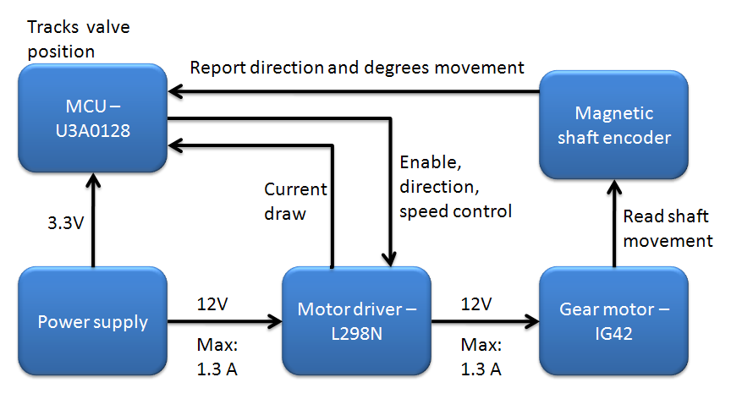
Functional Diagram

Slide 37
Logical Diagram

Slide 38
Temp Error to Rotation
Range: 60˚ - 80˚
Table for each temperature
Temperature < 60
Fully open
Temperature > 80
Fully close

Slide 39
Mechanical test criteria

Slide 40
Mechanical Components
IG42 Gear motor
Shaft encoder

Slide 41
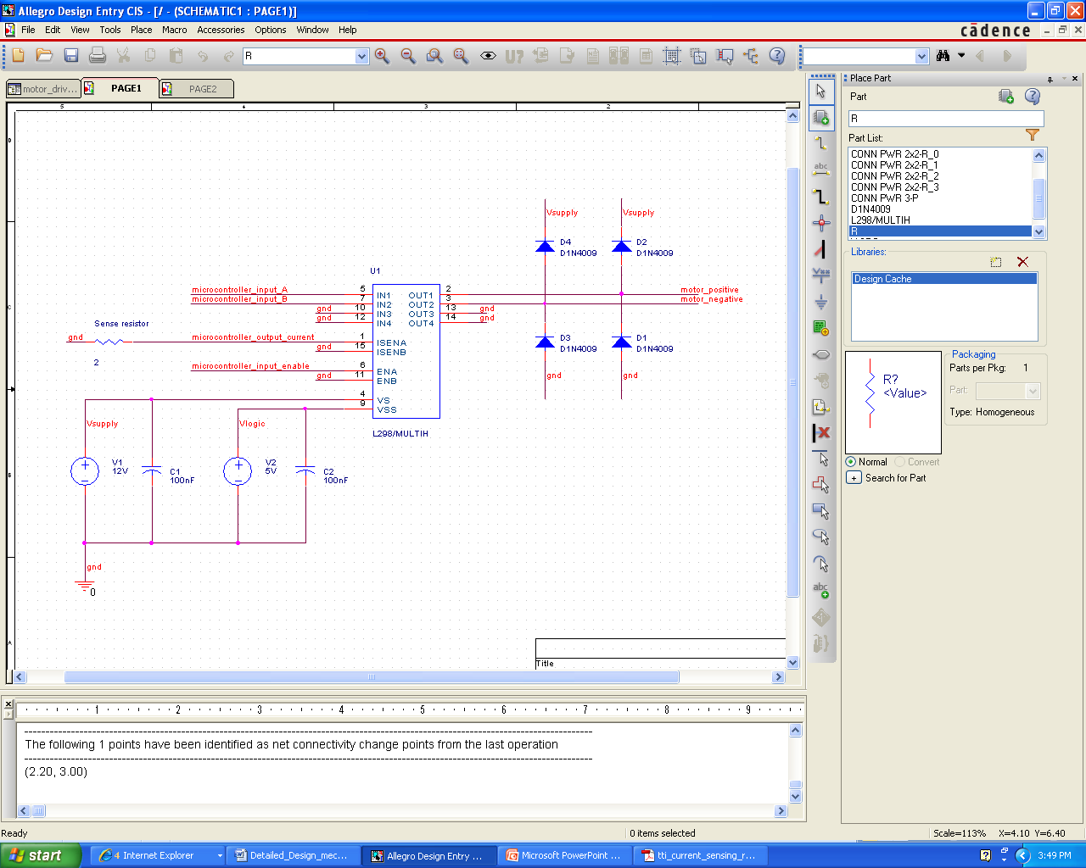
Motor control test circuit

Slide 42
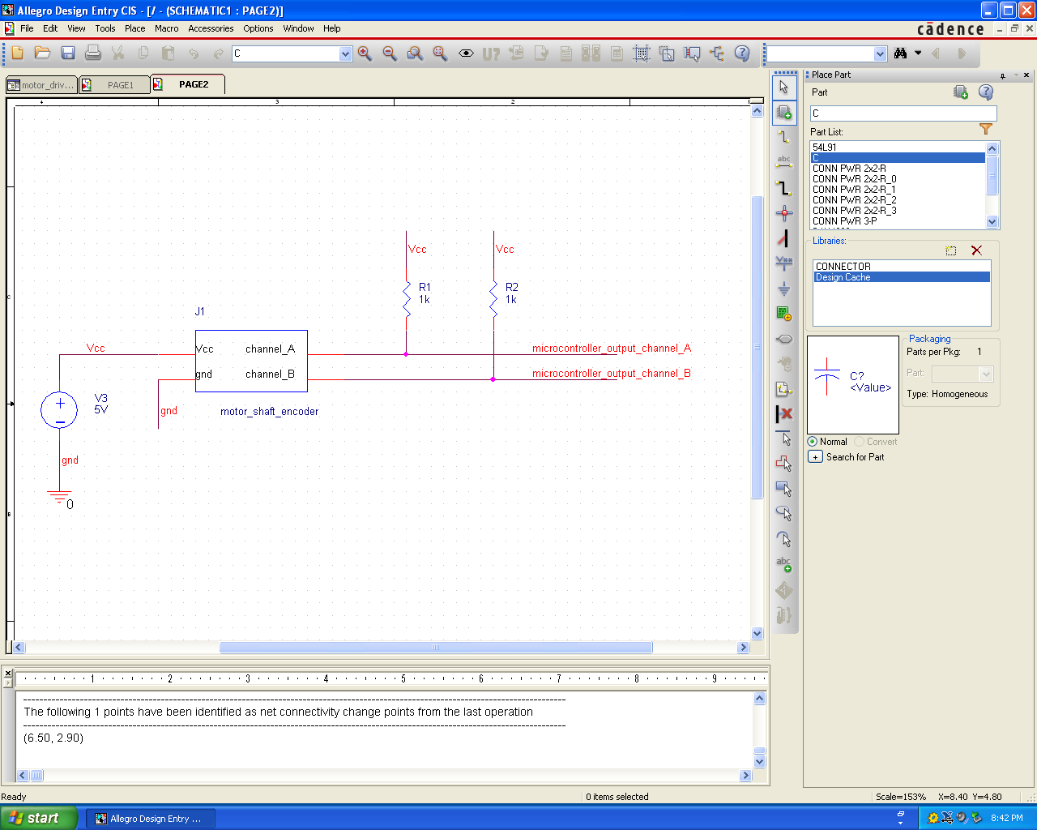
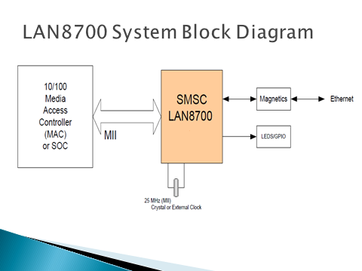
Shaft encoder output circuit

Slide 43
LAN8700 System Block Diagram

Slide 44
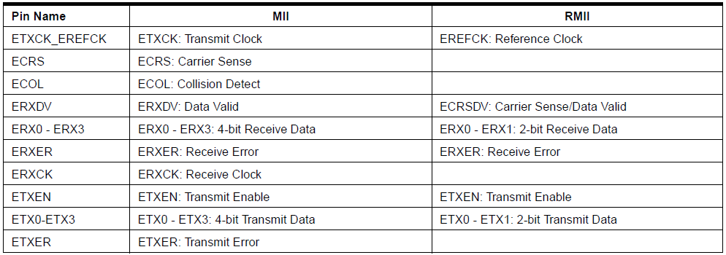
MII Ethernet standard pin mapping

Slide 45
DMA controller’s types of operation
Receive buffer manager write
Receive buffer manager read
Transmit data DMA read
Receive data DMA write
Transmit buffer manager read
Transmit buffer manager write

Slide 46
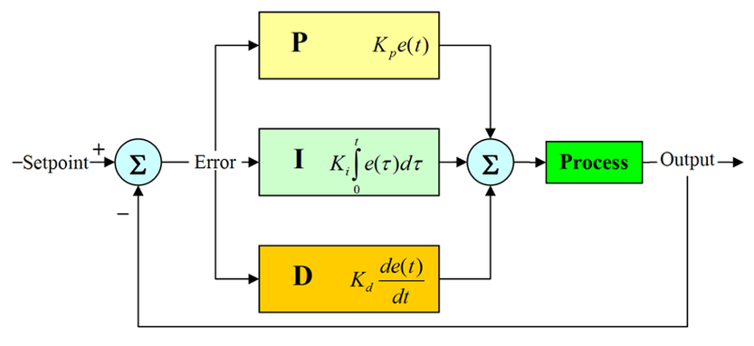
PID Algorithm

Slide 47
PID Controller Difference Equation

Slide 48
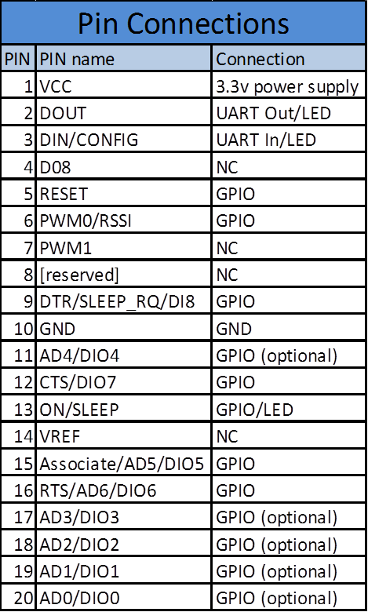
Xbee connections

Slide 49
Hardware Test Plan

Slide 50
Functional Test Plan

Slide 51
Set Point Algorithm

Slide 52
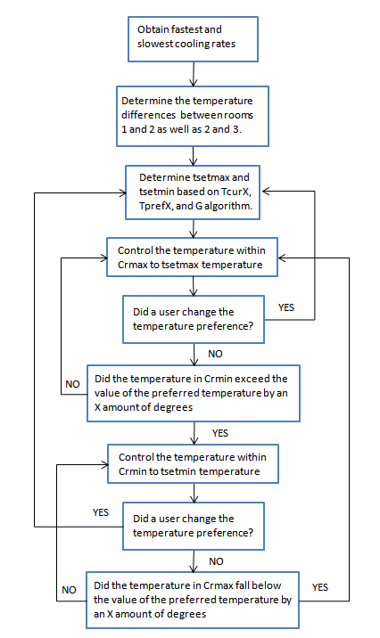
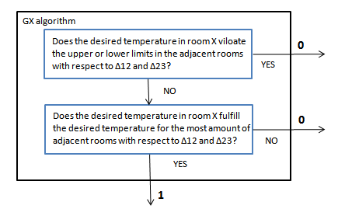

Slide 53
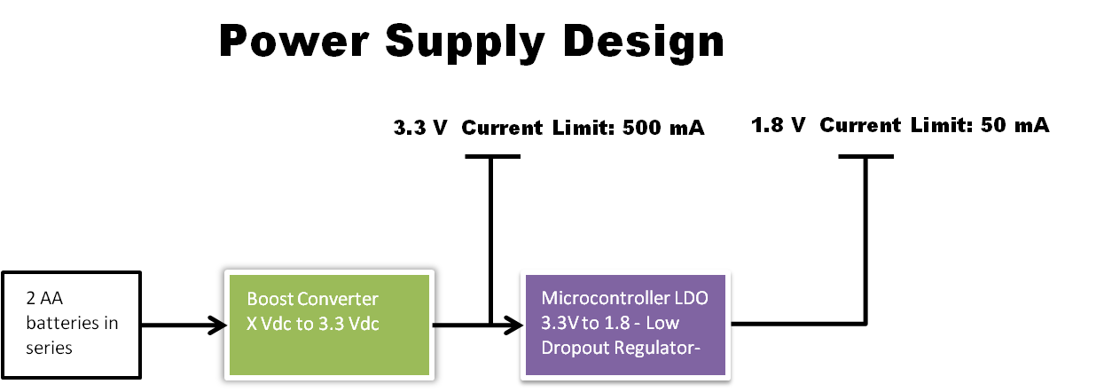
Power Supply

