Slide 1

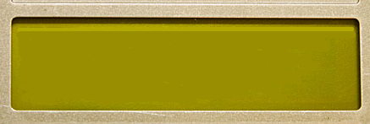
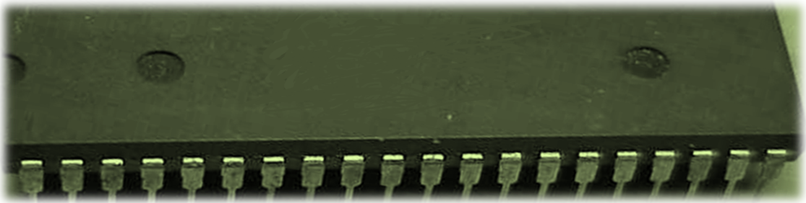
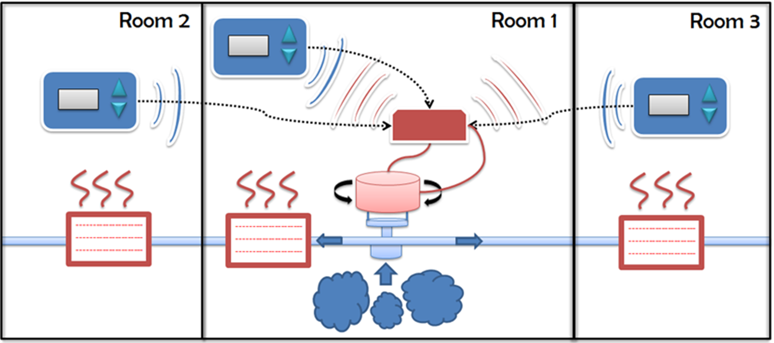
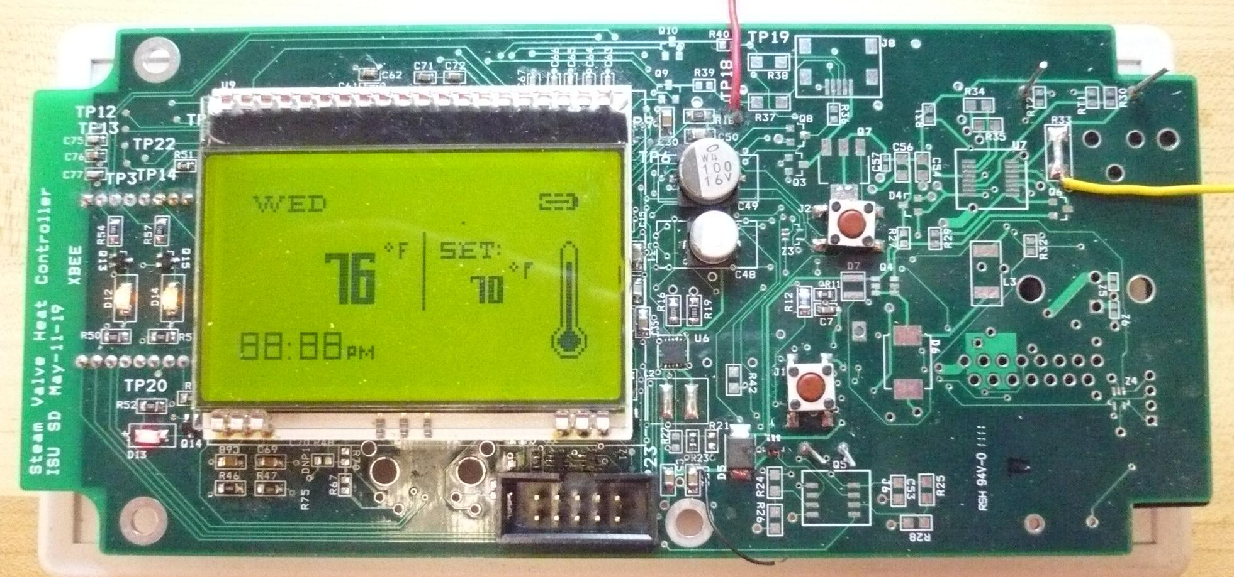
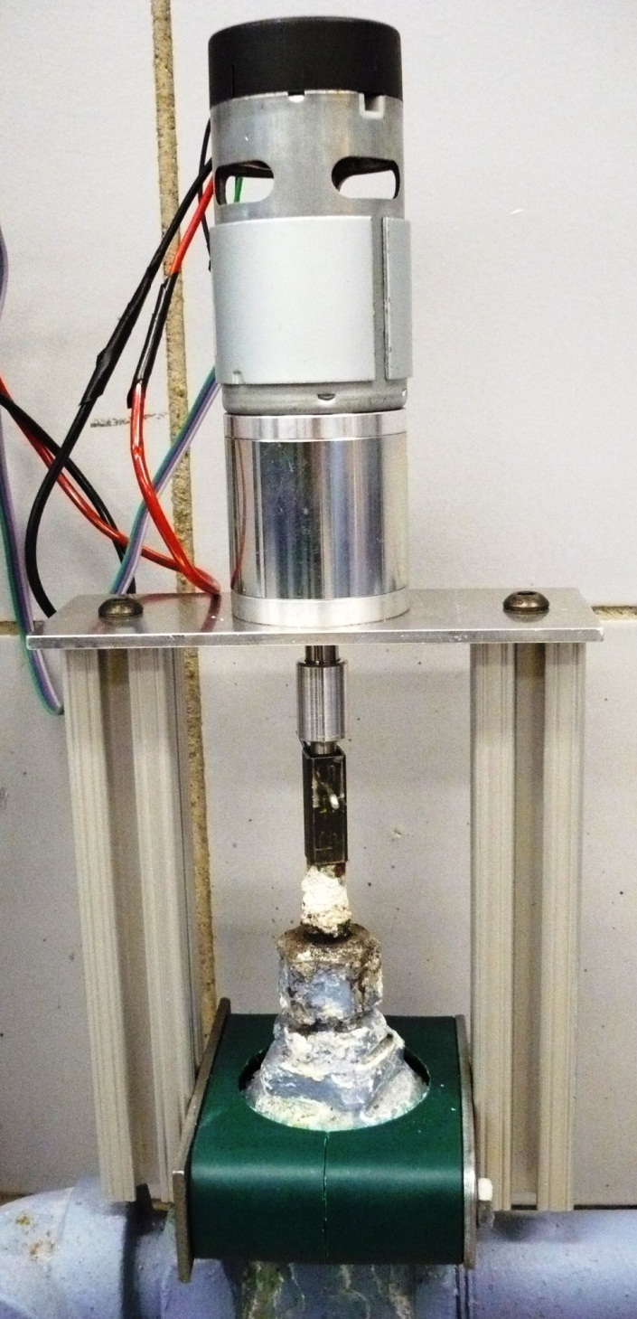
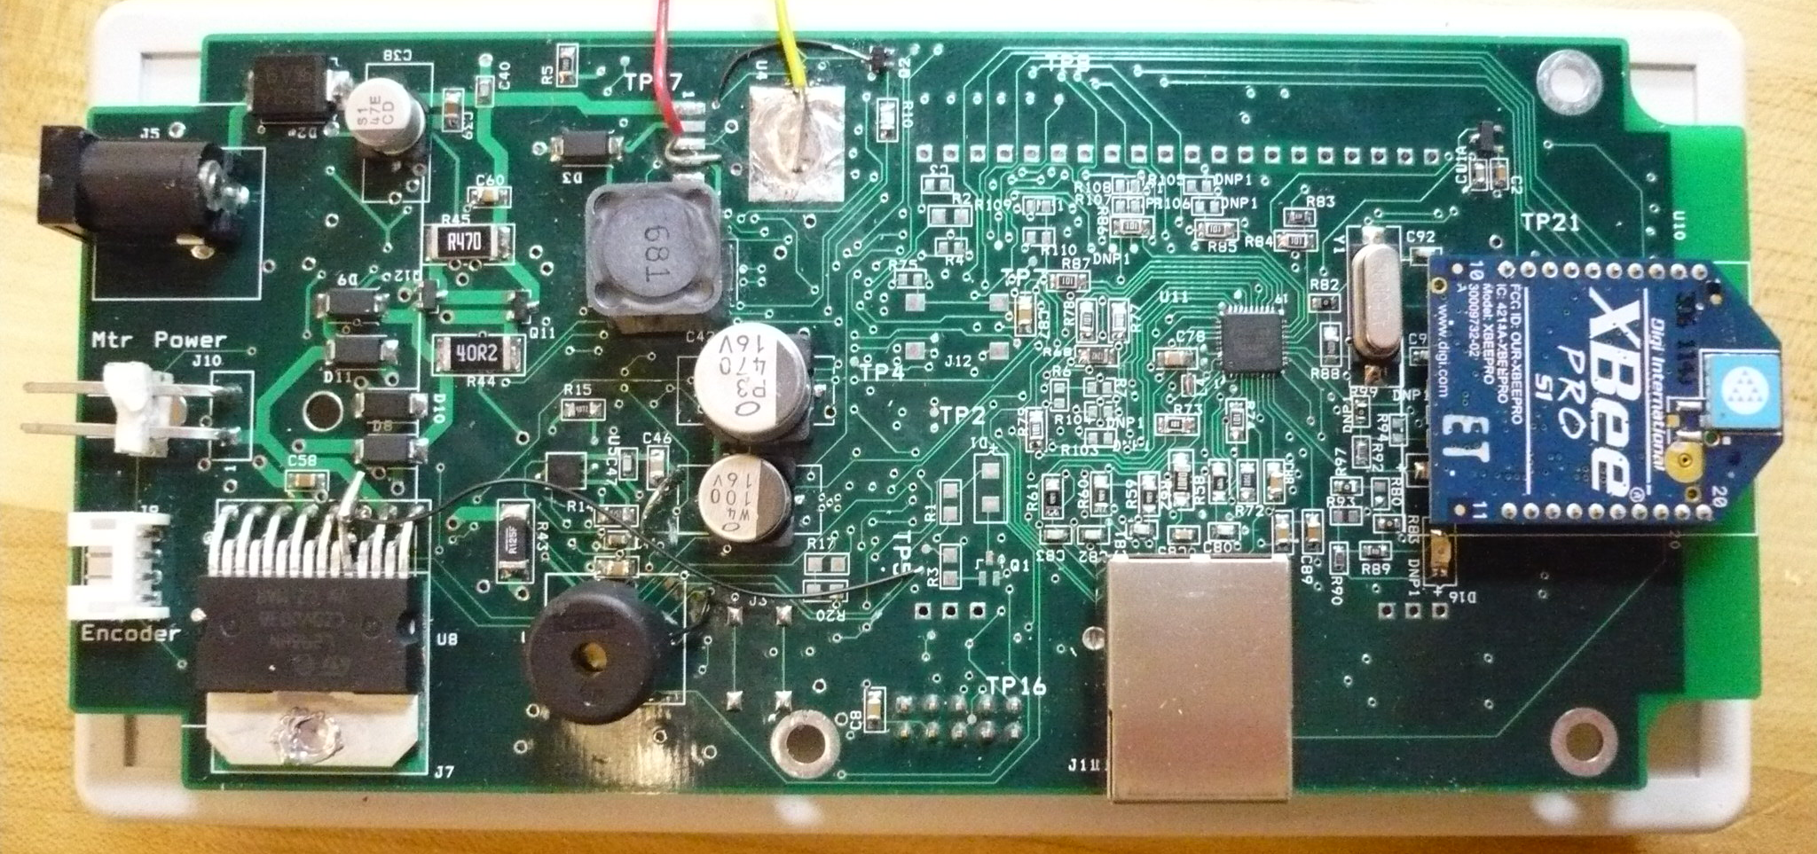
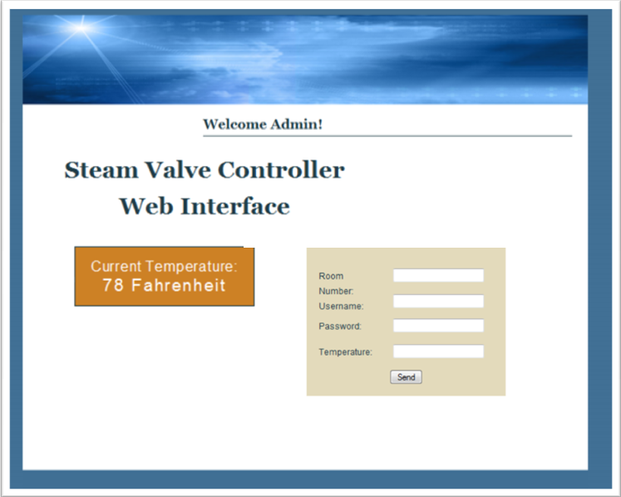
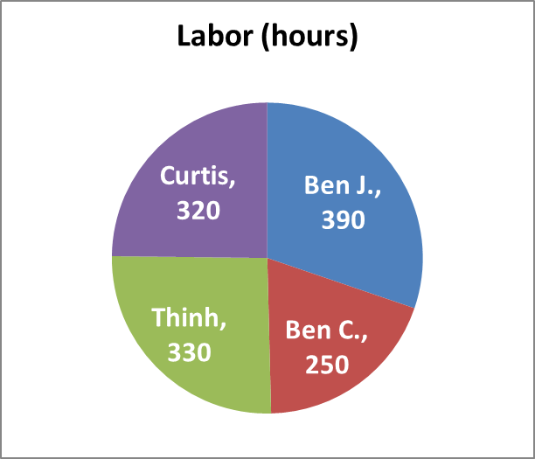

Faculty
Advisors:
Jason Boyd,
Lee Harker
Steam Heat Controller
Team 19: Ben Jusufovic, Ben Cao, Thinh Luong, Curtis Mayberry
Client:
Iowa State
University
Introduction
Requirements
Abstract
The team was asked to provide a temperature control system for steam heated rooms in Coover Hall. The system requires a user-friendly interface for each room and a steam valve controller unit that will accommodate the users’ temperature preferences. The system is designed to save on energy costs and allows for system management.
Problem Statement
One steam valve controls the temperatures of up to five different rooms.
Issues:
Temperature offset in different rooms
Difficulties adjusting temperature for different rooms
High energy consumption and costs
Functional
Effectively control the room temperature
Incorporate multiple users’ preferences
Removable mechanical system
Website interface
Constraints
Minimum alteration to existing infrastructure
Long heating time constant
User rationality
Non-Functional
Large and graphical LCD
Large rubber base push buttons
Neutral color product enclosure
Compact control panel
Deliverables
One Controller Box
Three Control Panels
Documentation
Implementation
Control Panel
Control Panel
Microcontroller
Wireless Transceiver
LCD Display
Power Supply
Buzzer
Push Buttons
Temperature Sensor
Recharging Circuitry
Controller Box
Microcontroller
Wireless Transceiver
Ethernet Module
Power Supply
Buzzer
Gear Motor System
Gear Motor
Shaft Encoder
Motor Driver IC
Controller Box
Website Interface
Access Levels
Displays Current Temp
Remotely Set Temp
Data Collections
Testing
System
Power Supplies
Microcontroller
Wireless Transceiver
Temperature Sensor
Gear Motor
LCD Display
Functional
Basic Functionality
Temp Control Functionality
Wireless Communication Range
Limitation Testing
Monitored Extended Use
Conclusion
Budget
The team was able to successfully implement and test the two unit system: the control panel and controller box. The control panel consists of a wall mountable unit similar to a thermostat. It accepts temperature values from users and measures room temperature. The controller box will be situated next to the steam valve and appropriately adjusts heat output.
Possible improvements include completion of the recharging circuitry, and the Ethernet connection for the steam valve controller. Additional testing under various seasonal and environmental conditions is recommended.

