Slide 1
Senior Design: Steam Heat Controller
Team Members: Curtis Mayberry, Ben Cao,
Thinh Luong, Ben Jusufovic
Advisors: Lee Harker, Jason Boyd

Slide 2
Overview
Project Goals & Concept Diagram
System Decomposition
Subsystems
Test Plan
Current Status

Slide 3
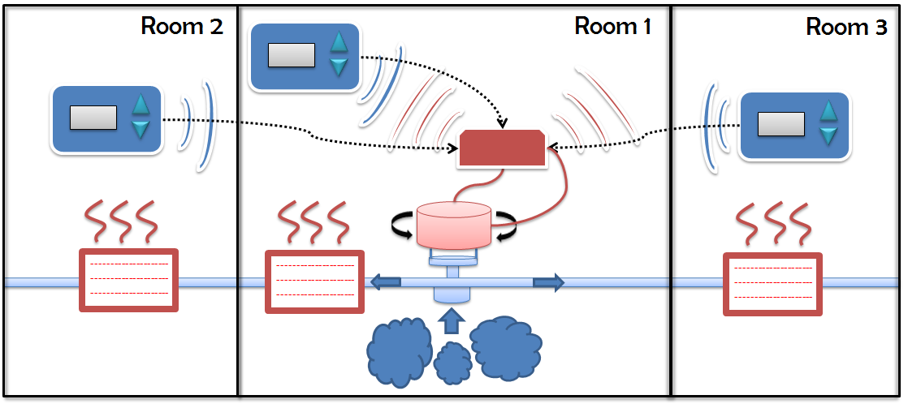
Project Goal
The goal of our project is to provide a user interface that will allow individuals to set a desired temperature within multiple rooms without ambiguity and a heat valve controller unit that will accommodate the desired temperature. Our project will also provide remote system access to Facilities Planning and Management in order to save on energy costs and system management.

Slide 4
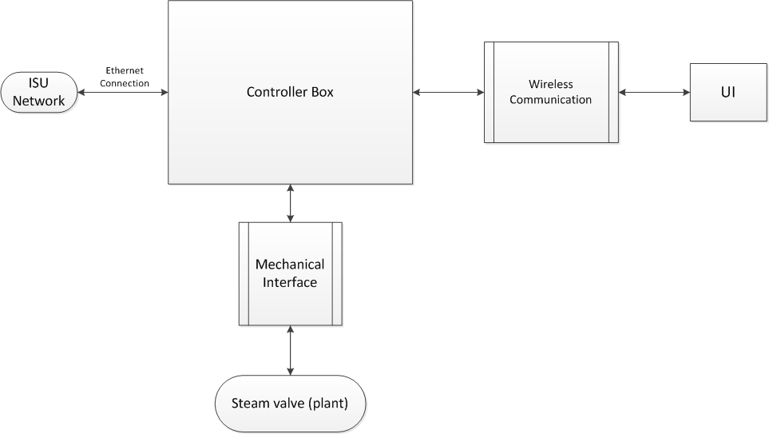
System Decomposition

Slide 5
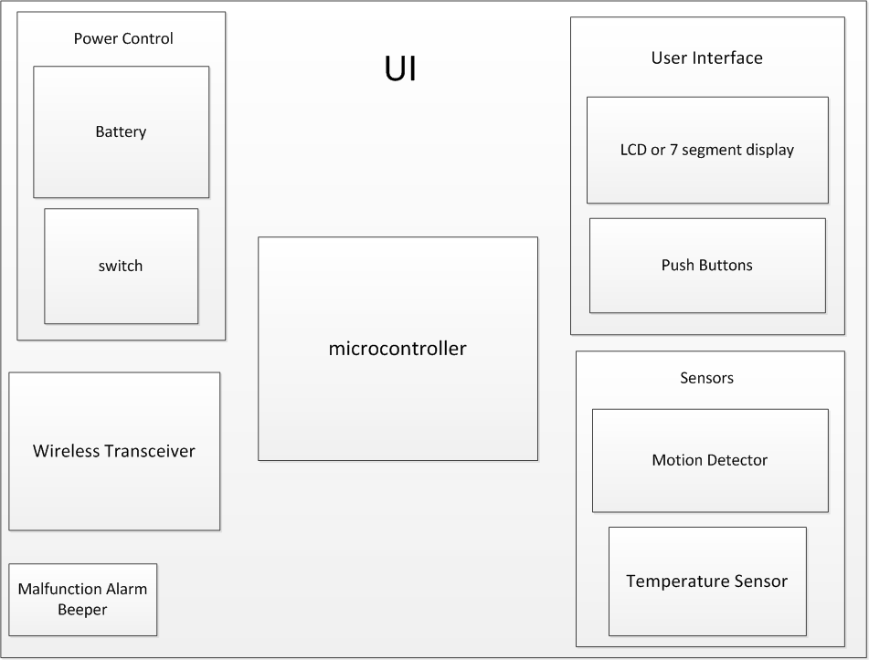
User Interface

Slide 6
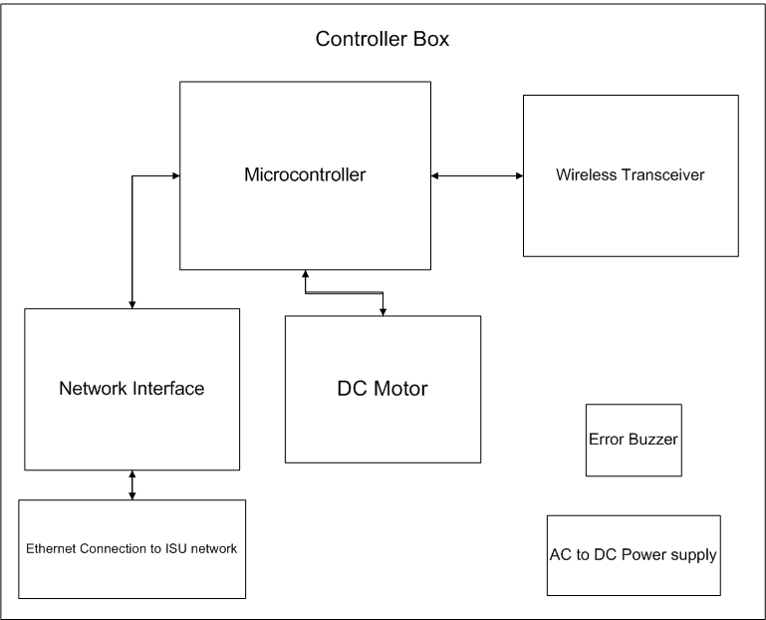
Controller Box

Slide 7
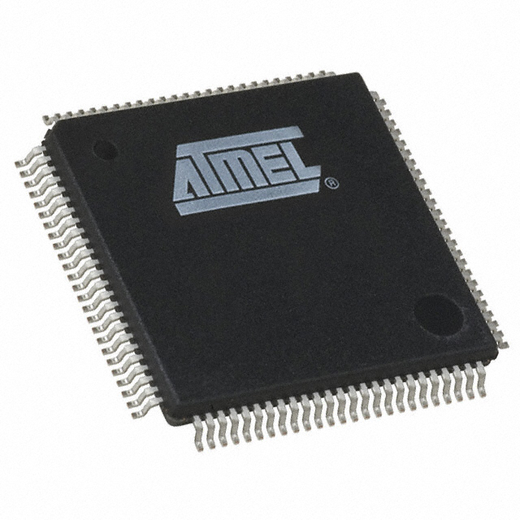
Microcontroller
Atmel 32-Bit AT32UC3A0128
144 pin LQFP and BGA
128 Kbytes Flash
32 Kbytes
Ethernet MAC support

Slide 8
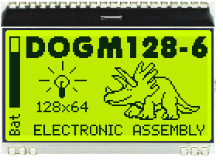
LCD - Liquid Crystal Display
Graphic Display
STN - Super Twisted Nematic
SPI - Serial Peripheral Interface
Operating Temp: -20 C to 70 C
55 mm x 46 mm

Slide 9
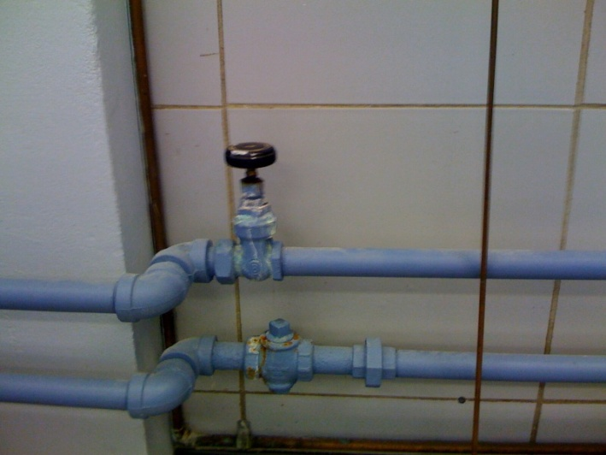
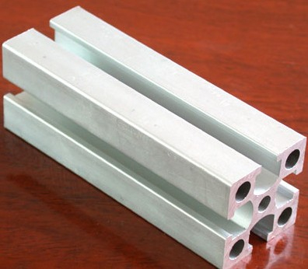
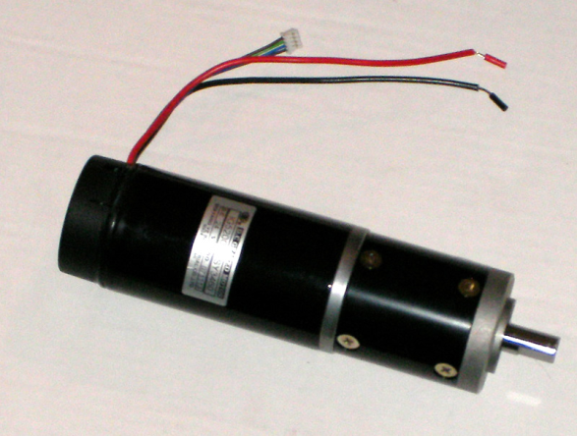
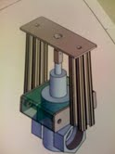
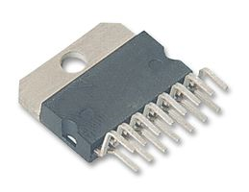
Subsystem: Mechanical
Extruded Aluminum
IG52 Gearmotor
L298N Motor Driver
Notes:
Photo references:
http://cpc.farnell.com/1/1/19192-dual-full-bridge-driver-4a-op-l298n-stmicroelectronics.html
http://detail.en.china.cn/provide/detail,1065484460.html
http://www.superdroidrobots.com/shop/item.aspx?itemid=937

Slide 10
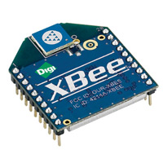
Wireless Communication
IEEE 802.15.4 Standard OEM module
Xbee module
Extended range (high power)
Serial interface

Slide 11
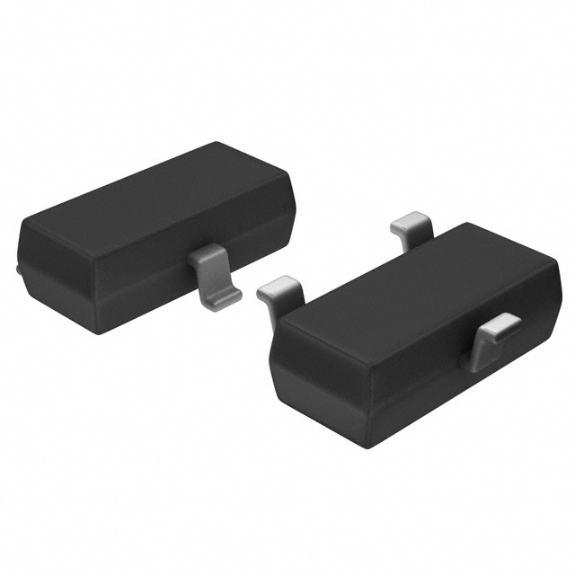
Temperature Sensor
Microchip TC1046
Supply Voltage Range: 2.7V to 4.4V
Wide Temperature Measurement Range:
-40oC to +125οC
Linear output temperature sensor
Small 3-Pin SOT-23B Package

Slide 12
Functional Test Plan
Valve calibration
Range Test
Response Test
Equalization and weighting Test
Environmental and extreme Tests
Monitored extended use testing

Slide 13
Software Test Plan
Component Testing
Microcontroller
Temperature Sensor
LCD
Wireless transceiver
Networking
Comprehensive systems

Slide 14
Hardware Test Plan
Power
DC Motor
Microprocessor
LCD
Unit casings
Temperature sensor
Push Buttons

Slide 15
Current Status

Slide 16
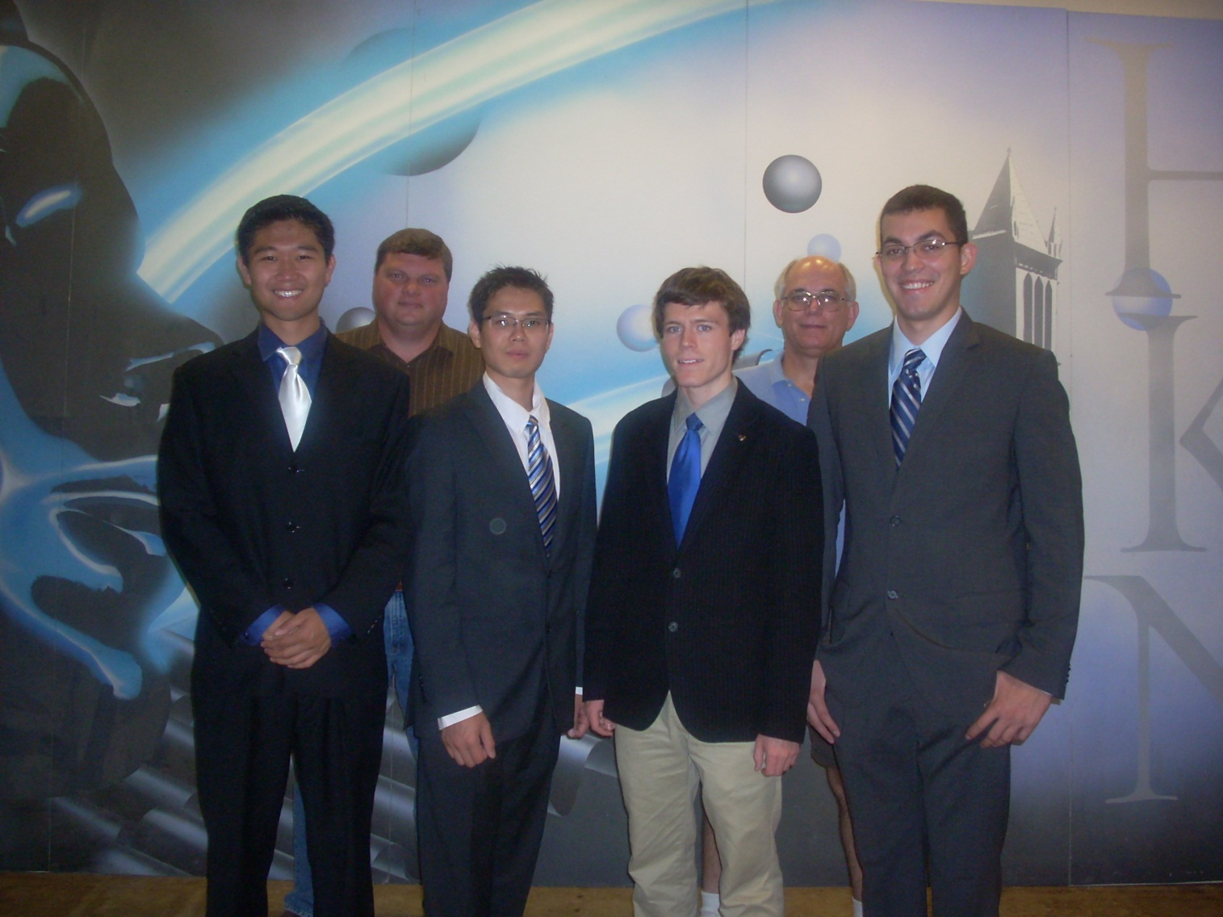
Questions?

