Slide 1
An Introduction to Python
22 August 2019 – ??

Slide 2

Introduction to Programming
Programming is critical to this course because in order to practice the methods we’ll be learning about, we have to have some way to do so
Python will be used in particular because it is relatively simple and is highly extensible (it also has a huge following, so there are many tools available which are perfect for data science & machine learning)
Given our situation, we will assume no prior knowledge of programming or Python
If you ARE familiar w/ programming & Python, please bear with us for these first few lectures

Slide 3
What is Programming?
Our way of telling a computer what to do
This is difficult because we speak different languages: machine code (or, a little more readable, assembly code) v. English
Programming languages are developed to be human-readable (even if it doesn’t always seem so) and to be translated into machine code for execution
Translations are done by computer programs called compilers
Why not just use English?
Designed to make programs human readable but also efficient to write. . . w/ logic in mind

Slide 4
What is Programming?
Like written & spoken languages, programming languages have different rules for “words” and “grammar” or, what we call syntax
Logic is the foundation of programming, but. . .
. . . while many of you may be familiar w/ MATLAB or C, their syntax differs from and therefore cannot be interchanged with Python
This syntax (which the compiler translates) includes definitions for tasks like addition, multiplication, file writing, picture generation, data extraction, matrix manipulation, etc.

Slide 5
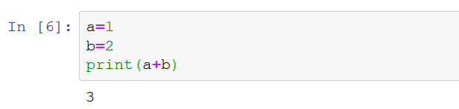
What is Programming?
Write code in Jupyter, then hit shift + enter to run
For example, take the following basic code:
What did we do?
We created two OBJECTS which are stored in the computer’s memory in this case as integers (don’t worry about where)
We bound those two objects to two REFERENCES (or VARIABLES)
We added the two objects and printed out the result

Slide 6
What is Programming?
Write code in Jupyter, then hit shift + enter to run
For example, take the following basic code:
But if we think about it, some questions arise:
How did the computer know 1 and 2 are integers?
How did the computer know to add the integers?
What did print() do?
When did our code get translated?
Notes:
Side note: Going to try to label Python functions in bold purple.

Slide 7
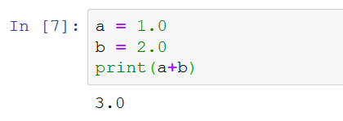
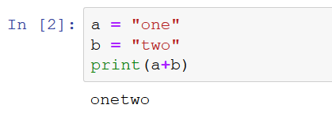
It’s the Language!
In Python the plus sign (+) means “add”, though the exact definition depends on the type of object
Adding INTEGERS (values w/o decimals) yields an integer
Adding FLOATS (values w/ decimals) yields a float
Adding STRINGS (literal translations) yields a string
In Python, print() is a built-in function
A group of statements which execute upon request
Modern languages (like Python) contain certain functions known to be commonly used by programmers
More functions can be introduced by importing MODULES (more on that later)

Slide 8
It’s the Language!
Many languages require a step between writing and running called compiling. . .
. . . where written code is translated to machine code for execution
Another reason Python is so useful is its use of an interpreter which handles this behind the scenes
A programming language is the set of rules and definitions which organize all the tools which allow the programmer to bend the computer to her will

Slide 9
Python Basics: Objects
Objects are values stored in memory
Python is an object-oriented language, which means it is built on using objects
1 & 2 are objects in this simple example
Objects can take many forms, what we call TYPES

Slide 10
Python Basics: Object Types
Some common types (which can be used for explicit typing):
int() – INTEGERS are numbers w/o decimals (1, 0, 9000)
float() – FLOATS are numbers w/ decimals (1.0, 3.1415926, 8.3333)
str() – STRINGS are words or sentences meant to be taken literally (“10”, “five”, “hello world!”). . . Python considers any terms b/w “” or ‘’ strings
complex() – COMPLEX NUMBERS which are understood by Python as a+bJ where a, b can be either integers or floats (1-3J, 0.5+1.2J)
bool() – BOOLEANS are objects which can only take one of two values (True and False). While you can use boolean objects, these are often running behind the scenes to evaluate certain statements (more on that later)
You can determine type in Python using the built-in type() function

Slide 11
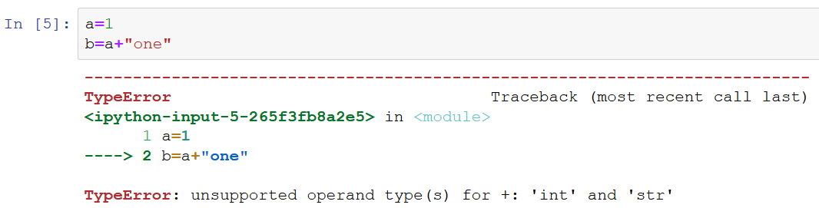
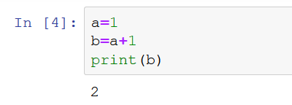
Python Basics: Dynamic Typing
Python uses dynamic typing, meaning it knows the type of your object based on the syntax
E.g. it knows 1 is an integer b/c you didn’t include any decimals or quotes
Otherwise, you’d have to explicitly specify the type of each object as you go
Python also uses what is called strong typing, meaning the types of objects stay fixed unless the user explicitly changes them
This is important b/c it means Python will scream TypeError! if you attempt to execute code where the types don’t make sense

Slide 12
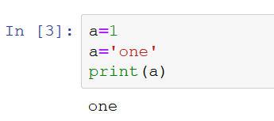
Python Basics: Variables
VARIABLES (or REFERENCES) are those values which refer to an object
So in this case a and b are variables which refer to the objects 1 and 2
Variables are bound to objects in chronological order
So you must be careful assigning them

Slide 13
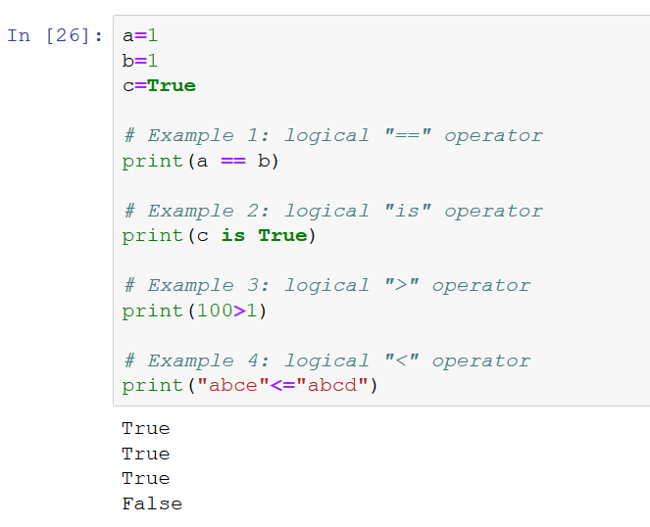
Python Basics: Operators
Operators are built-in tools which operate on objects
The most basic being those performing ARITHMETIC
+ for addition & - for subtraction
* for multiplication & / for division
** for exponential
But another useful set of operators are those performing LOGIC
<, >, <=, >= are self explanatory
==, != are “equal” and “not equal”
is, is not, in, not in test identity and membership
Check here for a list of common operators
Wut?
Notes:
What types of outputs are these?

Slide 14
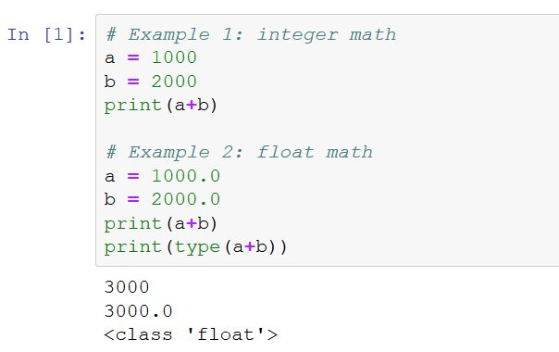
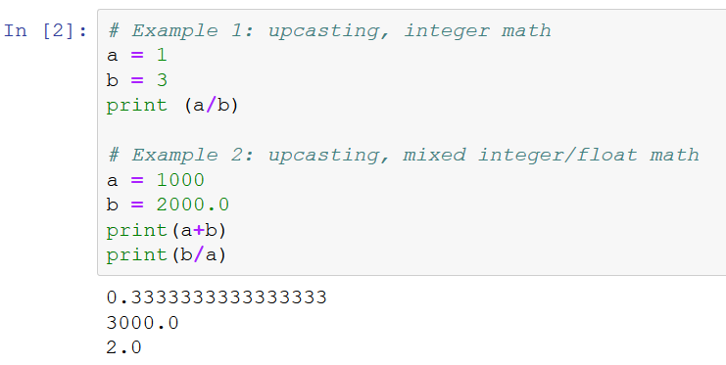
Python Basics: Upcasting
When types match the result of performing some operation yields an object of the same type
In some cases, however, Python has to change the type of the resulting object in order to perform the given task
This is called UPCASTING

Slide 15
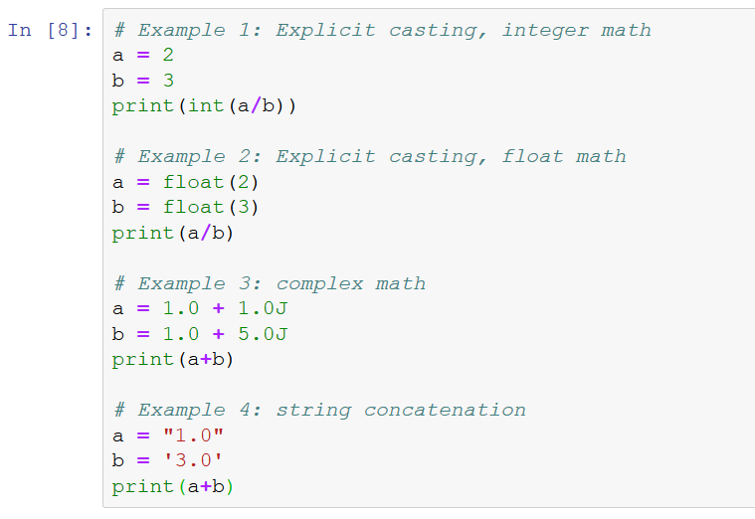
Python Basics: Examples 1
Important to be cognizant of your typing as you write
TOL: What type will the results be?
0. . . Why?
0.6666666666
(2+6j)
1.03.0. . . Why?
Notes:
TOL = “thinking out loud”

Slide 16
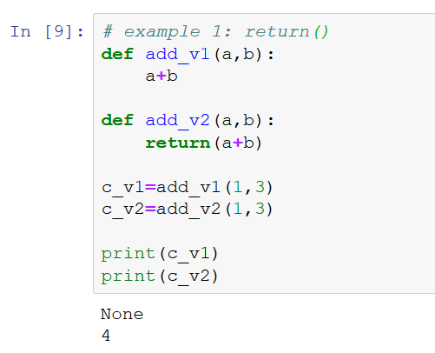
Python Basics: Functions
A FUNCTION is a special object in Python which transforms objects
Functions generally RETURN a new object
Convention is to use function w/ parentheses
We’ve already discussed one built-in function. . . print()
But there are many more. . .
int(), float(), str() all convert inputs (in parentheses) to objects of specific type
min(), max() finds the minimum/maximum value in a set
You can also create your own function using def()
If you want to return an object (or a few), close your def() statement w/ return()
Addition as part of function
Function returns addition
Notes:
Definitely encourage you to check out the myriad different built-in functions and explore creating your own function.

Slide 17
Python Basics: Indenting
Start definition of function 1 (f1)
Part of f1
Initiate subroutine
How does Python know you finished defining your function?
Most languages require a “start” word and a “finish” word
Python simplifies this by recognizing indention
Indenting indicates a line is part of a subroutine (block of code w/ assigned task)
Once code goes back to aligned, the subroutine (or block) is complete
Initiated using a colon (:)
f1 complete
Notes:
A subroutine is code w/i a program which performs a particular task.

Slide 18
Python Basics: Namespaces
In defining our functions add_v1() & add_v2(), how does Python distinguish b/w both sets of a & b?
def() creates a local, independent namespace (a container for organizing names with objects)
The global namespace includes all assigned variables
Care must be taken to avoid issues caused by redundancy (especially when importing modules. . . more on this later)

Slide 19
Data Structures
Inevitably (& especially in data science), using individual objects of the types discussed so far (int, float, str. . .) becomes cumbersome
Data structures are organized collections of objects
Akin to the relationship b/w scalars & vectors or matrices, etc.
Python contains many useful built-in data structures (lists, tuples, sets, dictionaries)
Others can be imported (<– don’t worry about this yet) from other packages
Notes:
EXAMPLES!

Slide 20
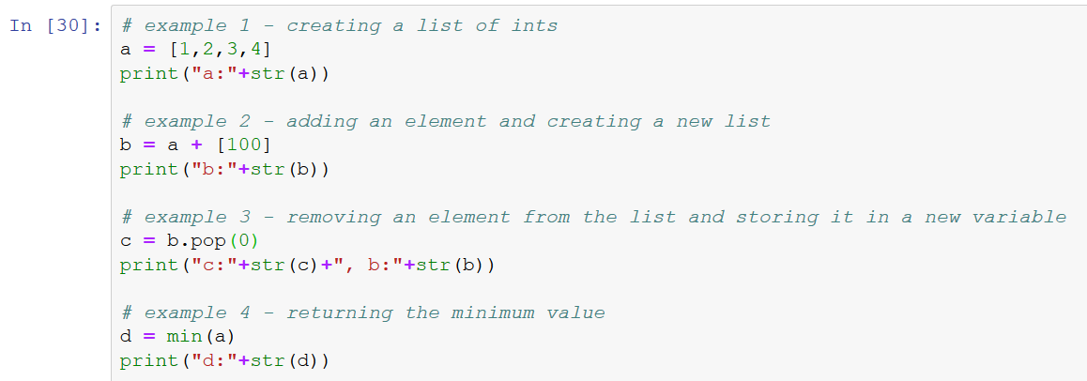
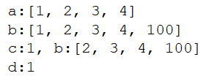
Built-in Data Structures: Lists
Lists are structures that store ORDERED data
They are MUTABLE (you can change them w/o creating a whole new list)
Created using brackets [ ]
They have built-in METHODS which act as object-associated functions

Slide 21
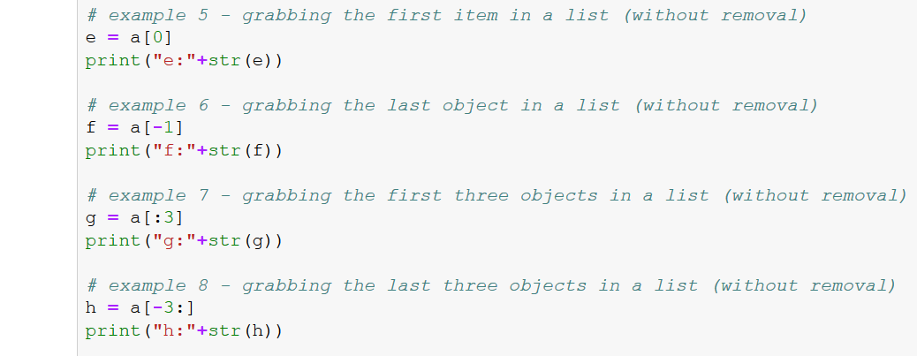
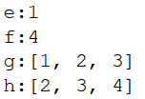
Built-in Data Structures: Lists
Lists are structures that store ORDERED data
They are MUTABLE (you can change them w/o creating a whole new list)
Created using brackets [ ]
They have built-in METHODS which act as object-associated functions
Indexing begins w/ 0

Slide 22
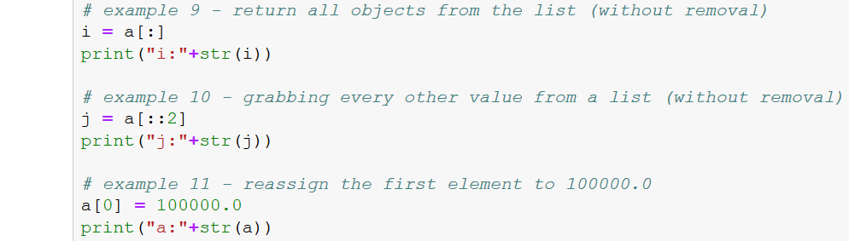

Built-in Data Structures: Lists
Lists are structures that store ORDERED data
They are MUTABLE (you can change them w/o creating a whole new list)
Created using brackets [ ]
They have built-in METHODS which act as object-associated functions
In exs.7-10 we are “slicing” w/ a colon (list[start:stop:step])
Notes:
Slicing actually a pretty important concept. . . Programmers use it often. It is a term we use for extracting objects from a list (w/ replacement).

Slide 23
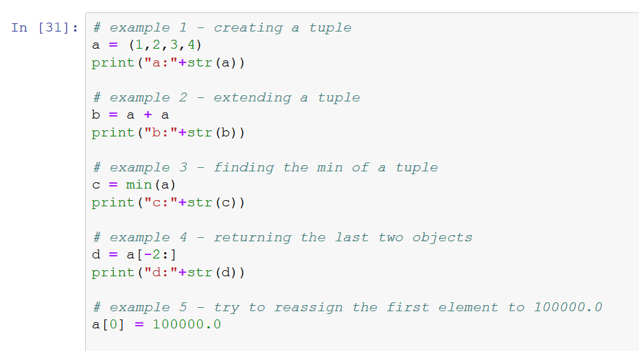
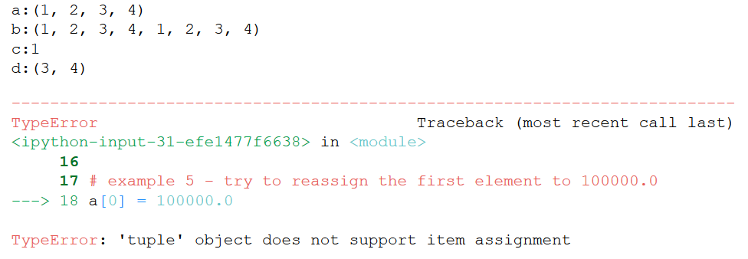
Built-in Data Structures: Tuples
Tuples are similar to lists, except:
They are IMMUTABLE (you cannot change them w/o creating a whole new list)
Created using parentheses ( )
They are usually used to group objects of different types
But. . . why?
Immutable objects can be useful in some circumstances (e.g. feature set)

Slide 24
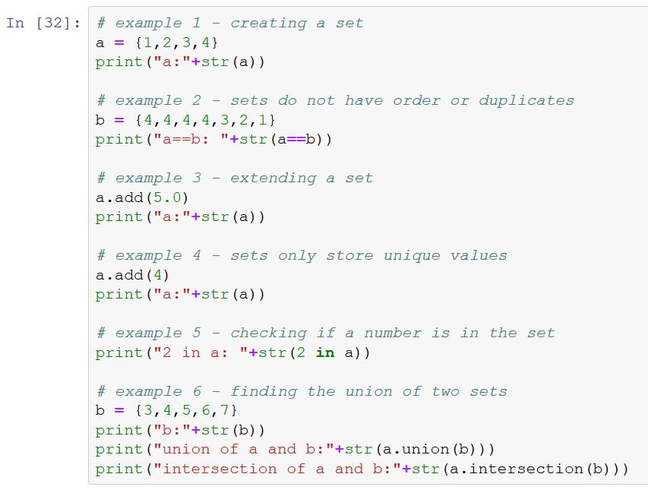
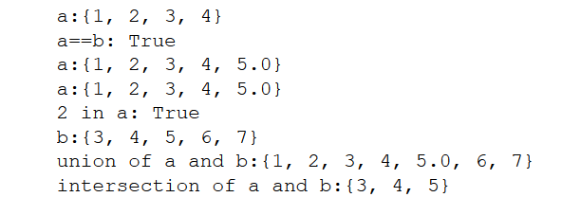
Built-in Data Structures: Sets
Sets are also like lists except:
They are UNORDERED
No duplicates allowed (which makes sense given there is no order)
Created using curly brackets { } or set()
They work kind of like the concept in set theory; efficient when checking membership or performing logic functions

Slide 25
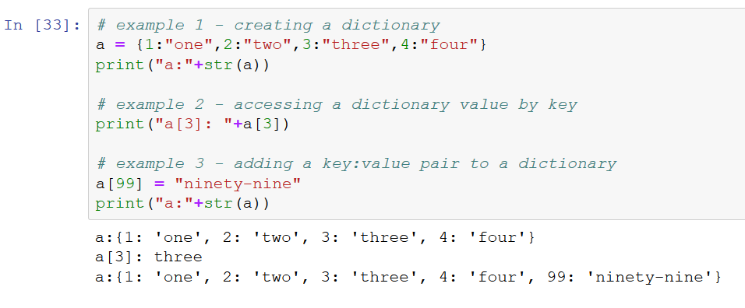
Built-in Data Structures: Dictionaries
Dictionaries are structures which store objects in pairs
Each pair consists of a KEY and a VALUE (like a phone book <– what’s that though, amirite!?)
This could be done instead using two matching lists, but dictionaries are advantageous b/c they store the keys as a set. . .
. . . they also allow you to call the value using the key (rather than slicing)
Since the keys are formed as a set, there can be no duplicates
Also created using curly brackets, but the notation is more complicated:
dict = { key1 : value1, key2 : value2, . . . }
Keys & values can any basic data type; values can be structures too

Slide 26
HW #1 Coming Soon!

