Slide 1
Version Control
Improving reproducibility in data science

Slide 2
The Meaning of Reproducibility
Project structure
Clear organization of analytic components
Version control
Controlled tracking of changes over time
Ability to update & iterate while maintaining functioning code
Coding standards
Commenting
Simplification
Modularity
Documentation
Providing context to code, both within code (e.g., commenting) and via external documents (e.g., README.md)
Virtual environments
Enables reproducibility across multiple machines post-distribution
Code testing
Small, modular testing of segments of code combined w/ large testing upon modification

Slide 3
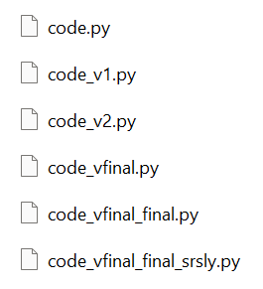
The Importance of Version Control
Prevents programmer from losing track of what’s what
Multiple versions of code
Multiple “final” versions of code
Enables updates without breaking functioning code
Enables reversion to older iterations, just in case
Documents the history of changes made for tracking purposes
Significantly improves collaboration amongst teams writing programs
Though the workflow can be difficult to pick up
Enables simpler & more effective dissemination
Point people to your GitHub to share code

