Slide 1
Version Control
Improving reproducibility in data science

Slide 2
The Meaning of Reproducibility
Project structure
Clear organization of analytic components
Version control
Controlled tracking of changes over time
Ability to update & iterate while maintaining functioning code
Coding standards
Commenting
Simplification
Modularity
Documentation
Providing context to code, both within code (e.g., commenting) and via external documents (e.g., README.md)
Virtual environments
Enables reproducibility across multiple machines post-distribution
Code testing
Small, modular testing of segments of code combined w/ large testing upon modification
Notes:
We will cover some of these concepts today, primarily version control, but will come back to most later.

Slide 3
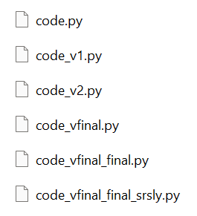
The Importance of Version Control
Prevents programmer from losing track of what’s what
Multiple versions of code
Multiple “final” versions of code
Enables updates without breaking functioning code
Enables reversion to older iterations, just in case
Documents the history of changes made for tracking purposes
Significantly improves collaboration amongst teams writing programs
Though the workflow can be difficult to pick up
Enables simpler & more effective dissemination
Point people to your GitHub to share code

Slide 4

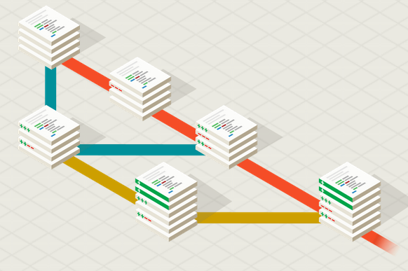
Introduction to Git
Most widely-used version control system
Completely open-source system developed by Linus Torvalds (who also created Linux) in 2005
What does Git do?
Manage coding projects using repositories
Controls & tracks changing w/ staging & committing
Enables code revision & updates w/o the risk of breaking code by branching & merging
Provides a local working copy via cloning (not like working on a Google doc, for example)
Sources: https://git-scm.com/, https://www.w3schools.com/git/git_intro.asp?remote=github

Slide 5
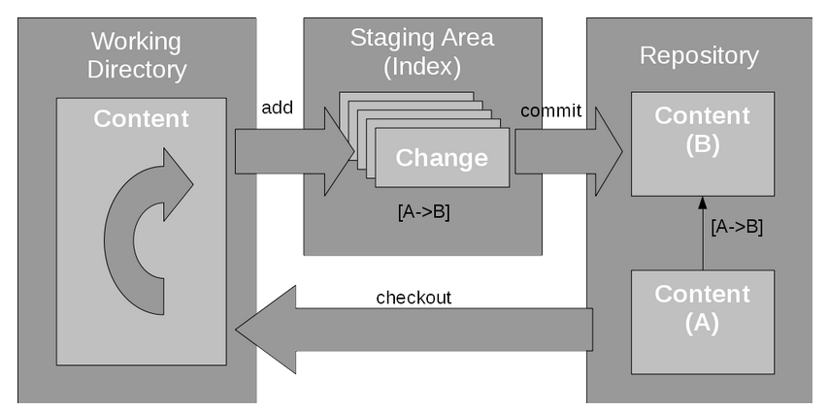
…but how does Git work?
Three primary components:
Working directory – Where changes are made
Staging area – Where changes are indexed (accounted for) & prepared for application
Repository – Where changes are applied
It’s all hidden in the .git directory…
objects/ stores snapshot (“commit”) metadata
refs/ points to commits
/index stores pointers to commits (e.g., branches)
/HEAD points to current branch
Sources: https://developer.ibm.com/tutorials/d-learn-workings-git/

Slide 6



Git or GitHub?
GitHub is a centralized, online hub for hosting & managing projects using Git
In a sense, provides a visual representation of what Git does, which enables simpler hosting, collaborating, & sharing

Slide 7
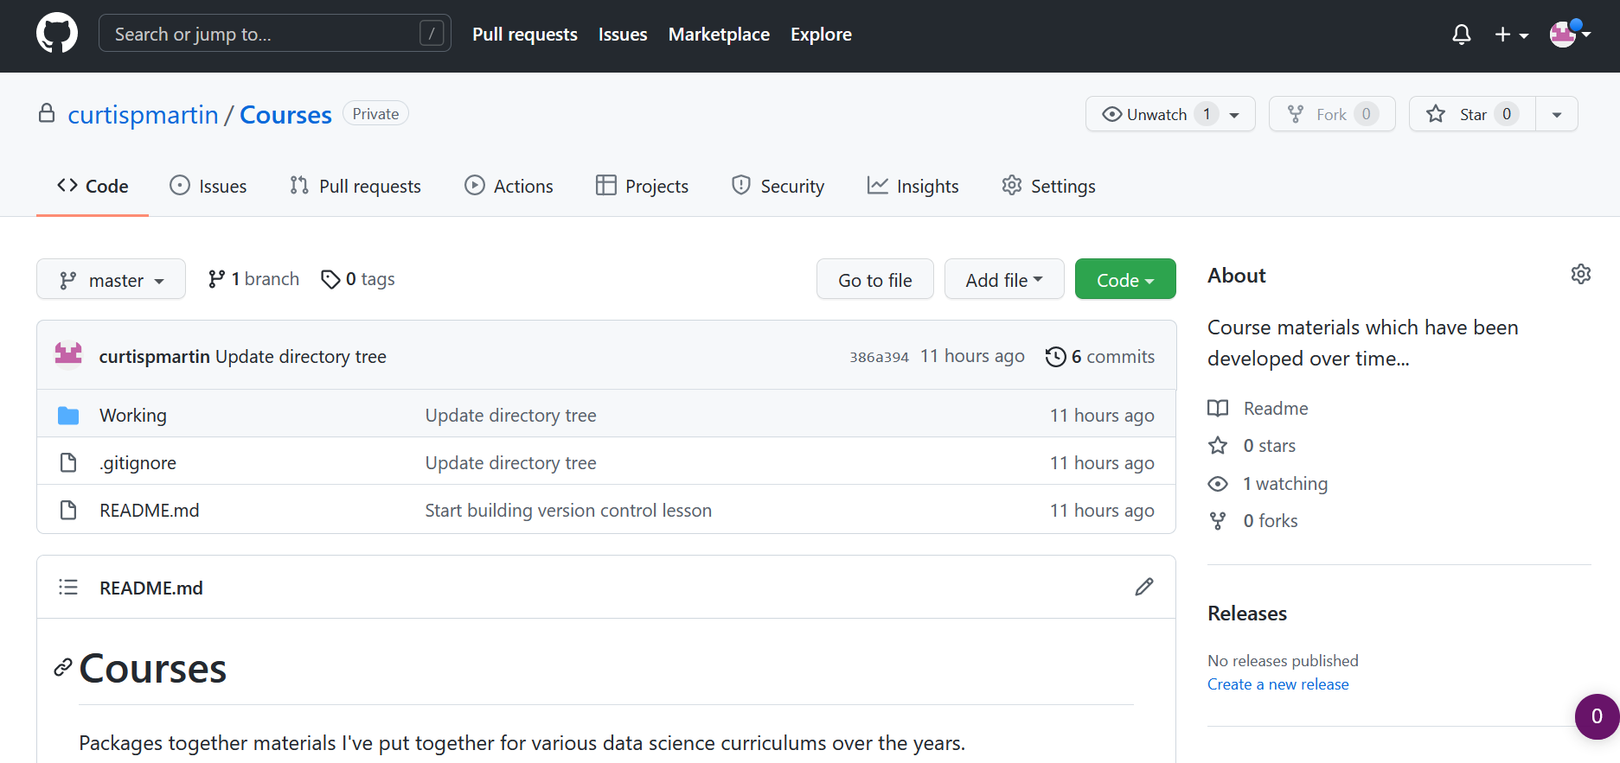
Git or GitHub?
Repo access type
Current repo – one per project
Current branch – master is default
Code & related information in current branch

Slide 8
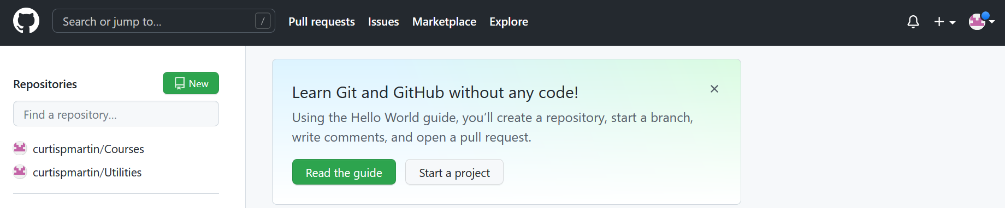
Setting up Git/Hub
First things first: Download necessary software & create accounts
Git: Download Git for Windows here; download Git for Mac here?
GitHub: Create an account here
Create your first repo on GitHub
Call it “XXX XXX”
Click here to create new repo!

Slide 9
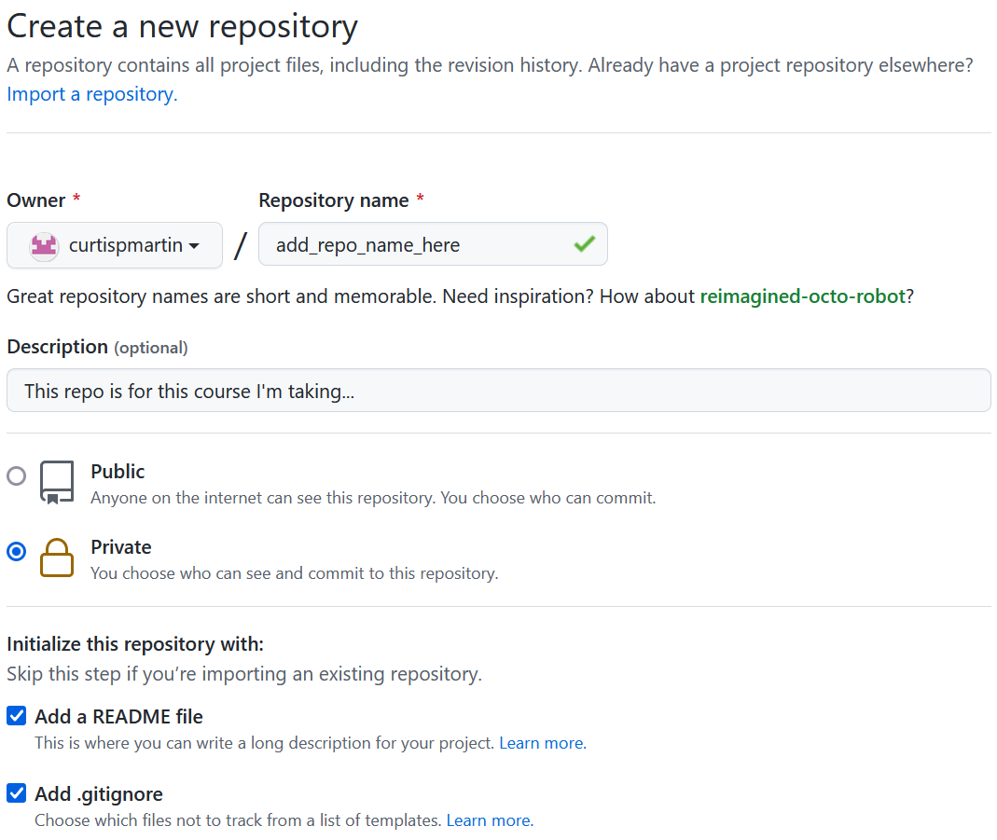
Name your repo
Make repo private for this course
This file will help you describe what the repo is for, as well as how it works
This file tells Git what types of files should not be added to staging/repo… Set “template” to Python

Slide 10
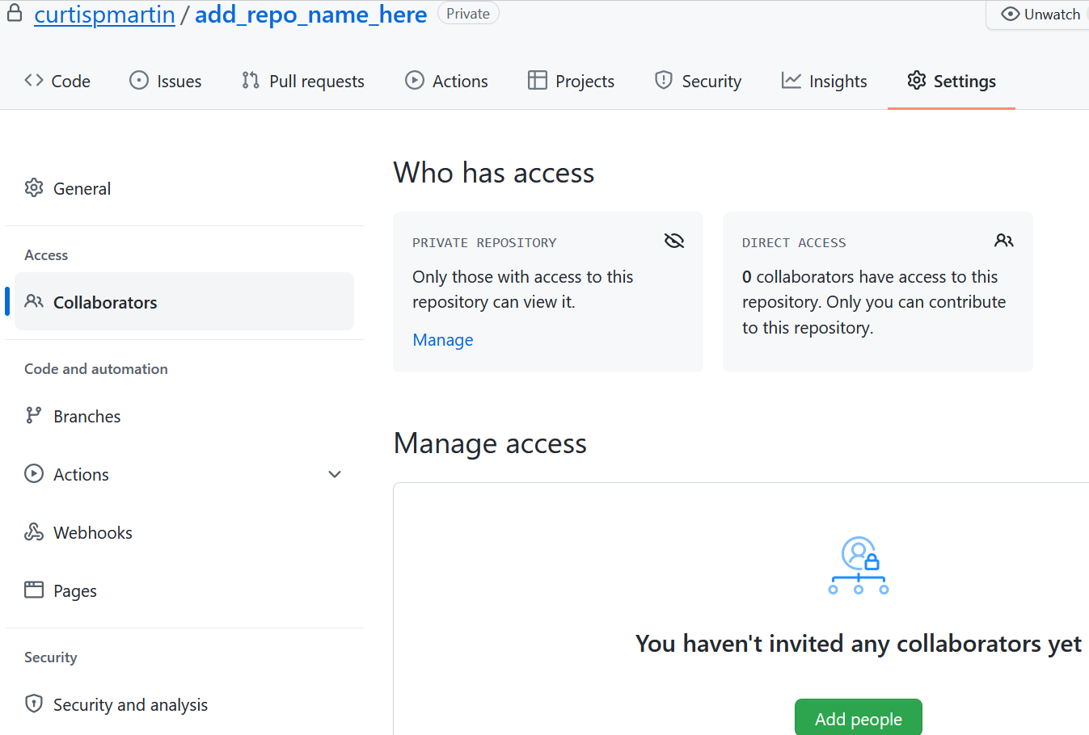
Go to Settings --> Collaborators & add me as a Collaborator

Slide 11
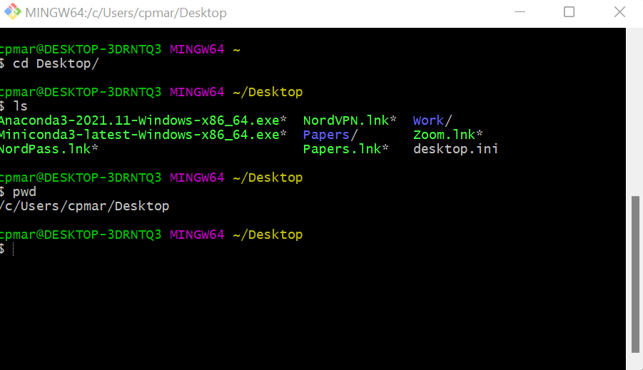
Setting up Git/Hub
Navigate to your Git bash… A few important commands are needed!
ls – List what’s in your current working directory (“CWD”)
cd <filepath> – Change CWD to that specified by filepath
mkdir <newdirectory> – Make new directory (folder) in CWD
pwd – Print path to CWD
mv <filename> <newfilepath> – Move file in CWD to new location
cp <filename> <newfilepath> – Copy file in CWD to new location
cat <filename> – Print out file contents in bash
touch <filename> – Create empty file w/ file name in CWD
You can find more commands here
Note: In this course, angle brackets (<>) indicate user input required

Slide 12
Connect Git to GitHub
Must authenticate Git client w/ your GitHub
SSH (recommended) – More on SSH here
HTTPS
Step 1: Create SSH key using Git bash
`ssh-keygen -t ed25519 -C <your_email_address>`
Accept default location for key
Enter & re-enter key passphrase for enhanced security
Step 2: Add SSH key to ssh-agent
`eval $(ssh-agent -s)`
`ssh-add ~/.ssh/id_ed25519`
Step 3: Add SSH key to Github account
`clip < ~/.ssh/id_ed25519.pub`
Log into Github
Go to settings > SSH and GPG keys
Click New SSH key
Paste into “Key” text box
Add “Title” (name of computer you’re using)
Click “Add SSH key”
Note: In general, backticks (`) indicate commands or lines of code

Slide 13
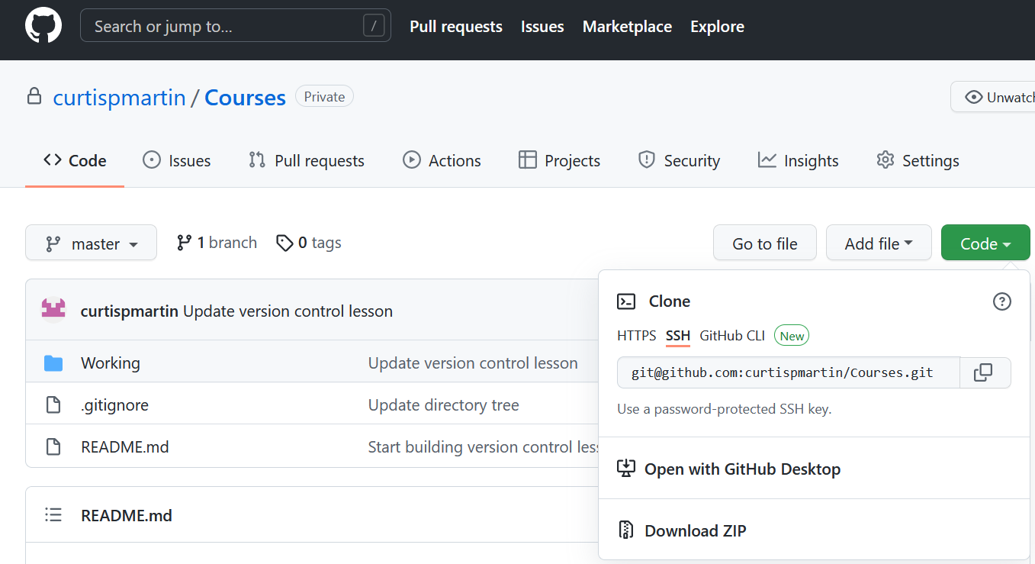
Cloning your Git Repo
Last thing before we start using Git: You need to clone your repo onto your computer
Makes a local copy of your repo so you can write/update/manage code
Step 1: Copy SSH link
In repo, go to Code > SSH
Step 2: Clone to location of choice
`cd <path_to_location>`
`git clone <SSH link>`

Slide 14
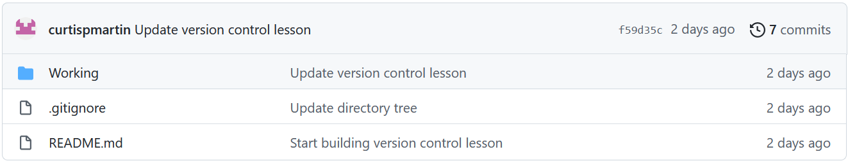
Git: Basic Workflow
Five basic commands to start:
`git status` – Gives you a status report for each file
`git add <filename>` – Adds file to staging… use `*` to add all files
`git commit -m <message>` – Commits changes in staging area; message should briefly summarize the point of the update
`git push` – Send commit to repo
`git pull` – Pull most recent commit from repo (only necessary for collaborative work)
Notes:
Do a live demo of the workflow using a dummy file.

Slide 15
Git: Branching
What is a branch?
Branches are essentially tracked copies of the master
Modifications in a branch aren’t incorporated into the master until explicitly merged
Why branching?
Allows you to modify code w/o the risk of breaking it
Simplifies (kinda) collaboration on projects
When to create a branch?
Developing a new feature
Making significant updates to current code
Merge branch
Master branch
Slave branch
Create branch
Sources: https://git-scm.com/book/en/v2/Git-Branching-Basic-Branching-and-Merging

Slide 16
Git: Branching
Step 1: Create the branch
Create new branch: `git checkout -b <branchname>`
Push branch to repo: `git push origin -u <branchname>`
Step 2: Do work in branch
Switch to branch: `git checkout <branchname>`
Make your updates; add, commit, push to repo as if nothing has changed
Step 3: Merge branch
Once feature/update is complete, checkout master: `git checkout master`
Then merge branch w/ master: `git merge <branchname>`
Delete branch using: `git branch -d <branchname>`
Push deletion to repo: `git push origin –d <branchname>`
Sources: https://git-scm.com/book/en/v2/Git-Branching-Basic-Branching-and-Merging
Notes:
Do a live demo of the workflow using a dummy file.

Slide 17



Preparing for Success
Directory structure
Create a system for organizing code & related files
Stick to it (but don’t be afraid to adapt)!
Highly dependent on the type of work you do
Internal documentation
Header detailing what the code does, inputs/outputs (I/O), etc.
Comments describing what blocks of code do
External documentation
“README.md” in Git repo – What is intent? How do files relate?
User manual – Not relevant here, but could be in future
CWD
CWD
Archive
HW1
Data
Data
Deliverables
Output
Output
script1.py
References
HW2
Utilities
Data
script1.py
Output
script2.py
Notes:
Will only really cover the “readme.md” file today – Will come back to many of these later in the course though.

Slide 18
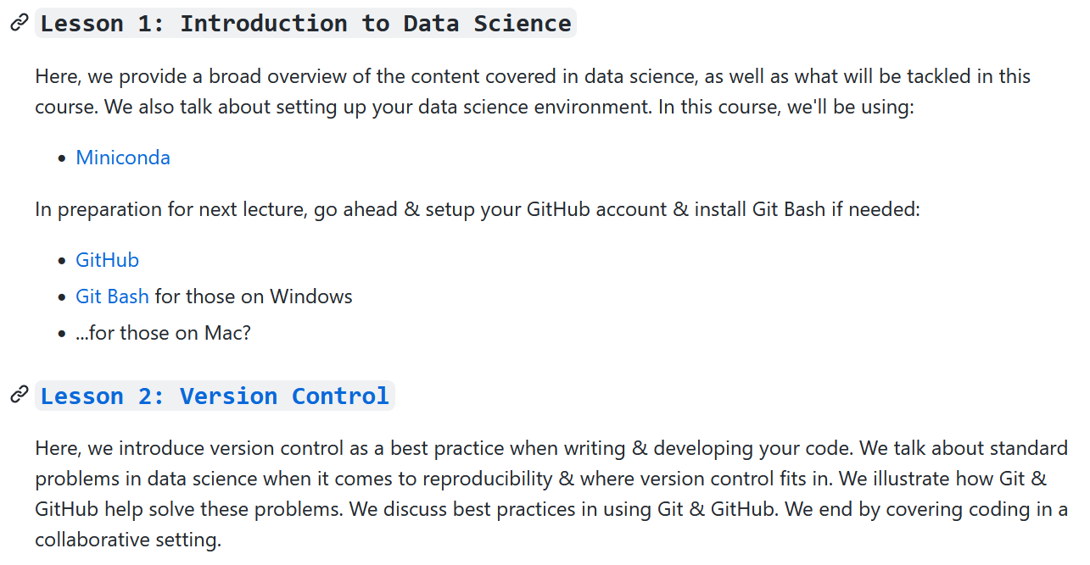
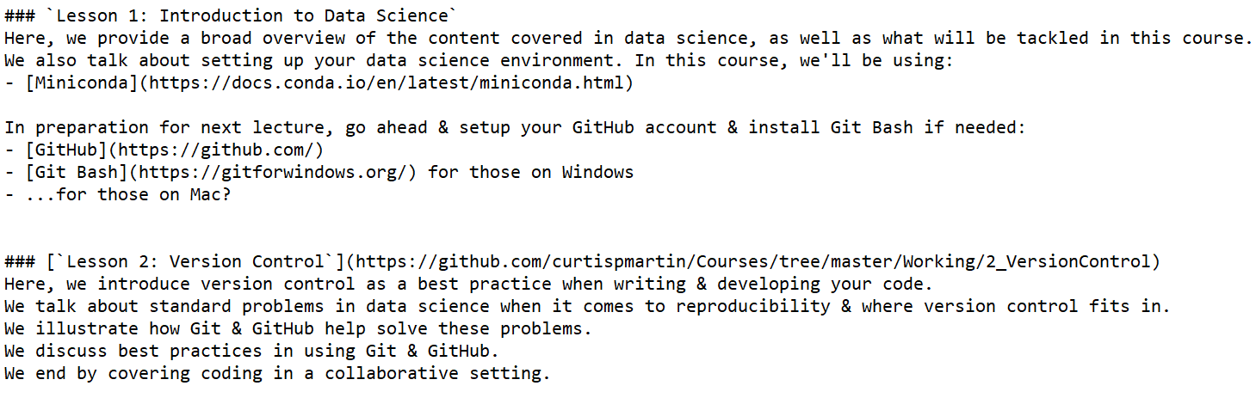
“README.md”
README files are found at top level of repo and inside each analysis folder
Markdown is used to create documentation
The simple things
Title headers are created at three levels using # (largest), ## (second largest), & ### (smallest)
Text not preceded by # will become body text
Asterisks or dashes to create bulleted lists
Inline code: `this will show up as code`

Slide 19
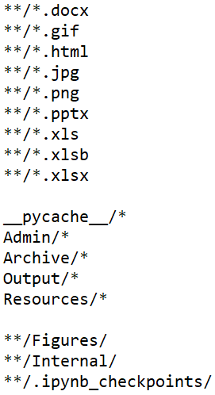
“.gitignore”
“.gitignore” file is how you tell repo what not to track
By default, repos track all files
Tend to want to ignore either specific file types… (**/*.<filetype>)
Data – .csv, .xlsx, .pkl, .Rdata, etc.
Output – .png, .jpg, .gif, .tif
Other – .docx, .pdf, .pptx (unless you’re teaching a class…)
…or we want to ignore specific directories (directory/* or **/directory/)
Want to put administrative stuff on GitHub?
Want to put sandboxes up?
What about old stuff which is no longer relevant?

Slide 20
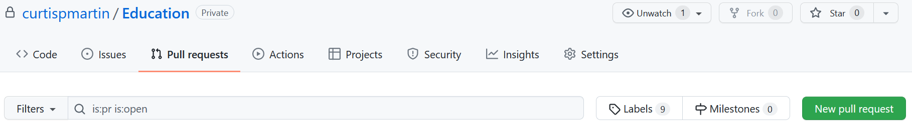
Git: Collaborative Coding
The process for using Git/Hub is largely the same, w/ (at least) one big exception: Pull requests
The workflow:
You create a new branch to start building out some new functionality
You write & finish the new functionality
You stage & commit the new code to the repo
You then submit a pull request which tells your collaborators the code is ready for merging
This prompts your teammates (or at least the owner of the repo) to review new code before merging
Once agreeable, you or a teammate can then accept the request, merge the branches, then `git pull`
Notes:
There are of course, other issues which inevitably arise, such as conflicts. In collaborative coding is where being deliberative & concise w/ code is important.

Slide 21
In-Class Activity…
Set up Git/Hub on your environment
Download & install Git
Set up GitHub account
Create SSH key on local machine
Link Git to GitHub using SSH key
Make your repo private
Create your own repo for this course called “XXX XXX”
Add me & TAs as collaborators
Confirm local copy & connection to GitHub
Create a subdirectory in repo called “2_VersionControl”
In it, create a Jupyter notebook (“inclass.ipynb”) & copy over code from file w/ same name
Stage & commit your repo
Create new branch called “newname”
Open “inclass.ipynb” using Jupyter
Change ‘myname’ to your name
Push new branch to GitHub
Once functional, merge “newname” w/ “master” branch, then stage & commit

Slide 22
Til next time…
Homework?

