Slide 1
Version Control
Improving reproducibility in data science

Slide 2
The Meaning of Reproducibility
Project structure
Clear organization of analytic components
Version control
Controlled tracking of changes over time
Ability to update & iterate while maintaining functioning code
Coding standards
Commenting
Simplification
Modularity
Documentation
Providing context to code, both within code (e.g., commenting) and via external documents (e.g., README.md)
Virtual environments
Enables reproducibility across multiple machines post-distribution
Code testing
Small, modular testing of segments of code combined w/ large testing upon modification

Slide 3
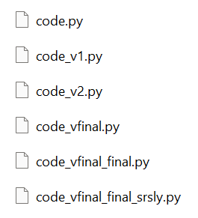
The Importance of Version Control
Prevents programmer from losing track of what’s what
Multiple versions of code
Multiple “final” versions of code
Enables updates without breaking functioning code
Enables reversion to older iterations, just in case
Documents the history of changes made for tracking purposes
Significantly improves collaboration amongst teams writing programs
Though the workflow can be difficult to pick up
Enables simpler & more effective dissemination
Point people to your GitHub to share code

Slide 4

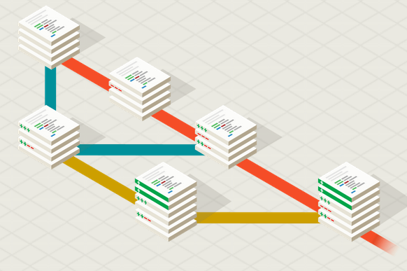
Introduction to Git
Most widely-used version control system
Completely open-source system developed by Linus Torvalds (who also created Linux) in 2005
What does Git do?
Manage coding projects using repositories
Controls & tracks changing w/ staging & committing
Enables code revision & updates w/o the risk of breaking code by branching & merging
Provides a local working copy via cloning (not like working on a Google doc, for example)
Sources: https://git-scm.com/, https://www.w3schools.com/git/git_intro.asp?remote=github

Slide 5
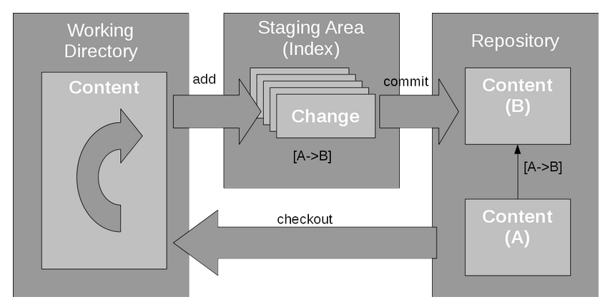
…but how does Git work?
Three primary components:
Working directory – Where changes are made
Staging area – Where changes are indexed (accounted for) & prepared for application
Repository – Where changes are applied
It’s all hidden in the .git directory…
objects/ stores snapshot (“commit”) metadata
refs/ points to commits
/index stores pointers to commits (e.g., branches)
/HEAD points to current branch
Sources: https://developer.ibm.com/tutorials/d-learn-workings-git/

Slide 6



Git or GitHub?
GitHub is a centralized, online hub for hosting & managing projects using Git
In a sense, provides a visual representation of what Git does, which enables simpler hosting, collaborating, & sharing

Slide 7
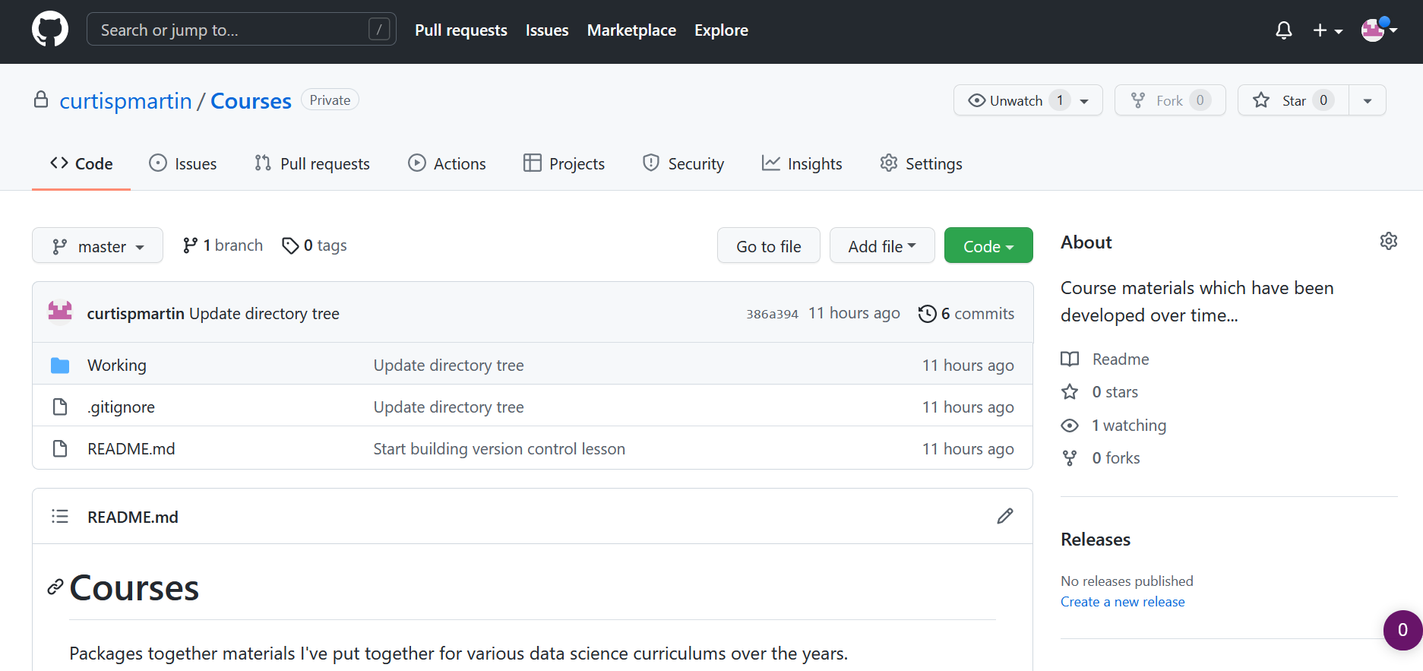
Git or GitHub?

Slide 8
Setting up Git/Hub

