Slide 1
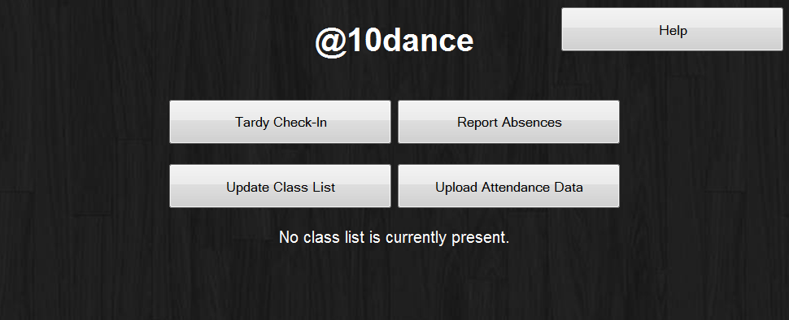
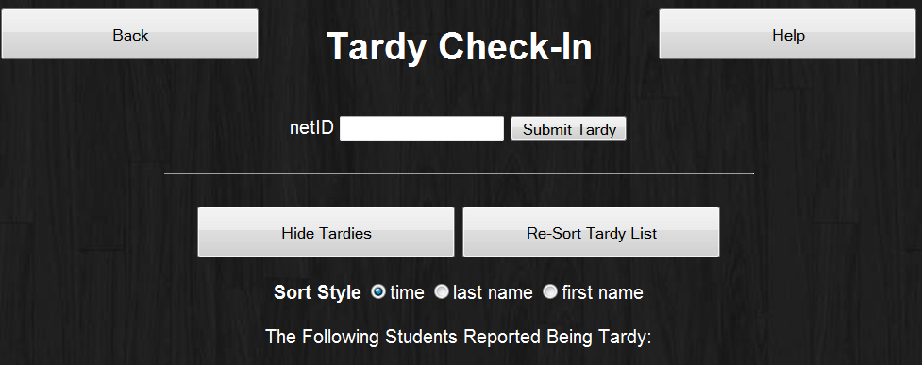
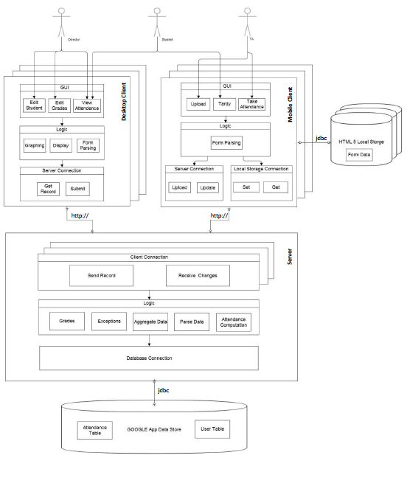
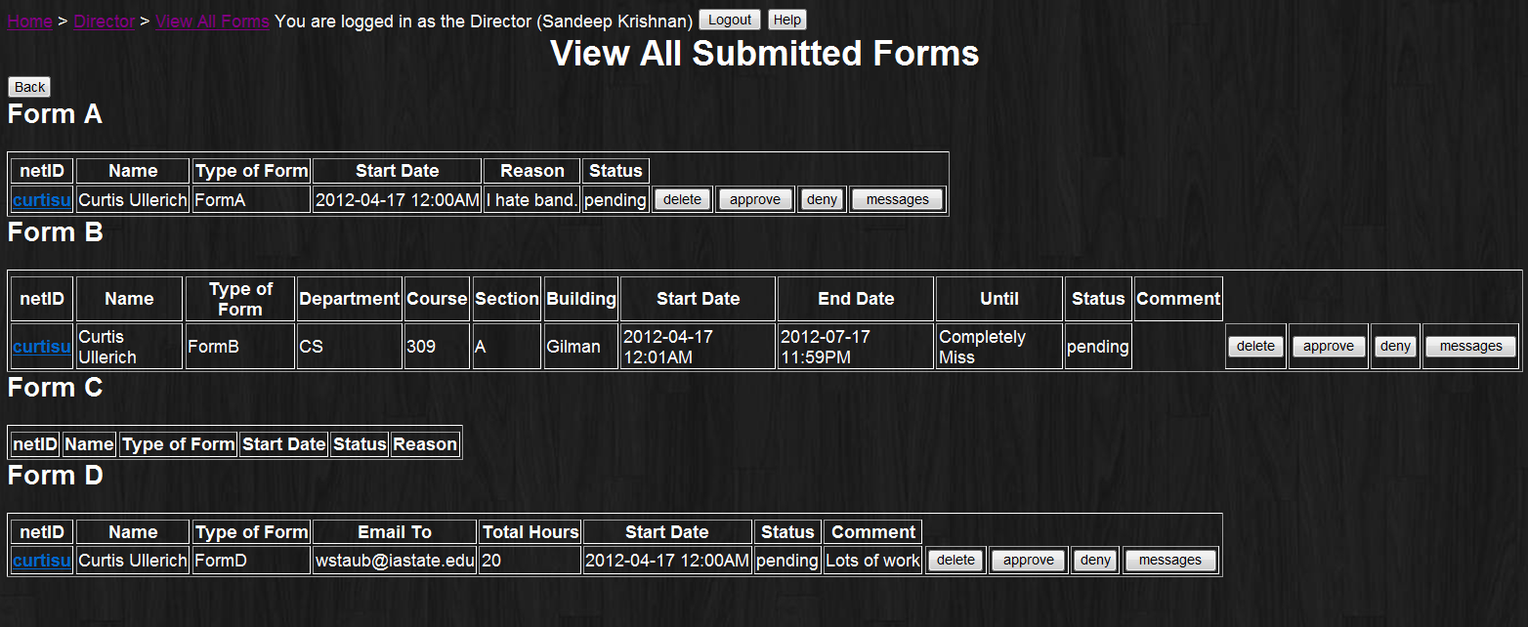
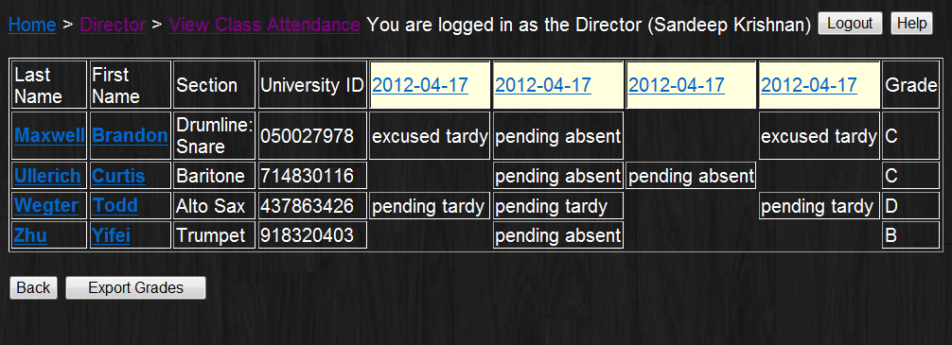
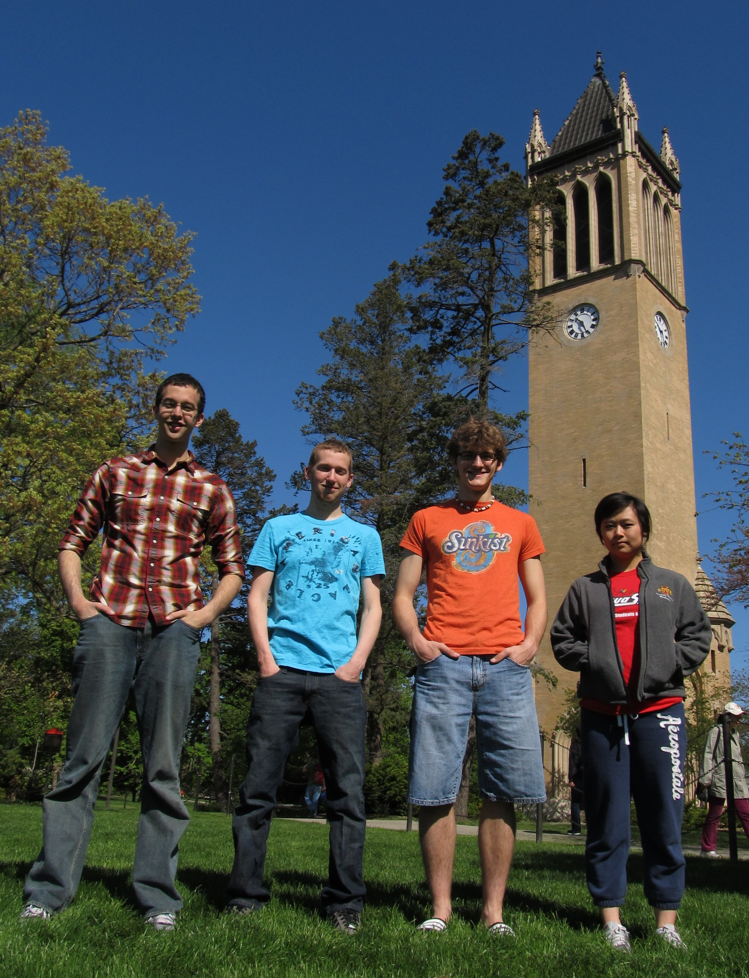
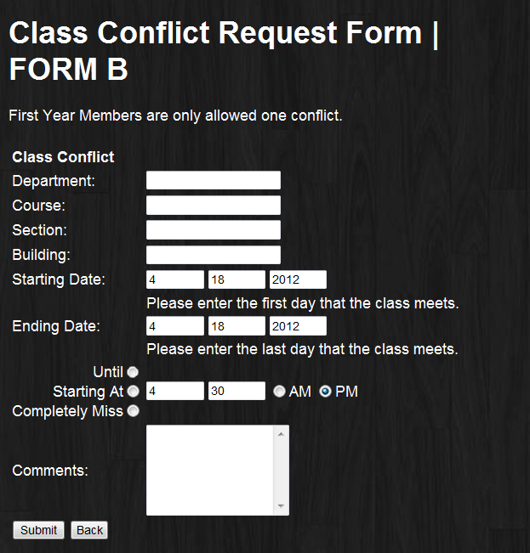
@10dance
Brandon Maxwell
Yifei Zhu
Curtis Ullerich
Todd Wegter
CS 309 Spring 2012
Project Description:
@10dance is designed for the ISU marching band in order to automate their attendance system and make it paperless. TAs take attendance during performances and rehearsals using a mobile HTML5 app, students submit absence forms and view their own attendance, and the director can view and keep track of the band’s attendance from our online system. @10dance automates the approval and denial of absences and tardies based on submitted forms, making this system much simpler than the old
manual paper system.
Users:
Students – track attendance, submit forms,
check in to events tardy
Director – monitor attendance, approve and
deny forms, absences, and tardies, check
grades and events
TA – submit attendance, submit student ranks
User Interfaces
Take Attendance – The TA can take attendance before performances and rehearsals
Check In – students can check in tardy
Forms – students can submit absence request forms online, and the Director approves them
Full Control – The Director can edit any event in the system
Messaging – Students and Directors can message each other about events and forms
Overview – Directors have a comprehensive view of every student’s attendance and grade
Module Interfaces
1.1 Google App Engine Datastore
Our desired schema is a top-level Person class with fields for all personal information as Strings
and an AttendanceRecord, which in turn has fields for all Tardies, Absences, AbsenceRequests, ClassConflictForms, etc. The datastore also contains a top-level Event object that has child types of Performance and Absence.
public void setAttendanceRecord(AttendanceRecord record);
This method sets the value of a private String field of the User to the key of AttendanceRecord record, which is stored as a top-level object in the datastore.
public AttendanceRecord getAttendanceRecord();
This queries the database using the private String field of the User that corresponds to the User's Attendance Record.
We add and remove entities from the database using an interface defined in our DatabaseUtil class. Simple getters and setters encapsulate the retrieval of the database service and persistence.
public static User getUser(String netID)
public static void addUser(User user)
public static void addEvent(Event event)
public static String[] listAllUsers()
1.2 http:// Communication Between Mobile Application and Server
This is accomplished through a data serialization interface. The mobile app needs to send all relevant data currently stored in localStorage to the server. It concatenates the keys of all absences, tardies, and events stored in localStorage (both as described above) into a comma-delimited string that is sent to the server via an HTML POST request and parsed using a servlet's doPost method. This interface for serialization makes parsing easy, as two calls to String.split(char delimiter) can create a 2D array of everything that was previously stored in localStorage at the client side.
1.3 Mobile Application html5 localStorage
HTML5 localStorage is a key-value map that deals only with Strings. Because of the many types of data we store in localStorage, we defined an interface for the common serialization of four different data types: User, Event, Tardy, and Absence.
Example for an absence: "absentStudentRehearsal Curtis Ullerich curtisu 2012-3-28 1630 1750 000001"
This allows for util functions for storing and retrieving items from localstorage, as well as searching and aggregating entities of a particular type for sorting, storing, POSTing, etc.
1.4 JSP-Backend
The JSPs that comprise the GUI for our web application pull user information from the datastore
using the interface defined in 5.1.1 above. We use a standard interface for servlets for pushing
data to the server using an HTML POST request:
public void doPost(HttpServletRequest req, HttpServletResponse resp)
For each type of servlet necessary (in which we send various types of data and handle the
POST differently), we use this method to accept data. Each servlet class extends HttpServlet.
From the HTML page, a POST is done as the method of a standard HTML form and sends the
values of all form fields to the servlet, where they are processed in our doPost method.
Design Decisions
Google App Engine as a server framework
Flattening the Java Hierarchy
(GAE Datastore Compatability)
Java and HTML5 for Mobile App
Store information in key of localStorage entries
The Team
Team B4
Brandon Maxwell – COM S
Yifei Zhu – CPR E
Curtis Ullerich – CPR E
Todd Wegter – CPR E
What went poorly
We couldn’t use polymorphism
or inheritance with GAE Datastore
Made N³ calls to the datastore
in some functions
What went well
Working, complete project
Tool will be used by ISU Marching Band
Lessons Learned
Databases
Javascript
HTML
Google App Engine
Teamwork

