Slide 1
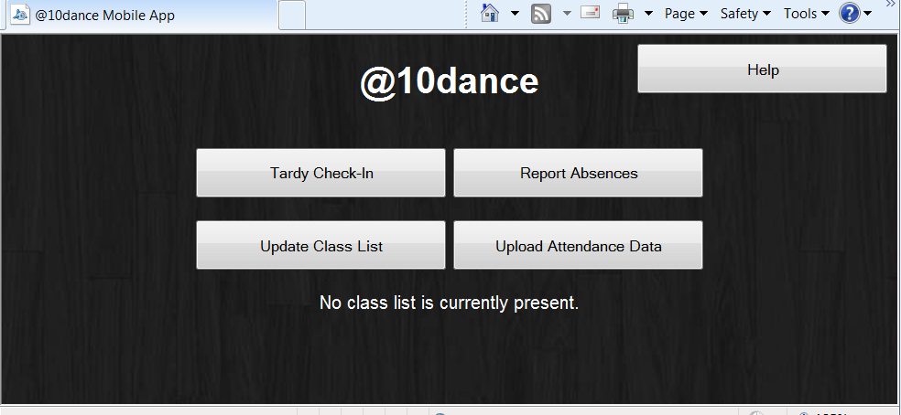
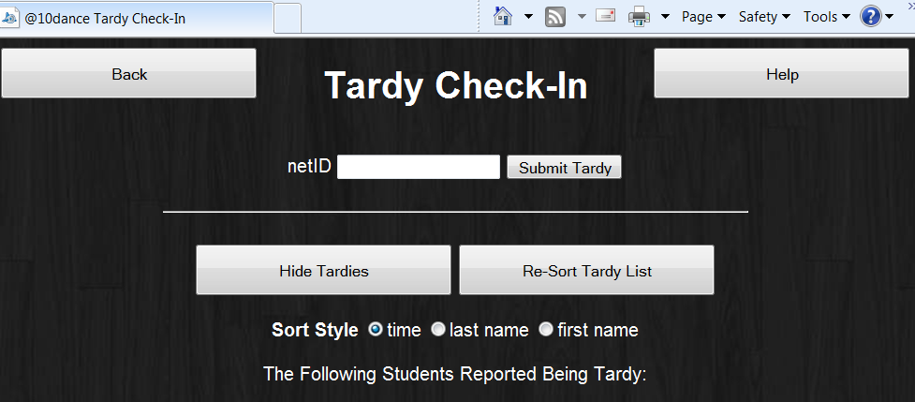
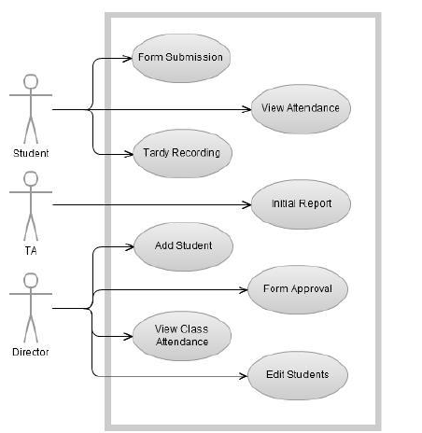
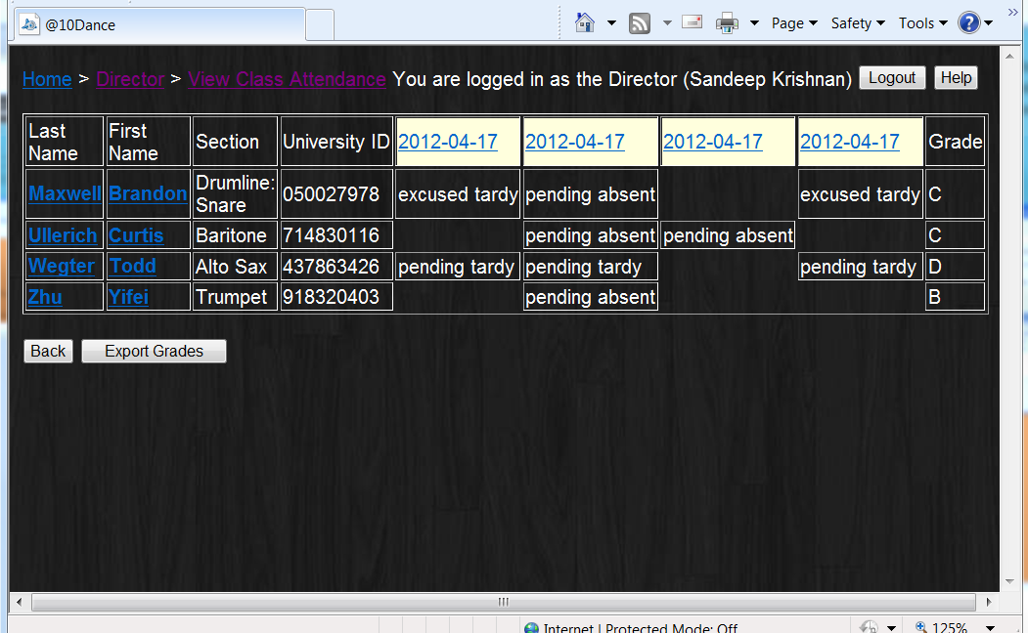
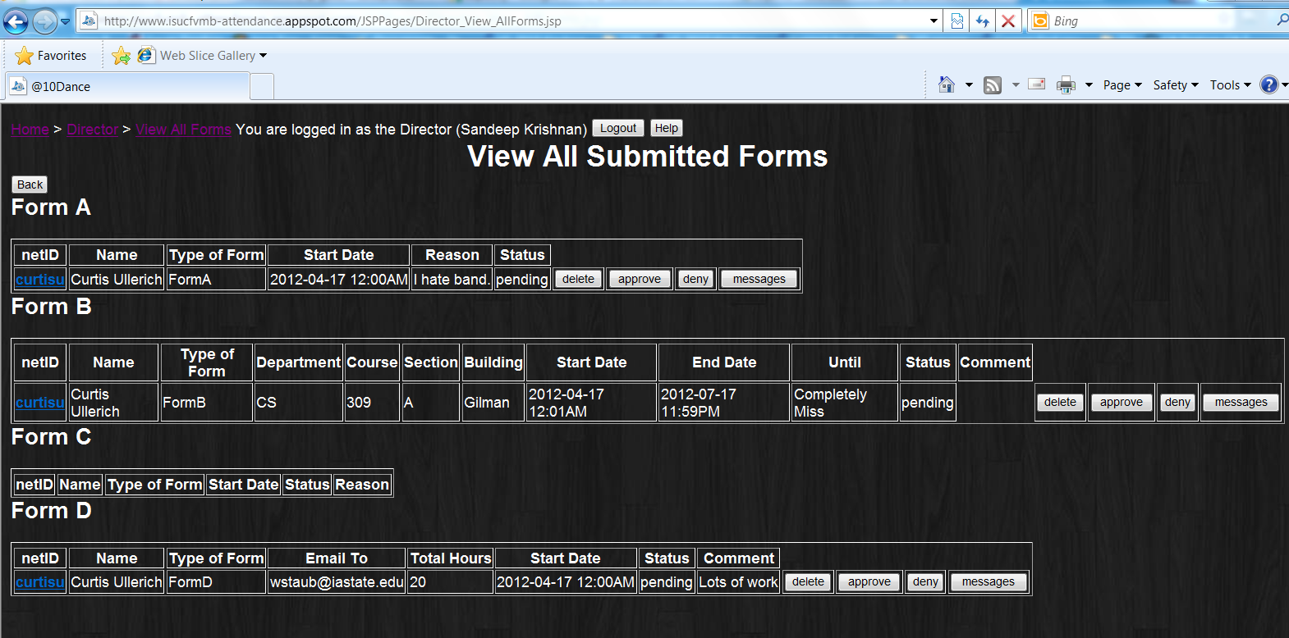
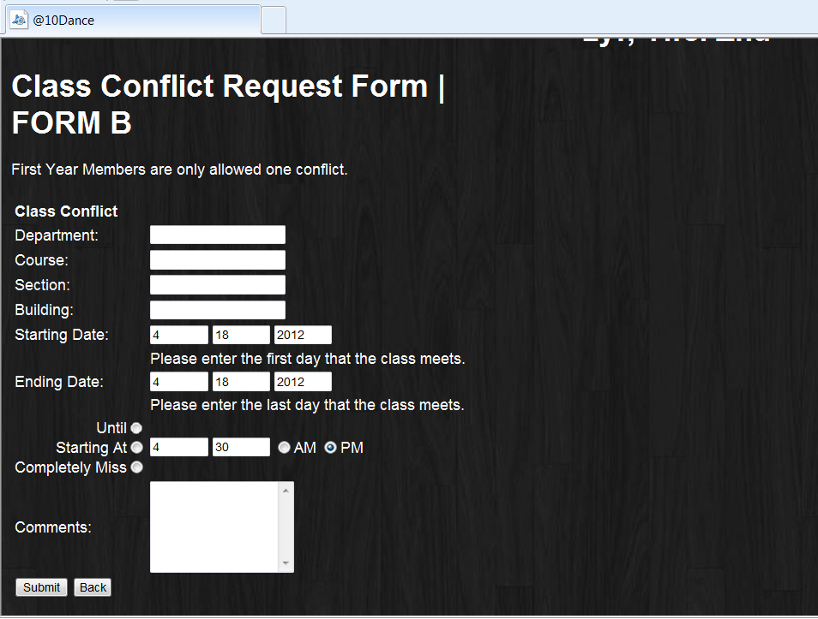
@10dance
Brandon Maxwell
Yifei Zhu
Curtis Ullerich
Todd Wegter
COM S 309 SPR 2012
Project Description:
@10dance is designed for ISU Marching band to take attendance. TA can be able to take attendance during performance and rehearsal, students can also be able to submit absence form, and the director can be able to view and keep track of attendance from our system
Users:
Students
Director
TA
User Interfaces
Take attendance
The TA can be able to take attendance before performance and rehearsal
Submit Tardy
The student can be able to submit tardy
Submit Form
The student can be able to submit forms online
Approve Form
The Director can be able to approve students’ forms
Module Interfaces:
1.1 Google App Engine Datastore
Our desired schema is a top-level Person class with fields for all personal information as Strings
and an AttendanceRecord, which in turn has fields for all Tardies, Absences, AbsenceRequests, ClassConflictForms, etc. The datastore also contains a top-level Event object that has child types of Performance and Absence.
public void setAttendanceRecord(AttendanceRecord record);
This method sets the value of a private String field of the User to the key of AttendanceRecord record, which is stored as a top-level object in the datastore.
public AttendanceRecord getAttendanceRecord();
This queries the database using the private String field of the User that corresponds to the User's Attendance Record.
We add and remove entities from the database using an interface defined in our DatabaseUtil class. Simple getters and setters encapsulate the retrieval of the database service and persistence.
public static User getUser(String netID)
public static void addUser(User guy)
public static void addEvent(Event toAdd)
public static String[] listAllUsers()
1.2 http:// Communication Between Mobile Application and Server
This is accomplished through a data serialization interface. The mobile app needs to send all relevant data currently stored in localStorage to the server. It concatenates the keys of all absences, tardies, and events stored in localStorage (both as described above) into a comma-delimited string that is sent to the server via an HTML POST request and parsed using a servlet's doPost method. This interface for serialization makes parsing easy, as two calls to String.split(char delimiter) can create a 2D array of everything that was previously stored in localStorage at the client side.
1.3 Mobile Application html5 localStorage
HTML5 localStorage is a key-value map that deals only with Strings. Because of the many types of data we store in localStorage, we defined an interface for the common serialization of four different data types: Users, events, tardies, and absences.
Example for an absence: "absentStudentRehearsal Curtis Ullerich curtisu 2012-3-28 1630 1750 000001"
This allows for util functions for storing and retrieving items from localstorage, as well as searching and aggregating entities of a particular type for sorting, storing, POSTing, etc.
1.4 JSP-Backend
The JSPs that comprise the GUI for our web application pull user information from the datastore using the interface defined in 5.1.1 above. We use a standard interface for servlets for pushing data to the server using an HTML POST request:
public void doPost(HttpServletRequest req, HttpServletResponse resp)
For each type of servlet necessary (in which we send various types of data and handle the POST differently), we use this method to accept data. Each servlet class extends HttpServlet.
From the HTML page, a POST is done as the method of a standard HTML form and sends the values of all form fields to the servlet, where they are processed in our doPost method.
Design Decisions:
Google App Engine.
Java and html5
common methods in all the sub-classes
store the information in the KEY
Team Info:
Team B4
Brandon Maxwell – COM S
Yifei Zhu – CPR E
Curtis Ullerich – CPR E
Todd Wegter – CPR E
What went wrong:
We couldn’t use polymorphism
What went right:
Working complete project
Tool can be able to use by ISU Marching Band
Lessons Learned:
Database , Javascript, HTML, Google App Engine

