Slide 1
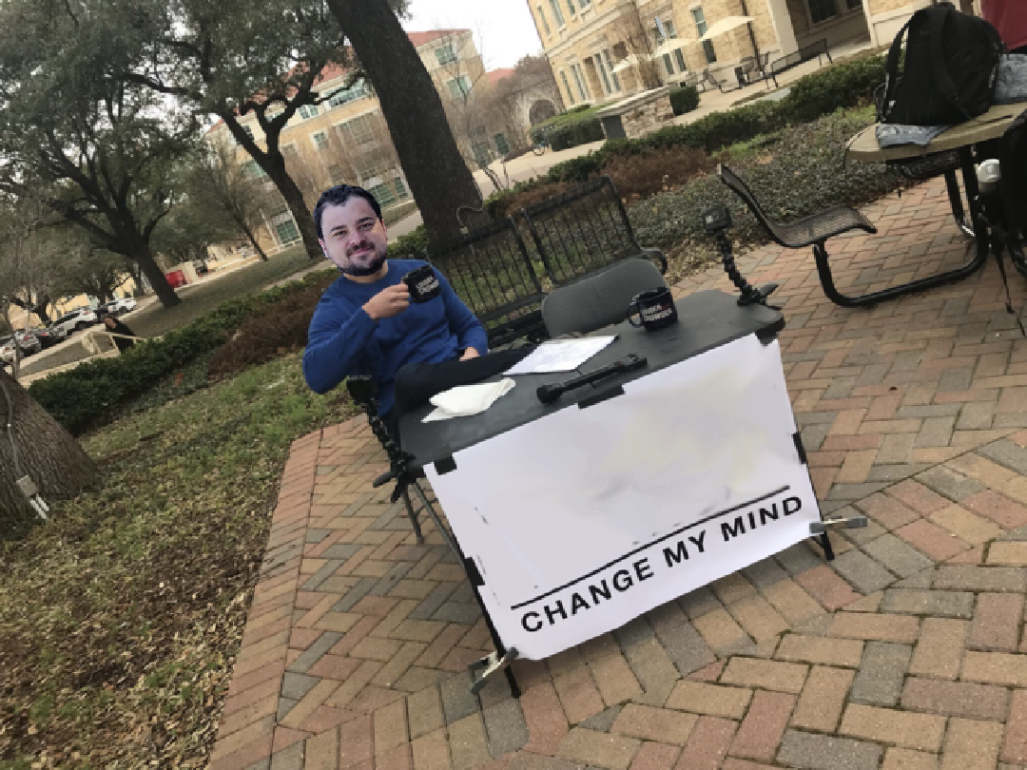
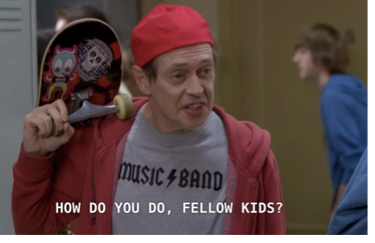
CS3102 Theory of Computation
www.cs.virginia.edu/~njb2b/cs3102
A number can be both even and odd
When your professor tries to meme

Slide 2
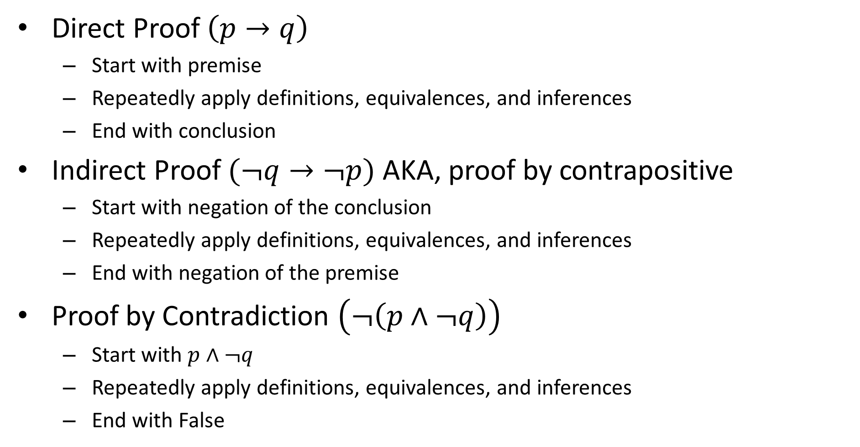

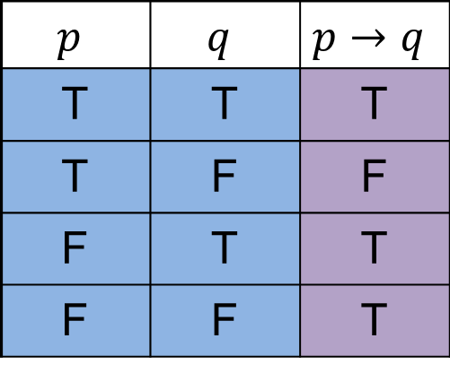
How to prove $p→q$
Direct Proof $\left(p→q\right)$
Start with premise
Repeatedly apply definitions, equivalences, and inferences
End with conclusion
Indirect Proof $(¬q→¬p)$ AKA, proof by contrapositive
Start with negation of the conclusion
Repeatedly apply definitions, equivalences, and inferences
End with negation of the premise
Proof by Contradiction $\left(¬\left(p∧¬q\right)\right)$
Start with $p∧¬q$
Repeatedly apply definitions, equivalences, and inferences
End with False
$$p$$ | $$q$$ | $$p→q$$
T | T | T
T | F | F
F | T | T
F | F | T

Slide 3
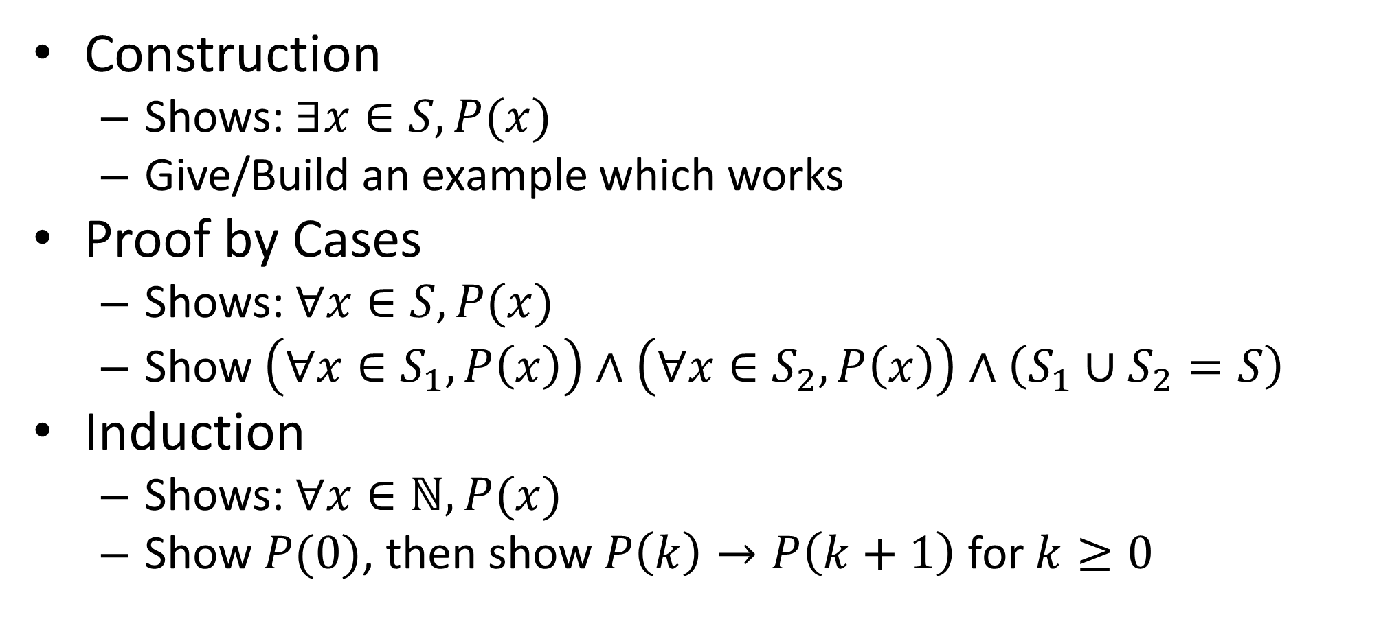
Proofs Techniques Cont.
Construction
Shows: $∃x∈S, P(x)$
Give/Build an example which works
Proof by Cases
Shows: $∀x∈S, P(x)$
Show $\left(∀x∈S_{1}, P\left(x\right)\right)∧\left(∀x∈S_{2},P\left(x\right)\right)∧\left(S_{1}∪S_{2}=S\right)$
Induction
Shows: $∀x∈ℕ, P(x)$
Show $P(0)$, then show $P\left(k\right)→P\left(k+1\right)$ for $k≥0$

Slide 4
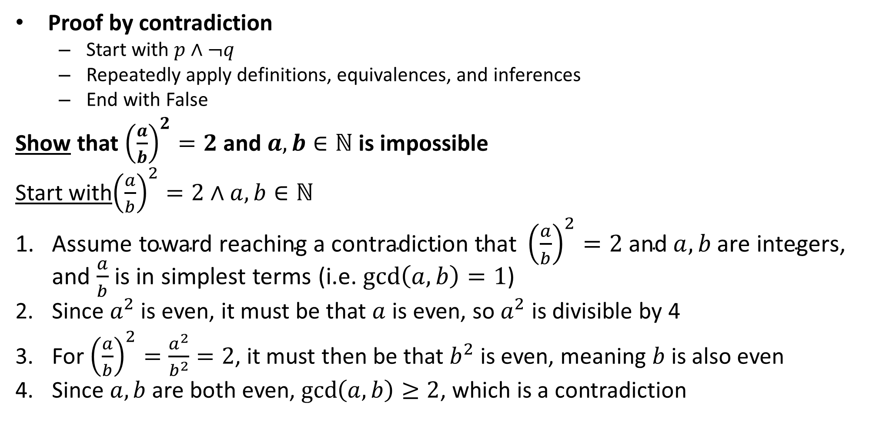

Proof: $√2$ is not rational
Proof by contradiction
Start with $p∧¬q$
Repeatedly apply definitions, equivalences, and inferences
End with False
Show that ${\left(\frac{a}{b}\right)}^{2}=2$ and $a,b∈ℕ$ is impossible
Start with${\left(\frac{a}{b}\right)}^{2}=2∧a,b∈ℕ$
$\text{Assume} \text{toward} \text{reaching} \text{a} \text{contradiction} \text{that} {\left(\frac{a}{b}\right)}^{2}=2 \text{and} a,b \text{are} \text{integers}$, and $\frac{a}{b}$ is in simplest terms (i.e. $\gcd\left(a,b\right)=1$)
Since $a^{2}$ is even, it must be that $a$ is even, so $a^{2}$ is divisible by 4
For ${\left(\frac{a}{b}\right)}^{2}=\frac{a^{2}}{b^{2}}=2$, it must then be that $b^{2}$ is even, meaning $b$ is also even
Since $a,b$ are both even, $\gcd\left(a,b\right)≥2$, which is a contradiction

Slide 5
A number can be both even and odd

Slide 6
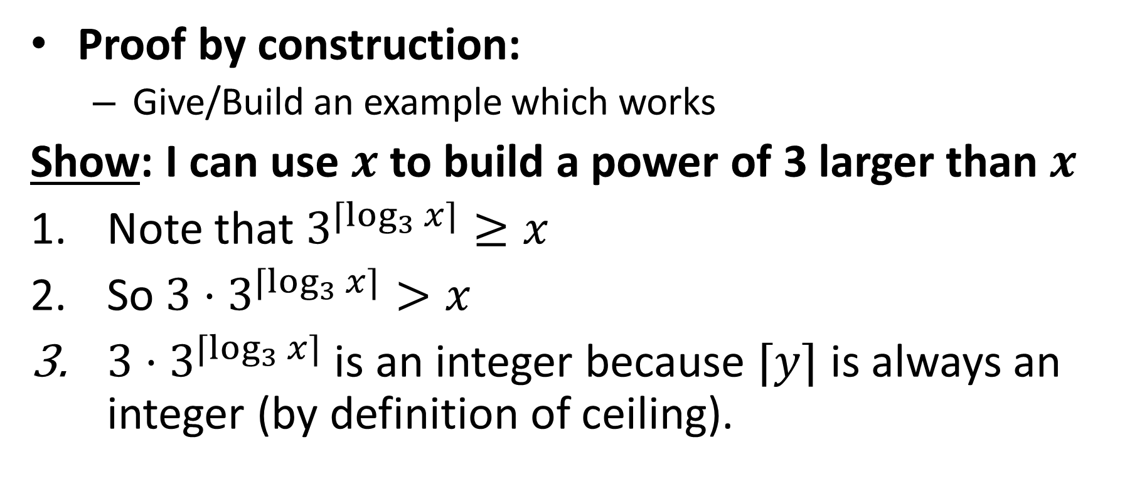
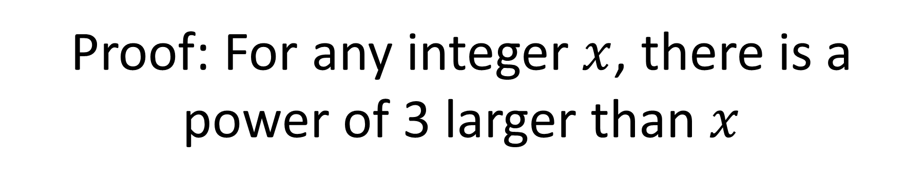
Proof: For any integer $x$, there is a power of 3 larger than $x$
Proof by construction:
Give/Build an example which works
Show: I can use $x$ to build a power of 3 larger than $x$
Note that $3^{⌈\log_{3}{x}⌉}≥x$
So ${3⋅3}^{⌈\log_{3}{x}⌉}>x$
${3⋅3}^{⌈\log_{3}{x}⌉}$ is an integer because $⌈y⌉$ is always an integer (by definition of ceiling).

Slide 7
There is a largest number

Slide 8
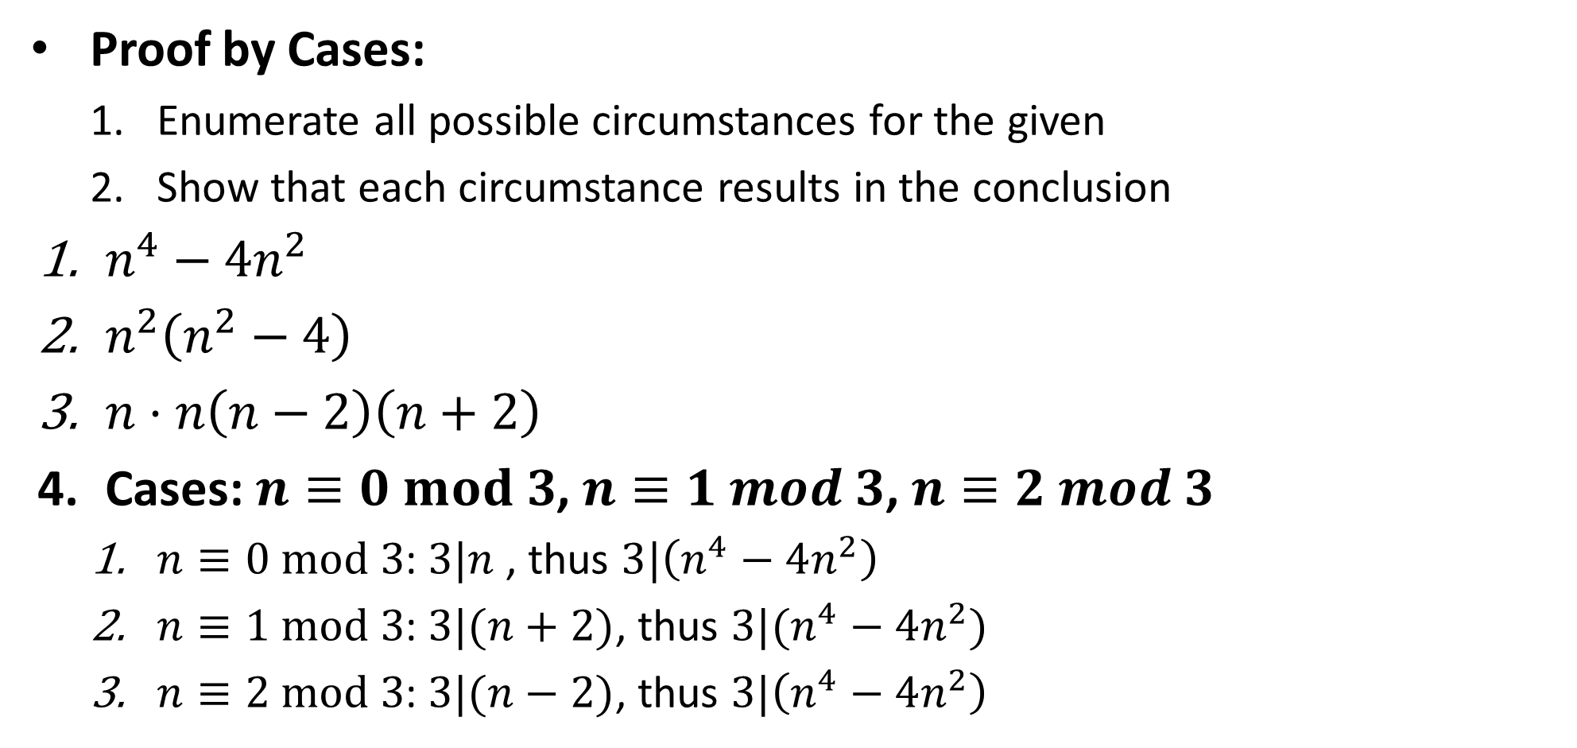
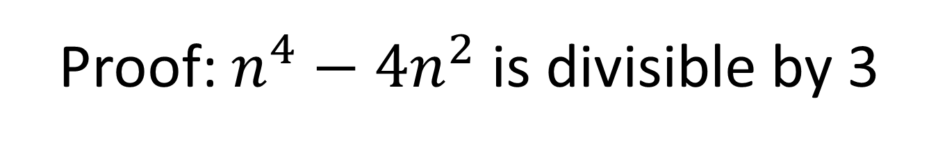
Proof: $n^{4}−4n^{2}$ is divisible by 3
Proof by Cases:
Enumerate all possible circumstances for the given
Show that each circumstance results in the conclusion
$n^{4}−4n^{2}$
$n^{2}\left(n^{2}−4\right)$
$n⋅n\left(n−2\right)\left(n+2\right)$
Cases: $n≡0 mod 3$, $n≡1 mod 3$, $n≡2 mod 3$
$n≡0 mod 3$: $3|n$ , thus $3|\left(n^{4}−4n^{2}\right)$
$n≡1 mod 3$: $3|(n+2)$, thus $3|(n^{4}−4n^{2})$
$n≡2 mod 3$: $3|(n−2)$, thus $3|\left(n^{4}−4n^{2}\right)$

Slide 9
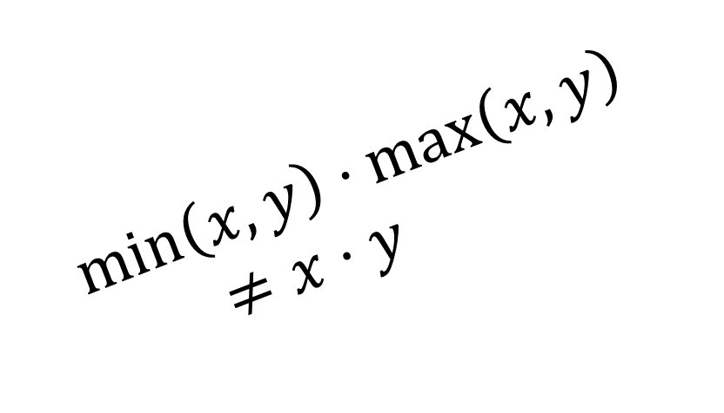
$$\min\left(x,y\right)⋅\max\left(x,y\right)≠x⋅y$$

Slide 10
When writing a proof
Mention method of proof you’re using
List everything given (all assumptions you’re making)
State formally what you are going to prove
State your proof as clearly and concisely as you can
providing accompanying intuition is often helpful)

Slide 11
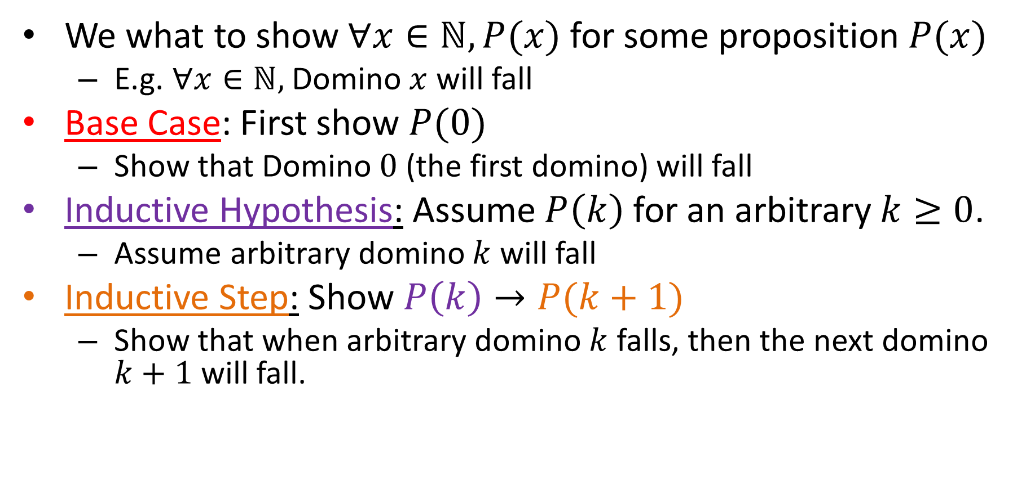
Mathematical Induction
We what to show $∀x∈ℕ, P(x)$ for some proposition $P(x)$
E.g. $∀x∈ℕ,$Domino $x$ will fall
Base Case: First show $P(0)$
Show that Domino $0$ (the first domino) will fall
Inductive Hypothesis: Assume $P\left(k\right)$ for an arbitrary $k≥0$.
Assume arbitrary domino $k$ will fall
Inductive Step: Show $P\left(k\right)→P(k+1)$
Show that when arbitrary domino $k$ falls, then the next domino $k+1$ will fall.

Slide 12
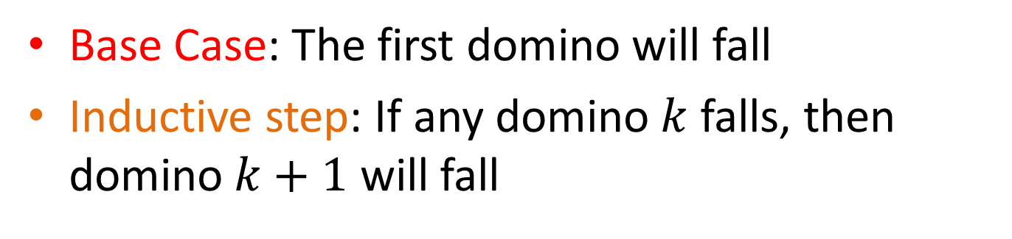
Mathematical Induction
Base Case: The first domino will fall
Inductive step: If any domino $k$ falls, then domino $k+1$ will fall
All dominos fall!!
Falls because of base Case
Falls because of Inductive Step
Falls because of Inductive Step
Falls because of Inductive Step

Slide 13
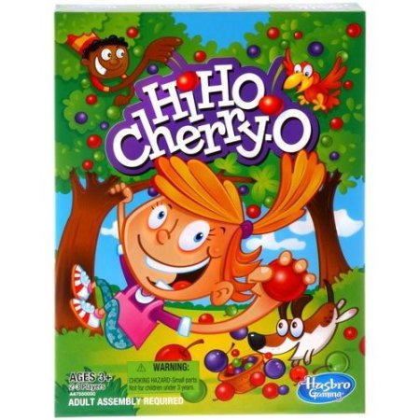
Hi-Ho-Cherry-O
Each Player takes turns removing 1, 2, 3, or 4 cherries from play
First player unable to pick a cherry loses

Slide 14
It’s better to go first

Slide 15
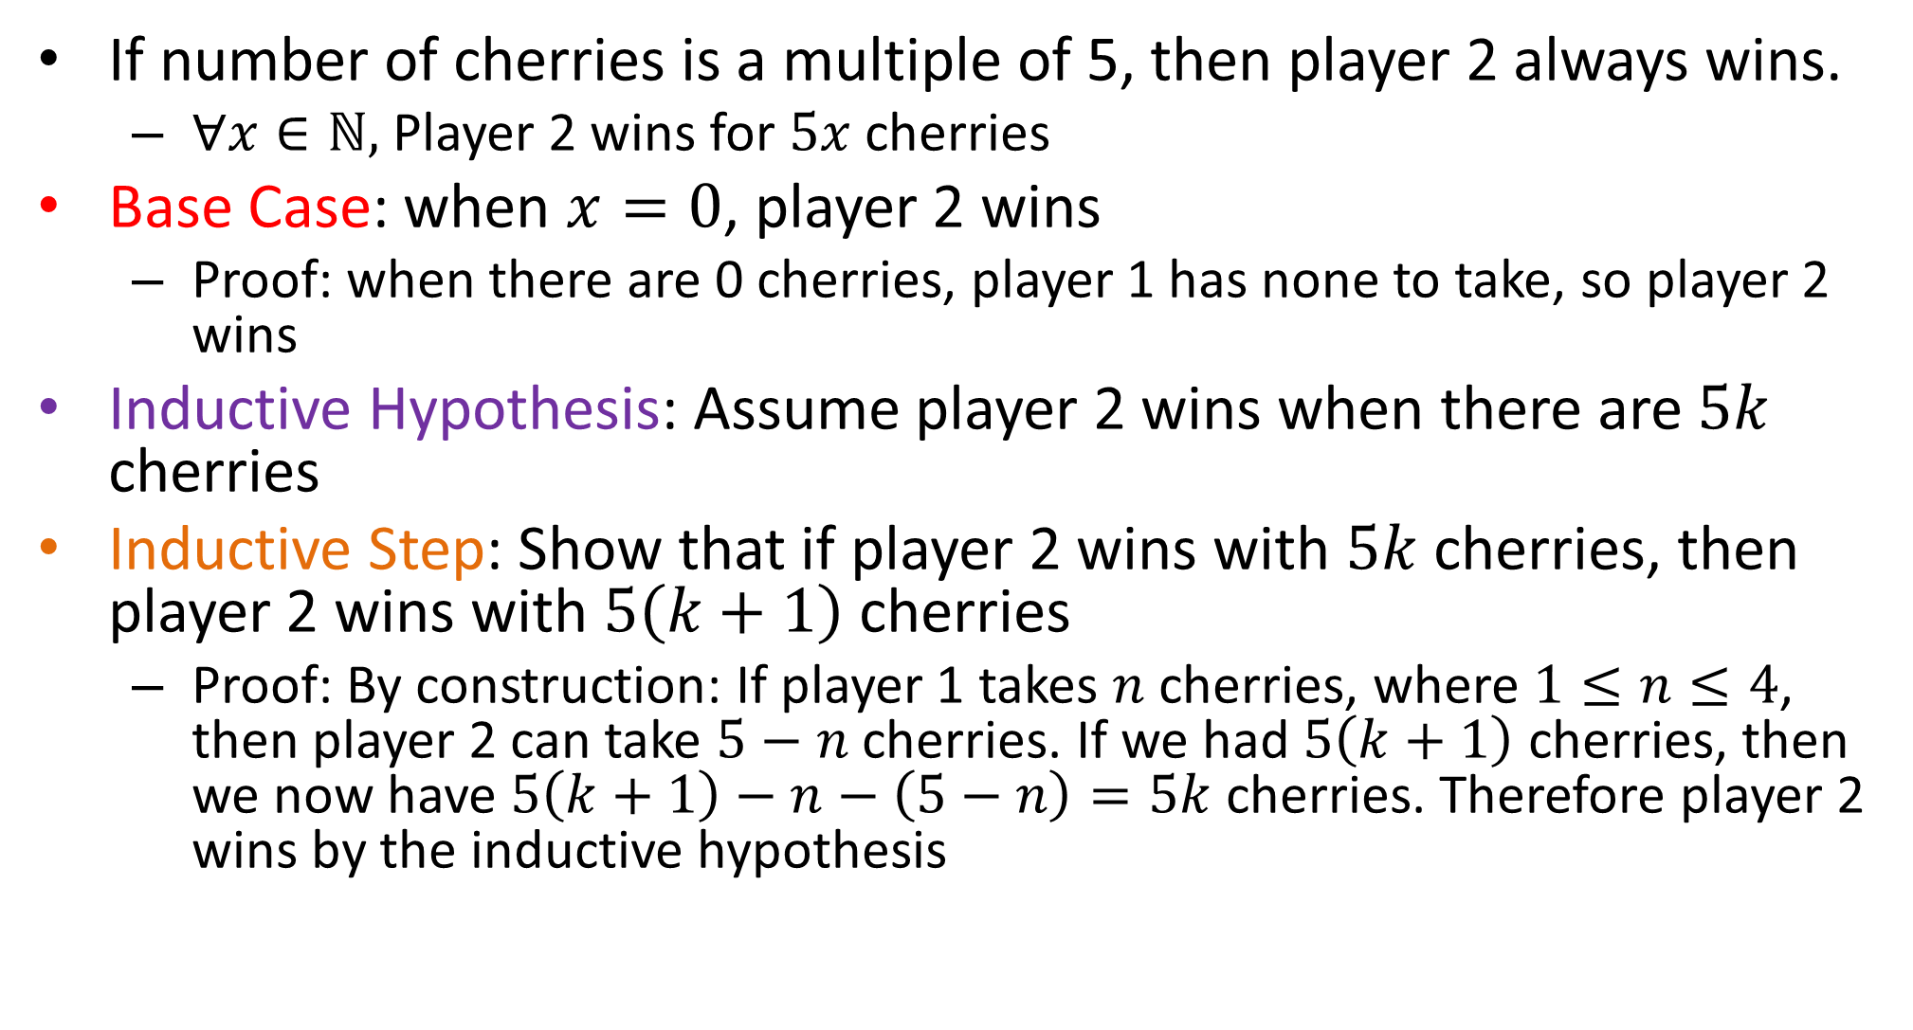
Player 2 always wins
If number of cherries is a multiple of 5, then player 2 always wins.
$∀x∈ℕ,$Player 2 wins for $5x$ cherries
Base Case: when $x=0$, player 2 wins
Proof: when there are 0 cherries, player 1 has none to take, so player 2 wins
Inductive Hypothesis: Assume player 2 wins when there are $5k$ cherries
Inductive Step: Show that if player 2 wins with $5k$ cherries, then player 2 wins with $5\left(k+1\right)$ cherries
Proof: By construction: If player 1 takes $n$ cherries, where $1≤n≤4$, then player 2 can take $5−n$ cherries. If we had $5\left(k+1\right)$ cherries, then we now have $5\left(k+1\right)−n−\left(5−n\right)=5k$ cherries. Therefore player 2 wins by the inductive hypothesis

Slide 16
Problems with induction
Useless for helping you to find the answer
You have to know the answer first
Does not provide insights into why something is true
Does not give any clues on how to correct if you’re wrong

Slide 17
“Carnot Engine” for computers?
General enough to describe any computation
Independent of specifics of construction
Enable discussion of limits of computability
Input
Computing Machine
/ Program / Algorithm
Output
What goes in here?
For now, Java.

Slide 18
Decider
Simplest idea of computation
Easier to work with than general funtions
String
Computing Machine
/ Program / Algorithm
Input
Accept/Reject
Output
What goes in here?
For now, Java.

Slide 19
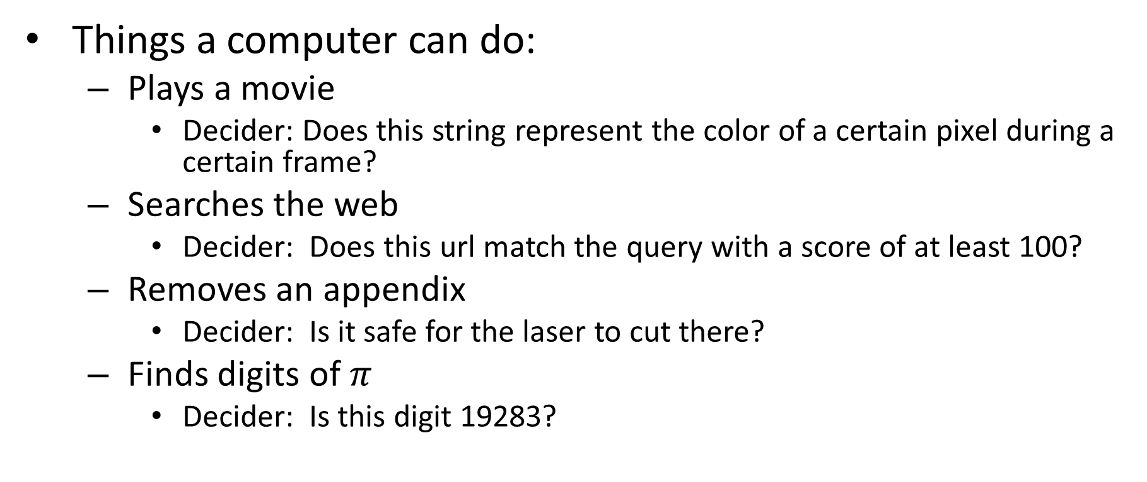
General Computations as Deciders
Things a computer can do:
Plays a movie
Decider: Does this string represent the color of a certain pixel during a certain frame?
Searches the web
Decider: Does this url match the query with a score of at least 100?
Removes an appendix
Decider: Is it safe for the laser to cut there?
Finds digits of $π$
Decider: Is this digit 19283?

Slide 20
Computability
A Decider’s “behavior” is the set of strings it accepts
A set of strings is computable by Java if we can find a program which accepts exactly those strings
String
Computing Machine
/ Program / Algorithm
Accept/Reject
What goes in here?
For now, Java.

Slide 21

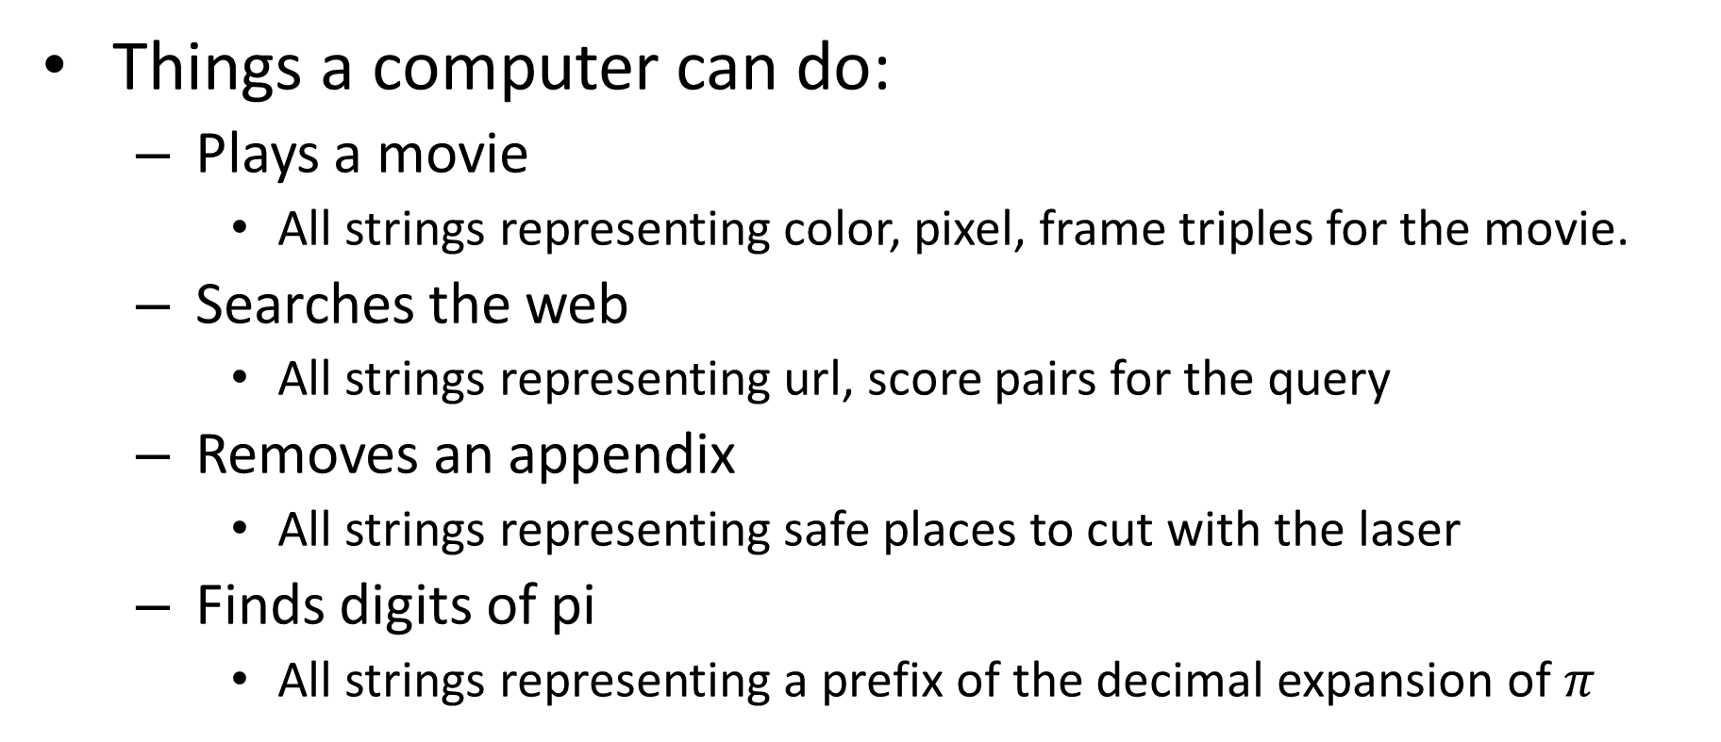
Computations as Sets of Strings
Things a computer can do:
Plays a movie
All strings representing color, pixel, frame triples for the movie.
Searches the web
All strings representing url, score pairs for the query
Removes an appendix
All strings representing safe places to cut with the laser
Finds digits of pi
All strings representing a prefix of the decimal expansion of $π$
$$∞$$

Slide 22
HW1
Released Friday (1/25)
Due Monday (2/4)
Programming portion:
Write Java code for deciders
Use those deciders to produce the sets of strings they compute
Written portion:
Proofs
Sets and functions (next time)

