Slide 1
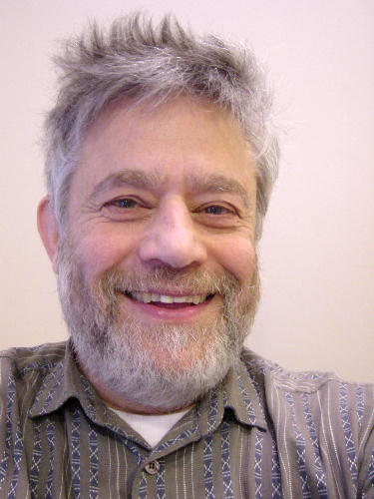
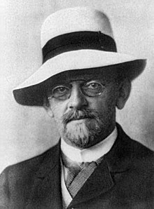
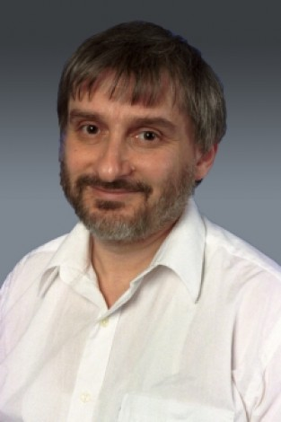
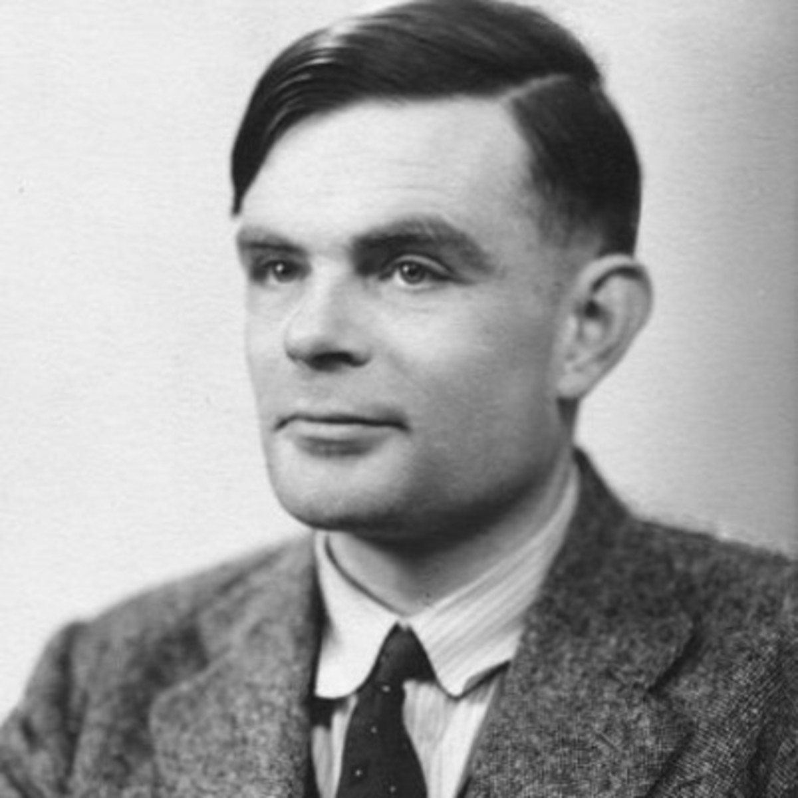
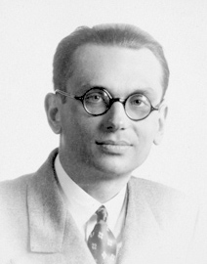
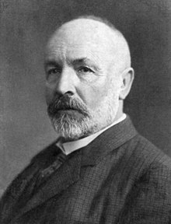
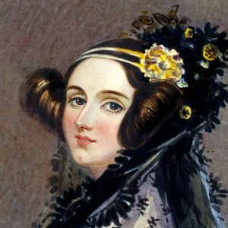
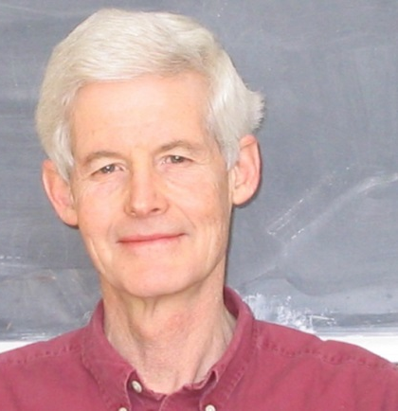
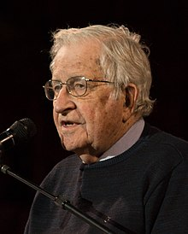
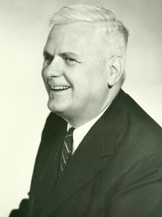
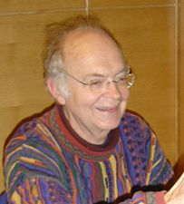
CS3102 Theory of Computation
www.cs.virginia.edu/~njb2b/cs3102

Slide 2
CS3102 Theory of Computation
www.cs.virginia.edu/~njb2b/cs3102
David Hilbert
Manuel Blum
Leonid Levin
Alan Turing
Georg Cantor
Kurt Gödel
Alonzo Church
Noam Chomsky
Stephen Cook
Donald Knuth
Ada Lovelace

Slide 3
Why Study Theory?

Slide 4
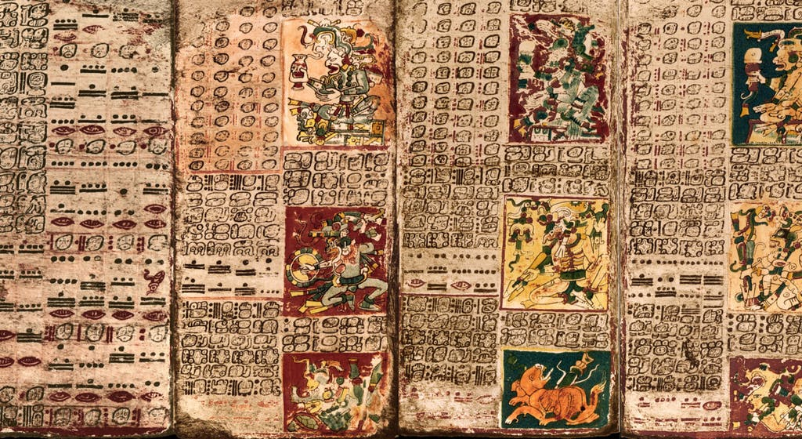
Consider a Mayan Astronomer

Slide 5
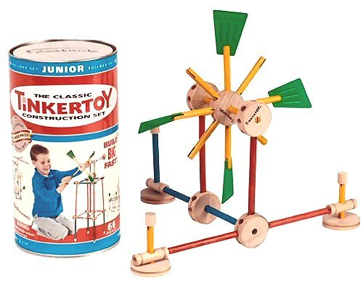
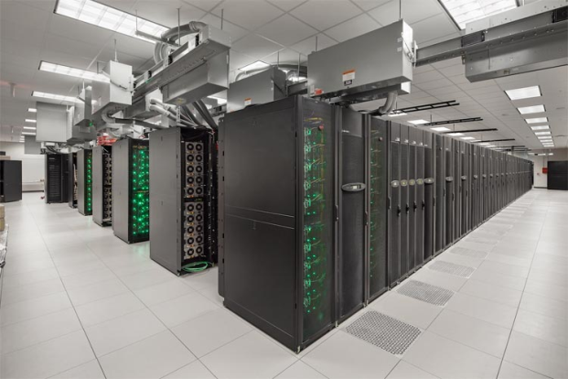

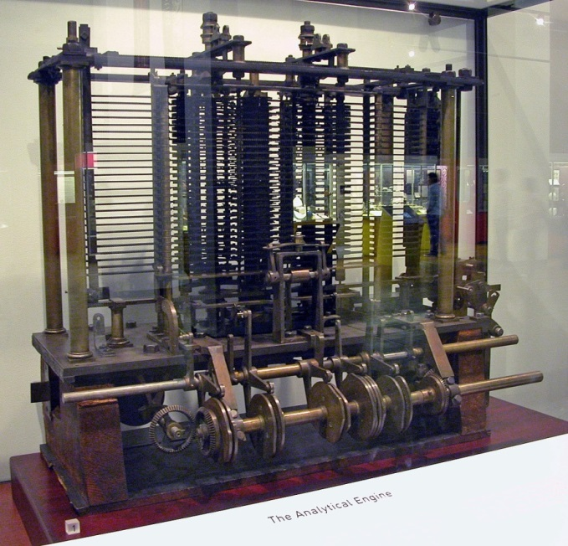
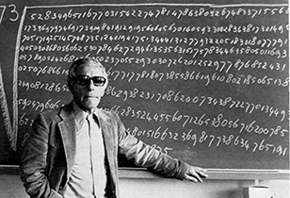
Computers

Slide 6
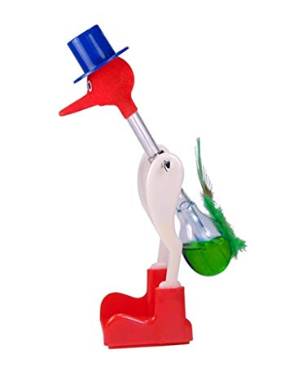

How Does it Work?

Slide 7
How Does it Work?
Evaporative Cooling
Lower Pressure
Higher Pressure

Slide 8
How would I power Charlottesville with a drinking bird?

Slide 9
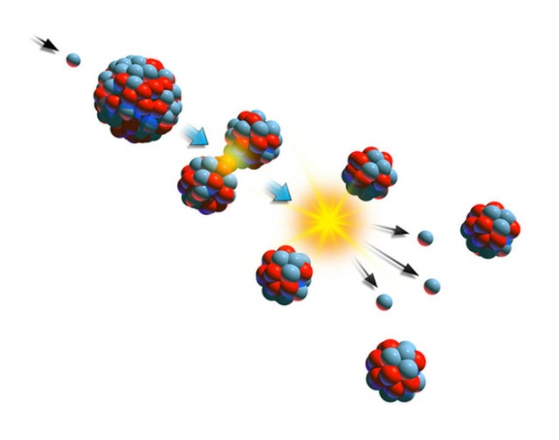
How does a nuclear power plant work?
Steam
Turbine Generator
Heavy Water
Heavy Water
Fission

Slide 10
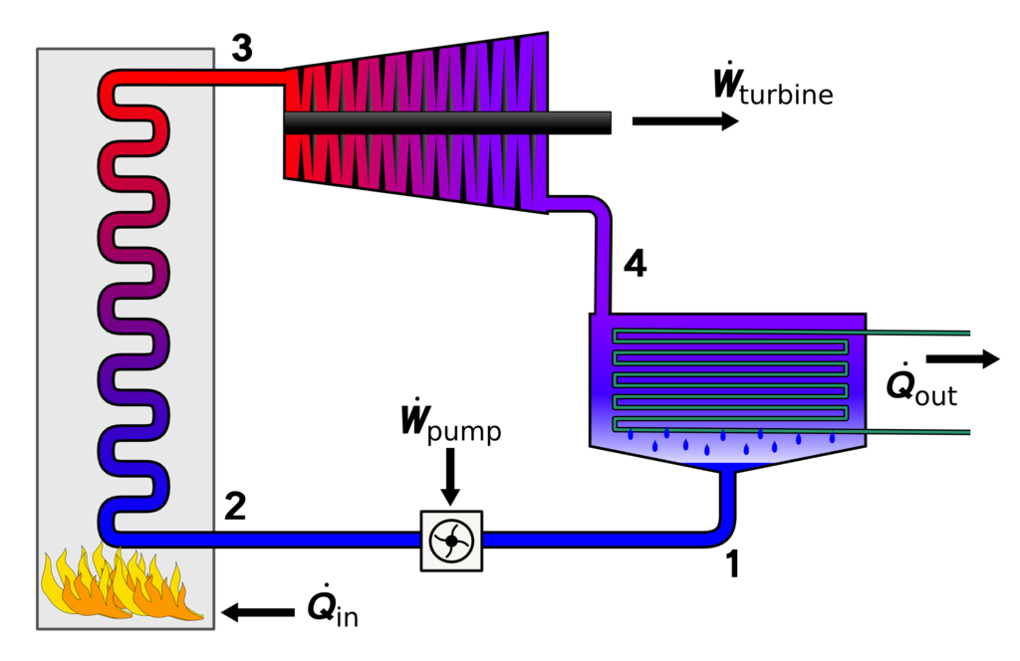

Slide 11
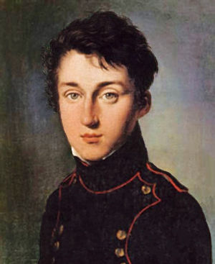
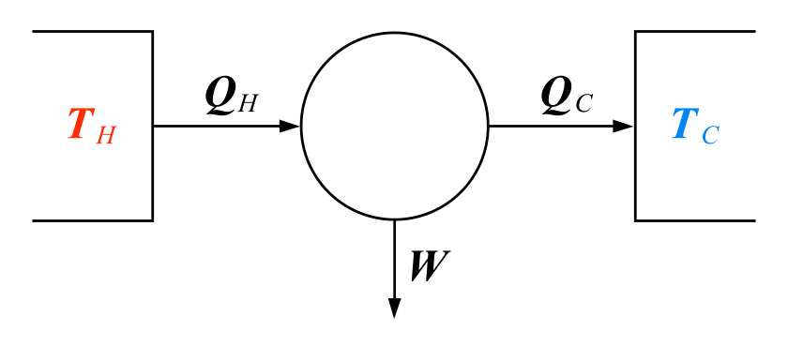
Carnot Engine
Model of any heat engine
Independent of specifics of construction
Provides fundamental limits on efficiency
Nicolas Lèonard Sadi Carnot
(1796-1832)

Slide 12
Goals
Create an awesome learning experience
Instill enthusiasm for problem solving
Give broad perspective on Computer Science
Have fun!

Slide 13
Warning
This will be a difficult class
Material is very subtle
Focussed on making strong/elegant/compelling arguments
Lots of opportunities to succeed!

Slide 14
Office Hours
Nate’s
Rice 209
W 3:30pm-5:30pm
By appointment
TA
TBD

Slide 15
Requirements
Discrete Math (CS 2102)
Software Development Methods (CS 2110)
Tenacity
Inquisitiveness
Creativity

Slide 16

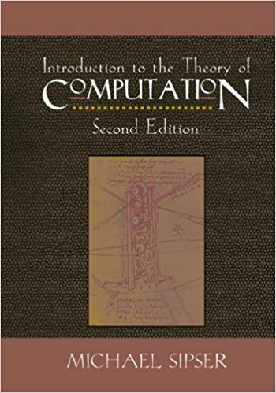
Text
Sipser, Introduction to the Theory of Computation. 2nd or 3rd edition

Slide 17
Homework
~9 assignments total
Mix of written and programming assignments
Written:
2/3 of all assignments
Must be typeset in LaTeX (tutorial is HW0)
Submit as zip folder containing tex file and pdf
Programming:
1/3 of all assignments

Slide 18
Acadmic Integrity
Collaboration Encouraged!
Groups of up to 4 per assignment (no limit on extra credit)
List your collaborators
Write-ups/code written independently
Be able to explain any solution you submit!
DO NOT seek published solutions online

Slide 19
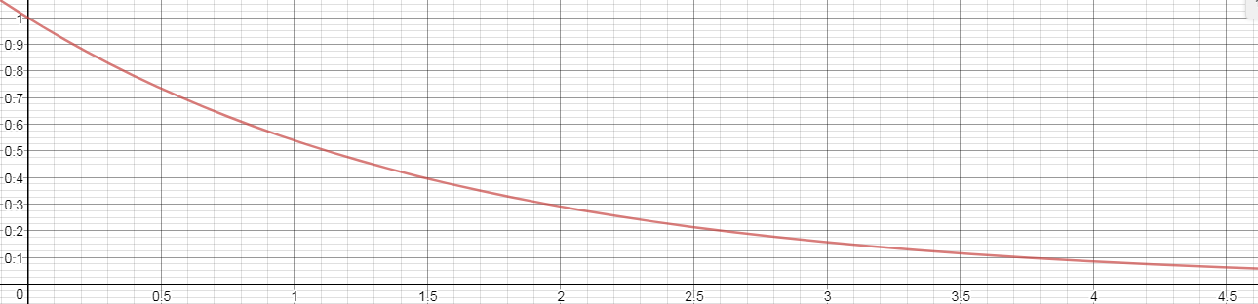
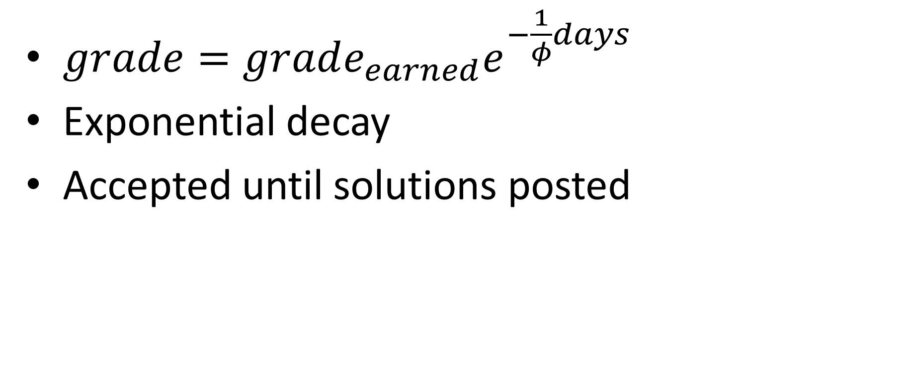
Late Policy
$grade=grade_{earned}e^{−\frac{1}{φ}days}$
Exponential decay
Accepted until solutions posted

Slide 20
Exams
Midterm
Est. March 5
Take home / in-class hybrid
Final
Registrar’s official date/time
Saturday May 6, 9am

Slide 21
Grade Breakdown
60% homework
20% Midterm
20% Final
10% Extra Credit
1% Questionnaire

Slide 22
Questionnaire
Due TONIGHT!
I expect it will take ~15 minutes
I will use this feedback when making decisions about lecture/assignment content

Slide 23
Questionnaire
Due TONIGHT!
I expect it will take ~15 minutes
I will use this feedback when making decisions about lecture/assignment content

Slide 24
Regrades
Conducted in person
Office hours in syllabus/on calendar

Slide 25
Extra Credit
Given for implementations of course content
Turing machine simulators
GUIs for programming assignments
Videos/graphics of concepts
Extensions of programming assignments
Another idea? Just ask!
Must be something you can “show off”

Slide 26

Feedback
I am not a course dictator, I am a civil servant
I’m open to any suggestion to help you learn
Let me know!
In person
Email
@ProfNateB

Slide 27
Waitlist

