Slide 1
CS3102 Theory of Computation
www.cs.virginia.edu/~njb2b/cs3102
People who have baked over 500 cookies in a day to give to their students
Professors at UVA
Nate Brunelle

Slide 2
Computability
A Decider’s “behavior” is the set of strings it accepts
A set of strings is computable by Java if we can find a program which accepts exactly those strings
String
Computing Machine
/ Program / Algorithm
Accept/Reject
What goes in here?
For now, Java.

Slide 3

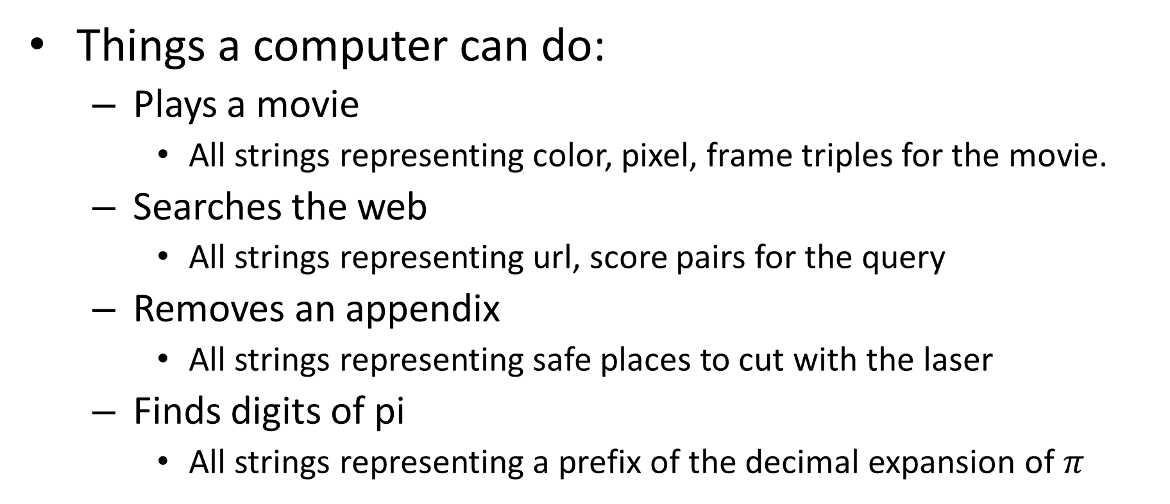
Computations as Sets of Strings
Things a computer can do:
Plays a movie
All strings representing color, pixel, frame triples for the movie.
Searches the web
All strings representing url, score pairs for the query
Removes an appendix
All strings representing safe places to cut with the laser
Finds digits of pi
All strings representing a prefix of the decimal expansion of $π$
$$∞$$

Slide 4
Languages
Natural
English
Vocabulary and grammar
Programming
Java
Commands and Syntax
Formal
A set of strings
Strings only, no rules for assembly

Slide 5
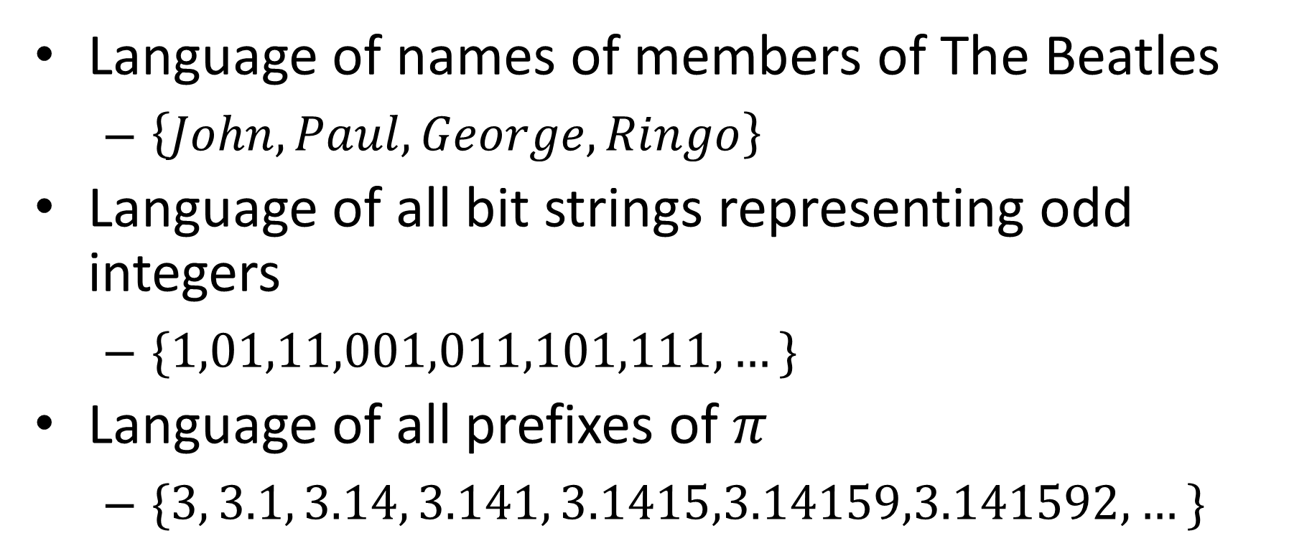
Example languages
Language of names of members of The Beatles
$\left\{John, Paul,George,Ringo\right\}$
Language of all bit strings representing odd integers
$\{1,01,11,001,011,101,111,…\}$
Language of all prefixes of $π$
$\{3, 3.1, 3.14, 3.141, 3.1415,3.14159,3.141592,…\}$

Slide 6
Strings
A language is a set of strings
May be infinite
What is a string?
A finite sequence of characters
Alphabet:
The set of characters available
Must be finite

Slide 7
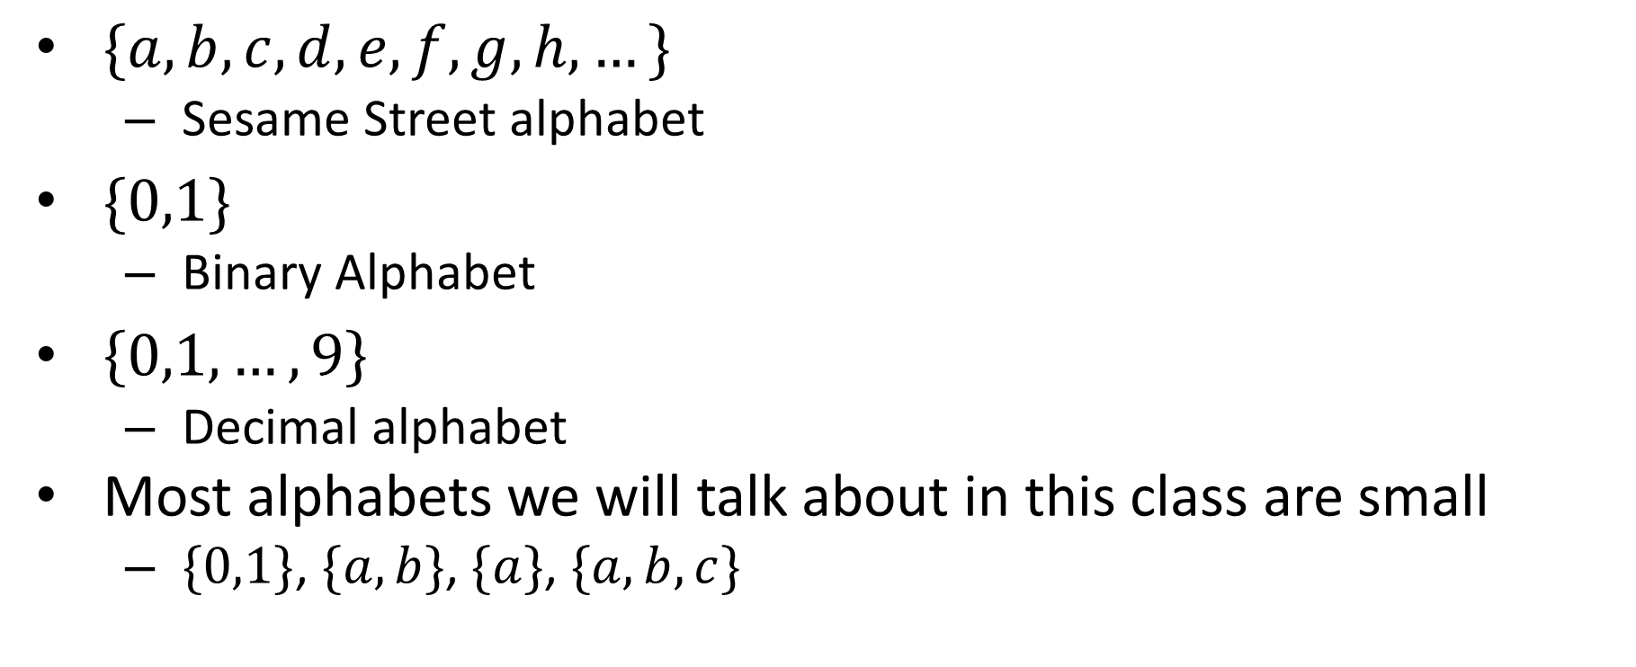
Alphabet examples
$\{a,b,c,d,e,f,g,h,…\}$
Sesame Street alphabet
$\{0,1\}$
Binary Alphabet
$\left\{0,1,…,9\right\}$
Decimal alphabet
Most alphabets we will talk about in this class are small
$\{0,1\}$, $\{a,b\}$, $\{a\}$, $\{a,b,c\}$

Slide 8
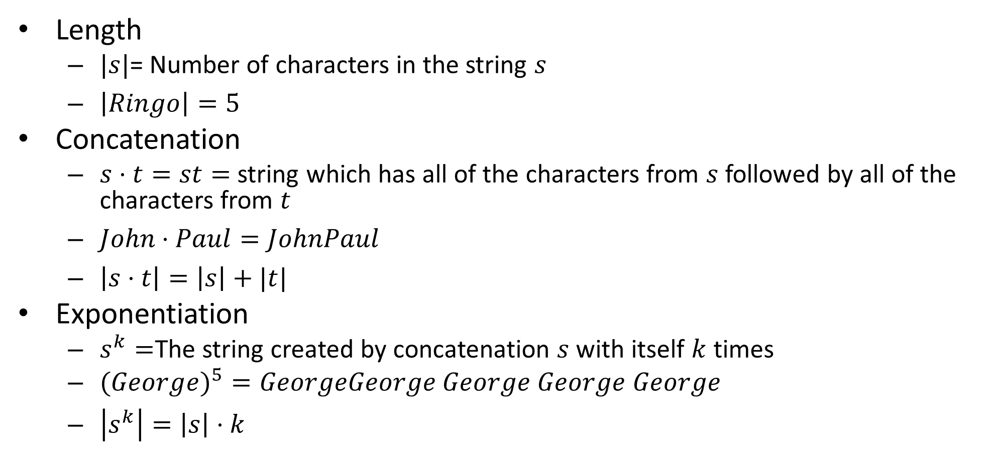
Operations on Strings
Length
$|s|$= Number of characters in the string $s$
$\left|Ringo\right|=5$
Concatenation
$s⋅t=st=$ string which has all of the characters from $s$ followed by all of the characters from $t$
$John⋅Paul=JohnPaul$
$\left|s⋅t\right|=\left|s\right|+|t|$
Exponentiation
$s^{k}=$The string created by concatenation $s$ with itself $k$ times
$(Georg{e)}^{5}=GeorgeGeorge$ $George$ $George$ $George$
$\left|s^{k}\right|=\left|s\right|⋅k$

Slide 9

Empty String (“”)
Notation for this class: $ε$
\varepsilon in Latex
$\left|ε\right|=0$
$s⋅ε=s$
$ε^{k}=ε$

Slide 10
Operations on Languages
Any operation on Sets
Union
Intersection
Complementation
Concatenation

Slide 11
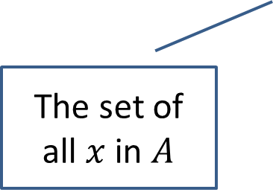
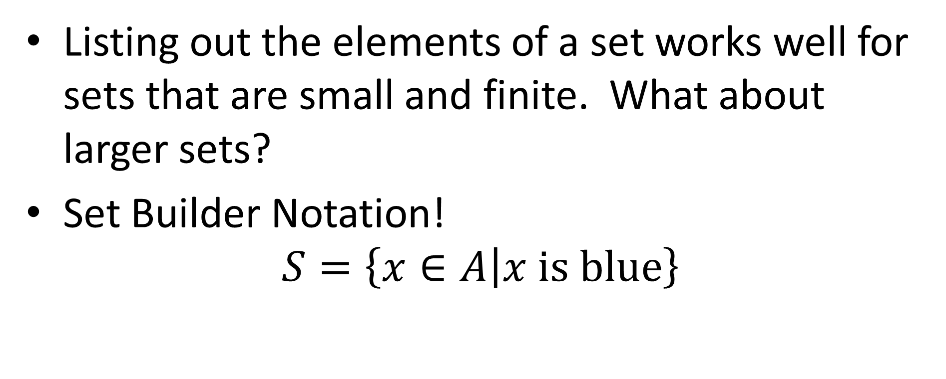
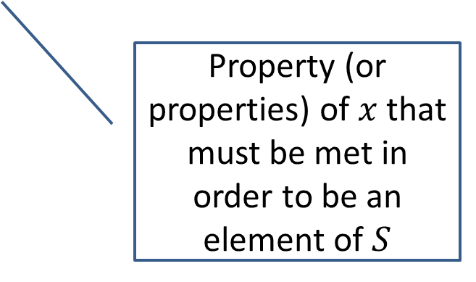
Set review
Listing out the elements of a set works well for sets that are small and finite. What about larger sets?
Set Builder Notation!
$$S=\left\{x∈A | x \text{is} \text{blue}\right\}$$
Property (or properties) of $x$ that must be met in order to be an element of $S$
The set of all $x$ in $A$
Vertical Bar is read “such that”

Slide 12
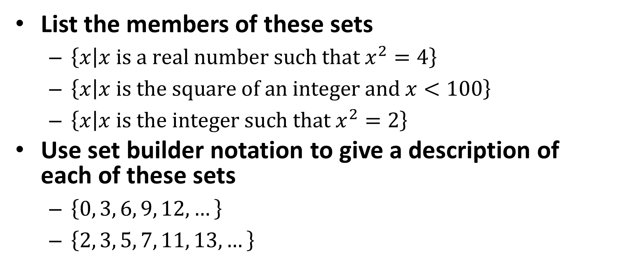
Examples
List the members of these sets
$\left\{x | x \text{is} \text{a} \text{real} \text{number} \text{such} \text{that} x^{2}=4\right\}$
$\left\{x | x \text{is} \text{the} \text{square} \text{of} \text{an} \text{integer} \text{and} x<100\right\}$
$\left\{x | x \text{is} \text{the} \text{integer} \text{such} \text{that} x^{2}=2\right\}$
Use set builder notation to give a description of each of these sets
$\left\{0, 3, 6, 9, 12, …\right\}$
$\left\{2, 3, 5, 7, 11, 13, …\right\}$

Slide 13

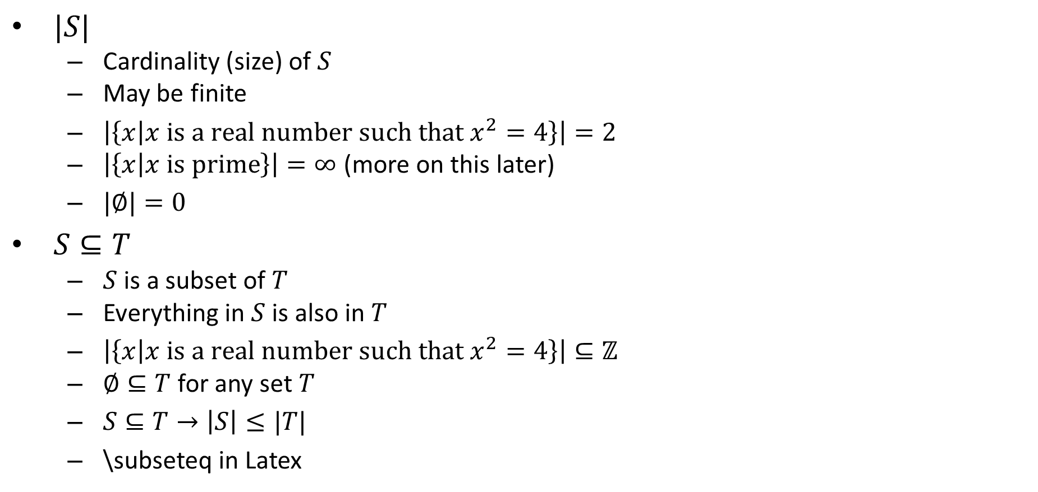


Set Operations
$|S|$
Cardinality (size) of $S$
May be finite
$\left|\left\{x | x \text{is} \text{a} \text{real} \text{number} \text{such} \text{that} x^{2}=4\right\}\right|=2$
$\left|\left\{x | x \text{is} prime\right\}\right|=∞$ (more on this later)
$|∅|=0$
$S⊆T$
$S$ is a subset of $T$
Everything in $S$ is also in $T$
$\left|\left\{x | x \text{is} \text{a} \text{real} \text{number} \text{such} \text{that} x^{2}=4\right\}\right|⊆ℤ$
$∅⊆T$ for any set $T$
$S⊆T→\left|S\right|≤|T|$
\subseteq in Latex
$$T$$
$$S=T$$
$$S$$

Slide 14

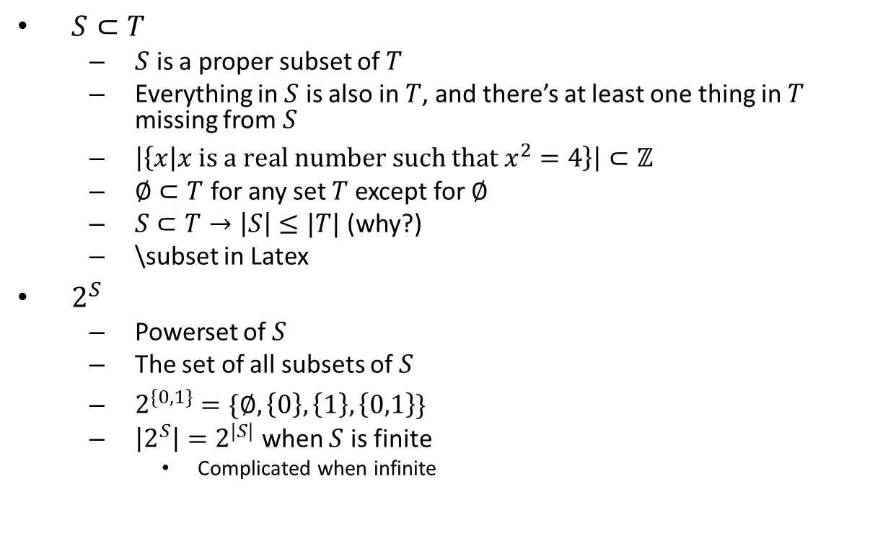


Set Operations
$S⊂T$
$S$ is a proper subset of $T$
Everything in $S$ is also in $T$, and there’s at least one thing in $T$ missing from $S$
$\left|\left\{x | x \text{is} \text{a} \text{real} \text{number} \text{such} \text{that} x^{2}=4\right\}\right|⊂ℤ$
$∅⊂T$ for any set $T$ except for $∅$
$S⊂T→\left|S\right|≤|T|$ (why?)
\subset in Latex
$2^{S}$
Powerset of $S$
The set of all subsets of $S$
$2^{\{0,1\}}=\{∅, \left\{0\right\},\left\{1\right\},\left\{0,1\right\}\}$
$\left|2^{S}\right|=2^{|S|}$ when $S$ is finite
Complicated when infinite
$$T$$
$$S$$
$$S=T$$

Slide 15



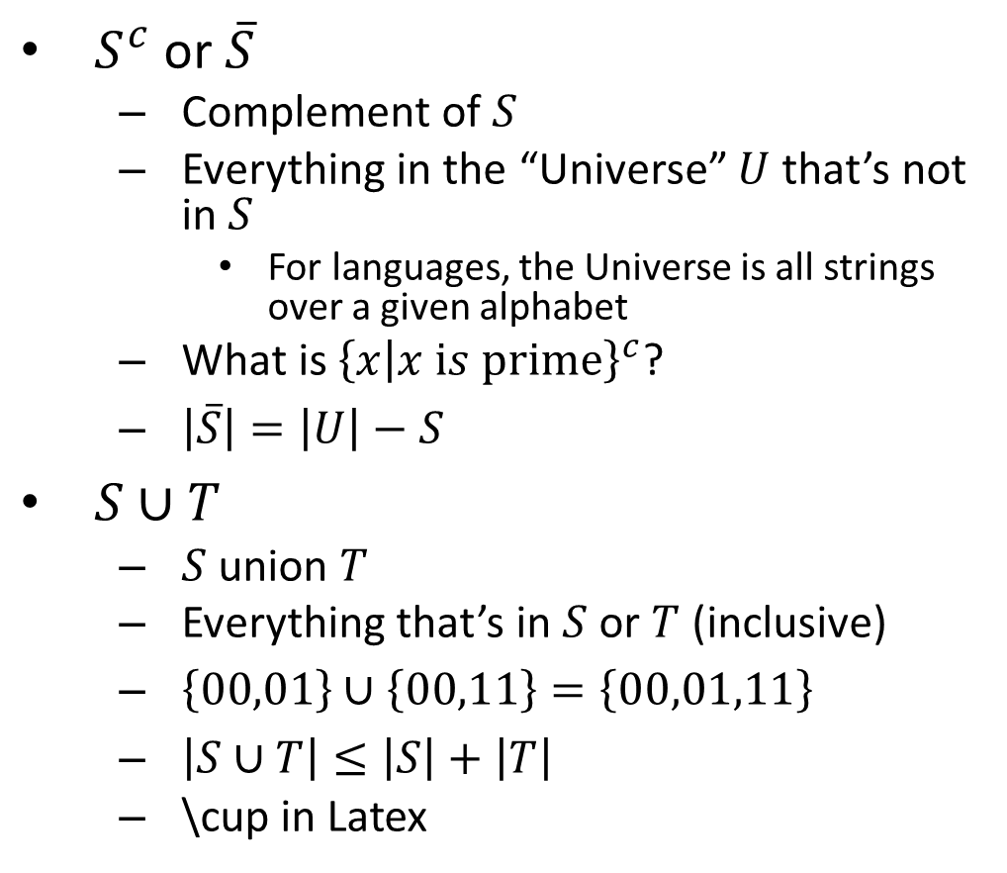



Set Operations Cont.
$$U$$
$S^{c}$ or $\overline{S}$
Complement of $S$
Everything in the “Universe” $U$ that’s not in $S$
For languages, the Universe is all strings over a given alphabet
What is ${\left\{x | x is prime\right\}}^{c}$?
$\left|\overline{S}\right|=\left|U\right|−S$
$S∪T$
$S$ union $T$
Everything that’s in $S$ or $T$ (inclusive)
$\left\{00,01\right\}∪\left\{00,11\right\}=\left\{00,01,11\right\}$
$\left|S∪T\right|≤\left|S\right|+\left|T\right|$
\cup in Latex
$$\overline{S}$$
$$S$$
$$S$$
$$T$$
$$S∪T$$

Slide 16








Set Operations Cont.
$S∩T$
$S$ intersect $T$
Everything that’s in both of $S$ and $T$
$\left\{00,01\right\}∩\left\{00,11\right\}=\left\{00\right\}$
$\left|S∩T\right|=\left|S\right|+\left|T\right|−\left|S∪T\right|$
\cap in Latex
$S−T$
$S$ minus $T$
Everying in $S$ that’s not in $T$
$S−T=S∩\overline{T}$
$S×T$
$S$ cross product $T$
Ordered pairs of something from $S$ with something from $T$
$\left\{a,b\right\}×\left\{a,c\right\}=\left\{\left(a,a\right),\left(a,c\right),\left(b,a\right),(b,c)\right\}$
$\left|S×T\right|=\left|S\right|⋅\left|T\right|$
\times in Latex
$$S$$
$$T$$
$$S∩T$$
$$S$$
$$T$$
$$S−T$$
$$T$$

Slide 17

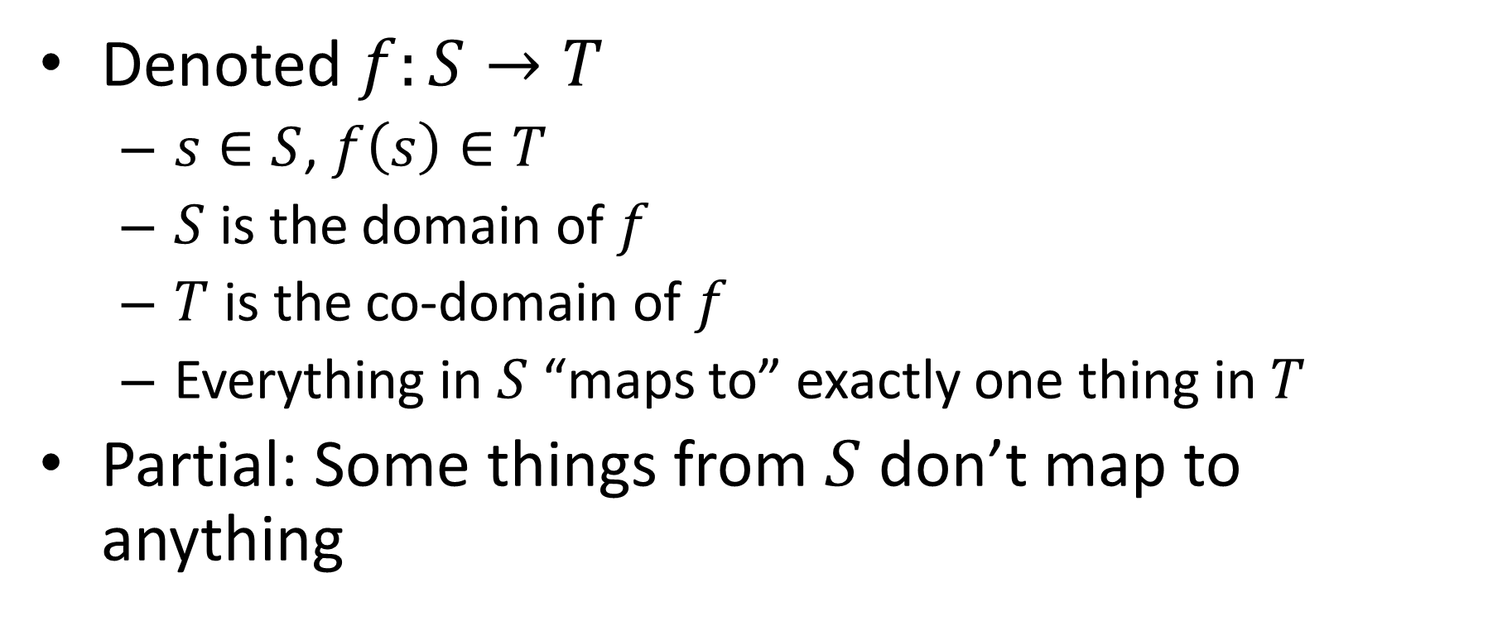


Functions
$$f$$
Denoted $f:S→T$
$s∈S$, $f\left(s\right)∈T$
$S$ is the domain of $f$
$T$ is the co-domain of $f$
Everything in $S$ “maps to” exactly one thing in $T$
Partial: Some things from $S$ don’t map to anything
$$T$$
$$S$$

Slide 18
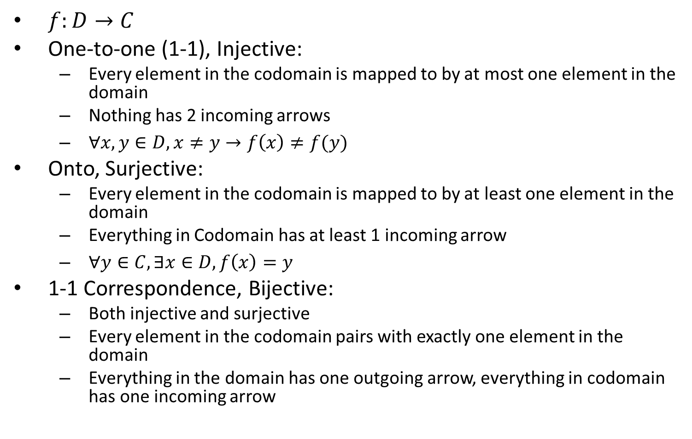
Properties of Functions
$f:D→C$
One-to-one (1-1), Injective:
Every element in the codomain is mapped to by at most one element in the domain
Nothing has 2 incoming arrows
$∀x,y∈D, x≠y→f\left(x\right)≠f(y)$
Onto, Surjective:
Every element in the codomain is mapped to by at least one element in the domain
Everything in Codomain has at least 1 incoming arrow
$∀y∈C, ∃x∈D, f\left(x\right)=y$
1-1 Correspondence, Bijective:
Both injective and surjective
Every element in the codomain pairs with exactly one element in the domain
Everything in the domain has one outgoing arrow, everything in codomain has one incoming arrow

Slide 19
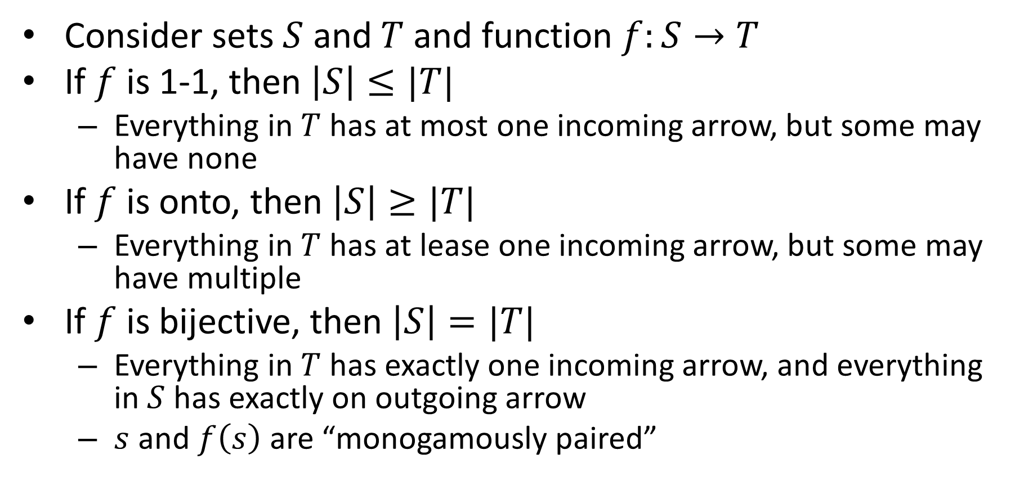
Functions and Set Cardinalities
Consider sets $S$ and $T$ and function $f:S→T$
If $f$ is 1-1, then $\left|S\right|≤|T|$
Everything in $T$ has at most one incoming arrow, but some may have none
If $f$ is onto, then $\left|S\right|≥|T|$
Everything in $T$ has at lease one incoming arrow, but some may have multiple
If $f$ is bijective, then $\left|S\right|=|T|$
Everything in $T$ has exactly one incoming arrow, and everything in $S$ has exactly on outgoing arrow
$s$ and $f\left(s\right)$ are “monogamously paired”

Slide 20
Set Cardinalities
How can I show that two sets are the same size?
How Can I show that two sets are different sizes?
What if the sets are infinite?

Slide 21
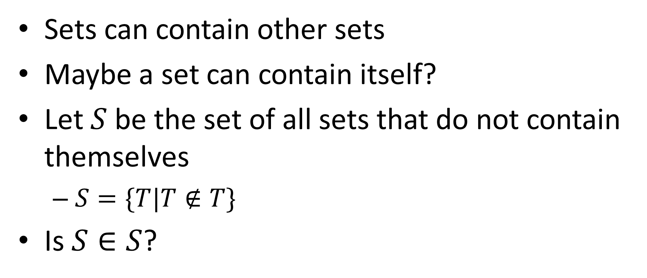
Brain Teaser
Sets can contain other sets
Maybe a set can contain itself?
Let $S$ be the set of all sets that do not contain themselves
$S=\{T|T∉T\}$
Is $S∈S$?

Slide 22
HW1
Due Monday (2/4)
Programming portion:
Write Java code for deciders
Use those deciders to produce the sets of strings they compute
Written portion:
Proofs
Sets and functions (next time)

