Slide 1


CS3102 Theory of Computation
www.cs.virginia.edu/~njb2b/cs3102
When your professor tries to meme
0.99999… < 1

Slide 2
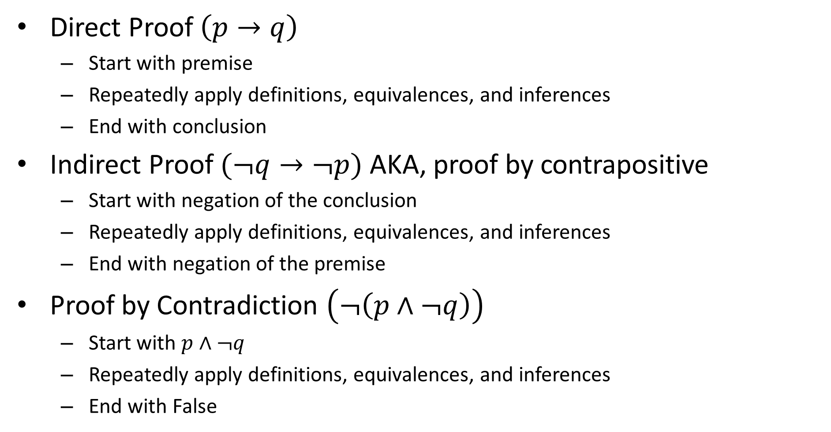

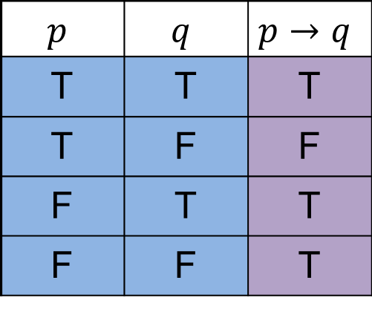
How to prove $p→q$
Direct Proof $\left(p→q\right)$
Start with premise
Repeatedly apply definitions, equivalences, and inferences
End with conclusion
Indirect Proof $(¬q→¬p)$ AKA, proof by contrapositive
Start with negation of the conclusion
Repeatedly apply definitions, equivalences, and inferences
End with negation of the premise
Proof by Contradiction $\left(¬\left(p∧¬q\right)\right)$
Start with $p∧¬q$
Repeatedly apply definitions, equivalences, and inferences
End with False
$$p$$ | $$q$$ | $$p→q$$
T | T | T
T | F | F
F | T | T
F | F | T

Slide 3
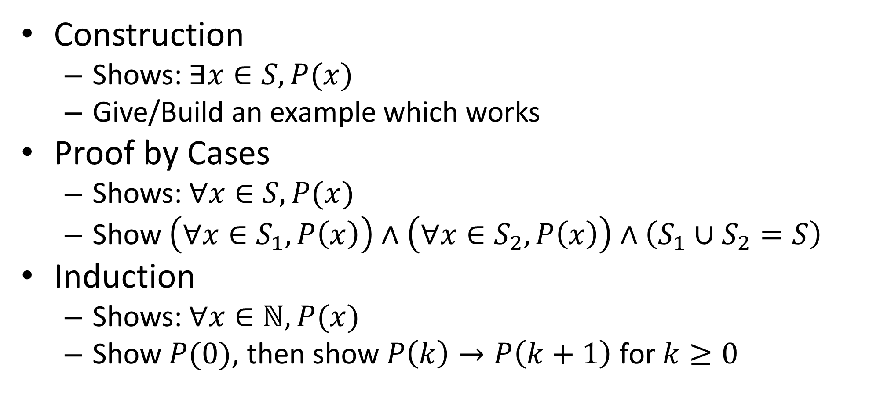
Proofs Techniques Cont.
Construction
Shows: $∃x∈S, P(x)$
Give/Build an example which works
Proof by Cases
Shows: $∀x∈S, P(x)$
Show $\left(∀x∈S_{1}, P\left(x\right)\right)∧\left(∀x∈S_{2},P\left(x\right)\right)∧\left(S_{1}∪S_{2}=S\right)$
Induction
Shows: $∀x∈ℕ, P(x)$
Show $P(0)$, then show $P\left(k\right)→P\left(k+1\right)$ for $k≥0$

Slide 4
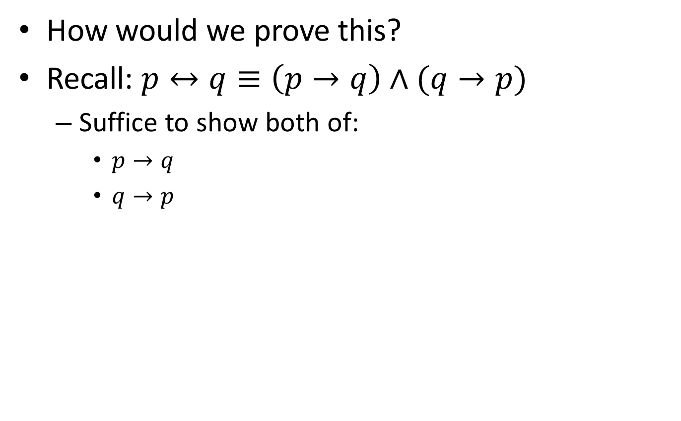

Proof: $n^{2}$ is even $↔$ $n$ is even
How would we prove this?
Recall: $p↔q≡\left(p→q\right)∧(q→p)$
Suffice to show both of:
$p→q$
$q→p$

Slide 5
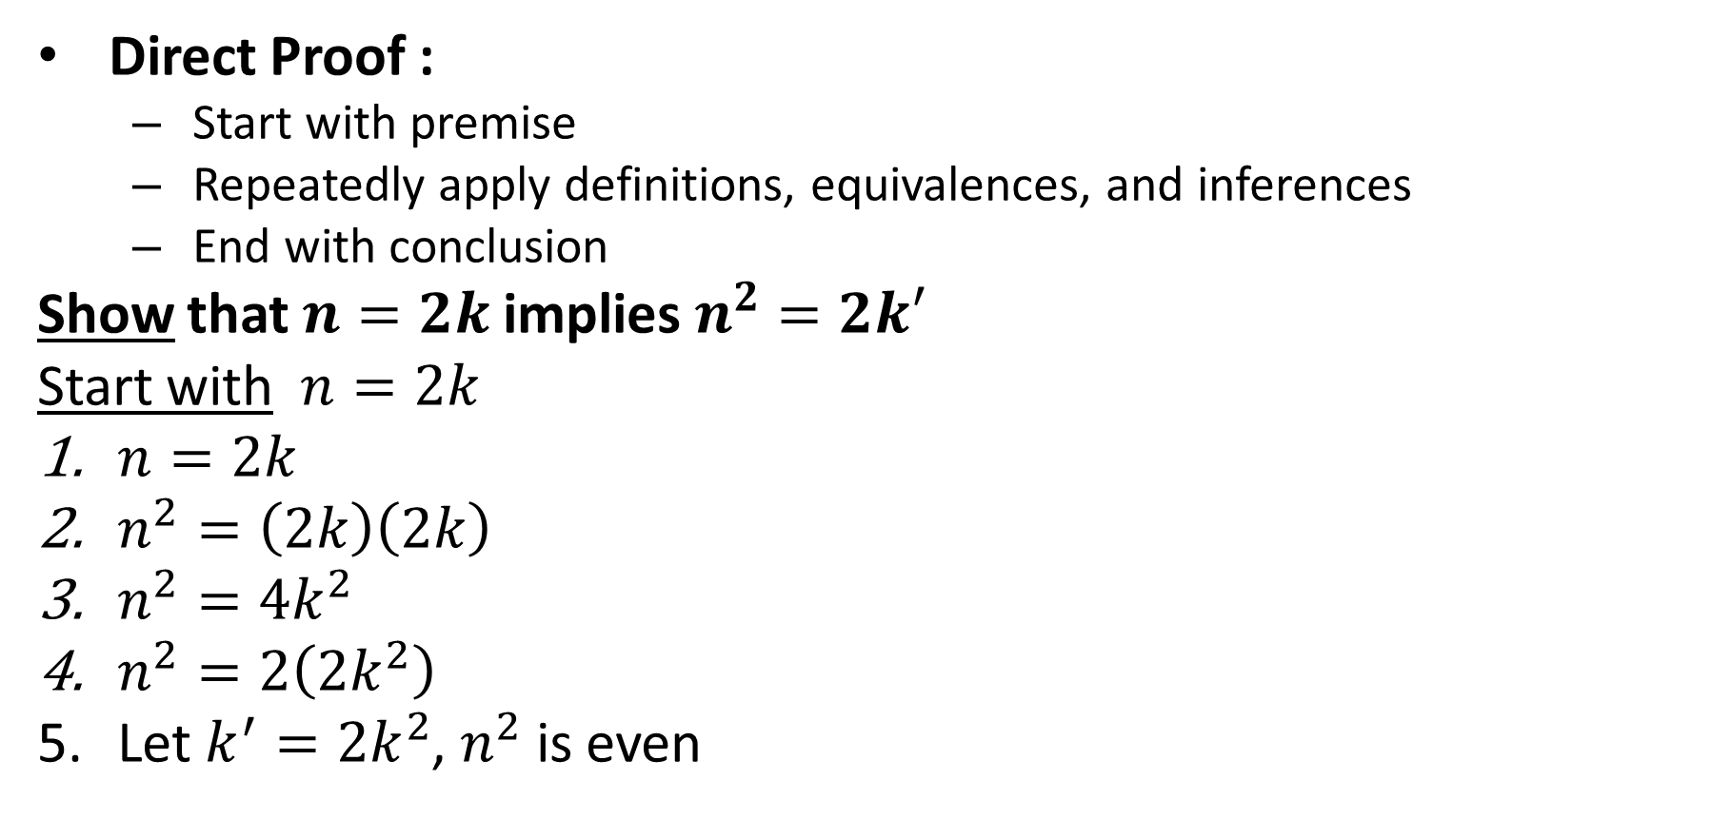

Proof: if $n^{2}$ is even $←$ $n$ is even
Direct Proof :
Start with premise
Repeatedly apply definitions, equivalences, and inferences
End with conclusion
Show that $n=2k$ implies $n^{2}=2k′$
Start with $n=2k$
$n=2k$
$n^{2}=\left(2k\right)\left(2k\right)$
$n^{2}=4k^{2}$
$n^{2}=2\left(2k^{2}\right)$
Let $k^{′}=2k^{2}$, $n^{2}$ is even

Slide 6
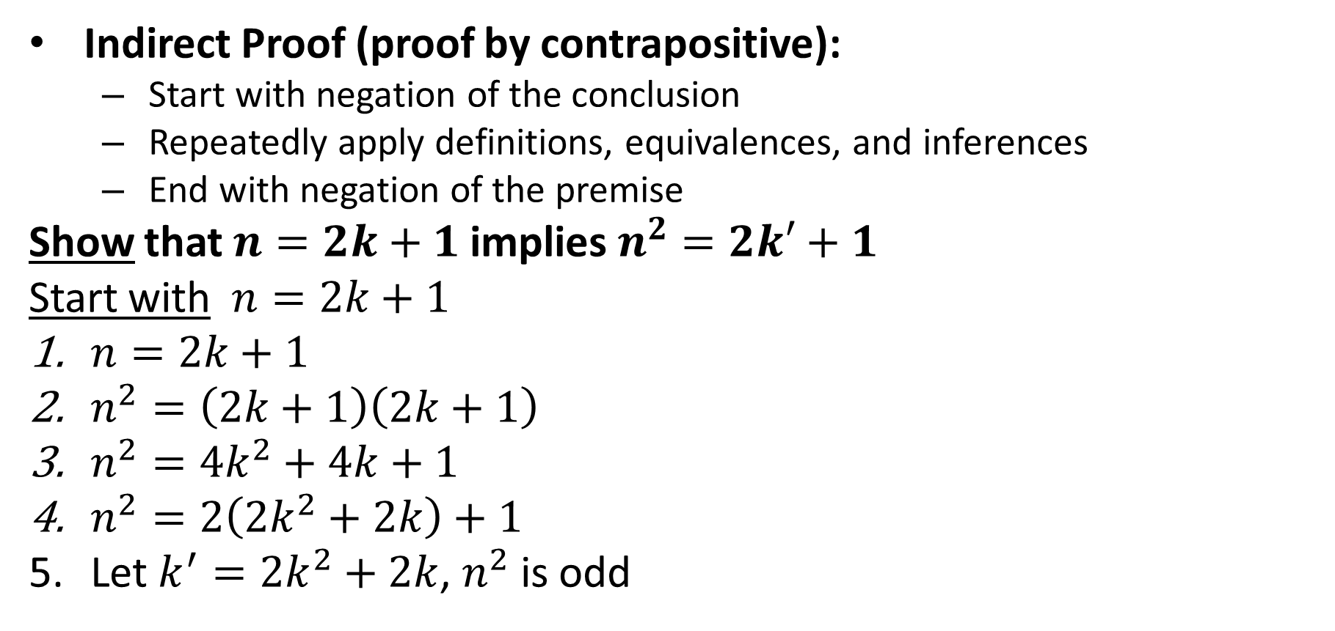

Proof: if $n^{2}$ is even $→$ $n$ is even
Indirect Proof (proof by contrapositive):
Start with negation of the conclusion
Repeatedly apply definitions, equivalences, and inferences
End with negation of the premise
Show that $n=2k+1$ implies $n^{2}=2k′+1$
Start with $n=2k+1$
$n=2k+1$
$n^{2}=\left(2k+1\right)\left(2k+1\right)$
$n^{2}=4k^{2}+4k+1$
$n^{2}=2\left(2k^{2}+2k\right)+1$
Let $k^{′}=2k^{2}+2k$, $n^{2}$ is odd

Slide 7
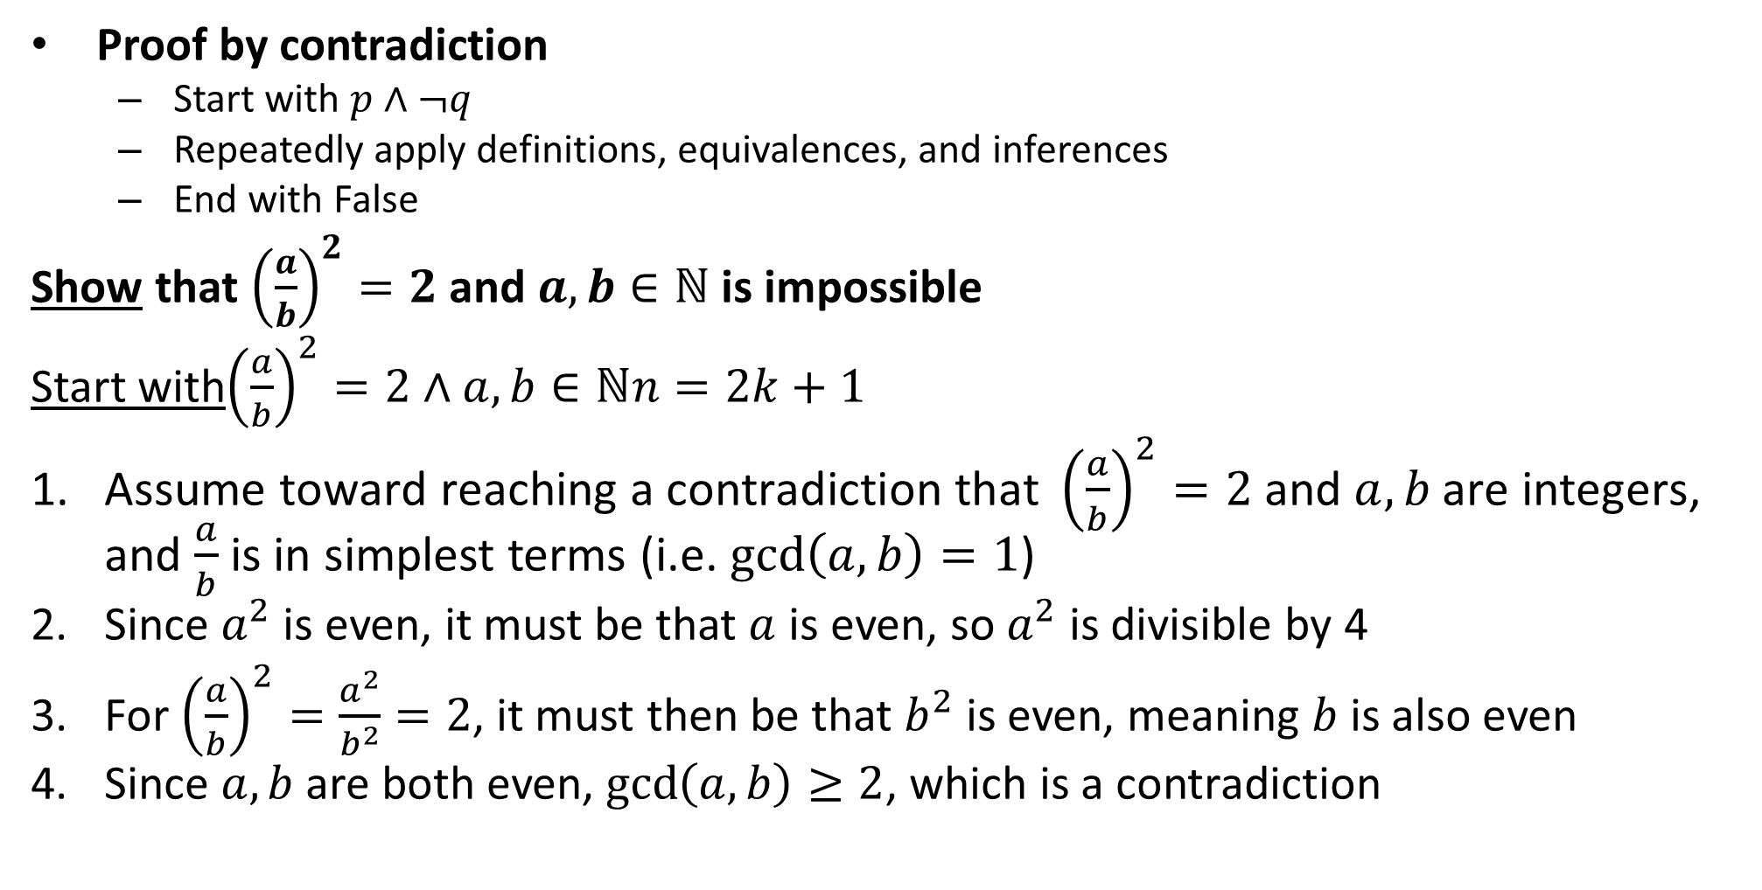

Proof: $√2$ is not rational
Proof by contradiction
Start with $p∧¬q$
Repeatedly apply definitions, equivalences, and inferences
End with False
Show that ${\left(\frac{a}{b}\right)}^{2}=2$ and $a,b∈ℕ$ is impossible
Start with${\left(\frac{a}{b}\right)}^{2}=2∧a,b∈ℕn=2k+1$
$\text{Assume} \text{toward} \text{reaching} \text{a} \text{contradiction} \text{that} {\left(\frac{a}{b}\right)}^{2}=2 \text{and} a,b \text{are} \text{integers}$, and $\frac{a}{b}$ is in simplest terms (i.e. $\gcd\left(a,b\right)=1$)
Since $a^{2}$ is even, it must be that $a$ is even, so $a^{2}$ is divisible by 4
For ${\left(\frac{a}{b}\right)}^{2}=\frac{a^{2}}{b^{2}}=2$, it must then be that $b^{2}$ is even, meaning $b$ is also even
Since $a,b$ are both even, $\gcd\left(a,b\right)≥2$, which is a contradiction

Slide 8
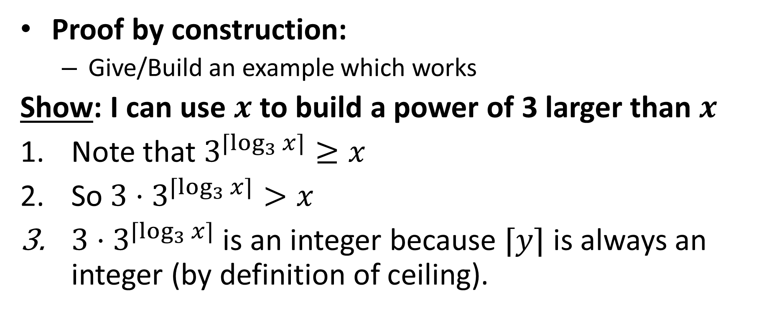

Proof: For any integer $x$, there is a power of 3 larger than $x$
Proof by construction:
Give/Build an example which works
Show: I can use $x$ to build a power of 3 larger than $x$
Note that $3^{⌈\log_{3}{x}⌉}≥x$
So ${3⋅3}^{⌈\log_{3}{x}⌉}>x$
${3⋅3}^{⌈\log_{3}{x}⌉}$ is an integer because $⌈y⌉$ is always an integer (by definition of ceiling).

Slide 9
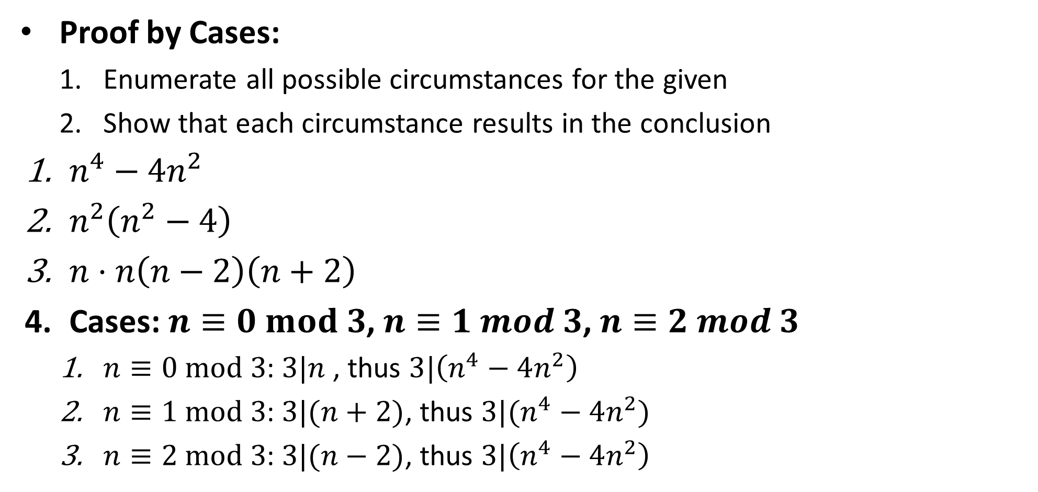

Proof: $n^{4}−4n^{2}$ is divisible by 3
Proof by Cases:
Enumerate all possible circumstances for the given
Show that each circumstance results in the conclusion
$n^{4}−4n^{2}$
$n^{2}\left(n^{2}−4\right)$
$n⋅n\left(n−2\right)\left(n+2\right)$
Cases: $n≡0 mod 3$, $n≡1 mod 3$, $n≡2 mod 3$
$n≡0 mod 3$: $3|n$ , thus $3|\left(n^{4}−4n^{2}\right)$
$n≡1 mod 3$: $3|(n+2)$, thus $3|(n^{4}−4n^{2})$
$n≡2 mod 3$: $3|(n−2)$, thus $3|\left(n^{4}−4n^{2}\right)$

Slide 10
When writing a proof
Mention method of proof you’re using
List everything given (all assumptions you’re making)
State formally what you are going to prove
State your proof as clearly and concisely as you can
providing accompanying intuition is often helpful)

Slide 11
Twice an odd number is sometimes odd

Slide 12
Some even numbers are the products of two odds

Slide 13
A number can be both even and odd

Slide 14
There is a largest number

Slide 15
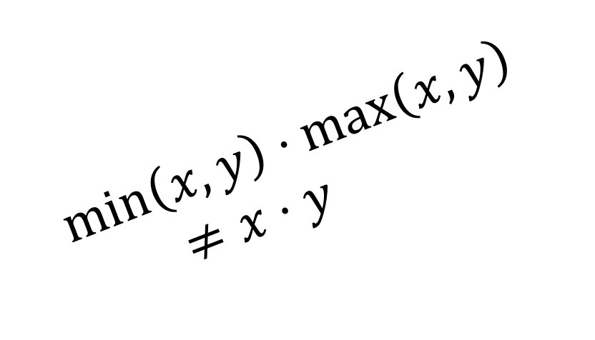
$$\min\left(x,y\right)⋅\max\left(x,y\right)≠x⋅y$$

Slide 16
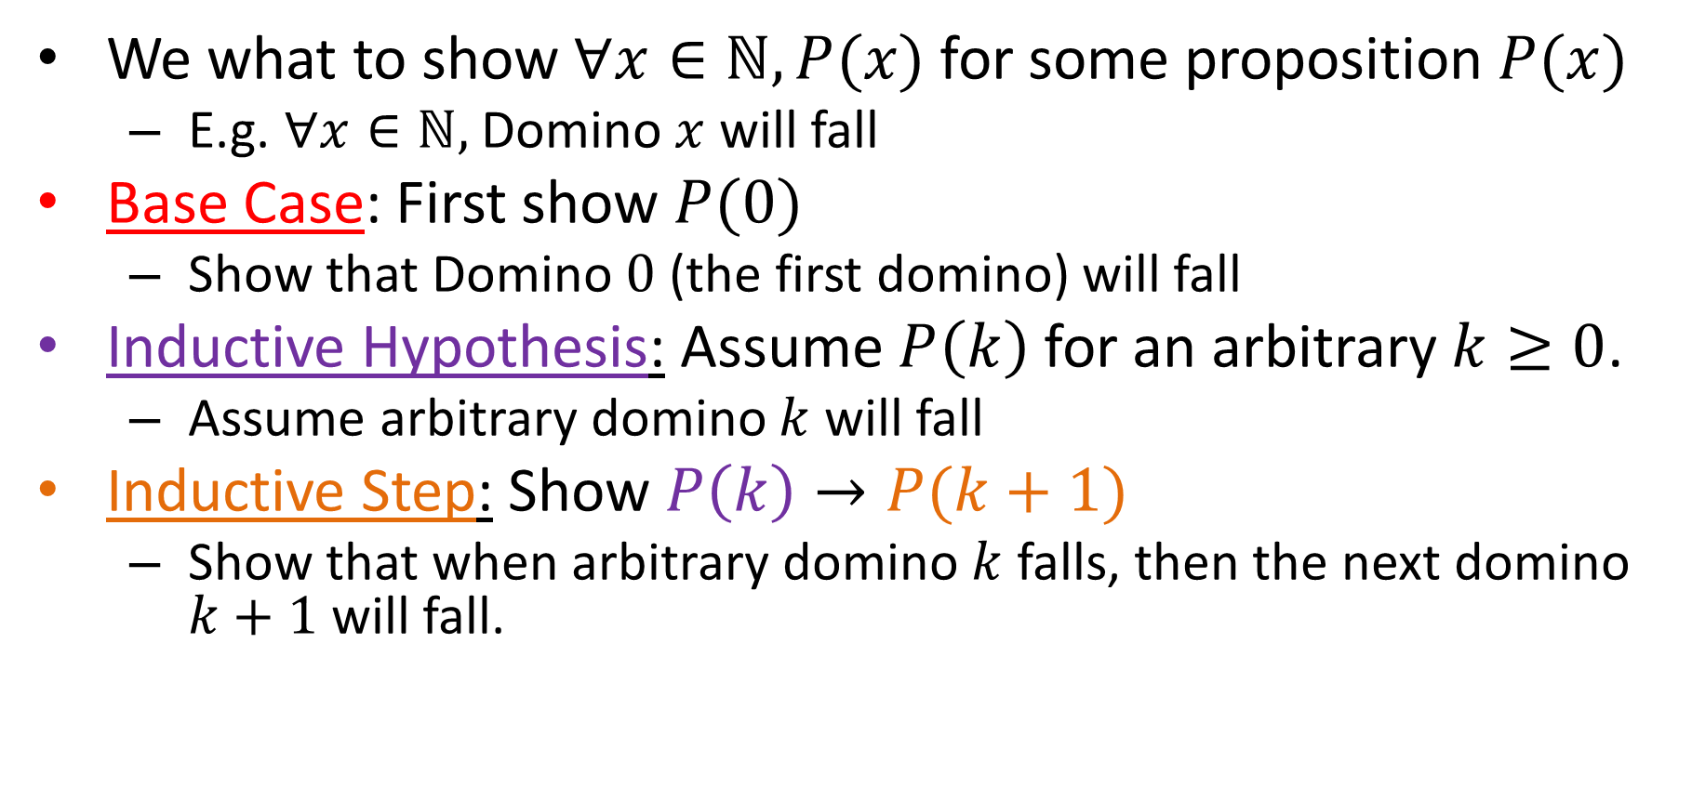
Mathematical Induction
We what to show $∀x∈ℕ, P(x)$ for some proposition $P(x)$
E.g. $∀x∈ℕ,$Domino $x$ will fall
Base Case: First show $P(0)$
Show that Domino $0$ (the first domino) will fall
Inductive Hypothesis: Assume $P\left(k\right)$ for an arbitrary $k≥0$.
Assume arbitrary domino $k$ will fall
Inductive Step: Show $P\left(k\right)→P(k+1)$
Show that when arbitrary domino $k$ falls, then the next domino $k+1$ will fall.

Slide 17
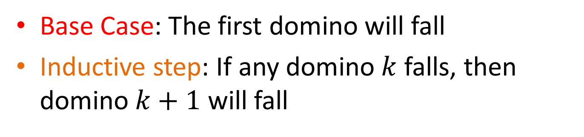
Mathematical Induction
Base Case: The first domino will fall
Inductive step: If any domino $k$ falls, then domino $k+1$ will fall
All dominos fall!!
Falls because of base Case
Falls because of Inductive Step
Falls because of Inductive Step
Falls because of Inductive Step

Slide 18

Hi-Ho-Cherry-O
Each Player takes turns removing 1, 2, 3, or 4 cherries from play
First player unable to pick a cherry loses

Slide 19
It’s better to go first

Slide 20
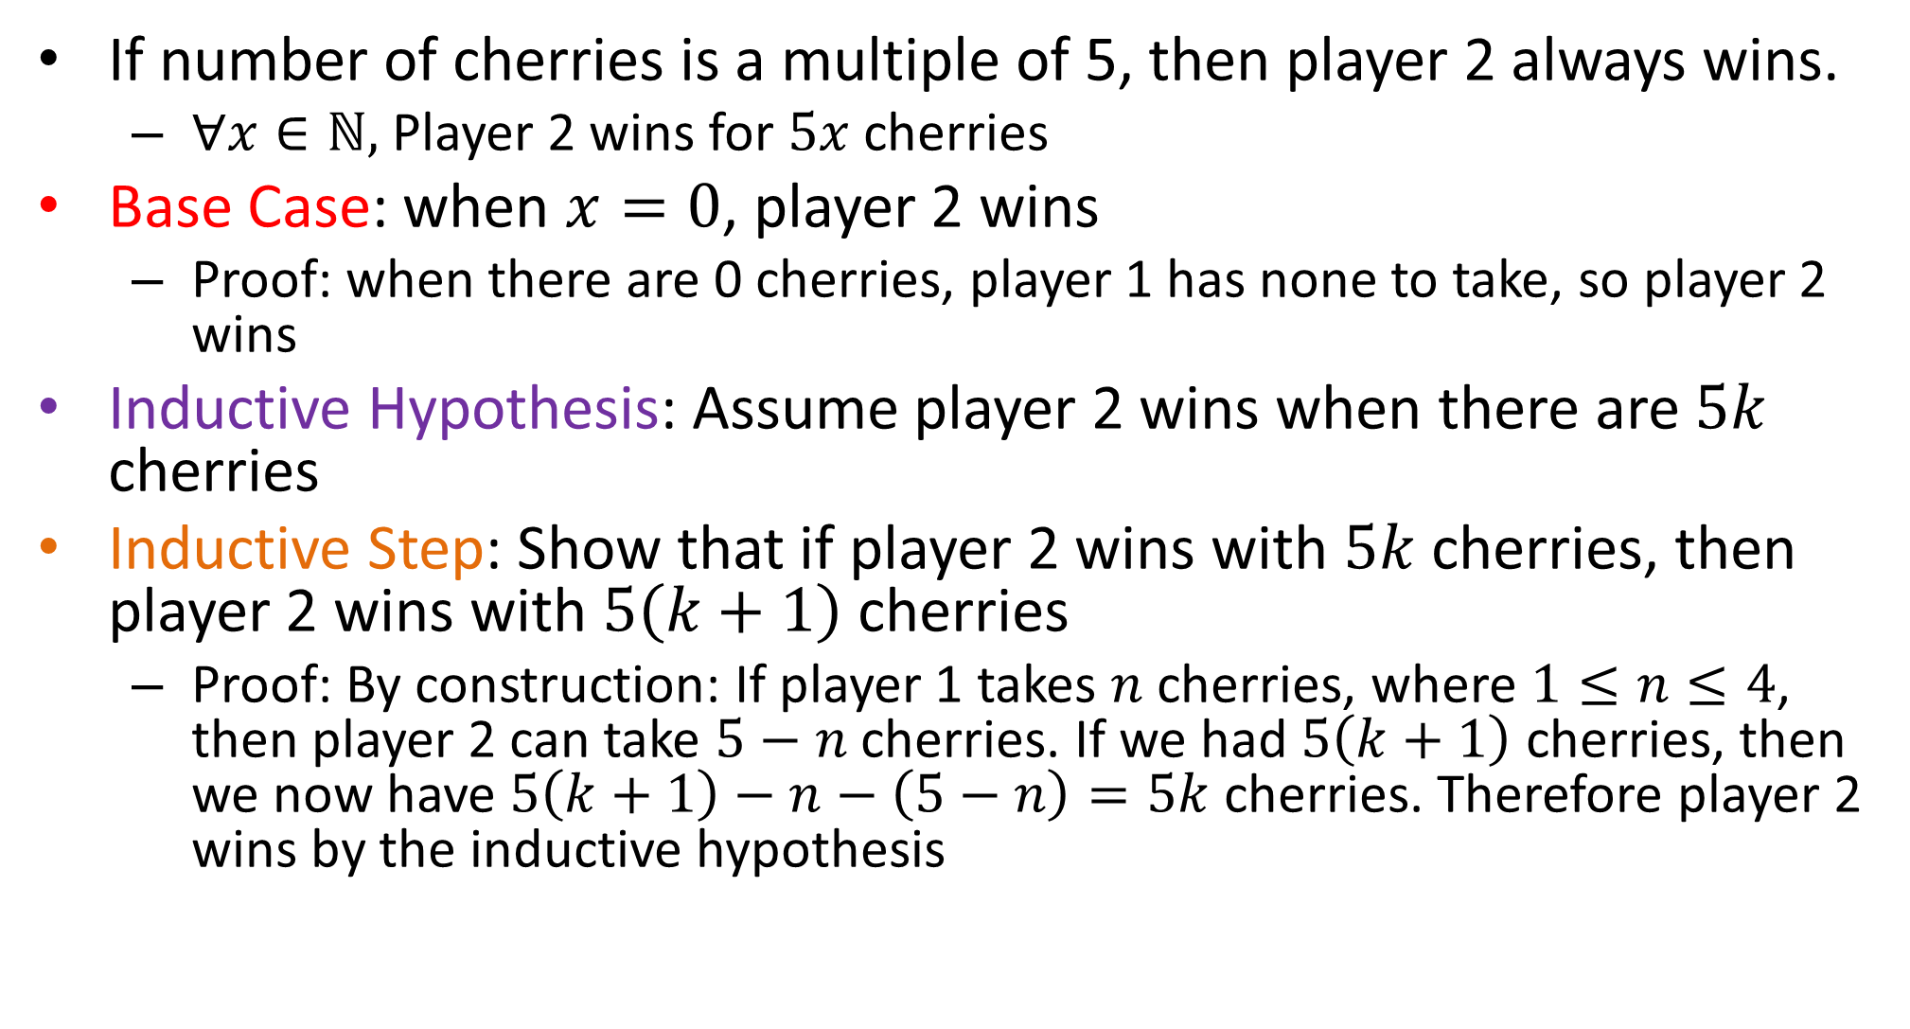
Player 2 always wins
If number of cherries is a multiple of 5, then player 2 always wins.
$∀x∈ℕ,$Player 2 wins for $5x$ cherries
Base Case: when $x=0$, player 2 wins
Proof: when there are 0 cherries, player 1 has none to take, so player 2 wins
Inductive Hypothesis: Assume player 2 wins when there are $5k$ cherries
Inductive Step: Show that if player 2 wins with $5k$ cherries, then player 2 wins with $5\left(k+1\right)$ cherries
Proof: By construction: If player 1 takes $n$ cherries, where $1≤n≤4$, then player 2 can take $5−n$ cherries. If we had $5\left(k+1\right)$ cherries, then we now have $5\left(k+1\right)−n−\left(5−n\right)=5k$ cherries. Therefore player 2 wins by the inductive hypothesis

Slide 21
Problems with induction
Useless for helping you to find the answer
You have to know the answer first
Does not provide insights into why something is true
Does not give any clues on how to correct if you’re wrong

