Slide 1
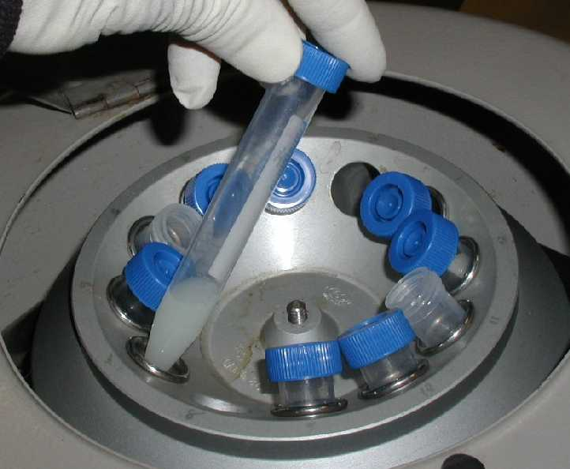
CS3102 Theory of Computation
www.cs.virginia.edu/~njb2b/cs3102
Can 5 test tubes be spun simultaneously in a 12-hole centrifuge in a balanced way?

Slide 2
Can 5 test tubes be spun simultaneously in a 12-hole centrifuge in a balanced way?
What does “balanced” mean?
Symmetry
Superposition
Complementarity

Slide 3
What makes a proof “good”?

Slide 4
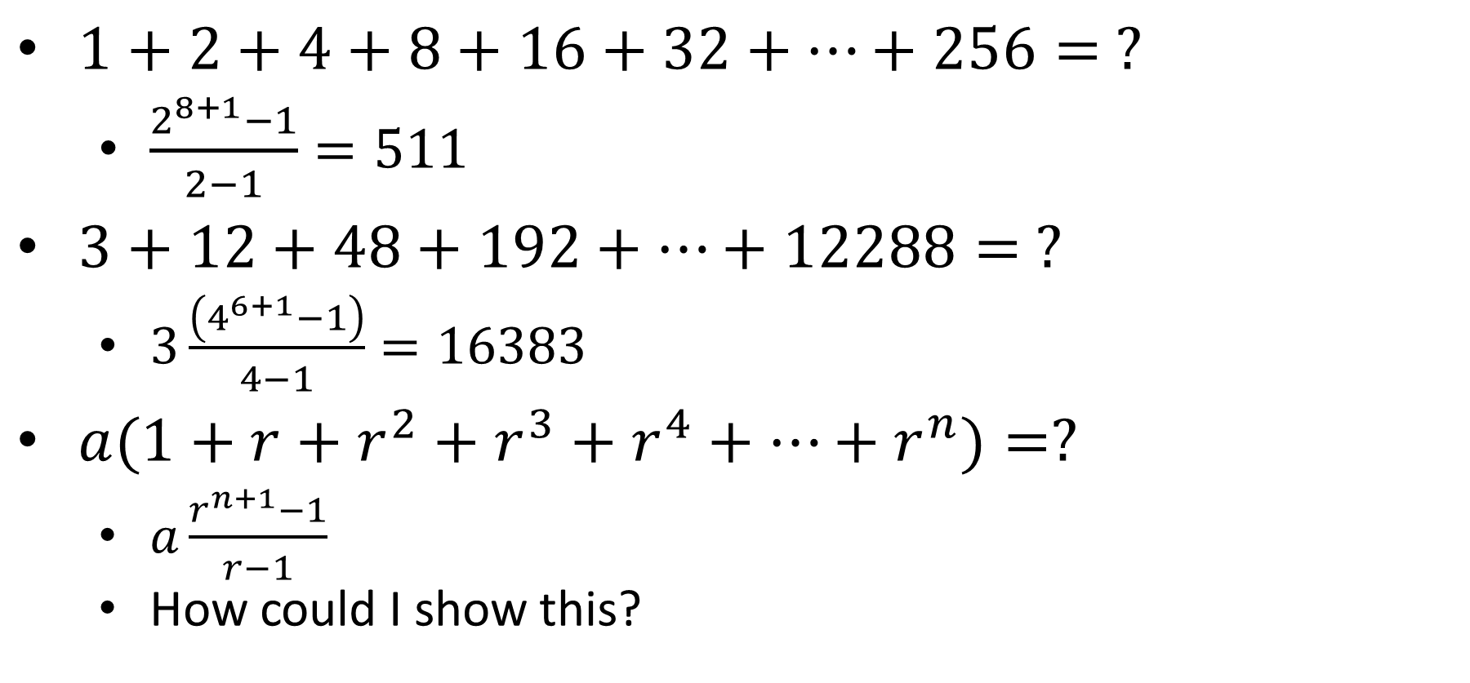
Finite Geometric Series
$1+2+4+8+16+32+…+256= ?$
$\frac{2^{8+1}−1}{2−1}=511$
$3+12+48+192+…+12288= ?$
$3\frac{\left(4^{6+1}−1\right)}{4−1}=16383$
$a(1+r+r^{2}+r^{3}+r^{4}+…+r^{n})=?$
$a\frac{r^{n+1}−1}{r−1}$
How could I show this?

Slide 5
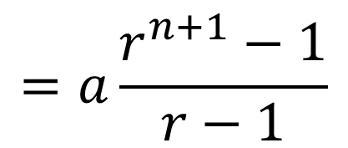
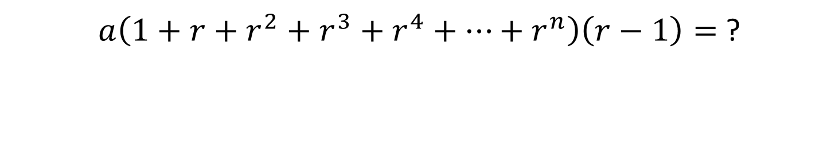
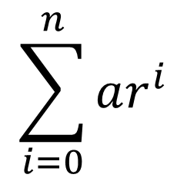

Finite Geometric Series
$a\left(1+r+r^{2}+r^{3}+r^{4}+…+r^{n}\right)\left(r−1\right)=$ ?
$$a\left(r+r^{2}+r^{3}+r^{4}+r^{5}+…+r^{n}+r^{n+1}\right)+$$
$$a\left(−r−r^{2}−r^{3}−r^{4}−r^{5}−…−r^{n}−1\right)=$$
$$a(r^{n+1}−1)$$
$$\sum_{i=0}^{n}{ar^{i}}$$
$$=a\frac{r^{n+1}−1}{r−1}$$

Slide 6

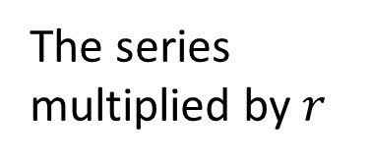





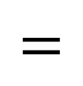

Finite Geometric Series
$$r>1$$
$$−$$
$$−$$
$$=$$
The series multiplied by $r$
The series
The next term in the series
The first term
$$\left(a+ar+…+ar^{n}\right)r$$
$$\left(a+ar+…+ar^{n}\right)1$$
$$ar^{n+1}$$
$$a$$

Slide 7
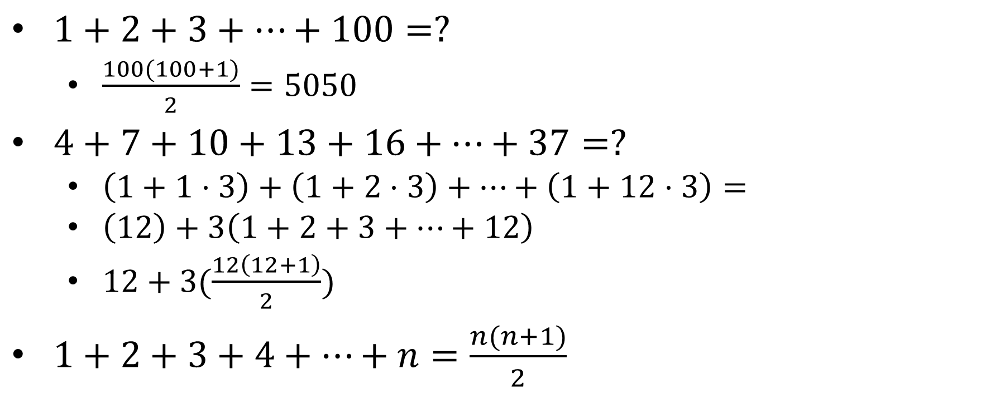
Finite Arithmetic Series
$1+2+3+…+100=?$
$\frac{100(100+1)}{2}=5050$
$4+7+10+13+16+…+37=?$
$\left(1+1⋅3\right)+\left(1+2⋅3\right)+…+\left(1+12⋅3\right)=$
$\left(12\right)+3\left(1+2+3+…+12\right)$
$12+3(\frac{12\left(12+1\right)}{2})$
$1+2+3+4+…+n=\frac{n(n+1)}{2}$

Slide 8



Finite Arithmetic Series
$$1+2+3+…+(n−1)+n=$$
$$\frac{n\left(n+1\right)}{2}$$
$$n$$
$$n+1$$

Slide 9


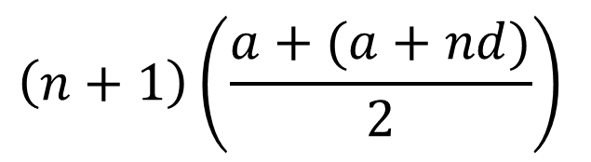
Finite Arithmetic Series
$$a(n+1)+\left(0d+1d+2d+…+nd\right)=$$
$$a\left(n+1\right)+\frac{nd\left(n+1\right)}{2}=$$
$$\left(n+1\right)\left(\frac{a+(a+nd)}{2}\right)$$
Number of terms
Average term value
$$nd$$

Slide 10
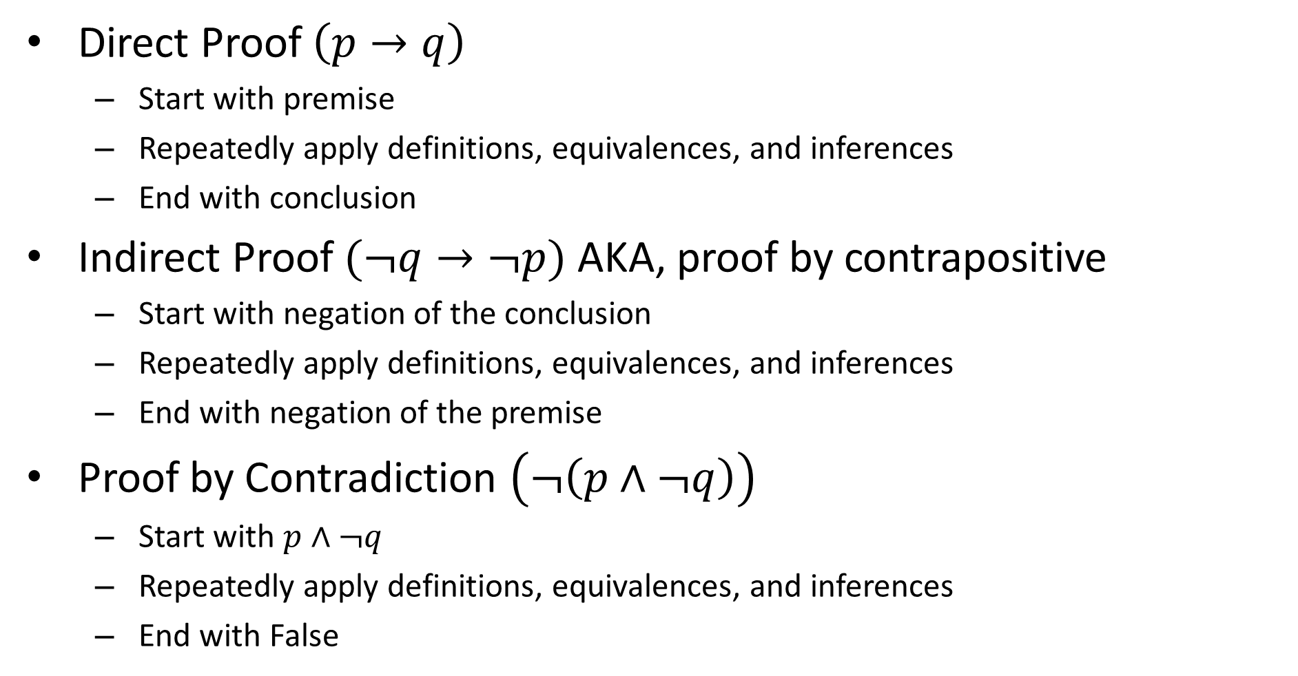

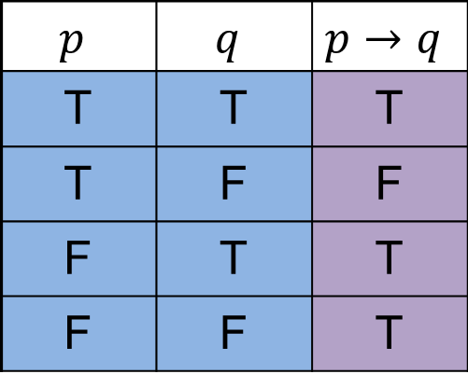
How to prove $p→q$
Direct Proof $\left(p→q\right)$
Start with premise
Repeatedly apply definitions, equivalences, and inferences
End with conclusion
Indirect Proof $(¬q→¬p)$ AKA, proof by contrapositive
Start with negation of the conclusion
Repeatedly apply definitions, equivalences, and inferences
End with negation of the premise
Proof by Contradiction $\left(¬\left(p∧¬q\right)\right)$
Start with $p∧¬q$
Repeatedly apply definitions, equivalences, and inferences
End with False
$$p$$ | $$q$$ | $$p→q$$
T | T | T
T | F | F
F | T | T
F | F | T

Slide 11
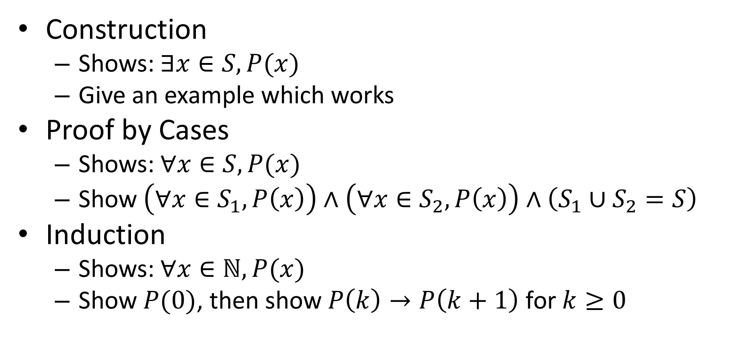
Proofs Techniques Cont.
Construction
Shows: $∃x∈S, P(x)$
Give an example which works
Proof by Cases
Shows: $∀x∈S, P(x)$
Show $\left(∀x∈S_{1}, P\left(x\right)\right)∧\left(∀x∈S_{2},P\left(x\right)\right)∧\left(S_{1}∪S_{2}=S\right)$
Induction
Shows: $∀x∈ℕ, P(x)$
Show $P(0)$, then show $P\left(k\right)→P\left(k+1\right)$ for $k≥0$

Slide 12
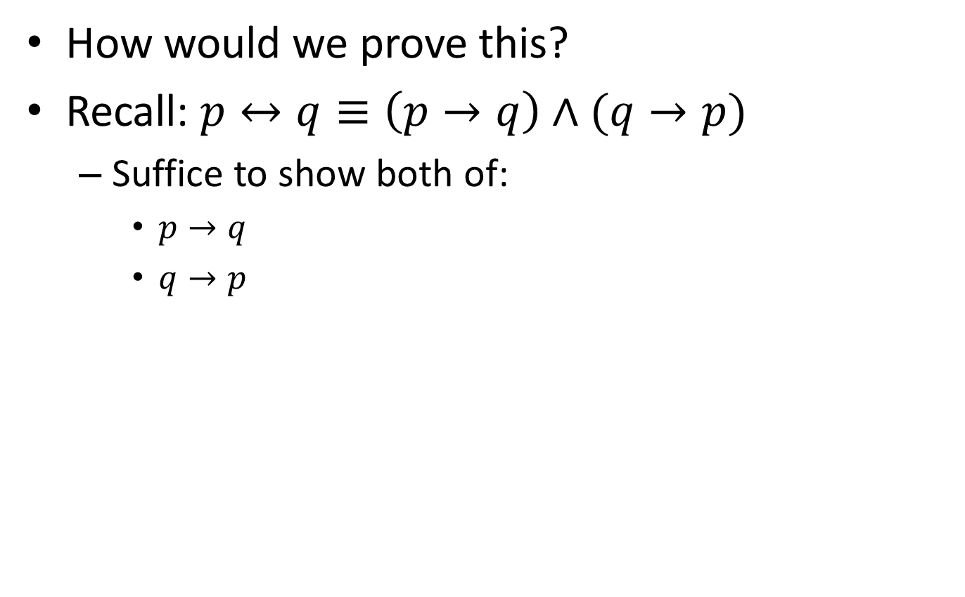

Proof: $n^{2}$ is even $↔$ $n$ is even
How would we prove this?
Recall: $p↔q≡\left(p→q\right)∧(q→p)$
Suffice to show both of:
$p→q$
$q→p$

Slide 13
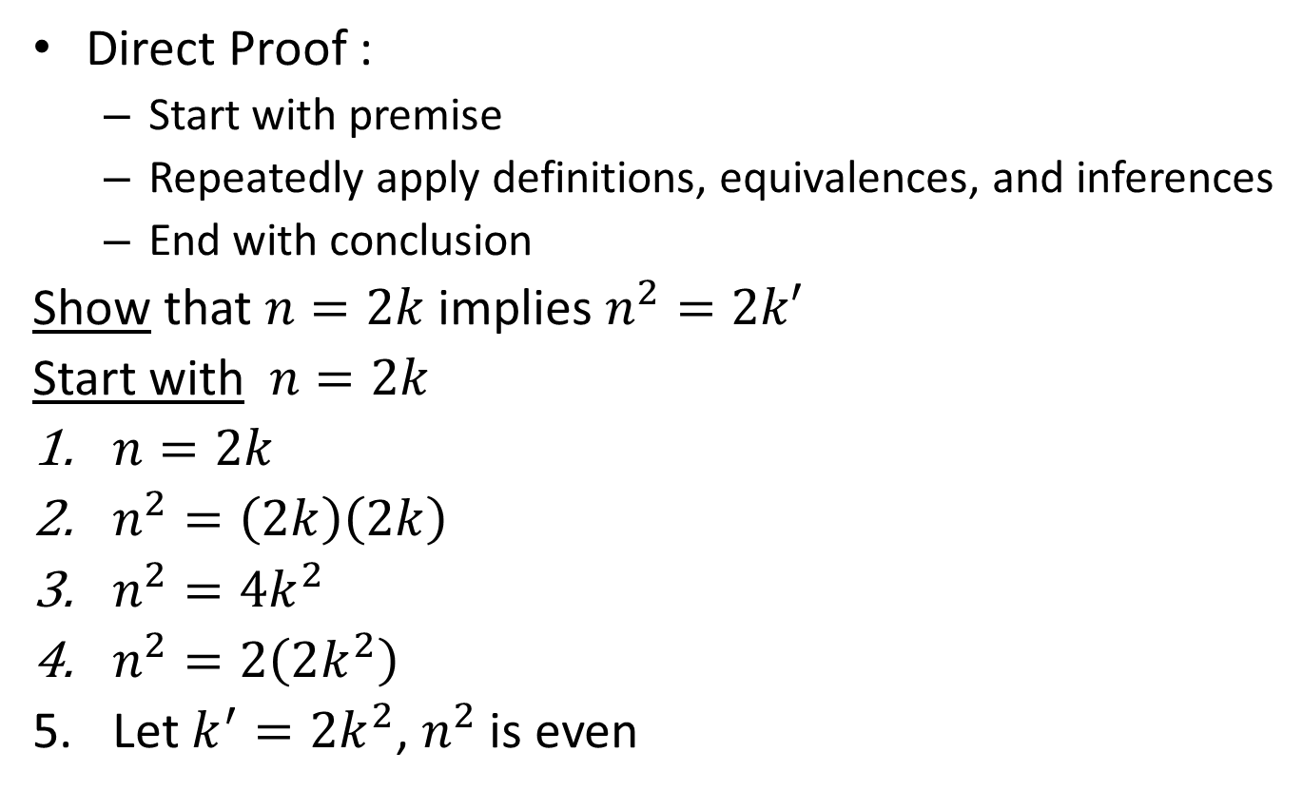

Proof: if $n^{2}$ is even $←$ $n$ is even
Direct Proof :
Start with premise
Repeatedly apply definitions, equivalences, and inferences
End with conclusion
Show that $n=2k$ implies $n^{2}=2k′$
Start with $n=2k$
$n=2k$
$n^{2}=\left(2k\right)\left(2k\right)$
$n^{2}=4k^{2}$
$n^{2}=2\left(2k^{2}\right)$
Let $k^{′}=2k^{2}$, $n^{2}$ is even

Slide 14
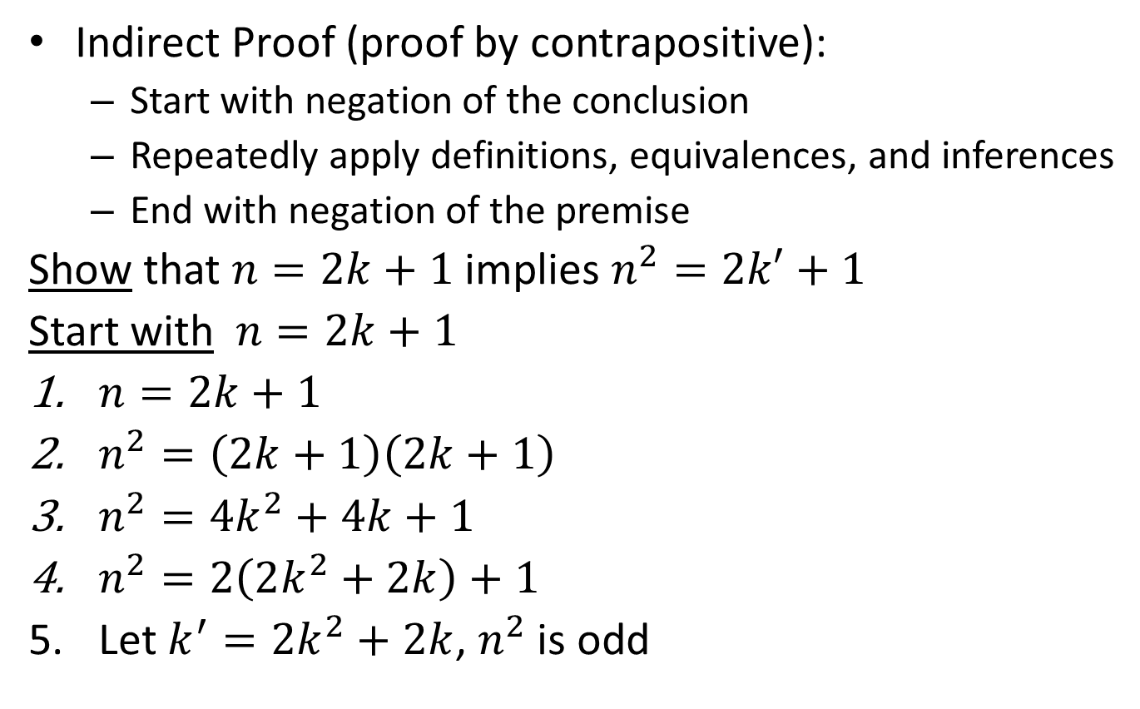

Proof: if $n^{2}$ is even $→$ $n$ is even
Indirect Proof (proof by contrapositive):
Start with negation of the conclusion
Repeatedly apply definitions, equivalences, and inferences
End with negation of the premise
Show that $n=2k+1$ implies $n^{2}=2k′+1$
Start with $n=2k+1$
$n=2k+1$
$n^{2}=\left(2k+1\right)\left(2k+1\right)$
$n^{2}=4k^{2}+4k+1$
$n^{2}=2\left(2k^{2}+2k\right)+1$
Let $k^{′}=2k^{2}+2k$, $n^{2}$ is odd

Slide 15

Proof: $5n+6$ even $↔n$ even

Slide 16
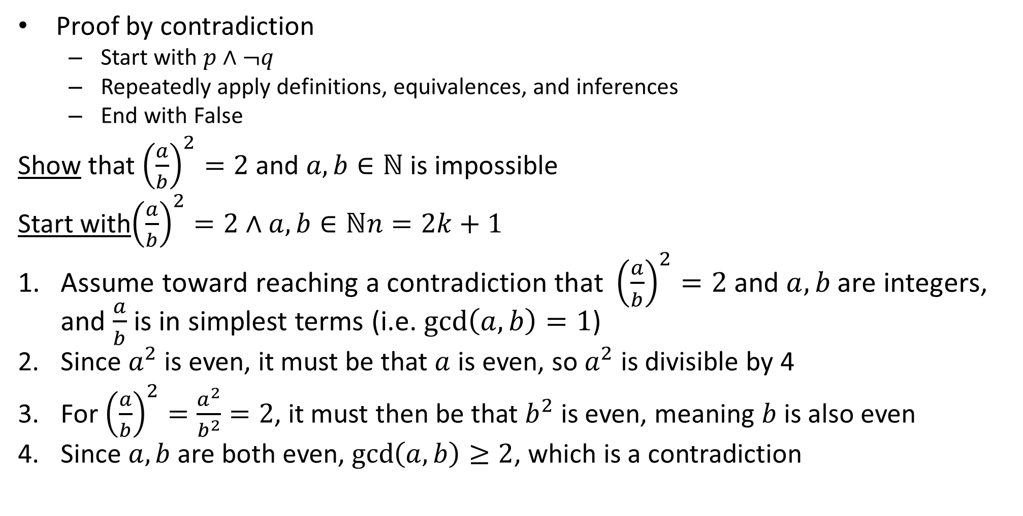

Proof: $√2$ is not rational
Proof by contradiction
Start with $p∧¬q$
Repeatedly apply definitions, equivalences, and inferences
End with False
Show that ${\left(\frac{a}{b}\right)}^{2}=2$ and $a,b∈ℕ$ is impossible
Start with${\left(\frac{a}{b}\right)}^{2}=2∧a,b∈ℕn=2k+1$
$\text{Assume} \text{toward} \text{reaching} \text{a} \text{contradiction} \text{that} {\left(\frac{a}{b}\right)}^{2}=2 \text{and} a,b \text{are} \text{integers}$, and $\frac{a}{b}$ is in simplest terms (i.e. $\gcd\left(a,b\right)=1$)
Since $a^{2}$ is even, it must be that $a$ is even, so $a^{2}$ is divisible by 4
For ${\left(\frac{a}{b}\right)}^{2}=\frac{a^{2}}{b^{2}}=2$, it must then be that $b^{2}$ is even, meaning $b$ is also even
Since $a,b$ are both even, $\gcd\left(a,b\right)≥2$, which is a contradiction

Slide 17
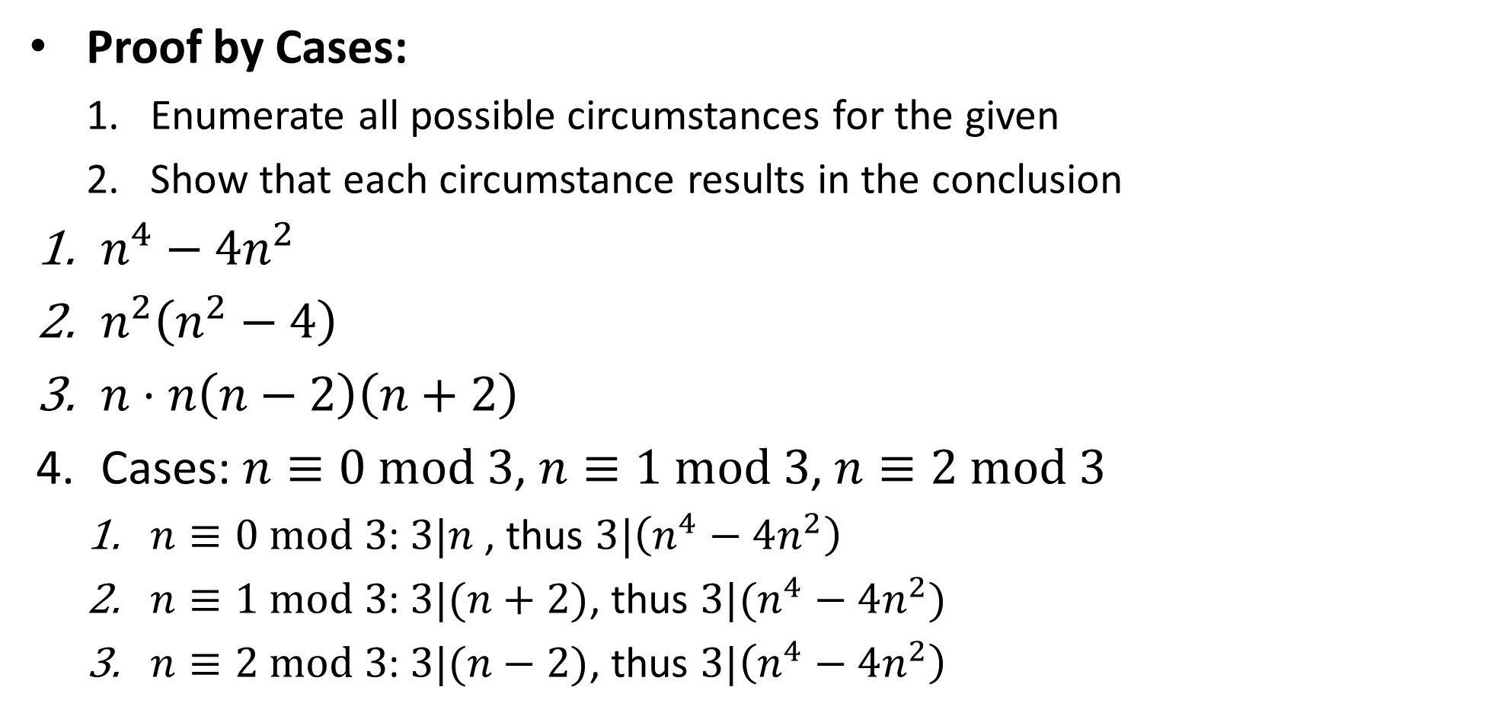
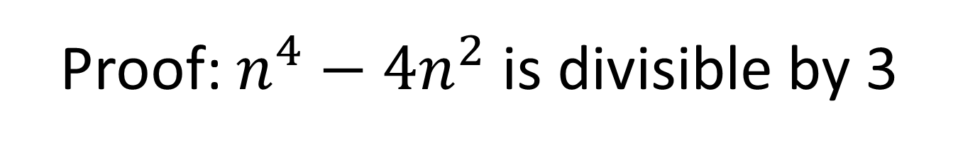
Proof: $n^{4}−4n^{2}$ is divisible by 3
Proof by Cases:
Enumerate all possible circumstances for the given
Show that each circumstance results in the conclusion
$n^{4}−4n^{2}$
$n^{2}\left(n^{2}−4\right)$
$n⋅n\left(n−2\right)\left(n+2\right)$
Cases: $n≡0 mod 3$, $n≡1 mod 3$, $n≡2 mod 3$
$n≡0 mod 3$: $3|n$ , thus $3|\left(n^{4}−4n^{2}\right)$
$n≡1 mod 3$: $3|(n+2)$, thus $3|(n^{4}−4n^{2})$
$n≡2 mod 3$: $3|(n−2)$, thus $3|\left(n^{4}−4n^{2}\right)$

Slide 18
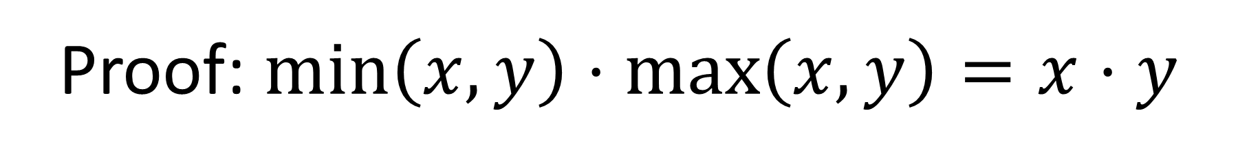
Proof: $\min\left(x,y\right)⋅\max\left(x,y\right)=x⋅y$

Slide 19
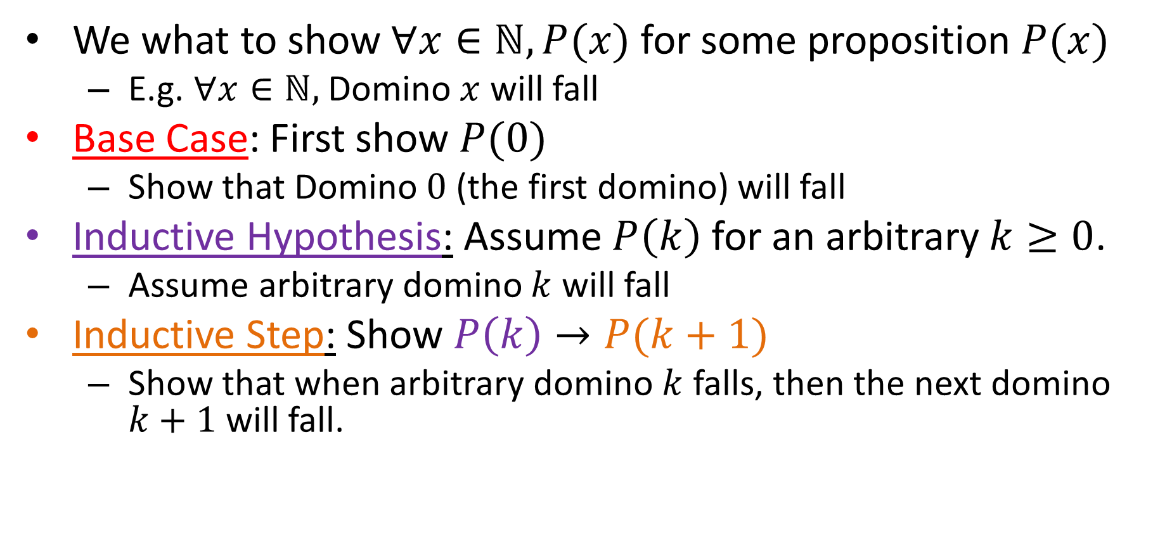
Mathematical Induction
We what to show $∀x∈ℕ, P(x)$ for some proposition $P(x)$
E.g. $∀x∈ℕ,$Domino $x$ will fall
Base Case: First show $P(0)$
Show that Domino $0$ (the first domino) will fall
Inductive Hypothesis: Assume $P\left(k\right)$ for an arbitrary $k≥0$.
Assume arbitrary domino $k$ will fall
Inductive Step: Show $P\left(k\right)→P(k+1)$
Show that when arbitrary domino $k$ falls, then the next domino $k+1$ will fall.

Slide 20
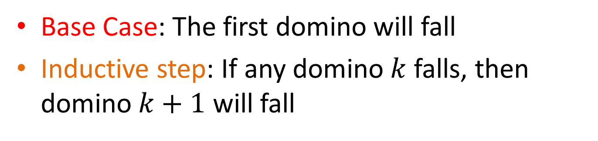
Mathematical Induction
Base Case: The first domino will fall
Inductive step: If any domino $k$ falls, then domino $k+1$ will fall
All dominos fall!!
Falls because of base Case
Falls because of Inductive Step
Falls because of Inductive Step
Falls because of Inductive Step

Slide 21

Hi-Ho-Cherry-O
Each Player takes turns removing 1, 2, 3, or 4 cherries from play
First player unable to pick a cherry loses

Slide 22
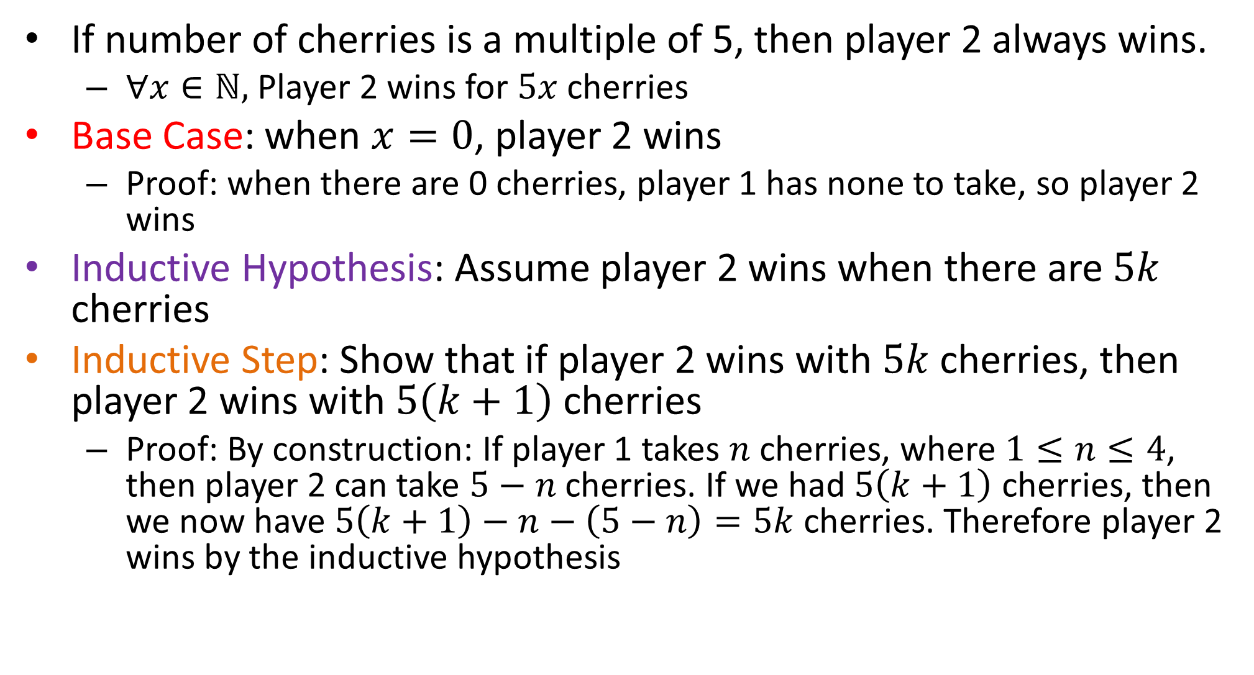
Player 2 always wins
If number of cherries is a multiple of 5, then player 2 always wins.
$∀x∈ℕ,$Player 2 wins for $5x$ cherries
Base Case: when $x=0$, player 2 wins
Proof: when there are 0 cherries, player 1 has none to take, so player 2 wins
Inductive Hypothesis: Assume player 2 wins when there are $5k$ cherries
Inductive Step: Show that if player 2 wins with $5k$ cherries, then player 2 wins with $5\left(k+1\right)$ cherries
Proof: By construction: If player 1 takes $n$ cherries, where $1≤n≤4$, then player 2 can take $5−n$ cherries. If we had $5\left(k+1\right)$ cherries, then we now have $5\left(k+1\right)−n−\left(5−n\right)=5k$ cherries. Therefore player 2 wins by the inductive hypothesis

Slide 23
Problems with induction
Useless for helping you to find the answer
You have to know the answer first
Does not provide insights into why something is true
Does not give any clues on how to correct if you’re wrong

