Slide 1
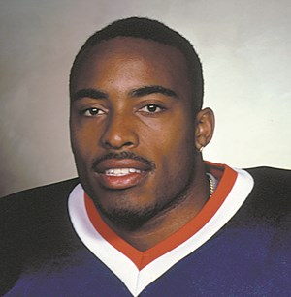

CS3102 Theory of Computation
www.cs.virginia.edu/~njb2b/cs3102
Charlottesville has one barber. This barber cuts everyone’s hair, except for those people who cut their own hair. Who cuts the barber’s hair?

Slide 2
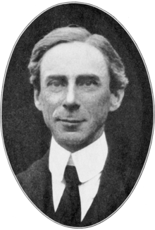
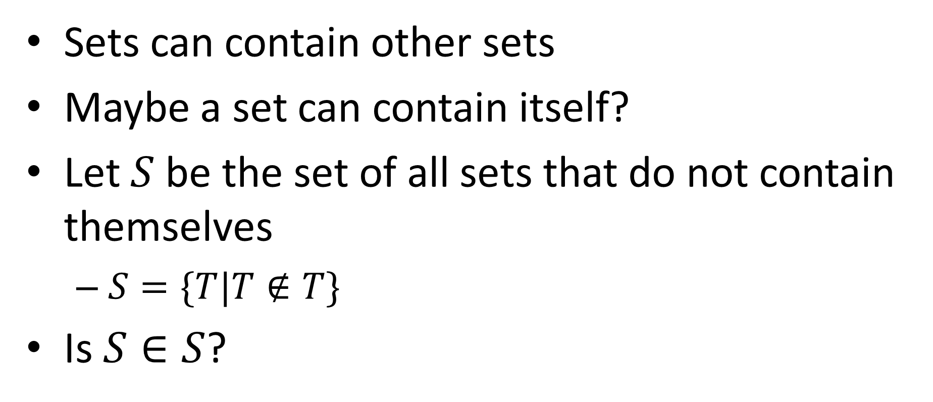
Russell’s Paradox
Sets can contain other sets
Maybe a set can contain itself?
Let $S$ be the set of all sets that do not contain themselves
$S=\{T|T∉T\}$
Is $S∈S$?

Slide 3
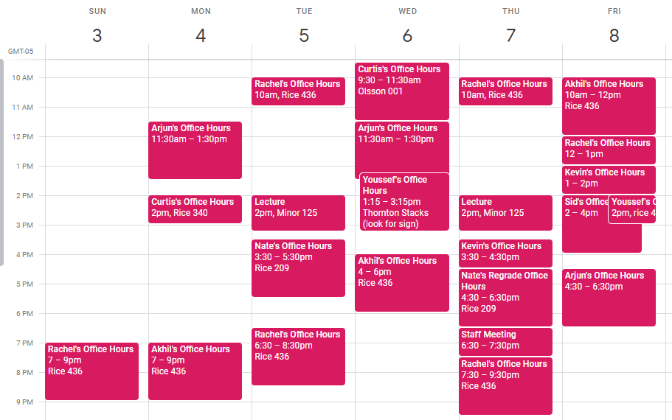
HW1
Due Monday (2/4)
Programming portion:
Write Java code for deciders
Use those deciders to produce the sets of strings they compute
Written portion:
Proofs
Sets and functions (next time)

Slide 4
Interested in a BACS Major?
Information session tonight
5-6pm
Rice 130
Application deadline:
Monday, February 18, 9:00am
http://bit.ly/apply-bacs-s19

Slide 5

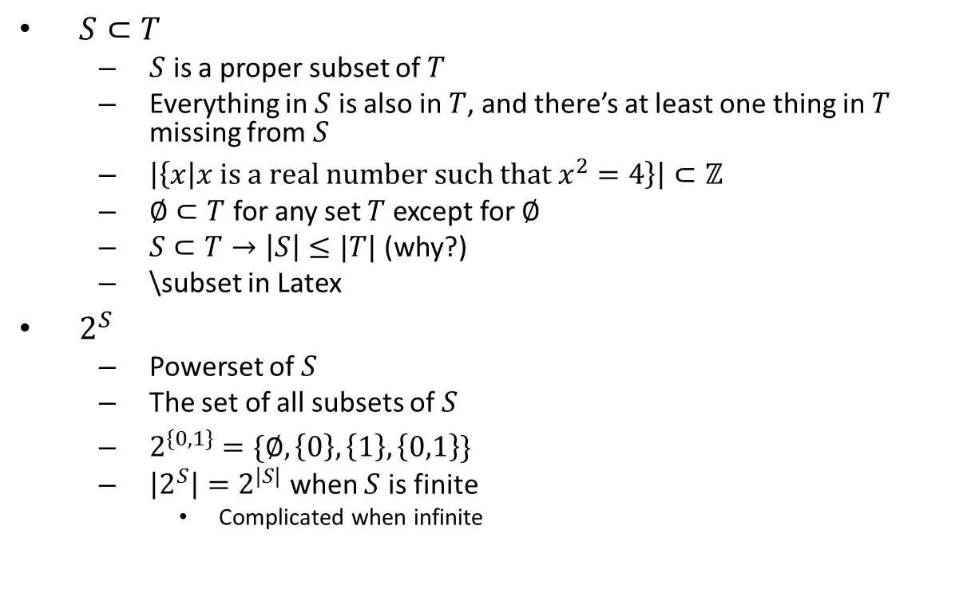


Set Operations
$S⊂T$
$S$ is a proper subset of $T$
Everything in $S$ is also in $T$, and there’s at least one thing in $T$ missing from $S$
$\left|\left\{x | x \text{is} \text{a} \text{real} \text{number} \text{such} \text{that} x^{2}=4\right\}\right|⊂ℤ$
$∅⊂T$ for any set $T$ except for $∅$
$S⊂T→\left|S\right|≤|T|$ (why?)
\subset in Latex
$2^{S}$
Powerset of $S$
The set of all subsets of $S$
$2^{\{0,1\}}=\{∅, \left\{0\right\},\left\{1\right\},\left\{0,1\right\}\}$
$\left|2^{S}\right|=2^{|S|}$ when $S$ is finite
Complicated when infinite
$$T$$
$$S$$
$$S=T$$

Slide 6



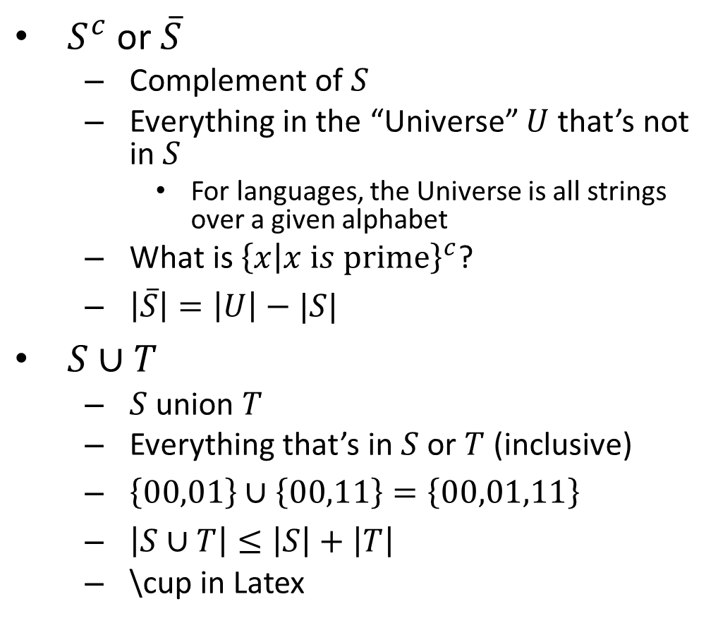



Set Operations Cont.
$$U$$
$S^{c}$ or $\overline{S}$
Complement of $S$
Everything in the “Universe” $U$ that’s not in $S$
For languages, the Universe is all strings over a given alphabet
What is ${\left\{x | x is prime\right\}}^{c}$?
$\left|\overline{S}\right|=\left|U\right|−|S|$
$S∪T$
$S$ union $T$
Everything that’s in $S$ or $T$ (inclusive)
$\left\{00,01\right\}∪\left\{00,11\right\}=\left\{00,01,11\right\}$
$\left|S∪T\right|≤\left|S\right|+\left|T\right|$
\cup in Latex
$$\overline{S}$$
$$S$$
$$S$$
$$T$$
$$S∪T$$

Slide 7








Set Operations Cont.
$S∩T$
$S$ intersect $T$
Everything that’s in both of $S$ and $T$
$\left\{00,01\right\}∩\left\{00,11\right\}=\left\{00\right\}$
$\left|S∩T\right|=\left|S\right|+\left|T\right|−\left|S∪T\right|$
\cap in Latex
$S−T$
$S$ minus $T$
Everying in $S$ that’s not in $T$
$S−T=S∩\overline{T}$
$S×T$
$S$ cross product $T$
Ordered pairs of something from $S$ with something from $T$
$\left\{a,b\right\}×\left\{a,c\right\}=\left\{\left(a,a\right),\left(a,c\right),\left(b,a\right),(b,c)\right\}$
$\left|S×T\right|=\left|S\right|⋅\left|T\right|$
\times in Latex
$$S$$
$$T$$
$$S∩T$$
$$S$$
$$T$$
$$S−T$$
$$T$$

Slide 8

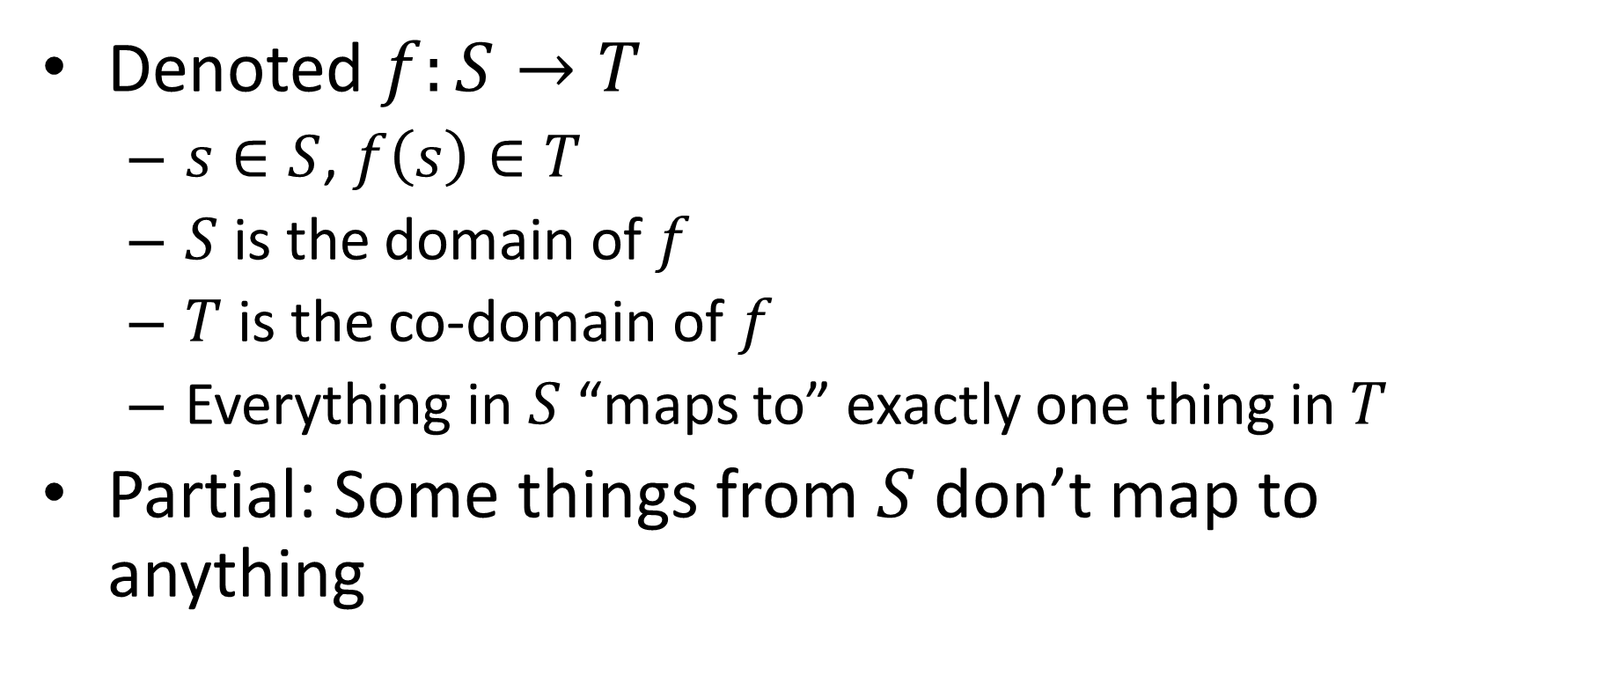


Functions
$$f$$
Denoted $f:S→T$
$s∈S$, $f\left(s\right)∈T$
$S$ is the domain of $f$
$T$ is the co-domain of $f$
Everything in $S$ “maps to” exactly one thing in $T$
Partial: Some things from $S$ don’t map to anything
$$T$$
$$S$$

Slide 9
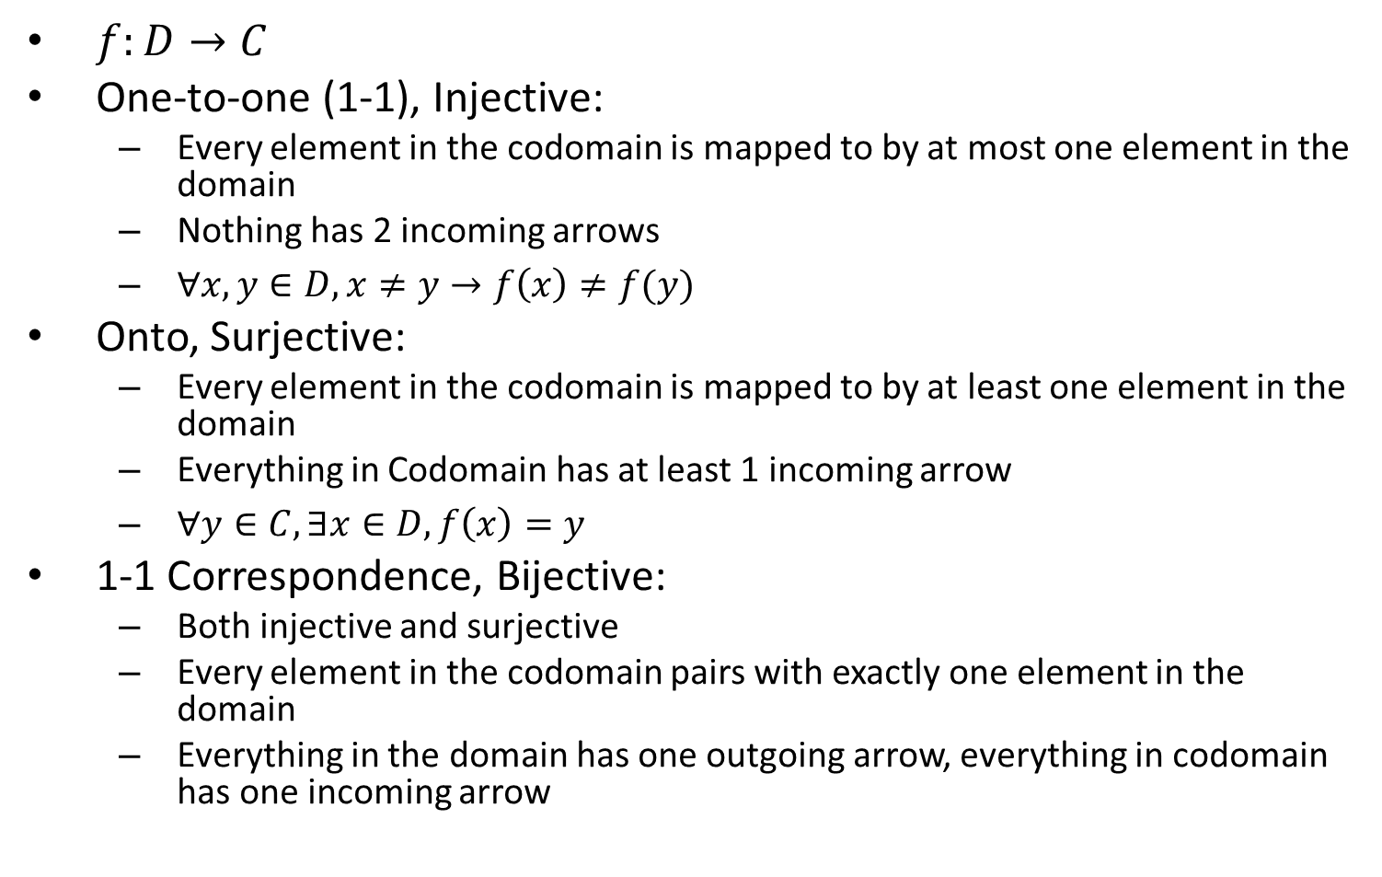
Properties of Functions
$f:D→C$
One-to-one (1-1), Injective:
Every element in the codomain is mapped to by at most one element in the domain
Nothing has 2 incoming arrows
$∀x,y∈D, x≠y→f\left(x\right)≠f(y)$
Onto, Surjective:
Every element in the codomain is mapped to by at least one element in the domain
Everything in Codomain has at least 1 incoming arrow
$∀y∈C, ∃x∈D, f\left(x\right)=y$
1-1 Correspondence, Bijective:
Both injective and surjective
Every element in the codomain pairs with exactly one element in the domain
Everything in the domain has one outgoing arrow, everything in codomain has one incoming arrow

Slide 10
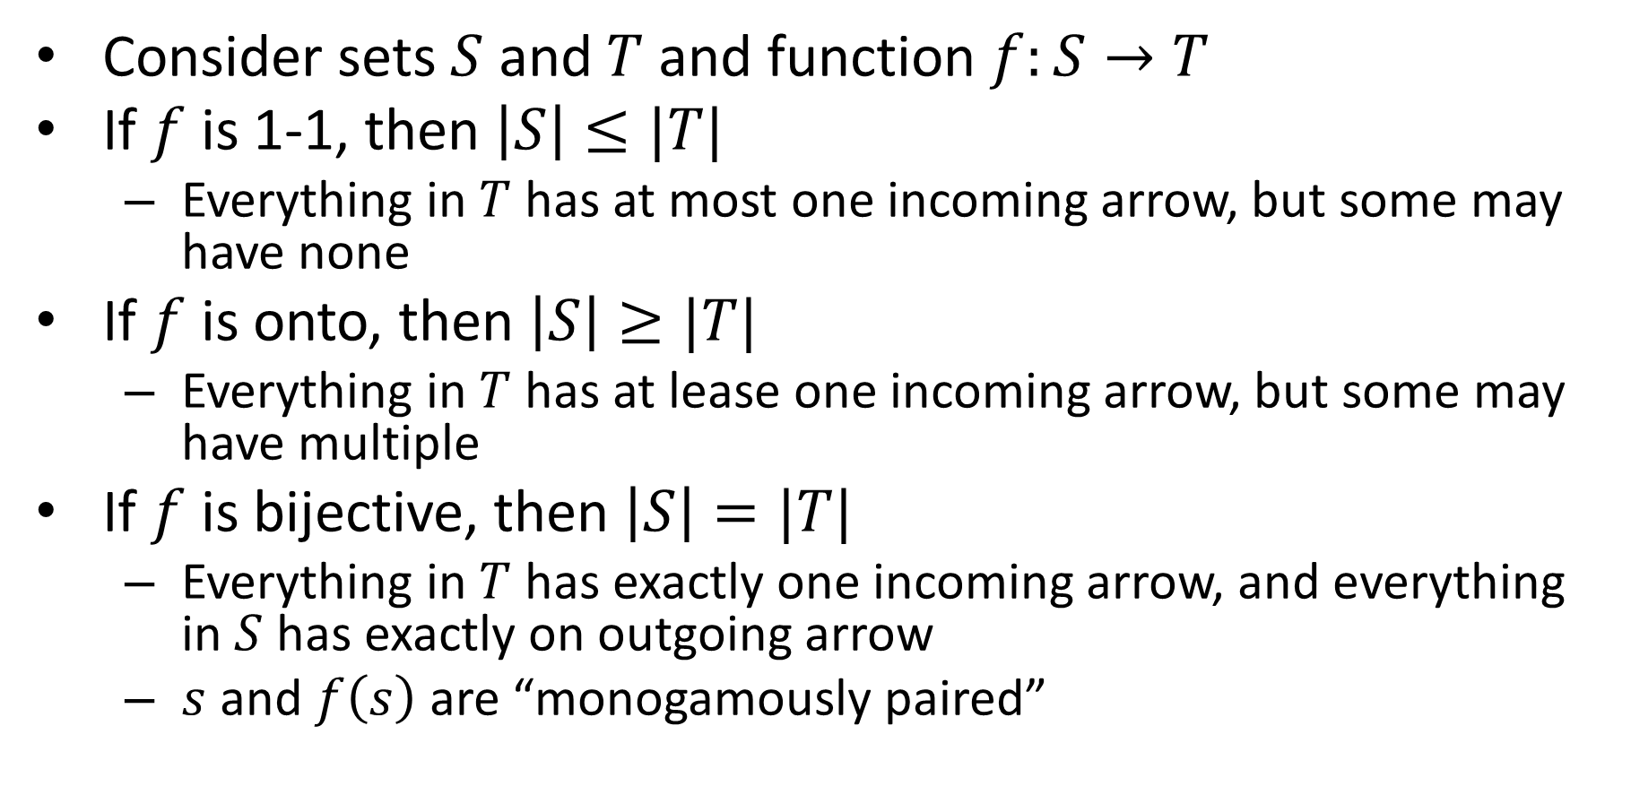
Functions and Set Cardinalities
Consider sets $S$ and $T$ and function $f:S→T$
If $f$ is 1-1, then $\left|S\right|≤|T|$
Everything in $T$ has at most one incoming arrow, but some may have none
If $f$ is onto, then $\left|S\right|≥|T|$
Everything in $T$ has at lease one incoming arrow, but some may have multiple
If $f$ is bijective, then $\left|S\right|=|T|$
Everything in $T$ has exactly one incoming arrow, and everything in $S$ has exactly on outgoing arrow
$s$ and $f\left(s\right)$ are “monogamously paired”

Slide 11
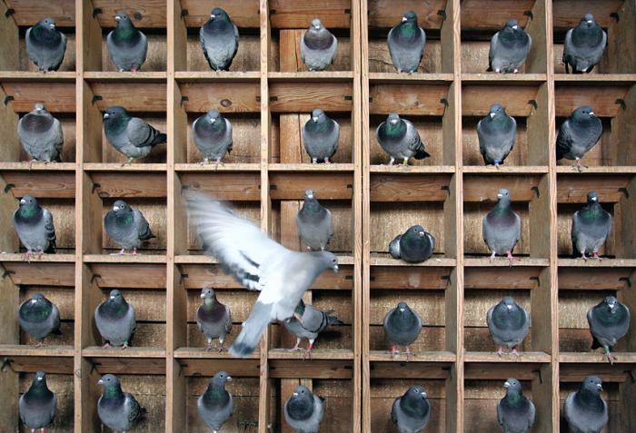
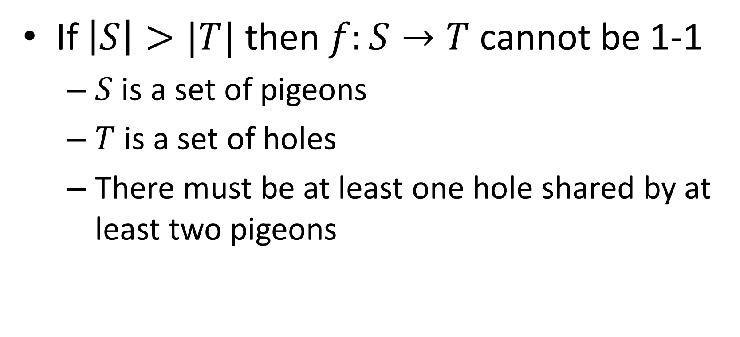
Pigeonhole Principle
If $\left|S\right|>|T|$ then $f:S→T$ cannot be 1-1
$S$ is a set of pigeons
$T$ is a set of holes
There must be at least one hole shared by at least two pigeons

Slide 12
Set Cardinalities
How can I show that two sets are the same size?
How Can I show that two sets are different sizes?
What if the sets are infinite?

Slide 13

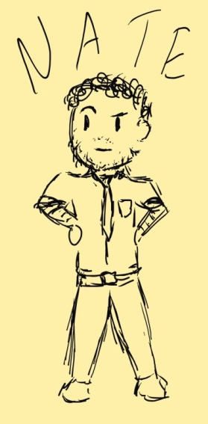
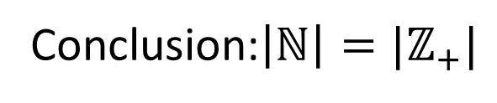
Hilbert’s Hotel
Conclusion:$\left|ℕ\right|=|ℤ_{+}|$
0
1
2
3
4
5
6
7
8
9
10
…
There are an infinite number of rooms,
each room is occupied.
A new guest arrives,
is there space?

Slide 14

As a Bijection
$$f:ℕ↔ℤ_{+}$$
$$f\left(x\right)=x+1$$

Slide 15
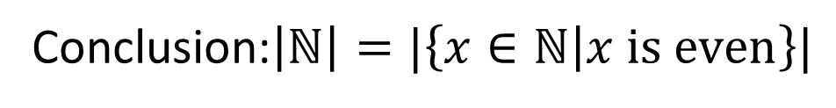
Hilbert’s Hotel
Conclusion:$\left|ℕ\right|=|\left\{x∈ℕ | x is even\right\}|$
0
1
2
3
4
5
6
7
8
9
10
…
There are an infinite number of rooms,
each room is occupied.
An infinite number of new guest arrive
is there space?
…

Slide 16

As a Bijection
$$f:ℕ↔\left\{x∈ℕ | x is even\right\}$$
$$f\left(x\right)=2x$$

Slide 17
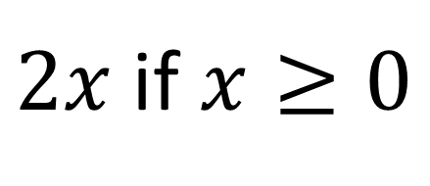

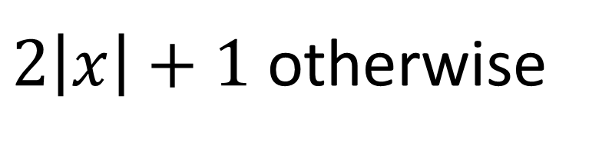
A Similar Bijection
$$f:ℤ↔ℕ$$
$f\left(x\right)=$
Positive values (and 0) are people already in the rooms
Negative values are the people who just arrived
$2x$ if $x≥0$
$2\left|x\right|+1$ otherwise

Slide 18

Hilbert’s Hotel
0
1
2
3
4
5
6
7
8
9
10
…
There are an infinite number of rooms,
each room is occupied.
An infinite number of infinitely-sized families arrive
is there space?
…
…
…
…
…
…

Slide 19
Dovetailing
0
1
8
9
…
3
2
7
…
4
5
6
…
…
…
…
…
…
…
…
…
…
…
…
…
…

Slide 20
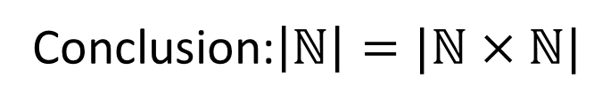
Hilbert’s Hotel
Conclusion:$\left|ℕ\right|=|ℕ×ℕ|$
0
1
2
3
4
5
6
7
8
9
10
…
There are an infinite number of rooms,
each room is occupied.
An infinite number of infinitely-sized families arrive
is there space?
…
…
…
…
…
…

Slide 21


Dovetailing
$$ℕ$$
0 1 2 3 4 5
$$ℕ$$
0
(0,0) (0,1) (0,2) (0,3) (0,4) (0,5)
…
1
(1,0) (1,1) (1,2) (1,3) (1,4) (1,5)
…
2
(2,0) (2,1) (2,2) (2,3) (2,4) (2,5)
…
3
(3,0) (3,1) (3,2) (3,3) (3,4) (3,5)
…
4
(4,0) (4,1) (4,2) (4,3) (4,4) (4,5)
…
…
…
…
…
…
…
…
…
…
…
…

Slide 22

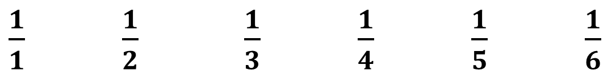

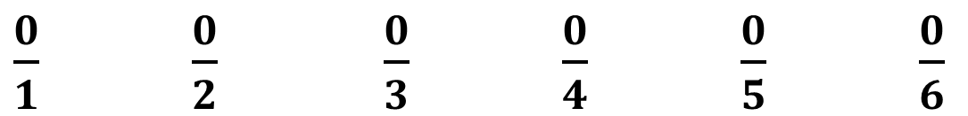
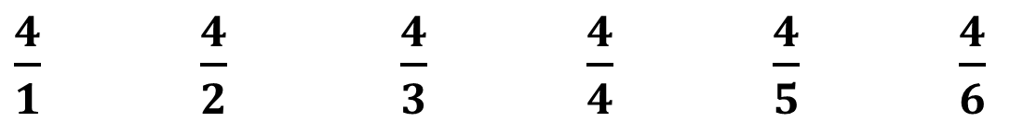
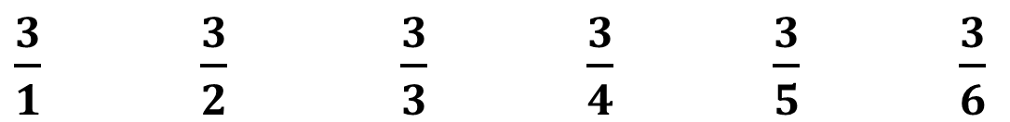
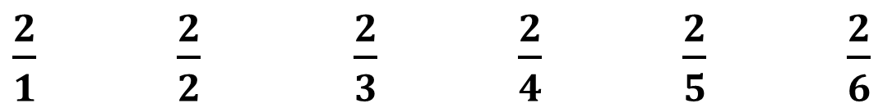
$$\left|ℚ\right|=|ℕ|$$
$$ℤ_{+}$$
1 2 3 4 5 6
$$ℕ$$
0
$\frac{0}{1}$ $\frac{0}{2}$ $\frac{0}{3}$ $\frac{0}{4}$ $\frac{0}{5}$ $\frac{0}{6}$
…
1
$\frac{1}{1}$ $\frac{1}{2}$ $\frac{1}{3}$ $\frac{1}{4}$ $\frac{1}{5}$ $\frac{1}{6}$
…
2
$\frac{2}{1}$ $\frac{2}{2}$ $\frac{2}{3}$ $\frac{2}{4}$ $\frac{2}{5}$ $\frac{2}{6}$
…
3
$\frac{3}{1}$ $\frac{3}{2}$ $\frac{3}{3}$ $\frac{3}{4}$ $\frac{3}{5}$ $\frac{3}{6}$
…
4
$\frac{4}{1}$ $\frac{4}{2}$ $\frac{4}{3}$ $\frac{4}{4}$ $\frac{4}{5}$ $\frac{4}{6}$
…
…
…
…
…
…
…
…
…
…
…
…

Slide 23
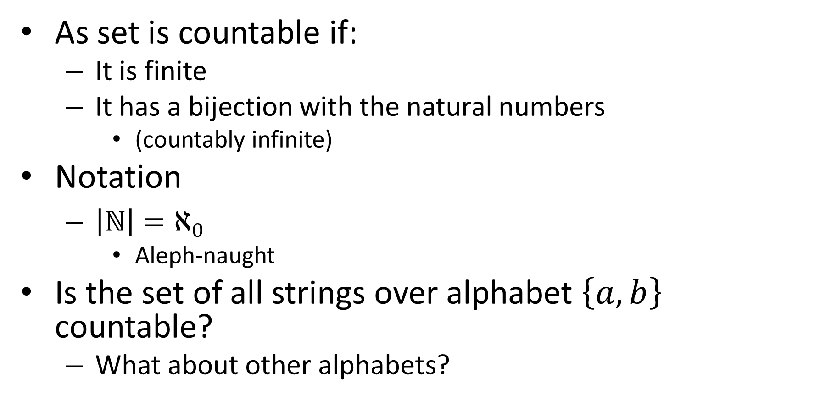
Countability
As set is countable if:
It is finite
It has a bijection with the natural numbers
(countably infinite)
Notation
$\left|ℕ\right|=ℵ_{0}$
Aleph-naught
Is the set of all strings over alphabet $\left\{a,b\right\}$ countable?
What about other alphabets?

Slide 24



The set of all strings is countable
0
Length 0
$$ε$$
1 string
1
2
Length 1
$a$ $b$
2 strings
3
4
5
6
Length 2
$aa$ $ab$ $ba$ $bb$
4 strings
8 strings
7
8
9
10
11
12
13
14
Length 3
$aaa$ $aab$ $aba$ $abb$ $baa$ $bab$ $bba$ $bbb$
16 strings
Length 4
$aaaa$ $aaab$ $aaba$ $aabb$ $abaa$ $abab$ $abba$ $abbb$ …
32 strings
Length 5
$aaaaa$ $aaaab$ $aaaba$ $aaabb$ …
…
…
Important: A countable union of countable sets is countable

Slide 25
Some more countable things
Any language ever!
Number of possible Java Programs
The empty set
The number of words in the English language
Number of possible novels

