Slide 1
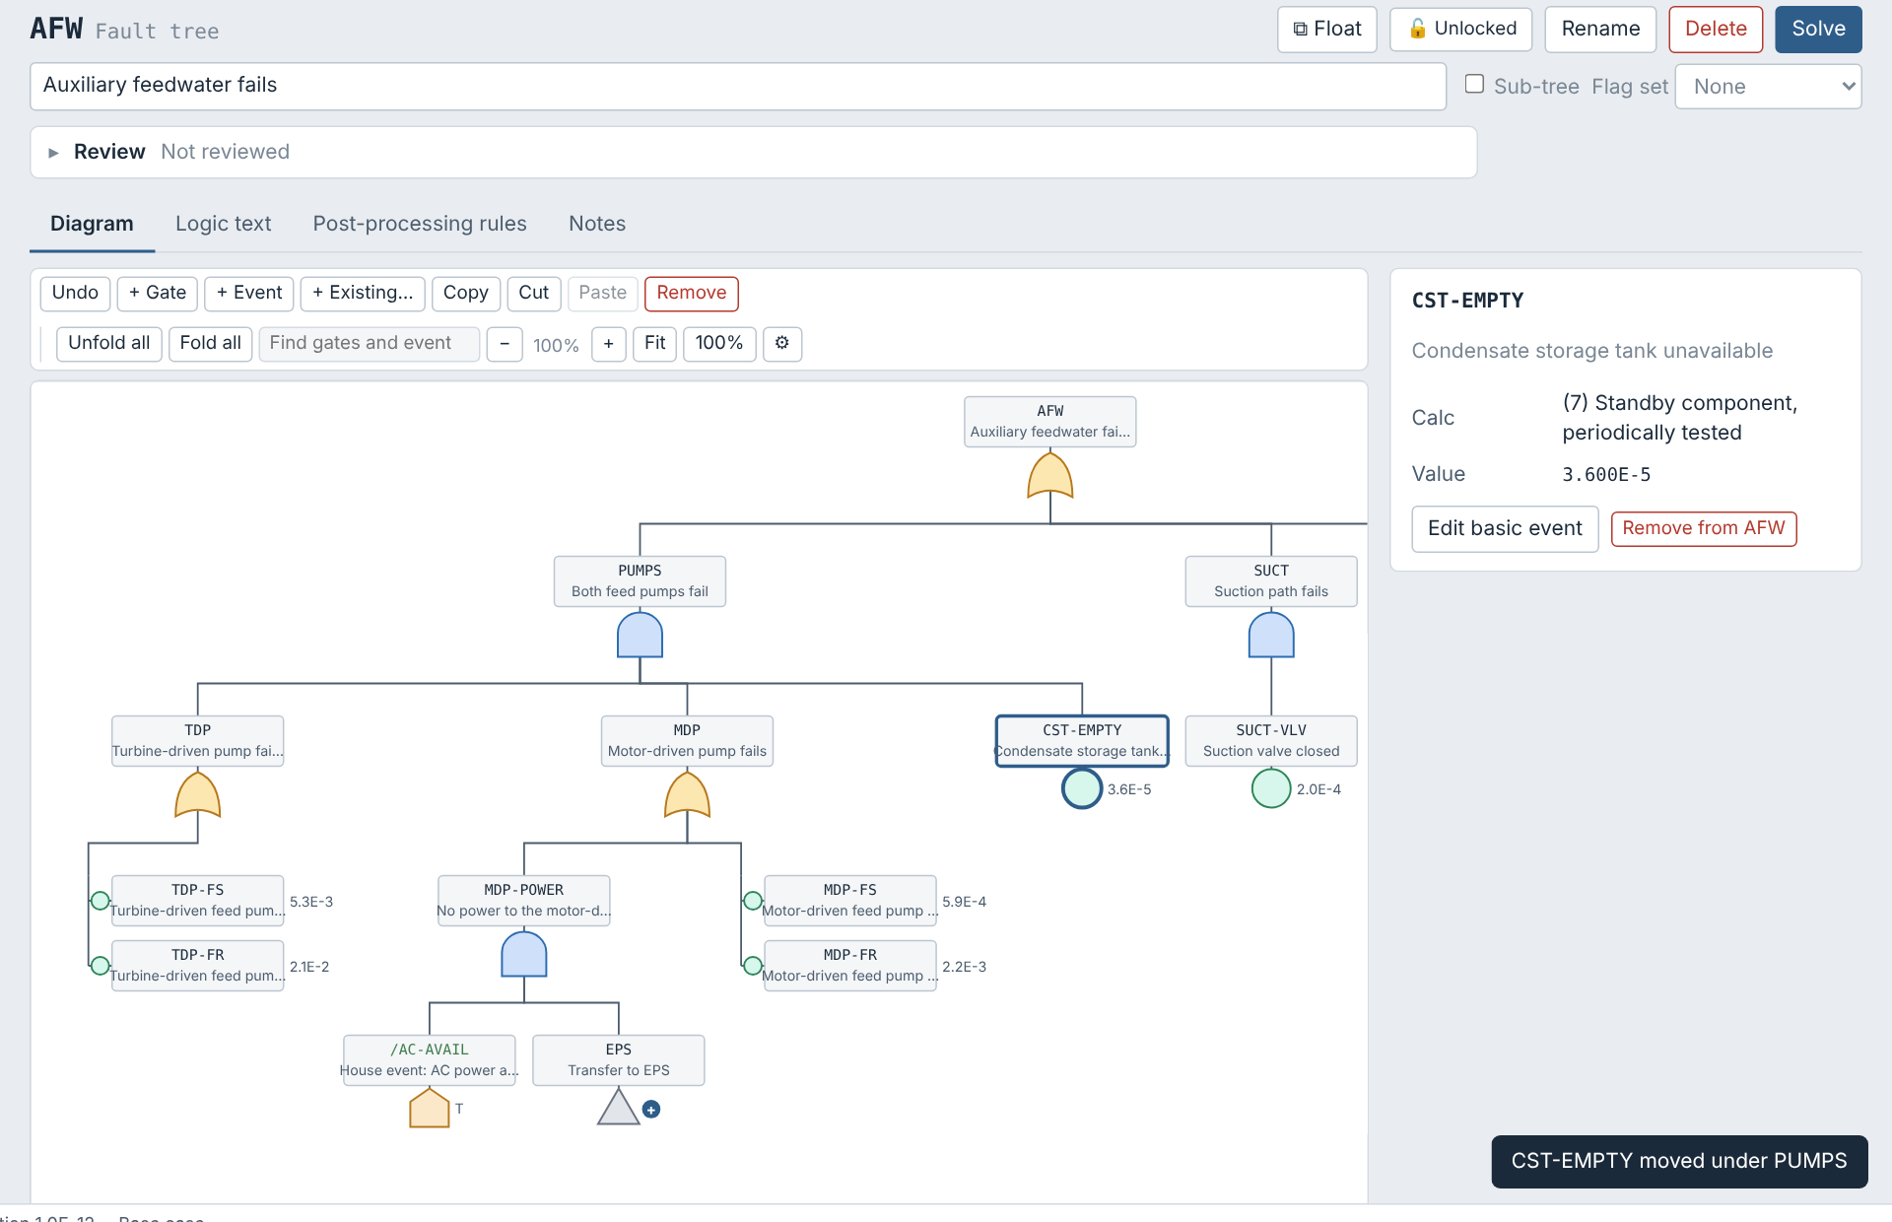
JADES User Guide
JavaScript Authored Design Environment for SAPHIRE
Version 0.3.35 · November 2026

Slide 2
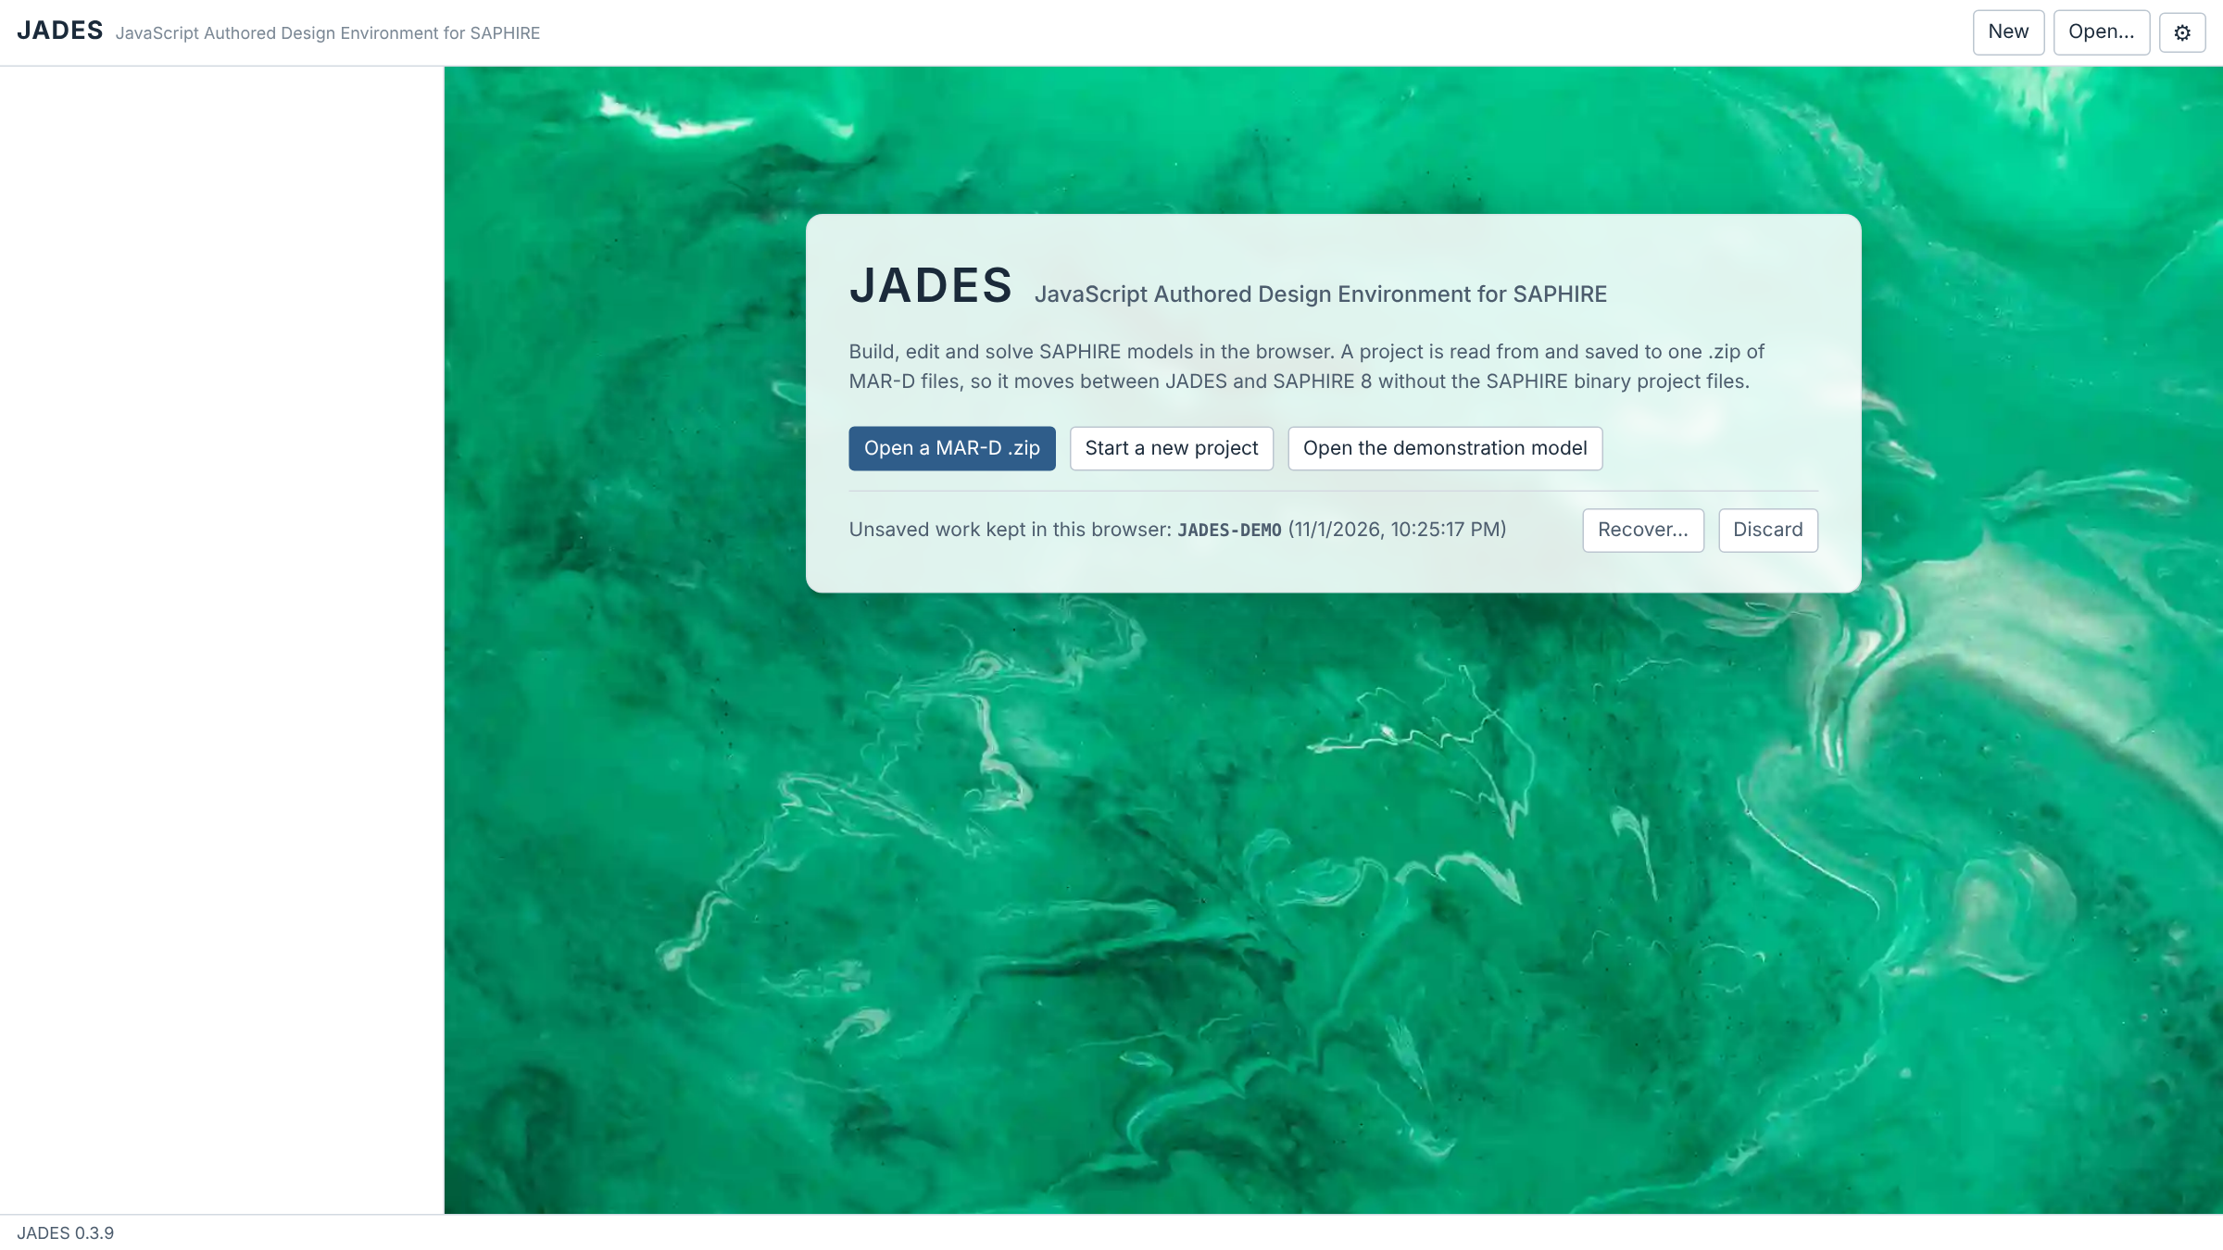
What JADES is
1
Runs in a web browser
One HTML file. Nothing to install and no server; open it in a modern web browser.
2
Uses SAPHIRE data
A project is read from and saved to one .zip of MAR-D files, so models move between JADES and SAPHIRE 8.
3
Builds and solves PRA models
Basic events, fault trees, event trees, end states, change and flag sets, and SAPHIRE rules.
4
Explains and records review
Shows how every number was obtained, checks truncation, runs sensitivity studies and keeps reviewer comments.
The welcome screen
Internet access is needed for the zip library (cdnjs) and, for Word output, the docx library (unpkg). Phased models are not supported.

Slide 3
The workflow at a glance
1
2
3
4
5
6
7
Open
Build
Solve
Understand
Assess
Review
Save & report
A MAR-D .zip, a new project or the demonstration model
Edit events, trees, end states, change sets and rules
Link and solve sequences, fault trees and end states
Why each cut set, truncation error, sensitivity
Initiating event, condition and what-if change set assessments
Comments, status and change tracking
Save the .zip; build reports in HTML, Word or Markdown
Header: Showing: Base case / Current case · project name · New · Open… · Save .zip · Undo · Analysis · Assessments · Review · Report (the page you are on is highlighted). Each section of this guide covers one step.

Slide 4
Getting started
1
Opening and saving projects, and finding your way around the screen

Slide 5
Open, start or save a project
▶
Welcome screen or header
›
Open… · New · Open the demonstration model
›
Save .zip (Ctrl+S)
Open… reads a project .zip (or choose "Open a MAR-D .zip" on the welcome screen).
New starts an empty project.
Open the demonstration model loads JADES-DEMO, an invented model for trying the features.
Save .zip (Ctrl+S) downloads the project with its solved cut sets. A dot beside the name means model changes or results not yet saved: closing or reloading the tab then asks Leave or Stay (the browser's own dialog), as it does while a solve is running. A copy of the model is kept for Recover on the opening screen.
Undo / redo Ctrl+Z and Ctrl+Y (or Ctrl+Shift+Z) undo and redo model edits.
MAR-D files that JADES does not read are kept and written back unchanged.
Stored cut sets (.FTC, .SQC, .ESC) open as results, quantified with the current data and marked "Loaded from the file"; they are kept when you save without solving again.
Recover… / Discard below the opening buttons: reopen the copy of unsaved work kept in this browser, or delete it.
Inside the project zip
PROJ.MARD | index of every MAR-D file
PROJ.JADES | JADES-only data (SPAR-H, assessments…)
PROJ.REVIEW | review comments and status
PROJ_Subs\ | folder of MAR-D files
PROJ.BED | basic event descriptions
PROJ.FTL | fault tree logic
PROJ.ETL … | event tree logic, and so on
The index lists each file as PROJ_Subs\PROJ.EXT. SAPHIRE ignores the .JADES and .REVIEW files at the root.

Slide 6
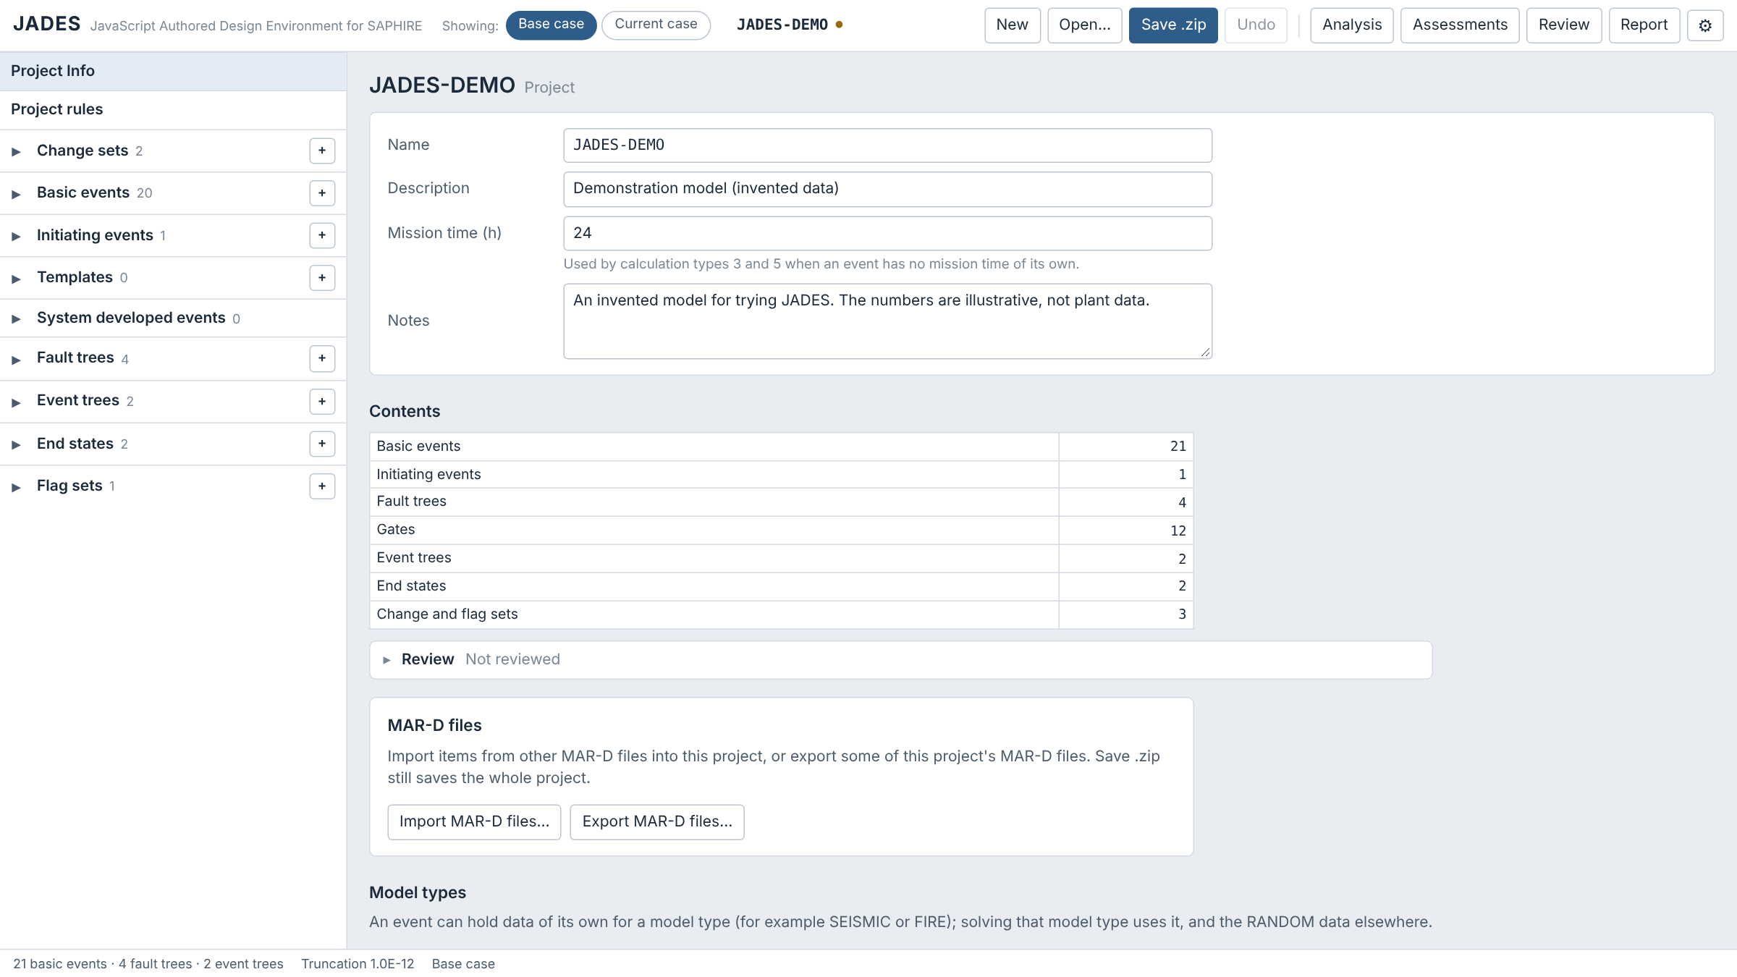
The main screen
2
3
1
7
1
Page buttons
Analysis, Assessments, Review, Report; the open page is highlighted
2
Showing: pills
Base case or Current case: which data the solves use
4
5
3
Project name and file buttons
name (● = unsaved), New, Open…, Save .zip, Undo
4
Model lists
▸ opens a list and its filter; hover an item for its card; ⧉ opens it in a floating window
5
Editor
the selected item, with its Review panel
6
Status bar
model size, truncation and case
6
7
Settings ⚙
font, text size, theme, and how trees are drawn

Slide 7
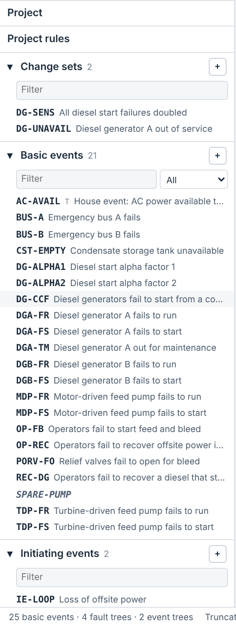
Finding items in the side lists
▶
Left side lists
›
Filter box
›
Show menu of a list
›
Click an item
List | Show | What it holds
Basic events | All, Standard, Compound, House, Value, Unused | Events used in modelling. Standard leaves out value events; Compound = C, R, A, Q, O; House = T, F, I, U, Y, D
Initiating events | — | Initiators (frequency or type N) and initiating-event CCF (Q)
Templates | — | Events marked as templates in .BEA
System developed events | — | SAPHIRE's <INIT>-style events, grade S or V (.BEG), and developed events (type DE, or named like a gate)
Fault trees | All, Main, Sub, Unused, Has rules | Main: event tree tops. Sub: transferred to, or flagged sub-tree
Event trees | All, Main, Sub, Linked, Has rules | Sub: transfer trees. Linked: linked and solved in this session
End states | All, Unused | Unused: no sequence ends there and no rule names it
Lists start collapsed: click ▸ to open one and show its filter. Names are bold with the description beside them; unused items are in italics; 🔒 marks a locked item. Drag an item into a fault tree, event tree or text editor; ⧉ (or Shift+click, or right-click) opens it in a floating window.

Slide 8
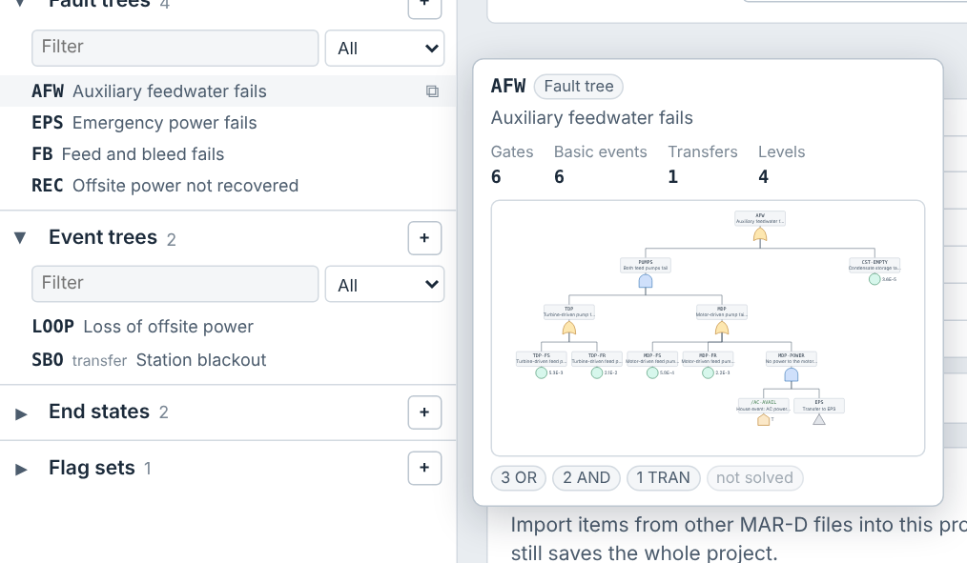
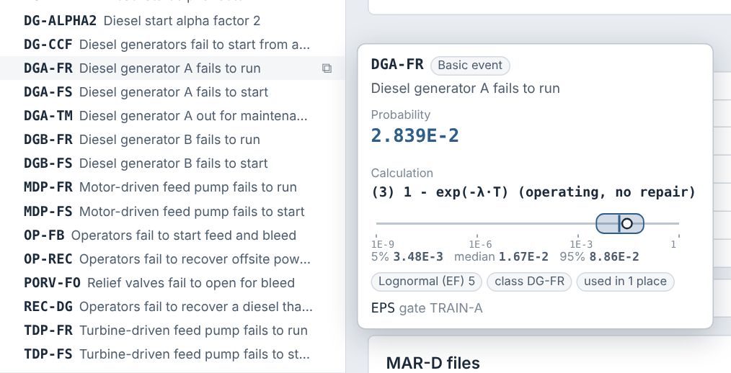
Hover cards
▶
Left side lists
›
Rest the pointer on an item
Basic event: value (dot) and its 5%–95% uncertainty box, median marked
Fault tree: counts, gate types and a small drawing
Item | The card shows
Basic event | Value, calculation type, a log-scale gauge: the value as a dot, the uncertainty as a rounded box from the 5th to the 95th percentile with the median; template, where it is used
Fault tree | Gates, basic events, transfers, levels, a small drawing (or gates per level), result when solved
Event tree | Initiator and frequency, tops, sequences, a small drawing, sequences or frequency by end state
End state, change set | Sequences by event tree (frequency when solved); the changes a set makes

Slide 9
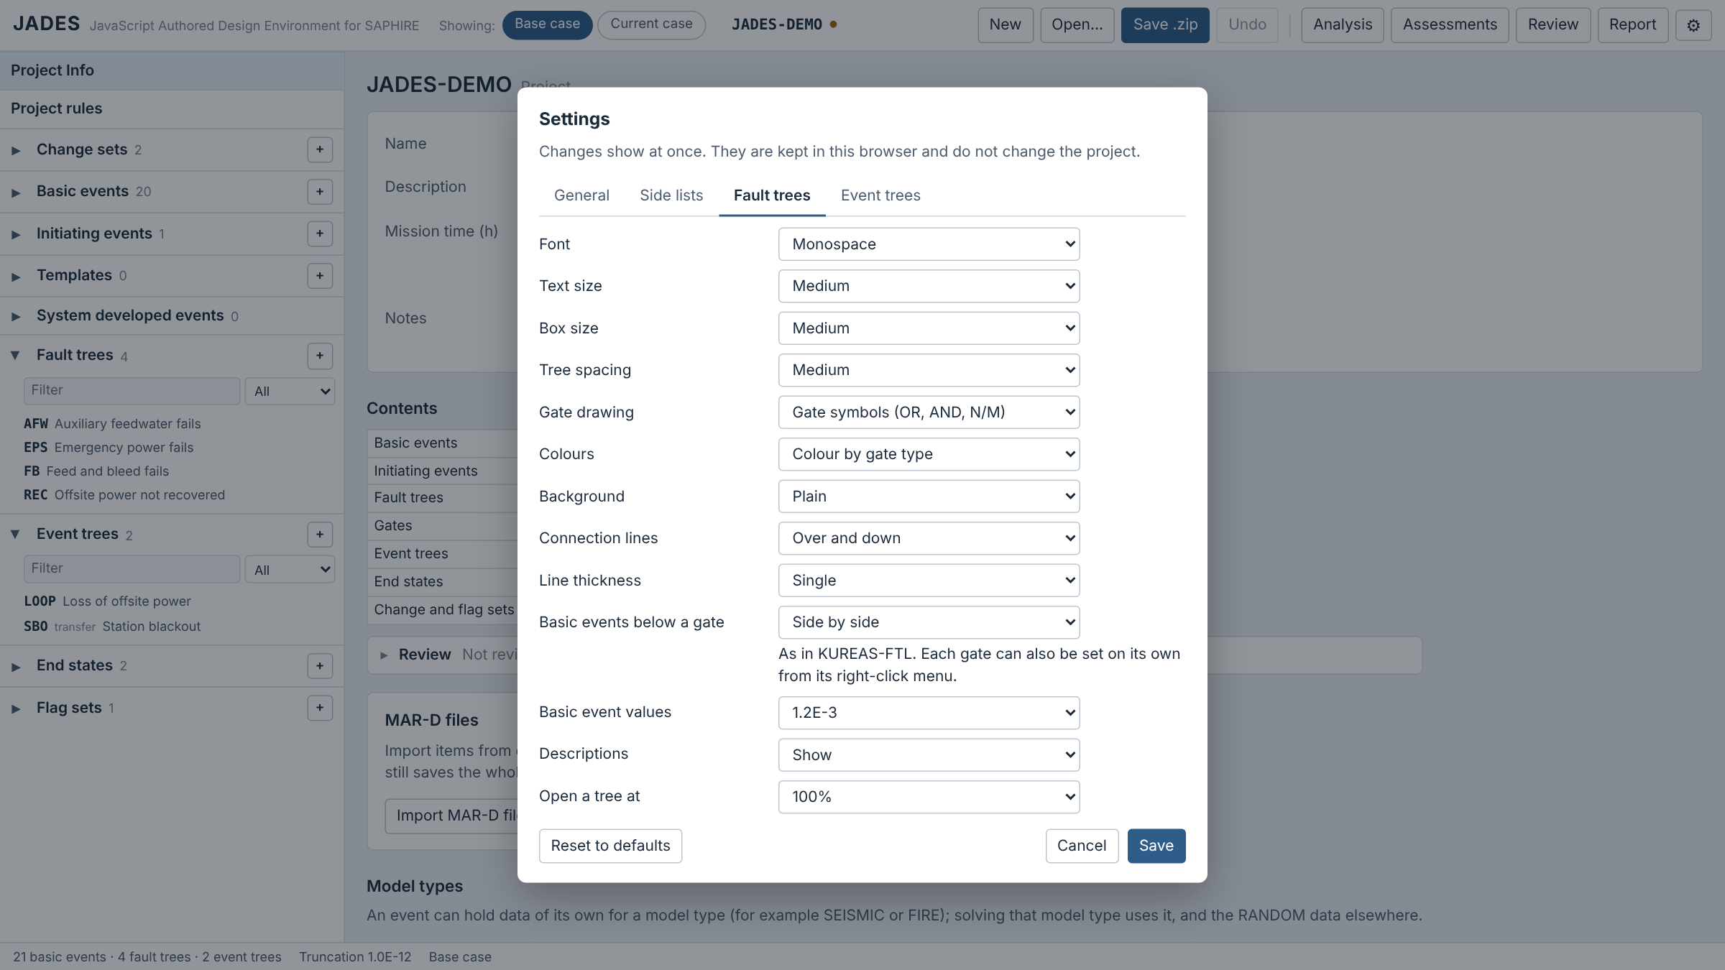
Settings
▶
Header
›
⚙ Settings
›
General · Side lists · Fault trees · Event trees · Solve
Tab | What it controls
General | Colour theme, font, text size (scales the window), font for names and numbers, Numbers (digits shown in results and value fields)
Side lists | Collapsed or expanded at start, Show items (default 25; the rest scroll), descriptions, hover card and its delay; which sections show and their order
Fault trees | Font, text and box size, spacing, gate drawing, colours, background, lines, basic events below a gate (side by side, stacked, in a table), value digits, descriptions, opening zoom
Event trees | Text size, column width, row spacing, sequence frequencies, S/F branch labels
Solve | The Analysis page's solve options: fault tree, sequence and end state truncation, size limit, quantification, success branches, Monte Carlo (apply at once)
Open with ⚙ in the header. Changes show at once; Cancel restores. Settings stay in this browser, not in the project.

Slide 10
Building the model
2
Basic events, fault trees, event trees, rules, end states, and change and flag sets

Slide 11
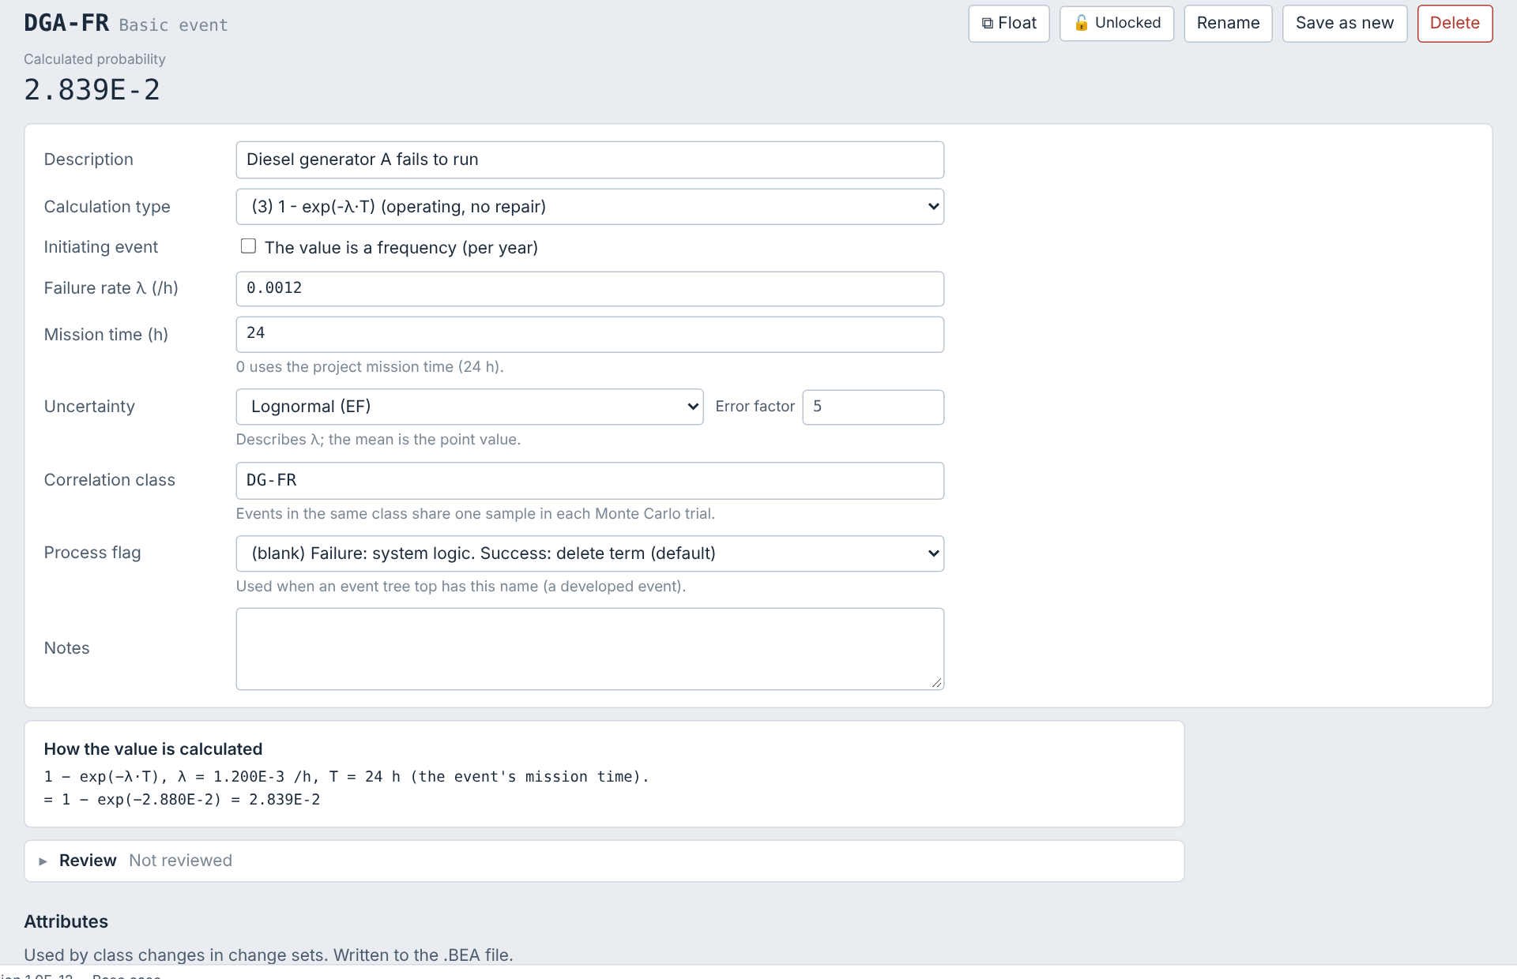
Basic events
▶
Side list
›
Basic events
›
Click an event
Calculation type listed as (1) Probability, (3) 1 − exp(−λ·T) and so on; all 22 SAPHIRE types. A new event starts at probability 1.0.
Values typed as 0.002 or 2E-3 (no spinner buttons); shown with the digits chosen in Settings → Numbers, in full while you edit.
Data λ, mission time, the uncertainty distribution with its parameters on the same line, correlation class, process flag.
How the value is calculated the formula with your numbers, under the form.
Rename updates every fault tree, rule and set that uses the event. Save as new copies it. 🔓/🔒 locks it.

Slide 12
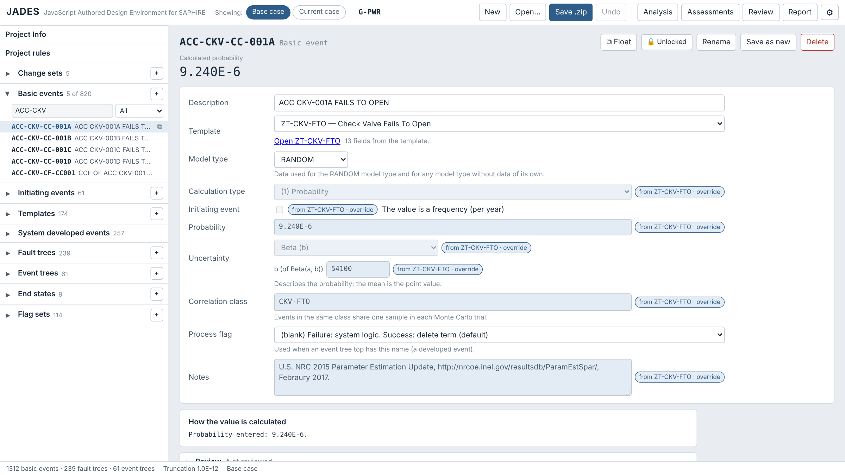
Templates
▶
Side list
›
Basic events
›
Click an event
›
Template row
Template row: the template the event uses (.BEA Template Name). Pick one, or (none).
From the template fields are read-only and marked "from ZT-… · override".
Override one field for this event only; "own value · use template" goes back.
On the template "Template supplies" ticks which fields it sets (.BEMT data flags, .BEA attribute flags) and lists the events using it. Editing the template updates them.
On reading, a field that differed from its template is kept as an override, so results do not change.

Slide 13
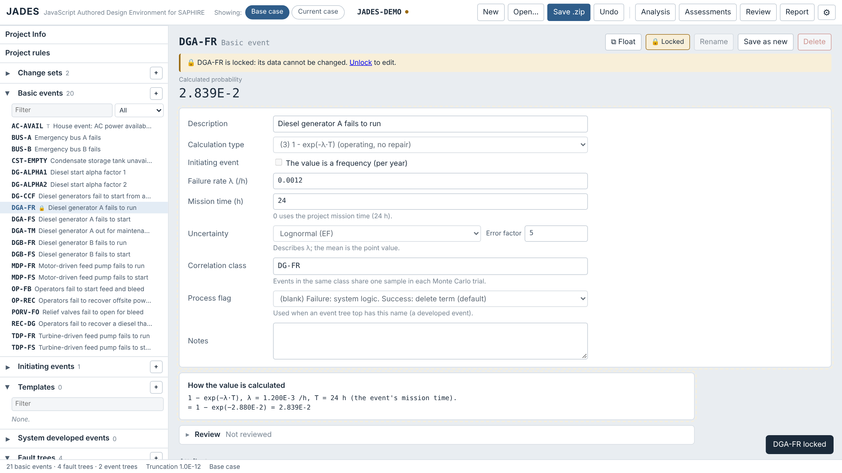
Locking an item
▶
Open the item
›
🔓 Unlocked button
🔓 Unlocked / 🔒 Locked beside the name of a basic event, fault tree, event tree, end state, change set or flag set.
A locked item cannot be changed from anywhere: its editor, the diagrams, drag and drop, renames or templates.
It can still be used, solved, reviewed and reported.
Locks are saved in the project zip (PROJ.JADES); 🔒 marks them in the side lists.

Slide 14
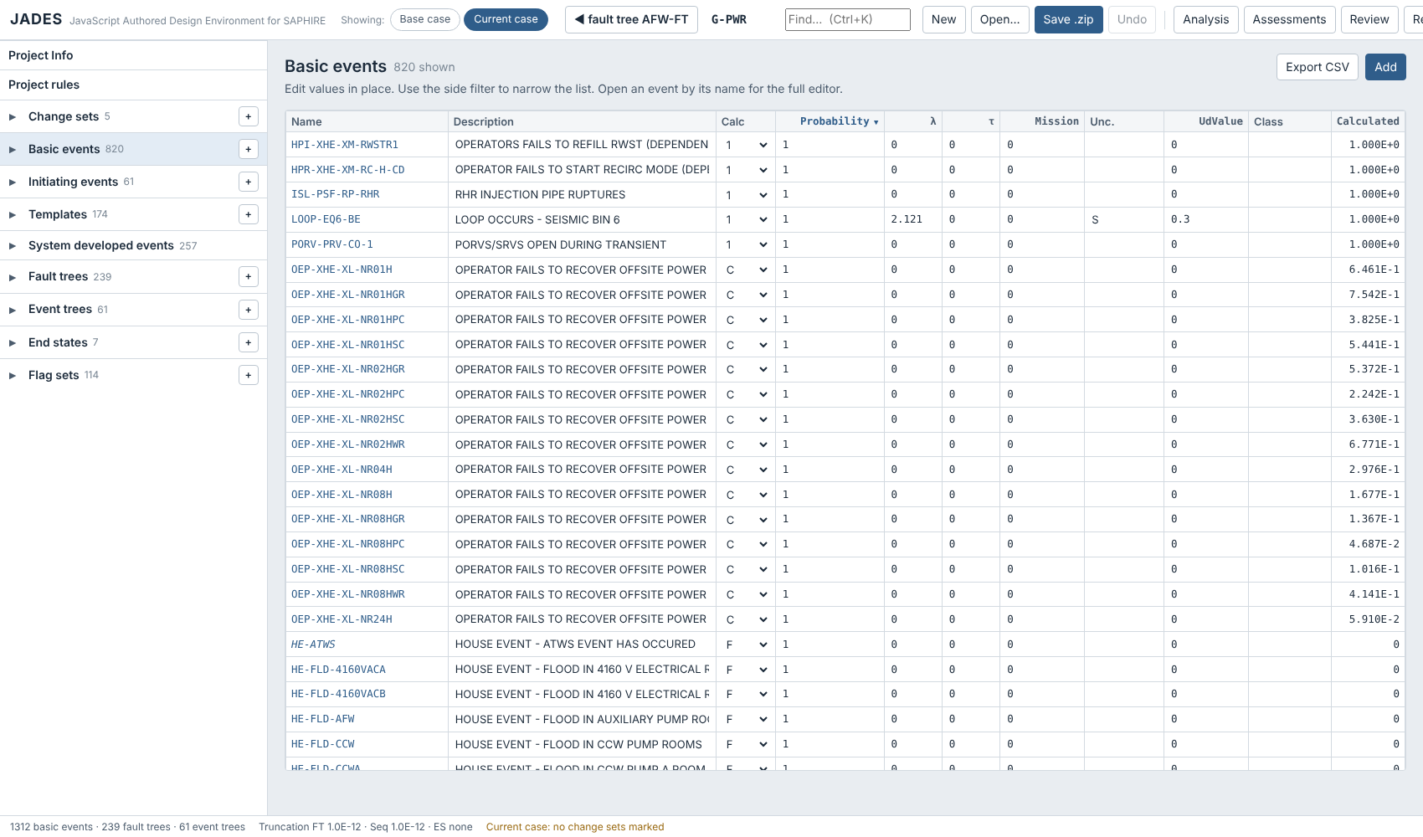
All basic events in one table
▶
Side list
›
Click the Basic events heading
Click the Basic events heading in the model list to open the table.
Edit values in place; click an event name for the full editor. The table uses the height of the window.
Click a column heading to sort by it, including the fields (probability, calculation type, description); click again to reverse.
Initiating events: the same table, with Frequency in place of Probability.
Use Filter names to narrow the list, Add for a new event and Export CSV for a spreadsheet copy.
Attributes (component type, system, failure mode, location, component ID, train) are set on each event, used by change-set classes and written to the .BEA file.

Slide 15
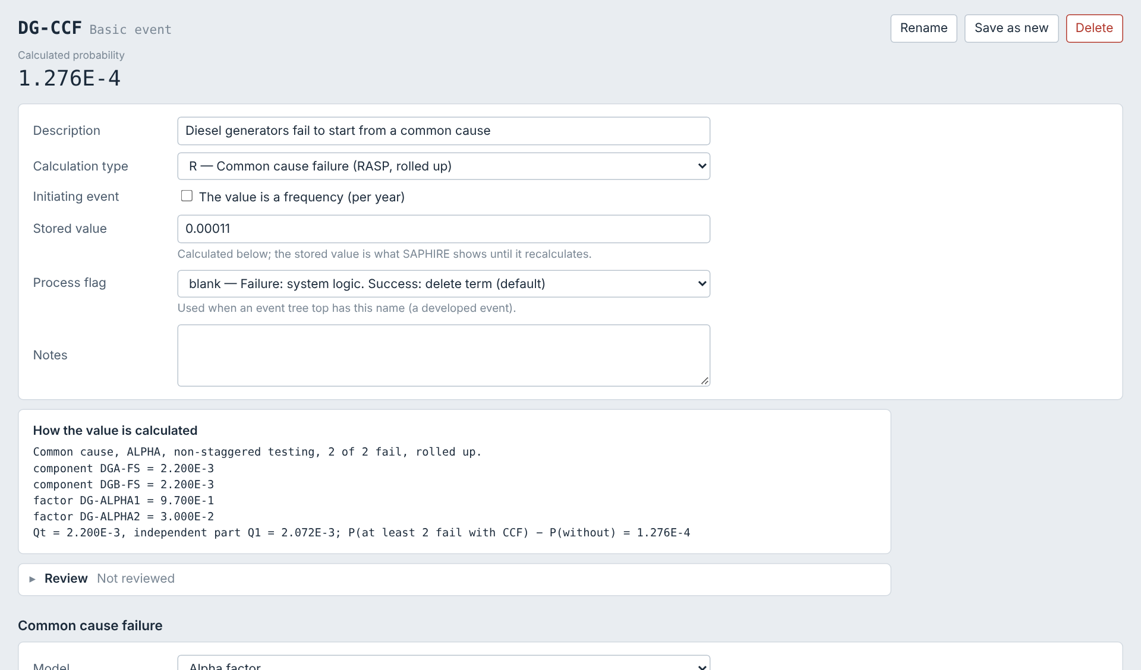
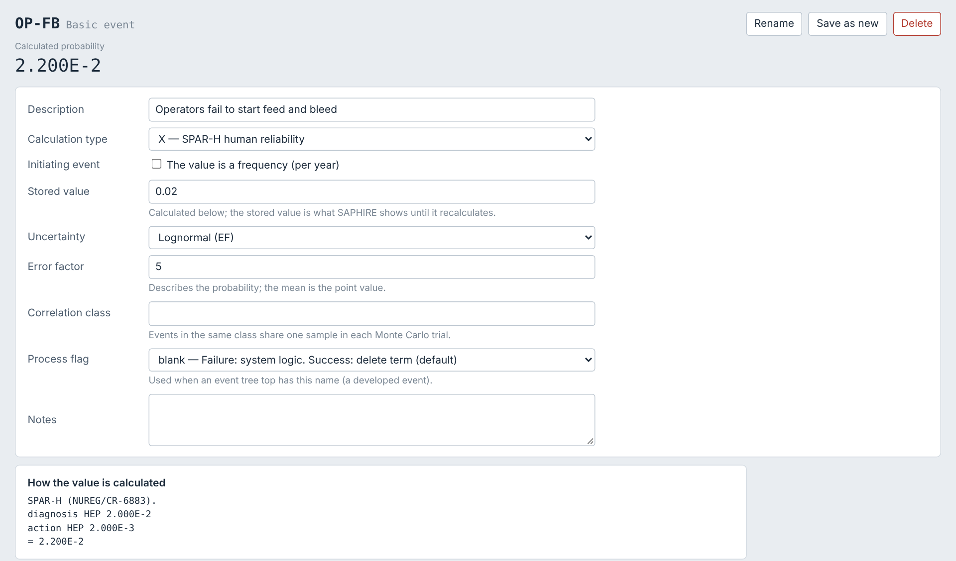
Common cause, human reliability and compound events
▶
Basic events
›
Click an event
›
Calculation type R, X or C
R: common cause failure (RASP)
X: SPAR-H human error probability
R, CCF: alpha factor or MGL, staggered or non-staggered testing, rolled up; conditional on members already failed. Alpha factors can have a Dirichlet uncertainty.
X, SPAR-H: NUREG/CR-6883 worksheet for diagnosis and action.
C, compound: PLUGUTIL arithmetic, MIN_CUT, and beta, MGL and alpha-factor CCF.

Slide 16
All SAPHIRE calculation types
▶
Basic events
›
Click an event
›
Calculation type
Type | Value
1 | Probability (or frequency for an initiator)
3 | 1 − exp(−λT), operating, no repair
5 | Operating with full repair
7 | Standby, tested: 1 + (exp(−λτ) − 1)/(λτ)
V | Value (input to other events)
N | Initiating event frequency
T, F, I | House event TRUE, FALSE, IGNORE
U, Y, D | TRUE: failed for an unknown, independent or dependent cause
Type | Value
C | Compound (PLUGUTIL, CCF plug-ins)
R | RASP common cause failure
A | Train-level CCF (members are trains)
Q | Initiating event CCF: ΣC(m,k)·Qk per year
X | SPAR-H human error probability
S, E | Fault tree or end state result
G | Seismic: Φ(ln(g/a)/βR) at a screening g
H | Seismic, at the hazard curve's highest g
O | Convolution correction factor
All 22 types in SAPHIRE 8 Vol. 7, B.3.10 are computed. Each event shows its formula with your numbers under "How the value is calculated".

Slide 17
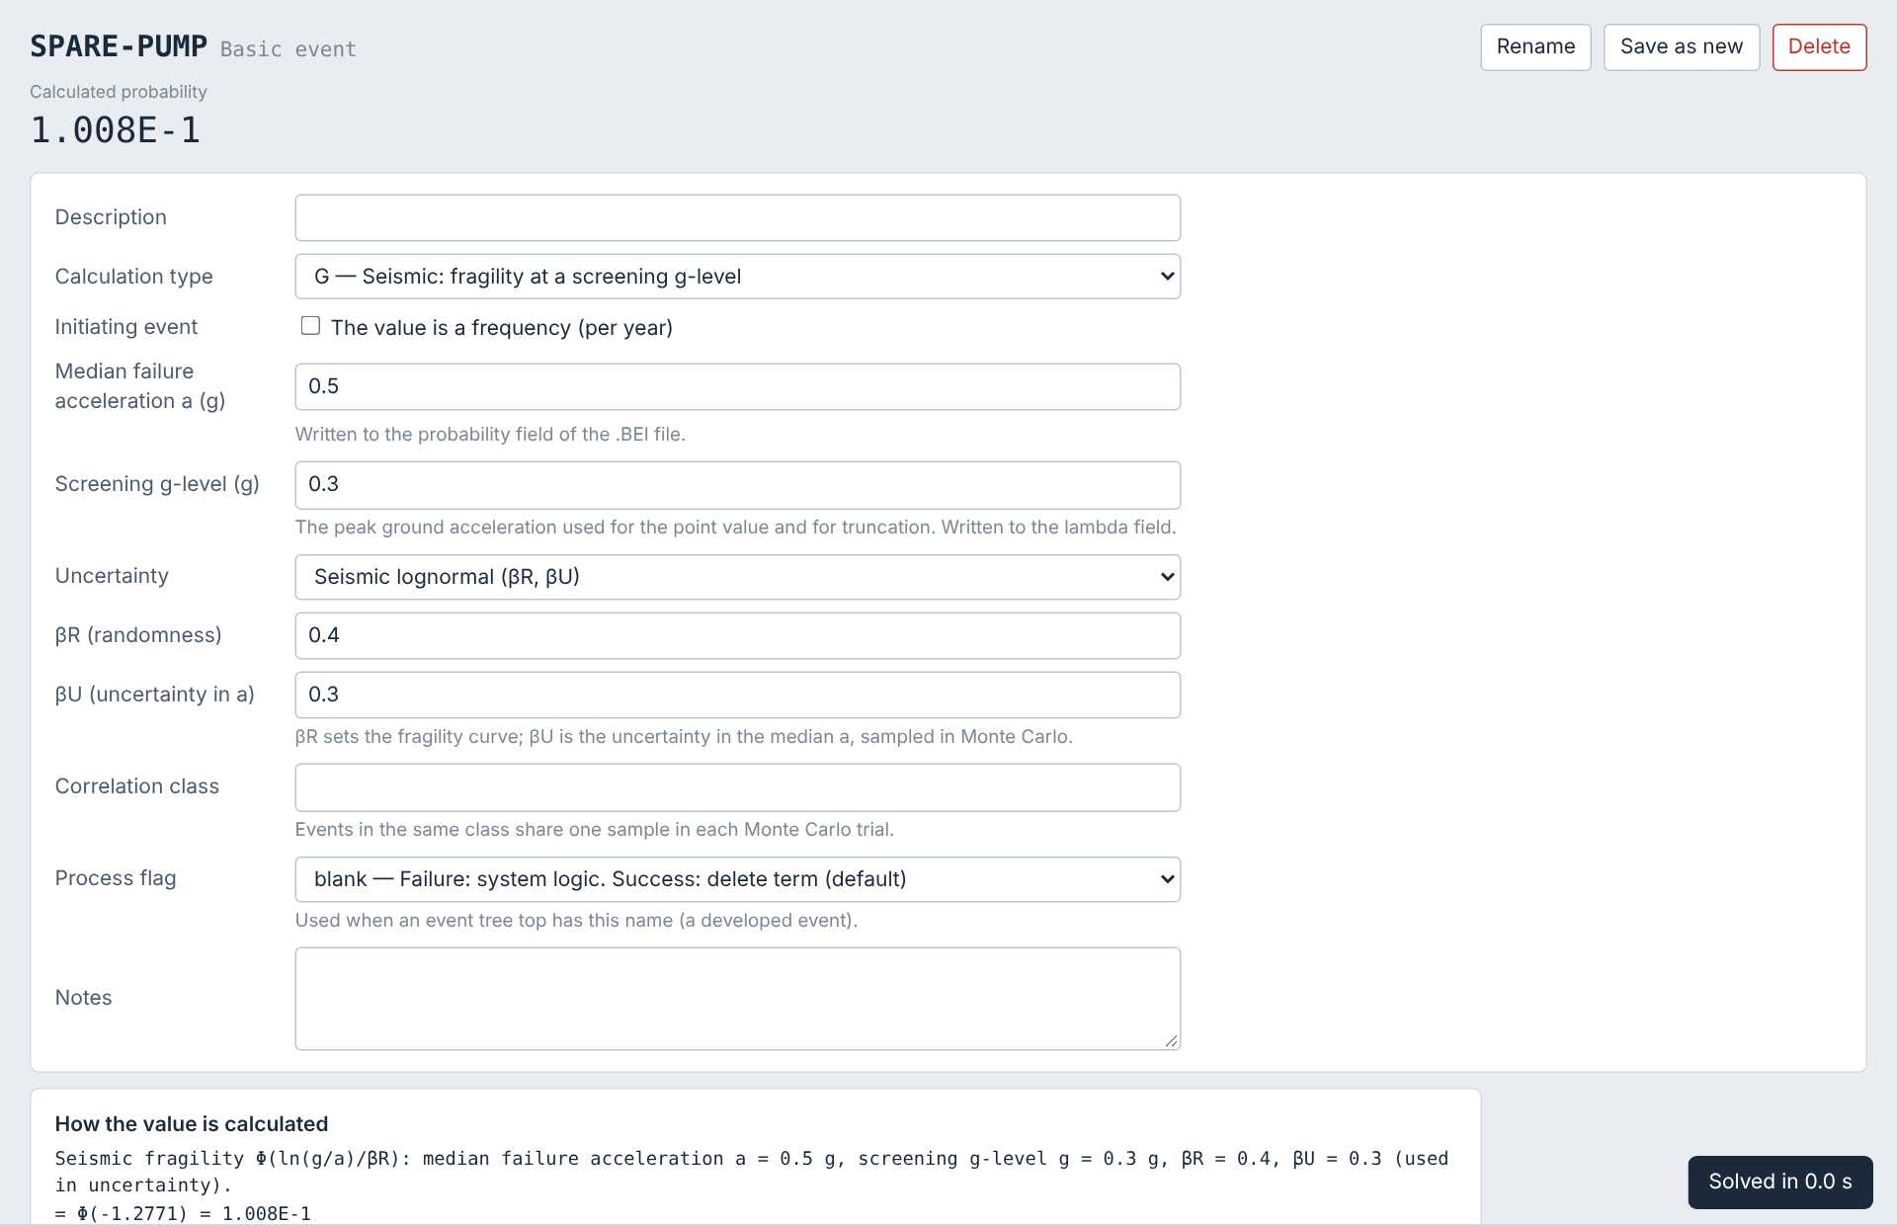
Seismic events and the hazard curve
▶
Basic events
›
Click an event
›
Calculation type G or H
or
Project Info
›
Hazard curve
G: P = Φ(ln(g/a)/βR) at a screening g-level.
H: the same at the highest g-level of the project's hazard curve (Project page; .HID/.HII files).
Fields: median failure acceleration a in the probability field, screening g in the lambda field, βR and βU as a seismic lognormal (S) uncertainty.
Uncertainty: Monte Carlo samples a with βU.

Slide 18
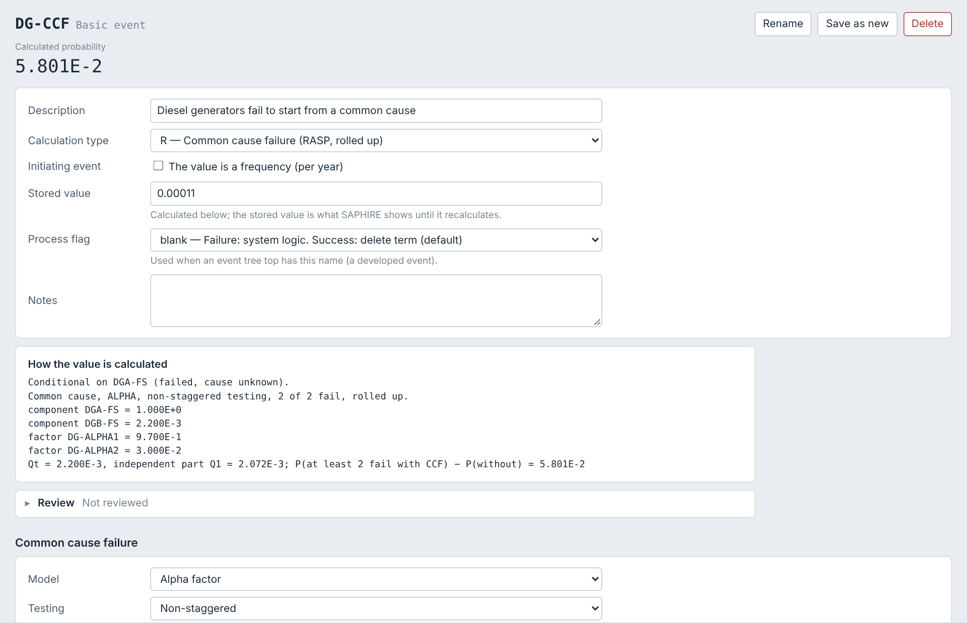
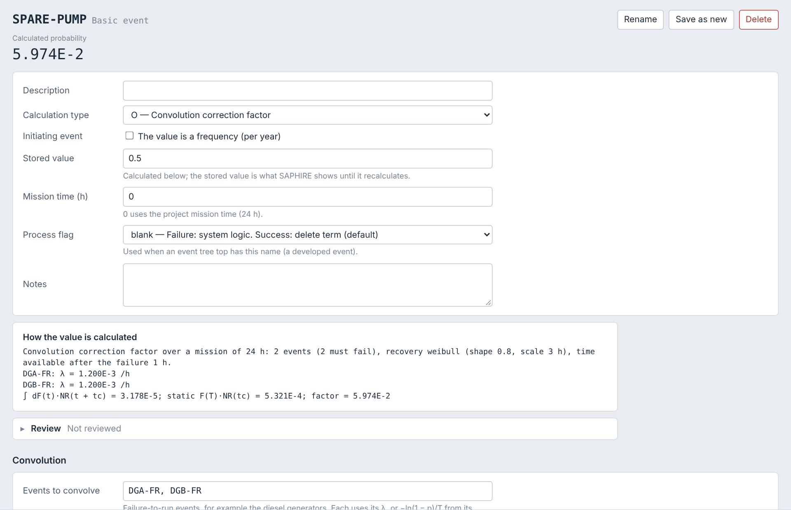
CCF conditioning and convolution
▶
Basic events
›
Click a CCF (R) or O event
›
Common cause failure or convolution panel
DG-CCF with DGA-FS failed for an unknown cause (U)
O: convolution correction factor
CCF members set TRUE/U, Y or probability 1, D, FALSE, probability 0 or IGNORE are treated as in SAPHIRE Vol. 2, Table B-1; Qt is the smallest member probability.
Convolution: ∫ dF(t)·NR(t + tc) over the mission, divided by F(T)·NR(tc), for k of the listed failure-to-run events with a Weibull, lognormal or exponential recovery.

Slide 19
Fault trees
▶
Side list
›
Fault trees
›
Click a tree
›
Diagram tab
1
Toolbar
+ Gate and + Event make new items; + Existing… adds one already in the project. Copy, Cut, Paste, Remove, fold, find, zoom (mouse wheel), fit. Drag the background to move the diagram.
2
Quick add
point at a gate: +BE and +Gate appear in its corners and add a new basic event or gate under it.
3
Double-click
a transfer to expand it in place (again to fold it), a basic event to open it in a floating window, a gate to fold it.
4
Right-click
a node: add under it, paste (as a reference or a renamed copy), complement, move left or right, remove, delete.
5
Drag
a node onto another gate to move it (Ctrl: copy), also into a tree in a floating window. Loops are refused. The bar beside the pane resizes it.
6
Drop
basic events and fault trees from the side lists onto a gate, or onto its input list.

Slide 20
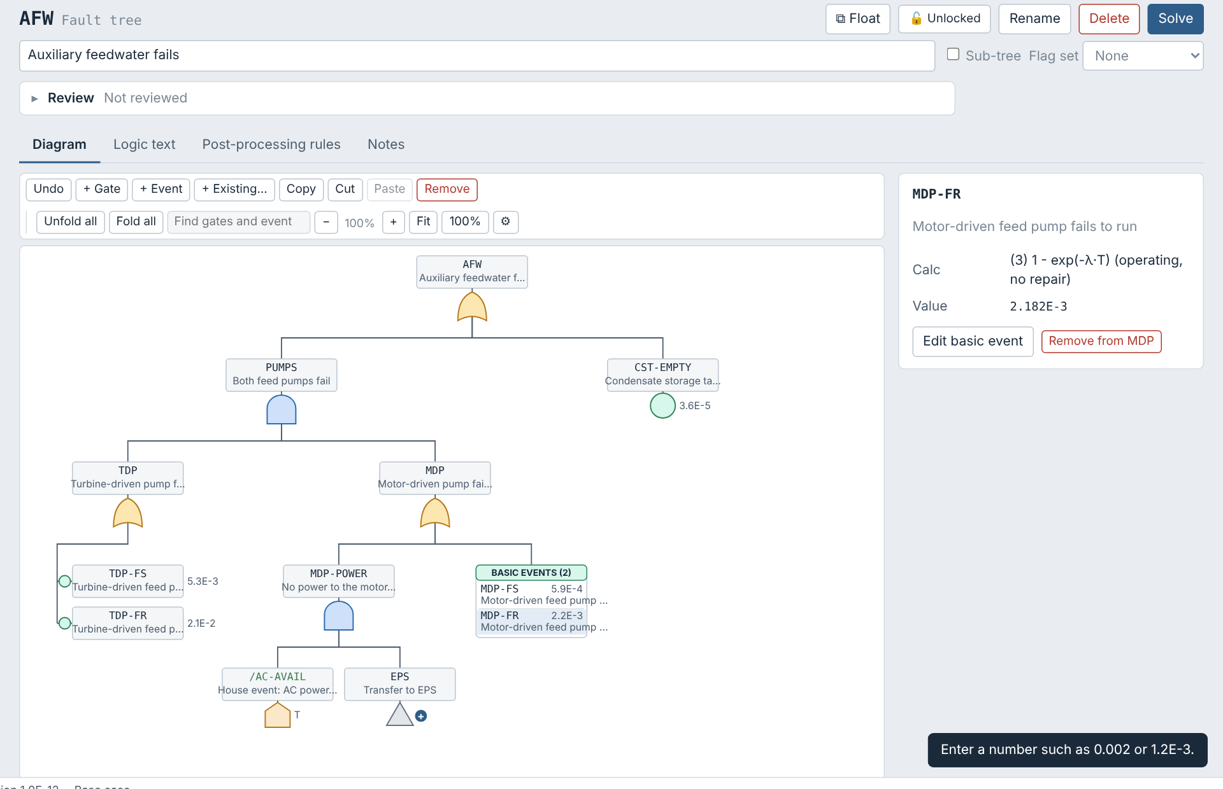
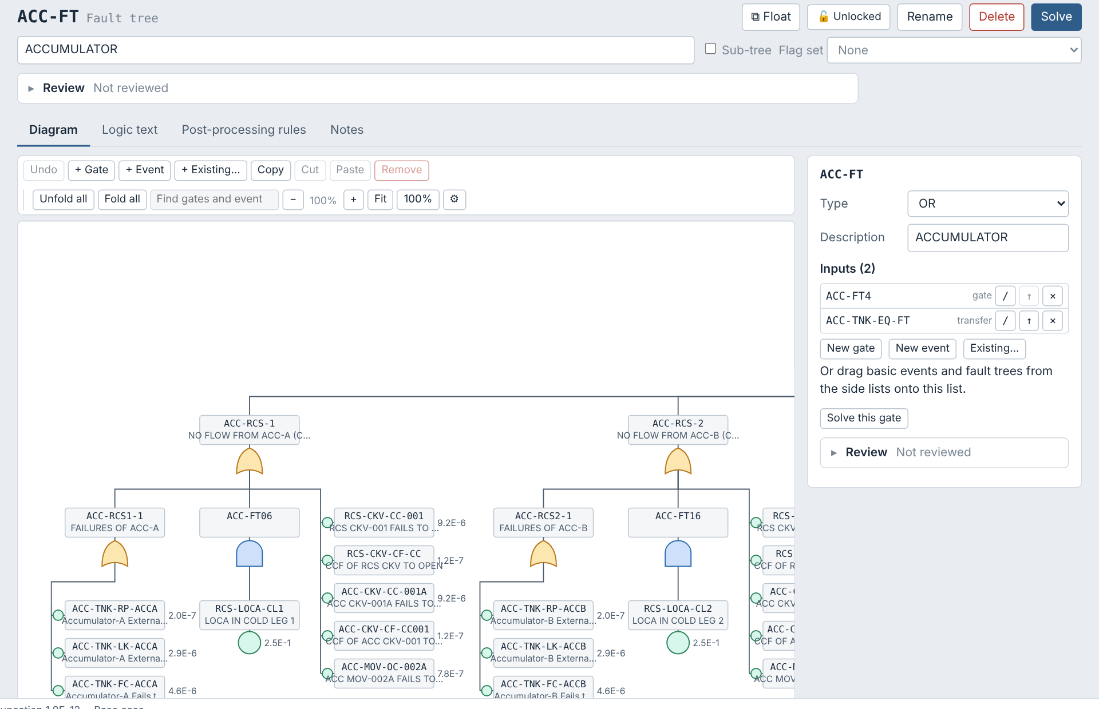
Basic events below a gate, and transfers
▶
Fault tree diagram
›
Right-click a gate
or
⚙ Settings
›
Fault trees
Stacked under TDP; in a table under MDP
GPWR ACC-FT with ACC-TNK-EQ-FT expanded in place
Basic events below a gate stacked in one column (the default), side by side, or listed in one table box (as in KUREAS-FTL): Settings → Fault trees for every gate, or a gate's right-click menu for that gate.
Transfers double-click (or click its +) to expand the transferred tree in place, dashed and labelled ⇲; − collapses it. Right-click for Open in a floating window or Go to the tree. Gates shown from another tree are edited in their own tree.

Slide 21
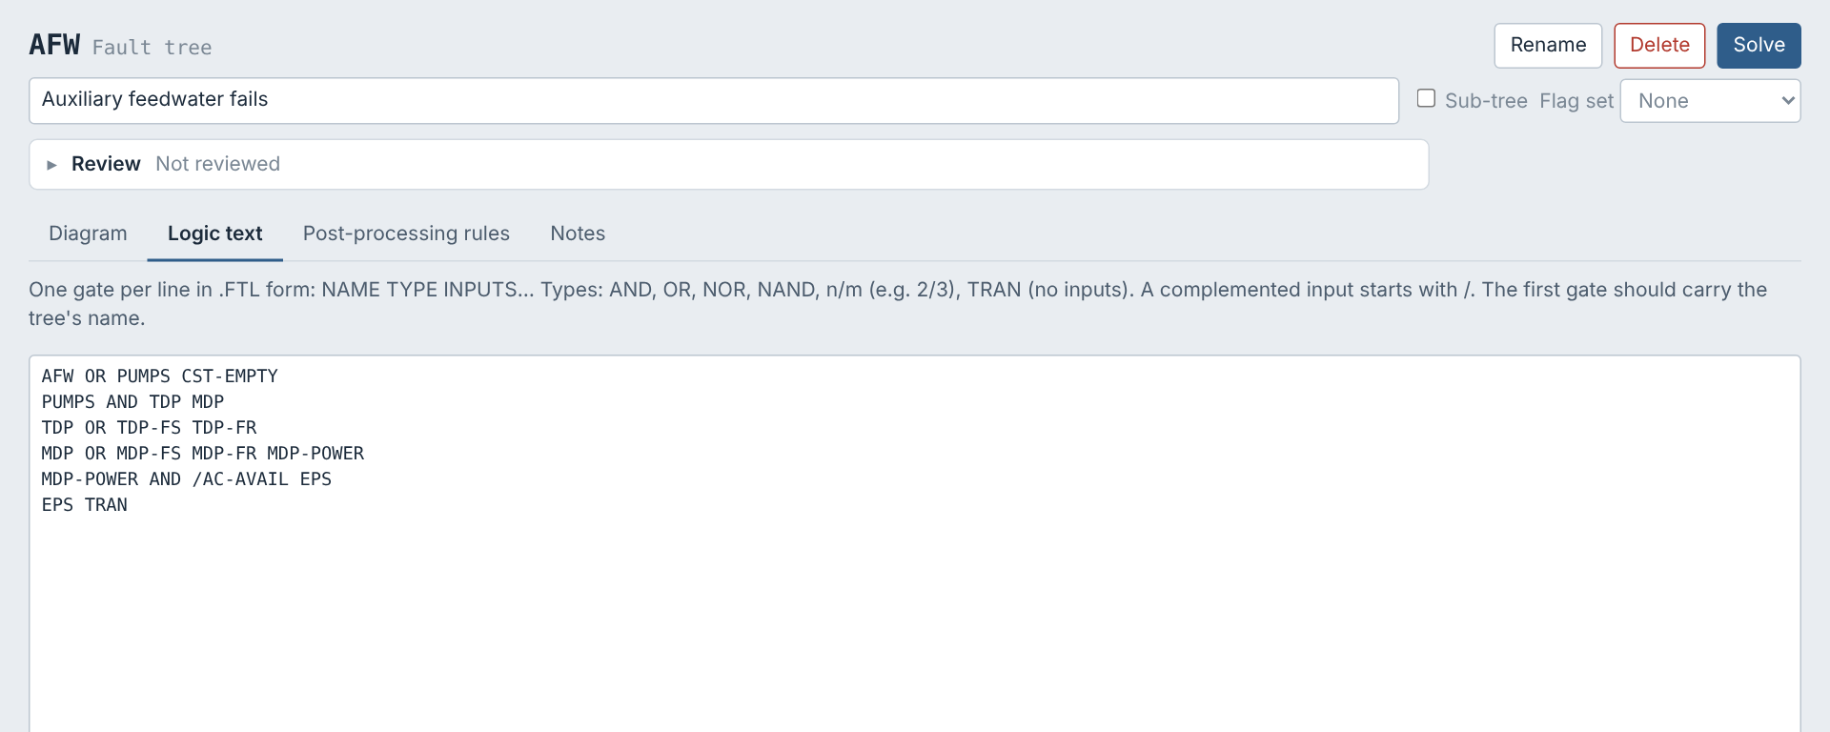
Fault tree logic as text
▶
Side list
›
Fault trees
›
Click a tree
›
Logic text tab
The Logic text tab shows the tree in FTL form, one gate per line: NAME TYPE INPUTS.
Types: AND, OR, NOR, NAND, n/m (for example 2/3) and TRAN. A complemented input starts with /.
The first gate is the top. Edit the text and click Apply logic; unknown names can be created as basic events.
Drag names from the side lists into the text (and into any rule editor).
FB OR FB-HW OP-FB
FB-HW 2/2 PORV-FO PZR-BLOCK

Slide 22
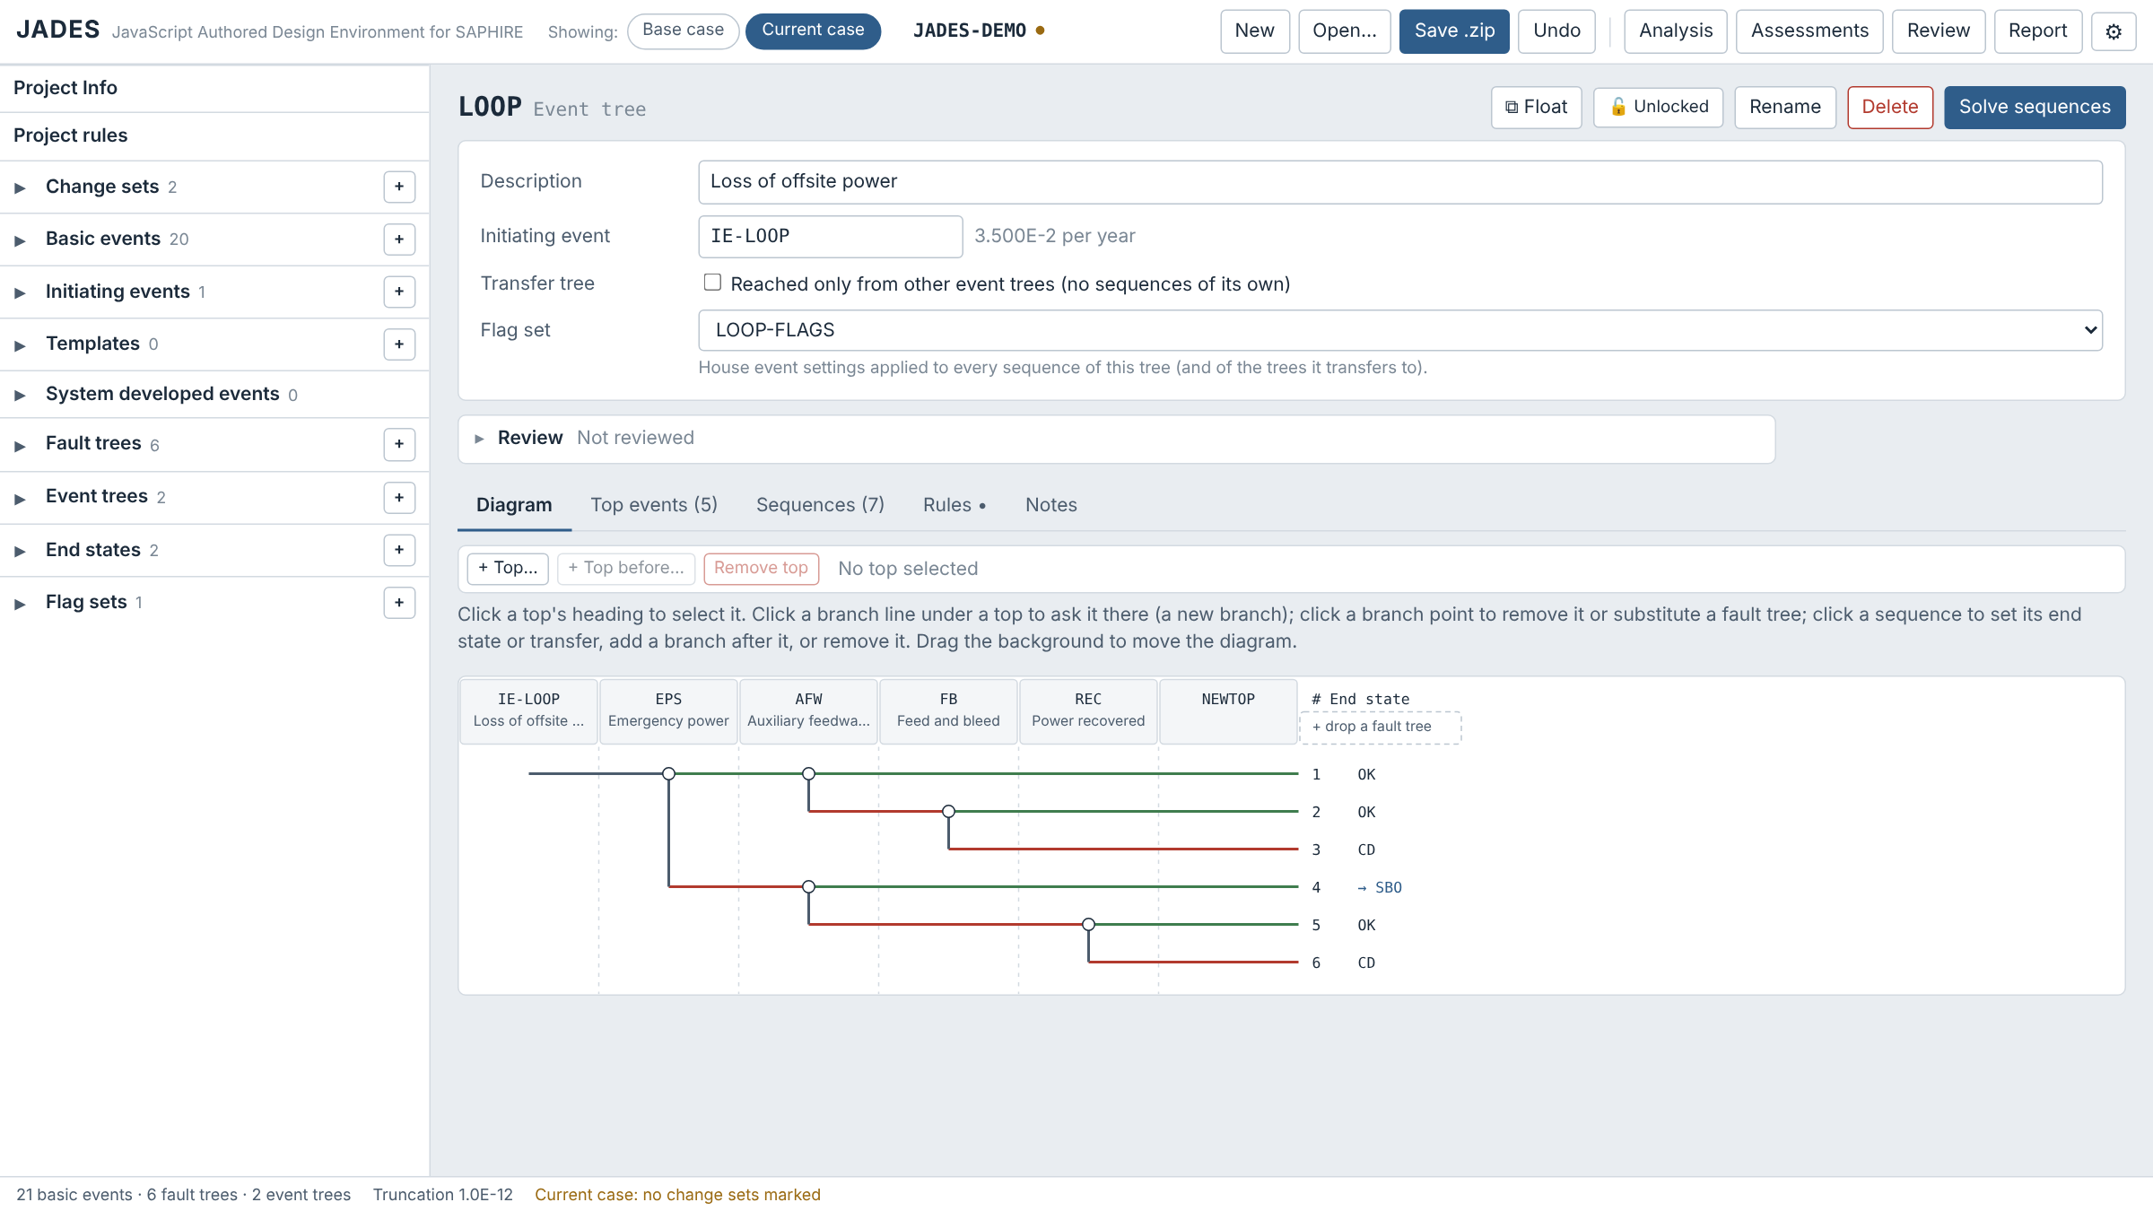
Event trees
▶
Side list
›
Event trees
›
Click a tree
›
Diagram tab
1
Tops
Toolbar: + Top… (at the end, or after the selected top), + Top before…, ◀ Move and Move ▶ (sequence logic kept), Remove top. Click a heading to select it; right-click it for the same.
2
Branches
Click the line under a top to ask it there. Click a sequence to add a branch after it or remove it.
3
Branch points
Click one to remove it (keeping either branch) or to substitute a fault tree.
4
Outcomes
Click a sequence for its end state, a transfer, a flag set or its name.

Slide 23
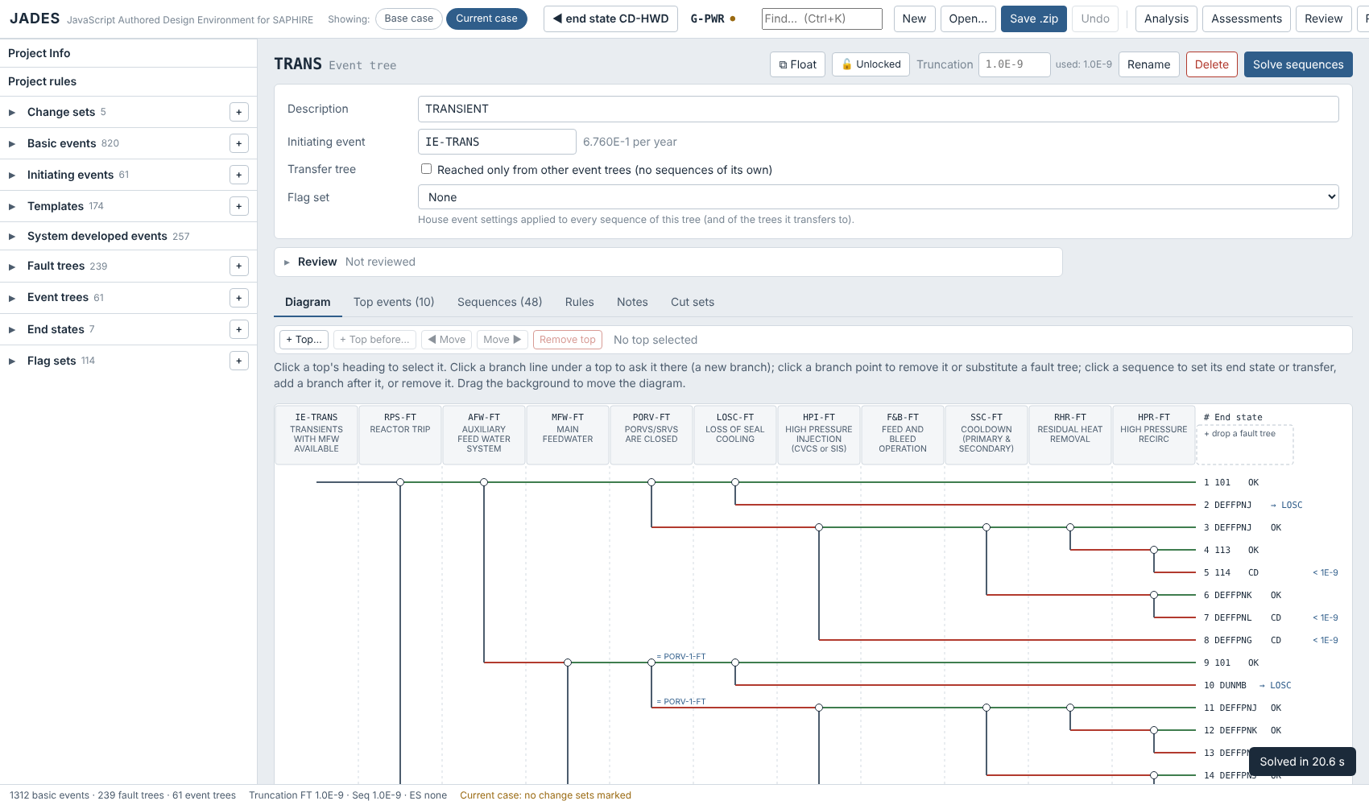
Event tree drawing
▶
Side list
›
Event trees
›
Click a tree
›
Diagram tab
or
⚙ Settings
›
Event trees
Headings: a long top description wraps onto up to four lines; the headings grow to fit.
Frequencies: once sequences are solved, each one's frequency sits just after the end state column ("< 1E-9" below the truncation).
Text weight: ⚙ Settings → Fault trees or Event trees → Text weight: Normal or Bold.
Background: ⚙ Settings → Event trees → Background, as for fault trees.

Slide 24
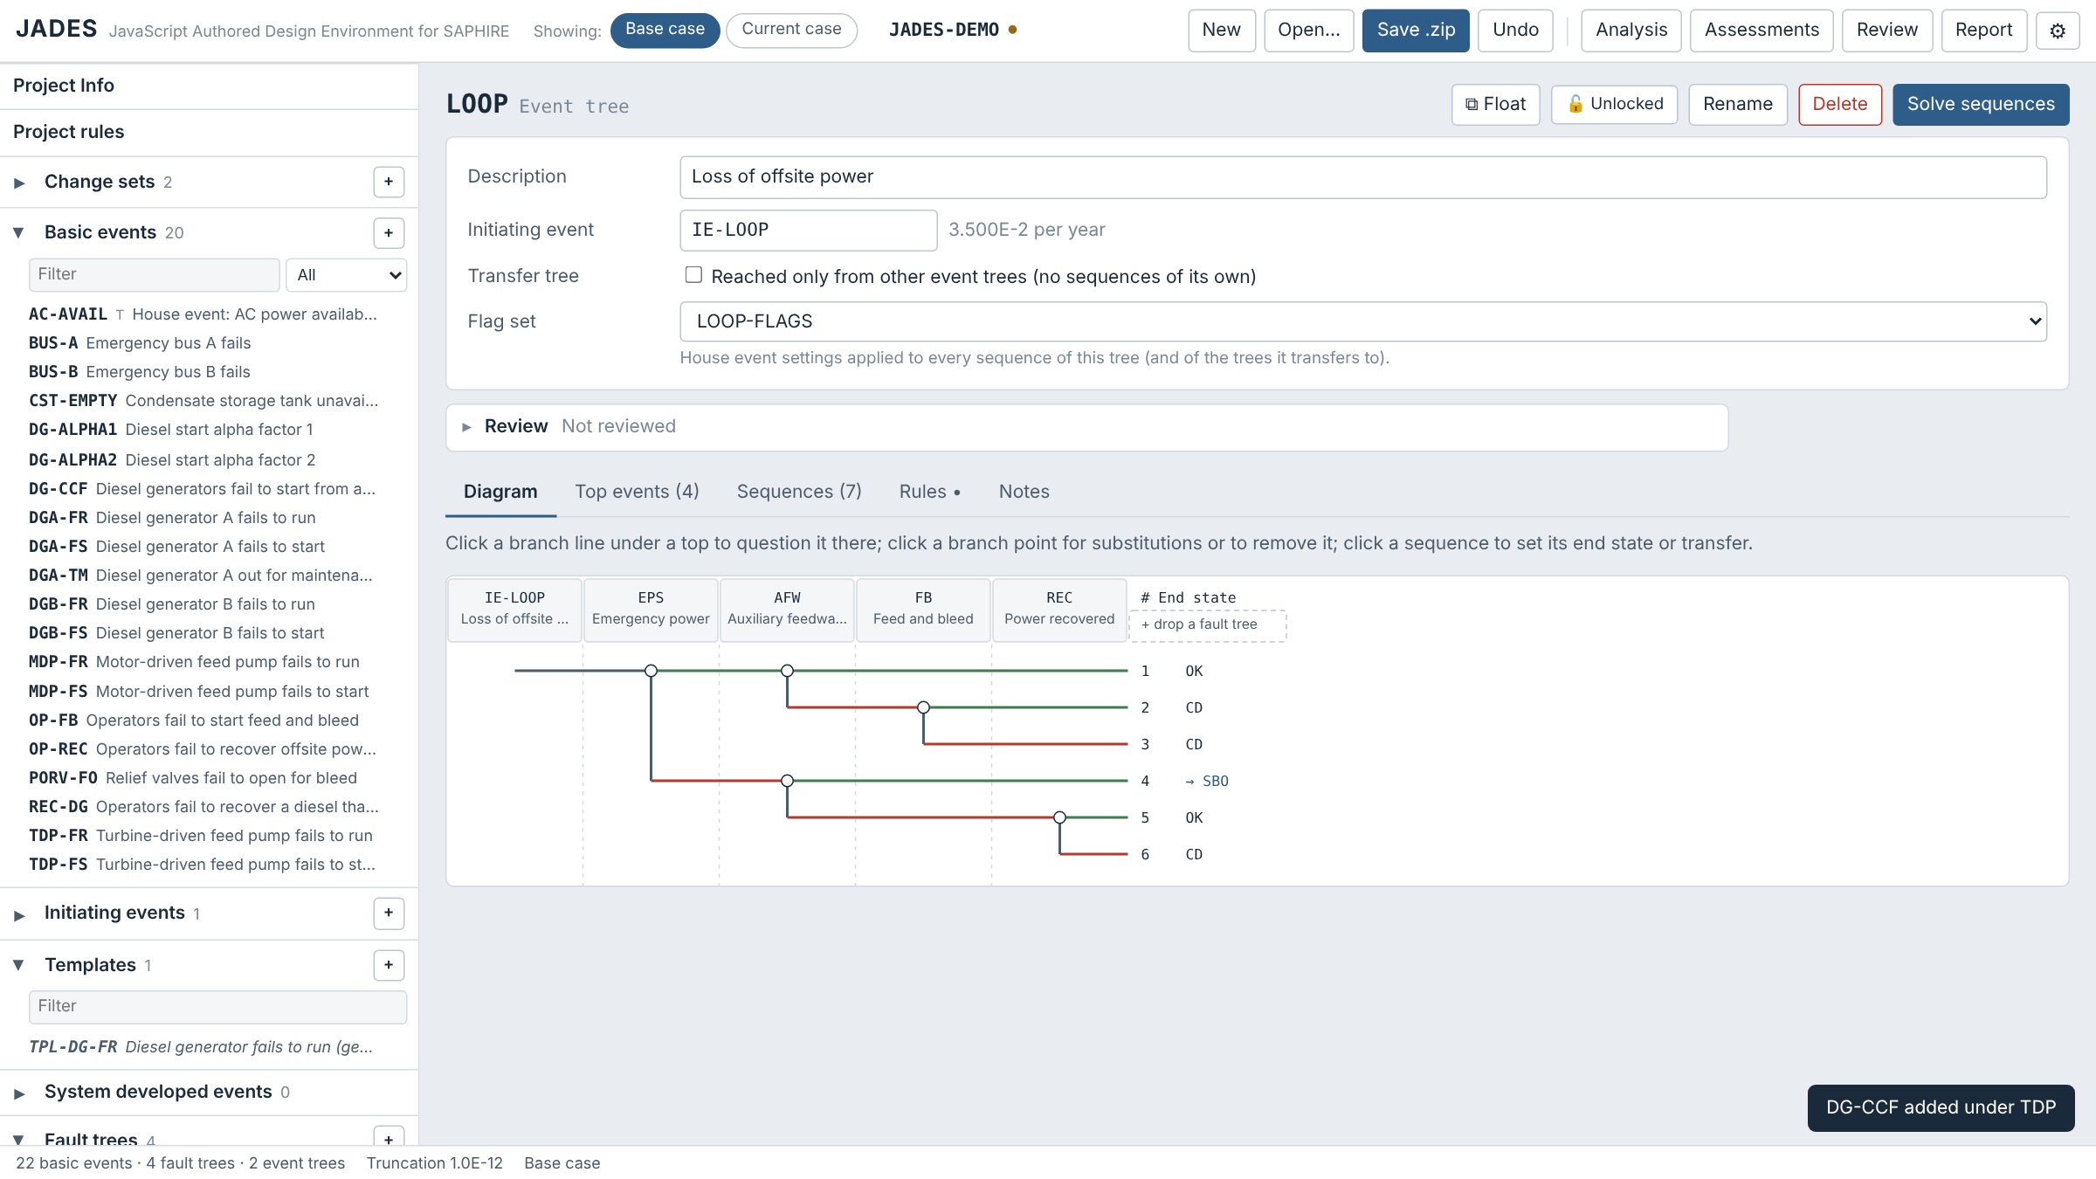
Drag and drop into event trees
▶
Event tree Diagram tab
›
Drag a fault tree or event from the side list
Drop | Onto | Result
Fault tree | a top column heading | inserted as a top there
Fault tree | "+ drop a fault tree" | added as the last top
Basic event | the initiator heading | the initiating event
End state | a sequence | its end state
Event tree | a sequence | a transfer to that tree
Flag set | a sequence | its flag set
Right-click a top heading to open or remove it. Solved sequences show their frequency.

Slide 25
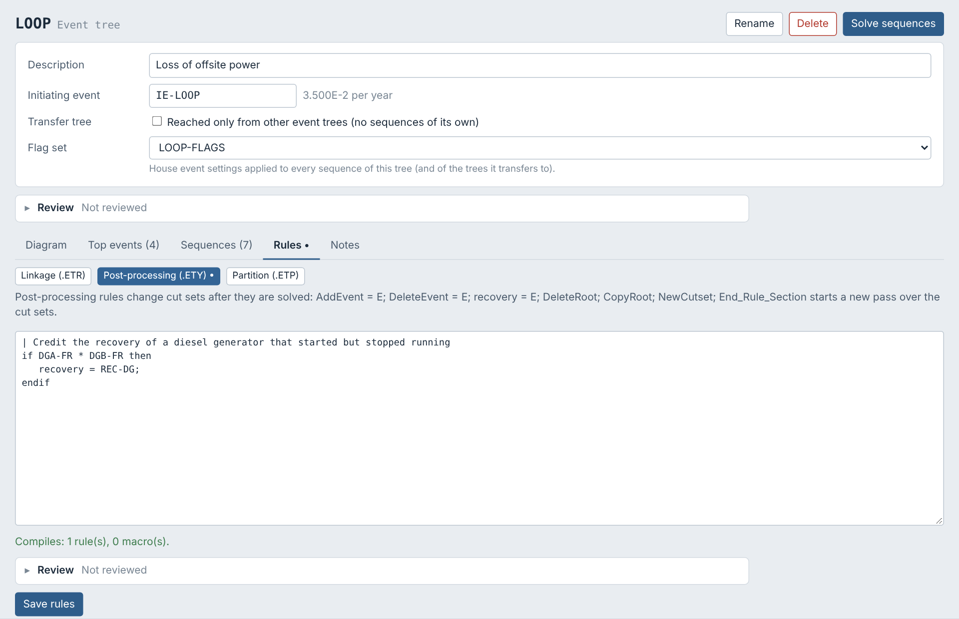
SAPHIRE rules
▶
Side list
›
Project rules
or
Event tree or fault tree
›
Rules tab
Kind | Where they live | What they do
Linkage | Project .FAL, event tree .ETR | Substitute tops, Skip, set end states, change transfers and flags
Post-processing | Project .FAY and .FAS; event tree .ETY; fault tree .FTY; sequence .SQY | AddEvent, DeleteEvent, recovery, DeleteRoot, CopyRoot, NewCutset
Partition | Project .FAP, event tree .ETP, sequence .SQP | Assign cut sets to end states
Rules compile as you type. Lines that will not compile, or that JADES would ignore, are highlighted (next slide). Project rules are on the Project rules page; tree and sequence rules are on their Rules tabs.

Slide 26
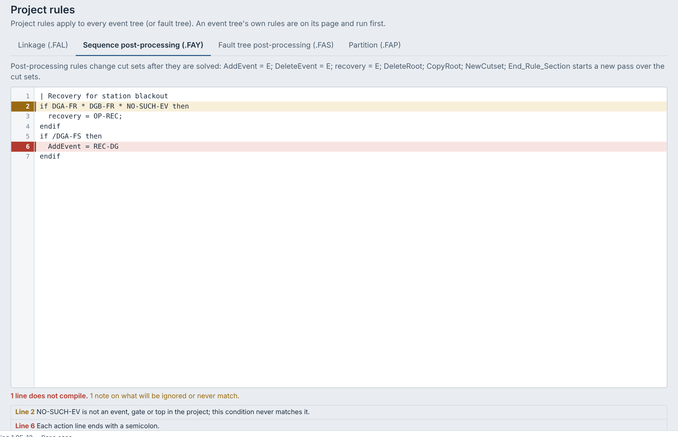
Rule checks in the editor
▶
Any rules editor
›
Type or paste rules
›
Red and amber line marks
Mark | Meaning | Examples
Red line | Does not compile: SAPHIRE (and JADES) will reject the rules | Missing ; after an action, if with no condition, unbalanced endif
Amber line | Compiles, but JADES ignores it or it can never match | A name not in the project; Convolve_Cut_Sets; TOP[n]; VarNum
Line numbers are in the gutter; the count of problems is under the editor.
Click a message to go to its line.
Tab inserts two spaces. The editor fills the window on the Project rules page.
The QA report type lists every rule problem in the project.

Slide 27
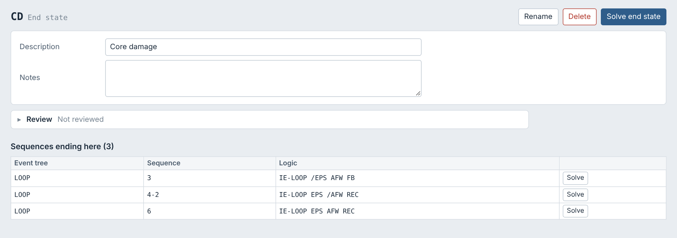
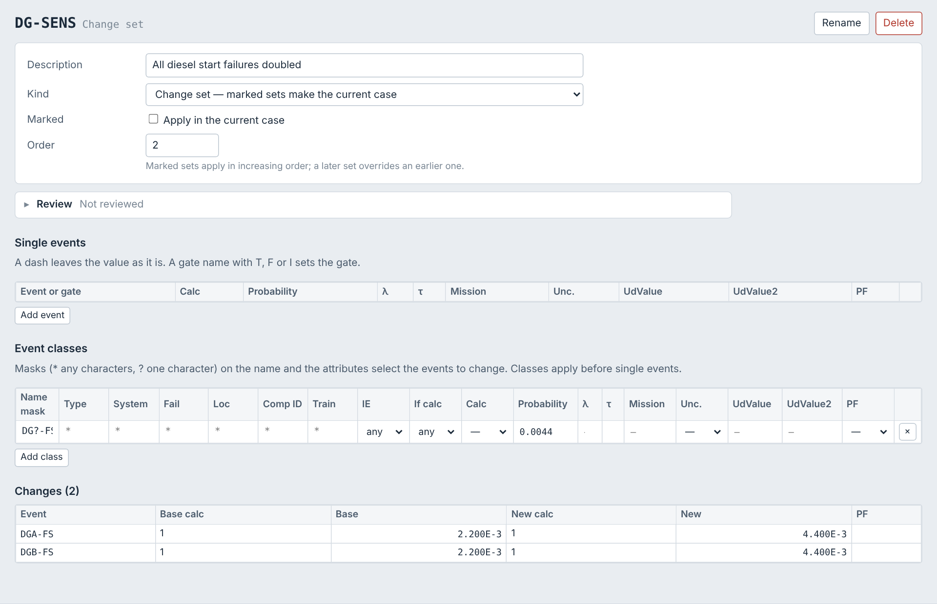
End states, change sets and flag sets
▶
Side list
›
End states · Change sets · Flag sets
›
Click an item
End state CD
End states list the sequences that end there; Solve end state gathers their cut sets.
Change sets (top of the side list) change single events, or classes of events chosen by name mask and attributes. Marked sets apply in order to make the current case.
Flag sets (own list, at the bottom) set house events and gates TRUE, FALSE or IGNORE for the sequences, event trees or fault trees that name them. Unused flag sets are in italics.
Change set DG-SENS

Slide 28
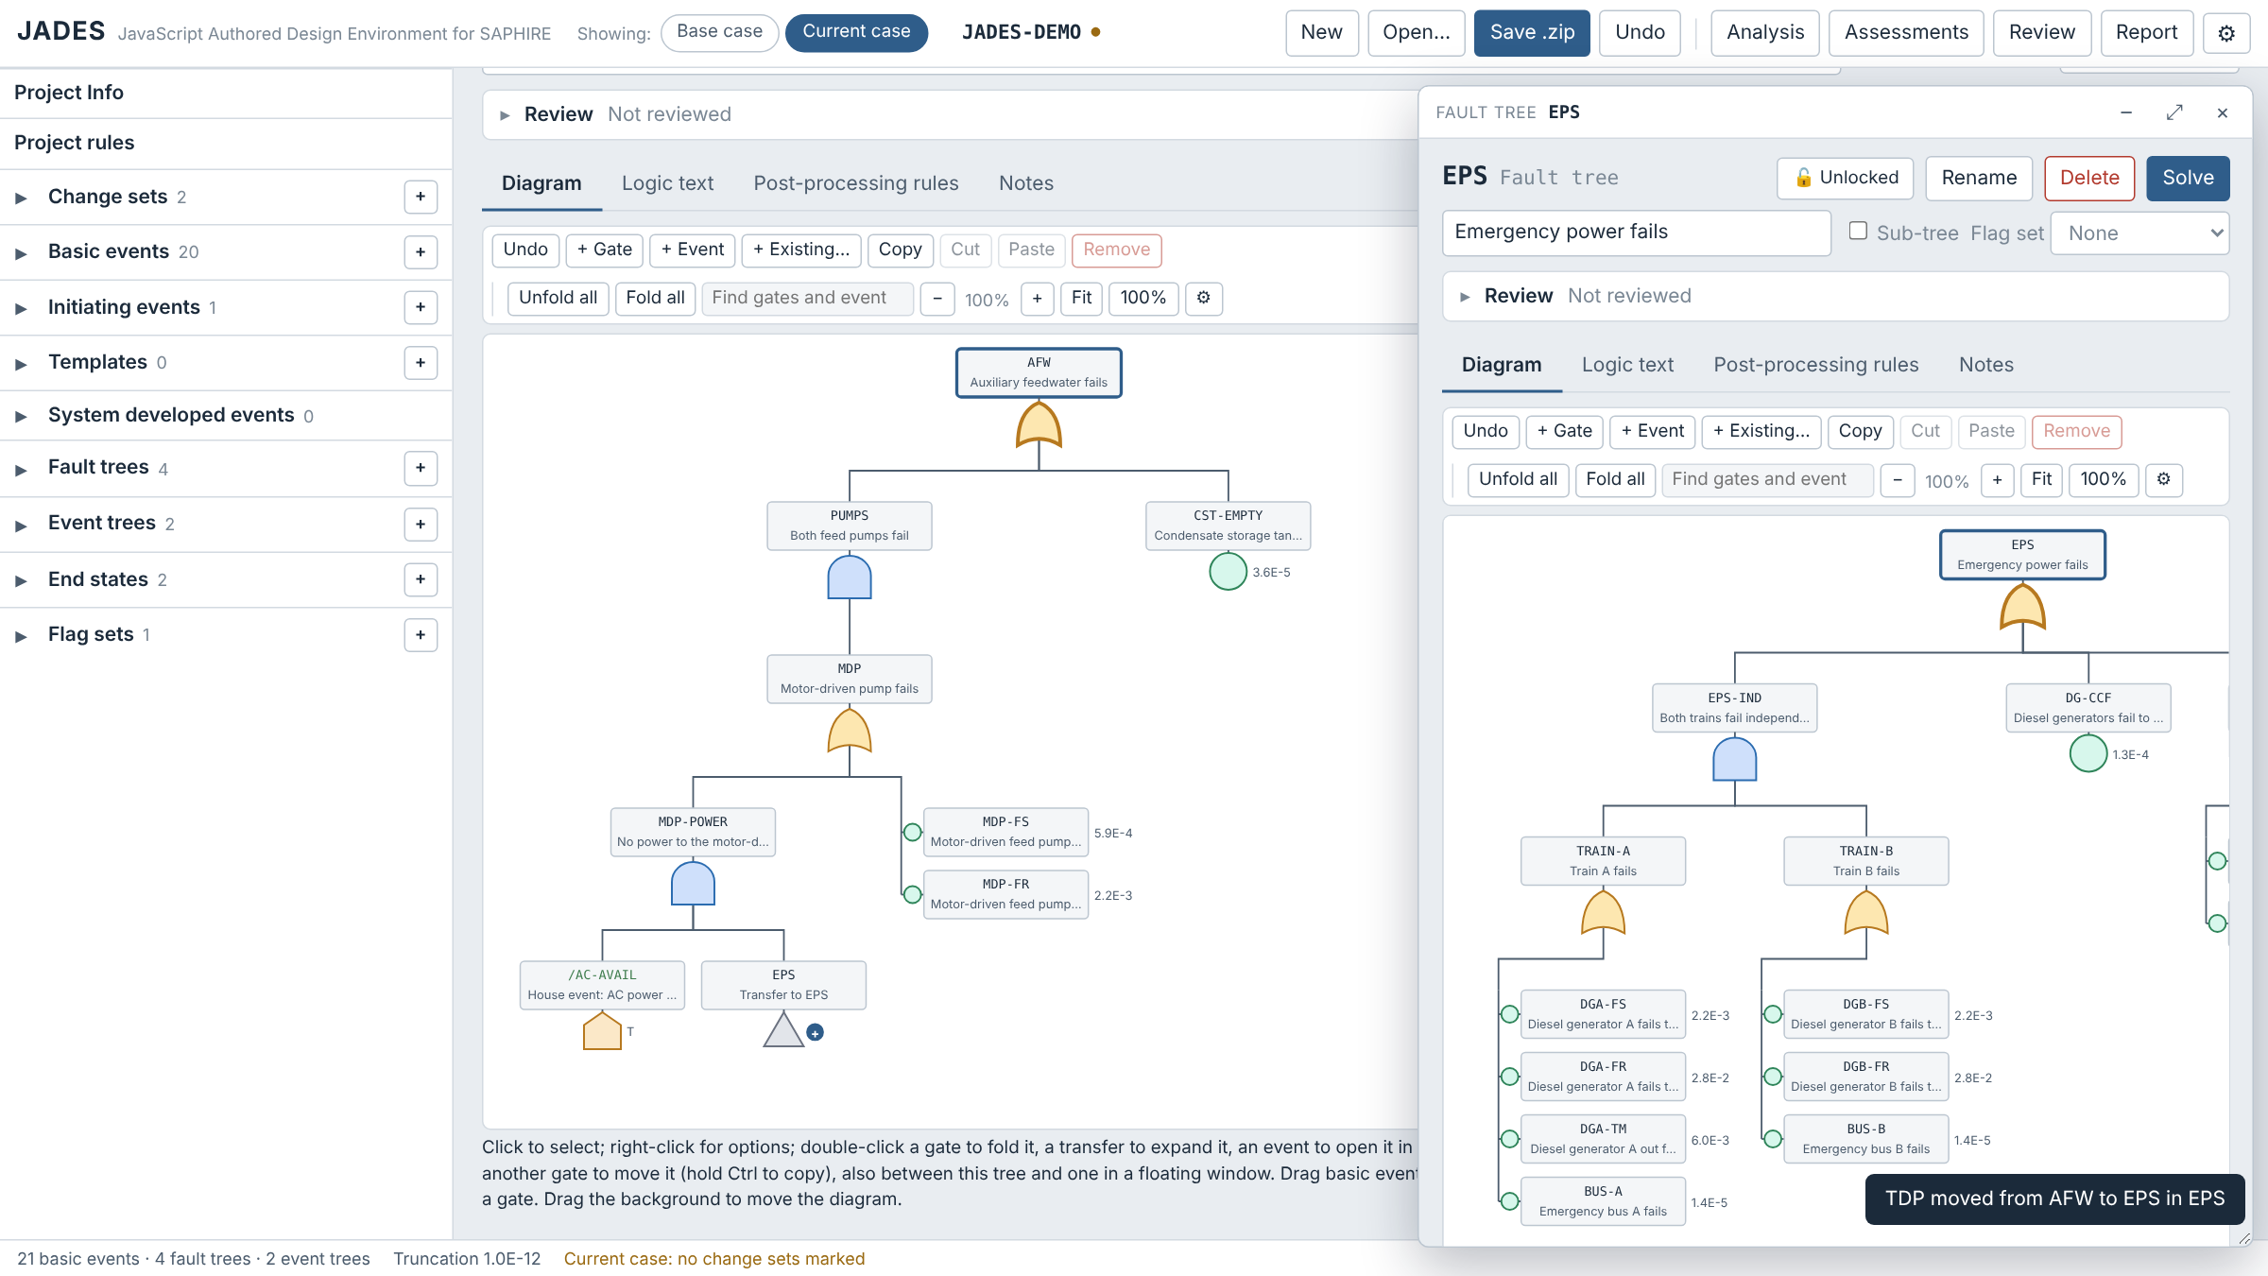
Floating windows
▶
Side list
›
⧉ beside an item
or
Editor
›
⧉ Float
1
Open
⧉ beside an item in the side lists, Shift+click or middle-click it, right-click → Open in a floating window, or ⧉ Float in an editor.
2
Arrange
Drag the title bar; resize from the bottom-right corner. Click a window to bring it to the front.
3
Work in it
Each window is a full editor. Drag fault tree nodes between a window and the page, either way: an event moves, a gate moves with the gates below it (Ctrl: a reference).
4
Close
× or Esc; – minimizes; ⤢ moves the item to the page.

Slide 29
Solving
3
Analysis settings, cut sets, importance, uncertainty, and base vs current case

Slide 30
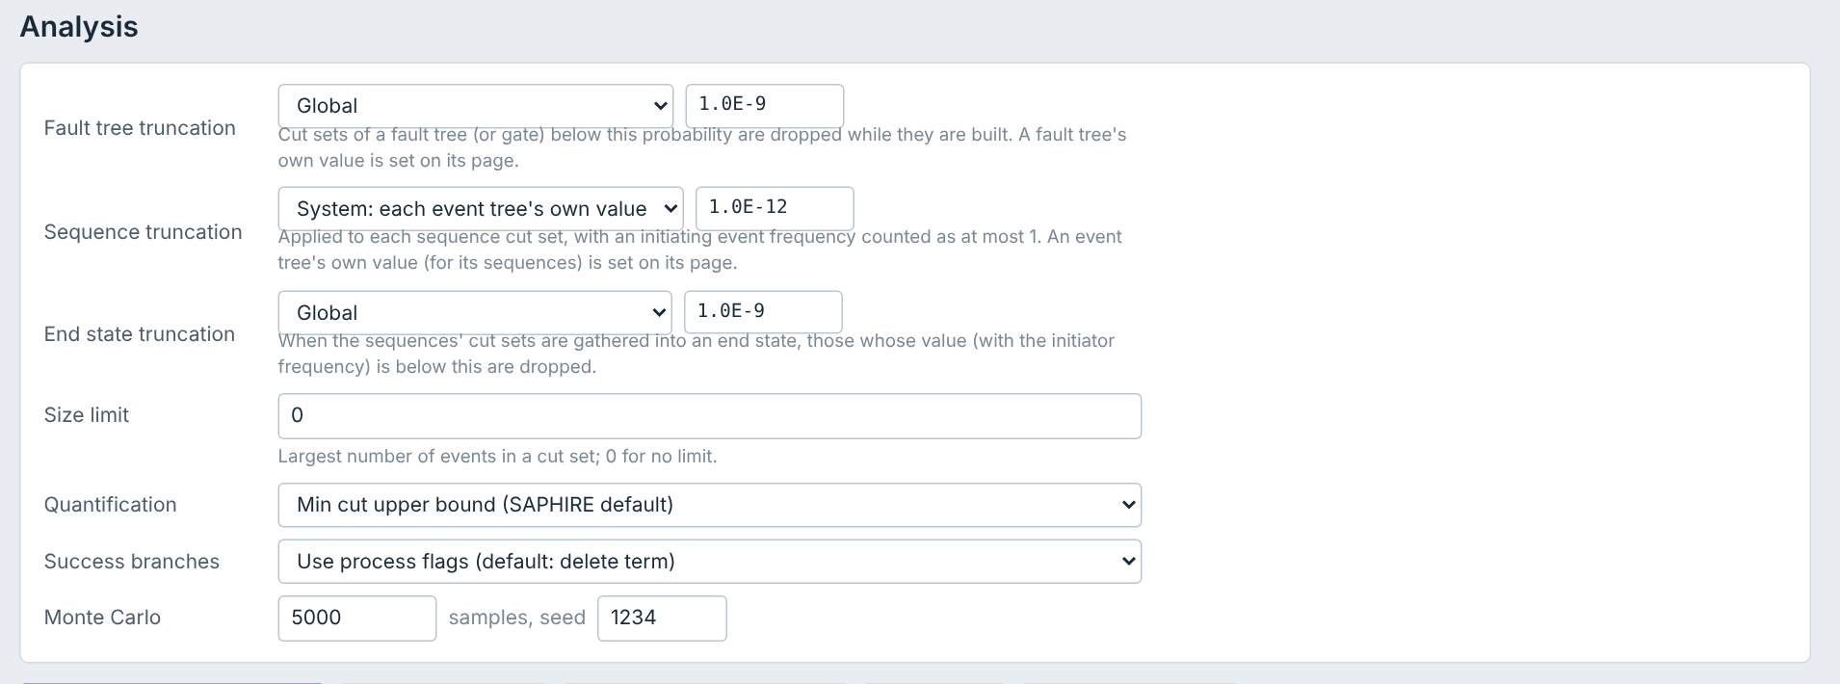
Analysis settings
▶
Header
›
Analysis
Setting | What it controls
Fault tree truncation | Global, System (each fault tree's own value, set on its page) or None. Cut sets below it are dropped while they are built.
Sequence truncation | Global, System (each event tree's own value, set on its page) or None; also after post-processing rules. A frequency counts at most 1.
End state truncation | None or Global: gathered cut sets below it (with the frequency) are dropped. With rules that raise cut sets (HFE dependency), solve the sequences lower and truncate here.
Size limit | Most failed events in a cut set (0 = no limit).
Quantification | Min cut upper bound (SAPHIRE default); exact BDD by KUREAS-QUANT; or rare event (sum of cut sets).
Success branches | Process flags (delete term by default), or ignore successes.
Monte Carlo | Samples and seed for uncertainty runs.
Buttons: Link and solve all sequences · Solve all fault trees · Compare base and current · Sensitivity…. Solving runs in a background worker, so the page stays responsive; a progress bar shows each solve and Cancel stops it (sequences already solved are kept).

Slide 31
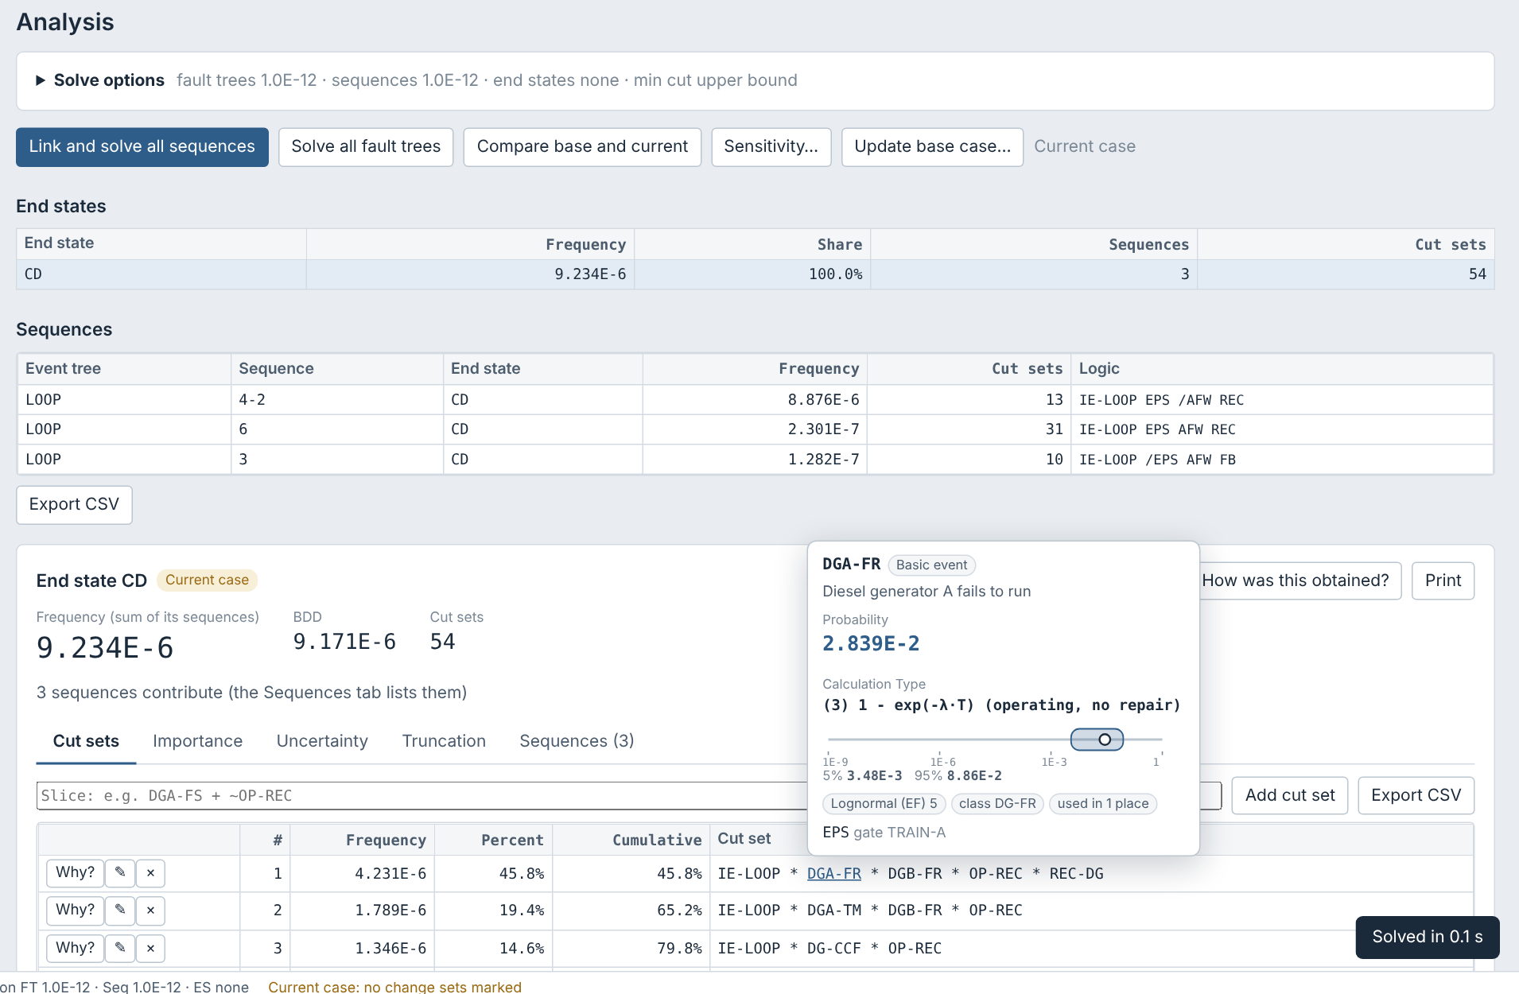
Cut set results
▶
Analysis
›
Link and solve all sequences
›
Click a row
›
Cut sets · Importance · Uncertainty tabs below
On the Analysis page: click an end state, sequence or fault tree row; its cut sets, importance, uncertainty, truncation (and an end state's sequences) show below the tables. Double-click, or Open on its own page, for a page of its own.
OK sequences (and @ end states) are not solved, as in SAPHIRE.
Slice: type a rule expression such as DGA-FR + DGB-FR to show the matching cut sets and their share.
Per row (left): Why? explains the cut set. ✎ Comment (top right) comments on the whole set of cut sets. The initiating event is listed first; point at an event for its card, click it to open it, then ◀ Back (header, Alt+←) returns here.
BDD: beside the frequency, the cut sets quantified exactly by a binary decision diagram.
End states: the Sequences tab lists the sequences that make it up. Sequences already solved with the same options are reused, not solved again.

Slide 32
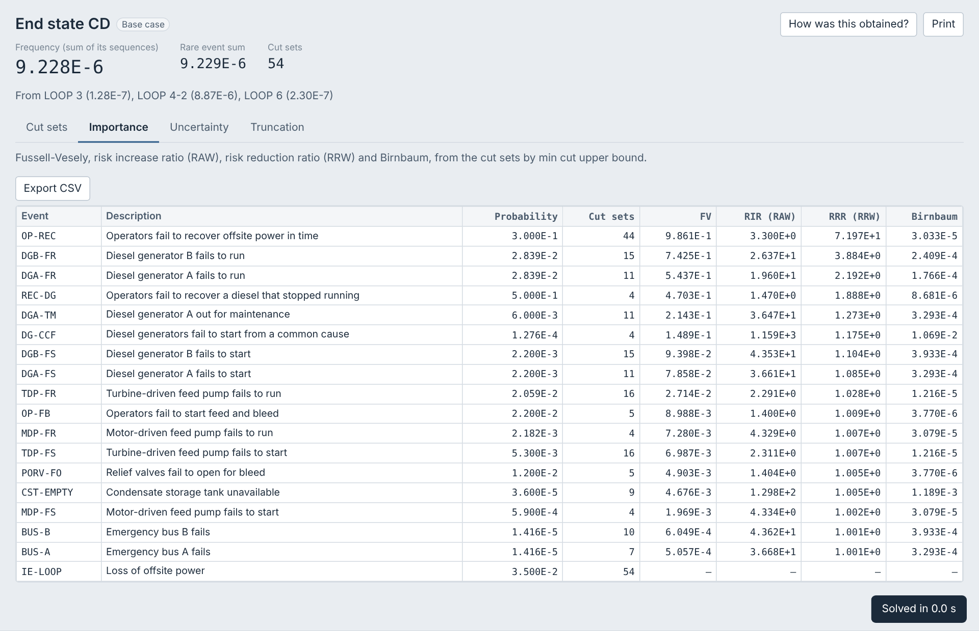
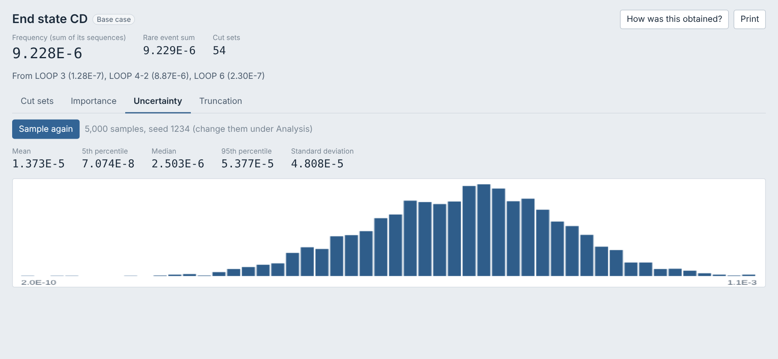
Importance and uncertainty
▶
Analysis
›
Click a solved row
›
Importance or Uncertainty tab
Uncertainty tab
Importance tab
Importance: Fussell-Vesely, RIR (RAW), RRR (RRW) and Birnbaum for every event, from the cut sets by the chosen quantification.
Uncertainty: Monte Carlo gives the mean, 5th percentile, median, 95th percentile and standard deviation, with a histogram. Events in one correlation class share a sample in each trial.

Slide 33
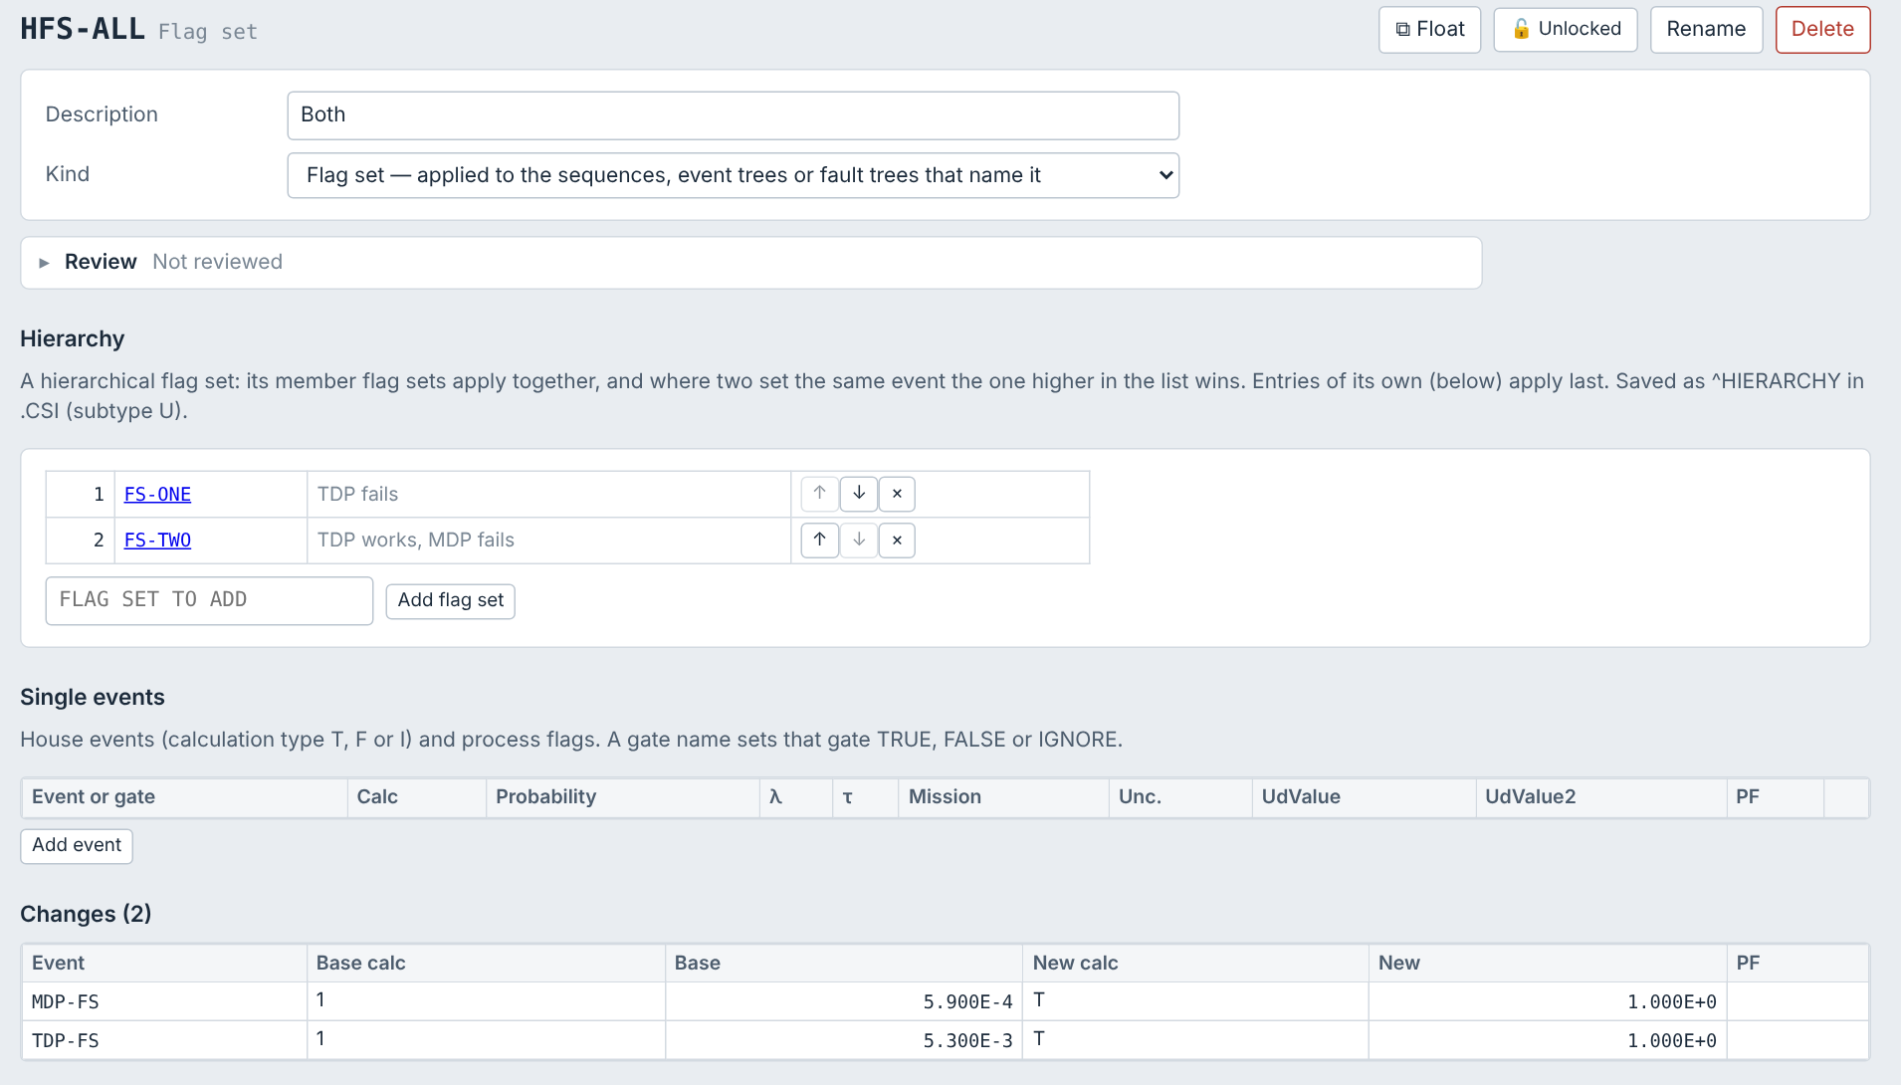
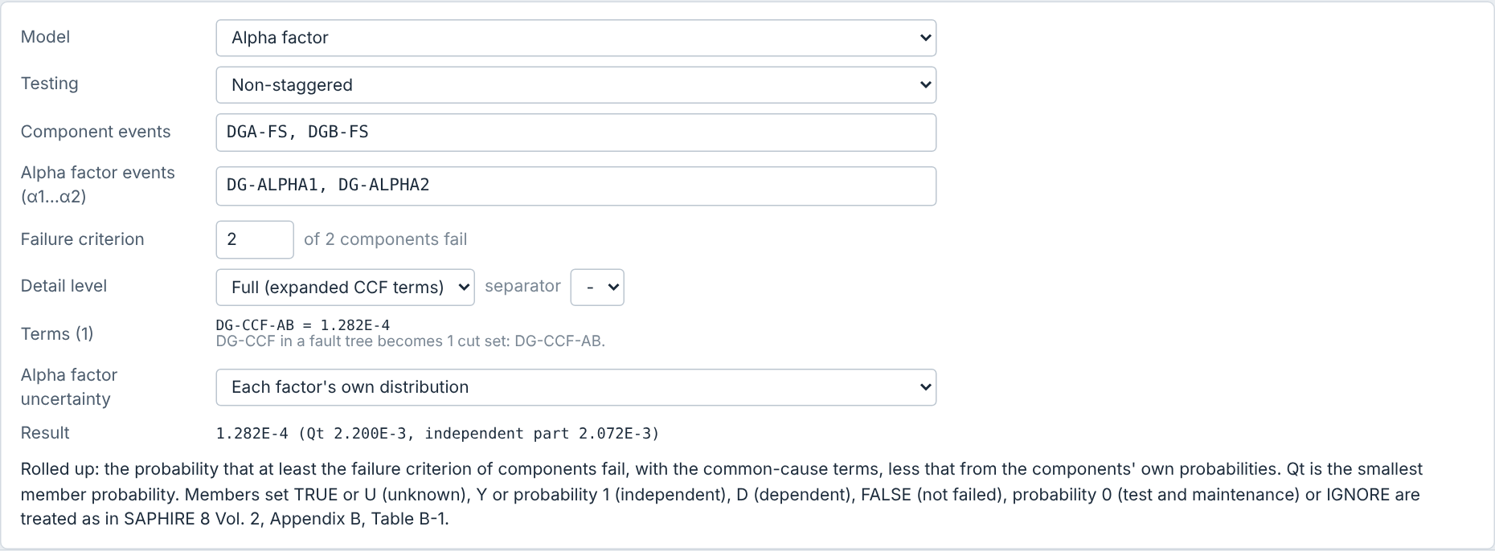
Hierarchical flag sets and expanded CCF
▶
Flag sets
›
Click a flag set
›
Hierarchy
or
CCF event
›
Detail level: Full
Hierarchical flag set (flag set page → Hierarchy): member flag sets apply together; the one higher in the list wins. ↑ ↓ change the order. Written as ^HIERARCHY in .CSI.
Expanded CCF (CCF panel → Detail level Full): the event becomes its CCF terms (EVENT-AB, EVENT-ABC…, separator selectable), each Q_k, with independent members where needed.
Members set TRUE drop out of the terms' cut sets; FALSE or IGNORE remove them. Q-type groups give initiator terms.

Slide 34
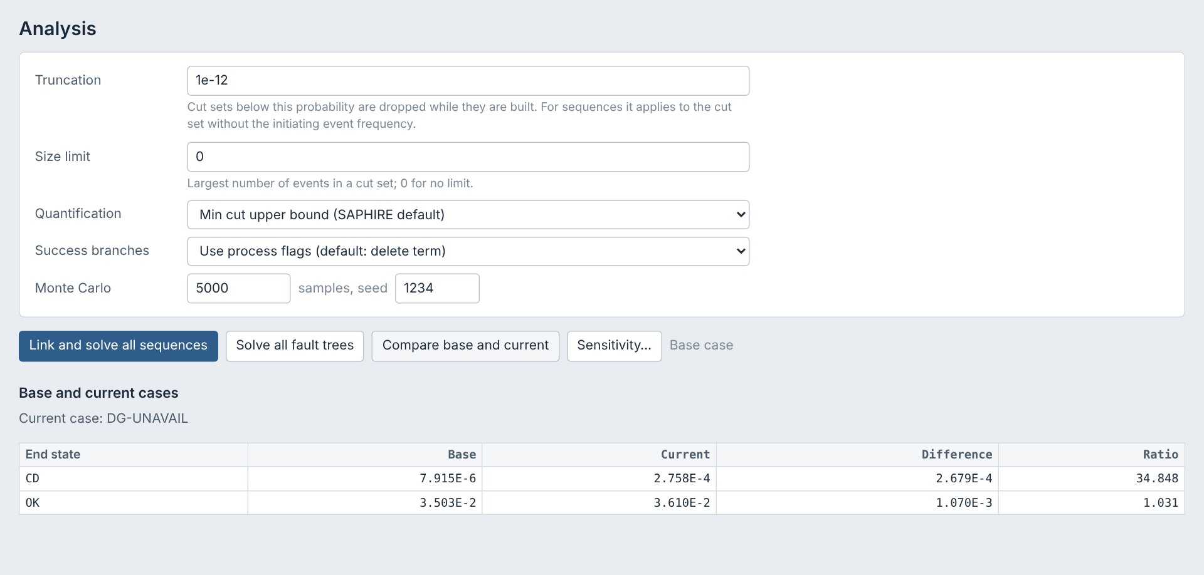
Base case and current case
▶
Change set page
›
Tick Apply in the current case
›
Header
›
Current case or Base case
1
Mark change sets
Tick "Apply in the current case" on each change set.
2
Switch case
Current case (the default, as in SAPHIRE) or Base case in the header; solves use that data.
3
Compare
Compare base and current on the Analysis page lists each end state with the difference and ratio.
4
Update base case
On the Analysis page: the marked change sets become the events' own data and are unmarked (Undo reverses it).

Slide 35
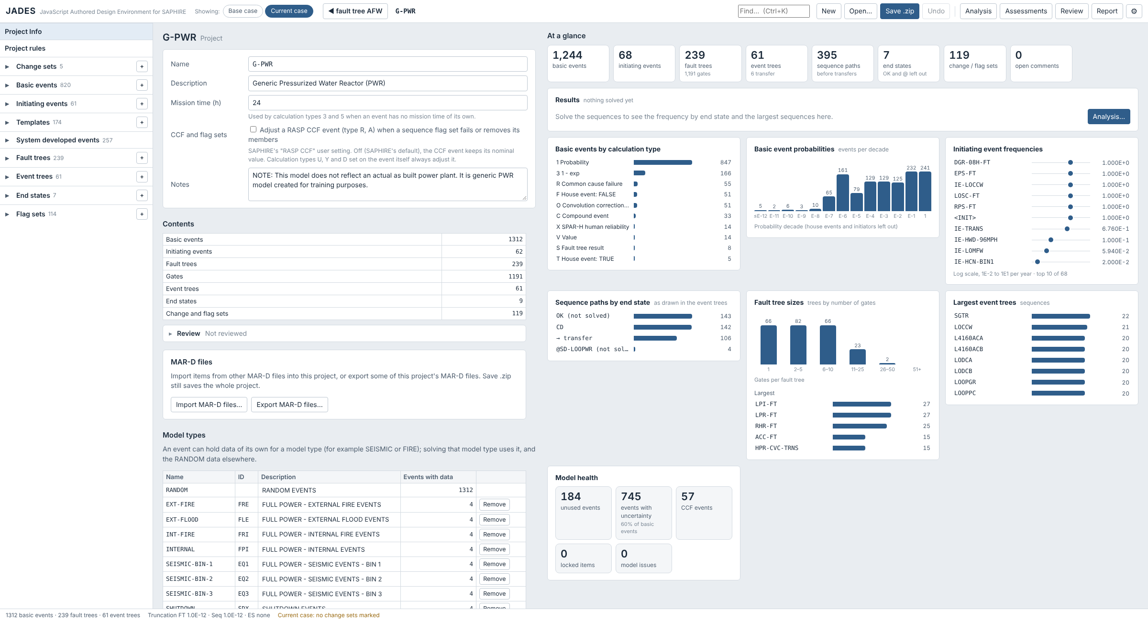
Project at a glance
▶
Side list
›
Project Info
›
At a glance (right side on a wide screen)
Where: Project Info. On a wide screen the pictures sit beside the form; on a narrow one, below it.
Tiles: counts of events, trees, sequence paths, end states (OK and @ left out), sets and open comments. Click one for its list.
Results: once sequences are solved, frequency by end state and the largest sequences (click to open).
Model: basic events by calculation type and by probability decade, initiating event frequencies (log scale), sequence paths by end state, fault tree and event tree sizes.
Model health: unused events, events with uncertainty, CCF events, locked items and model issues.
Hover a bar for its value.

Slide 36
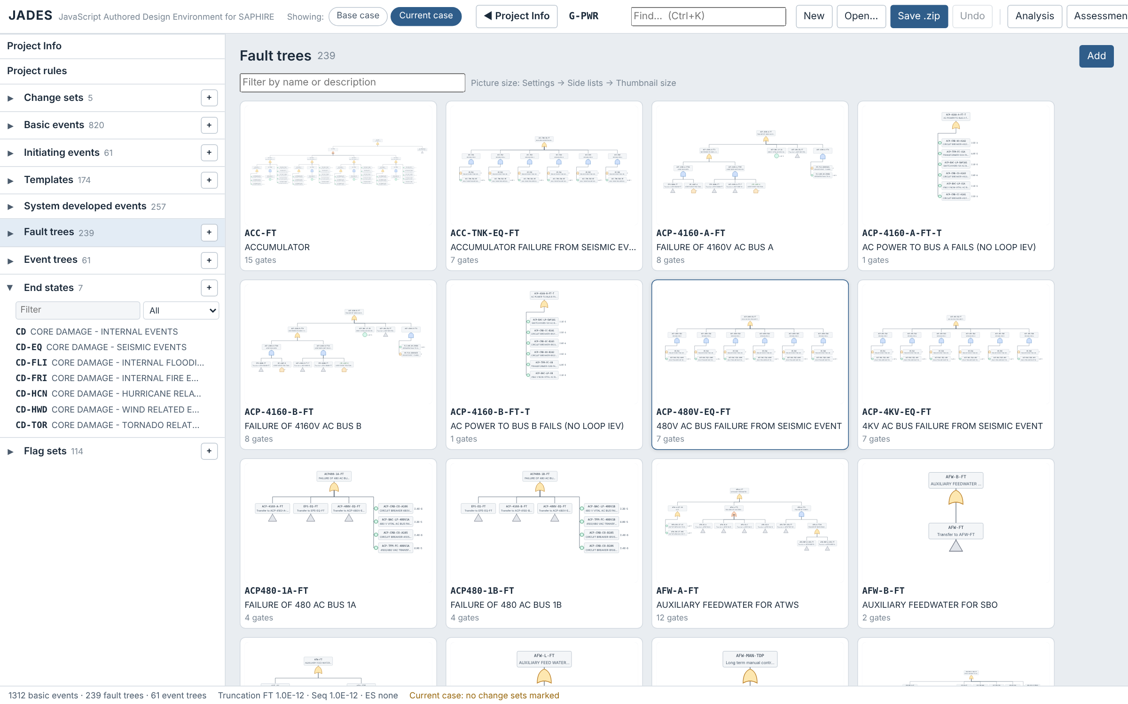
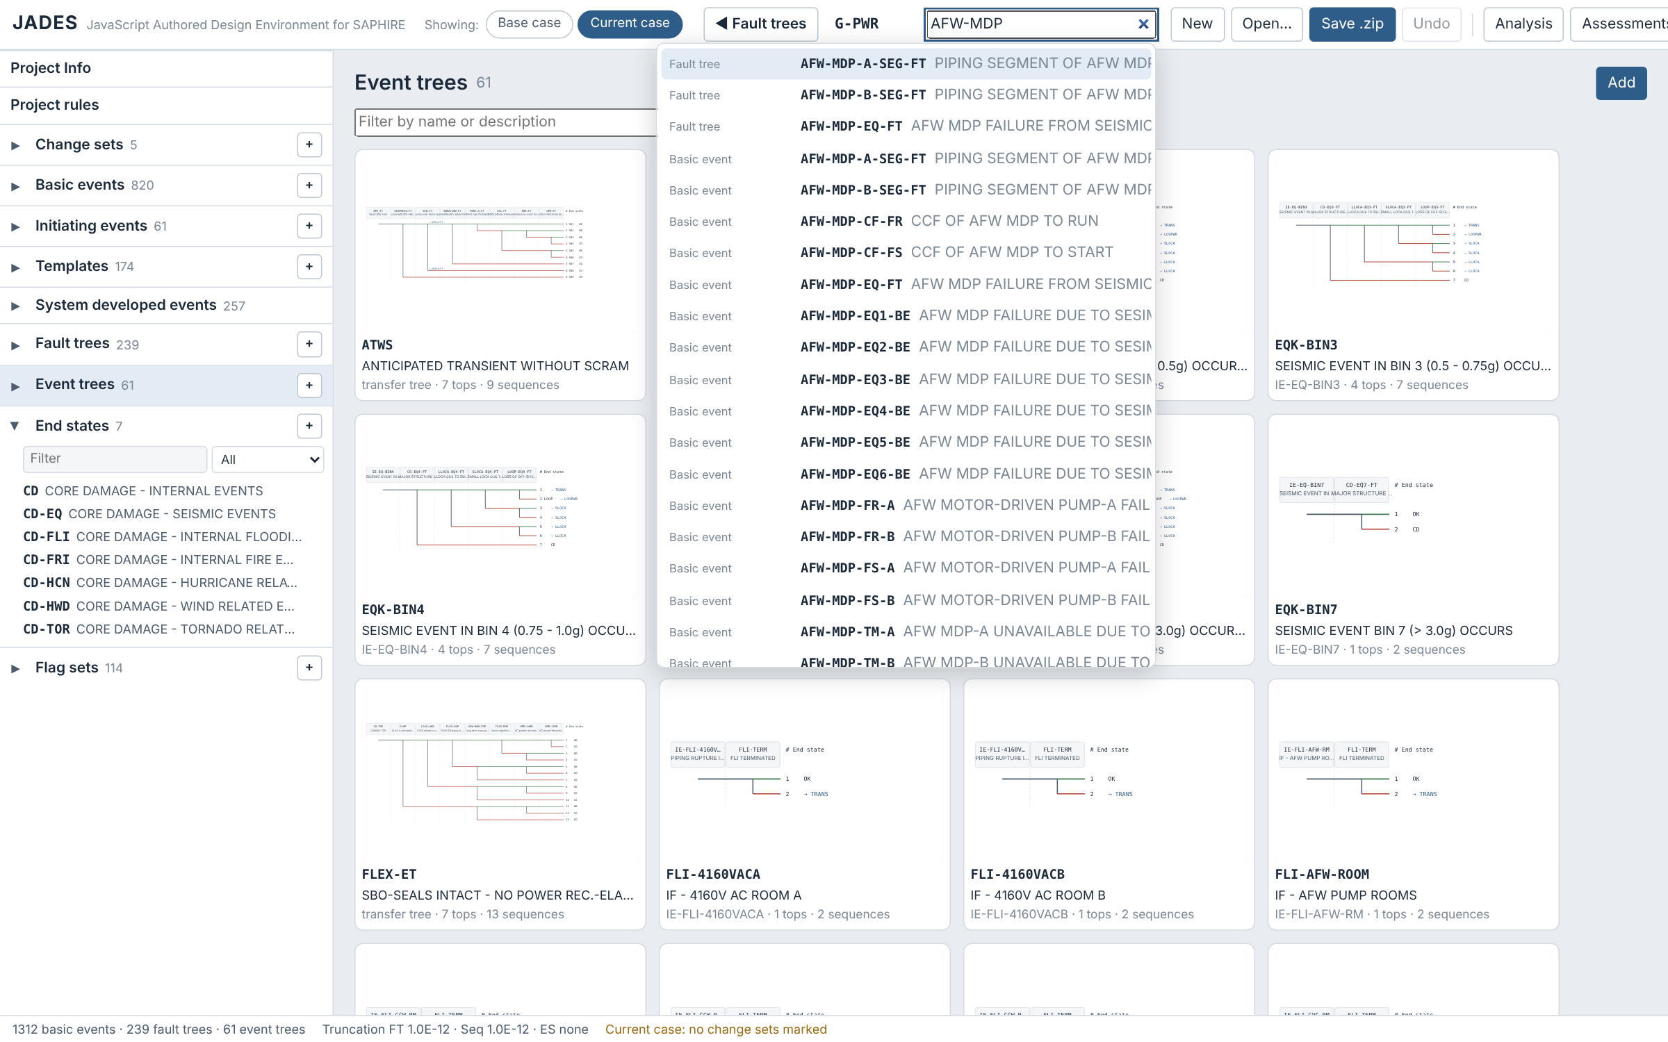
Tree pictures and Find
▶
Side list
›
Click the Fault trees or Event trees heading
›
Filter
or
Header
›
Find… (Ctrl+K)
Find in the header
GPWR Fault trees page
Tree pages: click the Fault trees or Event trees heading in the side list for a picture of each tree, with its description and size. Type in the filter to narrow them; click a picture to open the tree.
Picture size: ⚙ Settings → Side lists → Thumbnail size (Small, Medium, Large).
Find: searches names and descriptions of events, fault trees, gates, event trees, sequences, end states, change and flag sets. ↑ ↓ and Enter to open; a gate opens its tree with the gate outlined and scrolled into view, a sequence marks its row, anything else flashes its title. ◀ Back returns.

Slide 37
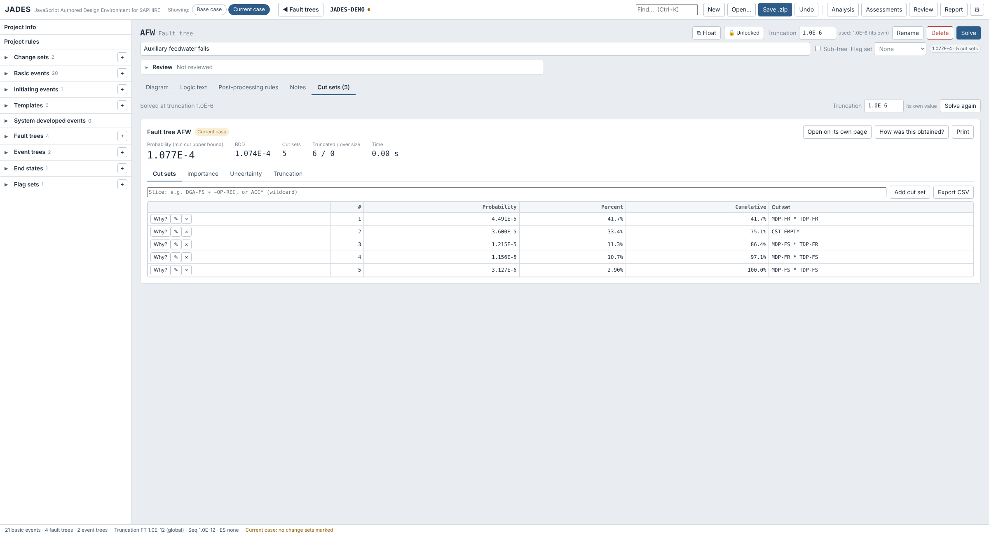
Cut sets on the tree pages
▶
Fault trees or Event trees
›
Click a tree
›
Cut sets tab
›
Solve
Fault tree: the Cut sets tab after Notes shows the cut sets, importance, uncertainty and truncation of the tree. With none yet, Solve solves it there.
Event tree: the Cut sets tab shows the tree's frequency by end state and the cut sets of an end state or a sequence; Solve sequences when none are solved.
Truncation: shown beside Solve. A new value is kept as the tree's own (the Analysis setting becomes System, so other trees keep the global value); blank goes back to the global value.
Slice: ACC* or *-FS for wildcards; A * B is still AND.
Background: ⚙ Settings → Event trees → Background, as for fault trees.
End state lists: OK and end states starting with @ are not solved, so they are left out; Show: Disabled (OK, @) lists them.

Slide 38
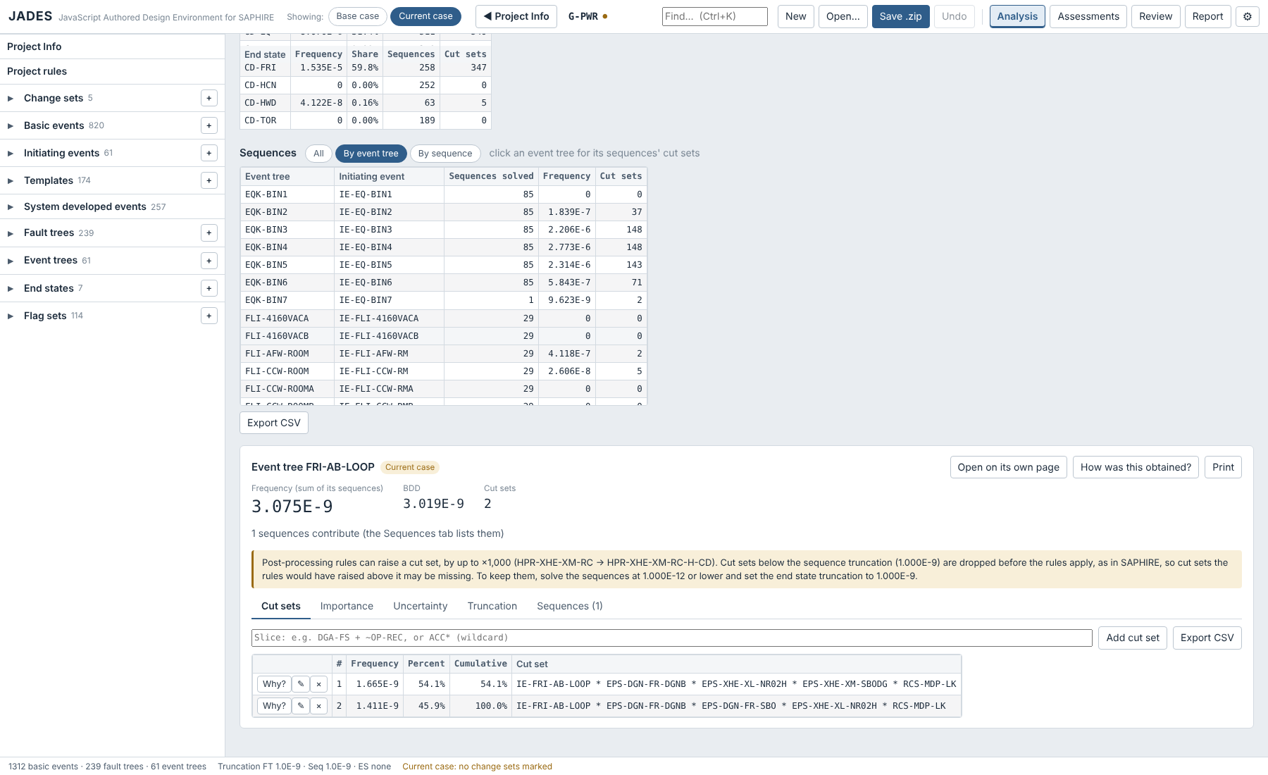
Sequence cut sets: all, by tree, by sequence
▶
Analysis
›
Link and solve all sequences
›
Sequences: All · By event tree · By sequence
›
Click a row
All: the cut sets of every solved sequence together, below the tables (GPWR at 1E-9: 1,156 cut sets).
By event tree: one row per tree: initiating event, sequences solved, frequency and cut sets. Click a tree for its sequences' cut sets.
By sequence: the sequence table; click a row for its cut sets.
Order: end states by name; sequences by event tree, then sequence. A column heading still re-sorts.
Alternating rows: ⚙ Settings → General → Highlight alternating rows in tables gives every other row a faint tint.

Slide 39
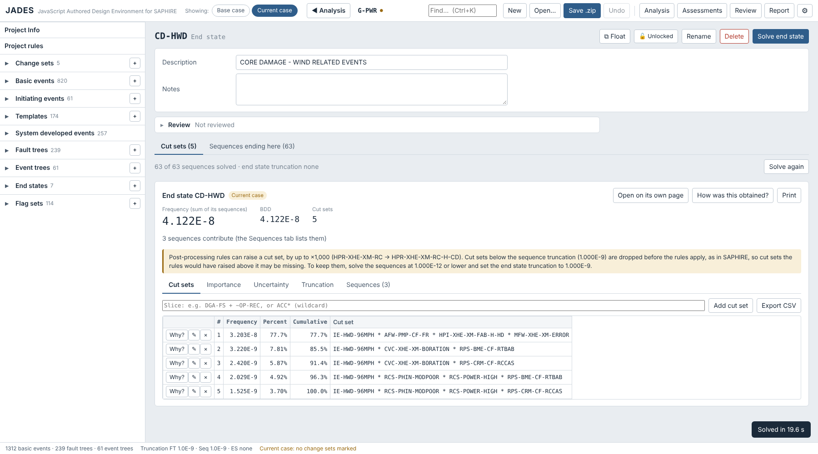
End state results
▶
Side list
›
End states
›
Click an end state
›
Cut sets tab
Cut sets tab: an end state's page shows its cut sets, importance, uncertainty and truncation, as on the Analysis page.
From Analysis: after Link and solve all sequences, the result is there at once (GPWR CD-HWD at 1E-9: 5 cut sets, 4.122E-8).
Partly solved: the cut sets of the sequences solved so far are gathered, with a note saying how many.
Solve end state: solves the missing sequences (reusing the others) and stays on the page.
Sequences ending here: the second tab lists them, with their logic.
Tables: result tables are only as wide as their columns.

Slide 40
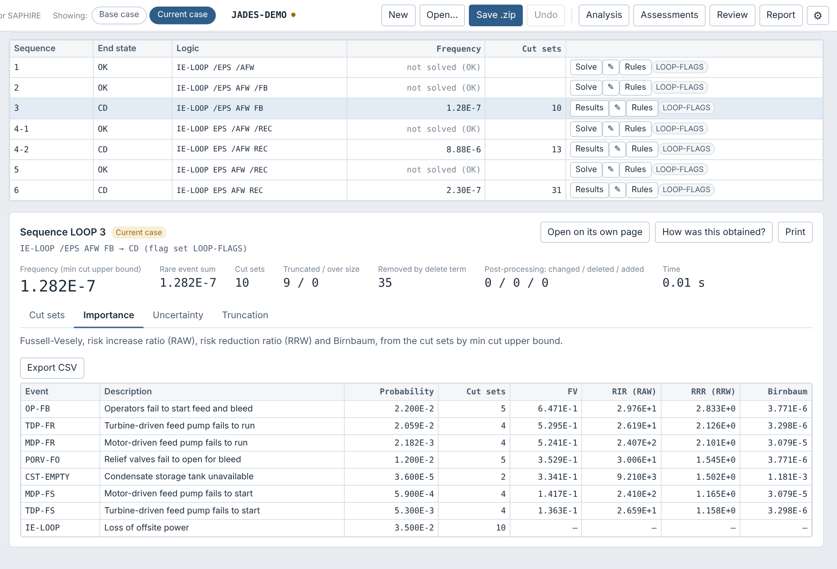
Event tree results
▶
Event trees
›
Click a tree
›
Sequences tab
›
Solve sequences
›
Click a row
Solve here: the Sequences tab says how many sequences are solved (OK and @ ones are not) and has Solve sequences.
By end state: this tree's frequency for each end state; click one for its cut sets from this tree.
Click a row: cut sets, importance, uncertainty and truncation of that sequence, below the table.
From the diagram: click a solved sequence → Show its cut sets. Below the truncation it reads "< 1E-10" rather than 0.
Any table: click a column heading to sort by it (again to reverse).

Slide 41
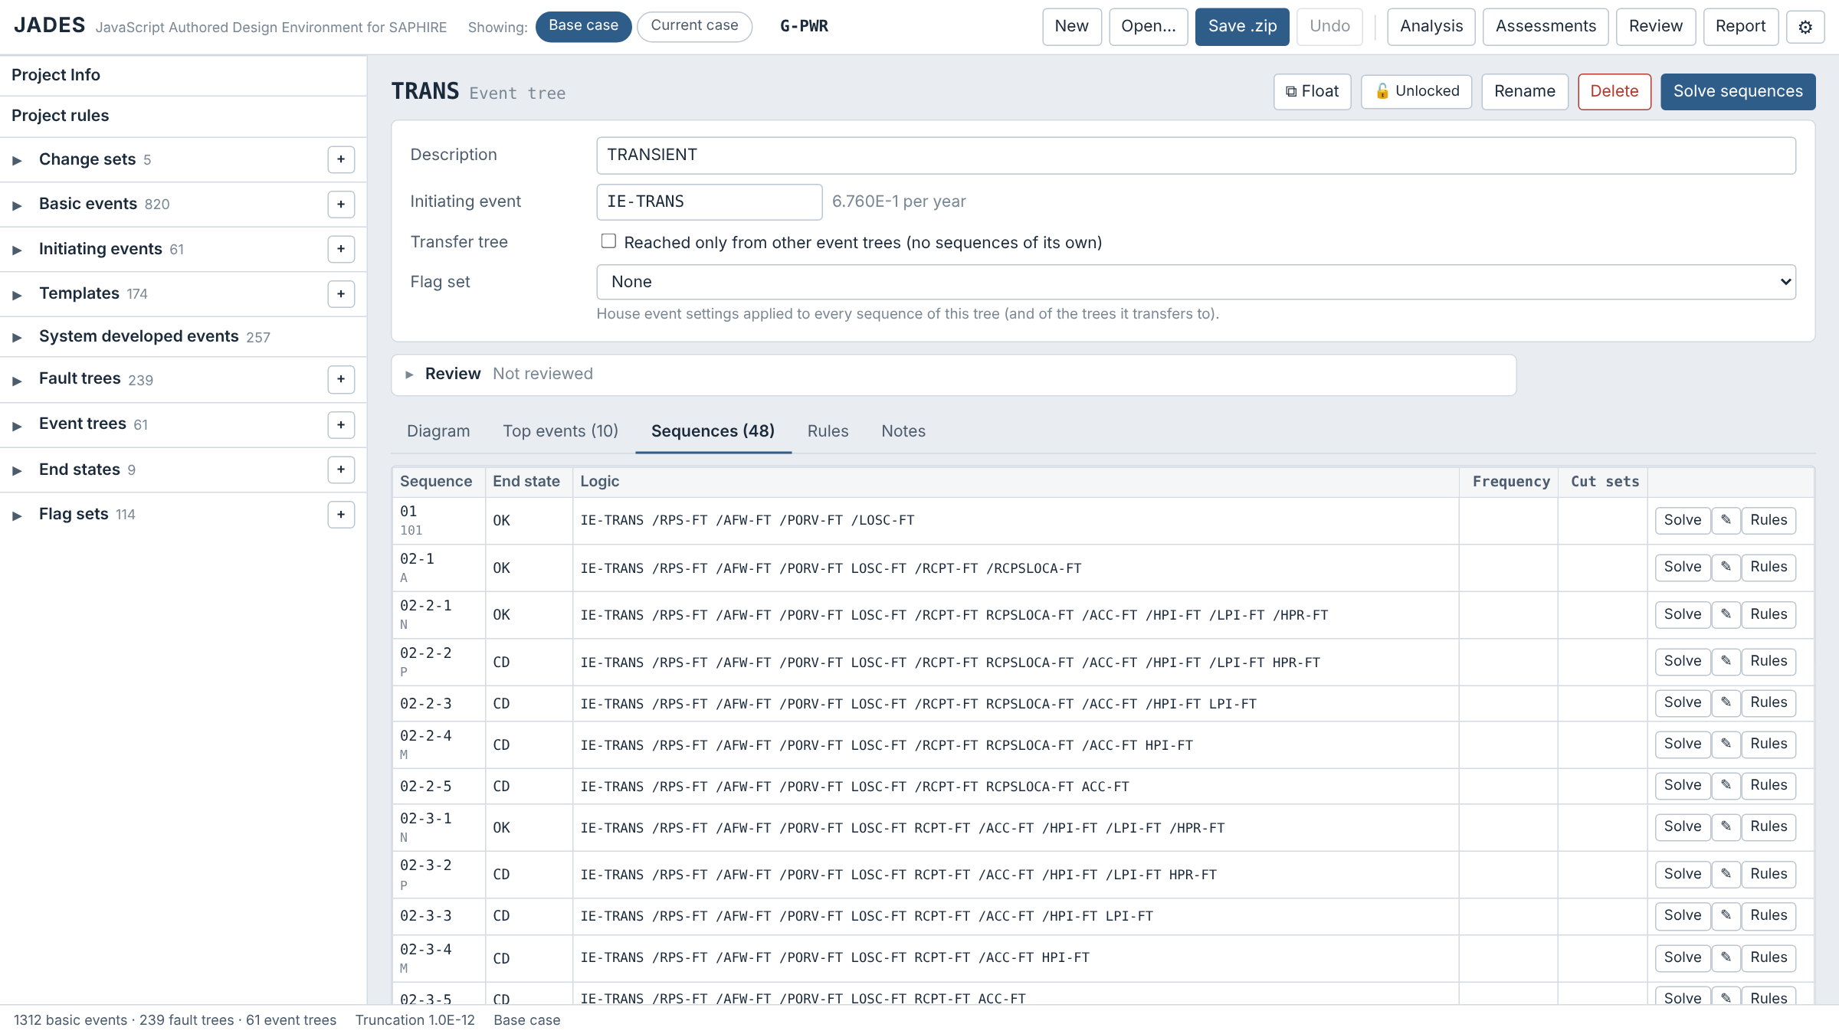
Sequences: names and the SAPHIRE check
▶
Event trees
›
Click a tree
›
Sequences tab
›
Solve sequences
Names: SAPHIRE's numbers (01, 02-2-3…), padded to the tree's sequence count; transfers add -k. The ETL sequence name is shown beneath.
Flag sets: a fault tree's own flag set applies to it in every sequence.
Convolution: Convolve_Cut_Sets and AddConvolEvent work; cut sets they take below the truncation are dropped.
CCF: Project Info → "Adjust a RASP CCF event" (SAPHIRE's RASP CCF setting; off by default).
OK and @: sequences ending there are not solved, and a linkage rule's end state does not change them (GPWR HWD-96MPH 1-01).
Checked on GPWR against SAPHIRE 8.2.12 (55 event trees, 1,965 sequences, 1E-14, rules on): the same cut set count for 1,958 sequences, frequencies within 0.1% for 1,960, all 11,493 listed cut sets found, total 2.69245E-5 against 2.69247E-5 per year.

Slide 42
Understanding results
4
Explain every number, check truncation error, and run sensitivity studies

Slide 43
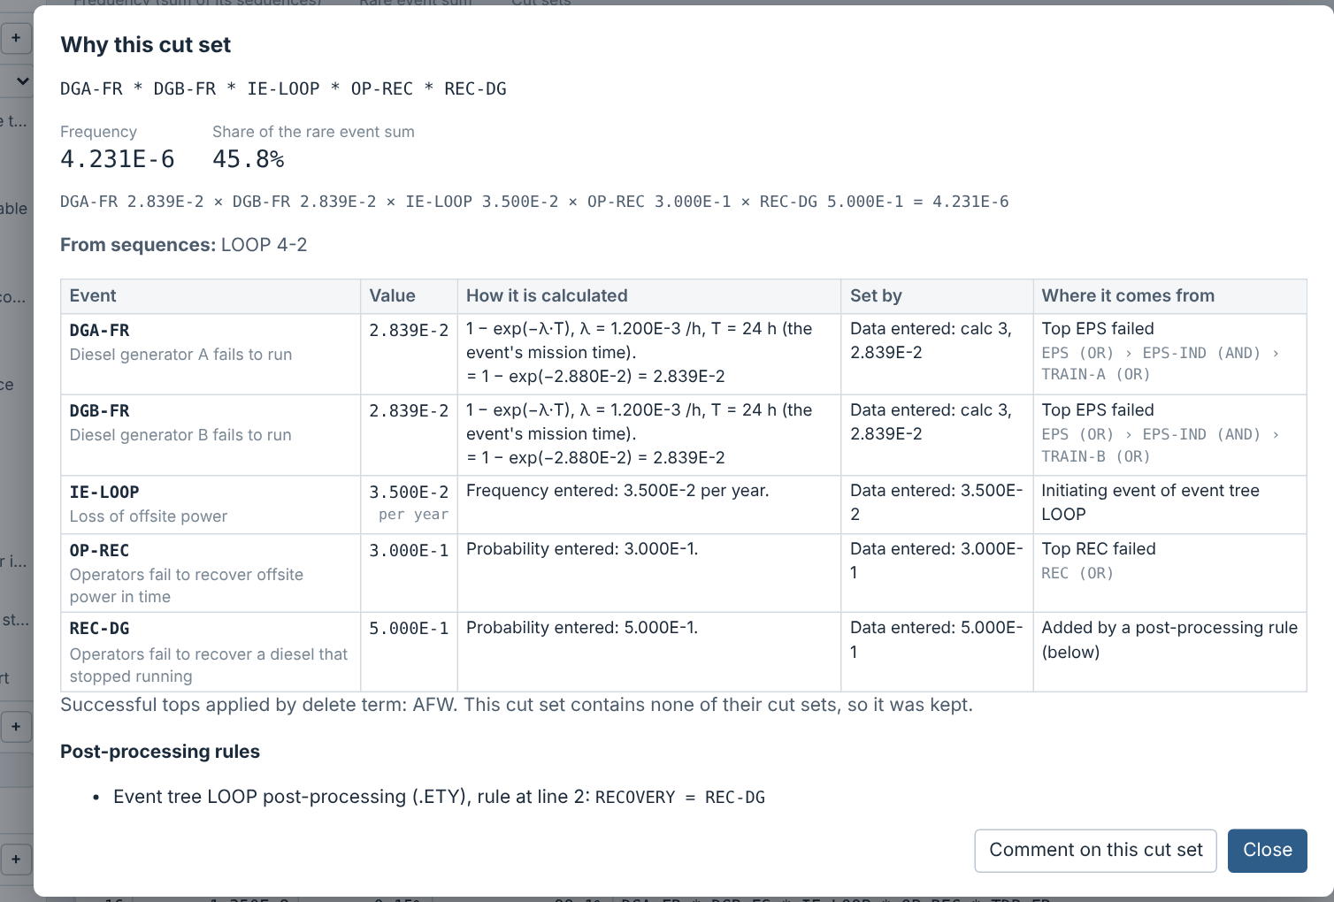
Why this cut set?
▶
Result page
›
Cut sets tab
›
Why? on a row
Click Why? on any cut set row.
Each event: its value, the formula with numbers, what set it (data entered, change set, flag set or assessment) and the gate path to it.
Delete term: which successful tops were checked.
Rules: every post-processing rule that changed the cut set, with its file and line number, and the partition rule that chose the end state.

Slide 44
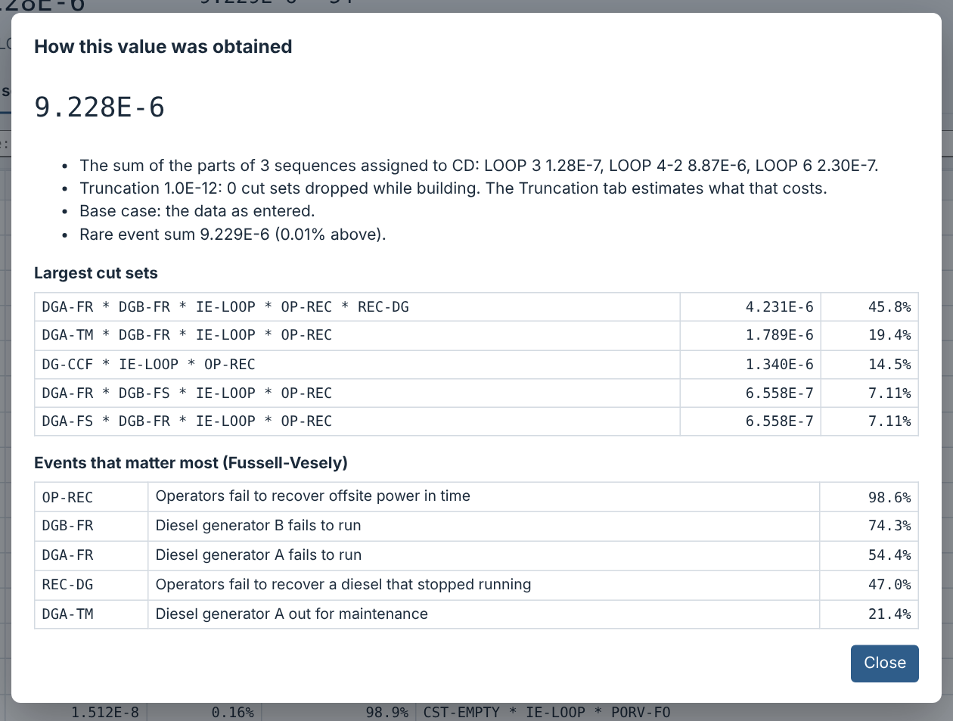
How was this value obtained?
▶
Result page
›
How was this obtained?
Click "How was this obtained?" at the top of any result.
It lists the parts that were added up (sequences for an end state), the truncation used, the case and the rare-event sum.
Then the largest cut sets and the events that matter most by Fussell-Vesely.
Use it as the plain-language basis for a result in a review or report.

Slide 45
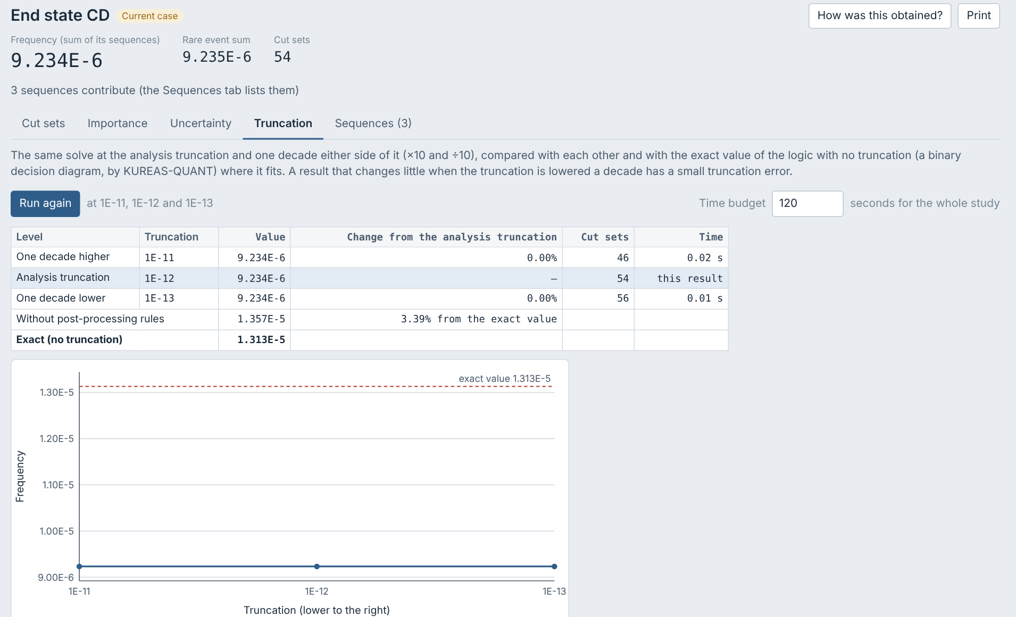
Truncation error
▶
Result page
›
Truncation tab
›
Time budget
›
Run the truncation study
On the Truncation tab, set the time budget (default 180 s; also in Settings → Solve) and click Run.
Three levels: one decade higher (T×10), the analysis truncation T (this result, not solved again) and one decade lower (T÷10).
Table: value, change from the analysis truncation, cut sets and time. A level the budget did not allow is marked; Cancel keeps what is done.
Exact value: the logic solved with no truncation by a BDD, shown as a reference line.
Without post-processing rules: a like-for-like comparison with the exact value when rules change the cut sets.
A verdict compares the three: under 5% change one decade lower means the truncation is adequate.

Slide 46
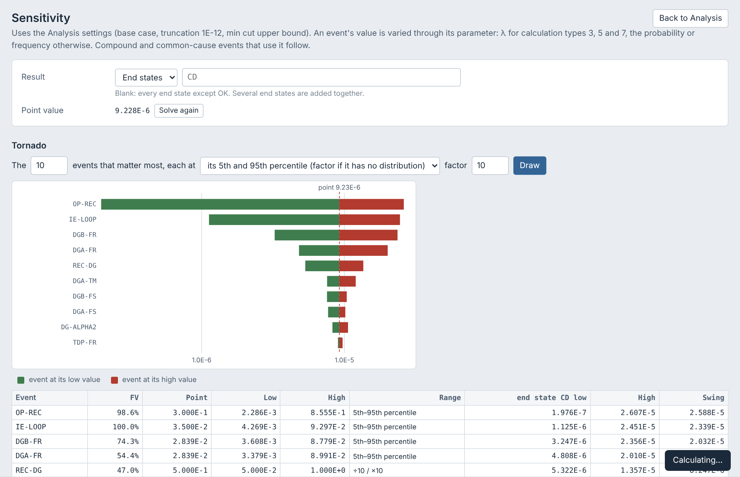
Sensitivity: tornado
▶
Analysis
›
Sensitivity…
›
Tornado
›
Run
Analysis → Sensitivity…
Result: one or more end states (blank = all except OK), or a fault tree.
Range: each event at its 5th and 95th percentiles, or its point value divided and multiplied by a factor.
Run: finds the result's cut sets once (the point value: every event at its own value), then varies the events. No separate Solve is needed.
Bars are sorted by swing; the table and Export CSV give the numbers.

Slide 47
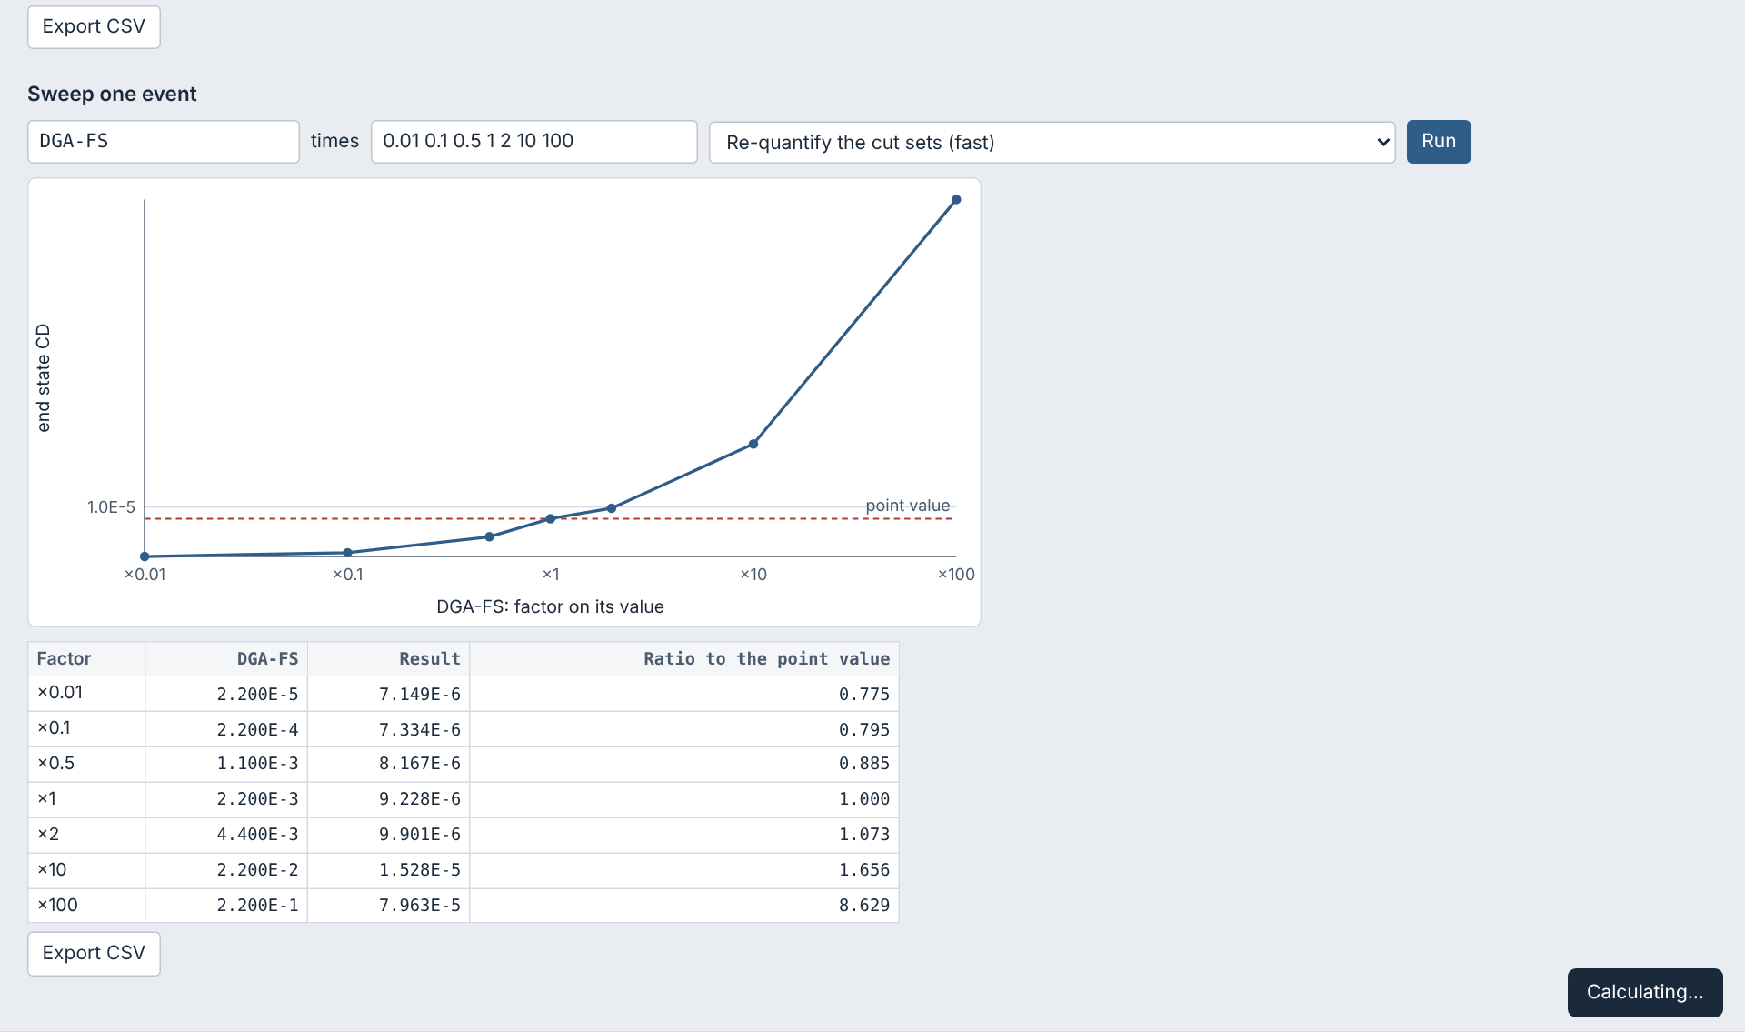
Sensitivity: sweep one event
▶
Analysis
›
Sensitivity…
›
Sweep one event
Setting | Default | What it controls
Top events | 10 | Number of tornado bars
Range | 5th–95th | Uncertainty range, or point value ÷ and × a factor
Factor | 10 | Used when Range is a factor
Sweep factors | 0.01 0.1 0.5 1 2 10 100 | Multipliers on the event (on λ for calc types 3, 5, 7); probabilities capped at 1
Sweep method | Fast | Fast re-quantifies the cut sets; re-solve finds new or dropped cut sets

Slide 48
Assessments
5
Initiating event and condition assessments, with uncertainty

Slide 49
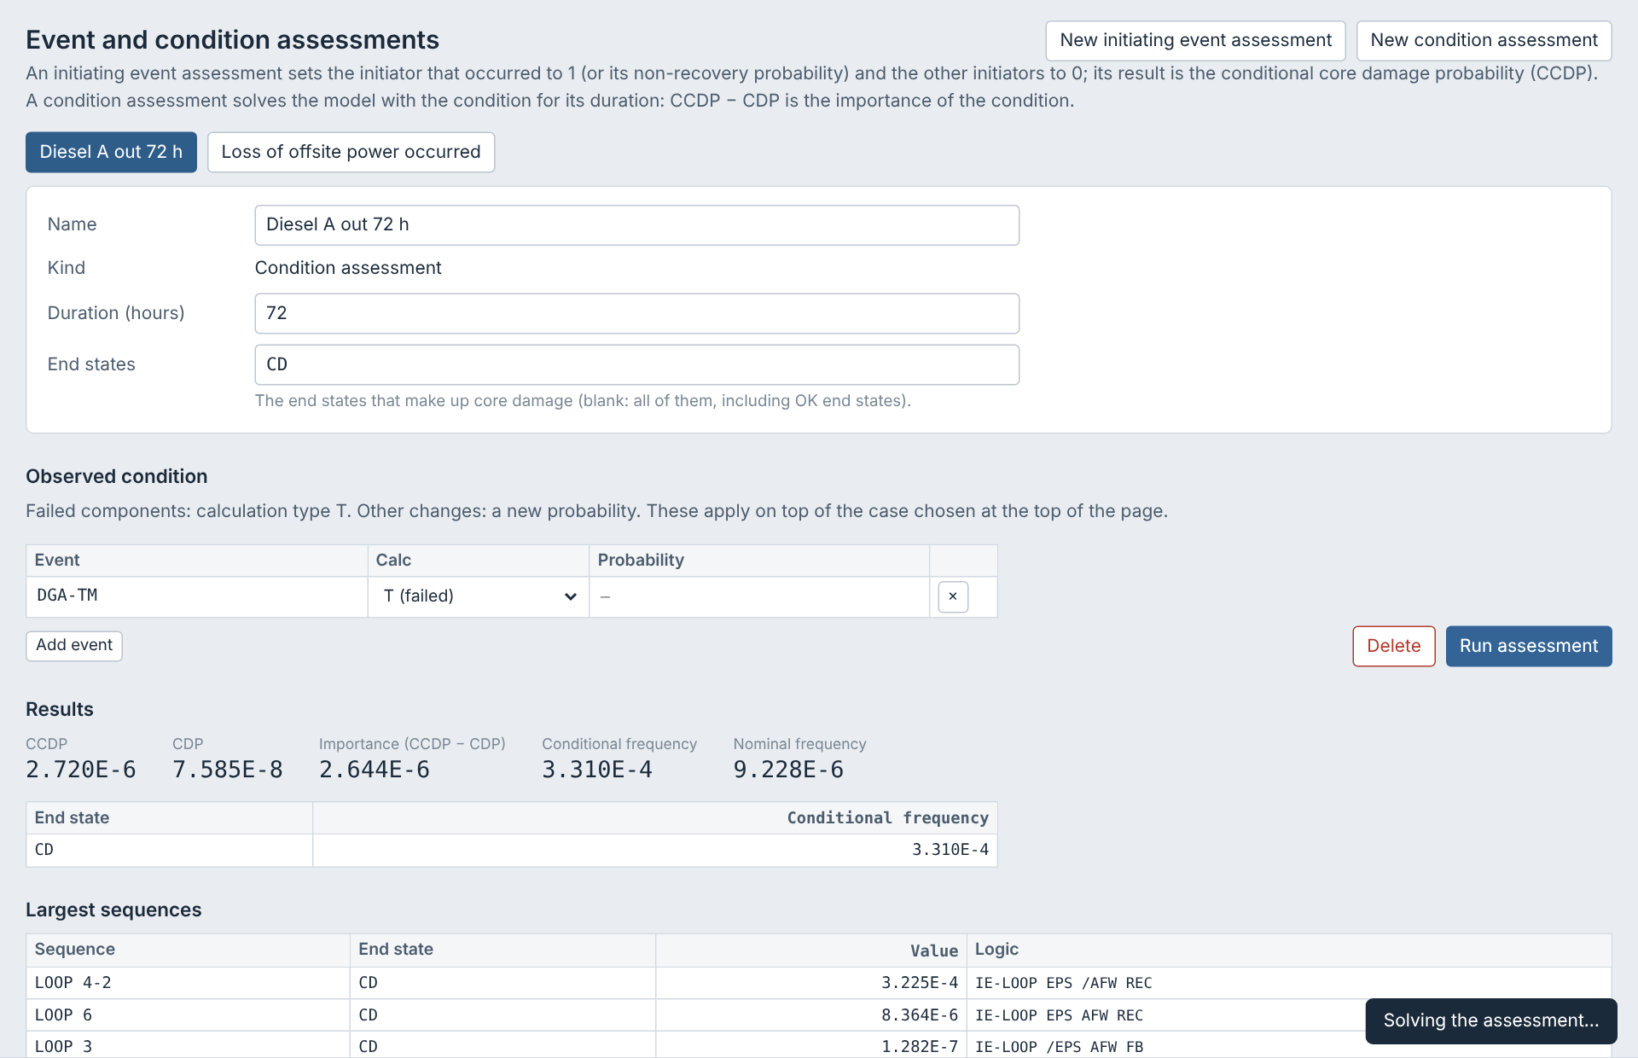
Event and condition assessments
▶
Assessments
›
New initiating event or condition assessment
›
Run assessment
Kind | Result
Initiating event | The initiator that occurred is set to 1 (or its non-recovery probability), the others to 0. Gives CCDP.
Condition | Failed components set to T (or a new probability) for a duration. Gives CCDP, CDP and importance = CCDP − CDP.
Choose the end states that make up core damage (blank = all). Assessments are saved with the project.

Slide 50
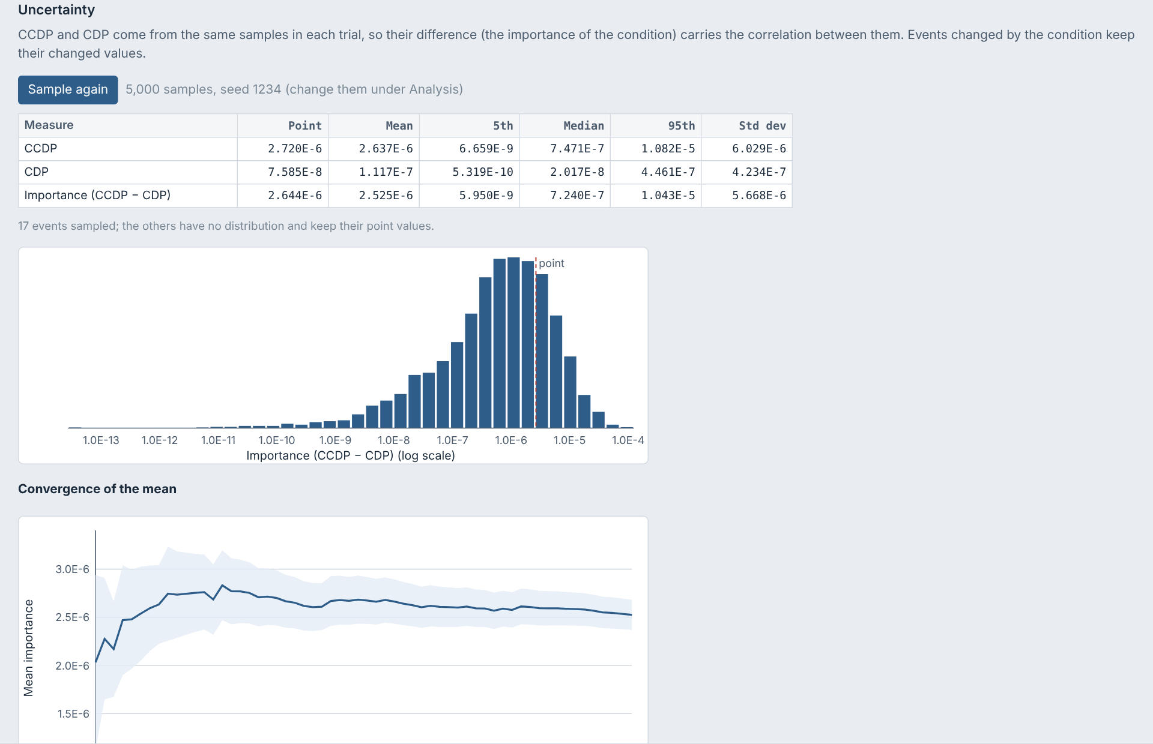
Uncertainty on assessments
▶
Assessments
›
Run assessment
›
Run Monte Carlo
Click Run Monte Carlo under the assessment results.
Paired sampling: the nominal and conditional cases use the same samples in each trial, so their difference (importance) is not swamped by noise.
Gives the mean, 5th, median and 95th percentiles for CCDP, CDP and importance.
Histogram, convergence of the mean with a band, and a samples CSV.

Slide 51
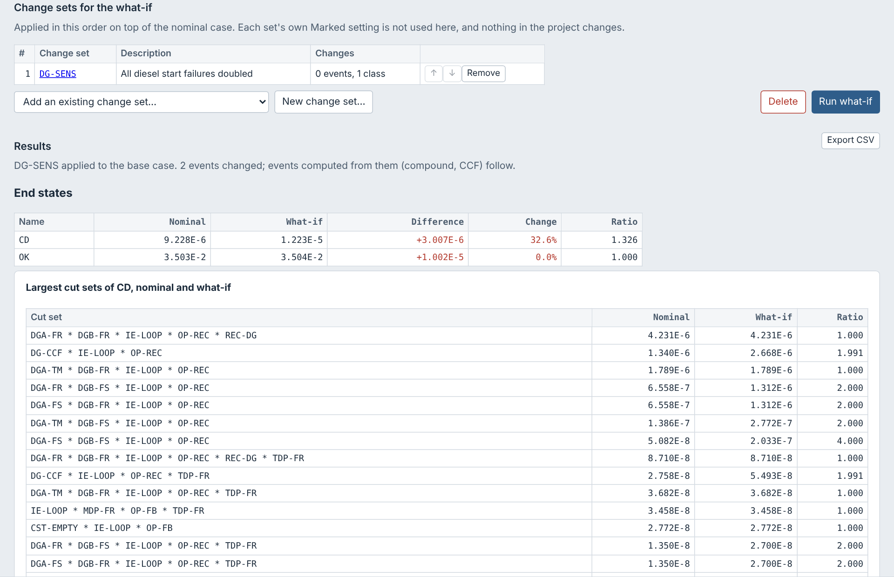
Change set assessment (what-if)
▶
Assessments
›
New change set assessment
›
Add change sets
›
Run what-if
1
Create it
Assessments → New change set assessment.
2
Pick the change sets
Add an existing change set, or New change set… (opens its editor). They apply in the order listed.
3
Choose what to compare
Fault trees, event trees, end states or all; blank lists mean all. Compare with the base or current case.
4
Run what-if
Progress is shown and the run can be stopped. Click a row for its cut sets or sequences; Export CSV.

Slide 52

SDP assessment: steps 1 to 3
▶
Assessments
›
New SDP assessment
›
1 Identify
›
2 Modify
›
3 Analyze
1
Create it
Assessments → New SDP assessment.
2
1 Identify
Pick a system, tick its components (from SPAR names SYS-COMP-FM-ID), or initiators.
3
2 Modify
Per failure mode: new probability, True (failed), or Out for T&M (on TM events). A failed component's TM event goes FALSE automatically.
4
3 Analyze
Start date, duration (hours to years), description, notes, model type, single or multi-pass, T&M off, CD and LERF end states. Analyze shows progress and can be cancelled.

Slide 53

SDP assessment: results
▶
Assessments
›
SDP assessment
›
3 Analyze
›
Analyze
›
4 Results
ΔCDF = (CCDP − CDP) / 1 yr; CCDP and CDP are the CDF of each case × the duration. Both cases at the same truncation; nominal is the base case.
Colour Green < 1E-6, White < 1E-5, Yellow < 1E-4, Red (LERF a decade lower).
Insights at ≥ 1E-7/yr; sequences by increase (with factor), components and operator actions (FV, RIR).
Figures risk profile, by initiator, ΔCDF against duration.
Also notes, conditional event changes, Monte Carlo on the increase, report (HTML, Word, Markdown).

Slide 54
Review
6
Comments, item status, change detection, and the review report

Slide 55
The reviewer workflow
Open
Answered
Accepted
Closed
Answer, Accept, Close comment and Reopen move a comment along. Open, answered and reopened comments still need action and count on the Review badge.
Comment kinds
Severities
Item status
Where to comment
Note
Question
Finding
High
Medium
Low
Editorial
Not reviewed
Reviewed
Reviewed with findings
Project, events, trees, gates
Sequences, end states, sets
Rules and single cut sets

Slide 56

Commenting on an item
▶
Open any item
›
Review panel
›
Add
1
Open the Review panel
Every editor has one; a result's cut sets (fault tree, sequence, end state, event tree, all) have ✎ Comment. Set your reviewer name once on the Review page.
2
Add a comment
Choose kind and severity, type, and click Add.
3
Set the item status
Reviewed, or Reviewed with findings.
4
See open comments
Red dots in the model list and on fault tree gates.

Slide 57


Changes since review
▶
Open a reviewed item
›
Review panel
›
"changed since review"
Each comment and status records a fingerprint of the item at that moment.
If the item is edited later, the panel shows "changed since review" and the comment shows "Item changed: show".
Click it to see a line-by-line difference: removed lines in red, added lines in green.
Use Review again to re-mark the item after checking the change.

Slide 58

The Review page
▶
Header
›
Review
Coverage: reviewed, with findings, changed since review and open comments for each kind of item.
Changed since review: items to check again.
Comments: filter by kind, status, severity, changed items or text; click a row to open the item.
Change name sets the reviewer name stored in this browser.

Slide 59

Exchanging comments and the review report
▶
Header
›
Review
›
Export comments · Import comments…
›
Review report
Analyst sends the project .zip
1
Reviewer comments and clicks Export comments (.REVIEW)
2
Analyst clicks Import comments; threads merge without duplicates
3
Review report: summary, findings, questions and notes, and full threads
Review report: HTML, Word or Markdown
4

Slide 60
Reports and files
7
Reports, importing and exporting MAR-D files, and current limits

Slide 61

The Report page
▶
Header
›
Report
Report type | Contents
Results summary | End states, sequences, cut sets, importance, fault trees, assessments
Model description | Fault tree and event tree logic, rules, change and flag sets
Basic event report | Data, attributes, CCF groups, SPAR-H
Fault tree / Event tree | Results and logic for that kind of item
QA and review package | Model checks, rule checks, review status
Full report | All of the above
New type copies the current one as your own; Export and Import share layouts. Types and layouts are saved in the project zip.

Slide 62

Sections, options and output
▶
Header
›
Report
›
Sections and options
›
Preview · Word · Markdown
Sections in Preface, Main Body and Appendices: tick to include, rename, choose the content, ✎ for your own text, ↑ ↓ and Move to; + Section adds a text section.
Options title, subtitle, date, numbering, contents, rows per table, cut sets per item, and an optional Word template.
Nothing is solved here: the report uses the results from Analysis and Assessments, and says what is not solved. Large models stay responsive.
Output Preview (with Word, Markdown, Print and Save HTML), or Word and Markdown directly.

Slide 63

Importing MAR-D files
▶
Side list
›
Project Info
›
MAR-D files
›
Import MAR-D files…
1
Start the import
Project page → MAR-D files → Import MAR-D files…
2
Pick the files
MAR-D files, a folder or a .zip. A .MARD index imports the files it lists; if they were not picked, JADES asks for their folder.
3
Settle conflicts
For each item that differs, keep the project's or use the imported. Compare shows the changed fields.
4
Import
New items are added; nothing else changes. One Undo reverses it.

Slide 64

Exporting MAR-D files
▶
Side list
›
Project Info
›
MAR-D files
›
Export MAR-D files…
Project page → MAR-D files → Export MAR-D files…
Tick the files, or use All, None, Basic events, Fault trees or Event trees.
Include the index writes PROJ.MARD listing the exported files, so they can be imported again through it.
Download gives one file as itself, or several as a zip in the PROJ_Subs layout.
Save to a folder… (Chrome, Edge) writes them straight to disk.

Slide 65
MAR-D files JADES reads and writes
Group | Extensions
Project | FAD, FAA, FAT; project rules FAS, FAY, FAL, FAP; model types MTD
Basic events | BED, BEI, BEN, BEA (attributes), BEC (compound), BER (CCF), BEG (grade)
Histograms | HID, HII (hazard curve for seismic events)
Fault trees and gates | FTD, FTL, FTT, FTY (rules), FTC (cut sets), GTD
Event trees | ETD, ETL, ETT, ETR, ETY, ETP
Sequences | SQD, SQL, SQY, SQP, SQC (cut sets)
End states | ESD, EST, ESC (cut sets)
Change and flag sets | CSA, CSD, CSI
JADES only (zip root) | PROJ.MARD index, PROJ.JADES, PROJ.REVIEW
Good to know
File formats follow SAPHIRE 8 Vol. 7, Appendix B.
Other MAR-D files in the zip are kept and written back unchanged.
The index is sorted, with CRLF line endings.

Slide 66
Not in JADES 0.3.35
Phased models (excluded by design).
Compound events: non-standard plug-in libraries keep their stored value.
Uncertainty types D, H and M are treated as point values (S is used for seismic events).
Rules: multiple-split branches (TOP[n]), partition transfer = and LERF reporting.
SDP: one model type at a time; screening LERF only from LERF end states you name.
To confirm against SAPHIRE
1
Seismic G/H fields
a in probability, g in lambda, βR/βU as S
2
JADES convolution (O)
formula and inputs
3
Q and A CCF
IE CCF as ΣC(m,k)·Qk
4
RASP CCF setting on
flag sets failing members
5
CopyRoot, partitions
later rules; end state gathering

Slide 67
Quick reference
To… | Go to
Open or save a project | Open… / Save .zip (Ctrl+S)
Undo or redo | Ctrl+Z / Ctrl+Y
Edit an item | Click it in the model list
Find an item | Find… in the header (Ctrl+K), or a list's filter
Solve everything | Analysis → Link and solve all sequences
Explain a cut set | Result → Why?
Check truncation | Result → Truncation tab
Run a sensitivity study | Analysis → Sensitivity…
Assess a condition | Assessments → Run assessment
Comment or review | Review panel on any item; Review page
Build a report | Report → type, sections → Preview, Word or Markdown
Change fonts or tree drawing | ⚙ Settings
Edit a tree | Right-click a node, or drag from the side lists
Compare a what-if | Assessments → New change set assessment
Import or export MAR-D files | Project page → MAR-D files

