Slide 1
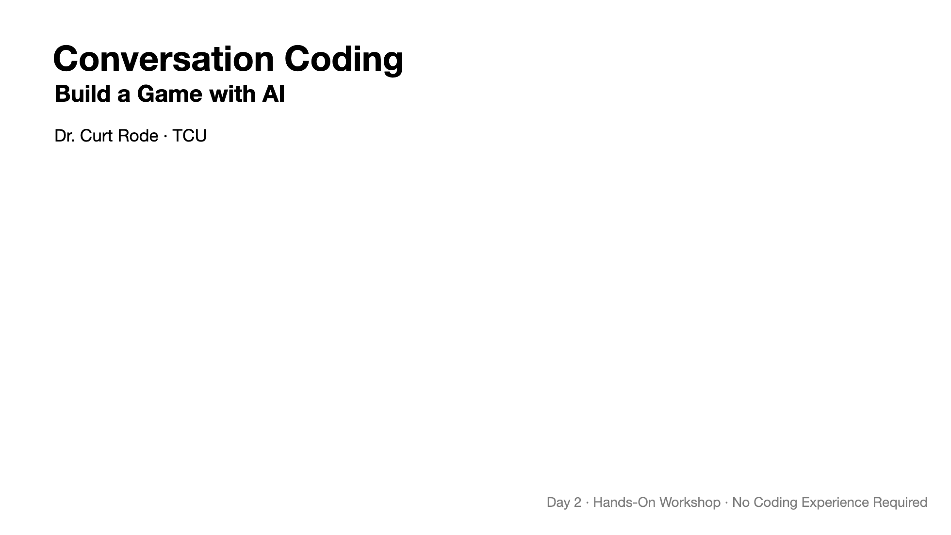
Notes:
Welcome back. Last time we built websites. Today we're building games — playable browser games — using the same conversation-with-AI approach. Same tools, bigger ambition.

Slide 2
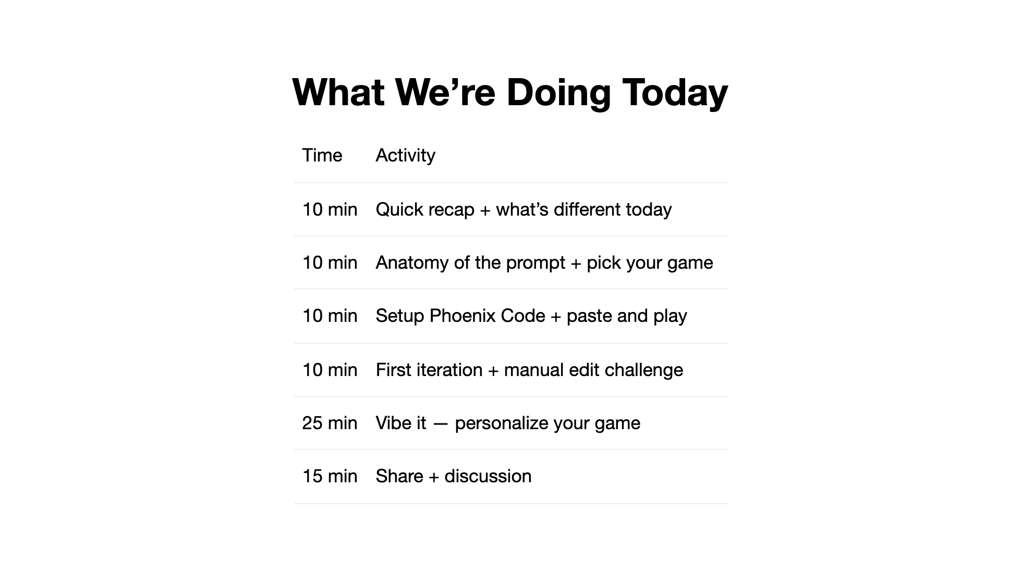
Notes:
The arc is similar to last time — concepts, then hands-on, then experimentation. But today we start with one big prompt instead of building up gradually. The iteration is where the real learning happens.

Slide 3
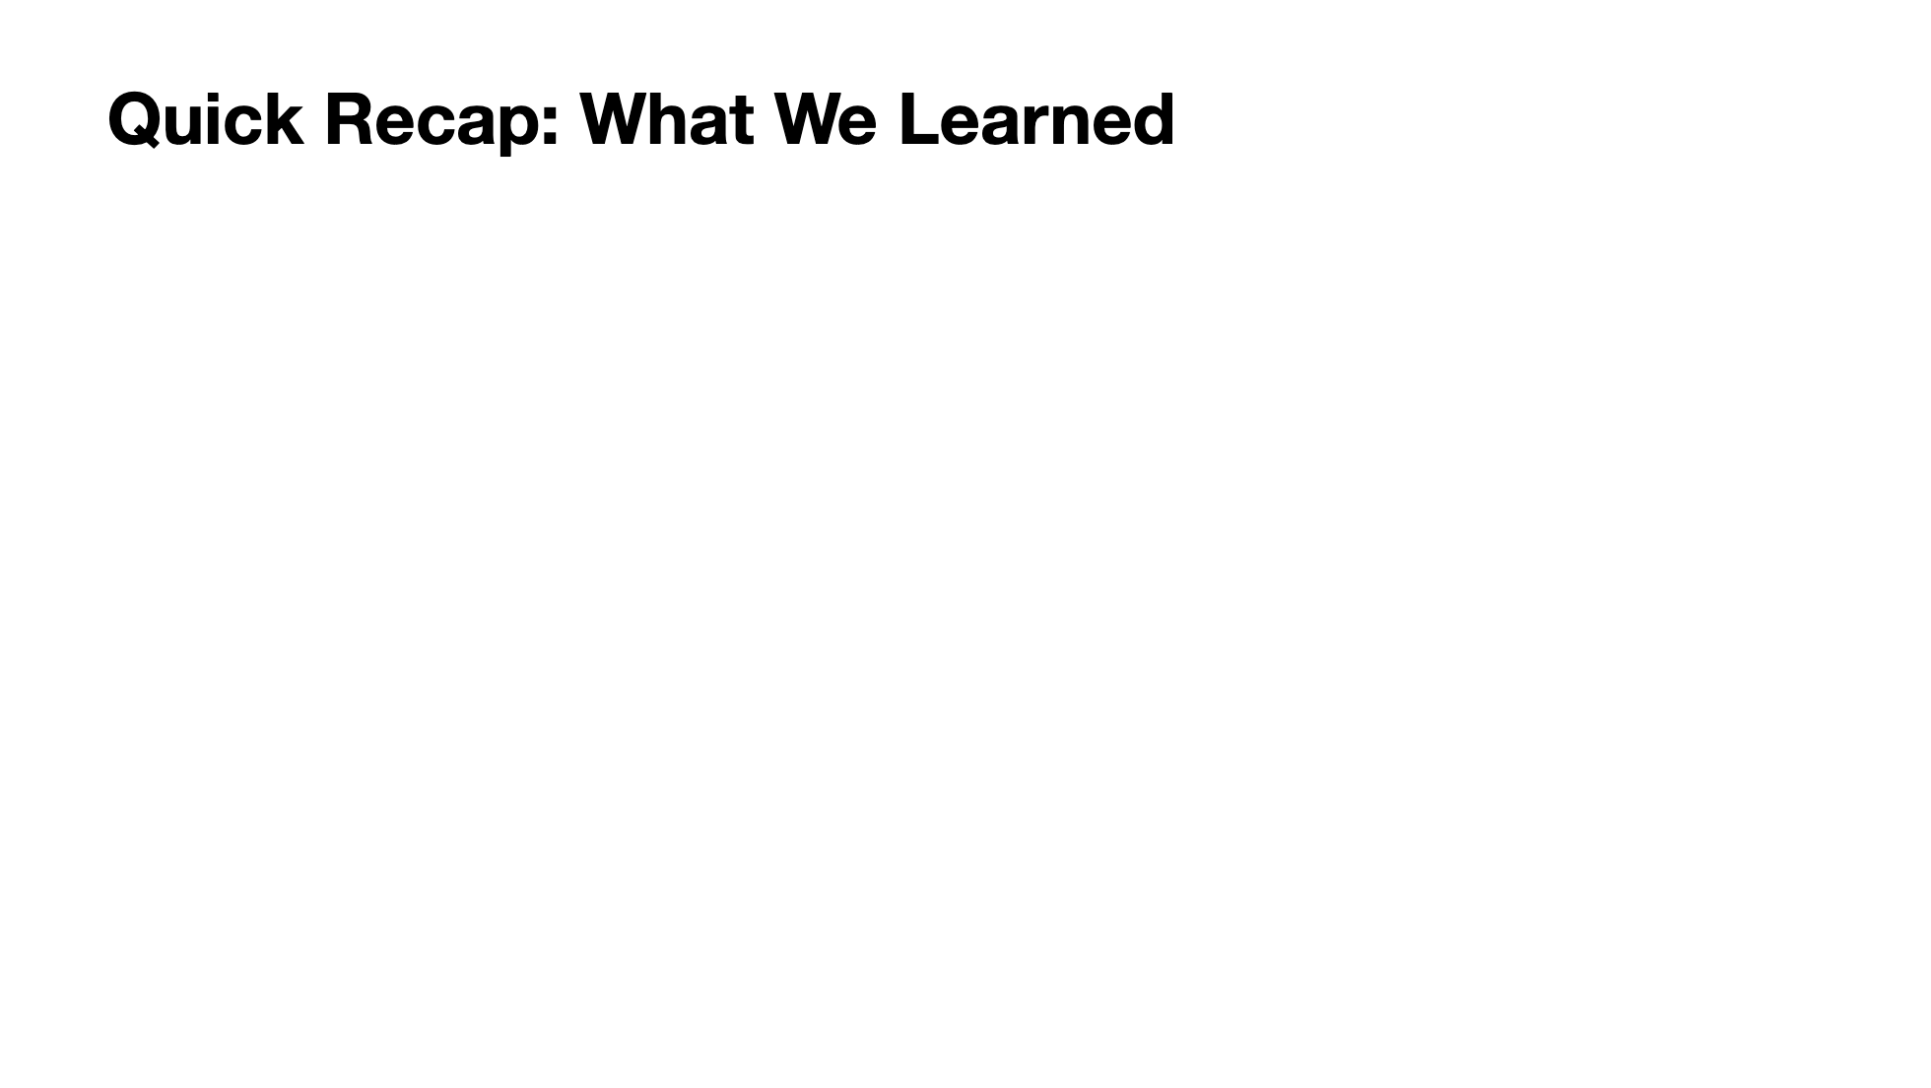
Notes:
Quick touch on the key ideas from Day 1. We're not re-teaching these — just activating prior knowledge. The spectrum, the cycle, good prompts, and personal guidelines. All of this carries forward. Today we're applying these same ideas to a harder challenge.

Slide 4
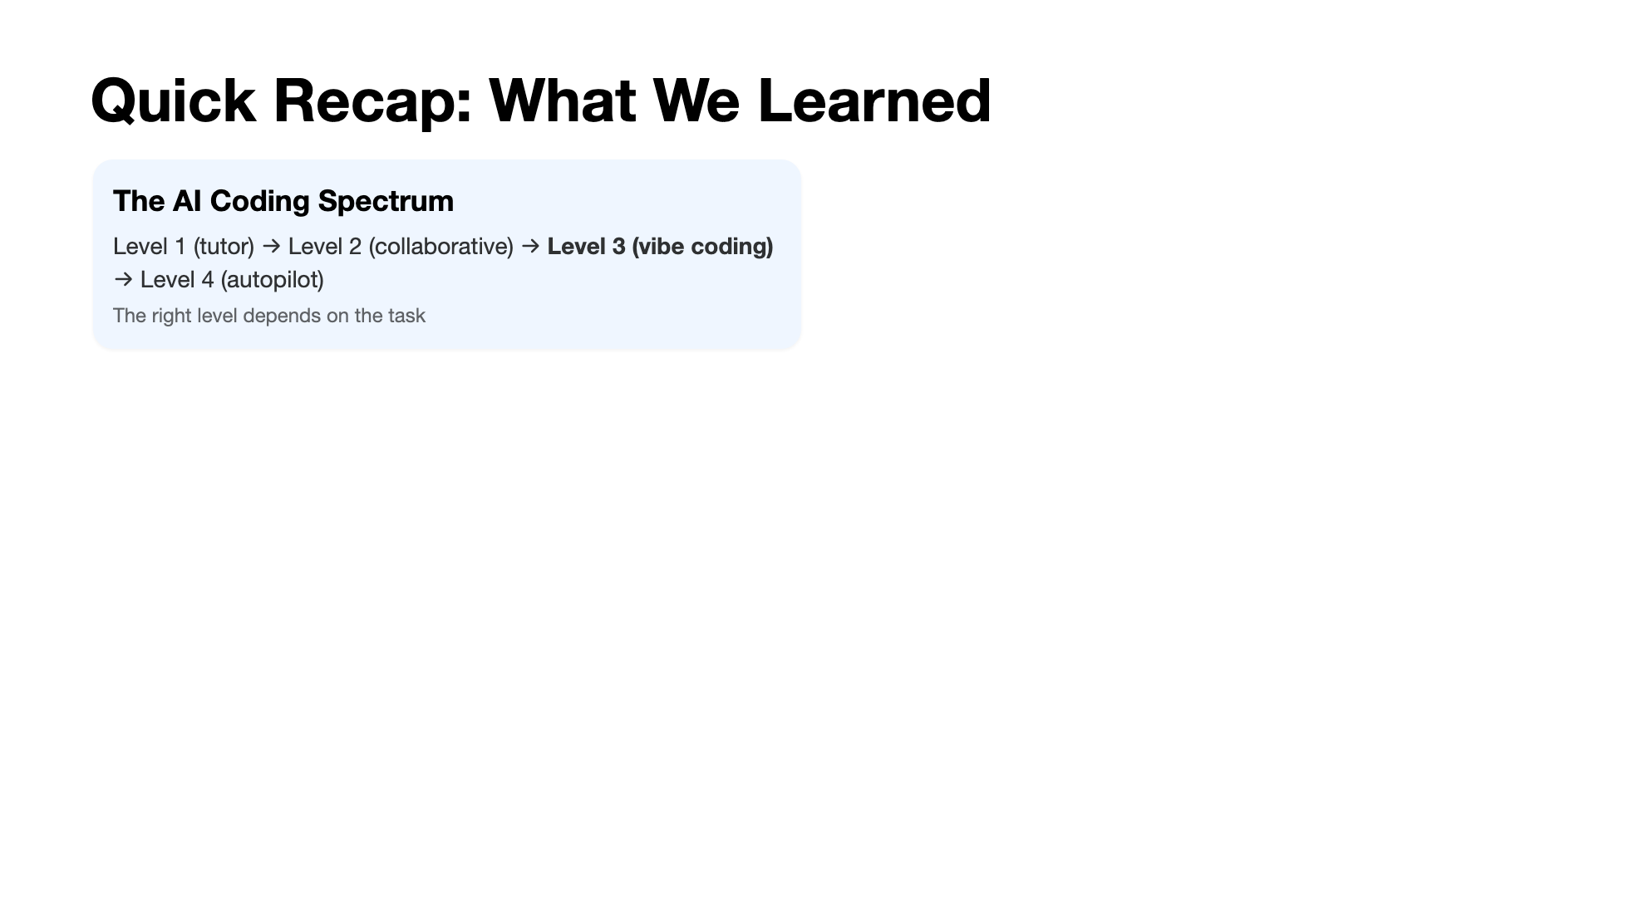
Notes:
Quick touch on the key ideas from Day 1. We're not re-teaching these — just activating prior knowledge. The spectrum, the cycle, good prompts, and personal guidelines. All of this carries forward. Today we're applying these same ideas to a harder challenge.

Slide 5
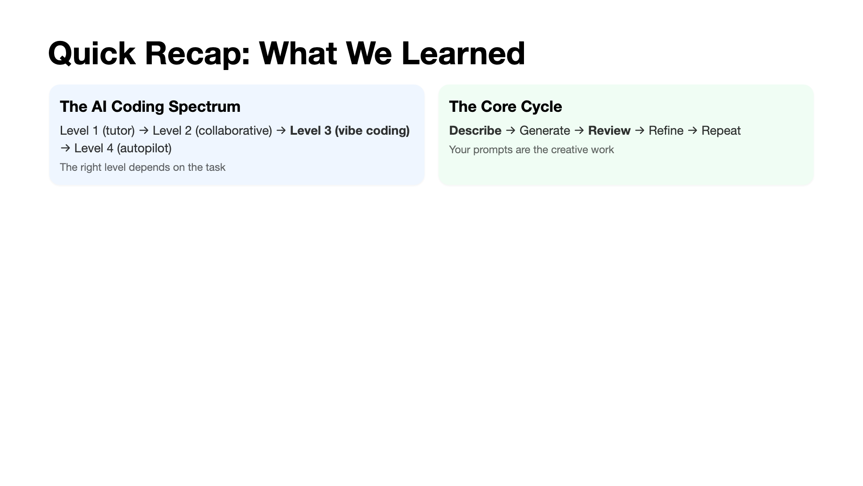
Notes:
Quick touch on the key ideas from Day 1. We're not re-teaching these — just activating prior knowledge. The spectrum, the cycle, good prompts, and personal guidelines. All of this carries forward. Today we're applying these same ideas to a harder challenge.

Slide 6
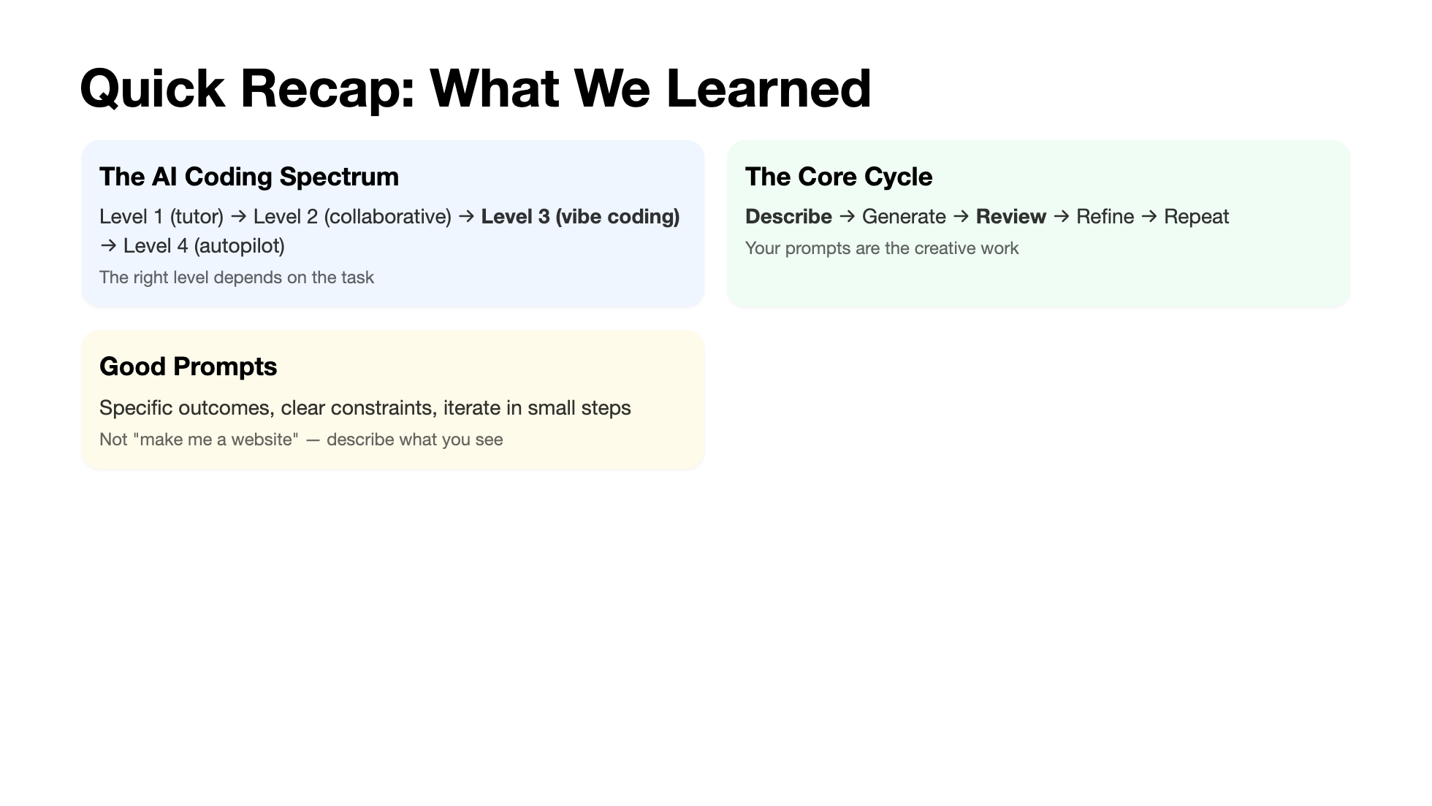
Notes:
Quick touch on the key ideas from Day 1. We're not re-teaching these — just activating prior knowledge. The spectrum, the cycle, good prompts, and personal guidelines. All of this carries forward. Today we're applying these same ideas to a harder challenge.

Slide 7
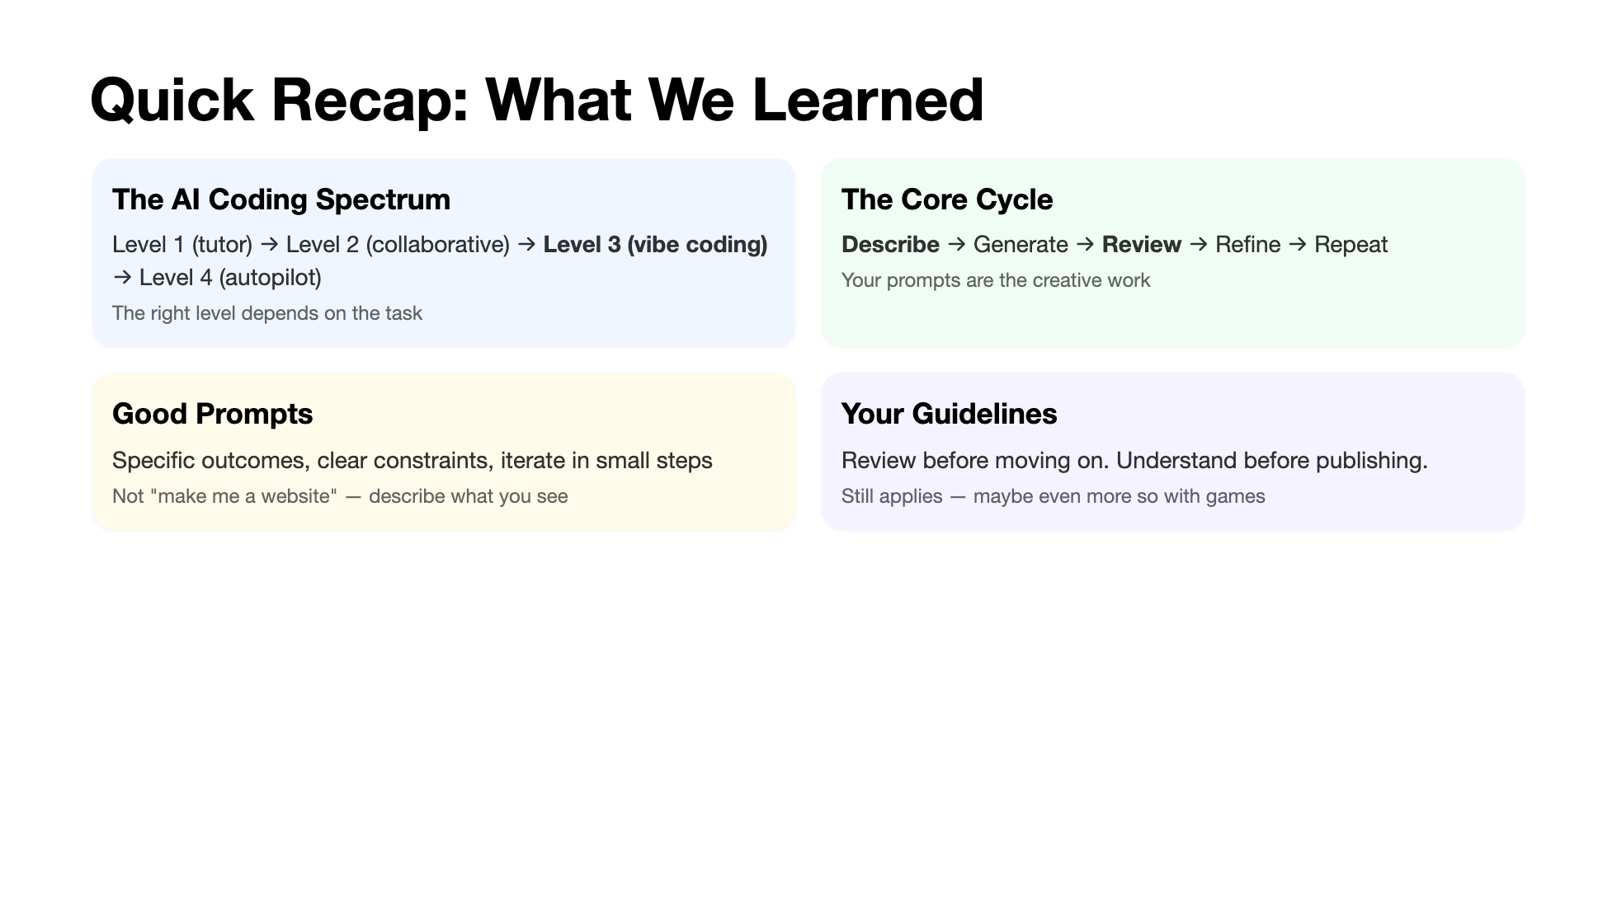
Notes:
Quick touch on the key ideas from Day 1. We're not re-teaching these — just activating prior knowledge. The spectrum, the cycle, good prompts, and personal guidelines. All of this carries forward. Today we're applying these same ideas to a harder challenge.

Slide 8

Notes:
Four key differences. The big one: we're front-loading the prompt. Last time we built up piece by piece. Today the first prompt does the heavy lifting, and our follow-ups are about refinement and personalization. Why? Because a game needs all its parts working together from the start — you can't play half a game. Also: single file. No switching between tabs. Everything is in one place, which makes iteration faster. p5.js is doing the heavy lifting under the hood — the AI knows how to use it, and it handles all the drawing and animation.

Slide 9
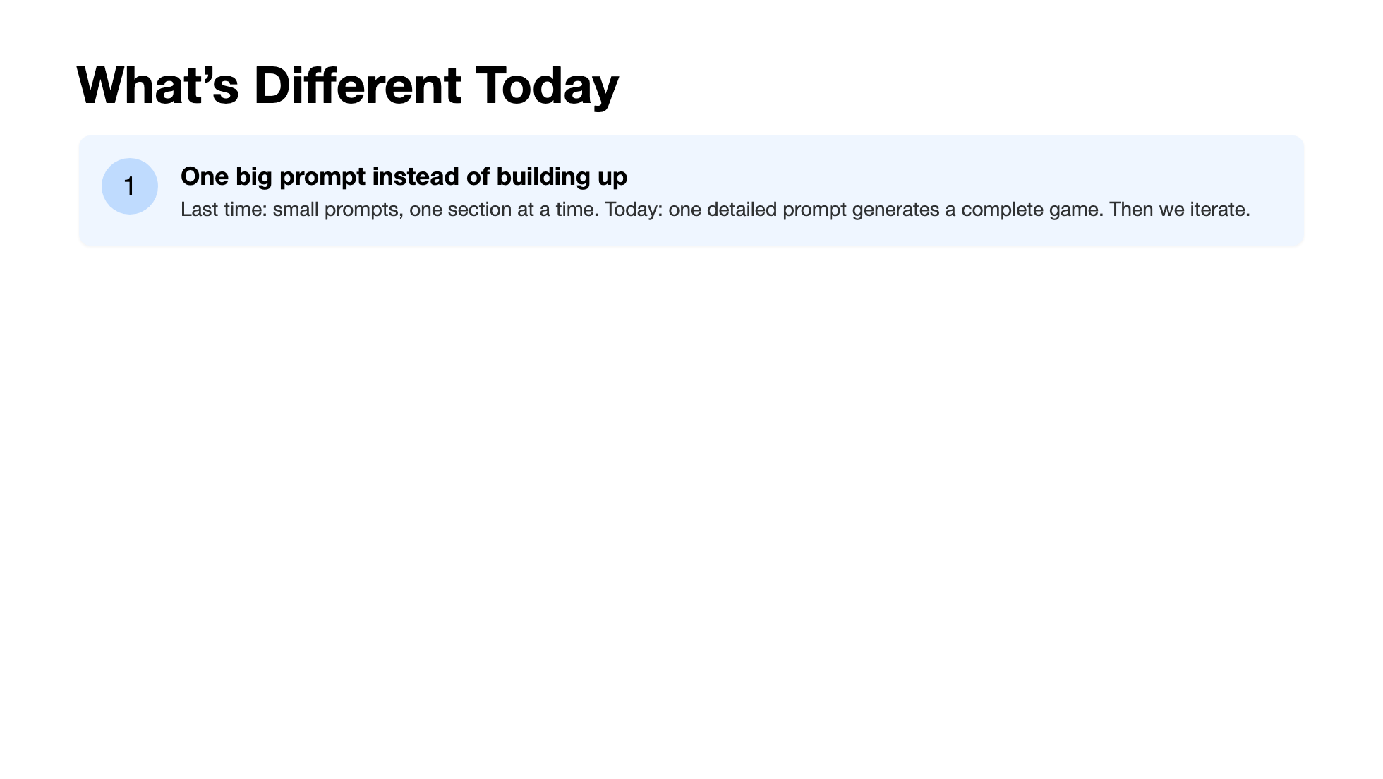
Notes:
Four key differences. The big one: we're front-loading the prompt. Last time we built up piece by piece. Today the first prompt does the heavy lifting, and our follow-ups are about refinement and personalization. Why? Because a game needs all its parts working together from the start — you can't play half a game. Also: single file. No switching between tabs. Everything is in one place, which makes iteration faster. p5.js is doing the heavy lifting under the hood — the AI knows how to use it, and it handles all the drawing and animation.

Slide 10
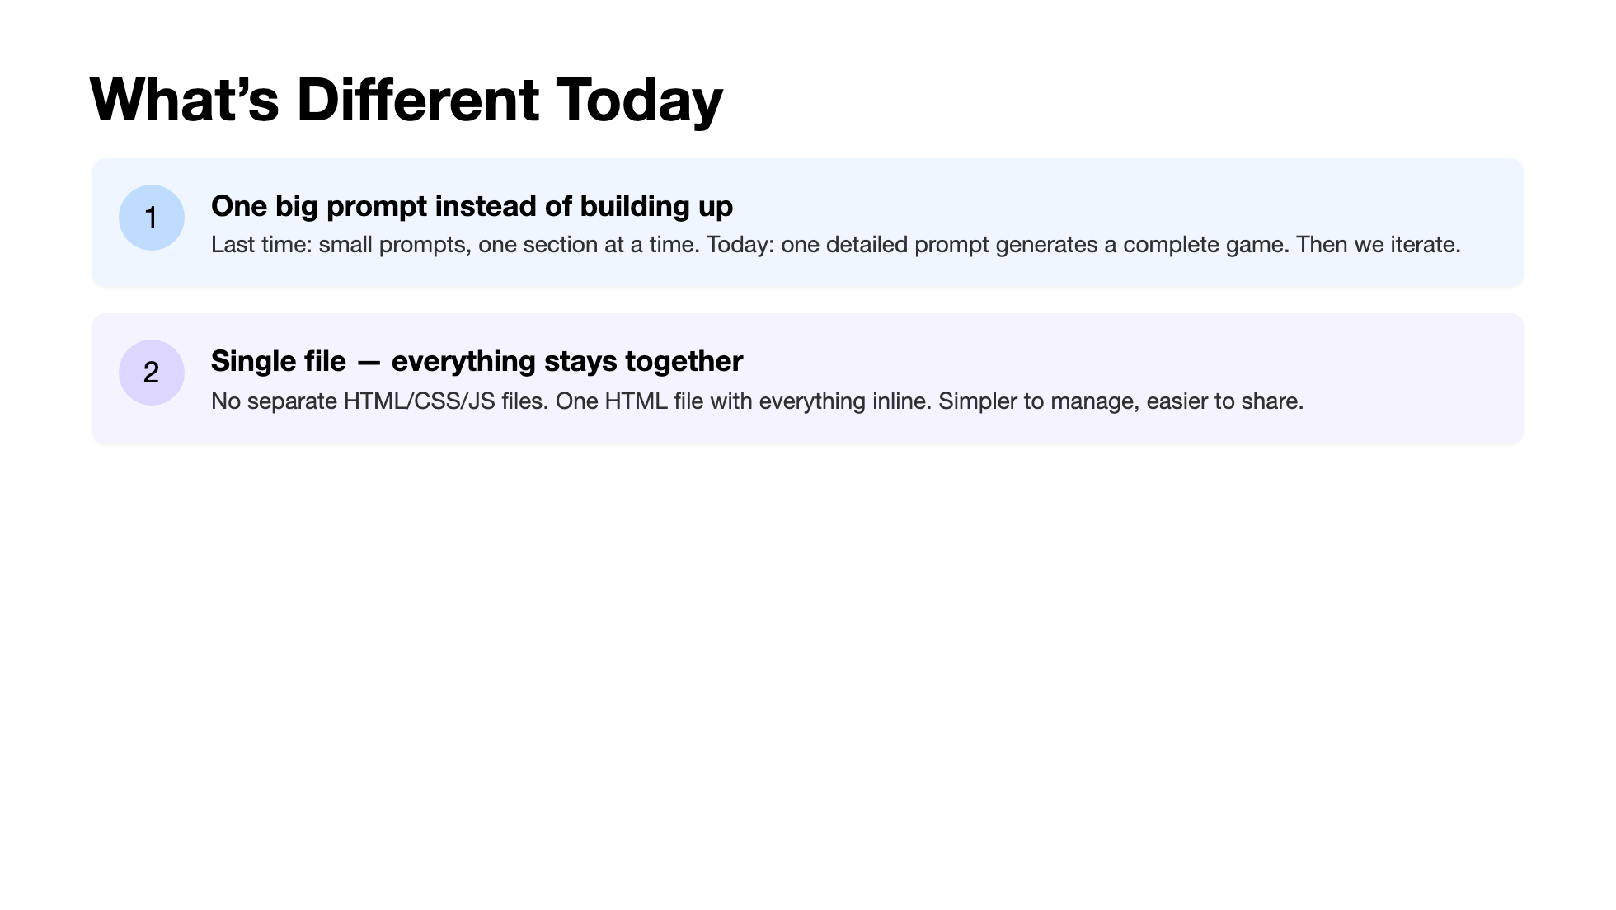
Notes:
Four key differences. The big one: we're front-loading the prompt. Last time we built up piece by piece. Today the first prompt does the heavy lifting, and our follow-ups are about refinement and personalization. Why? Because a game needs all its parts working together from the start — you can't play half a game. Also: single file. No switching between tabs. Everything is in one place, which makes iteration faster. p5.js is doing the heavy lifting under the hood — the AI knows how to use it, and it handles all the drawing and animation.

Slide 11
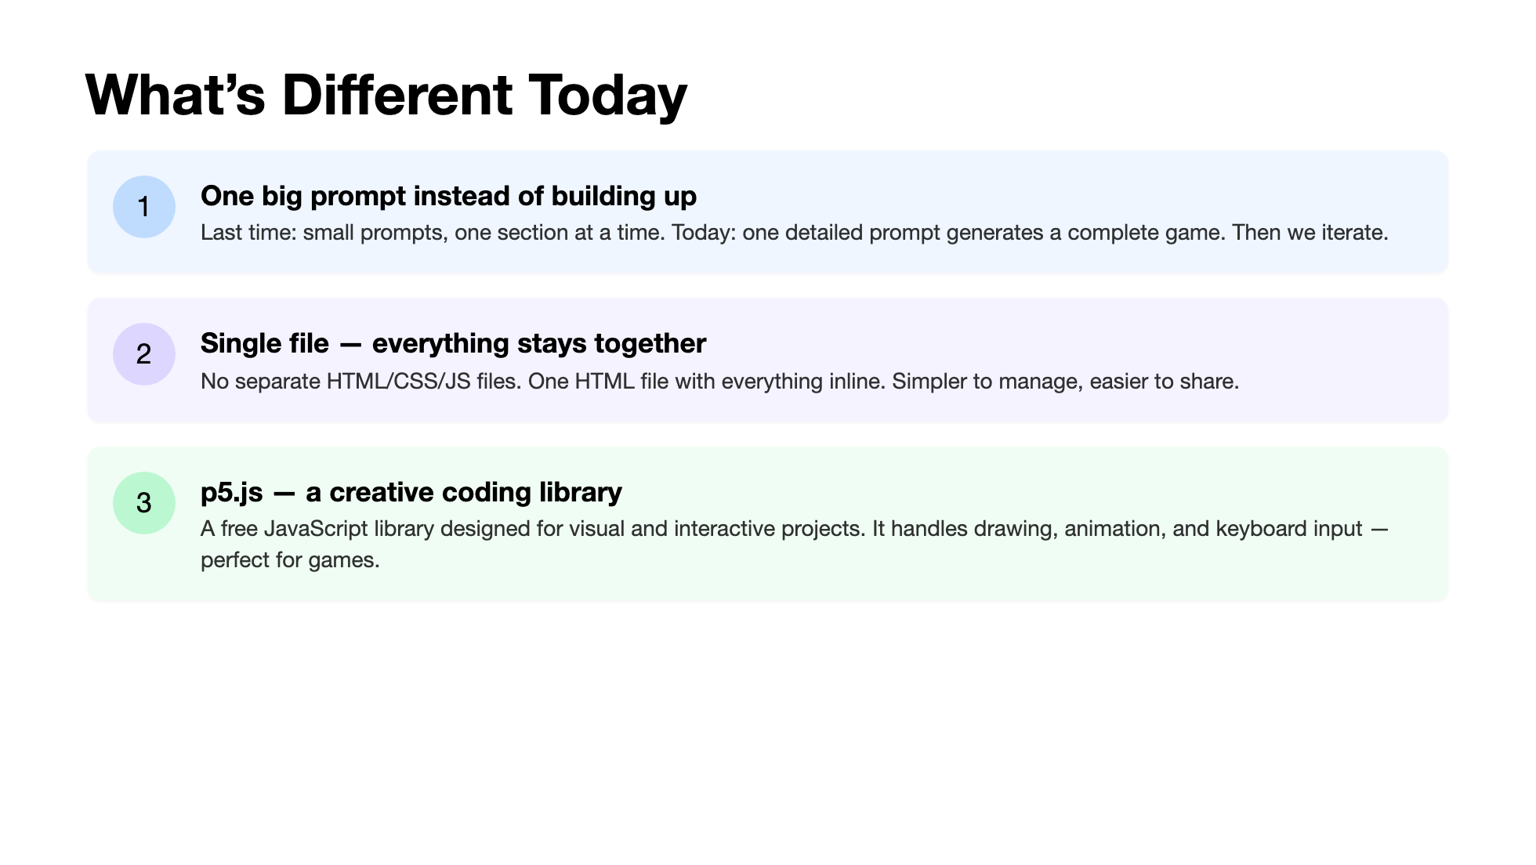
Notes:
Four key differences. The big one: we're front-loading the prompt. Last time we built up piece by piece. Today the first prompt does the heavy lifting, and our follow-ups are about refinement and personalization. Why? Because a game needs all its parts working together from the start — you can't play half a game. Also: single file. No switching between tabs. Everything is in one place, which makes iteration faster. p5.js is doing the heavy lifting under the hood — the AI knows how to use it, and it handles all the drawing and animation.

Slide 12
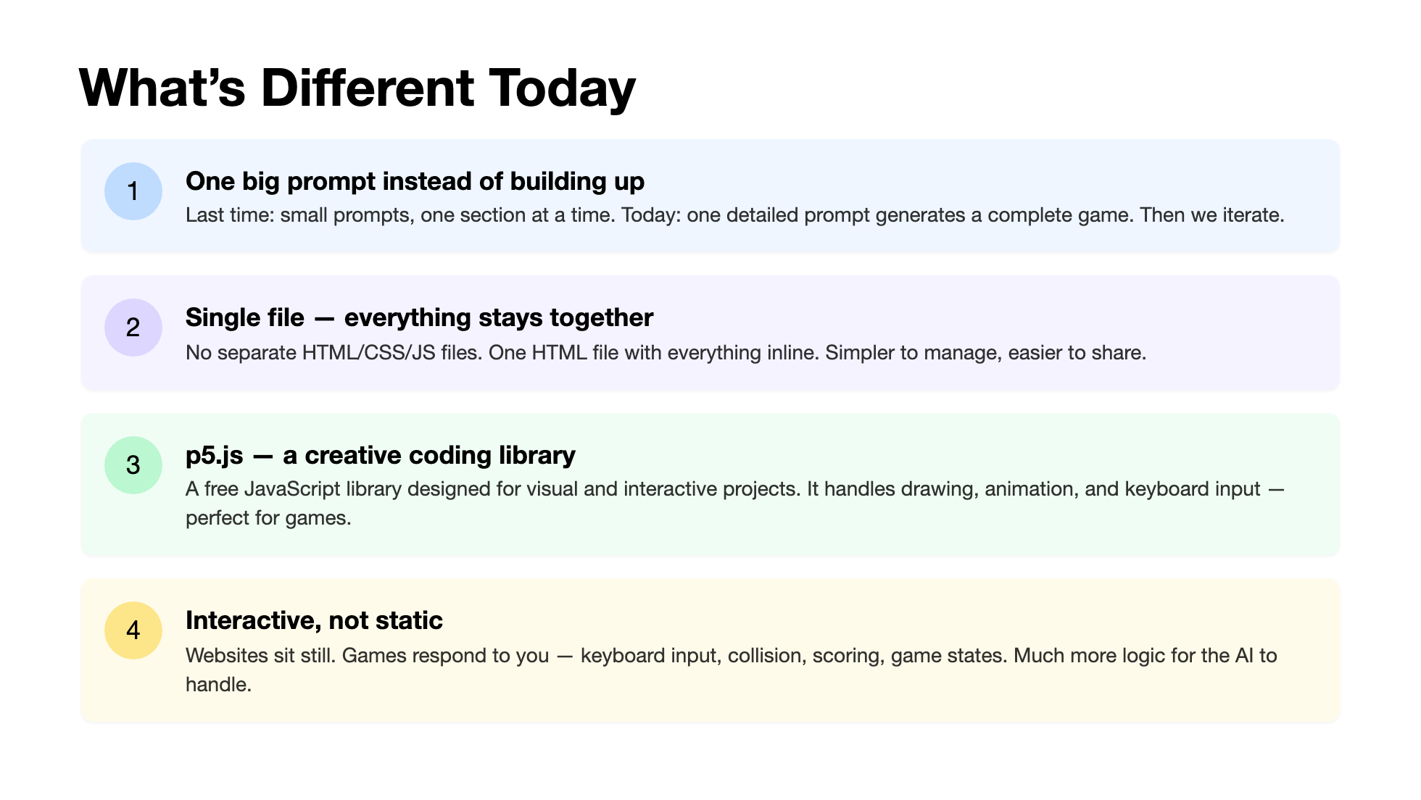
Notes:
Four key differences. The big one: we're front-loading the prompt. Last time we built up piece by piece. Today the first prompt does the heavy lifting, and our follow-ups are about refinement and personalization. Why? Because a game needs all its parts working together from the start — you can't play half a game. Also: single file. No switching between tabs. Everything is in one place, which makes iteration faster. p5.js is doing the heavy lifting under the hood — the AI knows how to use it, and it handles all the drawing and animation.

Slide 13
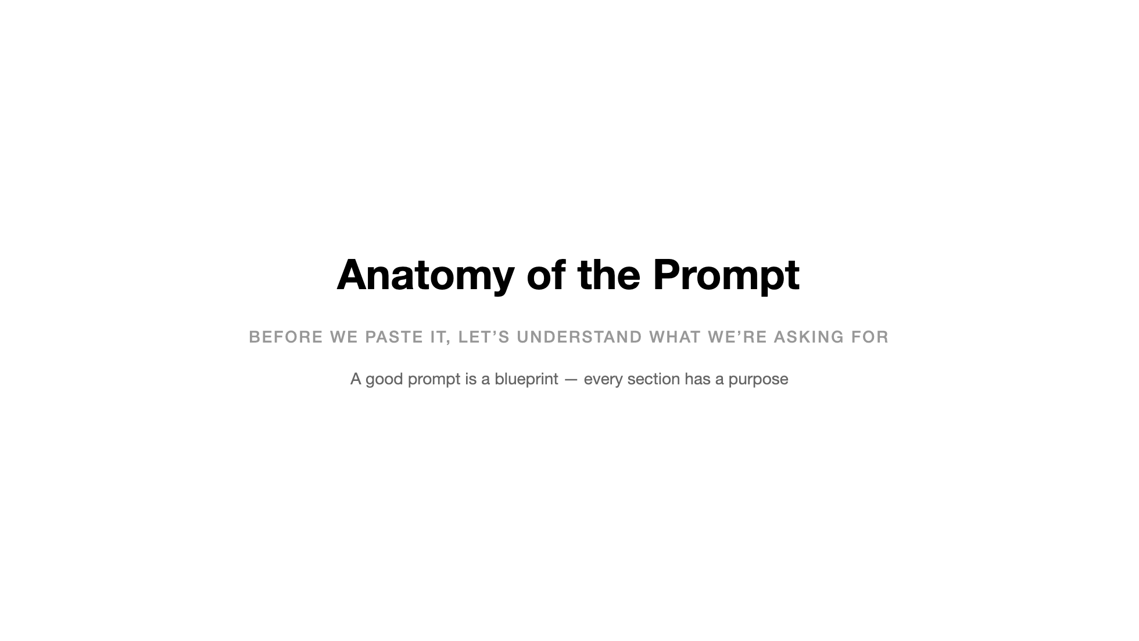
Notes:
We're going to look at the prompt piece by piece before anyone pastes it. This is deliberate: understanding what you're asking for is the difference between Level 3 and Level 4 on the spectrum.

Slide 14
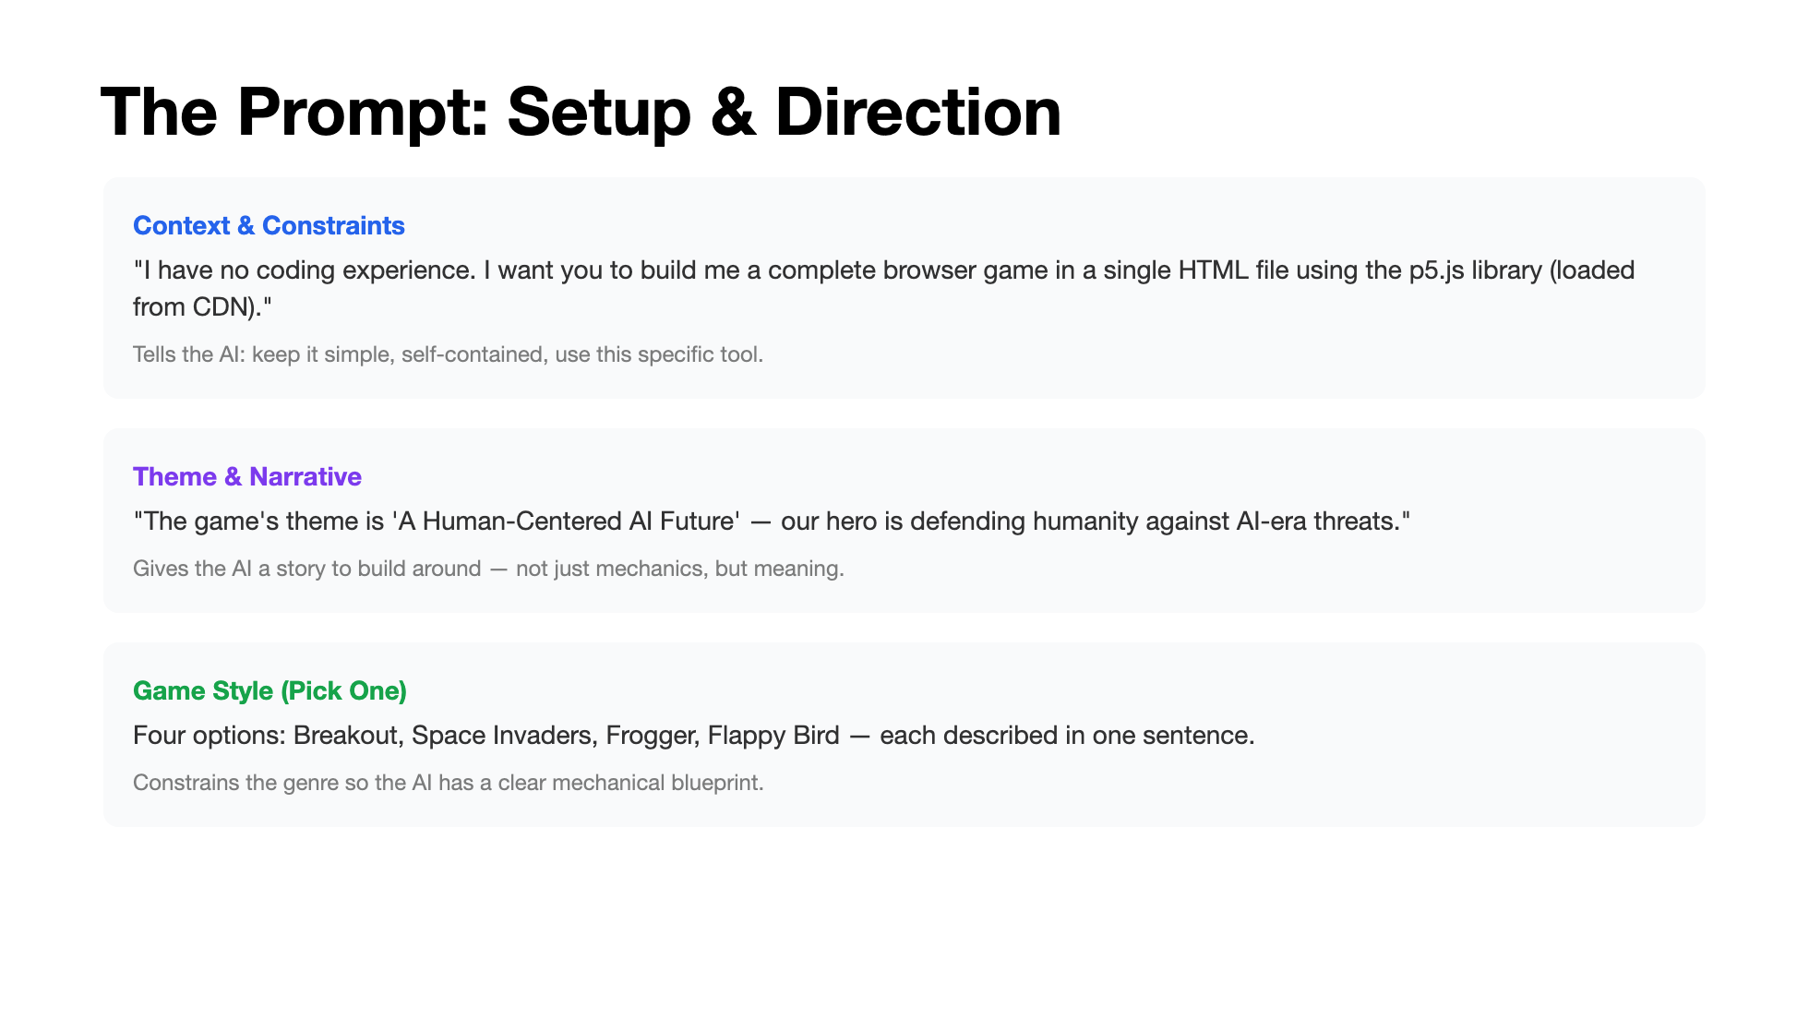
Notes:
Walk through the first three sections. Context sets the technical constraints — single file, specific library, beginner-level. Theme gives the AI narrative direction — not just "make a game" but a game with meaning. The game style pick is the single most important creative decision they'll make — it determines the entire mechanical structure.

Slide 15
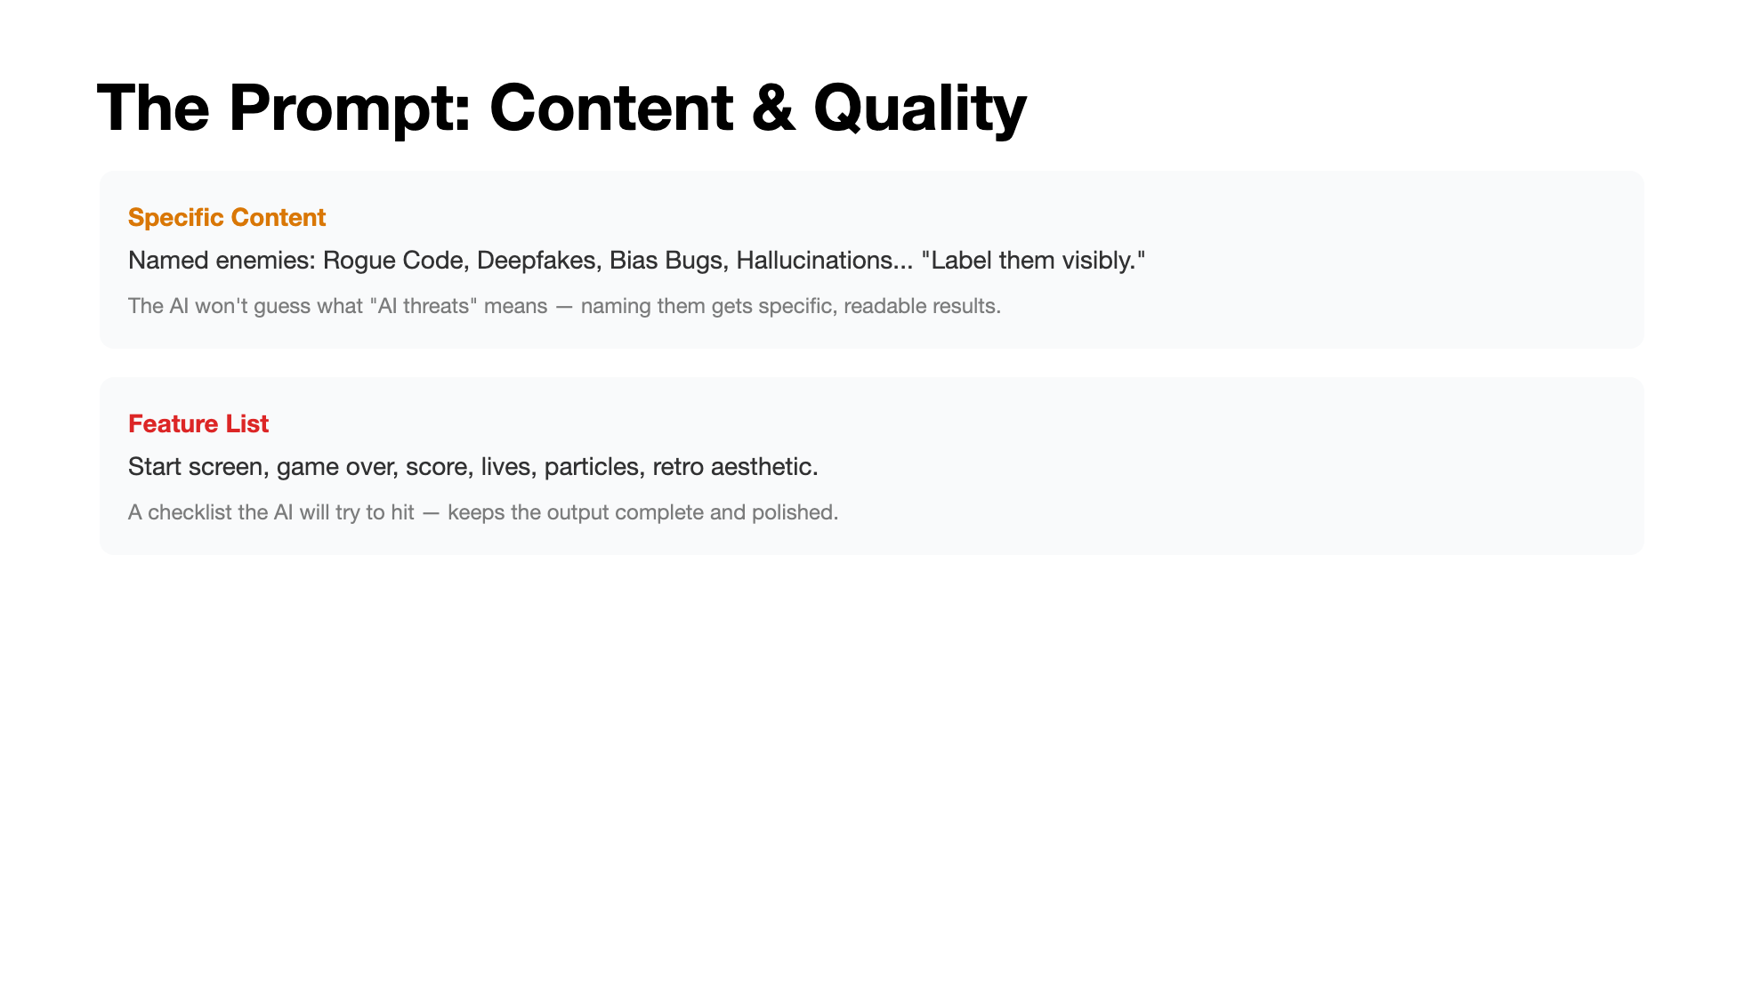
Notes:
The last two sections. Named enemies prevent vague, generic output — the AI needs concrete strings to render. The feature list is a quality checklist: without it, you might get a game that works but has no start screen or score display. Then the takeaway: every line in the prompt has a purpose. That's the difference between a wall of text and a blueprint.

Slide 16
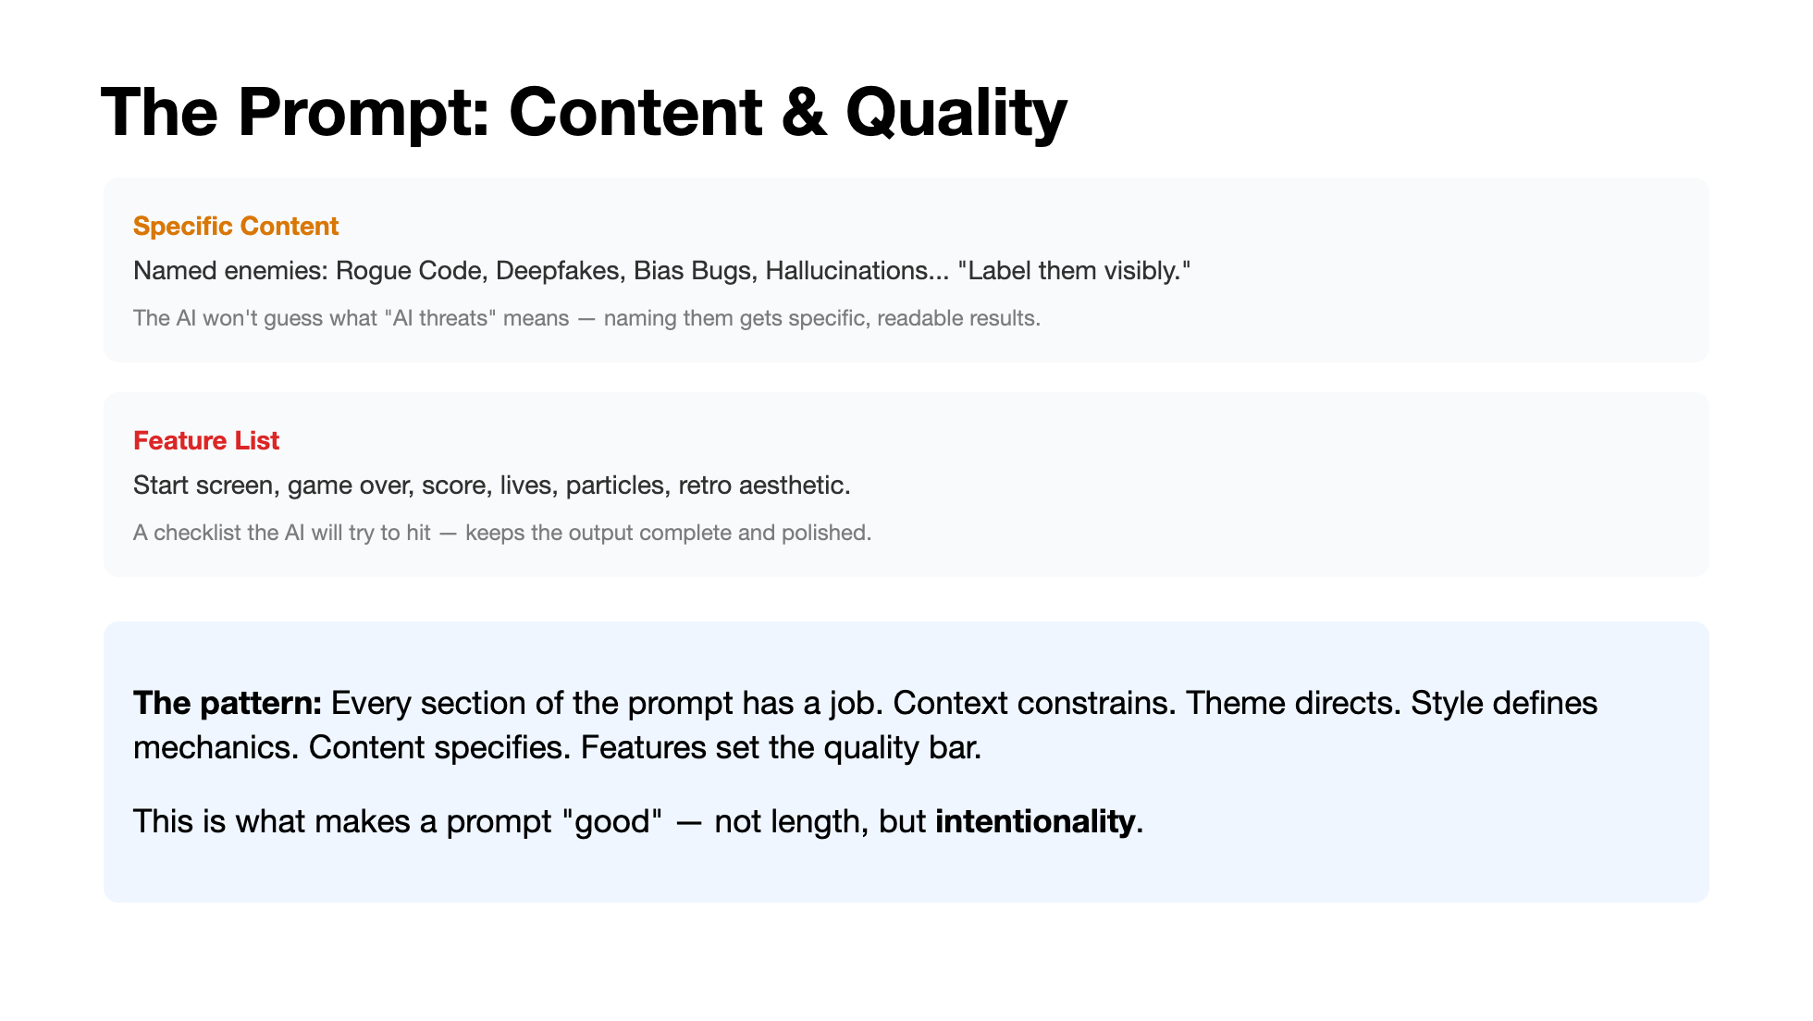
Notes:
The last two sections. Named enemies prevent vague, generic output — the AI needs concrete strings to render. The feature list is a quality checklist: without it, you might get a game that works but has no start screen or score display. Then the takeaway: every line in the prompt has a purpose. That's the difference between a wall of text and a blueprint.

Slide 17
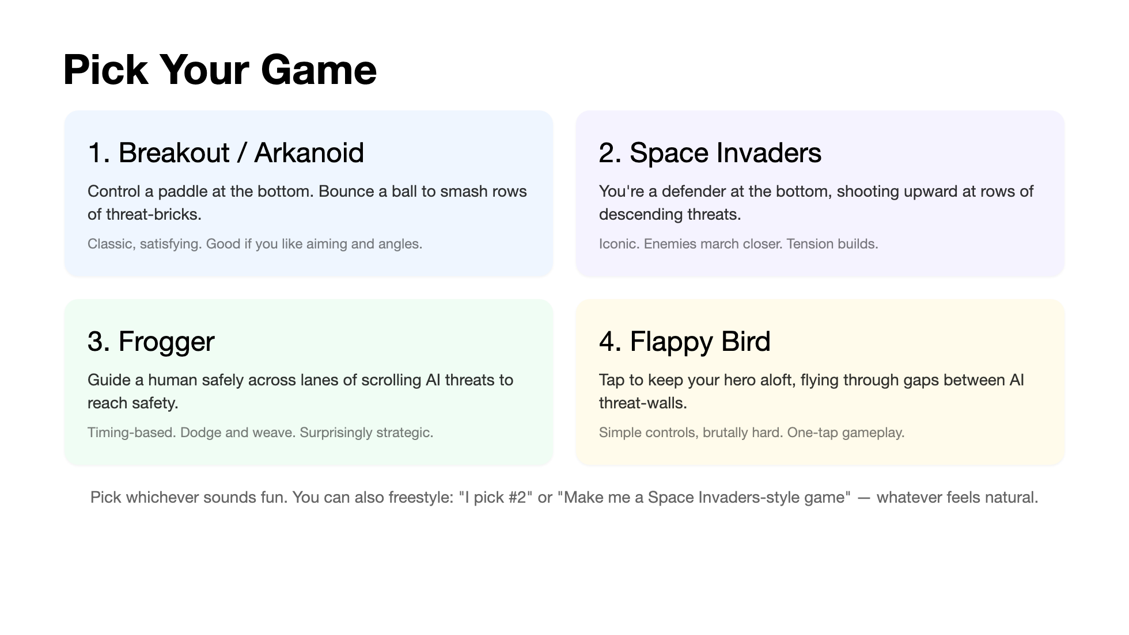
Notes:
Give them a minute to decide. There's no wrong choice. All four produce great results. If someone can't decide, tell them Breakout or Space Invaders tend to be the most visually impressive. If someone wants to do something completely different — a different genre — that's fine too, but suggest they start with one of these and modify later.

Slide 18
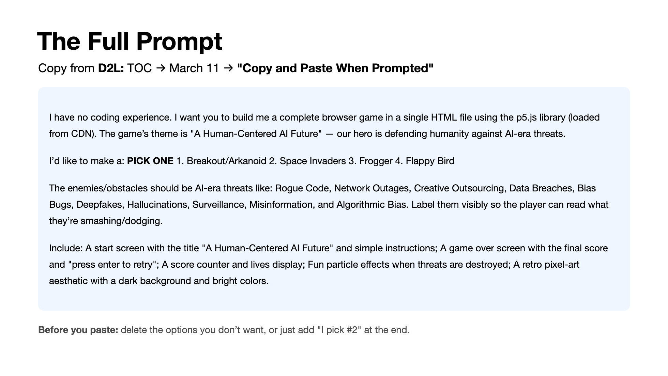
Notes:
D2L has the full prompt with the complete game descriptions for each option. This slide shows a condensed version so students can see the whole thing at a glance. Have them copy from D2L, make their game choice, and paste into Claude. While Claude generates, remind them: this is one prompt. It's detailed because we designed it to be. Every piece we just walked through is in there. Give Claude a minute to generate — the response will be long. That's normal.

Slide 19
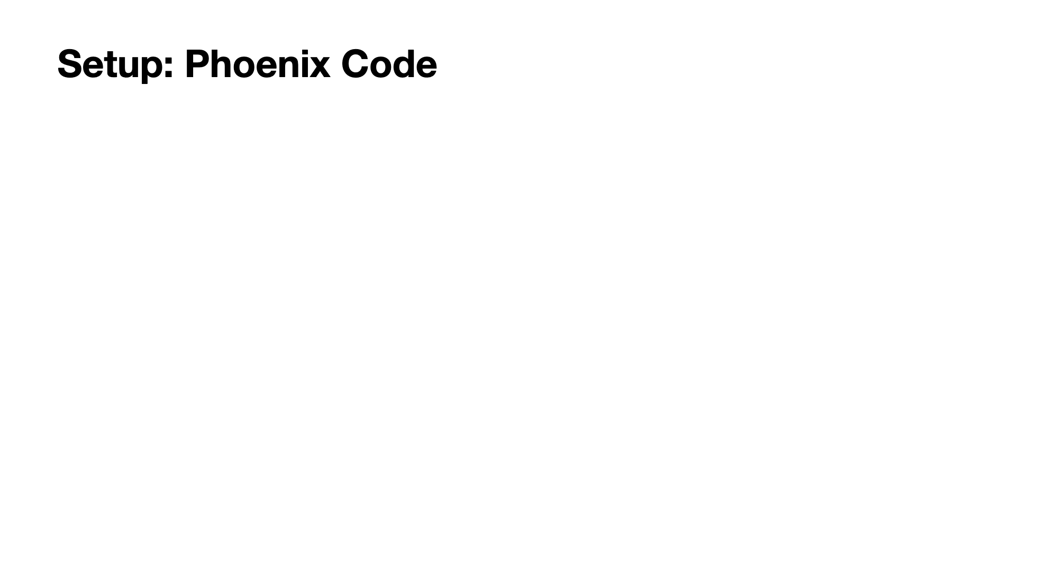
Notes:
If students already have Phoenix Code from Day 1, they can skip to Step 2. No GitHub Import needed this time — we're just creating a single file. Make sure everyone saves as game.html, not game.txt. The Live Preview should show the game running immediately. Walk the room and help anyone whose preview isn't loading. Common issue: if they accidentally copied only part of the code block from Claude, the file will be incomplete. Have them go back and copy the whole thing.

Slide 20

Notes:
If students already have Phoenix Code from Day 1, they can skip to Step 2. No GitHub Import needed this time — we're just creating a single file. Make sure everyone saves as game.html, not game.txt. The Live Preview should show the game running immediately. Walk the room and help anyone whose preview isn't loading. Common issue: if they accidentally copied only part of the code block from Claude, the file will be incomplete. Have them go back and copy the whole thing.

Slide 21
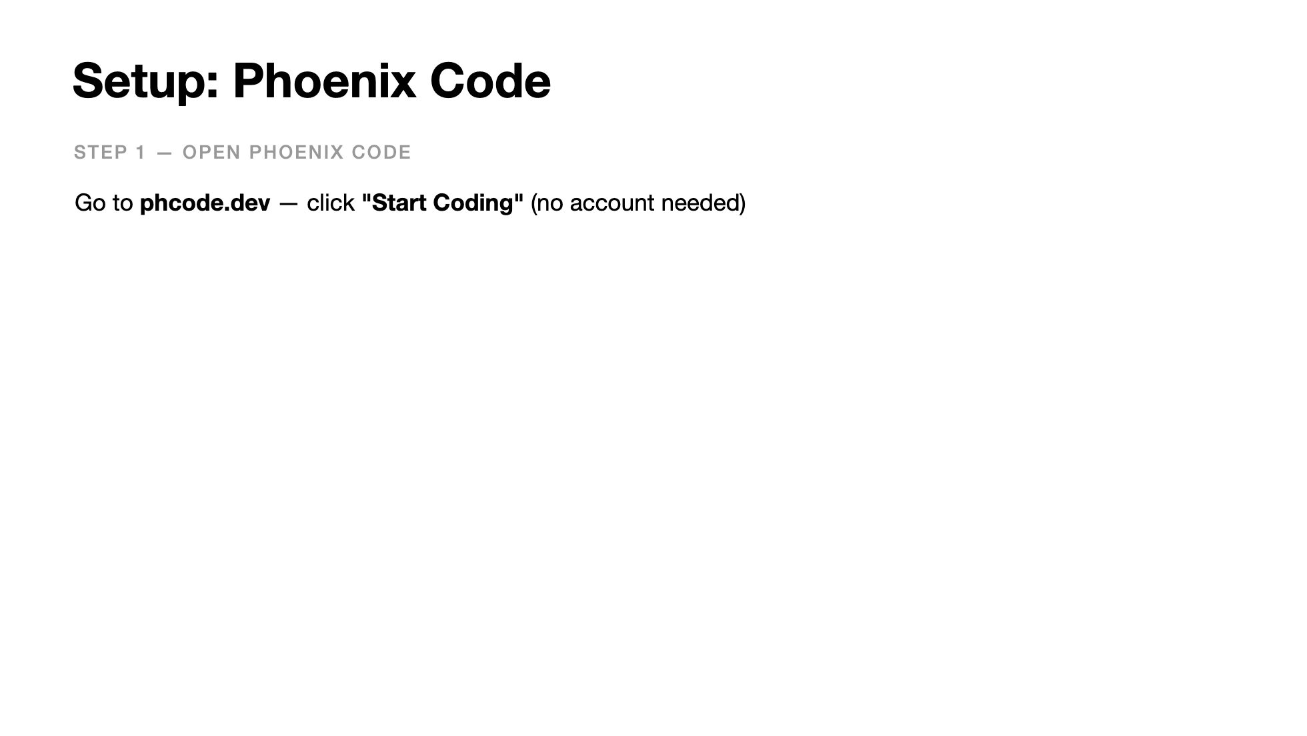
Notes:
If students already have Phoenix Code from Day 1, they can skip to Step 2. No GitHub Import needed this time — we're just creating a single file. Make sure everyone saves as game.html, not game.txt. The Live Preview should show the game running immediately. Walk the room and help anyone whose preview isn't loading. Common issue: if they accidentally copied only part of the code block from Claude, the file will be incomplete. Have them go back and copy the whole thing.

Slide 22
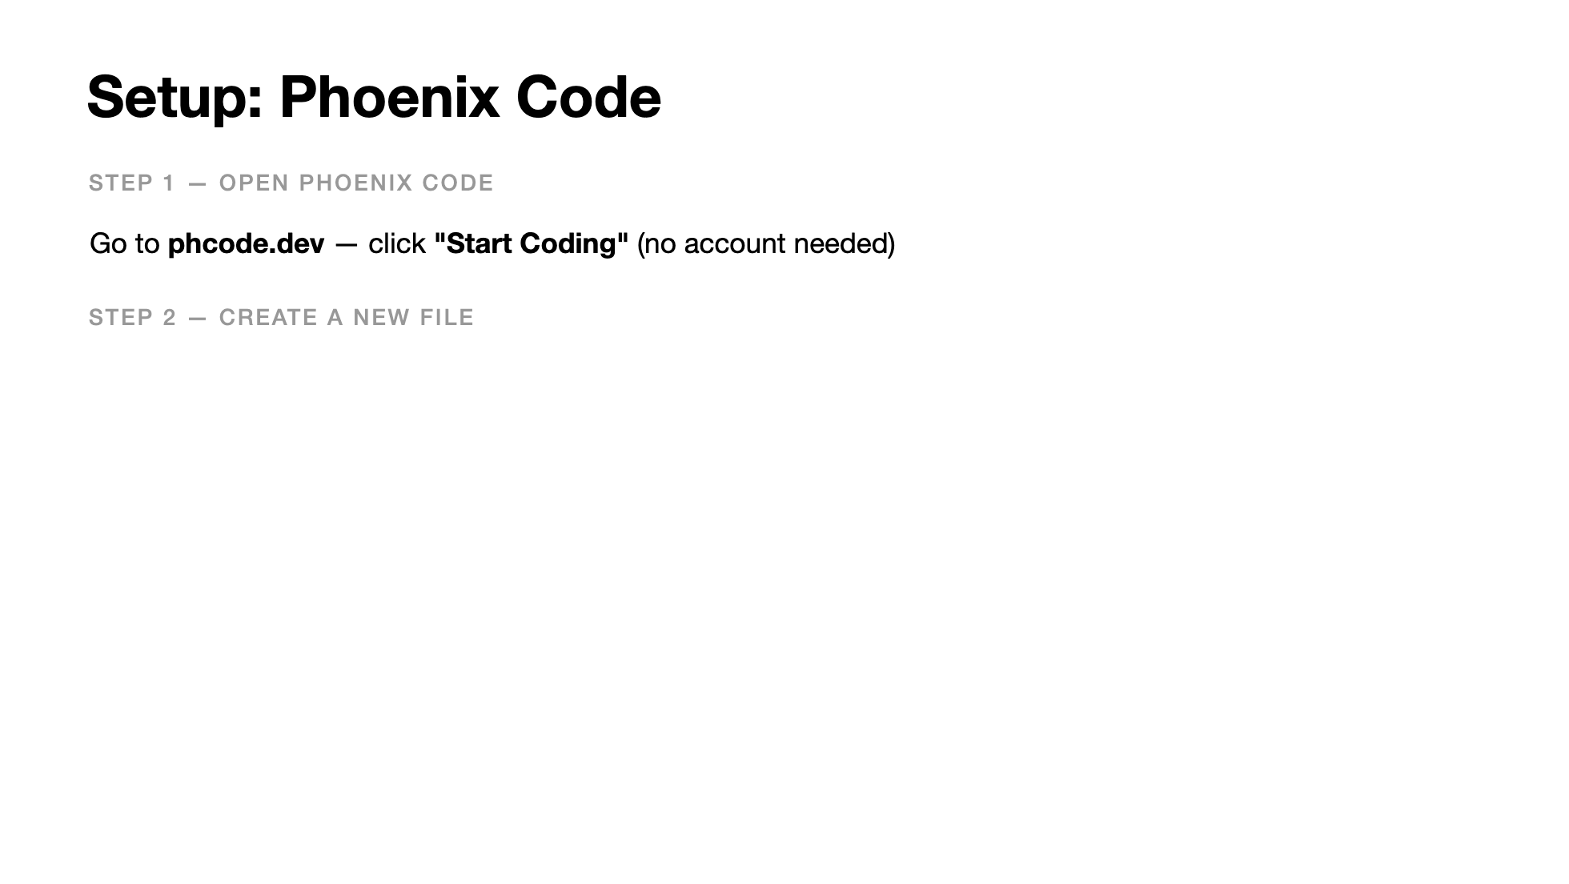
Notes:
If students already have Phoenix Code from Day 1, they can skip to Step 2. No GitHub Import needed this time — we're just creating a single file. Make sure everyone saves as game.html, not game.txt. The Live Preview should show the game running immediately. Walk the room and help anyone whose preview isn't loading. Common issue: if they accidentally copied only part of the code block from Claude, the file will be incomplete. Have them go back and copy the whole thing.

Slide 23
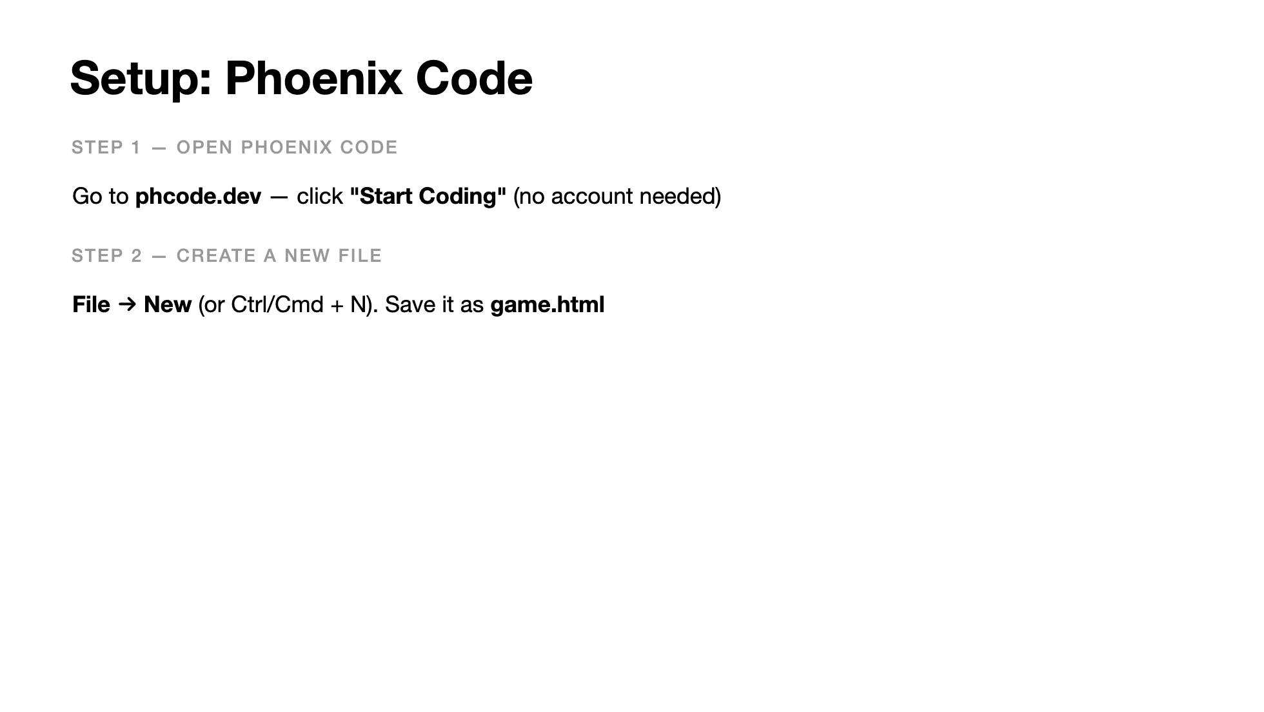
Notes:
If students already have Phoenix Code from Day 1, they can skip to Step 2. No GitHub Import needed this time — we're just creating a single file. Make sure everyone saves as game.html, not game.txt. The Live Preview should show the game running immediately. Walk the room and help anyone whose preview isn't loading. Common issue: if they accidentally copied only part of the code block from Claude, the file will be incomplete. Have them go back and copy the whole thing.

Slide 24
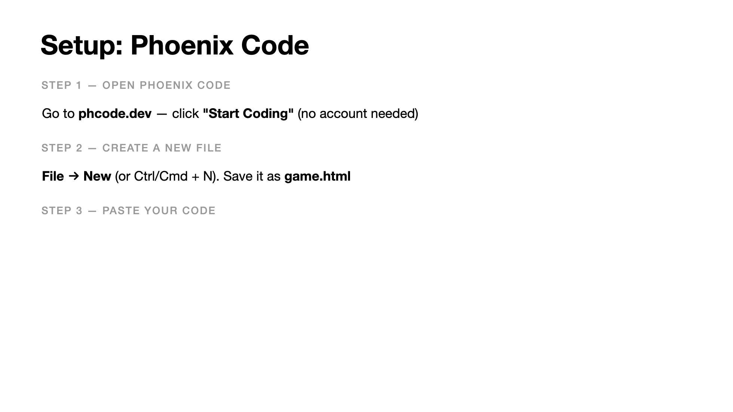
Notes:
If students already have Phoenix Code from Day 1, they can skip to Step 2. No GitHub Import needed this time — we're just creating a single file. Make sure everyone saves as game.html, not game.txt. The Live Preview should show the game running immediately. Walk the room and help anyone whose preview isn't loading. Common issue: if they accidentally copied only part of the code block from Claude, the file will be incomplete. Have them go back and copy the whole thing.

Slide 25
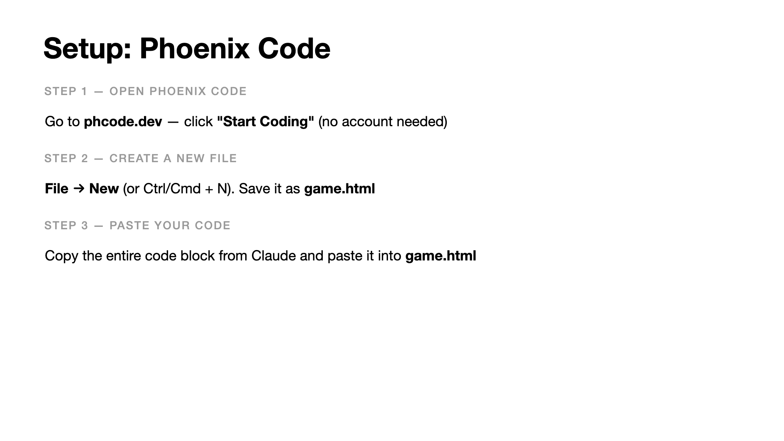
Notes:
If students already have Phoenix Code from Day 1, they can skip to Step 2. No GitHub Import needed this time — we're just creating a single file. Make sure everyone saves as game.html, not game.txt. The Live Preview should show the game running immediately. Walk the room and help anyone whose preview isn't loading. Common issue: if they accidentally copied only part of the code block from Claude, the file will be incomplete. Have them go back and copy the whole thing.

Slide 26
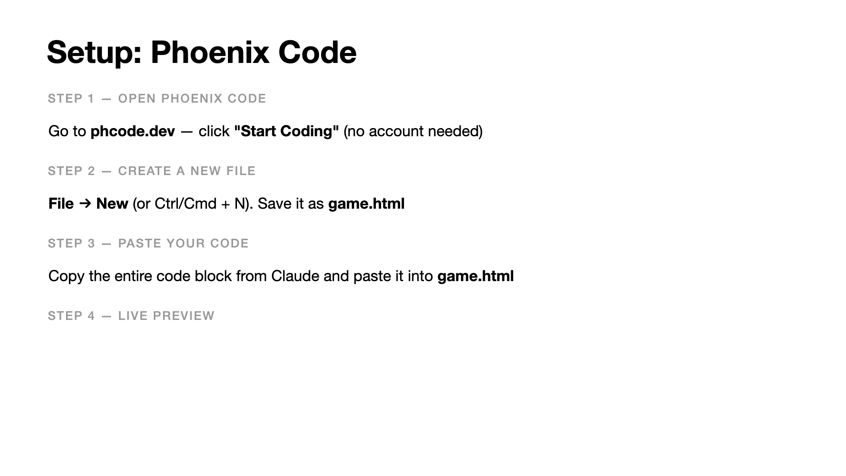
Notes:
If students already have Phoenix Code from Day 1, they can skip to Step 2. No GitHub Import needed this time — we're just creating a single file. Make sure everyone saves as game.html, not game.txt. The Live Preview should show the game running immediately. Walk the room and help anyone whose preview isn't loading. Common issue: if they accidentally copied only part of the code block from Claude, the file will be incomplete. Have them go back and copy the whole thing.

Slide 27
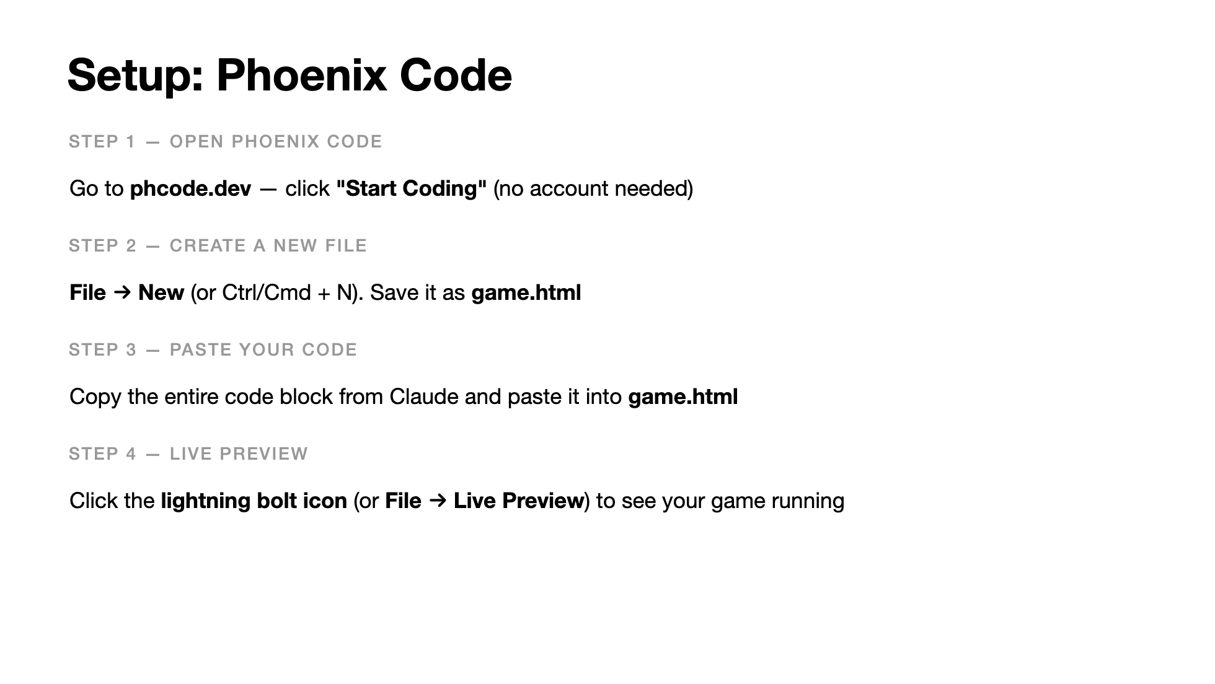
Notes:
If students already have Phoenix Code from Day 1, they can skip to Step 2. No GitHub Import needed this time — we're just creating a single file. Make sure everyone saves as game.html, not game.txt. The Live Preview should show the game running immediately. Walk the room and help anyone whose preview isn't loading. Common issue: if they accidentally copied only part of the code block from Claude, the file will be incomplete. Have them go back and copy the whole thing.

Slide 28
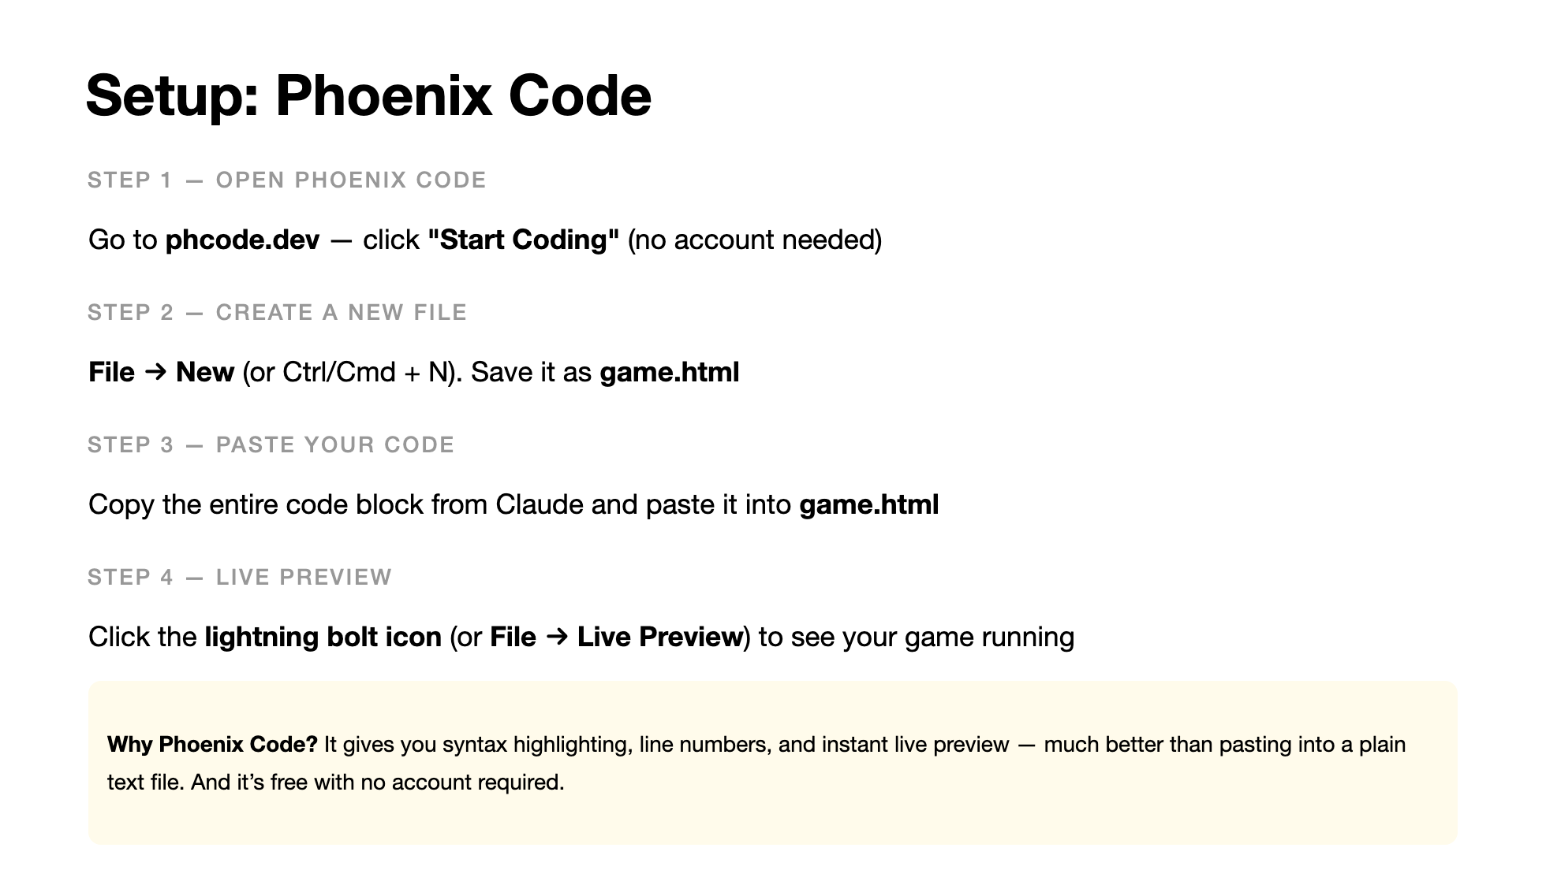
Notes:
If students already have Phoenix Code from Day 1, they can skip to Step 2. No GitHub Import needed this time — we're just creating a single file. Make sure everyone saves as game.html, not game.txt. The Live Preview should show the game running immediately. Walk the room and help anyone whose preview isn't loading. Common issue: if they accidentally copied only part of the code block from Claude, the file will be incomplete. Have them go back and copy the whole thing.

Slide 29
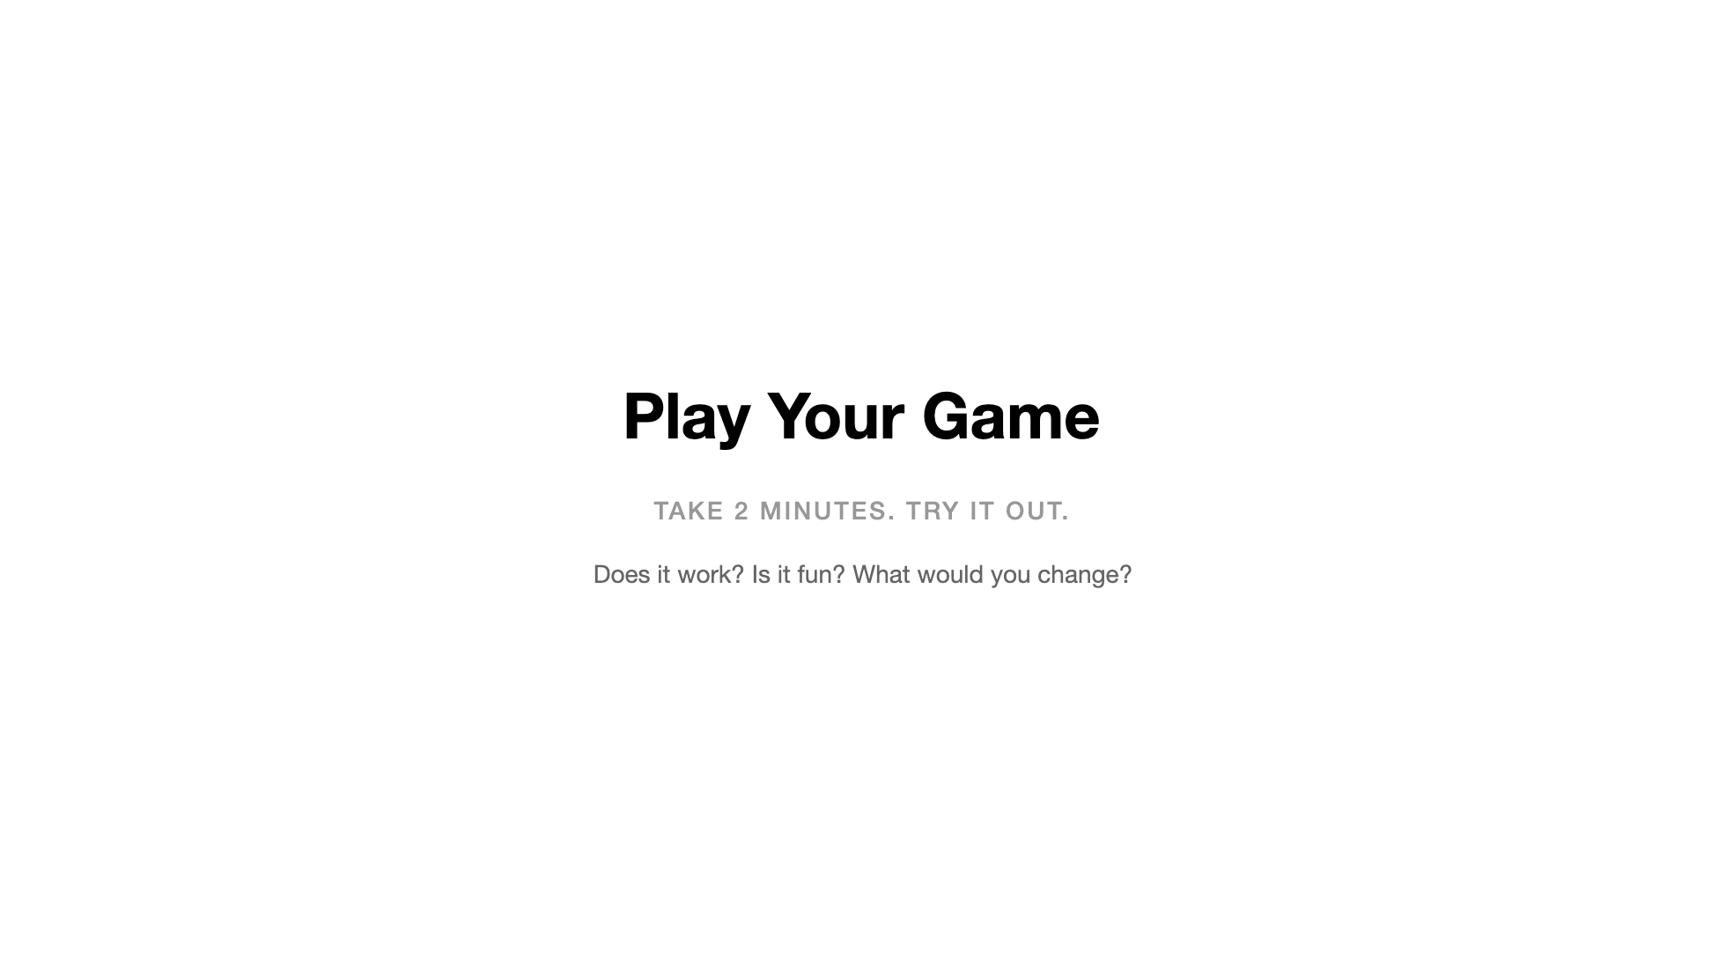
Notes:
Let them play. This is the payoff moment. Walk the room, look at screens, react to what they built. Some games will work perfectly. Some will have bugs — enemies off-screen, collisions not detecting, score not updating. That's fine. Let them experience it before we start fixing things. After 2 minutes, bring them back together.

Slide 30

Notes:
Quick group check-in. Show of hands: whose game works? Whose is partially broken? Whose won't load at all? Normalize all of these outcomes. The point isn't that AI gives you perfect code — it's that you now have something to work with. A broken game is closer to a working game than no game at all. If anyone's is completely broken, have them tell Claude: "The game won't load. Here's the error I see in the console." Or just ask Claude to try again.

Slide 31

Notes:
Quick group check-in. Show of hands: whose game works? Whose is partially broken? Whose won't load at all? Normalize all of these outcomes. The point isn't that AI gives you perfect code — it's that you now have something to work with. A broken game is closer to a working game than no game at all. If anyone's is completely broken, have them tell Claude: "The game won't load. Here's the error I see in the console." Or just ask Claude to try again.

Slide 32
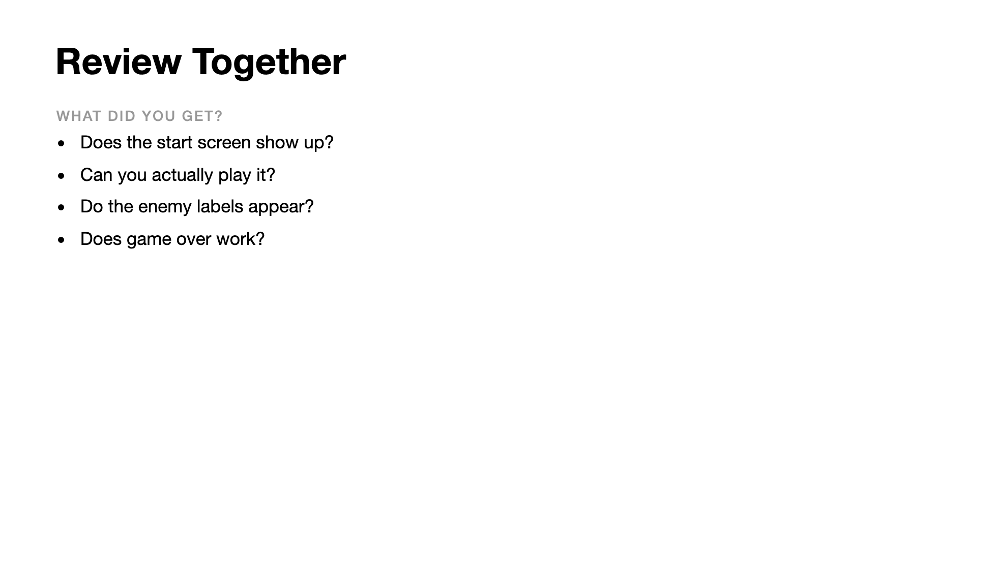
Notes:
Quick group check-in. Show of hands: whose game works? Whose is partially broken? Whose won't load at all? Normalize all of these outcomes. The point isn't that AI gives you perfect code — it's that you now have something to work with. A broken game is closer to a working game than no game at all. If anyone's is completely broken, have them tell Claude: "The game won't load. Here's the error I see in the console." Or just ask Claude to try again.

Slide 33
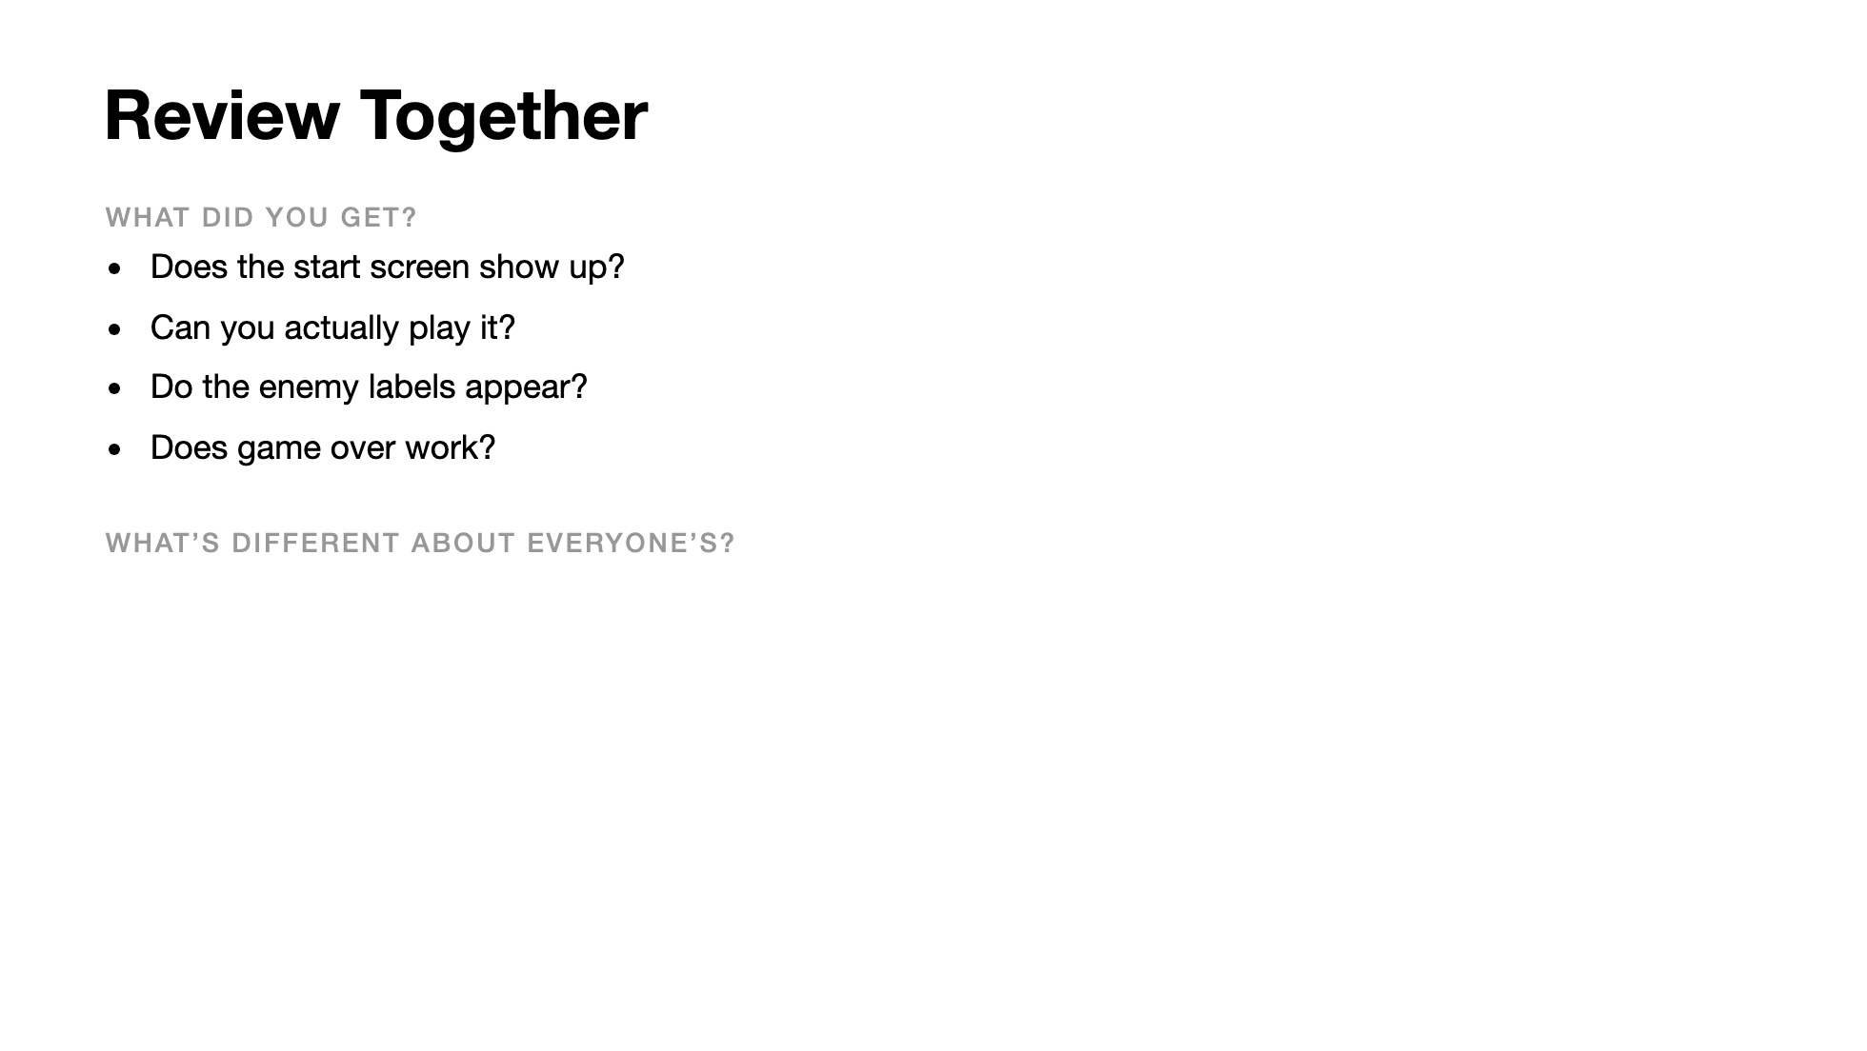
Notes:
Quick group check-in. Show of hands: whose game works? Whose is partially broken? Whose won't load at all? Normalize all of these outcomes. The point isn't that AI gives you perfect code — it's that you now have something to work with. A broken game is closer to a working game than no game at all. If anyone's is completely broken, have them tell Claude: "The game won't load. Here's the error I see in the console." Or just ask Claude to try again.

Slide 34
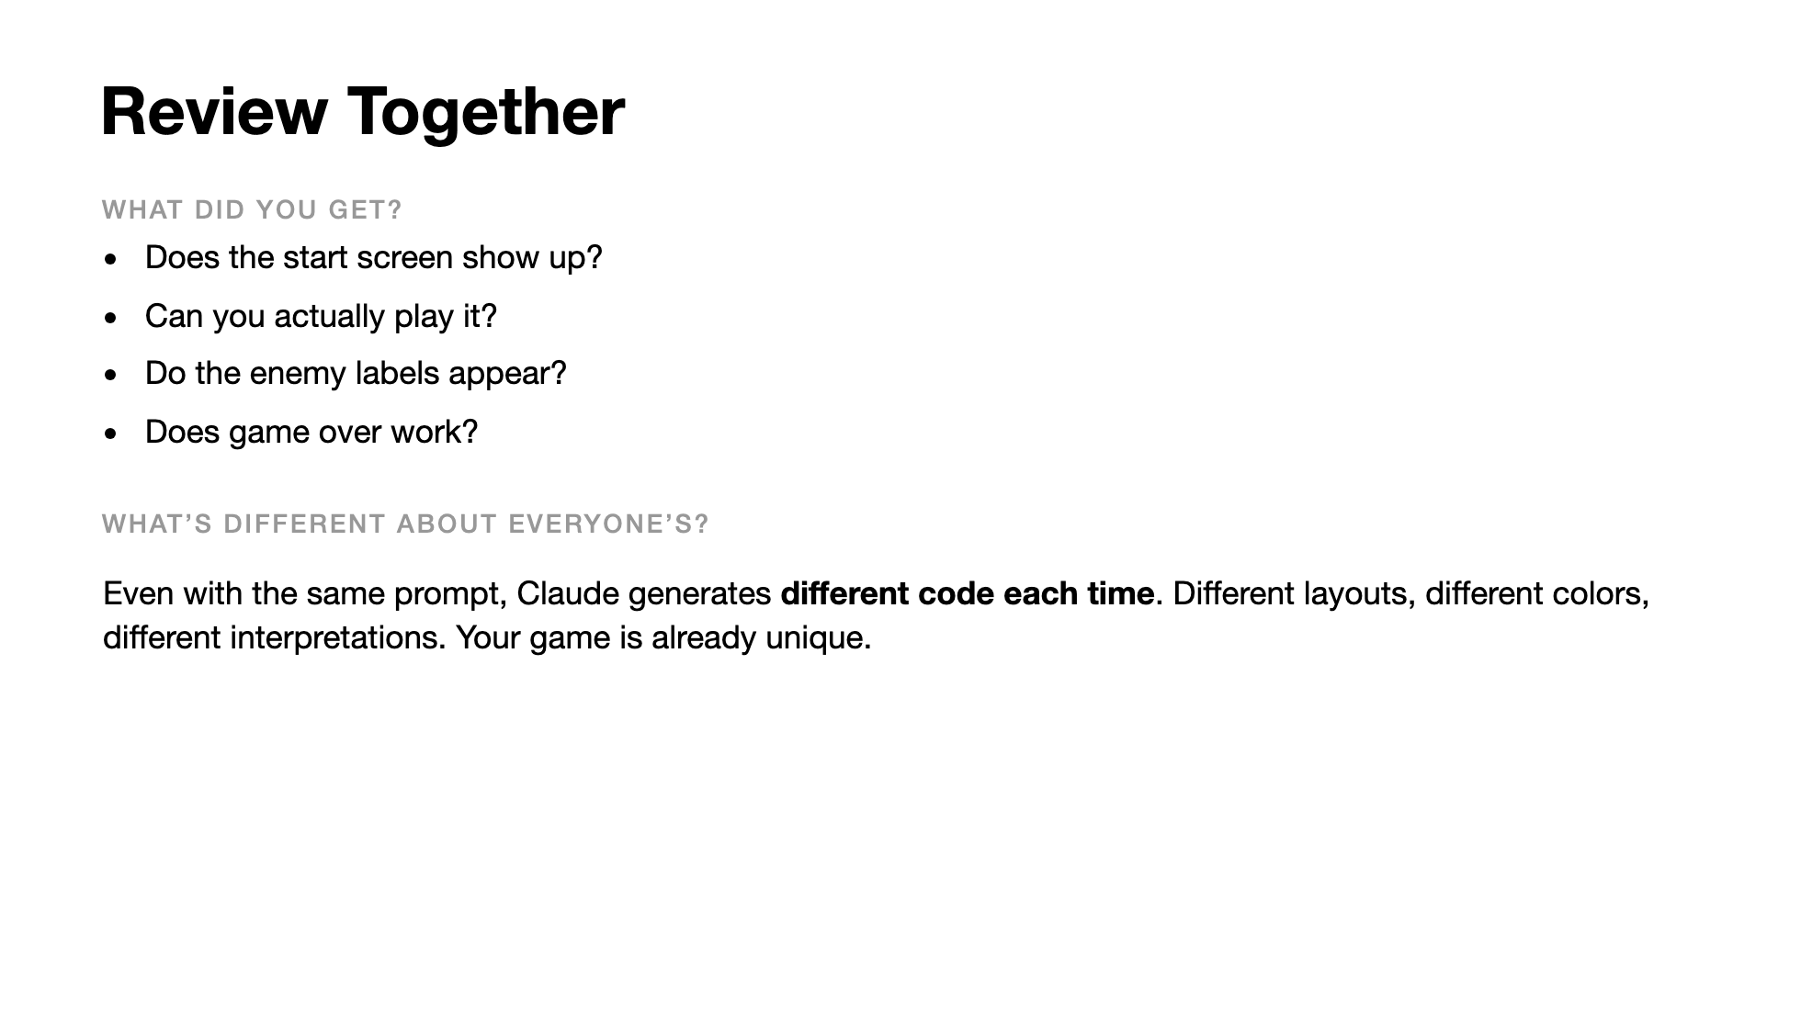
Notes:
Quick group check-in. Show of hands: whose game works? Whose is partially broken? Whose won't load at all? Normalize all of these outcomes. The point isn't that AI gives you perfect code — it's that you now have something to work with. A broken game is closer to a working game than no game at all. If anyone's is completely broken, have them tell Claude: "The game won't load. Here's the error I see in the console." Or just ask Claude to try again.

Slide 35
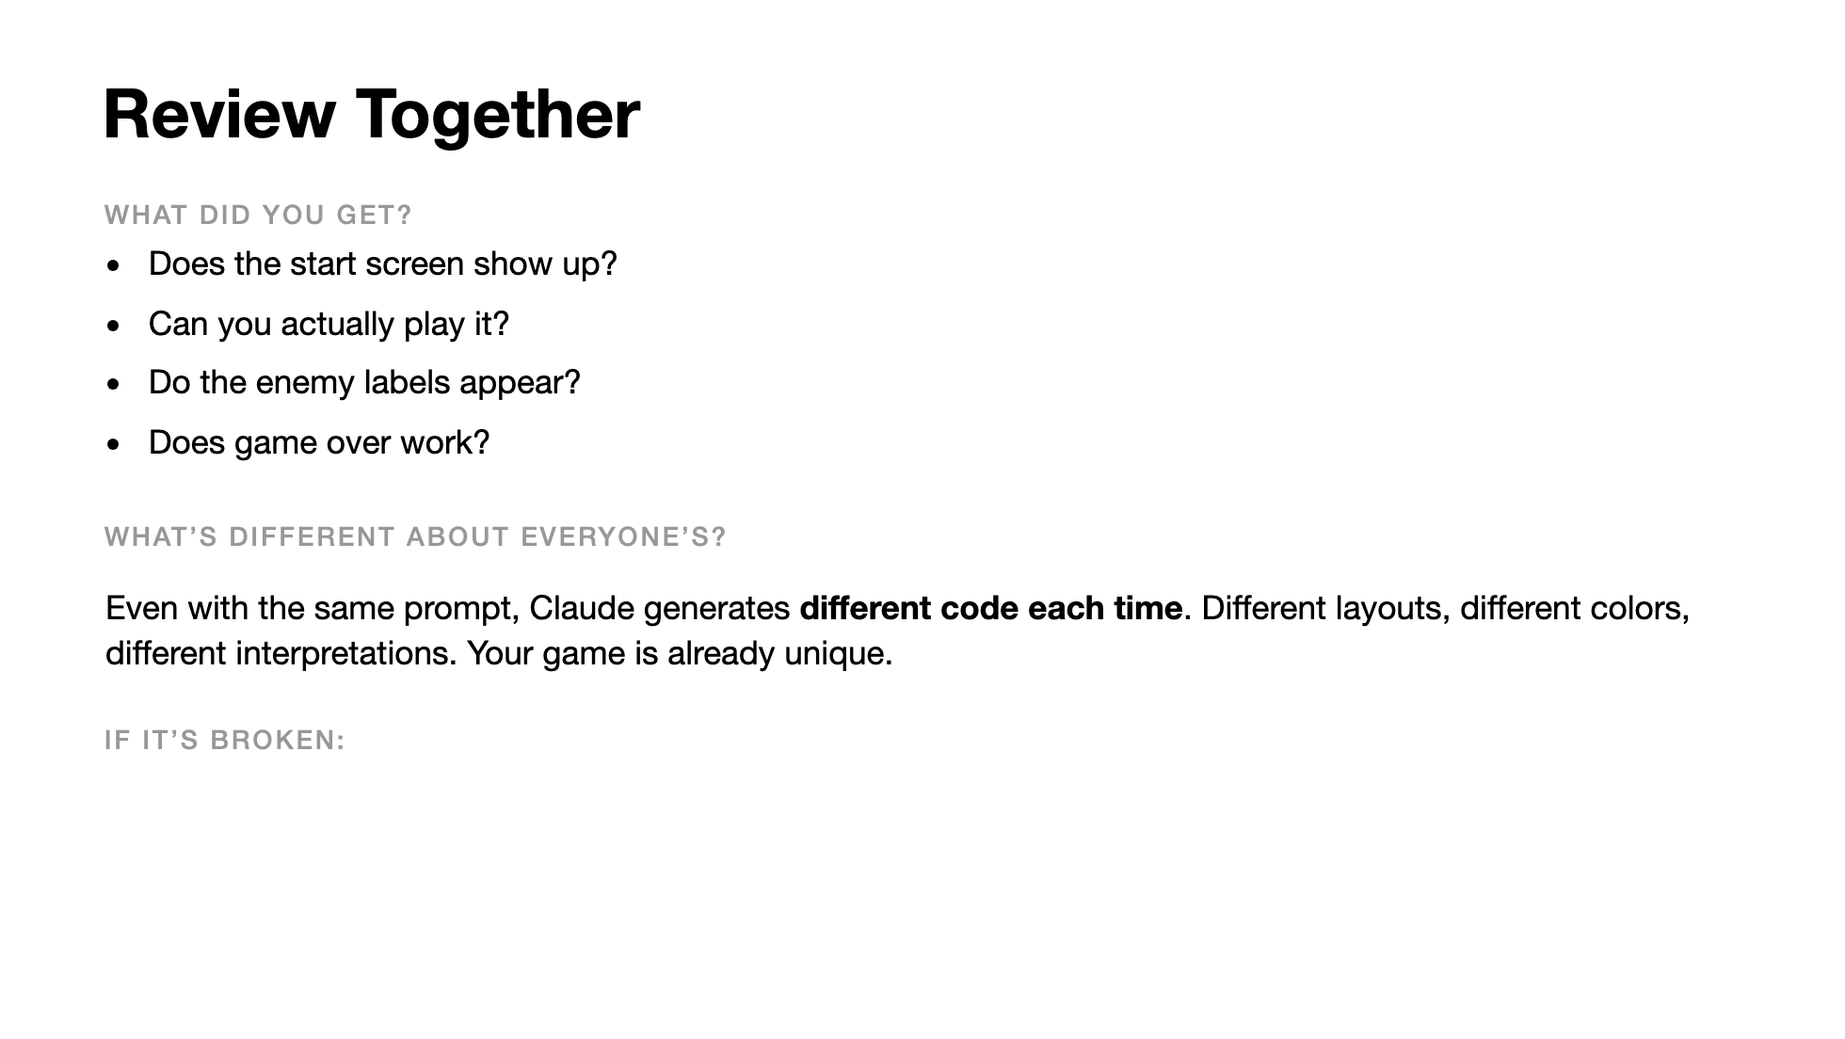
Notes:
Quick group check-in. Show of hands: whose game works? Whose is partially broken? Whose won't load at all? Normalize all of these outcomes. The point isn't that AI gives you perfect code — it's that you now have something to work with. A broken game is closer to a working game than no game at all. If anyone's is completely broken, have them tell Claude: "The game won't load. Here's the error I see in the console." Or just ask Claude to try again.

Slide 36
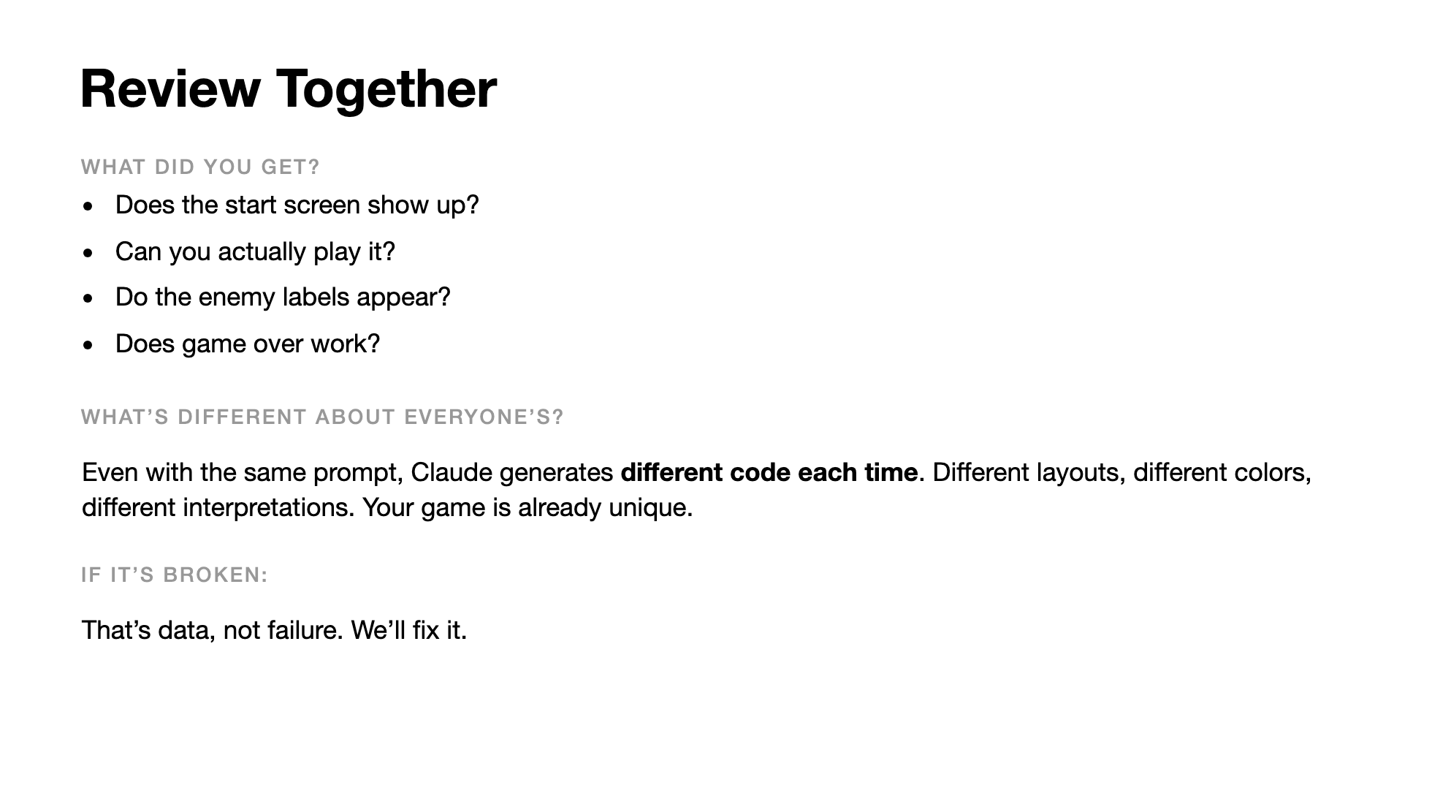
Notes:
Quick group check-in. Show of hands: whose game works? Whose is partially broken? Whose won't load at all? Normalize all of these outcomes. The point isn't that AI gives you perfect code — it's that you now have something to work with. A broken game is closer to a working game than no game at all. If anyone's is completely broken, have them tell Claude: "The game won't load. Here's the error I see in the console." Or just ask Claude to try again.

Slide 37
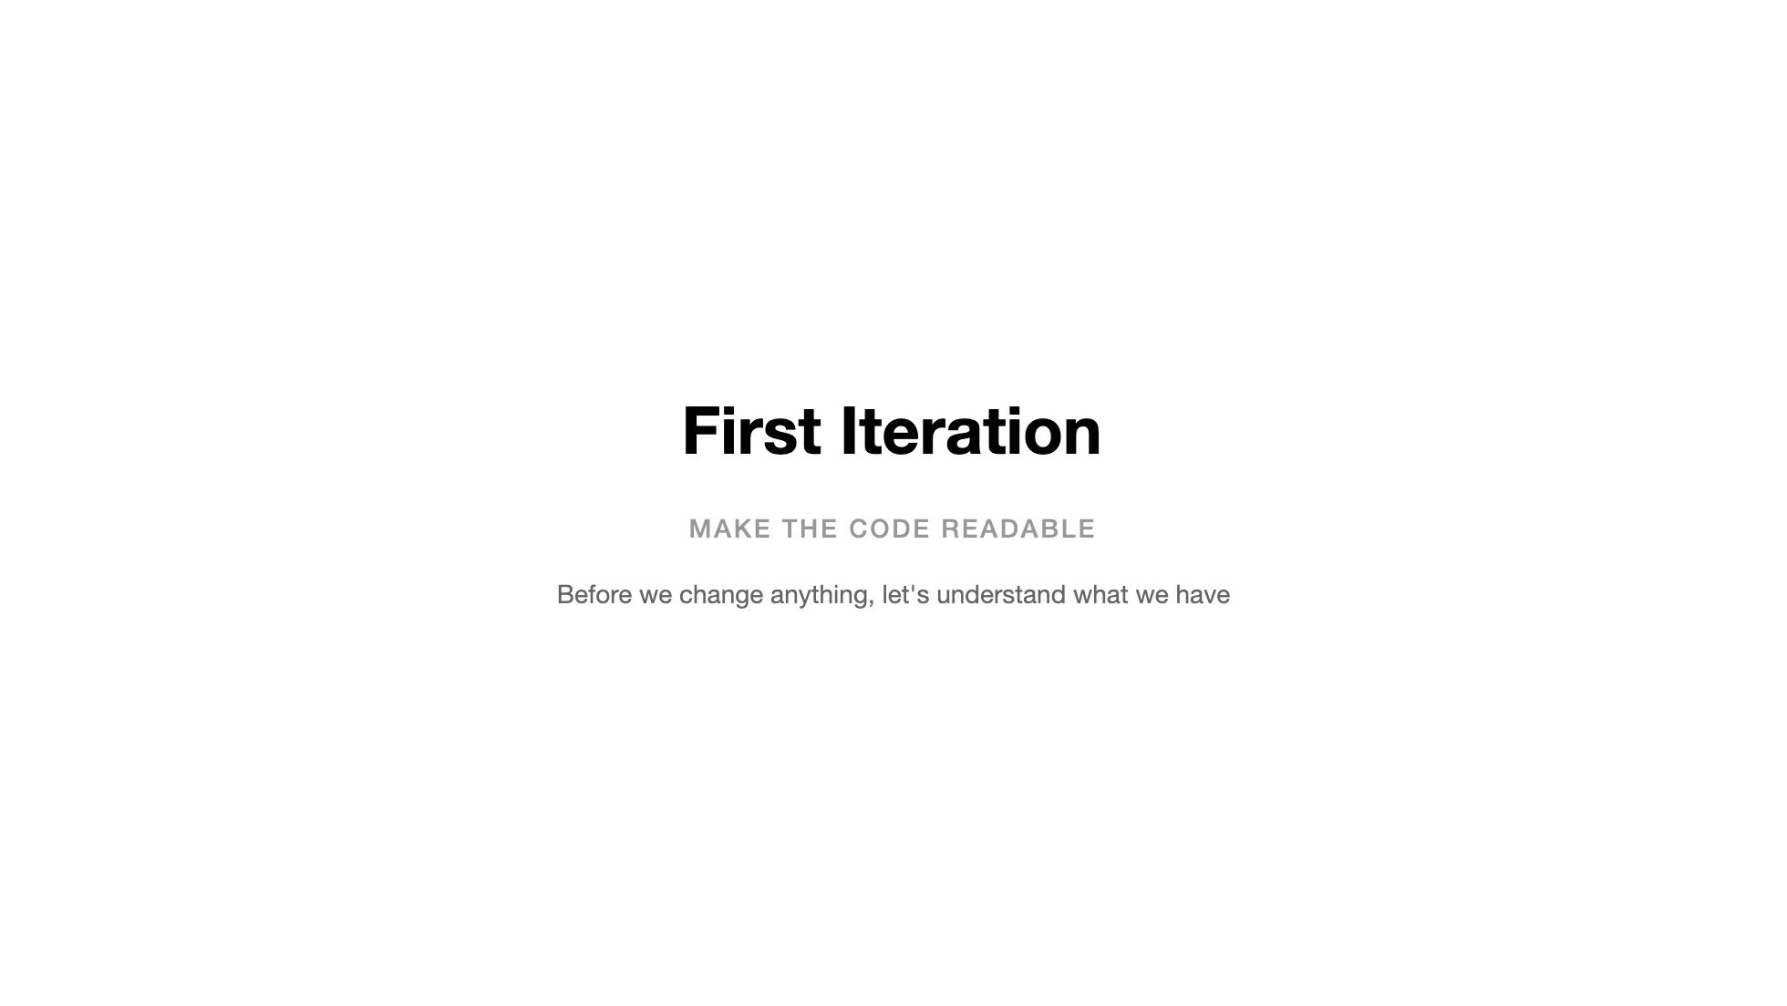

Slide 38
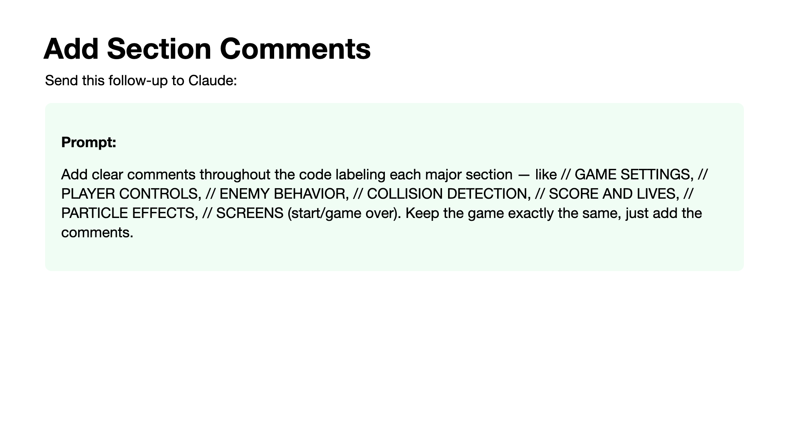
Notes:
This is a deliberately low-risk first iteration. Nothing changes about the game — it just becomes readable. When they paste the new version, they should see the same game in Live Preview but much clearer code in the editor. This sets up the next step: if you can find a section, you can change a value in it. Walk the room and make sure everyone has commented code before moving on.

Slide 39
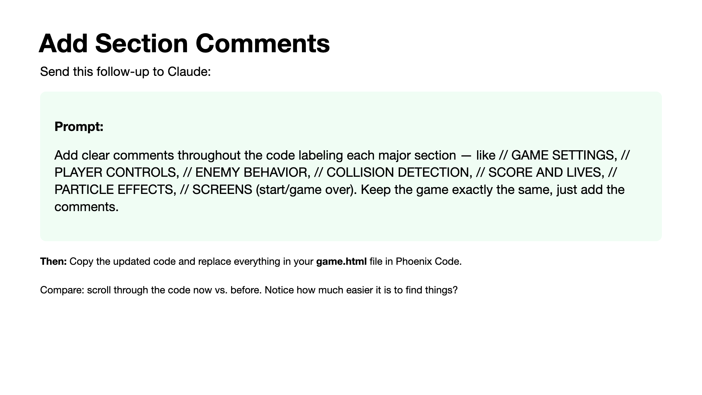
Notes:
This is a deliberately low-risk first iteration. Nothing changes about the game — it just becomes readable. When they paste the new version, they should see the same game in Live Preview but much clearer code in the editor. This sets up the next step: if you can find a section, you can change a value in it. Walk the room and make sure everyone has commented code before moving on.

Slide 40
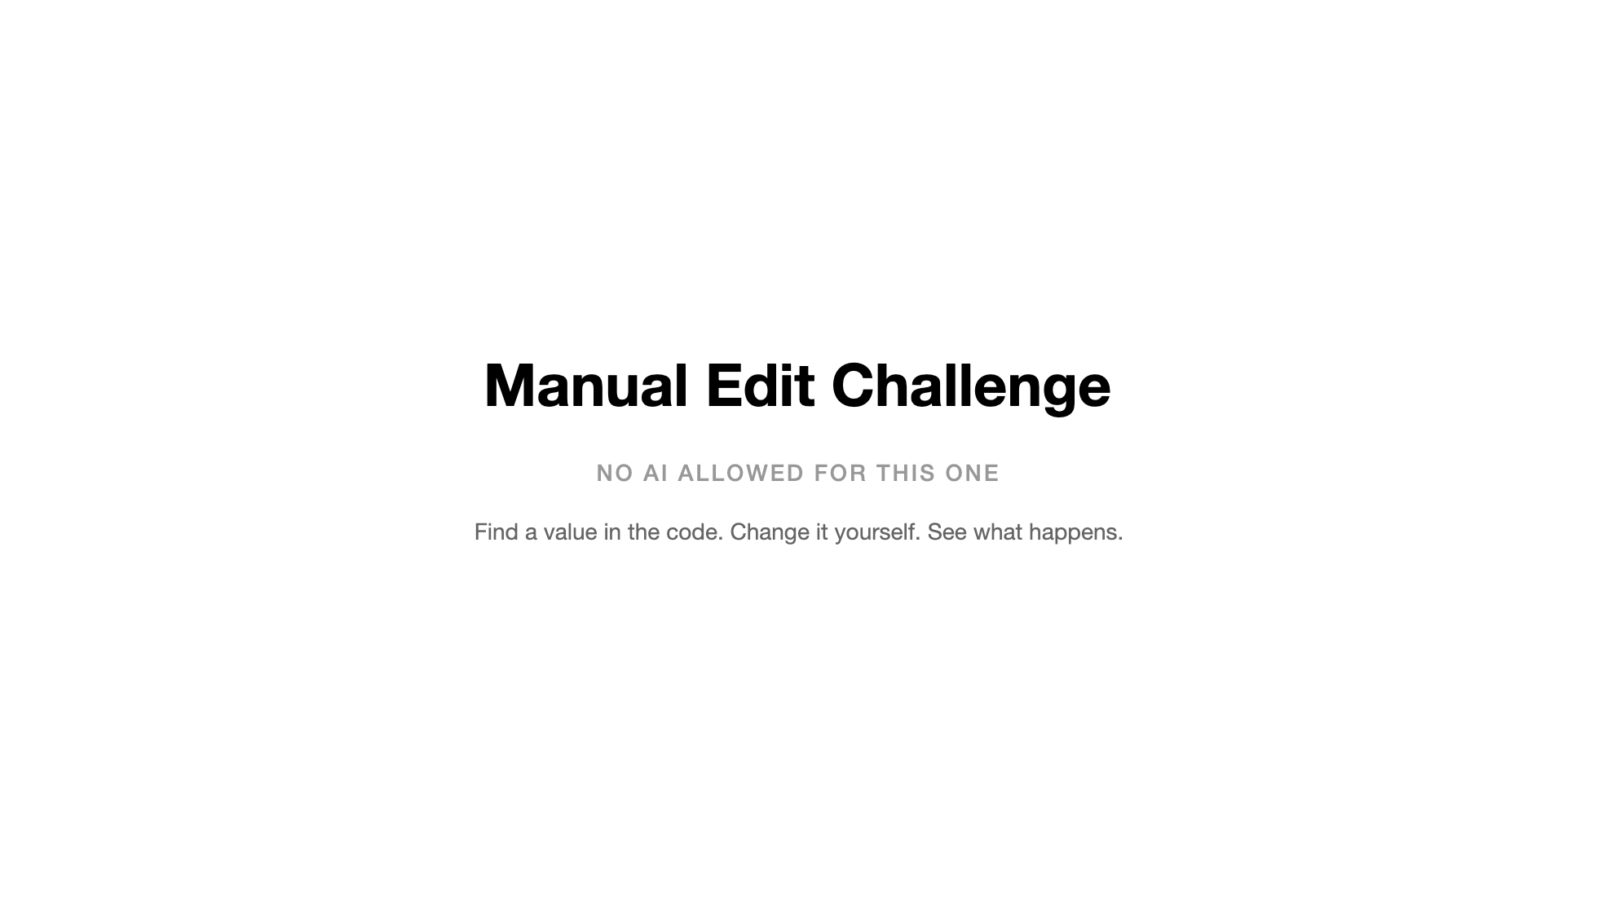

Slide 41
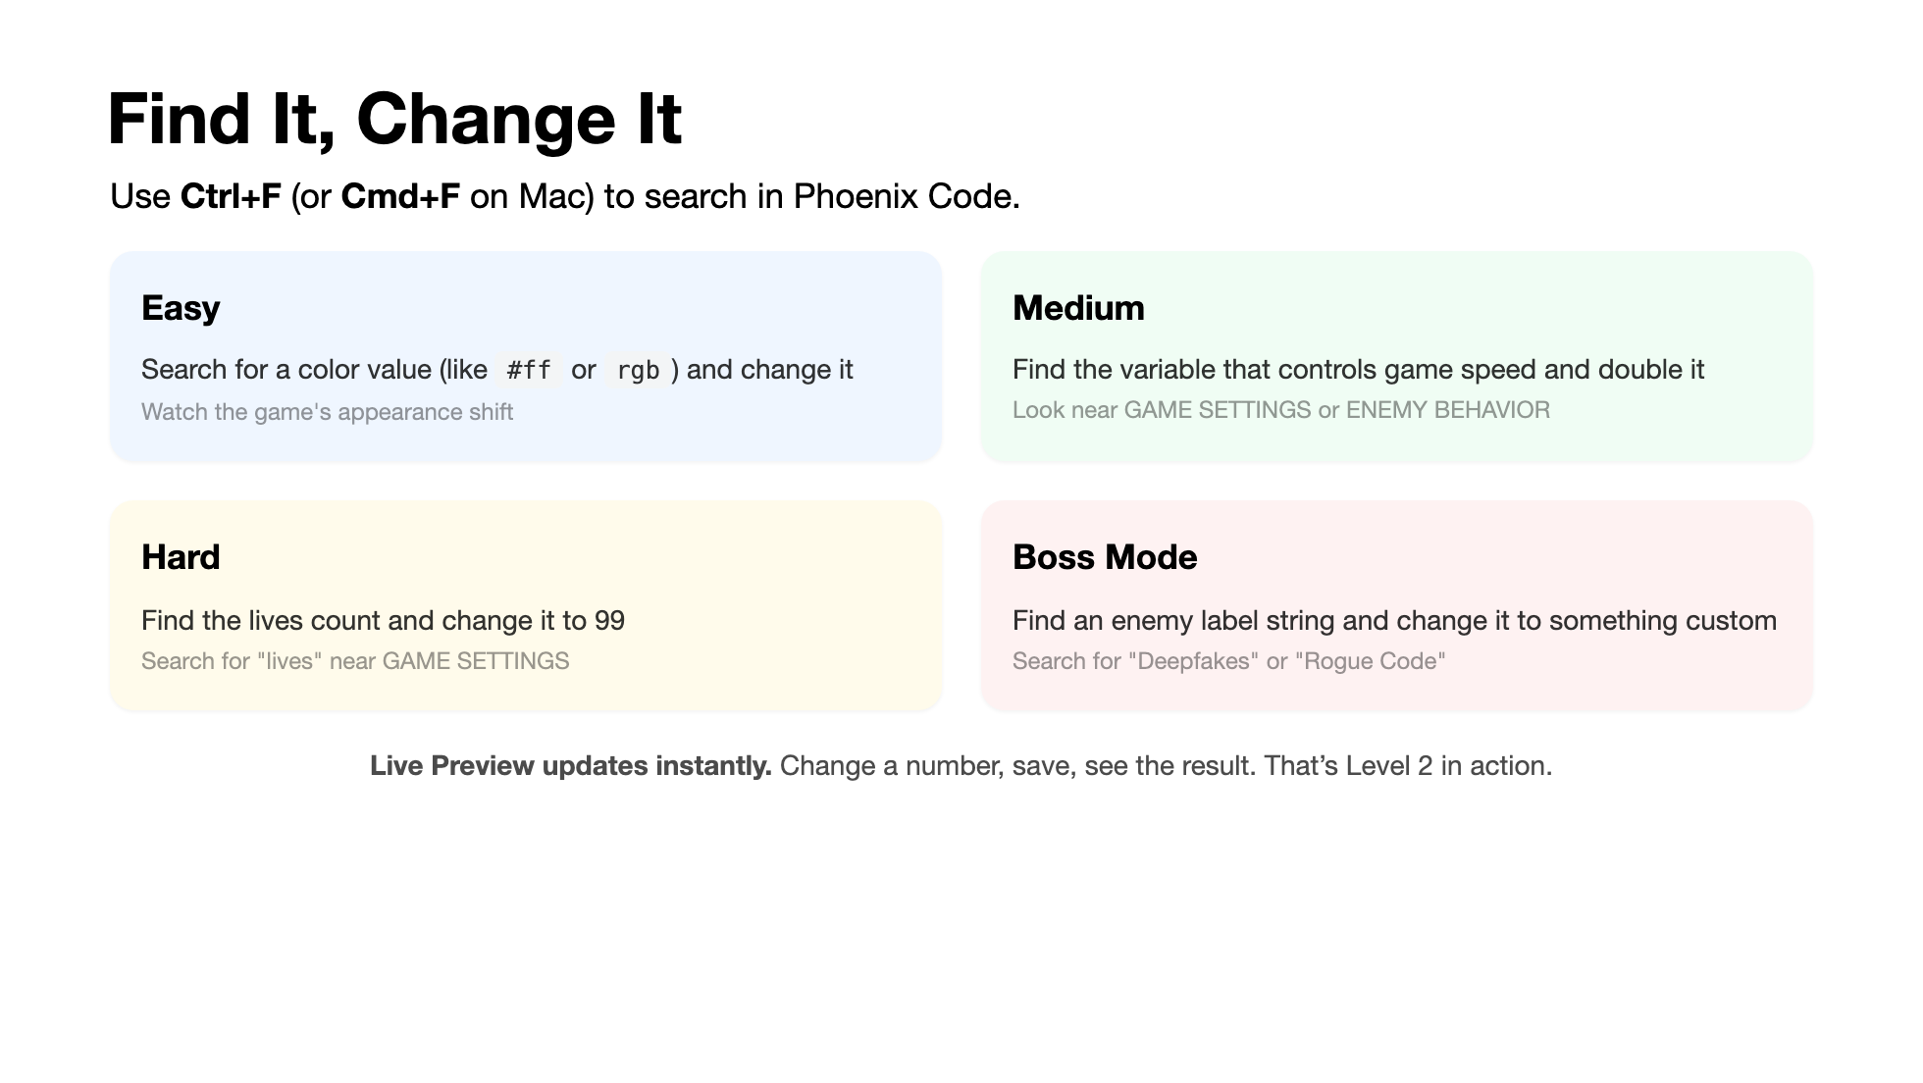
Notes:
This is the key pedagogical moment. They're editing code — real code — by hand. No AI. They searched for a variable, changed a value, and saw the result. That's the bridge between "I can only prompt" and "I can also tinker." Some will change a color and get excited. Some will break something — which is also great, because they can Ctrl+Z to undo. Give them 3-5 minutes here. The section comments from the last step make this possible.

Slide 42


