Slide 1
Performance comparison of MIPv6 and HIP Anukriti Shrimal Simon Curty May 30, 2016

Slide 2
Contents
Introduction
Updates since last presentation
Experimental Setup and Metrics
Evaluation
Result
Conclusion

Slide 3
Introduction
Mobility protocols provide reachability and connectivity to mobile devices.
Objective is to compare performance of two such protocols : MIPv6 and HIP
Performance measured is terms of
Handover Latency.
Rehoming Time.
Performance studied using OMNeT++ and following libraries:
Inet-3.2.4, for MIPv6
Inet-hipsim-v102, for HIP

Slide 4
Updates
Evaluated rehoming time in HIP using multi-homed mobile node.
Mobile node initially is not in range of any access point. This is done to enable auto-configuration of the mobile node.
Re-baselined the two networks and configuration.

Slide 5
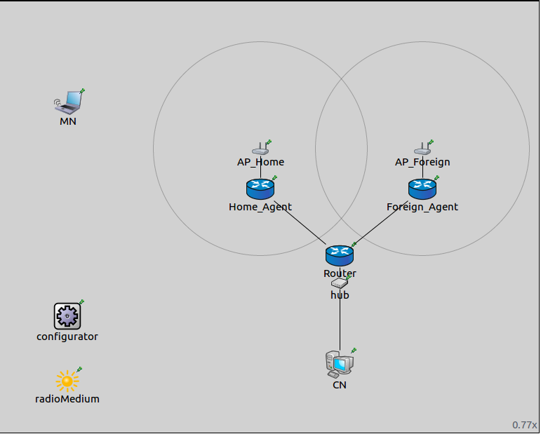
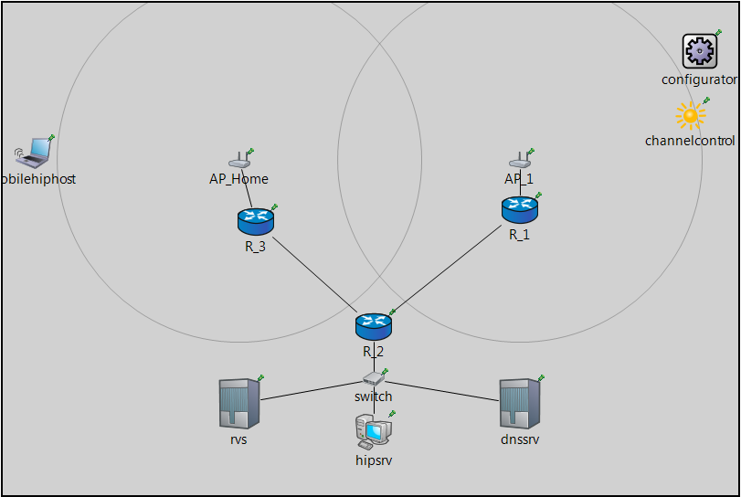
Experimental Setup
Fig 1. MIPv6 network
Fig 2. HIP network

Slide 6
Metrics
Handover latency/Rehoming Time is calculated as follows:
MIPv6:
Elapsed time between the moment of association of the MN with the new access point and the instant MN receives the binding acknowledgement message from the Home Agent, measured in seconds.
HIP:
Elapsed time between the moment of association of the MN with the new access point and the instant CN receives the third UPDATE message from the MN, also measured in seconds.
Evaluated using three speeds :
Pedestrian – 5Km/hr.
In-Town – 40 km/hr
Train speed – 200 km/hr

Slide 7
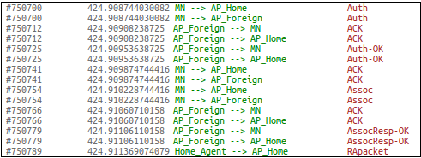
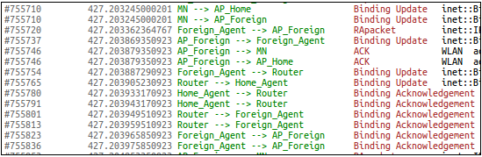
Experimental Evaluation
Fig. Sample MIPv6 output

Slide 8
Experimental Evaluation (Contd..)
Fig. Sample HIP output

Slide 9
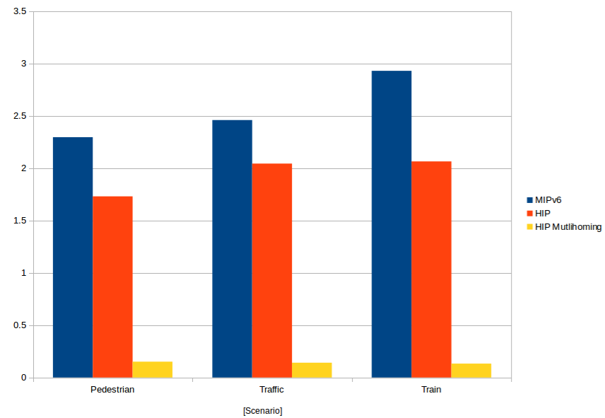
Experiment Results

Slide 10
Conclusion
The HIP protocol has an average handover latency of 1.73 seconds compared to 2.29 seconds for MIPv6.
MIPv6 is slower because it involves more signalling.
However, HIP adds the overhead of new network nodes and added functionality implementation.
As the speed increases, the latency increases.
Rehoming is not available in MIPv6.
Rehoming (as tested in HIP) performs way better because of proactive IPv6 address configuration.

Slide 11
THANK YOU!
Questions?

