Slide 1
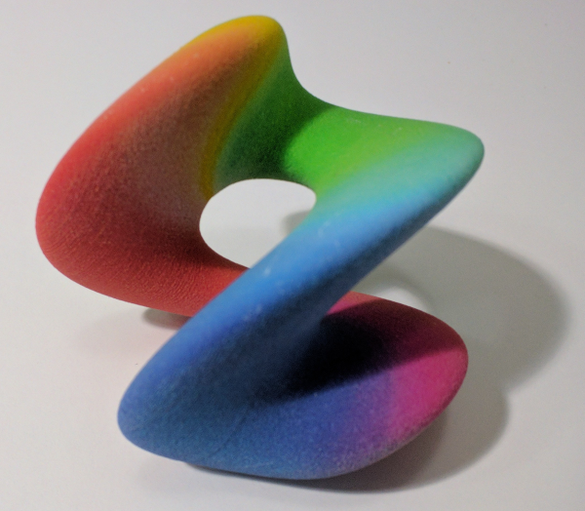
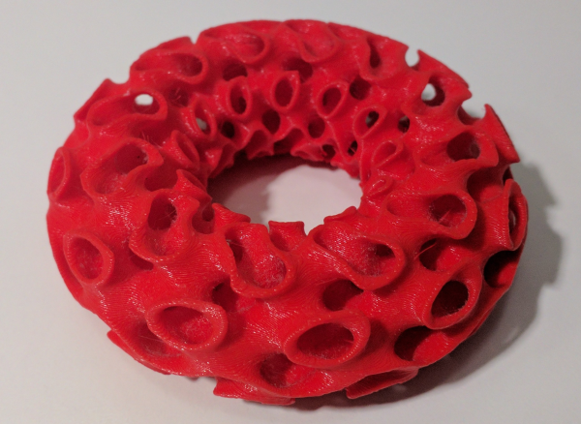
Creative Coding making art on a 3D printer

Slide 2
Curv is...
A domain specific functional language
for 2D and 3D solid modelling.
Live Coding and Generative Art
for artists, designers, 3D printer enthusiasts.
Simple, easy and powerful.
https://github.com/curv3d/curv Apache 2 licence

Slide 3
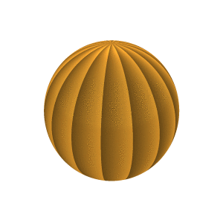
Creative Coding
make_shape {
dist(x,y,z,t) =
let r = mag(x,y,z);
incl = acos(z/r);
a = sin((abs(incl-tau/4)-tau/8)*2);
b = a * sin t;
in r - (2 + b);
colour(x,y,z,t) =
let ph = mod(phase(x,y),tau/16)
/(tau/16);
in sRGB.HSV(.1,.8,ph/2+.5);
bbox = [[-3,-3,-3],[3,3,3]];
is_3d = true;
}

Slide 4
3D-Printed Generative Art
smooth 0.375 .intersection [
gyroid
>> shell .40
>> set_bbox [[-tau*6, -inf, -inf],
[tau*6, 0, inf]]
>> bend {d:0},
torus {major: tau*4, minor: tau*2}
]
>> colour red

Slide 5
Parametric Design
(live demo)

Slide 6
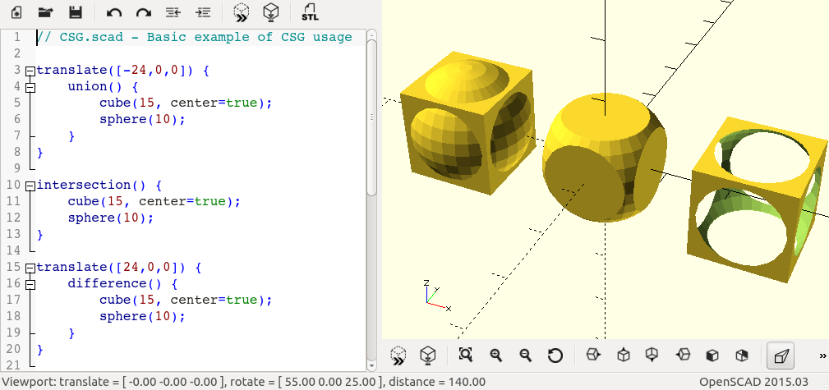
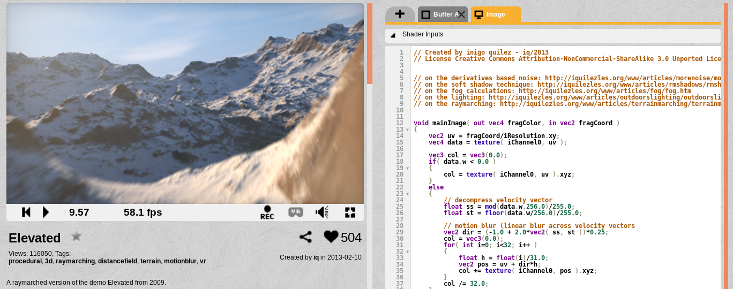
The Curv Project

Slide 7
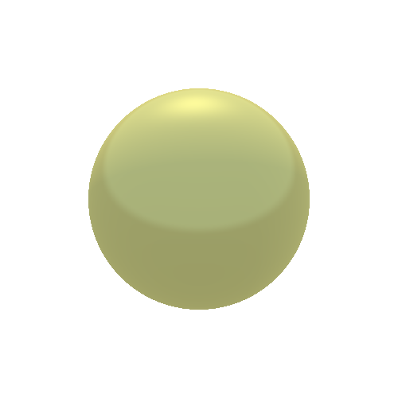
Two Programming Interfaces
sphere r =
make_shape {
dist(x,y,z,t) = mag(x,y,z) - r;
bbox = [[-r,-r,-r],[r,r,r]];
is_3d = true;
};
sphere 1

Slide 8
Transforming a Shape
(live demo)

Slide 9
How Curv Works
Function representation of shapes:
  Distance function: signed distance field
  Colour function: colour field
A powerful representation:
  Resolution independent: infinite detail, deep zooms
  Compact (size doesn’t increase with resolution)
  Generalizes to support advanced 3D printing
Direct GPU execution of function rep

Slide 10
The Future
Doug: Make it more powerful.
Sebastien: Make it easier and more accessible (CurvEd project).

Slide 11
More Power!
Construct any kind of 3D model, using a wider range of modelling techniques.
Import 2D image files, 3D voxel grids & triangle meshes.
Support advanced 3D printing (eg, Stratasys J750).
Construct any kind of procedural, animated 3D art (my users).
  Beautiful 3D rendering: lighting, shadows, materials, camera control.
  Duplicate anything on shadertoy.com.
  Why not ray-tracing as well?

Slide 12
Making Curv More Powerful
Core language: more expressive and powerful.
An expanded set of shape primitives, implemented by a set of libraries.
Some F-Reps are too slow, therefore:
  A more general representation of shapes: both function representation and data structure representations of signed distance fields.
  A high performance GPU rendering system based on a pipeline of shaders, rather than on a single shader.

Slide 13
Ease and Accessibility
Web UI. No need to install an app.
Web community: share your projects with other users.
Progressive disclosure UI, from easy to powerful.
  Browse through a collection of examples.
  Select an example. Use sliders to customize it. Export STL file.
  Open source code for the example. Clone the example and modify the source.
  Create a new project, create source code from scratch.
Graphical editing of source code

Slide 14
CurvEd project plan
V1: Text-based IDE with interactive value manipulation (ie. Shadertoy)
V1.5: Weave code, documentation and parameter controls into a "sketch"
V2: Replace the text editor with a structural editor (uncharted territory)
V2.5: Add control point support in the rendering view for interactive manipulation
V3: (me) Diagram-based representation of source code

Slide 15
Engine Support for CurvEd
For the web UI:
web assembly port
incremental compiler (eg, Language Server Protocol)
For the web community:
Package manager, packages referenced using URLs.
Distributed/decentralized web community? IPFS or DAT?

Slide 16
How to Get Involved
Processing.org
OpenSCAD.org
MandelBulber.org and Fractal Forums
The Demoscene; ShaderToy.com
Curv3D.org and github.com/Curv3D

