Slide 1
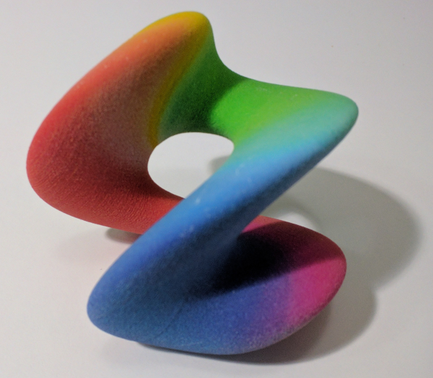
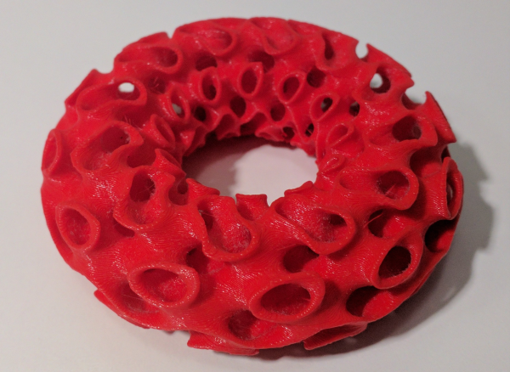
Creative Coding making art on a 3D printer

Slide 2
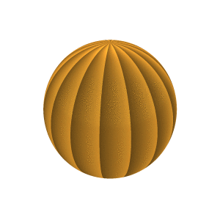
Creative Coding
make_shape {
dist(x,y,z,t) =
let r = mag(x,y,z);
incl = acos(z/r);
a = sin((abs(incl-tau/4)-tau/8)*2);
b = a * sin t;
in r - (2 + b);
colour(x,y,z,t) =
let ph = mod(phase(x,y),tau/16)
/(tau/16);
in sRGB.HSV(.1,.8,ph/2+.5);
bbox = [[-3,-3,-3],[3,3,3]];
is_3d = true;
}

Slide 3
3D-Printed Generative Art
smooth 0.375 .intersection [
gyroid
>> shell .40
>> set_bbox [[-tau*6, -inf, -inf],
[tau*6, 0, inf]]
>> bend {d:0},
torus {major: tau*4, minor: tau*2}
]
>> colour red

Slide 4
Parametric Design

Slide 5
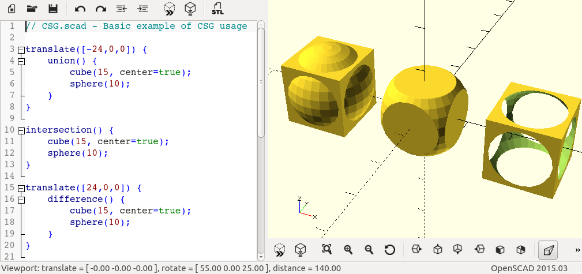
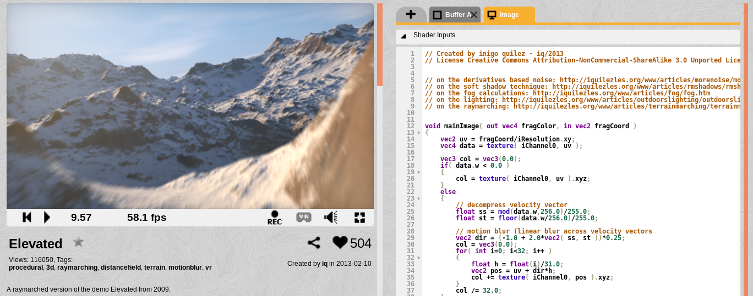
The Curv Project

Slide 6
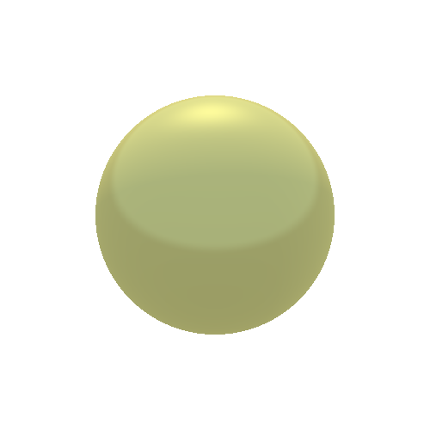
Two Programming Interfaces
sphere r =
make_shape {
dist(x,y,z,t) = mag(x,y,z) - r;
bbox = [[-r,-r,-r],[r,r,r]];
is_3d = true;
};
sphere 1

Slide 7
Transforming a Shape
(live demo)

Slide 8
How Curv Works
Function representation of shapes:
  Distance function: signed distance field
  Colour function: colour field
A powerful representation:
  Resolution independent: infinite detail, deep zooms
  Compact (size doesn’t increase with resolution)
  Generalizes to support advanced 3D printing
Direct GPU execution of function rep

Slide 9
How to Get Involved
Processing.org
OpenSCAD.org
MandelBulber.org and Fractal Forums
The Demoscene; ShaderToy.com
Curv3D.org and github.com/Curv3D

