Slide 1
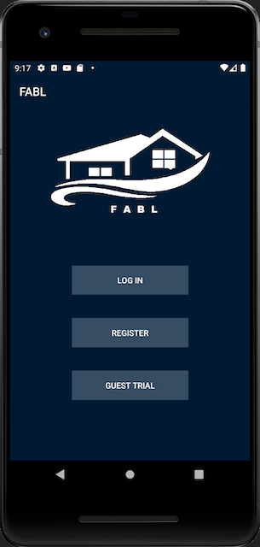

FABL Short Stay Accommodation
Group 3 members |
Faezah Shafeee (u6724278)
Alan Kantserov (u6481257)
Ben Cusack* (u4022214)
Long Vu (u6699146)
*presenter(s)

Slide 2

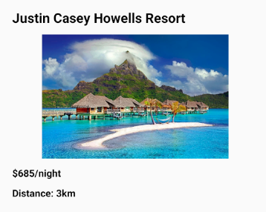
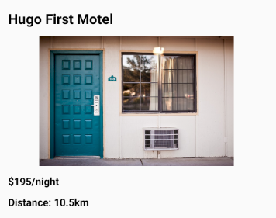
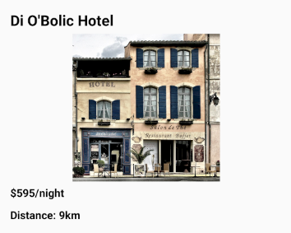
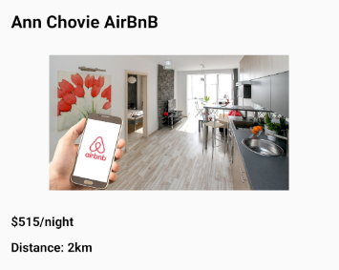
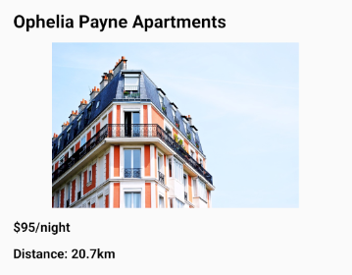
Need a place to stay in Canberra?
1/3
Notes:
Are you having a big night out with friends and want a place to crash? Would you like to host an awesome party in the city? Would you like to pamper your partner with a romantic retreat? Then FABL is the app for you! Whether hotel, motel, resort, serviced apartment or AirBnB, FABL will help you quickly and easily find the perfect place for you and your friends to stay.

Slide 3
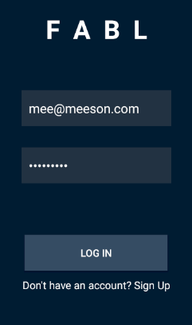
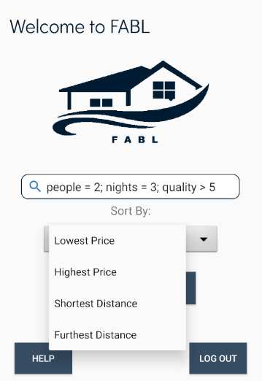
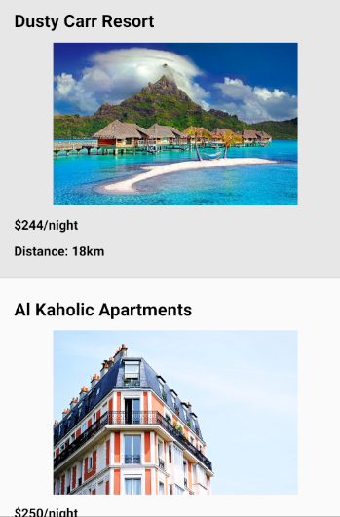
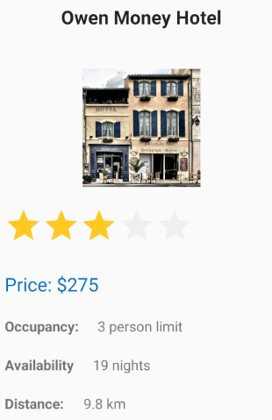
Slide 2
Features
TEMPLATE (DO NOT CHANGE THIS SLIDE)
2/3
Notes:
Sign in with Firebase, or as a Guest.
FABL loads all the nearby JSON listings,
while you type in how many people need a place for how many nights.
Two binary search trees help you find the cheapest, or closest places in just milliseconds,
Or get away to the furthest and spoil yourself with the most expensive!
And if you get stuck, the help pages are right at your fingertips!

Slide 4
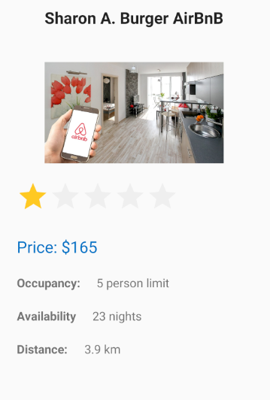
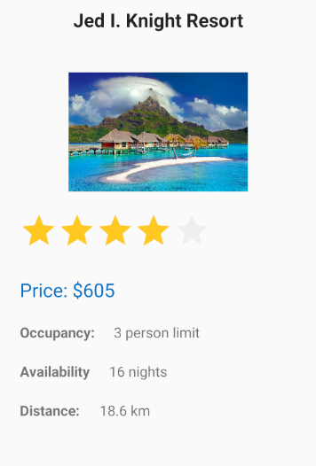
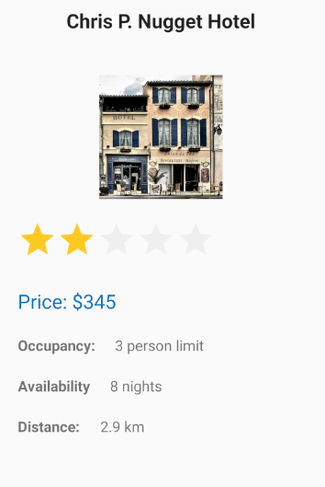
Download FABL today! It's FABULOUS!
Testimonials
3/3
Notes:
Long - "I used FABL. It's so quick and easy! 4 of us were partying late at the city, and we booked an AirBnB right nearby"
Faezah - "FABL helped me find the perfect spa retreat for a weekend away with my partner!"
Alan - "When we visited Canberra, FABL helped us find an affordable hotel near all the monuments!"
Ben - Download the FABL app today, for your next getaway!
Everyone together – IT'S FABULOUS!

