Slide 1
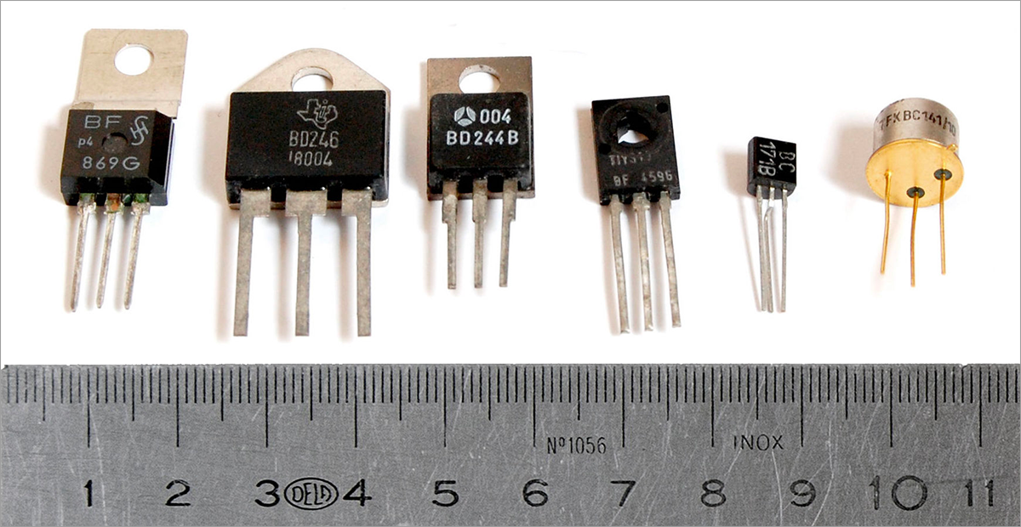
Transistors
CONTENTS
Characteristics - why do they exist and what do they do?
Structure – how do they work?
Applications - what do we use them for?
For a non-technical audience
PW1 Group 2

Slide 2

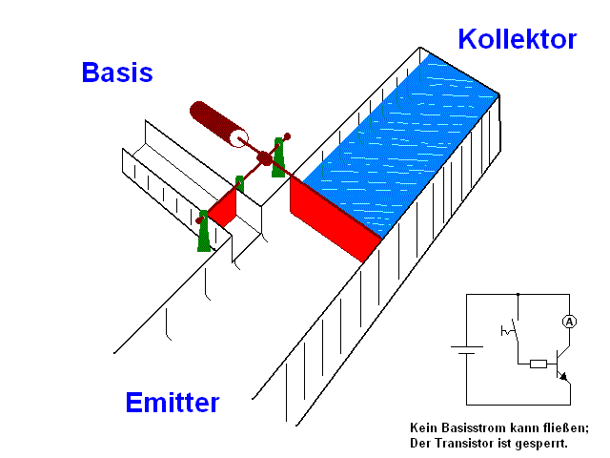
Transistor Characteristics
3 terminal device
Allows small signals to control big ones – works as an amplifier
Miniature switch – can let us easily control signals
This animation here shows how it can work as either

Slide 3

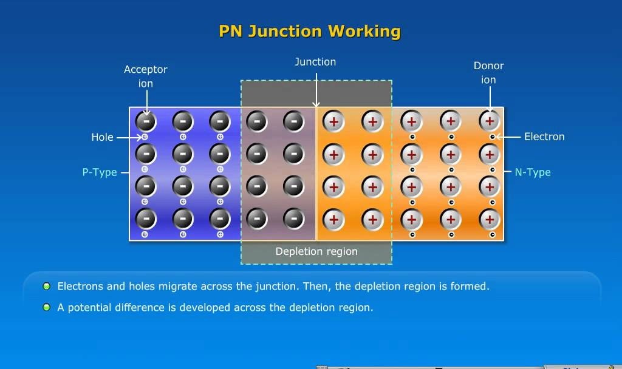
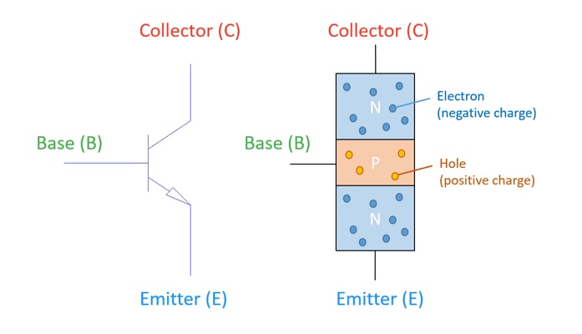
Basic principles
PN junctions are the basic building block of a transistor – they let us set up a potential difference across a semiconductor.
By putting several of these together, we can make transistor
Applying charge to the middle allows charge to flow through the whole thing

Slide 4
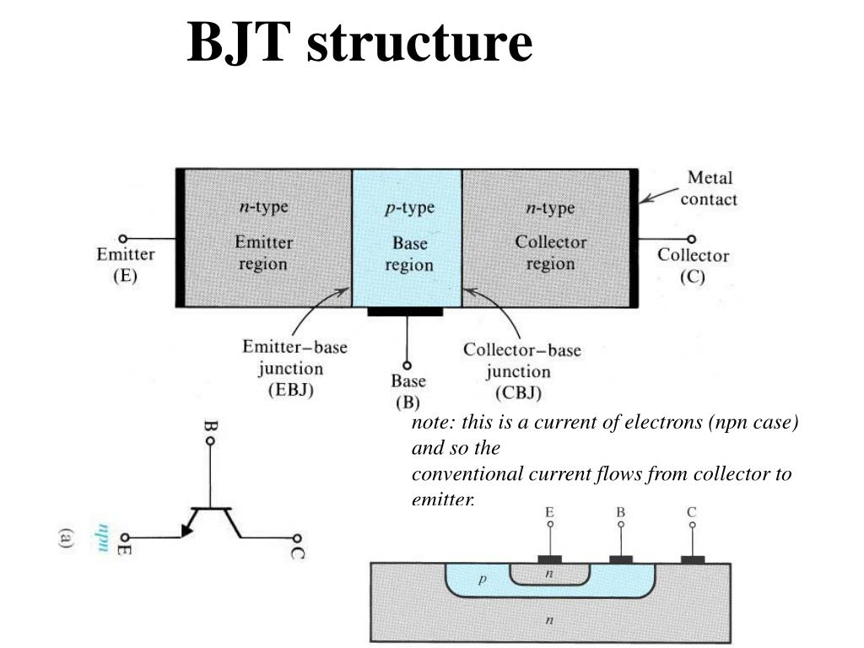
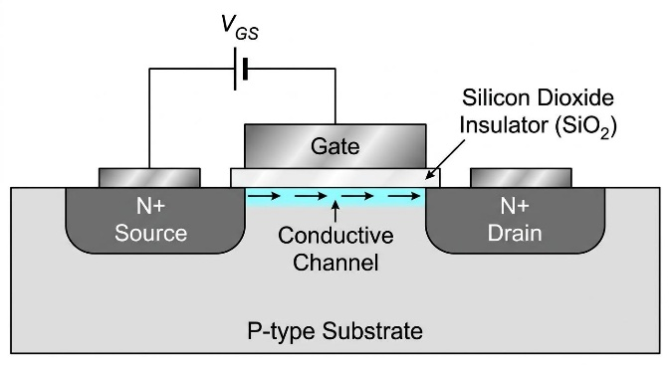
BJT & MOSFET
Bipolar Junction transistor
Sandwich of junctions
Stimulate the middle to allow charge to flow from top to bottom
Mainly used to amplify weak signals or switch on/off high currents
Current controlled
Metal Oxide Semiconductor Field Effect Transistor
A charged metal strip oxidises an insulator and semiconductor layer below
Charge the strip to allow a current to flow between the two sides
Mainly used in high frequency signals or power control
Voltage controlled

Slide 5
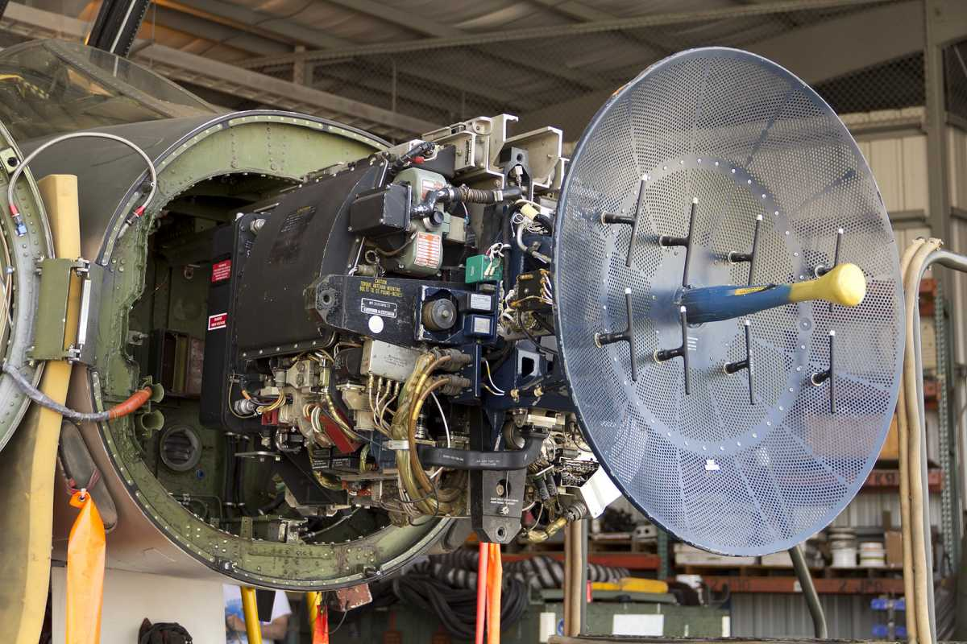
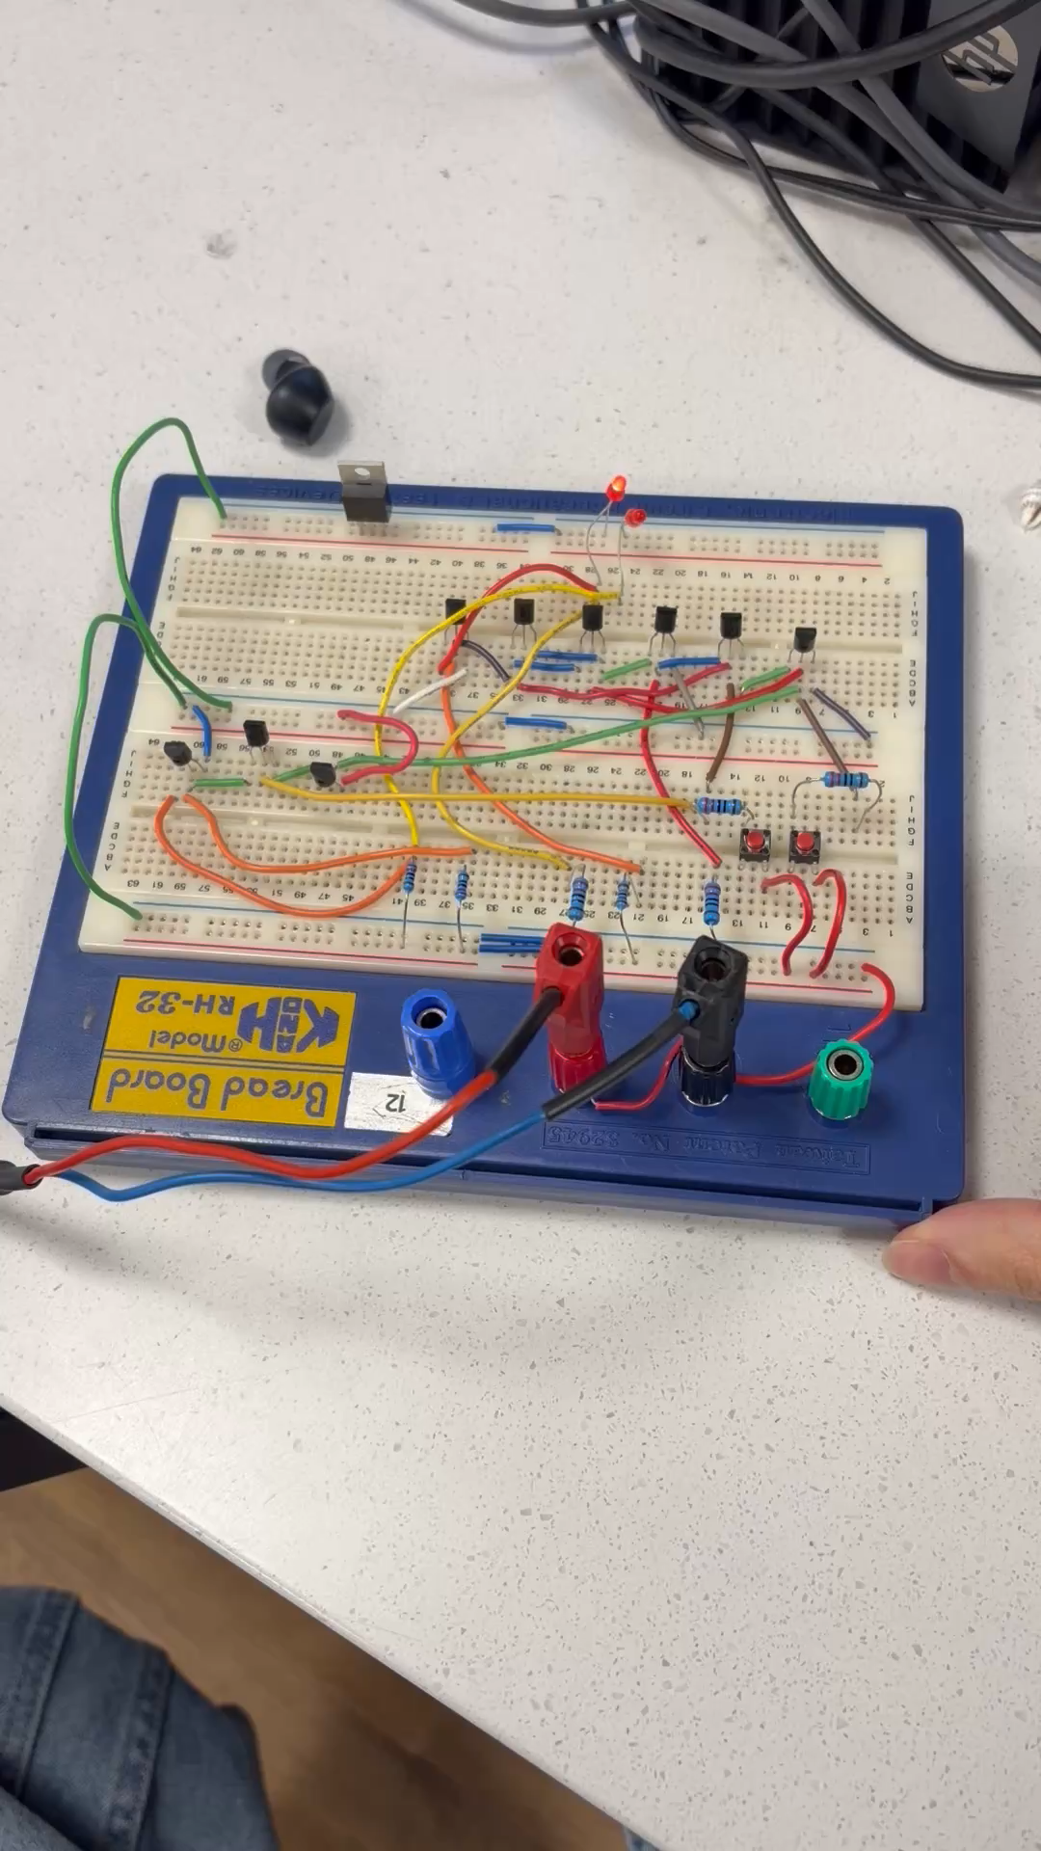
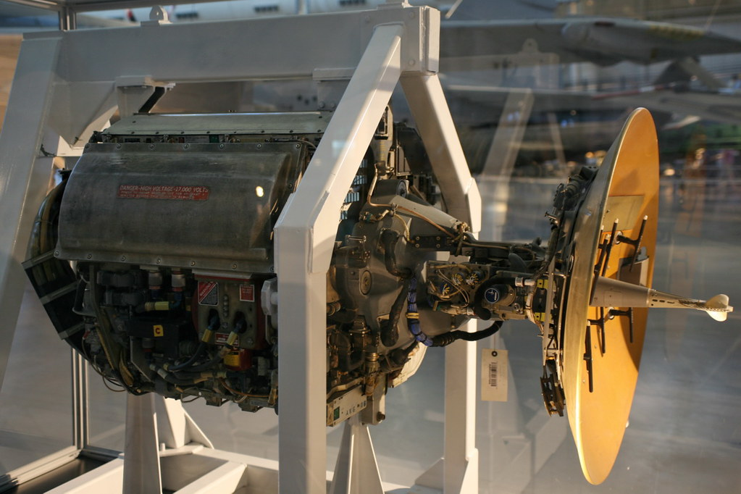
Applications
A valve based (top) vs transistor based radar (bottom). The transistor radar can track a similar sized object at up to twice the range for the same size
The half adder below combines a transistor based AND and XOR gate

