Slide 1
Changing Software Engineering
Peter Grogono
    Department of Computer Science
    Concordia University
Notes:
CUSEC is a \bd{student} conference. Its success is due to the hard work of many students, including:
John Kopanas,
Chae Dickie-Clark,
Madeline Taing,
Marc Abbyad,
Chadi Freiha,
Jason Essebag,
Jacinthe Gagnon.
My name is on the organizer's page of the website but I just sat in on meetings and made sure nothing went seriously off course.

Slide 2
Software Engineering is changing

Slide 3
Making changes to
Software Engineering

Slide 4
The Engineering of changing Software

Slide 5
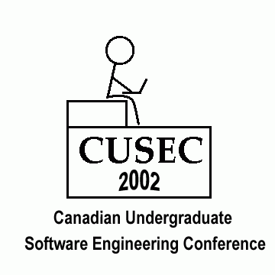

Slide 6
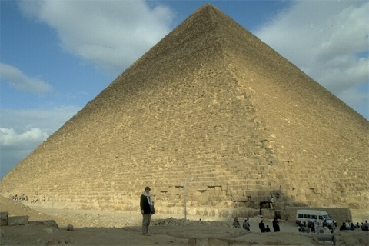

Slide 7


Slide 8


Slide 9


Slide 10


Slide 11


Slide 12
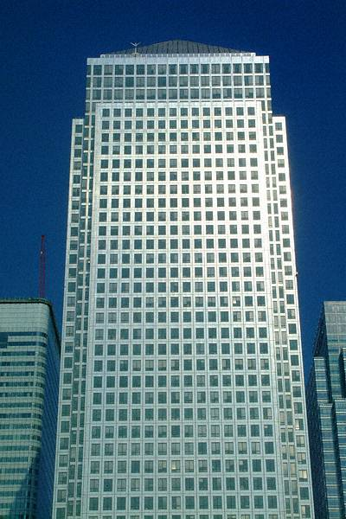

Slide 13
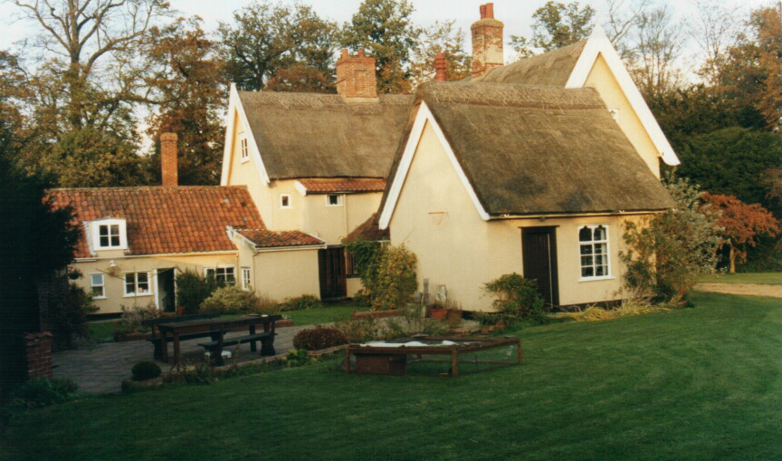

Slide 14
If builders built buildings the
way programmers wrote
programs, then the first
woodpecker that came along
would destroy civilization.
Jerry Weinberg

Slide 15
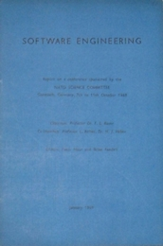
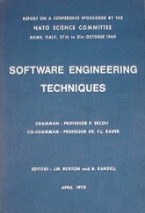

Slide 16
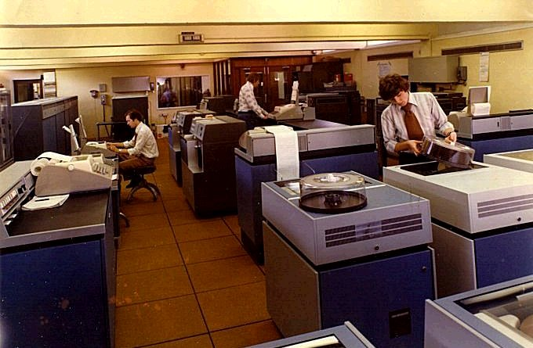

Slide 17
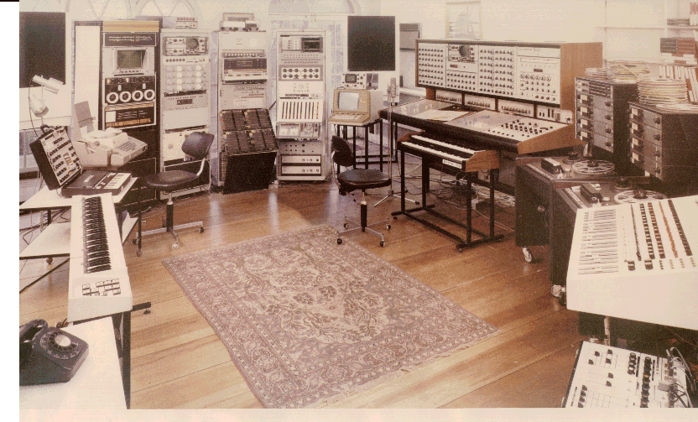

Slide 18
Paradigm shifts
Structured design
Abstract data types
Information hiding
Object oriented design
Aspect oriented design
Learner centered design

Slide 19
Programming languages
COBOL
FORTRAN
C
Pascal
C++
Java
C#

Slide 20
But, as we look to the horizon of a
decade hence, we see no silver bullet.
Fred Brooks

Slide 21
I find myself more and more exasperated
with great inflexible sets of rules that many
companies try to pour into concrete and
sanctify as rules. The idea that a single
method should govern even two different
projects is highly suspect: the differences
between projects are much more important
than the similarities.
Tom DeMarco

Slide 22
Progress 1995 - 2000
Cancelled | 31% | 23%
Challenged | 53% | 49%
Successful | 23% | 16%
Overrun | 12% | 2.5%
Cost of failure | $81 billion | $75 billion
Cost overrun | $59 billion | $22 billion

Slide 23
void qsort
(
char *base,
unsigned count,
int size,
int (*compar)
(void *px, void *py)
);

Slide 24
template<
typename RandomAccessiterator,
typename Compare>
void sort(
RandomAccessIterator first,
RandomAccessIterator last,
Compare comp );

Slide 25
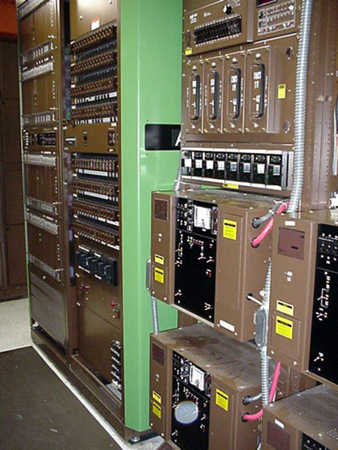

Slide 26
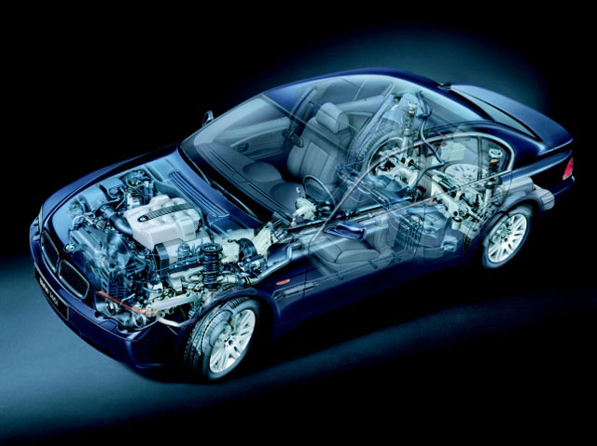

Slide 27
BMW Series 7 has 65 microprocessors
One for each headlight
One for each airbag
One for the rear-view mirror
Transmission talks to mirrors
ABS talks to the radio
GPS talks to the cell phone

Slide 28
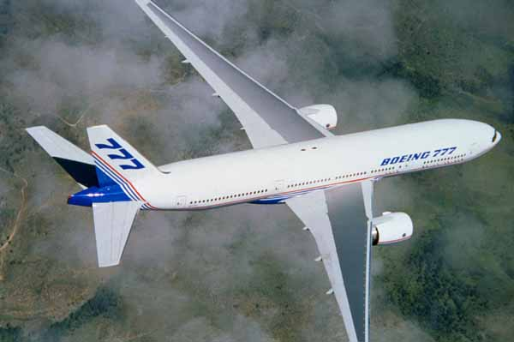

Slide 29
BMW hires automotive engineers and teaches them to program
Boeing hires aeronautical engineers and teaches them to program
Software engineers must learn to speak the jargon

Slide 30


Slide 31
Software Engineers

Slide 32


Slide 33
What Software Engineers have to do:
Learn to talk to other engineers
Be familiar with lots of tools and techniques
Know how to choose the best tools
Be prepared to learn local practices
Stop being scared by mathematics
Accept professional responsibilities

Slide 34
What Software Engineering educators have to do:
Identify basic principles
Relate principles to practice
Be active researchers
Be leaders, not followers
Keep improving the curriculum
Insist on high standards

Slide 35
Training = how to use a tool
Education = how to choose the best tool

Slide 36
What Software Engineering researchers have to do:
Empirical research: find out what works, what doesn’t work, and why
Theoretical research: discover the basic principles that underlie software engineering
Stop selling snake oil

Slide 37
But, in our enthusiasm, we could not
resist carrying out a complete overhaul
of the system, during which
weaknesses were exposed, analyzed,
and replaced with new weaknesses.
Bruce Leverett

Slide 38
Logic, like whiskey, loses its
beneficial effect when taken in too
large quantities.
Lord Dunsany (1878-1957)

Slide 39
You are not here to worship what is
known, but to question it.
Nancy Leveson

Slide 40
Rules are my very humble,
obedient servants.
Josef Haydn (1732-1809)

Slide 41
