Slide 1
Usability Pattern-Oriented Design:
Maximizing Reusability of Pattern Languages over the Web
Homa Javahery
Human-Centered Software Engineering Group
Faculty of Engineering and Computer Science
Concordia University

Slide 2
Outline
General Overview
  Patterns as a Design Solution
  Usability Pattern Examples
  Pattern Languages
Research at Concordia University
  MOUDIL
  UPADE Environment

Slide 3
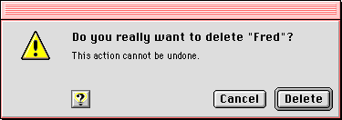
Tools for Gathering and Disseminating Design Knowledge
Aim to capture best practices about the design of usable systems
Most used tools: guidelines and patterns
Guideline Example: Dialog boxes from the Macintosh Human Interface Guidelines
  4 types
  Eg. Alert boxes
Notes:
These tools aim to capture the best practices about the design of usable systems and to disseminate (distribute) this knowledge
Examples of such tools include various databases and repositories of information; the most popular by far are guidelines and patterns – we will therefore discuss these
Guidelines: come as a package of “small rules” which aim to capture design knowledge about the successful design of usable systems
these rules can then be applied to the design of new user interfaces
important for both novice and experienced designers
Example:
Dialog box design from The Macintosh Human Interface Guidelines
Four types of dialog boxes
Alert boxes (a type of modal dialog box) -- useful for communicating error conditions or preventing any other activity until the user responds to the error conditions

Slide 4
Disadvantages of Guidelines
Numerous and difficult to select appropriate guideline for particular design problem
Difficult to apply, especially for novice designers
Guidelines contradict each other at times
Notes:
Usually guidelines are numerous, and therefore it is difficult to select the appropriate guideline to apply to the design problem in question
According to Tidwell, it was hard for a novice designer to remember all the guidelines, let alone apply them effectively
At times, guidelines contradict each other. One guideline may indicate one approach, while another guideline indicates another approach. Consequently, the designer may not solve the design problem
When a number of principles come into conflict, the designer has to figure out the best solution be guessing or resorting to other methods.
Software tools can help to work with guidelines, but they do not address the core problems of guidelines as just discussed…and that brings us to our next slide….

Slide 5
Patterns as Alternative
Design Tool
A pattern is a proven solution to a common problem in a specified context
Good alternative to guidelines -- concrete, easier to use
Focus on context
Tells the designer when, how & why
Notes:
The emergence of Patterns…
Why Patterns as an Alternative Design Tool?
Formal Definition: A pattern is a proven solution to a common problem in a specified context
Patterns are a good alternative to design guidelines -- more concrete and easier to use for novice designers
explicitly focus on context -- as we saw with our dialog box example, guidelines are quite ABSTRACT. Patterns are more structured and the knowledge is put in a CONTEXT.
tell the designer WHEN, HOW and WHY the solution can be applied -- since it is context-oriented, the solution is related to a specific activity
Therefore, we can say that Patterns are accessed via their context, unlike Guidelines

Slide 6
Software Engineering
Patterns Mania
Organization
People
Pedagogical Patterns (Manns, 1996)
Human-to-Human Communication Patterns (Cockburn, 1997)
Organizational Patterns (Coplien, 1998, Cockburn, 1997)
Business Reengineering Patterns (Beedle, 1997)
Product
HCI Patterns (Tidwell, 1998)
Software Design Patterns (Gamma, 1995)
Process
Steps and Task Patterns (Ambler, 1998; Coplien, 1995)
Process Improvement Patterns (Appleton, 1997)
Notes:
Patterns have been popularized by the software engineering community:
Erich Gamma, Richard Helms, Ralph Johnson and John Vlissides. Design Patterns: Elements of Reusable Object-Oriented Software, Addison-Wesley, 1995.
Product, process, organizational
Design, implementation, testing, requirements steps, etc.
Management, communication, promotion, marketing, etc

Slide 7
Example 1: Go Back to a Safe Place
Problem
Users often get lost when exploring
Users often want to go back to previous state they were happy with
Users more likely to explore if they feel safe
Backtracking out of a long navigation path can be tedious
Solution
Provide a way to go back to a checkpoint of the user’s choice

Slide 8
Example 1: Pattern Definition
Pattern Name: Go back to a safe place
Pattern Description:
  Specific example → Home button
  Context → move through steps **
  Problem → how to make navigation easy
  Forces → users get lost, etc.
  Solution → go back to checkpoint
Notes:
Examples: description: both good and bad examples of the uses of the pattern
this case: the “Home” button on a browser is a good example
Context: ** we are told WHEN to use the pattern
description: context of use that problem designer needs to solve
this case: allows the user to move through spaces or steps
Problem: this case: how to make navigation easy, convenient and psychologically safe
Forces: description: a set of forces pushing the designer in different directions
this case: Users often get lost when exploring; Users often want to go back to previous state they were happy with; Users more likely to explore if they feel safe; Backtracking out of a long navigation path can be tedious
Solution:
description: rules on how these forces might be resolved to best solve the problem
this case: Provide a way to go back to a checkpoint of user’s choice; Likely to be used together with “Go back one step” and “Interaction history” patterns

Slide 9
Usability Pattern – A Definition
Distilled lessons learned and best design practices from real world experiences about how to develop usable systems
Patterns expose knowledge that has been gained from different projects by many experts over many years

Slide 10
Example 2: Web Convenient Toolbar
Provides a direct access to frequently used pages or services.
Includes navigation controls for What’s New, Search, Contact Us, Home Page, Site Map, and so on.
Groups these actions together in a toolbar, labels them with terms or pictures whose meanings are self-explanatory, puts them in a fixed place so that they are easily accessible to a user visiting any page of the site.

Slide 11

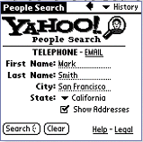
Example 2: Web Convenient Toolbar

Slide 12
Advantages
Reduce the cost of usability evaluation and testing
Improve the reusability and standardization of applications
Their assimilation, convey expert insight and knowledge to inexpert developers
Help forge the foundation of a shared vision, and a collective of styles for developing usable products
Notes:
Reduce the cost of evaluation and testing -- design from existing solutions -- from design stage -- less chance to make errors
forge foundation -- common ground or wisdom

Slide 13
Pattern Languages
A collection of interrelated patterns
Objective: to capture the collective wisdom of designers in a way that can be immediately used, especially by novice designers
2 criterion
  1. Standard Pattern Description
  2. Relationship between patterns
If both criterion not fulfilled, it is not a language but a catalogue of patterns
Notes:
A pattern language is a collection of interrelated patterns
The objective of a pattern language is to capture the collective wisdom of designers in a way that can be immediately used, especially by novice designers
Furthermore, to aspire towards a common language that can be spoken amongst fellow designers, interdisciplinary design teams, and customers
2 essential criterion to make a pattern language a pattern language:
1. Standard pattern description
- one format was described in previous slide, and includes specific examples, context of use, problem, forces, and solution
2. Relationship between patterns
a pattern language must depict the interrelationship between different patterns
If both criterion not fulfilled, it is not a language but a catalogue of patterns

Slide 14
Examples of Pattern Languages
Experiences -- A Pattern Language for UI Design (Coram & Lee, 1996)
The Brighton Usability Pattern Collection (University of Brighton, 2001)
Common Ground (Tidwell, 1999)
The Amsterdam Collection of Patterns in UI Design (van Welie, 2000)
Notes:
Pattern catalogue --
competes, similar patterns
this pattern can be embedded in this pattern
--all above relationships and more should be contextualized
pattern description -- not just narrative form

Slide 15
Experiences
Emphasis on the user’s experience within software systems
Patterns grouped by focus areas
Pattern Description: narrative form using natural language
Pattern Relationships: clear mapping of pattern interrelationships
Notes:
Concentrates on the user’s experience within software systems
Focuses on the interactions between the user and the interfaces of software applications
Patterns are grouped according to different focus areas such as interaction style, explorable interface, symbols, etc.
The Pattern description is in a narrative form using natural language
The interrelationships between patterns are clearly mapped

Slide 16
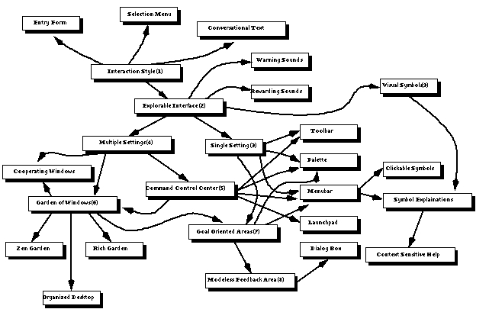
Experiences -- Pattern Relationships
Notes:
Interaction style is described as a meta-pattern, and is seen as a starting point in this mapping
The four major user interface paths in the language consist of the following patterns: conversational text, entry form, selection menu, and explorable interface
Explorable interface can then lead to a whole subset of other patterns
As an example, the pattern description of Selection menu is:
easy to learn, reduces keystrokes, structures the decision making path, and allows fairly easy support of handling errors, however may slow down frequent users when there are many sub-menus

Slide 17
Problems with Pattern Languages
Patterns...
  There are NO standards for documenting patterns
  We need tools to formally validate patterns
Pattern Languages…
  Need for formal language with syntax and semantics; not just narrative description
  Need for context of use-oriented relationships
Notes:
Patterns
There are no standards for documenting patterns as of yet. The Human Computer Interaction Community has no uniformly-accepted pattern form or language. The Alexandrian form, as described by Dr. Seffah, was originally derived for the architecture field and then adopted by user interface designers
We need tools to formally validate patterns. There should be some formal reasoning and method behind the creation of patterns, and in turn, pattern languages.
Pattern Languages
A language in computer science is described as having some sort of syntax and semantic
None of the pattern languages described had a specific syntax or semantic; most of them resorted to narrative text format of the problem and solution
Furthermore, the relationships between patterns in the languages introduced are static relationships and NOT context-oriented. We need context-oriented relationships. As an example, the conditions underlying the use of a pattern in a desktop application and in a mobile device application are different, and this should be addressed in the language
-----→ the UPADE Pattern Language tries to address some of these issues

Slide 18
Projects in Development
By the Human-Centered Software Engineering Group at Concordia University
http://hci.cs.concordia.ca
  MOUDIL -- Montreal Online Usability Digital Library
  UPADE -- Usability Patterns-Assisted Design Environment
    UPADE Web Language
    UPADE editor

Slide 19
UPADE Environment
Usability Patterns Database
MOUDIL
Digital Library
UPADE
Environment
feedback
Notes:
UPADE environment -- framework developing to automate the devpt of pattern-oriented design
to do this, put in a central db, all the well-known and validated patterns
MOUDIL -- web interface to gather and validate patterns via internet
-- not just to gather patterns, but way that people use these patterns

Slide 20
MOUDIL
Montreal Online Usability Digital Library
Online digital library for sharing usability and user interface pattern information
Target: software and usability engineers, developers
Objective: provide pattern information and receive feedback
Functionality: Browse, Search, MySpace
Notes:
MOUDIL stands for the Montreal Online Usability Digital Library
It is an online digital library for sharing usability and user interface pattern information -- it is basically a repository of information
Target for use: software and usability engineers, and developers
Objective
provide pattern information such as pattern descriptions, references, and related code
collect feedback from the software development community about various aspects related to patterns
Functionality:
Browse by alphabetical order
Search by Pattern name, context of use, usability problem
MySpace -- where developers/contributors can keep patterns they are interested in
like “shopping cart” of patterns

Slide 21
MOUDIL Objectives
Use feedback to answer certain questions about patterns and their uses
How do developers create and document patterns?
How are patterns used?
Use this information to develop UPADE
Notes:
MOUDIL’s main objectives lie in providing pattern information to developers, and then receiving feedback to answer some questions that can help improve patterns and help develop a universal pattern language
We want to know for a developer...
What makes a pattern a pattern?
What makes a pattern language a pattern language?
We also want to know how developers create and document patterns, and how they use them in practice
We hope that all this information can help us to further develop the UPADE Pattern Language

Slide 22
UPADE Web Language Characteristics
UPADE Web language is a usability pattern language for Web applications
A set of usability patterns
Patterns are interrelated
Patterns are documented in formal notations
Patterns are related to Web design process
Notes:
A set of usability patterns.
Each pattern provides a proven solution for a common usability problem that occurs in a specific context of use for Web applications.
18 patterns have been defined.

Slide 23
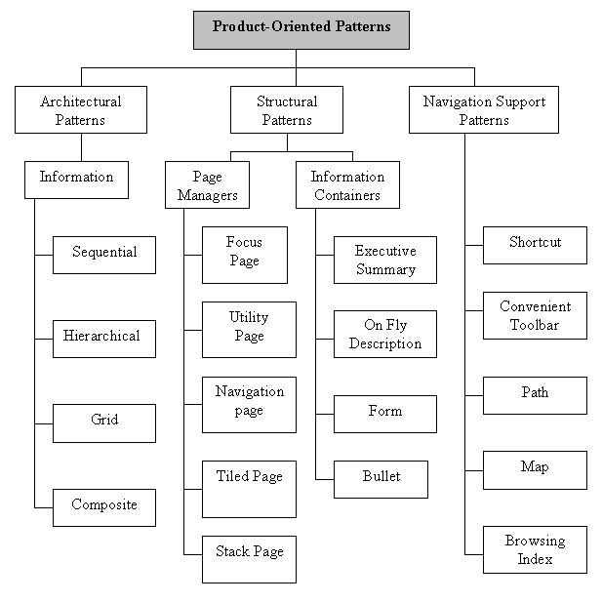
Overview of UPADE Web Language

Slide 24
Pattern Categories
This language define 3 categories of product patterns:
Architectural Patterns:
  Describe different schemes for organizing the content of a Web application
Structural Patterns:
  Define physical and logical layout of commonly used web pages. Suggests how to group info in cognitively respectable structure and how to display them
Navigation Support Patterns:
  Provide navigation between a set of pages and segments of information

Slide 25
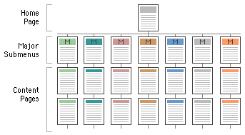
Hierarchical Pattern
Architectural Pattern
Pages are organized in a hierarchical model. The user can easily go from the most general overview of the web site, such as the home page, down to more specific topics

Slide 26
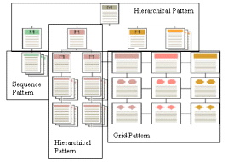
Composite Pattern
Architectural Pattern
A complex and large web application is generally organized using a combination of several architectural patterns

Slide 27
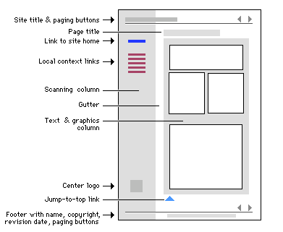
Focus Page Pattern
Page Manager Pattern – subcategory of Structural Pattern
Helps to build a Web page that is the fountainhead and center of the Web site. Balances aesthetics and practicality to attract users from their first glances

Slide 28
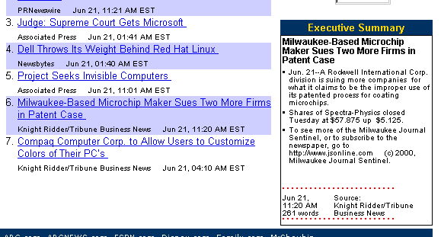
Executive Summary Pattern
Information Container Pattern – subcategory of Structural Pattern
This pattern gives users a preview of underlying information before spending time in downloading and reading large amounts of information.

Slide 29
UPADE Web Language Format
Pattern_Name: Convenient Toolbar Pattern
  type of Navigation Support Pattern
Context_Use
  User: Expert
  Task: Assist the user to reach the most useful and frequently visited pages at any time throughout the Web site.
  Workplace: Web applications
Usability_Problem:
  The user can easily find the most commonly used pages regardless of the current state of the artifact.
  The user can reach these convenient pages promptly.
Notes:
Convenient Toolbar Pattern is a
Navigation Support Pattern

Slide 30
Example - Convenient Toolbar Pattern 2
Usability_Factor
  Factor: Efficiency, Safety
  Criteria: Consistency, Minimal Action, Minimal Memory, User Guidance, Helpfulness
Example

Slide 31
Example - Convenient Toolbar Pattern 3
Design_Solution
  Group the most convenient action links, such as home, site map, help and etc.
  Use meaningful metaphors and accurate phrases as labels
  Place it consistently throughout the Web site

Slide 32
Example - Convenient Toolbar Pattern 4
Other Language Attributes:
Design_Principle
Related Usability_Patterns
Reading
Notes:
Design_Principle
Conceptual Model: Affordance, Mapping, Causality
Dialog style: Metaphors
Related Usability_Patterns: It provides all the related patterns.
Super-ordinate pattern: it is the superior of the described patterns, which can contain the target pattern and other patterns.
Sub-ordinate pattern: it can be embedded into the described pattern.
Competitor pattern: it can provide the same or competitive function as the described pattern.
Neighboring pattern: it belongs to the same Pattern category as the described pattern.

Slide 33
Final Remarks
Patterns at different levels of the organization
Usability Patterns as an alternative design solution
Pattern Language
  Pattern Definition
  Pattern Interrelationships
UPADE Web Language
MOUDIL Digital Library – receive feedback
Our website: http://hci.cs.concordia.ca

Slide 34
Questions...

