Slide 1
Software Engineering
Best Practices
Practical things we can all do
David Loo
IMS Health
CUSEC 2002

Slide 2

About IMS Health
In Canada from 1960
Offices in over 100 countries (HQ in US)
Canada’s leading supplier of health information
  Pharmaceutical consumption rates/patterns
  Prescription estimates
  Disease & treatment patterns

Slide 3

About me
BSc, MSc McGill (Physics)
16+ years in software industry
Held positions as software architect, software engineer, project manager
Matrox, Clinidata, IMS Health
In charge of development standards & methodology at IMS Health

Slide 4
Agenda
Introduction
Caveats
Best practices
Where to get more information
Questions and Answers

Slide 5
Introduction
What is Software Engineering?
What is a Best Practice (BP)?
How these BPs are chosen

Slide 6
What is Software Engineering?
“The intelligent application of proven principles, techniques, languages, and tools to the cost-effective creation and maintenance of software that satisfies users’ needs.” [Dav95]

Slide 7
What is a Best Practice (BP)?
“A principle, technique, or rule about Software Engineering that is applicable regardless of the development methodology, language, or application domain.” [Dav95]

Slide 8
How these BPs are chosen
They’re proven in the field
Personal experience
Practical, easy to implement

Slide 9
Agenda
Introduction
Caveats
Best practices
Where to get more information
Questions and Answers

Slide 10
Caveats
List is not exhaustive
Not everything has to be followed
Not everything works all the time
Not every BP is compatible with each other
Not necessarily for project managers or leads only

Slide 11
Agenda
Introduction
Caveats
Best practices
Where to get more information
Questions and Answers

Slide 12
Best Practices
General BPs
BPs for Construction
BPs for Test
BPs for Documentation

Slide 13
Best Practices
General BPs
BPs for Construction
BPs for Testing
BPs for Documentation

Slide 14

Quality First
Users won’t tolerate product of poor quality, no matter how quality is defined
Quality cannot be “retrofitted”
It’s better to have poor efficiency than poor reliability
High quality = low productivity
Most every BP ultimately traces to ensuring Quality in software products

Slide 15
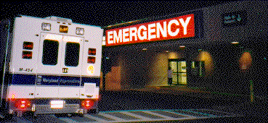
Triage
“A system used to allocate a scarce commodity, such as food, only to those capable of deriving the greatest benefit from it.” [You97]
Major application is in requirements management

Slide 16
Triage (cont’d)
Classify requirements using MoSCoW rule: “Must have”, “Should have”, “Could have”, “Wish to have” [Sta97]
Focus only on “Must have” requirements first
Must actively & continuously manage this with all stakeholders (Users, development, QA, Marketing, management)

Slide 17

Top 10
List of 10 most serious risks to project
Include status, context, possible resolutions
Update every week
Raises awareness of project risks
More timely solutions possible
Improves visibility of progress

Slide 18
Configuration management
Use CM tool (SourceSafe, etc.)
Archive all versions of all intermediate Artefacts (specifications, code, test-plans, user manuals, etc.)
Assign name/version number
Have a baseline as early as possible
Control ALL changes to baseline
Track every change

Slide 19

Defect tracking
Log of all defects found in all stages of life cycle
Include also suggestions
Must have version number from CM tool
Easier post-mortem analysis
Easier metrics gathering

Slide 20
Have standards
Promotes discipline
Ensures uniformity of artefacts
Use of common language
Easier maintenance
Availability of tools

Slide 21
Don’t follow standards
Good methodology is one that makes sense to the company
Don’t have to follow every single step
Adopting new methodology often accompanied by huge productivity drop
Fix fundamental problems first
Be careful when following trends

Slide 22
Miniature milestones
Milestones that are achievable in 1-2 days
Good for crisis or project recovery
Good for team motivation
Increased status visibility

Slide 23

Avoid Waterfall methodology
Trying to freeze requirements, design,…
Trying to plan details from beginning to end
Not suitable for new, unfamiliar projects
Not adaptable to changes
Pushes risks to tail-end of project
Testing way too late
Integrating way too late
*

Slide 24
Use Iterative methodology
Project goes through many iterations
Each iteration includes usual 4 stages
Each iteration refines requirements, design, build, tests, …
Each iteration adds more and more features
Users see value with each iteration

Slide 25
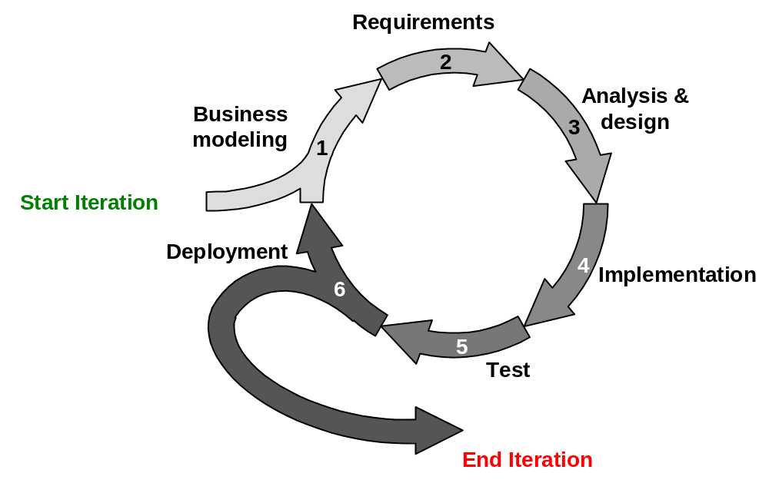
Iteration

Slide 26
Iterative methodology
Embraces changes, not resists them
Emphasis on working software, not documents
Creates working system as early as possible
Continuous testing, continuous integration
Risk driven: greatest risks handled first

Slide 27
Release early
Define & create release process and actual release deliverables as early in project life-cycle as possible (iterations)
Minimizes integration problems
Avoids “end of build” rush

Slide 28
Framework group
A group to define company-wide common architecture, development tools, & methodology
Promotes reuse of common components
Decreases risks

Slide 29
Do a post-mortem
At project end, key players analyze every problem that occurred in project
Goal is to document, analyze, and learn from mistakes
Metrics can also be gathered
Usually takes 3-5 days
Great benefits to future projects

Slide 30
Best Practices
General BPs
BPs for Build
BPs for Testing
BPs for Documentation

Slide 31
Captain’s Log
Keep a log of what was done
Can be written or electronic
Especially important for build
Easier recall of what or why
Easier post-mortem analysis

Slide 32

Daily build
System completely rebuild every day (usually overnight)
Treat it as heartbeat or synch pulse of project [Cus95]
Fixing broken build is given top priority
Minimizes integration risk
Easier defect diagnosis

Slide 33

Daily smoke tests
A set of tests that exercises major functional areas of system
Should be automated
Run it after each Daily Build
Update the set as more functionality are added to each iteration

Slide 34

Fix bugs as soon as found
Don’t wait “until later”; “later” never comes
Fix while code is still fresh in memory
No new features until bugs are fixed
Greatly increases quality of product

Slide 35
Best Practices
General BPs
BPs for Build
BPs for Testing
BPs for Documentation

Slide 36
Single-step through every line of code
Step through code in debugger
Step through EVERY SINGLE line of code that was added, changed, moved

Slide 37

Branch, path, and other things
Test every branch
Test every path

Slide 38

Do Inspections
Catches high percentage of bugs
Promotes good coding practices
Promotes use of coding standards
Great for people new to project or code

Slide 39
Best Practices
General BPs
BPs for Build
BPs for Testing
BPs for Documentation

Slide 40
Create a glossary & index
Every document should have glossary & index
Especially important for User documents (requirements specs, user manuals)

Slide 41

Be boring
Which is better?
  “There are three types of special commands. Regular commands come in four varieties.”
  “There are three types of special commands. There are four types of regular commands.”
  [Dav95]

Slide 42
Speak the reader’s language
Don’t put technical terms in documents destined for Users
Use the reader’s terminology

Slide 43
Agenda
Introduction
Caveats
Best practices
Where to get more information
Questions and Answers

Slide 44
Where to get more information
S.McConnell, Rapid development. Microsoft Press, Redmond, Wash., 1996.
A.M. Davis, 201 principles of software development. McGraw Hill, 1995.
Bibliography lists 31 other books, papers, and web sites.

Slide 45


Questions and Answers

